Slide 1
INSTRUCTIONS
This template deck is a resource for applicants to turn and adapt and use in presenting their co-developed Longitudinal Performance Growth Targets (LPGTs) and Local Optional Metrics (LOMs) under, “Aligning for Student Success: Integrated Guidance for Six ODE programs.’’
This resource is designed for school boards but could, often with translation, be used for communicating to families and communities served.
Highlighted words point out parts of the template that may most need adaptation.
Questions? Contact your ESD Integrated Liaison, your Regional Support in OEII or email ODE.EII@ode.oregon.gov

Slide 2
[Applicant name(s)]
2023 Longitudinal Performance Growth Targets Presentation
In Alignment with “Aligning for Student Success: Integrated Guidance for Six ODE Programs”
Notes:
Suggestion: Add district/applicant logo

Slide 3

Purpose for Presentation
To share back information about Longitudinal Performance Growth Targets (LPGTs) and Local Optional Metrics (LOMs) and measuring progress related to the Integrated Plan for 6 ODE Programs
To provide additional context on LPGTs
To seek board approval for the SIA Grant Agreement with embedded LPGTs and Local Optional Metrics

Slide 4
Contents
Background & Context
LPGT & LOM Guidance & Development Process
LPGTs & LOMs in [insert district/school name]
Notes:
Explain that ‘’plan’’ includes your application, budget, and all materials submitted under the IG

Slide 5
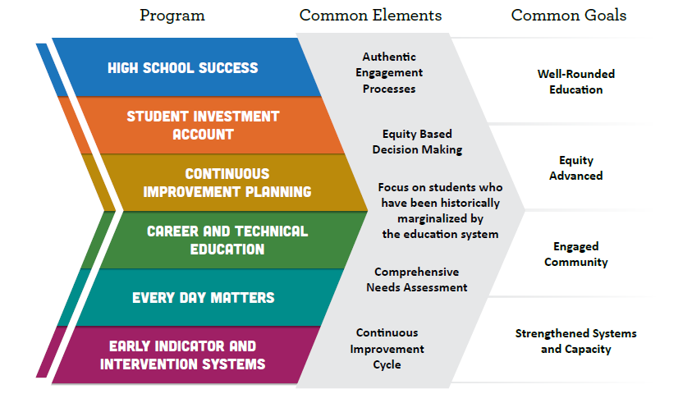
Background: Six Programs & Common Goals
Notes:
This slide is optional and is a placeholder to share a reminder or contextual reminders about your district’s Integrated Application and Plan - If something else will cue your board feel free to use that instead.

Slide 6
Our Integrated Plan
Outcomes and Strategies
Notes:
This is a placeholder slide to remind your board on the key investments of your integrated application as they align with or inform your LPGTs closely or loosely

Slide 7
Context for LPGTs
The final stage of our application process
Statutorily required under the Student Investment Account
Embedded in our Grant Agreement
Reported on Annually
Performance Review Required every Four Years

Slide 8
ODE’s Approach to Shared Responsibility
Shared Responsibility. ODE is responsible for ensuring that taxpayer dollars are being expended appropriately for compliance with federal and state laws, regulations and policies, while also meeting the intent of the legislation and enacting real change in districts, charter schools, communities and the lives of students.
Monitoring and reporting progress is a responsibility and opportunity to share a performance review back to our communities and boards whether our investments are reaching outcomes we were aiming for.
Previous accountability measures often served to narrow the curriculum, using shame and blame of schools as an overly simplistic tactic while offering over-promised or oversimplified outcomes.

Slide 9
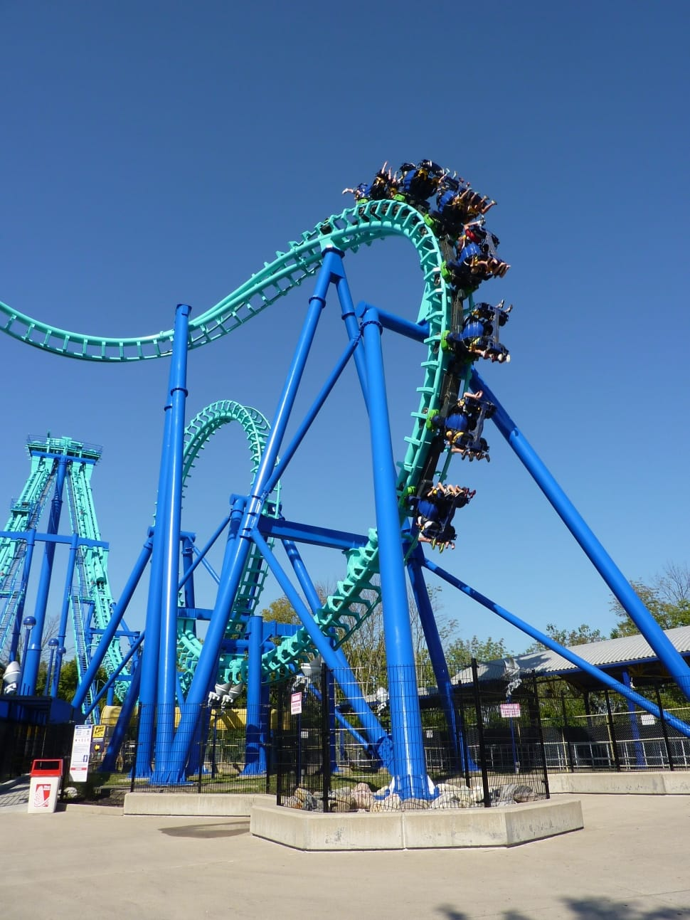
ODE’s Values
Monitoring and evaluation is central to learning and program implementation.
Context matters. LPGTs & LOMs must be flexible and adaptive.
Goals and metrics need to be realistic,
ambitious and attainable.
Progress is not linear and all measures of
progress are not created equal.
Notes:
Optional Speaker Notes: The LPGTs required by the Student Success Act can provide a picture of key points of student progress and growth. They don’t, however, show every aspect of student growth, cohort growth, or system improvement, nor are they intended to. It is important to acknowledge that several of the ways the funds and programs described in this integration can be used support corresponding changes in these metrics over time. It is also important to name that there are meaningful and allowable investments that could be pursued that would not directly or immediately correspond to changes in these metrics.

Slide 10
Additional Performance Measures
Besides LPGTs, these additional inputs inform progress:
High School Success Eligibility Requirements
State CTE Perkins Performance Targets
Progress Markers
Local Optional Metrics
Quarterly and Financial Reporting
Annual Reporting
Auditing (SIA funds only)
Performance Reviews
Notes:
Optional Slide to help build context about the other mechanisms and forms of information that help illustrate progress over time. Here, if the district or school developed LOMs, highlighted the purpose and reasons may be appropriate alongside more context on why local optional metrics may help tell the story of growth in your setting in a more nuanced or construction way

Slide 11
Co-Development Process
ODE has supported applicants in co-developing LPGTs & LOMs in collaboration with ESD Liaisons.
This work will included finalizing baseline, stretch and gap-closing targets for each of the common metrics detailed on the next slide.
The aim of this co-development effort was to create meaningful opportunities for grantees to re-analyze current data, center focal student groups, and support public transparency and learning, while not being penalized for complexities in the current available data.

Slide 12
LPGTs - What’s Required
Four-year Graduation: The percentage of students earning a regular or modified diploma within four years of entering high school.
Five-year Completion: The percentage of students earning a regular, modified, extended or adult high school diploma, or a GED within five years of entering high school.
Third Grade Reading: The percentage of students proficient on statewide English Language Arts (ELA) assessments in 3rd grade.
Ninth Grade On-Track: The percentage of students earning at least one-quarter of their graduation credits by the end of the summer following their 9th grade year.
Regular Attenders: The percentage of students attending more than 90 percent of their enrolled school days.

Slide 13
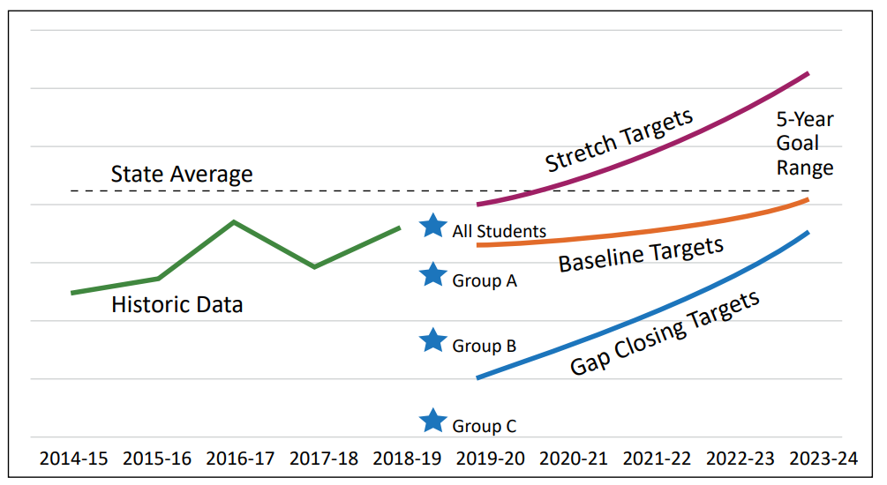
LPGTs – What’s Required, con’t
5 Year Targets
Visual Example
Baseline – the minimum level of realistic growth
Stretch – more ambitious, still realistic
Gap Closing – reduction of academic disparities for focal student groups

Slide 14
Local Optional Metrics
Applicants are encouraged to put forward local optional metrics that may more accurately align to the particular strategies, activities and investments outlined in their integrated plan.
Notes:
For example: Where a district might be prioritizing investments in reading proficiency, they are welcomed and encouraged to consider a range of optional metrics in addition to the 3rd grade Reading common metric. A district could add their own formative and interim assessment strategies and data along with assessments of Cognitive Academic Language Proficiency that might show measures of literacy in languages other than English or show a fuller student learning profile that they want to customize and use as part of their overall monitoring and evaluation framework.

Slide 15
LPGTs & LOMs Must Be:
Realistic and Attainable
Districts and schools working with ODE considered:
Historic trends for that metric
An evaluation of the likely impact of new or expanded programs on that metric
Statewide averages and trends for LPGTs

Slide 16
CoDeveloped Targets
Four Year Graduation
Notes:
Placeholder slide for your district/school metrics
Tip: Use the LPGT Worksheet to copy and paste your metrics or copy from grant agreement

Slide 17
CoDeveloped Targets
Fifth Year Completion
Notes:
Placeholder slide for your district/school metrics
Tip: Use the LPGT Worksheet to copy and paste your metrics or copy from grant agreement

Slide 18
CoDeveloped Targets
Regular Attenders
Notes:
Placeholder slide for your district/school metrics
Tip: Use the LPGT Worksheet to copy and paste your metrics or copy from grant agreement

Slide 19
CoDeveloped Targets
3rd Grade ELA
Notes:
Placeholder slide for your district/school metrics
Tip: Use the LPGT Worksheet to copy and paste your metrics or copy from grant agreement

Slide 20
CoDeveloped Targets
9th On Track
Notes:
Placeholder slide for your district/school metrics
Tip: Use the LPGT Worksheet to copy and paste your metrics or copy from grant agreement

Slide 21
CoDeveloped Metrics
Local Optional Metrics

Slide 22
What we learned through this process
Notes:
Share 3 to 4 high level notes of what they learned along the way

Slide 23
Questions & Comments
23

