Slide 1

Setting Longitudinal Performance Growth Targets
Setting Longitudinal Performance Growth Targets
Webinar #1
February 6, 2020

Slide 2


Welcome
Welcome!
SIA Application Questions
Rachael Moser rachael.moser@state.or.us
SIA Grant Agreement Questions
Shpresa Halimi shpresa.halimi@state.or.us
General Questions
SIAinfo@state.or.us

Slide 3

Save the Date
Save the Date
Setting Longitudinal Performance Growth Targets
Webinar #2 - Live! Feb. 12, 2020
Details and Open Q&A
Email SIAinfo@state.or.us to attend.
Submit your questions through this Google form ahead of time!
Will be recorded and posted.

Slide 4
Objectives
Objectives
In viewing this webinar, you can expect to come away with a clear understanding of the:
Overall approach;
Terminology and concepts;
Requirements set out in law;
Process for setting targets; and
Responsibilities and roles to co-develop targets with the Oregon Department of Education.

Slide 5
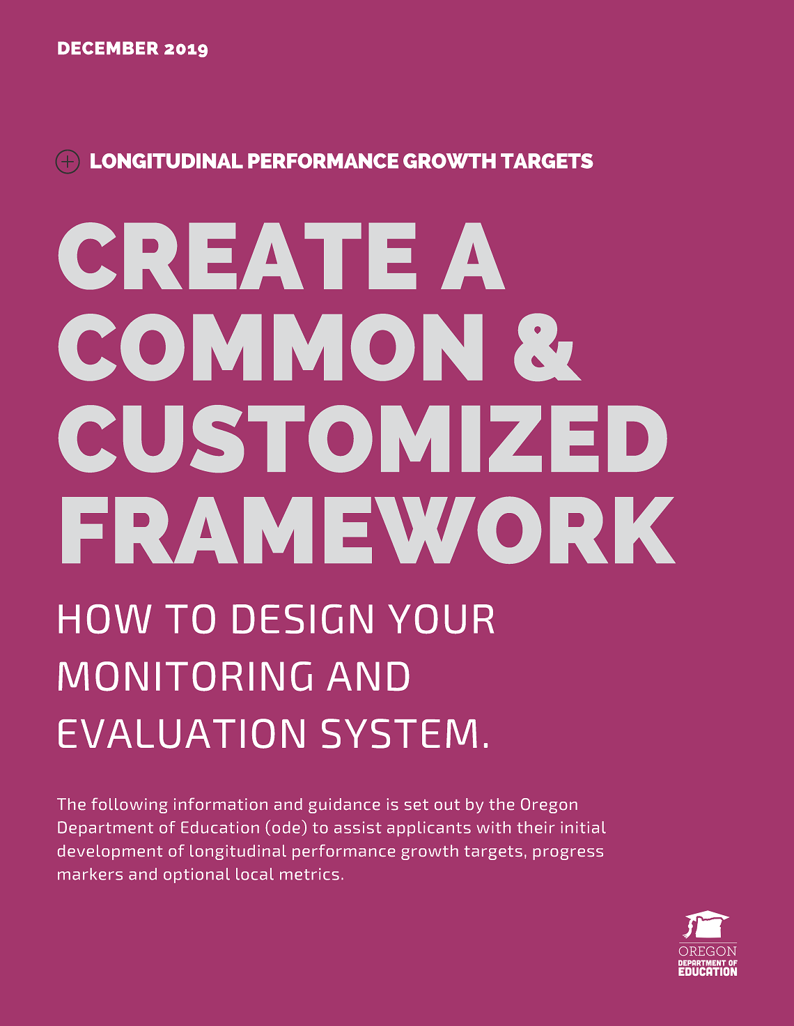
For More Information
For More Information
Section Four in the SIA Comprehensive Guidance
How to Design Your Monitoring and Evaluation System
Longitudinal Performance Growth Targets
Progress Markers
...and more!

Slide 6
Approach & Terminology
Approach & Terminology
Understand the basics

Slide 7
Common Metrics
Common Metrics
1. Four-year Graduation - The percentage of students earning a regular or modified diploma by the end of the summer following their first four years in high school.
2. Five-year Completion - The percentage of students earning a regular, modified, extended or adult high school diploma, or a GED within five years of entering high school.
3. Third Grade Reading - The percentage of students proficient on statewide English language arts (ELA) assessments in 3rd grade.
4. Ninth Grade On Track - The percentage of students earning at least one-quarter of their graduation credits by the end of the summer following their 9th grade year.
5. Regular Attenders -The percentage of students attending more than 90 percent of their enrolled school days.

Slide 8

What are Longitudinal Performance Growth Targets?
What are Longitudinal Performance Growth Targets?
Longitudinal Performance Growth Targets are:
Based on data available for longitudinal analysis;
Use overall rates for districts and gaps in disaggregated rates; and
Include the common metrics and any locally defined metrics included in an applicant’s SIA plan.

Slide 9

What are Progress Markers?
What are Progress Markers?
Progress Markers:
For each of the five common metrics, ODE is introducing the use of “progress markers” - sets of indicators that identify the kinds of changes we would expect and like to see in policies, practices and approaches over the next three years that we think would lead to applicants reaching their longitudinal performance growth targets.

Slide 10

A Foundational Year
A Foundational Year
The first year of implementation is a foundational year. At the start of the 2020-2021 school year, grant recipients will implement their SIA plans and begin monitoring progress toward meeting longitudinal performance growth targets.
Grant recipients are required by law to revisit each aspect of SIA planning in engaging with focal students, families, staff and community to set four year plans.

Slide 11
Values & Approach
Values & Approach
Monitoring and evaluation is central to learning. We’ll focus on the use of measures that authentic, ambitious and realistic.
Context matters. Approaches to the development and monitoring of growth targets must be flexible, responsive and adaptive.
Center the two core purposes of the SIA. The law aims to improve student health and well-being and achieve equity-based outcomes in student learning.
Progress is not linear and all measures of progress are not created equal. We have the opportunity to develop and grow an approach to monitoring and evaluating systems for district learning and performance.

Slide 12

Oregon’s Smallest Districts
Oregon’s Smallest Districts
For those school districts within the “floor” of SIA grant allocations (with a student body of fewer than 50 students):
ODE will focus solely on the local metrics and the progress markers. While ODE will monitor changes to the required five common metrics, Oregon’s smallest districts will not be required to provide any projections or forecasts of these measures.
Technical assistance will also be available through ODE and regional ESDs to support your work.

Slide 13

A few notes
A Few Notes on this Approach
Creates the most flexibility for districts to respond to the variance of differing demographics while keeping a focus on closing opportunity and achievement gaps.
Does not create undue burden through the creation of page after page of targets.
Creates a system that highlights focal groups that are experiencing the greatest academic disparities.
Eliminates the confusion of setting or not setting targets individually for small groups of students.

Slide 14
Requirements
Requirements
Understand what’s
required by law

Slide 15

What You’ll Develop & Submit
What You’ll Develop & Submit
Each applicant and ODE will co-develop:
5-year targets for each of the common metrics (4-year graduation, 5-year completion, 3rd grade reading, 9th grade on track, and regular attendance);
Baseline and stretch targets for each of the common metrics; and
Gap closing targets for each of the five common metrics.
Check out ODE’s Simplified Worksheet!

Slide 16
Required by Law
Required by Law
Longitudinal performance growth targets must apply to the applicant as a whole and to the following student groups, which have historically experienced academic disparities (as defined by House Bill 3427):
Students eligible for Free or Reduced Prices school meals
Students with disabilities
English learners
American Indian/Alaska Natives
Black/African Americans
Hispanic/Latinos
Native Hawaiian/Pacific Islanders
Homeless students
Students who are foster children[1]
[1] Data for this student group is not yet available for all indicators.

Slide 17
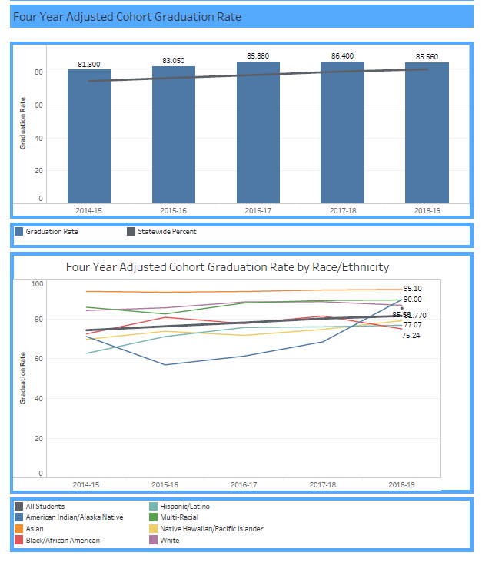
Data Visuals
Data Visuals
Check it Out!
All school districts and eligible charter schools received suppressed and unsuppressed data visuals that include each of the five metrics, rates by race / ethnicity, and raw data.

Slide 18
Long Term, Five-Year Targets
Long-Term, Five-Year Targets
Four-Year Graduation
District-Wide
 | Year 1 20-21 | Year 2 21-22 | Year 3 22-23 | Year 4 23-24 | Year 5 24-25
Stretch Target
Baseline Target
Focal Student Groups
 | Year 1 20-21 | Year 2 21-22 | Year 3 22-23 | Year 4 23-24 | Year 5 24-25
Gap Closing

Slide 19
Baseline & Stretch Targets
Baseline & Stretch Targets
Four-Year Graduation
District-Wide
 | Year 1 20-21 | Year 2 21-22 | Year 3 22-23 | Year 4 23-24 | Year 5 24-25
Stretch Target
Baseline Target
Focal Student Groups
 | Year 1 20-21 | Year 2 21-22 | Year 3 22-23 | Year 4 23-24 | Year 5 24-25
Gap Closing

Slide 20
Gap Closing Targets
Gap Closing Targets
Four-Year Graduation
District-Wide
 | Year 1 20-21 | Year 2 21-22 | Year 3 22-23 | Year 4 23-24 | Year 5 24-25
Stretch Target
Baseline Target
Focal Student Groups
 | Year 1 20-21 | Year 2 21-22 | Year 3 22-23 | Year 4 23-24 | Year 5 24-25
Gap Closing

Slide 21
The Process
The Process
Follow these steps to draft your longitudinal performance growth targets

Slide 22
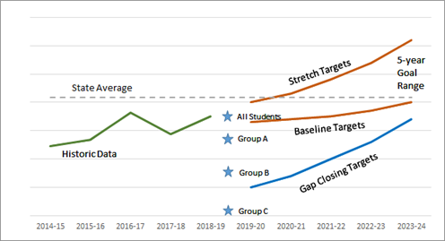
A Visual for Our Work
A Visual for Our Work

Slide 23
Metrics “Move” Differently
Metrics “Move” Differently
Growth Achieved by the Top 10 percent of Oregon’s Districts
Indicator | Growth Achieved by top 10% of Districts
Regular Attenders | 1.2
3rd Grade ELA | 3.7
9th Grade On Track | 4.4
4-year Graduation | 3.8
5-year Completion | 2.3
For Consideration:
The table shows the growth that top 10 percent of districts have achieved or exceeded over the last five years.
Average yearly growth at this pace represents a significant achievement..

Slide 24
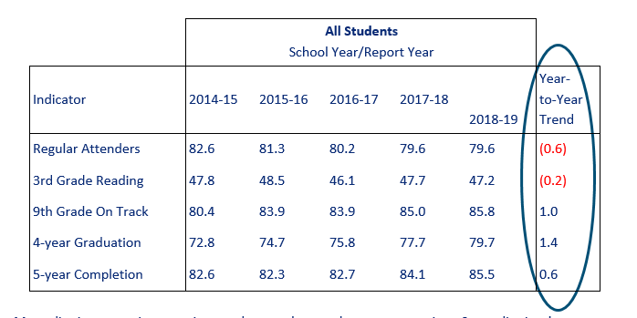
Considering Historic State & District Trends
Considering Historic State & District Trends
The table below shows the last five years of state-level data on each of the five common metrics.

Slide 25
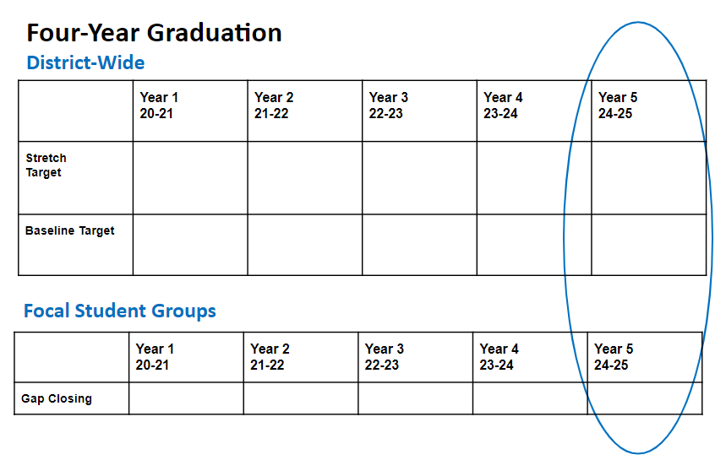
Setting Long-Term, Five-Year Targets
Setting Long-Term, Five-Year Targets
STEP ONE: Start with the end in mind: where do you want to be in five years? (This is your 5-year target)
Please Note:
There is no single formula for setting these targets as investments in programs and interventions will vary from district to district.

Slide 26
Setting Baseline & Stretch Targets
Setting Baseline & Stretch Targets
STEP TWO: How will you make realistic progress toward your 5-year long,term targets? (These are your baseline and stretch targets)
General Guidelines
Applicants below statewide averages, should strive to match or exceed statewide progress, and not to see a decline in indicators.
Applicants at the very high end of achievement might expect less or slower growth, or perhaps to hold steady and see maintenance at these levels as a signal of excellence.

Slide 27
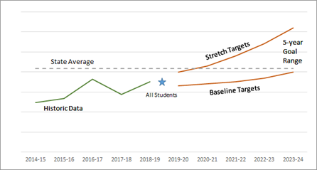
Baseline and stretch targets
Baseline & Stretch Targets
Baseline Targets: The minimum expectations for progress. Baseline targets are not formulaic; they should be based on:
The applicant’s historic trends for that metric; and
An evaluation of the likely impact of SIA programs on that metric.
Stretch Targets: the higher end of the range – an ambitious achievement target. This “stretch” target is also realistic and represents significant improvement by the district in either:
Raising academic achievement; or
Reducing academic disparities and closing gaps.

Slide 28
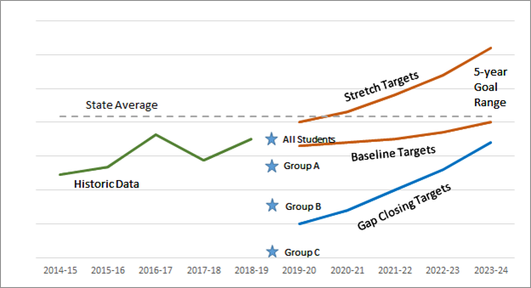
Setting Gap Closing Targets
Setting Gap Closing Targets
STEP THREE: How will you begin to close gaps for the focal student groups? (These are your gap closing targets)
General Guidelines
When setting gap closure targets we encourage districts to consider the following gaps:
Within-district gap between the focal group and the applicant as a whole (e.g., Group A at the district level compared to all students in the district).
Within-state gap between focal groups for the applicant and the state as a whole (e.g., Group A at the district level compares to all students in the state, or to Group A at the state level).

Slide 29
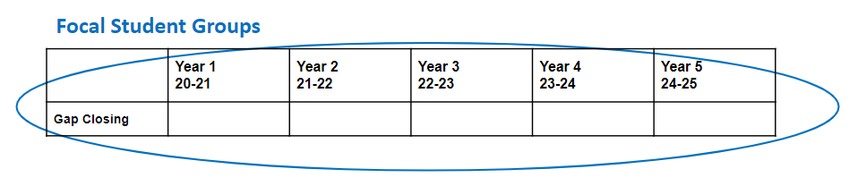
Setting Gap Closing targets continued
Setting Gap Closing Targets
Gap Closing Targets, while a single set of targets, are used for all focal groups meeting the minimum n-size requirement. The actuals for each focal group should be plotted. The group of focal targets, while each group has different needs and strengths, allows for a projection that can put a central focus not just on achievement but on closing gaps in academic disparity.

Slide 30
Customizing your Monitoring & Evaluation Framework
Customizing your Monitoring & Evaluation Framework
An introduction.
Progress Markers and Optional Local Metrics

Slide 31
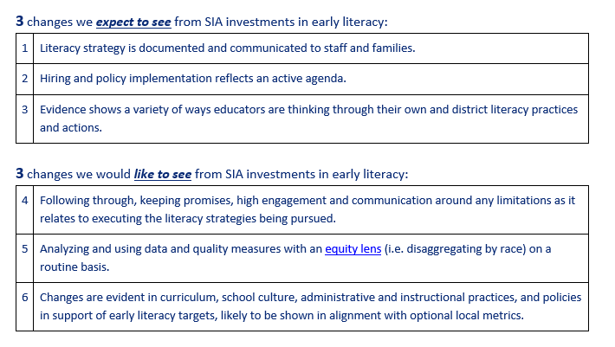
Progress markers
Progress Markers
Examples of Draft Progress Markers for 3rd Grade Reading

Slide 32

Optional Local Metrics
Optional Local Metrics
Applicants may also elect and are encouraged to put forward optional local metrics (in addition to the five common metrics) that may more accurately align to the particular strategies, activities and investments outlined in their SIA grant application and plan.

Slide 33
Roles & Responsibilities
Roles & Responsibilities
How we’ll work together to co-develop growth targets.

Slide 34
Co-Development to Agreement
Co-Development to Agreement
Co-Development of Targets begins once Application Meets Requirements
Facilitate Public Review of Grant Agreement & Obtain Board Approval
Submit DRAFT Targets
ODE Initiates Grant Agreement Process
Once your SIA application is reviewed and meets all requirements, ODE will contact you to begin co-development based on the draft targets you submitted.
Applicants must post on webpage and/or make available in district office; present grant agreement at an open board meeting and obtain board approval.
Submit Documentation of Board Approval
Attach your DRAFT targets with your complete SIA Application during submission:
March 2 - April 15, 2020.
ODE will initiate the grant agreement process, to include growth targets as an exhibit for monitoring purposes.
Grant agreement is finalized with ODE and applicant.

Slide 35

Process for Co-Development
Process for Co-Development
Step 1
Applicants should include draft longitudinal performance growth targets with their application submission (March 2 - April 15, 2020). These will not be included in the application review.
Step 2
Application meets requirements.
Step 3
ODE staff will review your draft targets.
Step 4
ODE point of contact will communicate with applicant about status of draft targets. Email and Google folder structure will be used for iterative back and forth exchange until agreement is reach.

Slide 36
Roles and Shared Responsibility
Roles & Shared Responsibility
ODE will | Applicants will
Engage in open and regular communication with applicants. Provide each applicant with access to a Google folder for shared artifacts and documents, including the draft longitudinal performance growth targets. Collaborate with applicants to determine what longitudinal performance targets should be. | Engage in open and regular communication with ODE. Submit SIA application with draft longitudinal performance growth targets by the deadline, April 15, 2020. Collaborate with ODE to determine what longitudinal performance growth targets should be.

Slide 37
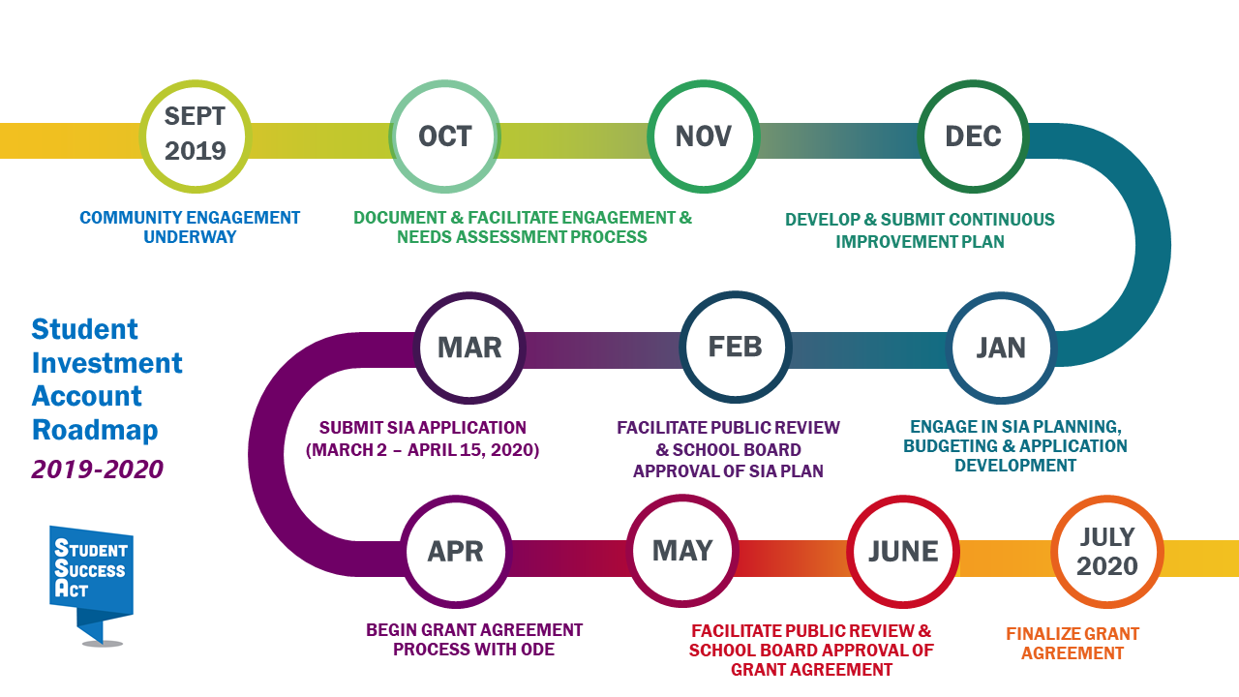
Keeping the Big Picture in Mind
Keeping the Big Picture in Mind

Slide 38

ESDs a Pivotal Partner
ESDs a Pivotal Partner
Education Service Districts
ESDs have regular access to ODE staff and are frequently previewing information. Use them to elevate your questions for quicker response.

Slide 39

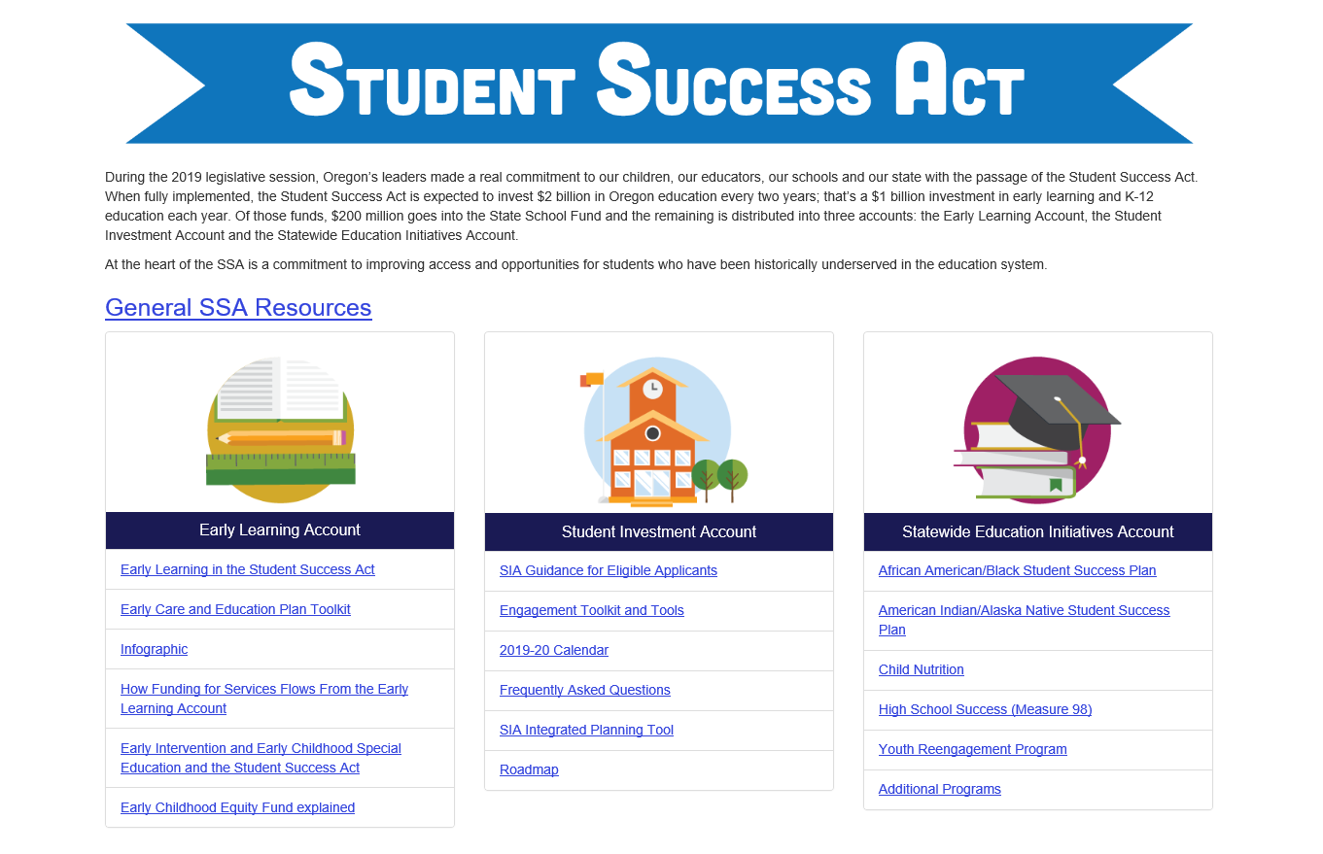

Stay Connected
Stay Connected
www.oregon.gov/ode/studentsuccess

Slide 40

Thank you!
Thank You!
Contact us with Questions
SIAinfo@state.or.us

