Slide 1

Deeper Dive
A “Deeper Dive” and Q&A in Support of Setting Growth Targets
Webinar #2
February 12, 2020

Slide 2

Today’s Workshop
Today’s Workshop
A real time deep dive into a district case study to illuminate an approach to setting longitudinal performance growth targets and developing the monitoring and evaluation framework for your SIA investments.
Open question and answer
Add questions to the chat the whole time!

Slide 3

Setting LPGTs
Setting LPGTs
Each applicant and ODE will co-develop:
5-year targets for each of the common metrics (4-year graduation, 5-year completion, 3rd grade reading, 9th grade on track, and regular attendance);
Baseline and stretch targets for each of the common metrics; and
Gap closing targets for each of the five common metrics for focal student groups.

Slide 4
Common & Customized Monitoring & Eval Framework
Common and Customized Monitoring and Evaluation Framework
Longitudinal Performance Growth Targets
These are your 5-year, baseline, stretch and gap-closing targets for the 5 common metrics
 |  | Year 1 | Year 2 | Year 3 | Year 4 | Year 5
District-wide | Stretch
 | Baseline
Focal Student Groups | Gap-Closing
Progress Markers
These are developed by ODE for the 5 common metrics and will be the same for all applicants. Applicants also have the option to develop additional progress markers.
1 | Literacy strategy is documented and communicated to staff and families.
2 | Hiring and policy implementation reflects an active agenda.
3 | Evidence shows a variety of ways educators are thinking through their own and district literacy practices and actions.
Optional Local Metrics
These are locally-developed by the applicant.

Slide 5
Start with a Review
Start with a Review of 5 Years Prior Data
Knowing where you have been is an important step in understanding where you can go.
Understanding past trends provides a baseline for how current investments have moved student outcomes.
New investment in the SIA should “bend the curve” on the historic data.

Slide 6
Digging into a case study
Digging into a Case Study
3rd Grade Reading

Slide 7
Introductions
Introductions
Sue Wilson, Lane ESD
Administrator from School District Y
About District Y:
Medium-Sized School District (2,500)
Focused efforts on community engagement
Currently developing SIA plan

Slide 8
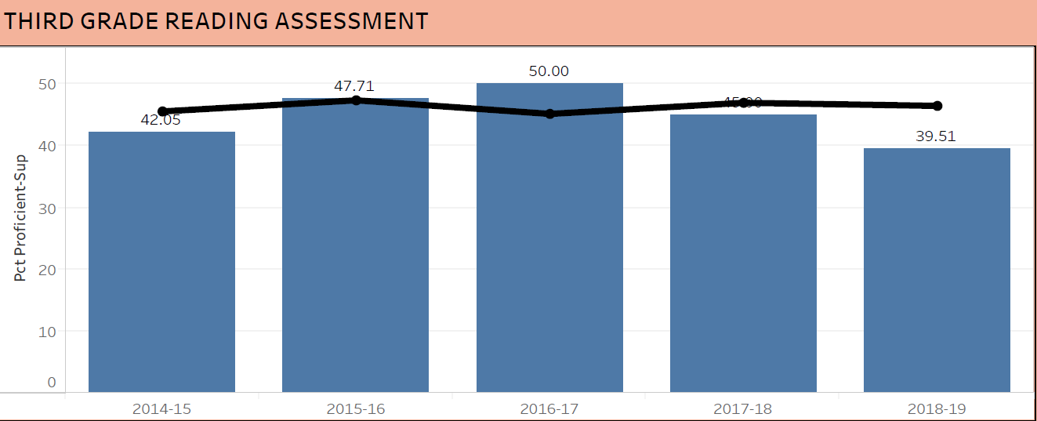
Case Study: 3rd Gr. Reading
Case Study: 3rd Grading Reading

Slide 9
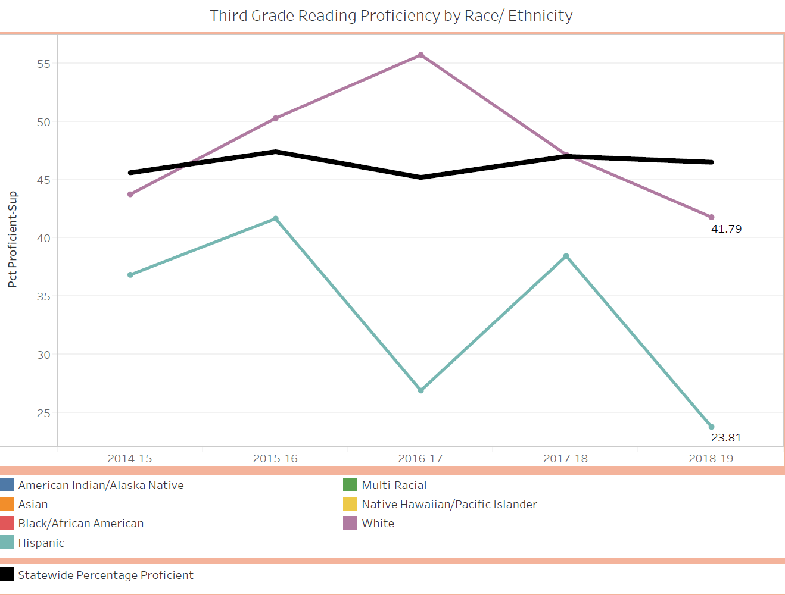
Case Study: 3rd gr reading 2
Case Study: 3rd Grading Reading

Slide 10
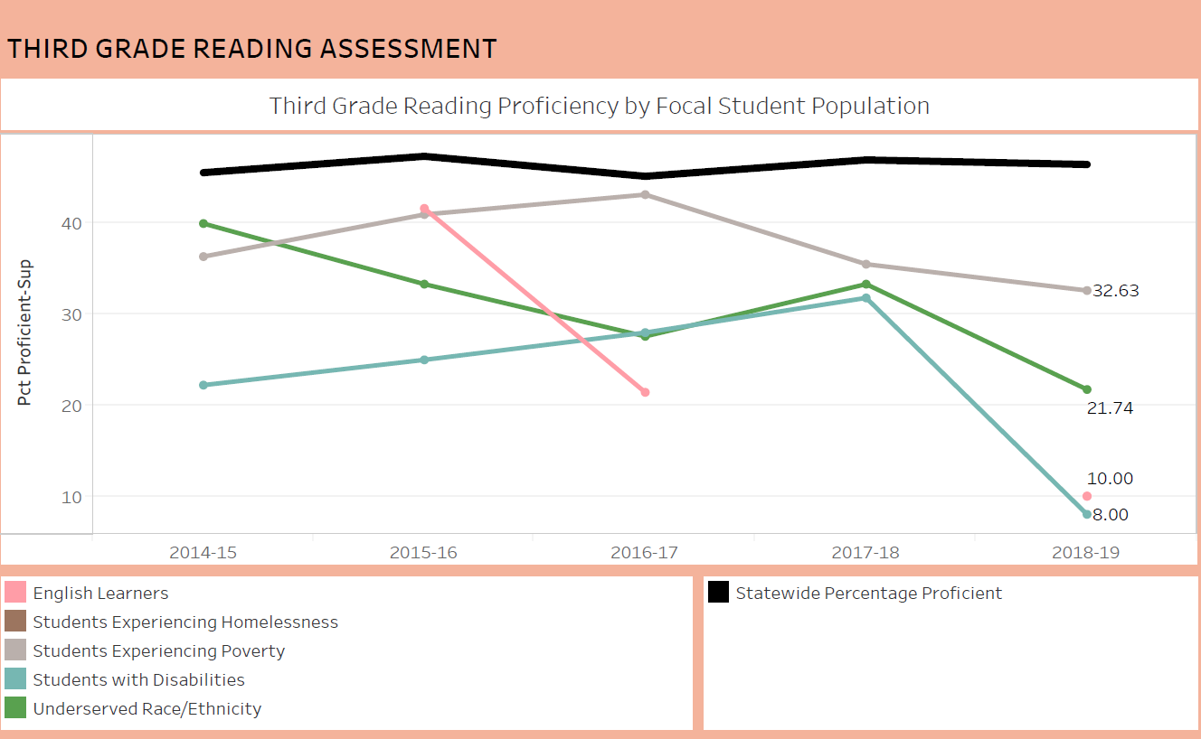
Case Study pg 3
Case Study: 3rd Grading Reading

Slide 11
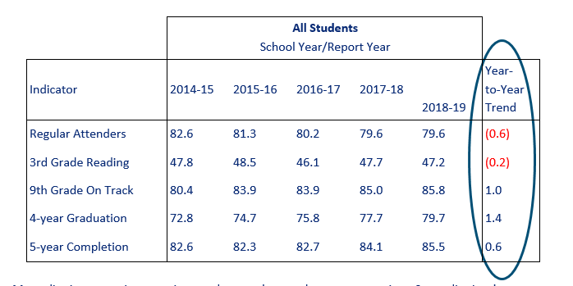
Considering Historic State & Dist. Trends
Considering Historic State & District Trends
The table below shows the last five years of state-level data on each of the five common metrics.

Slide 12
Metrics “Move” Differently
Metrics “Move” Differently
Growth Achieved by the Top 10 percent of Oregon’s Districts
Indicator | Growth Achieved by top 10% of Districts
Regular Attenders | 1.2
3rd Grade ELA | 3.7
9th Grade On Track | 4.4
4-year Graduation | 3.8
5-year Completion | 2.3
For Consideration:
The table shows the growth that the top 10 percent of districts have achieved or exceeded over the last five years.
Average yearly growth at this pace represents a significant achievement..

Slide 13
How we got started
Case Study: How We Got Started
During needs assessment, large group with stakeholder representation identified six summary statements:
Example:
Summary Statement #1: Compared to their peers in District Y, LatinX and English Language Learners: (1) score lower on statewide reading and math assessments, (2) graduate at lower rates, and (3) experience poorer high school attendance. This group of students does receive fewer behavior referrals and - up through the 8th grade - show better than average attendance rates.

Slide 14

Our Process
Case Study: Our Process
Plot current data from ODE data visualization on template provided by Willamette ESD
Trends/storyline - what is realistic?

Slide 15
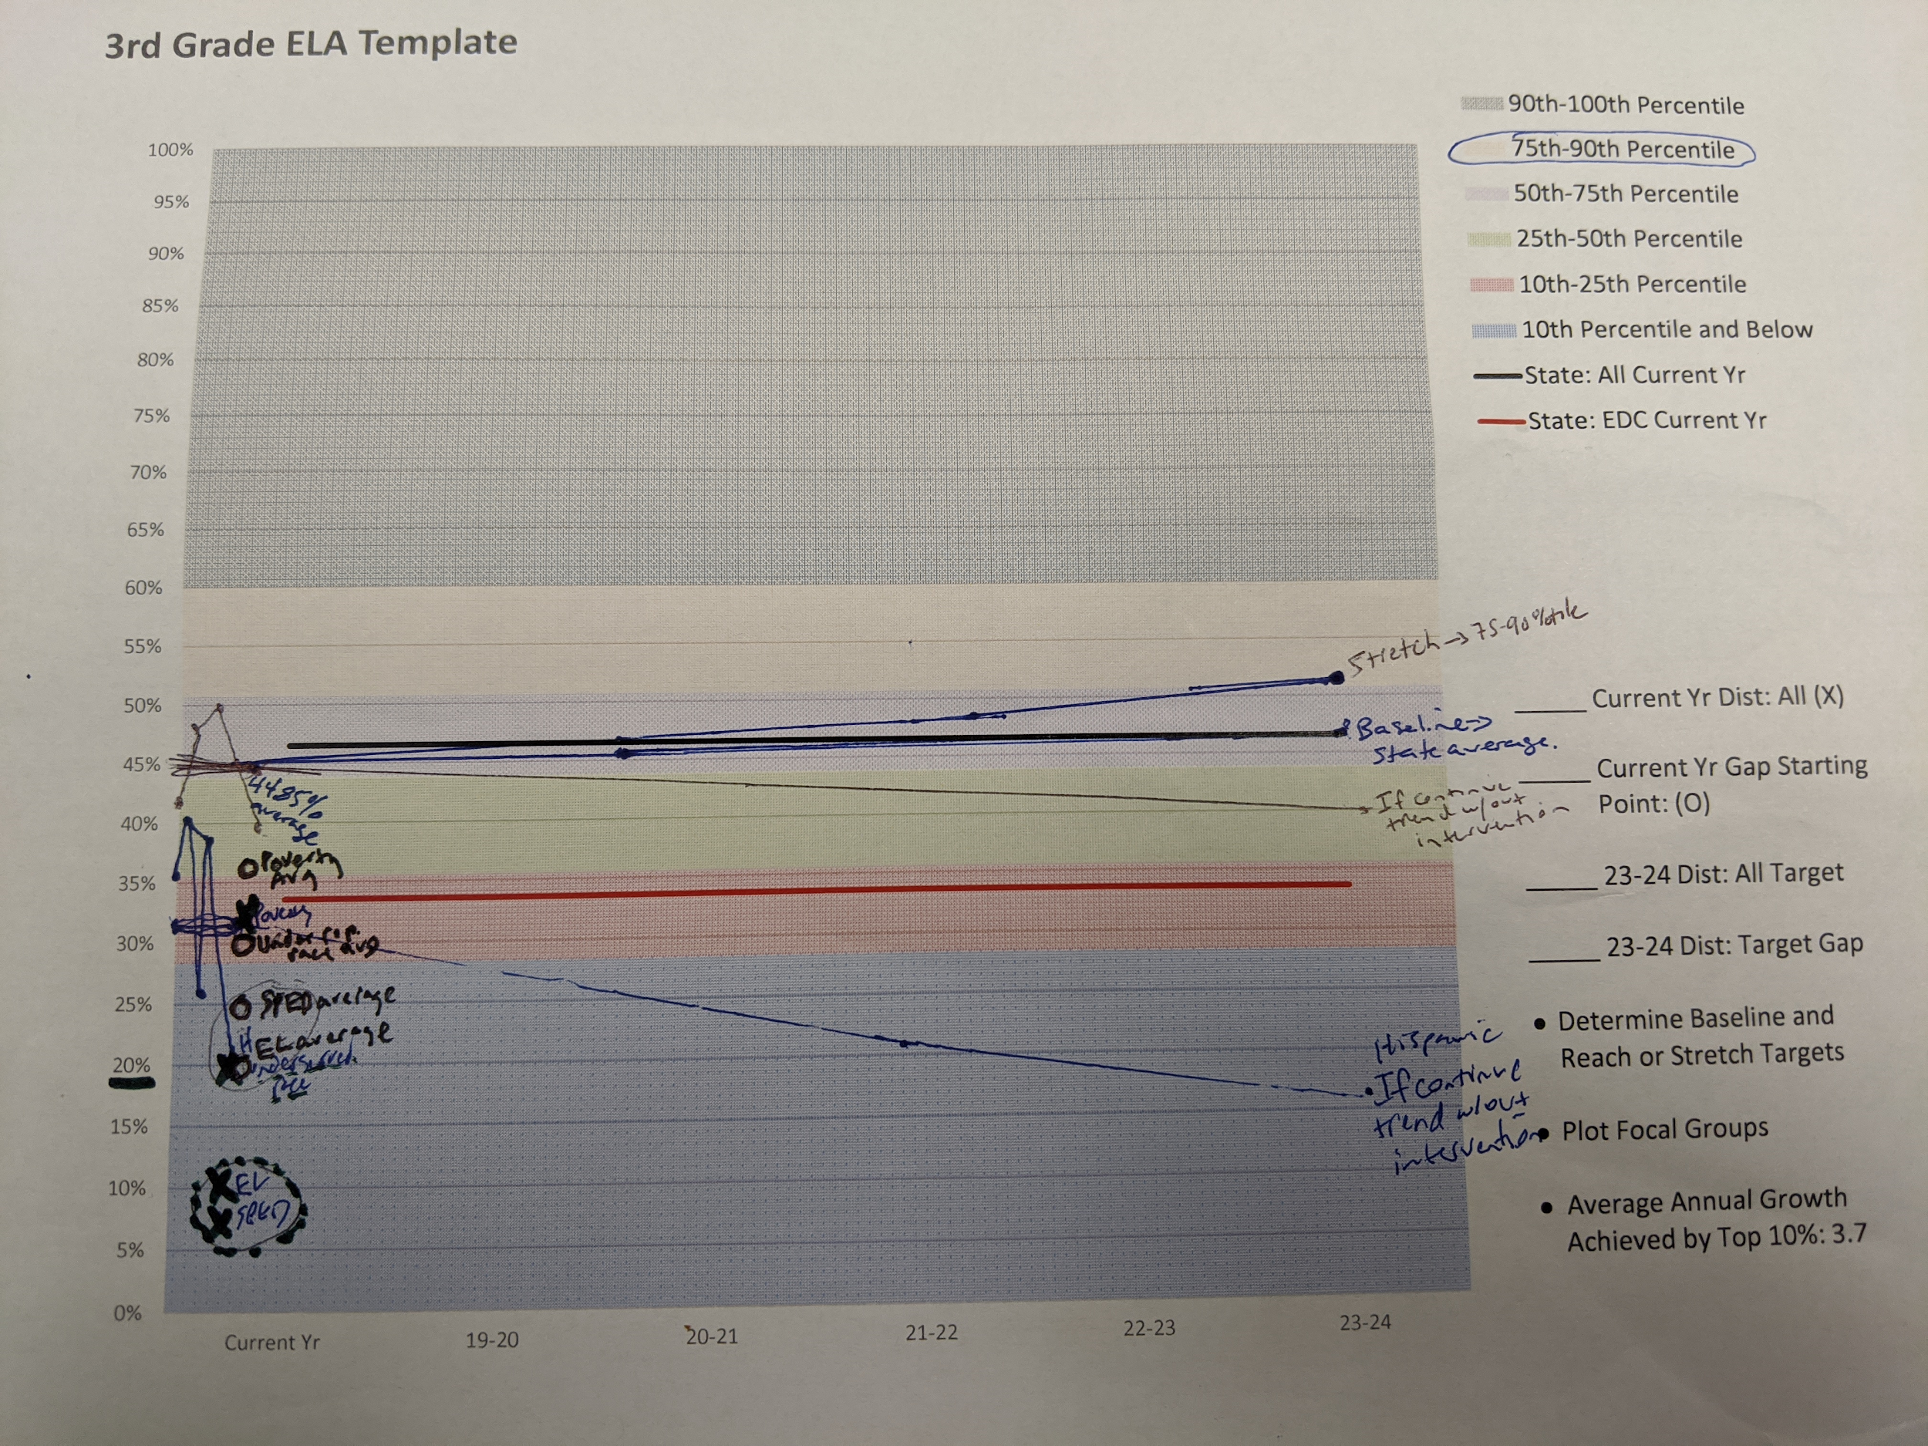
ELA Template

Slide 16
Gap Closing Targets
Case Study: Gap Closing Targets
Realized all groups scored much lower than five year average this past year.
Struggled to find current aggregate % for combined focal groups, so hard to write this target.
We know we want all groups in the 10-25 percentile, and that if Hispanic students and students in poverty meet their 5 year average, we will meet/exceed our stretch target.

Slide 17
ELA Template 2

Slide 18
Developing LPGTs for 3rd gr Reading
Developing LPGTs for 3rd Grade Reading
 |  | Year 1 | Year 2 | Year 3 | Year 4 | Year 5
District-wide | Stretch | 45 | 47 | 49.5 | 51 | 52
 | Baseline | 43 | 44 | 45 | 46.5 | 48
Focal Student Groups | Gap-Closing | 22 | 25 | 28 | 31 | 34

Slide 19
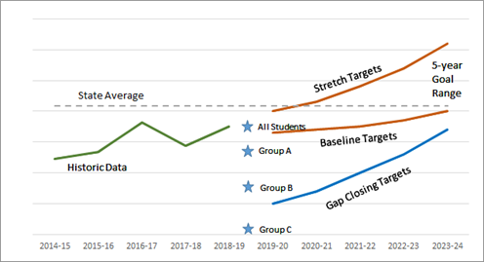
Visualization
Visualization of 3rd Grade

Slide 20
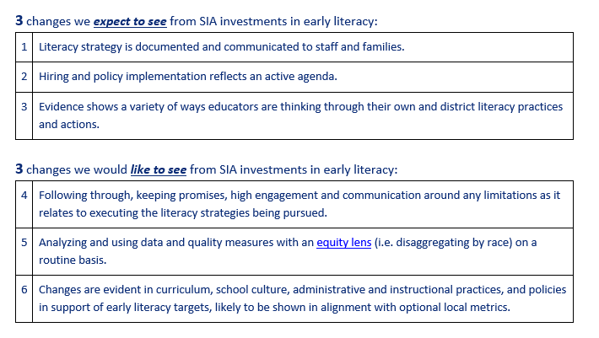
Progress Markers
Progress Markers
Examples of Draft Progress Markers for 3rd Grade Reading

Slide 21
Optional Progress Markers
Optional Progress Markers for 3rd Grade Reading
Partnerships to support EL students language and mental health needs
Shifting progress monitoring platforms

Slide 22
Monitoring Performance
Monitoring Performance Framework for 3rd Grade Reading

Slide 23
Our Questions & Sticky Points
Case Study: Our Questions & Sticky Points
Setting the gap closing target with one number feels opposed to the disaggregated approach to data we have used in the process. Where do we access current aggregate number and how do we continue to communicate specific needs for each focal group while using this target?

Slide 24

Optional Local Metrics
Optional Local Metrics
Applicants may also elect and are encouraged to put forward optional local metrics (in addition to the five common metrics) that may more accurately align to the particular strategies, activities and investments outlined in their SIA grant application and plan.

Slide 25
Local Optional Metrics
Case Study: Local Optional Metrics
Oregon Healthy Teens survey data
Math metric

Slide 26
Big Takeaways
Case Study: Big Takeaways

Slide 27
Co-Development to Agreement
Co-Development to Agreement
Co-Development of Targets begins once Application Meets Requirements
Facilitate Public Review of Grant Agreement & Obtain Board Approval
Submit DRAFT Targets
ODE Initiates Grant Agreement Process
Once your SIA application is reviewed and meets all requirements, ODE will contact you to begin co-development based on the draft targets you submitted.
Applicants must post on webpage and/or make available in district office; present grant agreement at an open board meeting and obtain board approval.
Submit Documentation of Board Approval
Attach your DRAFT targets with your complete SIA Application during submission:
March 2 - April 15, 2020.
ODE will initiate the grant agreement process, to include growth targets as an exhibit for monitoring purposes.
Grant agreement is finalized with ODE and applicant.

Slide 28

Your Questions Answered
Your Questions Answered

Slide 29
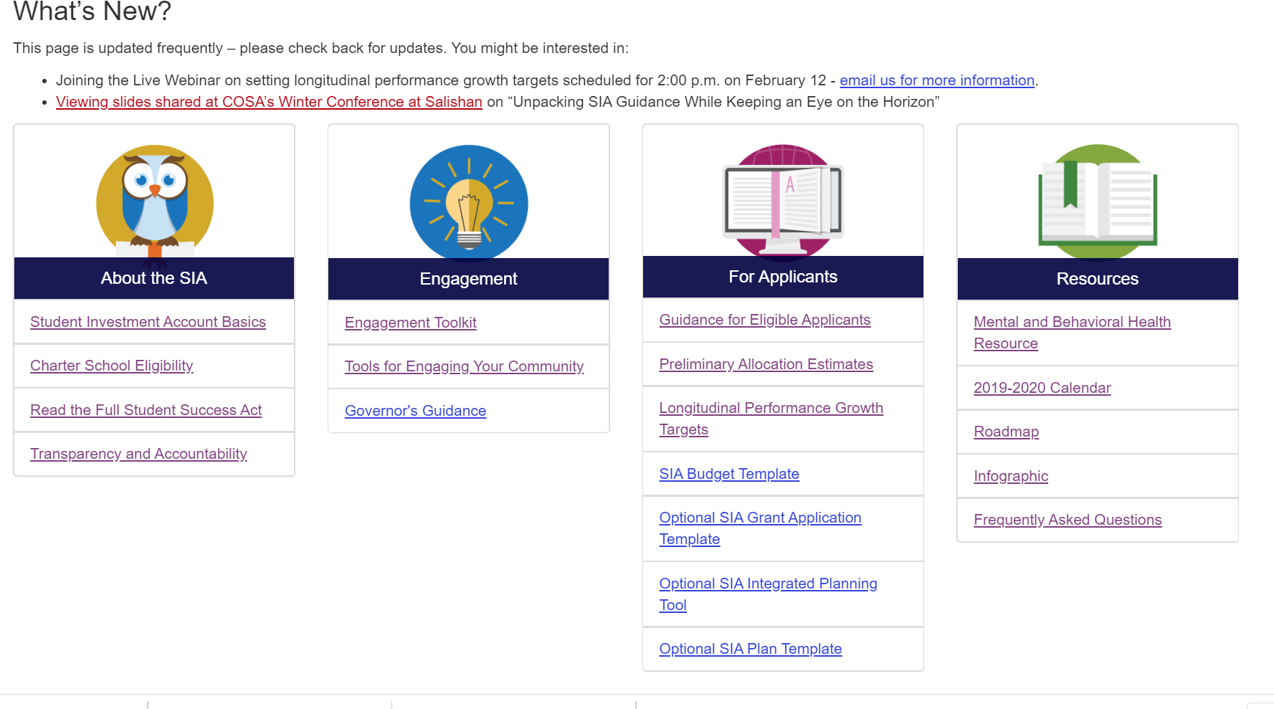
SIA Webpage
SIA Webpage

Slide 30

Here to Help
Here to Help
SIA Application Questions
Rachael Moser rachael.moser@state.or.us
SIA Grant Agreement Questions
Shpresa Halimi shpresa.halimi@state.or.us
General Questions
SIAinfo@state.or.us

