Slide 1
Local Optional Metrics
Webinar 3 of 4 addressing how existing or additional data can be leveraged to broaden the narrative of particular successes and challenges within districts?

Slide 2
A four-part series
Data in Context
How are connections between diverse data sources essential to setting inclusive targets?
Setting Targets by Making Sense of the Mosaic of Data
How can realistic, ambitious, and attainable targets be developed with the data that is available?
Local Optional Metrics
How can existing or additional data be leveraged to broaden the narrative of particular successes and challenges within districts?
Deep Dive Workshop: Setting Growth Targets
How can collaboration support the complexities of establishing realistic targets?
January 11, 2022
3:30-5:00 PM
January 18, 2022
4:00-5:30 PM
February 1, 2022
4:00-5:30 PM
February 15, 2022
4:00-5:30 PM

Slide 3

Today’s Objectives
Our focus this session is to:
Define Local Optional Metrics (LOMs)
Discuss LOM best practices & criteria
Address the synergy between implementation of LOMs and execution of strategies and investments
How can existing or additional data be leveraged to broaden the narrative of particular successes and challenges within districts?

Slide 4

What are Local Optional Metrics (LOMs)?
Metrics established in addition to the five common metrics:
  Third-grade reading proficiency rates measured by ELA
  Ninth-grade on-track rates
  Regular attendance rates
  Four-year or on-time graduation rates
  Five-year completion rate
Local optional metrics are designed to allow applicants to set & monitor metrics connected to the outcomes they set forward.
Sven Ihrke
(thenounproject.com)
From: ODE Integrated Guidance pg. 77

Slide 5
Why Set Local Optional Metrics?
How might investments show positive impacts in student and/or educator well-being, belonging, and health?
LOM are an invitation to track IG investments that honor the needs of students and educators as identified by your regional context and engagement with local communities.
What commitments are you working towards in your districts?
This provides a fuller narrative of what the plan is accomplishing alongside and beyond the 5 Common Metrics.

Slide 6
Why Set Local Optional Metrics?
Discuss:
How could a LOM in this situation tell an even better story to a district’s own community beyond and alongside the 5 Common Metrics ?
Thought Experiment:
Consider: Your community engagement & needs assessment point to prioritizing investments towards student mental & behavioral health, particularly fostering a positive, welcoming, and inclusive school culture & climate.
This priority is not one of the 5 common metrics, though it certainly can impact them.
Your team decides to draft a LOM reflecting community engagement input to tell a story that your investments are producing positive outcomes.

Slide 7

LOM Guiding Principles
Measurable, valid, reliable & evidence-based
Numeric, proportional measurements
Student experiences & outcomes metrics: Overall & by focal student populations
Annual measurement
Broadly representative
Some allowances for metrics attending to a specific focal student group
Employ an equity lens
Sven Ihrke & Seoul Nahwan
(theounproject.com)
From: ODE Integrated Guidance pg. 77

Slide 8

HB 2060: An Opportunity to Monitor Supports of Student Mental and Behavioral Health
Authorizes State Board of Education to establish targets for student mental & behavioral health
Not required
Allow alignment of SIA funds to desired changes that traditional metrics do not capture
Creative Stall
(theounproject.com)
Recommendations:
  Systems-level rather than individual, static outcomes
  Focus on domains:
    safety
    belonging
    school culture and climate
    access to mental health services and supports

Slide 9
Criteria for LOMs focused on Mental and Behavioral Health
Consistently measurable
Evidence-based
Data are disaggregated by focal student groups &/or staff
Culturally responsive
Align with the purpose of optional targets
Connect to an investment
From: 581-014-0028
Sven Ihrke & Seoul Nahwan
(theounproject.com)

Slide 10
LOM Activity
We’ll spend some time looking at mock data for a mid-sized Sample District.
The mock data we’ll look at together is from the Community Engagement Survey Item Bank, specifically from the domain of School Culture & Climate.
Our Steps:
Review the data
In break-outs:
Read the scenario for Sample District
Consult Sample District using the template
Prepare to share back out with the group

Slide 11
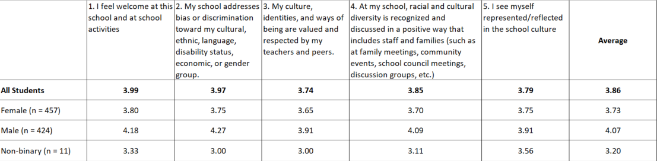
School Climate & Culture for Sample District
What are some main takeaways?
.

Slide 12
Share Out
What observations or questions emerged from this activity?

Slide 13
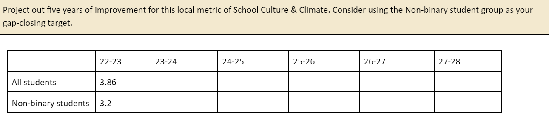
Projecting Ahead

Slide 14
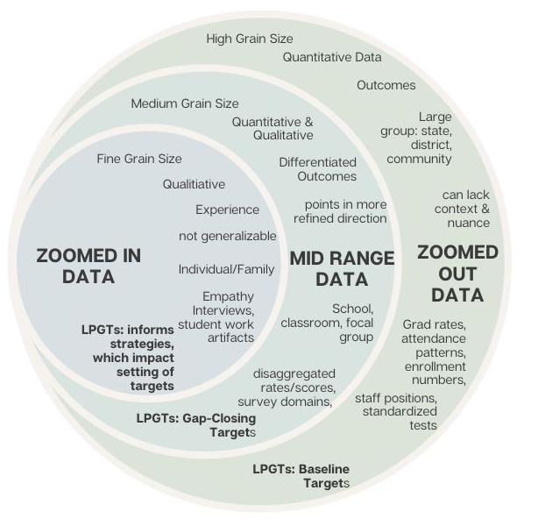

LOM with a Small & Rural School Lens
Schools w/ > 80 ADMr not required to set LPGTs of the 5 Common Metrics, but can choose to set Local Optional Metrics as part of their evaluation & monitoring processes in addition to Progress Markers that are required for all.
Advantages of LOM specifically for Small & Rural Schools:
Data sources with a smaller grain size (with appropriate N size of 10+ Students)
  Zoomed-In data = local context → capture more detail
Consider strengths specific to the local community and prioritized investments- powerful additions to the overall narrative

Slide 15
The Many Possibilities of LOM
Student Health Survey
Local culture and climate survey for students and families
5th / 7th Grade Math Proficiency
Teacher to student ratio
Exclusionary discipline rates
Multilingual literacy in grades 4 or 5
Mental health provider to student ratio
Advanced coursework completion rates
Dropout/Pushout rates
Rates of students completing ___ project (capstone, senior, 8th grade, etc.)
Number of co-curricular or extracurricular student clubs
Percentage of 11th grade students taking career exploration opportunities
Staff climate survey

Slide 16
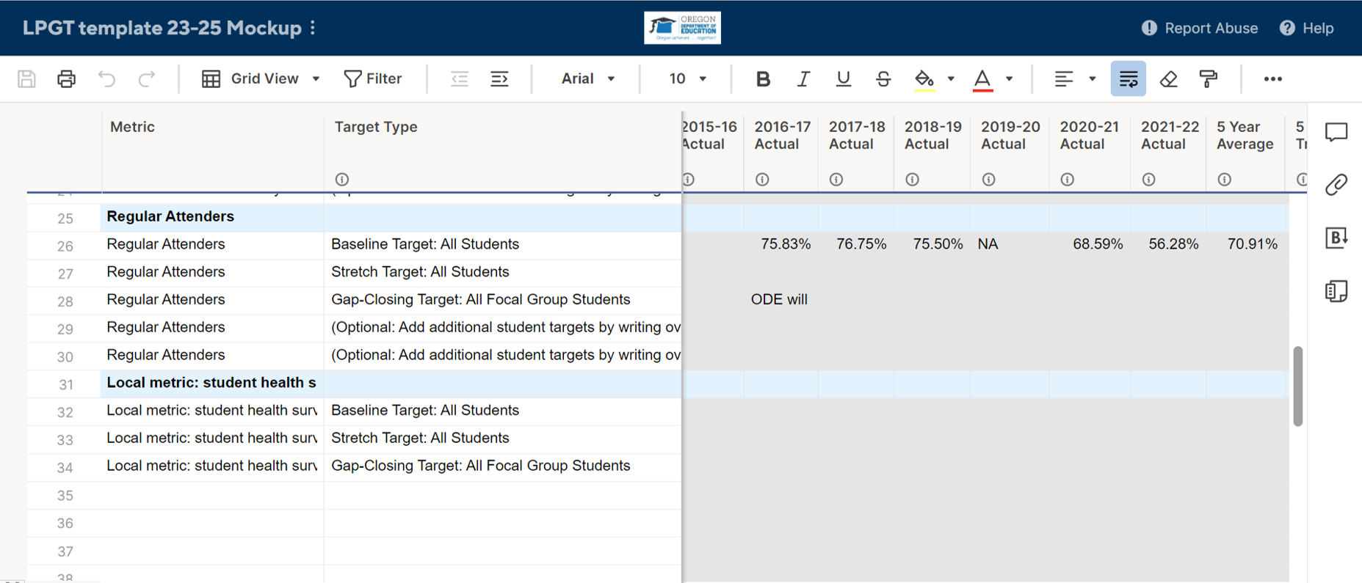
Submitting Draft LOMs
Number not restricted
Meet minimum N (sample) size
Data from prior years submittable
Baseline and Gap-closing targets encouraged
Comments: Information on the metric and how criteria are met

Slide 17
Co-Development: Working Together
Goal: collaborative crafting of ambitious, attainable, and realistic targets for applicants.
In this process, we’re looking to really understand the why behind how draft targets were determined and to understand decision making that is based on regionally specific context.
We can offer these supports: | Applicants can support this process by:
Collaborative, open & regular communication with Applicants. Access to a Google folder of shared artifacts, documents, and Smartsheet spreadsheets. | Collaborative, open & regular communication with ODE. Submitting Smartsheet application with draft LPGTs by deadline: March 31, 2023.

Slide 18
Address ‘’Open Meeting with Public Comment”
The statutes say opportunity for the public to comment at an open meeting. They could have said just opportunity to comment on the plan or LPGTs. But they chose to specify that the comment had to occur at an open meeting.
Options that work
Allow real-time public comment during the meeting after the presentation or clear prior posting of the plan for the public to comment on. | Allow access and input through electronic public comment with enough time for the public to have seen the plan and presentation prior to finalizing.
Remember, your board needs to approve your plan/application submission AND they will need to review and approve your final agreement with your LPGTs

Slide 19
Resources from this Session
Integrated Guidance
Oregon state Legislature
  House Bill 2060
Oregon Administrative Rules Chapter 581 Division 14:
  581-014-0022 Definitions of Optional Targets for Mental and Behavioral Health for the Student Investment Account
  581-014-0025 Purpose of Optional Targets for Mental and Behavioral Health for the Student Investment Account
  581-014-0028 Optional Targets Criteria for Mental and Behavioral Health for the Student Investment Account
  581-014-0031 Optional Targets Administration & Reporting for Mental and Behavioral Health for the Student Investment Account
U.S. Department of Education Office of Elementary and Secondary Education:
  Leveraging Evidence-Based Practices for Local School Improvement
ODE Community Engagement Survey Bank

Slide 20
Next Session & Beyond:
Contextualizing Data
Thank you for joining us!
Setting Targets by Making Sense of the Mosaic of Data
Thank you for joining us!
Local Optional Metrics
Thank you for joining us!
Deep Dive Workshop: Setting Growth Targets
How can collaboration support the complexities of establishing realistic targets?
February 15, 2022
4:00-5:30 PM

