Slide 1
Welcome
LPGT Workshop
What are we learning about?
Sharing, Insights, Development of Progress Markers, LPGT
and SIA Evaluation Approach
June 25, 2020

Slide 2

Introductions
Introductions
Please use chat to introduce yourself.
Type your name and affiliation in the chat box.

Slide 3
Agenda
Agenda Items
Welcome, Introductions, Goals, Norms
SIA Common and Customized Framework Overview
Progress Markers
LPGT Development Examples (Trends, lessons learned)
Q+A Session
Closing

Slide 4
Workshop Goals
Workshop Goals
Honor SD’s work that went into the development of Progress Markers and LPGTs.
Share some of the patterns, trends and lessons learned from the Progress Markers and LPGT development and review process
Create space for shared learning and growth opportunities
Explore opportunities for using a Common and Customized Framework to inform decision making processes that are bigger than the SIA framework.
Provide SD’s who didn’t draft growth targets with ideas and insights into where to begin with LPGT development.

Slide 5
Protocol
Suggested Protocol for Dialogue
Trust is earned - and let’s attempt to move in conversation like we’ve got several years working together already behind us.
Engage tension, don’t indulge drama.
Share space - help collectively balance the insights of verbal and quick processors with the wisdom of those who might appear more reticent.
Dialogue, not selling - let’s converse not pitch.
Assume best intent, attend to impact.
Pay attention (neighbors, yourself, group process and dynamics).

Slide 6
Student Success Act (SSA)
SIA Common and Customized Monitoring & Evaluation Framework
Presenter: Shpresa Halimi, SIA Grant Management and Monitoring (ODE)

Slide 7
Framework
Common and Customized Monitoring and Evaluation Framework
Longitudinal Performance Growth Targets for 5 Common Metrics
Four Year Graduation
Five Year Completion
Third Grade Reading
Ninth Grade on Track
Regular Attenders
Progress Markers
Optional Local Metrics

Slide 8

LPGT
What are Longitudinal Performance Growth Targets (LPGT)?
Longitudinal Performance Growth Targets are:
Based on data available for longitudinal analysis;
Use overall rates for districts and gaps in disaggregated rates; and
Include the common metrics and any locally defined metrics included in an applicant’s SIA plan.

Slide 9
LPGT Tables
LPGT
District-Wide
 | Year 1 20-21 | Year 2 21-22 | Year 3 22-23 | Year 4 23-24 | Year 5 24-25
Stretch Target
Baseline Target
Focal Student Groups
 | Year 1 20-21 | Year 2 21-22 | Year 3 22-23 | Year 4 23-24 | Year 5 24-25
Gap Closing

Slide 10
Progress Markers
What are Progress Markers?
For each of the five common metrics, ODE introduced the use of “progress markers” - sets of indicators that identify the kinds of changes we would expect and like to see in policies, practices and approaches over the next three years that we think would lead to applicants reaching their longitudinal performance growth targets.
“Expect to see” progress makers represent initial, easy to achieve changes that indicate a recognition of and commitment to SIA plan goals.
“Would like to see” progress markers represent longer term likely changes and indicate more active learning and engagement.
Enabling Conditions: changes that seem to be essential enabling conditions for growth towards each of the Common Metrics. E.g. Equity lens is in place, adapted, and woven through all policies, procedures and practices.

Slide 11

Optional Local Metrics
Optional Local Metrics
Applicants may also elect and are encouraged to put forward optional local metrics (in addition to the five common metrics) that may more accurately align to the particular strategies, activities and investments outlined in their SIA grant application and plan.

Slide 12
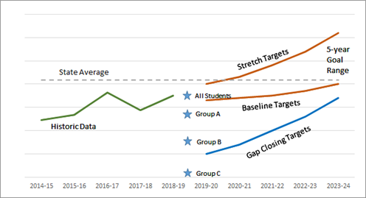
Monitoring Performance Framework
Monitoring Performance Framework
LPGT
Optional
Local
Metrics
Progress Markers
Expect to See
Would like to See

Slide 13

A Few Notes
A Few Notes on this Approach
Creates the most flexibility for districts to respond to the variance of differing demographics while keeping a focus on closing opportunity and achievement gaps.
Does not create undue burden through the creation of page after page of targets.
Creates a system that highlights focal groups that are experiencing the greatest academic disparities.
Eliminates the confusion of setting or not setting targets individually for small groups of students.

Slide 14
Student Success Act (SSA)
Launching Draft Progress Markers
Presenters: Shpresa Halimi (ODE)
ESD Liaisons:
Sue Wilson, Lane ESD
Angie Arriola, Malheur ESD

Slide 15
Progress Markers Development
Progress Markers Development
This framework was developed through rounds of engagement with leading experts in each common metric, practitioners, and policy advocates. This work was completed and refined prior to the significant impacts associated with the ongoing public health crisis.
This work is being shared now as ODE continues work to implement the Student Investment Account amidst uncertain circumstances. The progress markers being presented could change and evolve through the year based on school district, ESDs and community feedback to further adapt to the evolving Oregon’s educational system.
While there are many questions about the future of Student Investment Account we are releasing Progress Markers in the spirit of continuous improvement and a desire to support learning that helps SDs inform decisions that are bigger than the SIA framework.

Slide 16
Examples
Examples
Progress Markers | Four Year Graduation | Five Year Completion | Third Grade Reading | Ninth Grade on Track | Regular Attenders
Expect to See | Meaningful community engagement informs strategies for increasing the number of students who graduate ready for college or ready to pursue meaningful work. |  | Schools and districts have a complete inventory of literacy assessments, tools, and curriculum being used (or not used) | Systems analysis is conducted to identify district and school level barriers to 9th grade success. | Schools and families are partnering to promote the importance of engagement in school and identify barriers that impact student attendance.
Would Like to See | Changes are evident in curriculum, school culture, administrative and instructional practices, master schedule, and policies in support of graduation targets. |  | Increased communication exists between educators and families about student growth, literacy trajectory, areas for improvement, and providing individualized supports. | Develop with students and families a 9th grade on track intervention plan | District policies reflect geographic and cultural norms of the community and schools implement practices that are proactive for medical/health/bereavement needs

Slide 17
Experts
Hearing from the experts...
Sue Wilson
Angie Arriola

Slide 18
Launching Draft Progress Markers
Launching Draft Progress Markers
Draft Progress Markers can be accessed here
Provide Feedback on Progress Markers using this form

Slide 19
Student Success Act (SSA)
LPGT Development - Examples
Presenters: Tim Boyd, Leah Thorp, Shawna Moran (ODE)
ESD Liaisons:
Ella Taylor, Willamette ESD
Brian Bain, Northwest Region ESD
Madi Koenig, InterMountain ESD

Slide 20
Review Protocol
LPGT Review Protocol
Did the applicant include targets for each of the 5 common metrics?
Did the applicant include a “gap closing metric” for focal student groups?
Are the targets reasonable (not too high or too low)?
Do the “gap closing targets” begin to close gaps?
( Optional Local Metrics - if any)

Slide 21
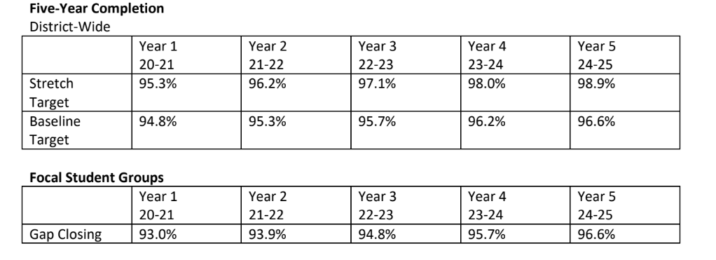
Strong Examples
LPGT - Strong Examples
Four-Year Cohort Graduation Rate Targets
 | 14/15 - 18/19 5-Year Median | Year 1 2019-2020 | Year 2 2020-2021 | Year 3 2021-2022 | Year 4 2022-2023 | Year 5 2023-2024 | Factor
Starting Point | 84 | 84 | 84 | 84 | 84 | 84 | NA
Baseline Targets | 84 | 85.0 | 86.0 | 87.0 | 88.0 | 89.0 | 1.0
Stretch Targets | 84 | 85.9 | 87.8 | 89.7 | 91.6 | 93.5 | 1.9
Gap Closing Targets | 79 | 81.0 | 83.0 | 85.0 | 87.0 | 89.0 | 2.0

Slide 22
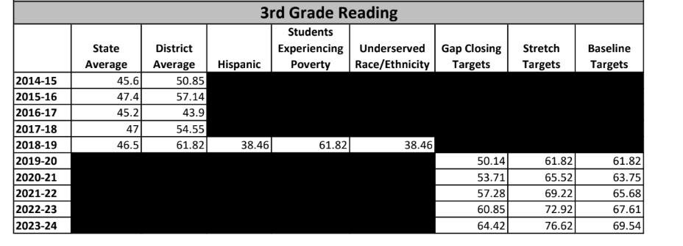
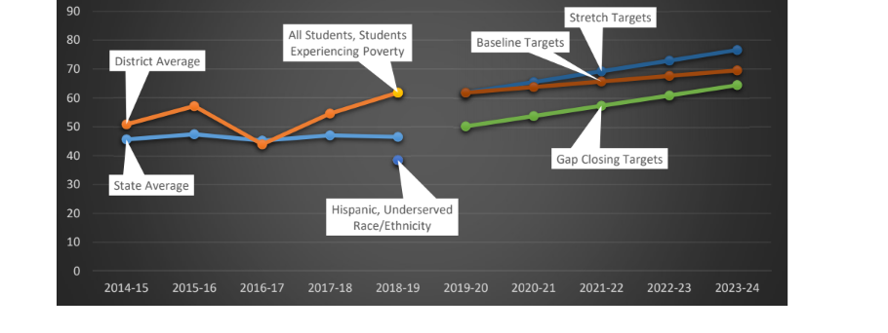
Strong Examples Continued
Strong Examples….

Slide 23
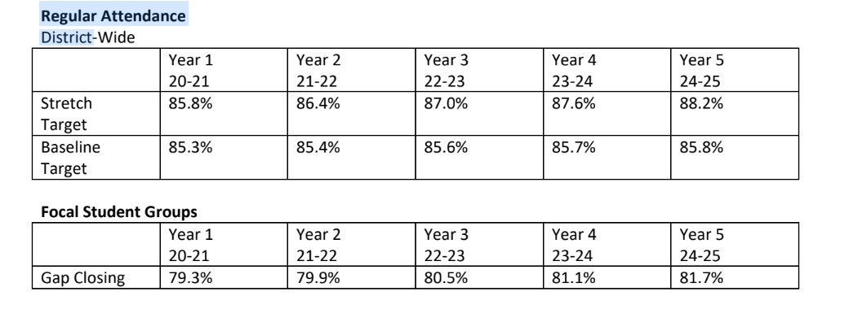
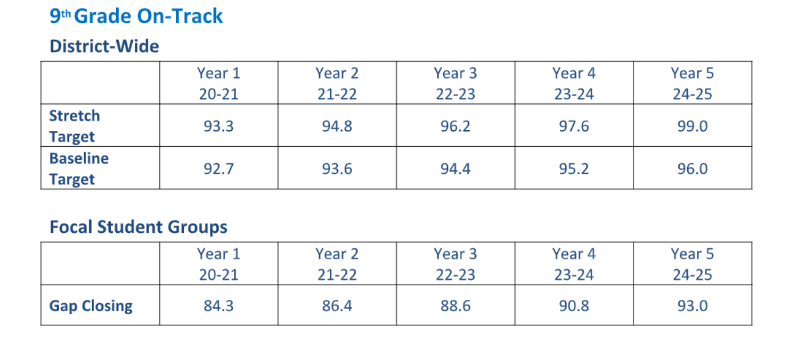
Continued
Strong examples….

Slide 24
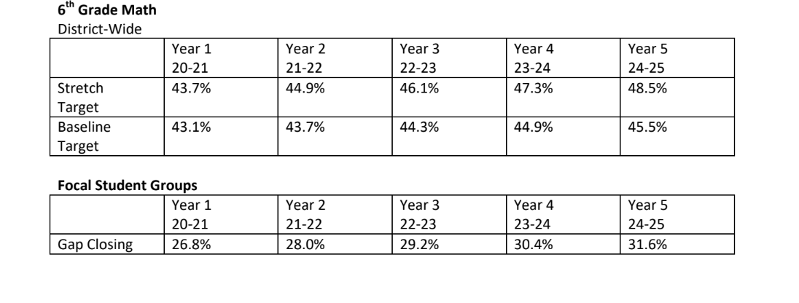
Local Optional Metric
Local Optional Metric

Slide 25
ESD Liaisons
LPGT Development Process
ESDs Liaisons

Slide 26
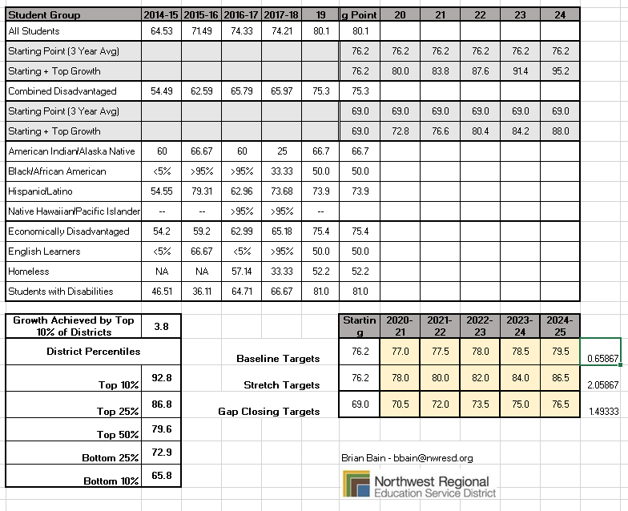
Templates
Templates used by ESDs

Slide 27
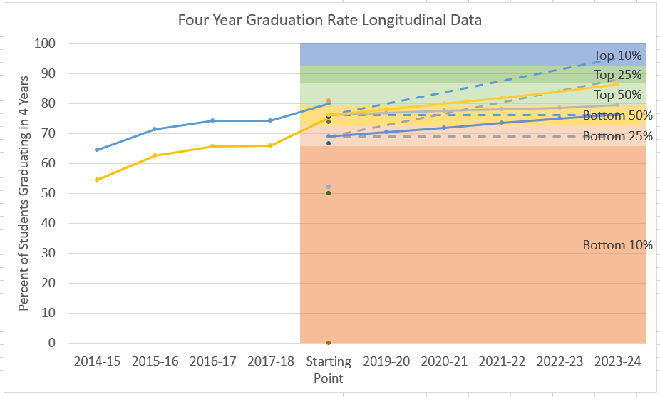
Templates continued
Templates used by ESDs

Slide 28
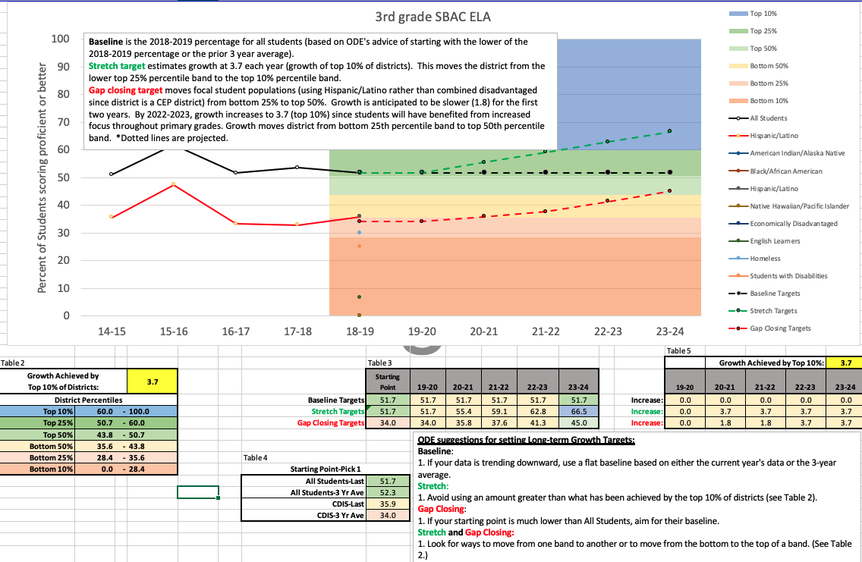
Templates Continued.
Templates used by ESDs

Slide 29
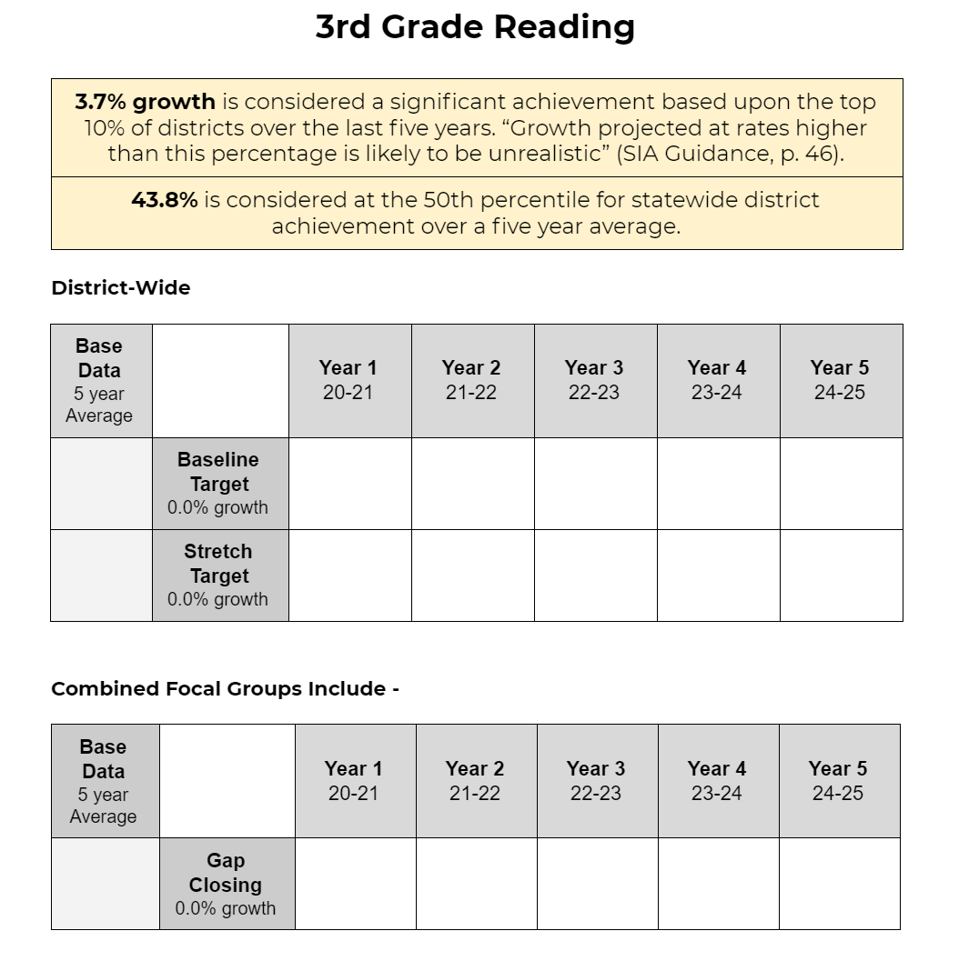
More Templates
Templates used by ESDs

Slide 30
Counter Examples
LPGT - Counter Examples
Unrealistic Targets
Gap widening vs Gap Closing Targets
Gap Closing Targets for one focal group
Flat Baseline
Optional Local Metrics must be in addition to the Common Metrics

Slide 31
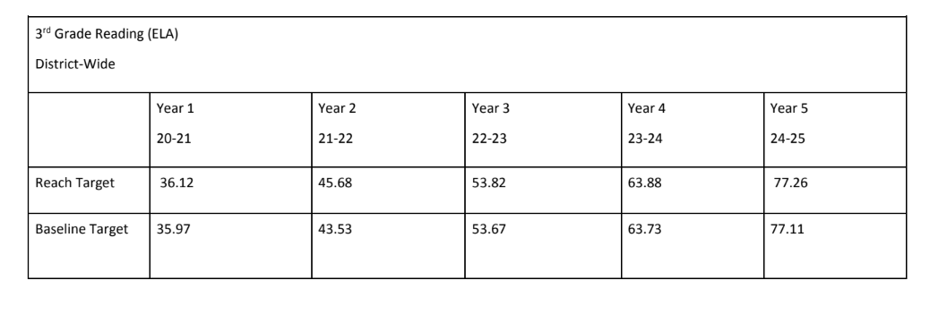
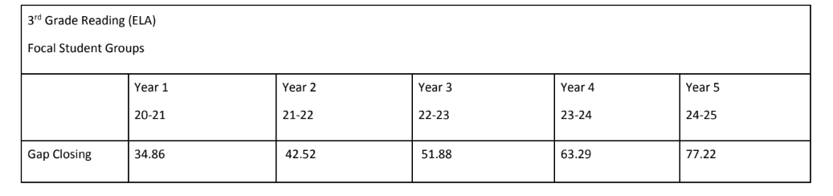
Unrealistic Targets
Unrealistic Targets

Slide 32
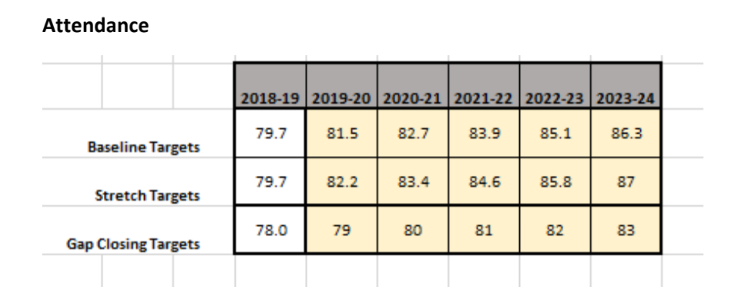
Gaps
Gap widening vs. Gap Closing Targets
Difference: 1.7 2.5 2.7 2.9 3.1 3.3

Slide 33
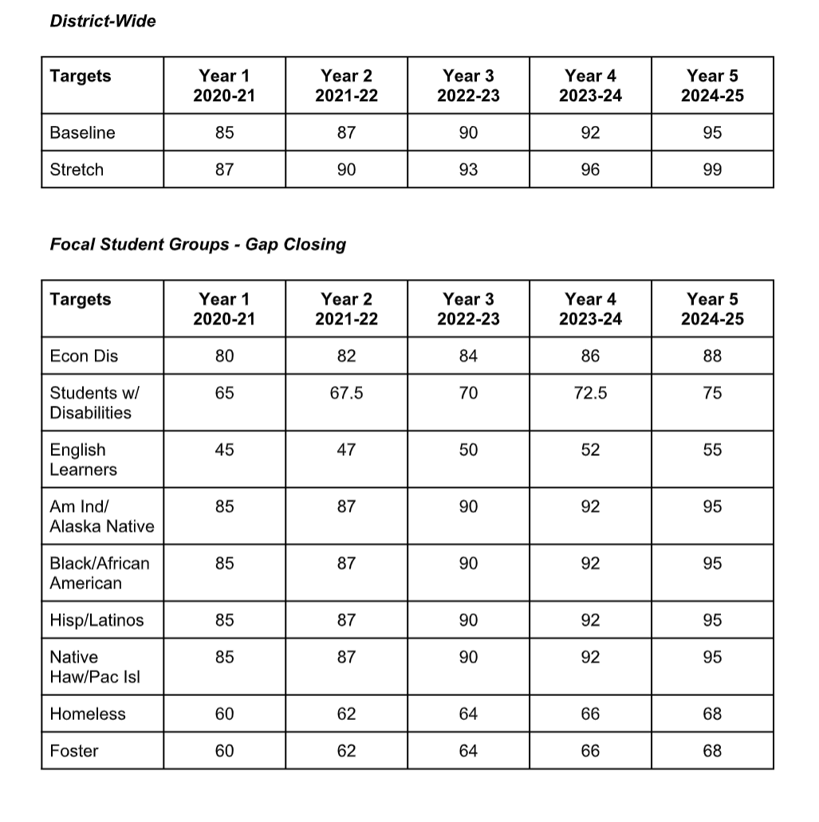
Gap Targets
Gap closing targets for all groups

Slide 34
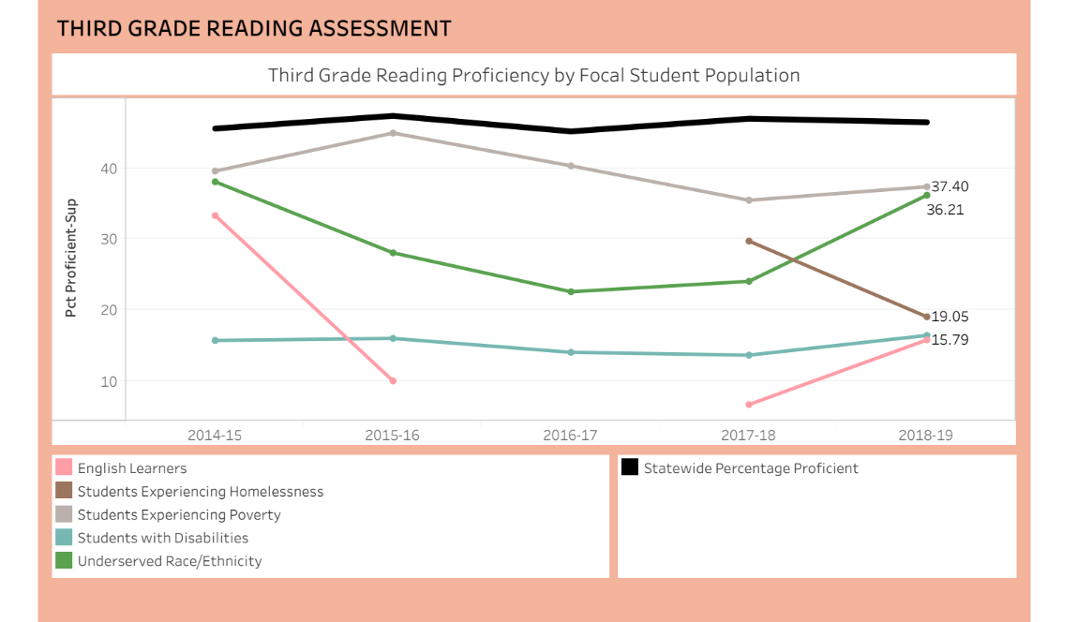
Gaps on one focal group
Gap closing target focused on one focal group
3rd Reading | All | 37 | 37 | 38 | 39 | 40 | 40
 |  |  | 38 | 39 | 40 | 40 | 41
 | Latino | 33 | 34 | 35 | 36 | 38 | 40

Slide 35
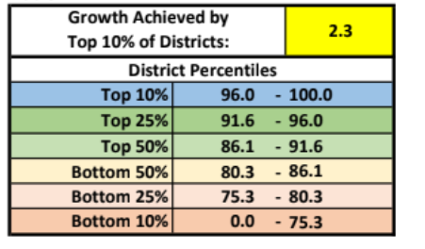
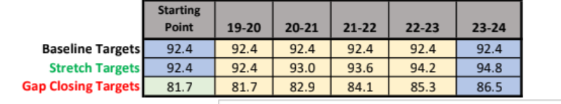
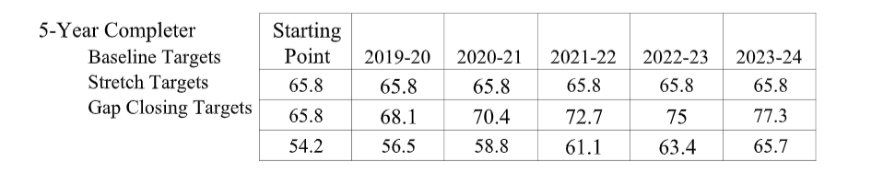
Flat Baseline
Flat Baseline - 5 Year Completion (example)

Slide 36
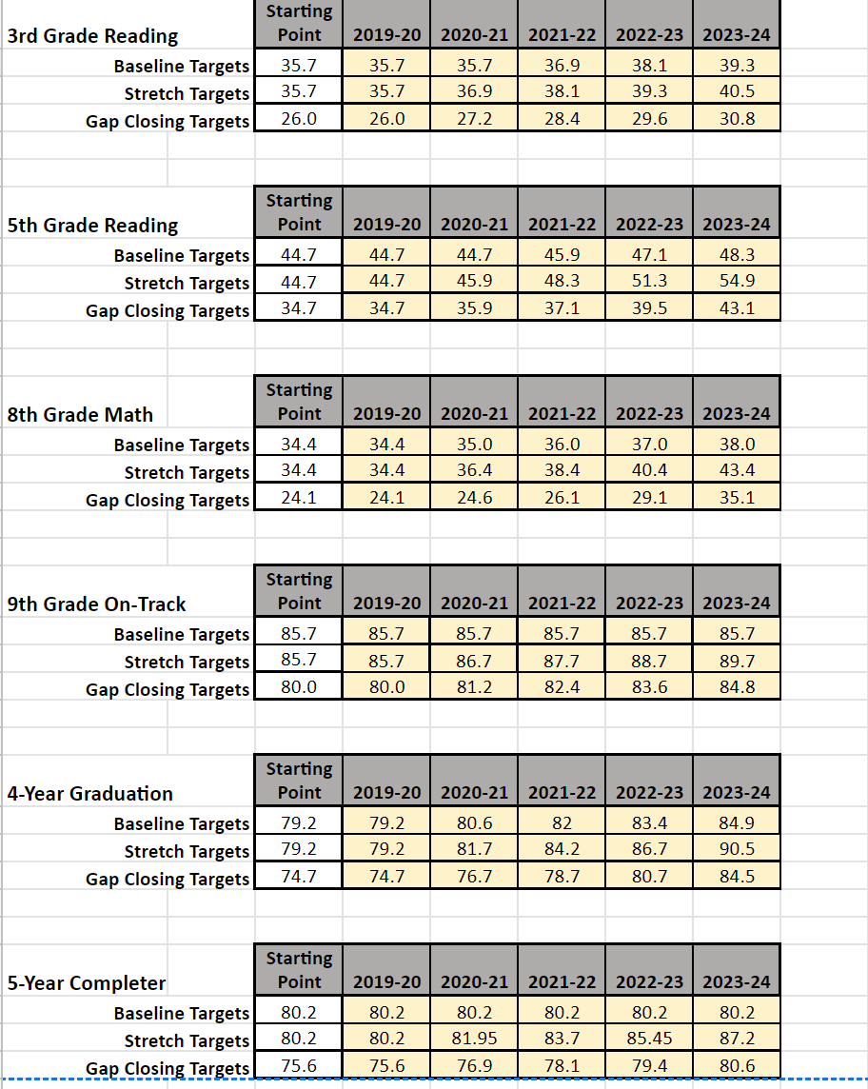
Optional Local Metrics.
Optional Local Metrics must be in addition to the Common Metrics

Slide 37
Observations, Comments, Lessons
Observations, Comments, Lessons Learned
ESDs Liaisons

Slide 38
Q+A
Q+A Session

Slide 39
Thank you
THANK YOU!
Please provide feedback on the workshop using the Chat function...

