Slide 1

STEM & CTE UPDATE
Mark Lewis Laura Roach Patrick Crane
STEM/CTE Policy Director CTE Director, Dept. of Education Director, CCWD
Chief Education Office
Notes:
LC to lead… emphasize importance of STEM and CTE to the Governor.

Slide 2


Slide 3
High Quality Jobs
Differential Income
 | Non-STEM Job | STEM Job | % Difference
High School Diploma or Less | $15.55 | $24.82 | 60%
Some College or Associate Degree | $19.02 | $26.63 | 40%
Bachelor’s Degree Only | $28.27 | $35.81 | 27%
Graduate Degree | $36.22 | $40.69 | 12%
STEM = higher lifetime earnings (~25% more on average)
Higher state tax revenues
More $ in the economy
Family wage jobs and break cycle of poverty
Decreased reliance on social services

Slide 4
STEM Outcomes for the Class of 2005
Oregon’s STEM Pipeline

Slide 5
STEM Investment Council
Established by HB 2636 (2013)
    Advance Science, Engineering, Technology and Mathematics (STEM) education goals to drive economic growth:
    By 2025, double number of students proficient in math and science
    By 2025, double post-secondary STEM degrees and certificates

Slide 6
STEM Investment Council
Chief Education Officer
STEM Investment Council
Develop STEM Strategy
Engage industry & other partners
Guide & support innovation initiatives
Recommend investments and policies
Define outcomes & metrics
Monitor impact of investments
Higher Education Coordinating Commission
Universities
Community Colleges
Oregon Department of Education
Early Learning Division
Advisory Committee
Youth Development Council
Notes:
LC
The STEM Investment Council plays a critical role in advising the Chief Education Officer. The charge that we heard from the Legislature was to more tightly connect education with workforce and economic development. As we take actions to improve and build a seamless system of education, we recognize that the purpose of education is to drive the health and prosperity of individuals, communities, and our economy.

Slide 7
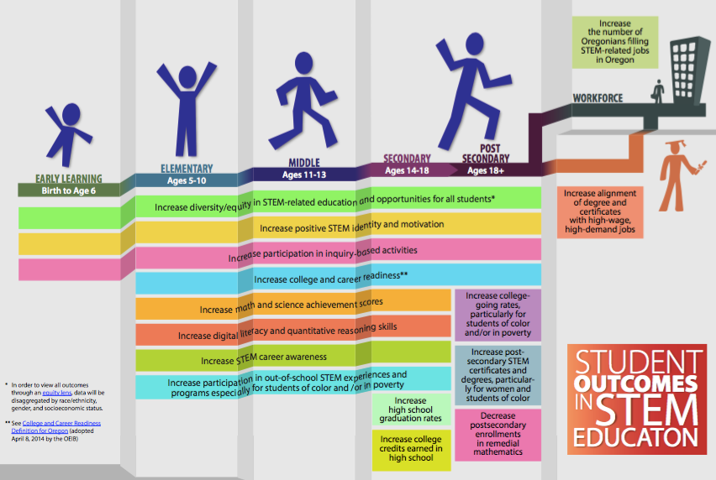
Student Outcomes
Notes:
One of the committees of the STEM Investment Council has been focused on determining the outcomes and metrics that we will use to monitor the impact of investments.
If we hope to inspire and prepare students to meet the needs of high-wage, high-growth sectors in our economy, we know that we need to start early and invest in actions along the entire continuum. Individuals make up their minds begin to form their individual identities in late elementary and middle school. We also recognize that

Slide 8
Strategic Plan
Vision: To build an inclusive, sustainable, innovation-based economy by reimagining and transforming how we educate and empower individuals and communities.
GOALS
Inspire and empower our students to develop the knowledge, skills, and mindsets necessary to thrive in a rapidly-changing, technologically rich, global society.
Ensure equitable opportunities and access for every student to become a part of an inclusive innovation economy.
Continuously improve the effectiveness, access to resources, and the number of formal and informal STEM educators.
Create sustainable and supportive conditions to achieve STEM outcomes aligned to Oregon’s economic, education, and community goals.

Slide 9
2015-2017 Investments
HB 3072
Regional STEM Hubs, $5m
  “Backbone” Coordination functions
  Program Funding
  Scale-up Initiatives
STEM Innovation Grants, $4.75m
  Mathematics
    Pilot adaptive learning platforms
    “Math in real life” – contextualized professional development
  Digital Literacy & Computer Science
  Out of School network and programs
Post Secondary Success, $2m
  Underserved and underrepresented students
  Support services: Recruitment, retention, attainment
Notes:
Working closely with the Department of Education – State CTE Director, Laura Roach and Salam Noor.

Slide 10
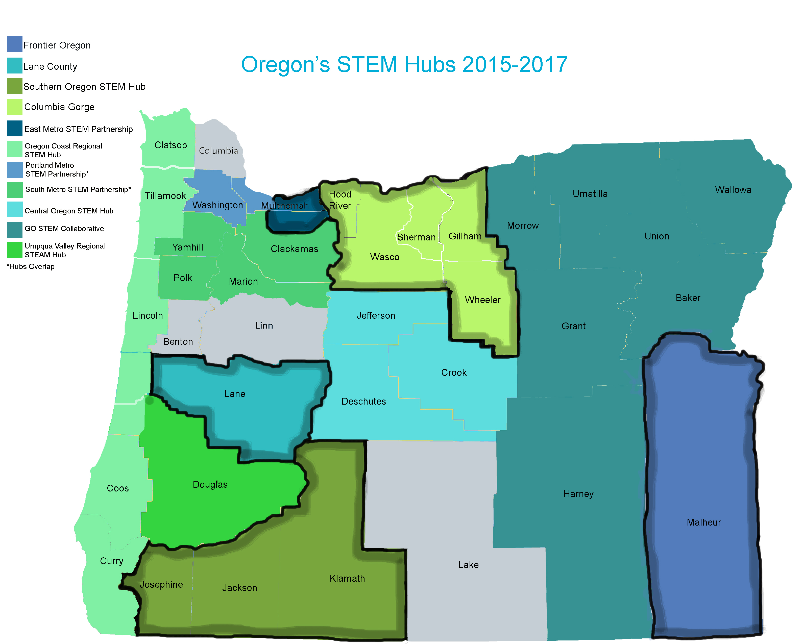
Notes:
Recently added

Slide 11

K-12 CTE Initiatives

Slide 12
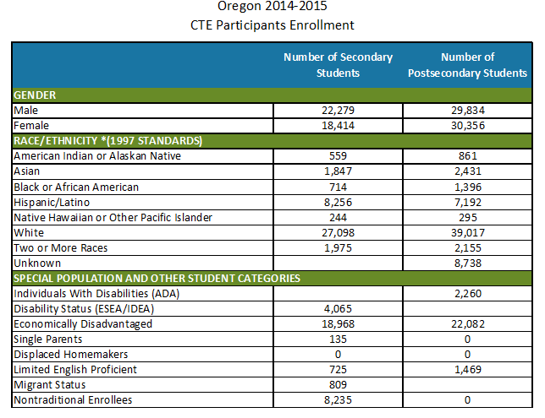
Participants: Concentrators:
Secondary = 40,693 Secondary = 18,182
Postsecondary = 60,190 Postsecondary = 21,656

Slide 14
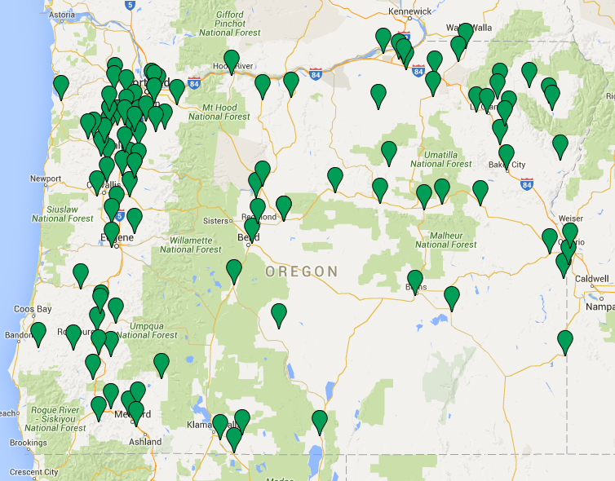
Agriculture, Food & Natural Resources
108 Programs

Slide 15
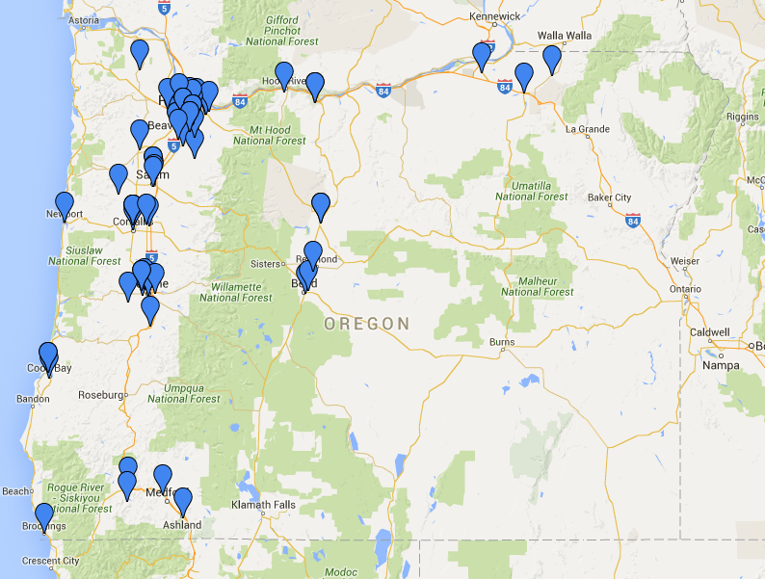
Arts, Information & Communication
79 Programs

Slide 16
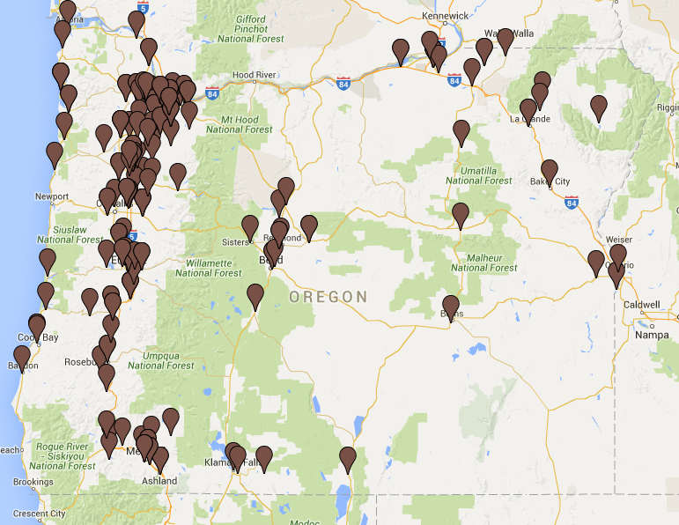
Business & Management
188 Programs

Slide 17
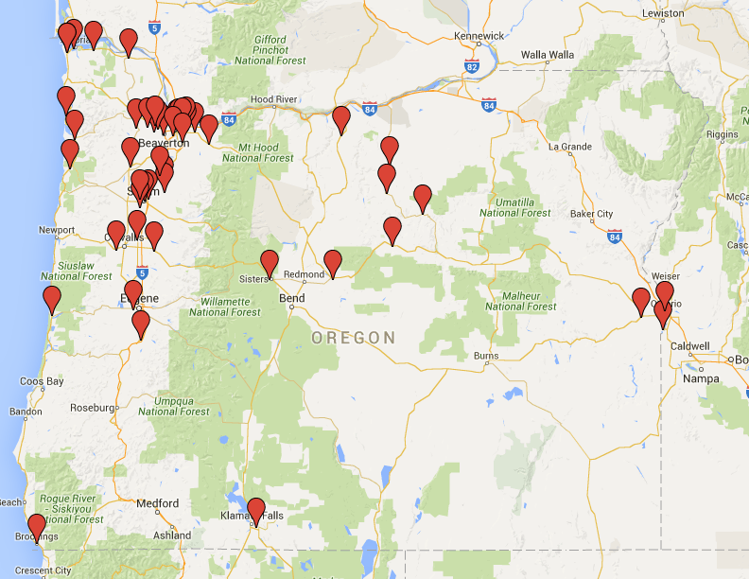
Health Sciences
49 Programs

Slide 18
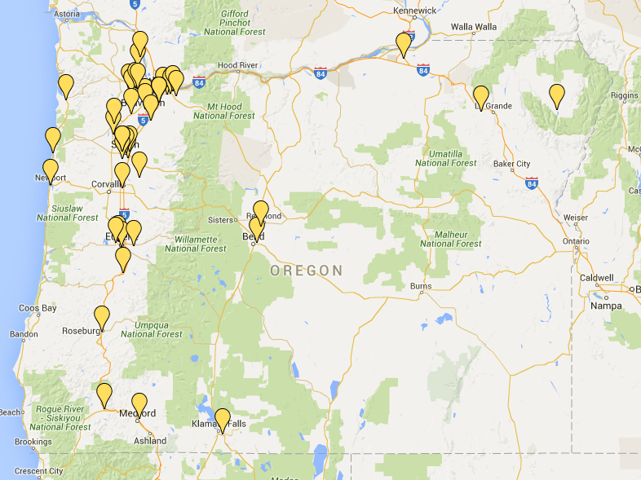
Human Resources
47 Programs

Slide 19
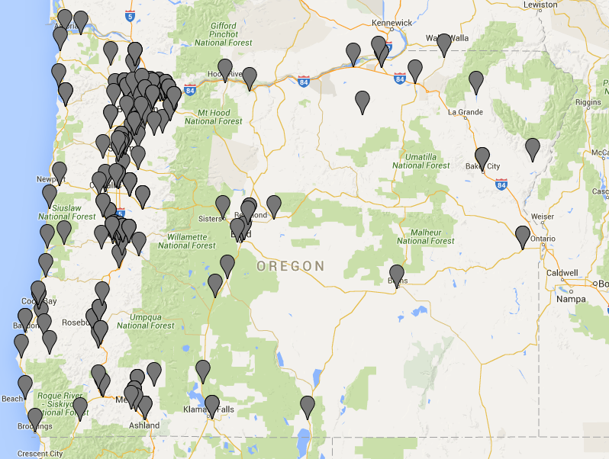
Industrial & Engineering Systems
219 Programs

Slide 20
CTE Approved Programs
High Wage/High Demand
Non-approved programs that have structure
ELECTIVES Called CTE

Slide 21
CTE Secondary Dedicated FUNDING
Perkins Federal Grants- census based
                $13m 50/50 split with community colleges
CTE Revitalization $9m
Career Pathways Secondary $8.75m
Summer Programs- $1.75m
Student Leadership Orgs. $0.75m
Course Equivalency $0.12m
Teacher Development & Mentoring $1.10m
$21.5m

Slide 22
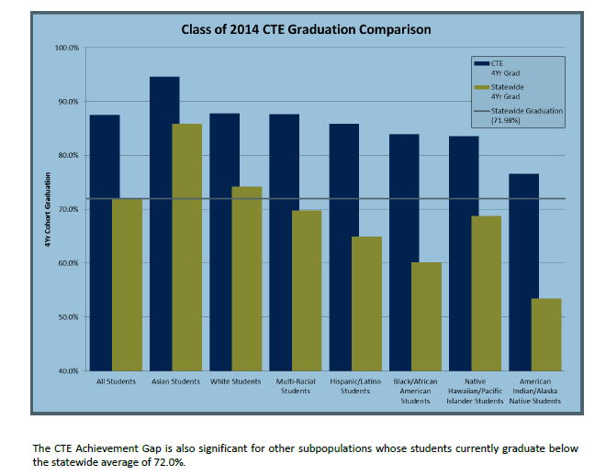

Slide 23
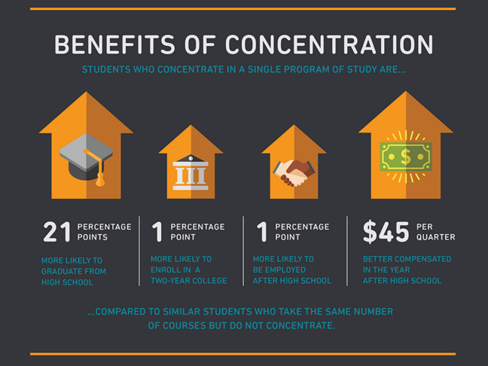

Slide 24
Post-secondary Career Pathways

Slide 25
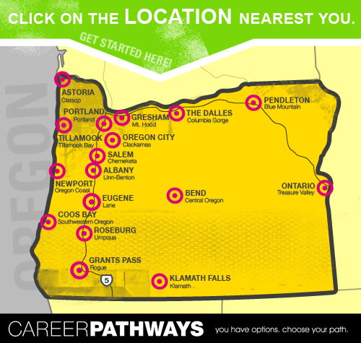
What is a Career Pathway?
Career Pathways are linked education and training services that enable students, often while they are working, to advance over time to successfully reach higher education and employment goals.
Launched in 2004 through the National Governors Association’s Pathways to Advancement Initiative, Oregon’s Career Pathways Initiative began with five colleges. In 2006, the Initiative expanded to 11 colleges and scaled to all 17 community colleges in spring 2007.
Career Pathway Certificates of Completion (CPC) are between 12-44 credits and are fully embedded in an Associate of Applied Science degree or One Year Certificate.
Currently there are more than 240 Career Pathway Certificates offered at Oregon's 17 community colleges.

Slide 26
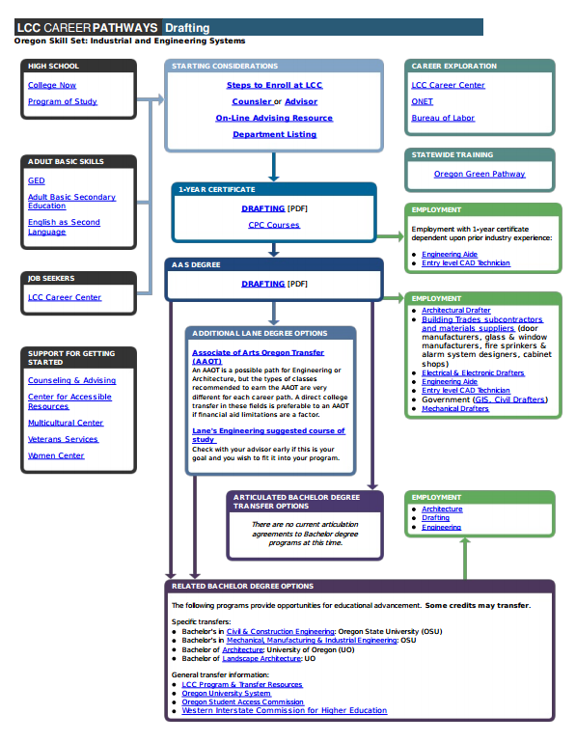
Career Pathways Road Map

Slide 27
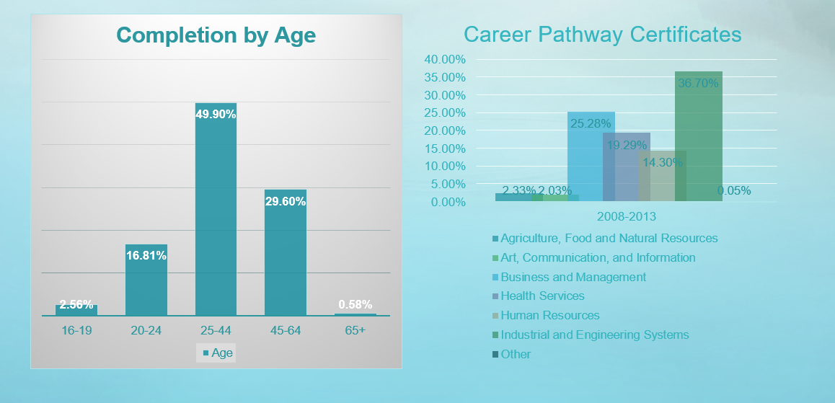
Career Pathway Certificates by
Focus Area

Slide 28
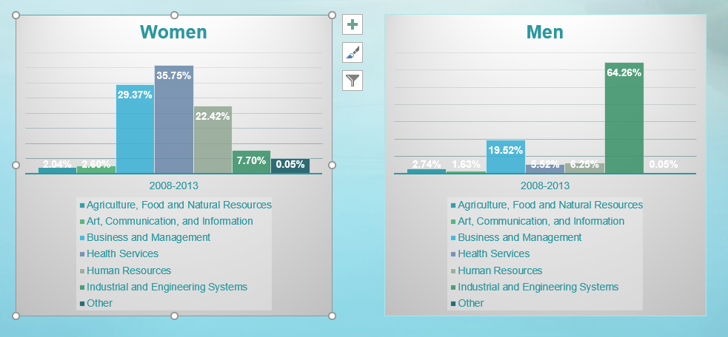
Career Pathway Certificates by Gender and Focus Area

Slide 29
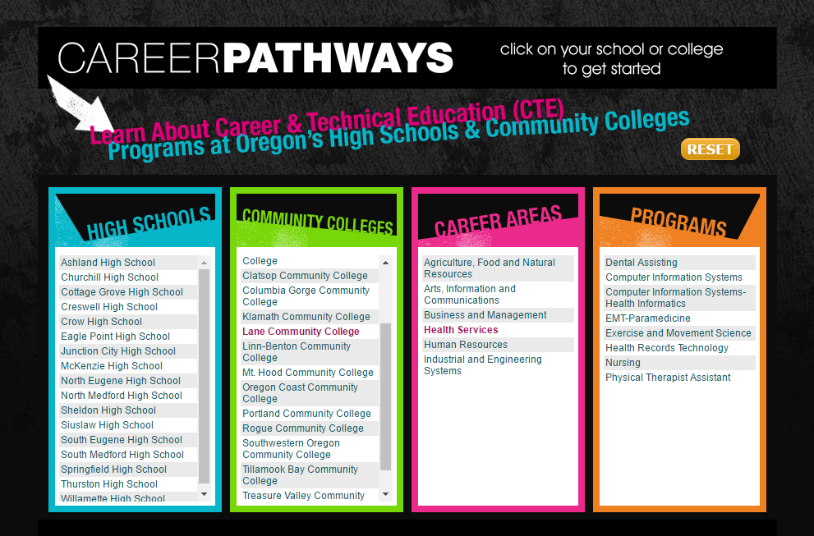
http://oregon.cteprogramsofstudy.org/#/cc/5

Slide 30
Some of the work ahead
Operationalizing the STEM/CTE Strategic plan
CTE/STEM educator workforce
Expand CTE revitalization efforts to include middle school
Improved career information system
Increased alignment of pathways between HS and post-secondary with workforce needs
Mathways and major pedagogical shifts
Capacity and program equity in rural areas

Slide 31
Questions?

