Slide 1
Education Accountability - Shared Responsibility. Real Results.
Implementing the Education Accountability Act (Senate Bill 141)
October 2025

Slide 2
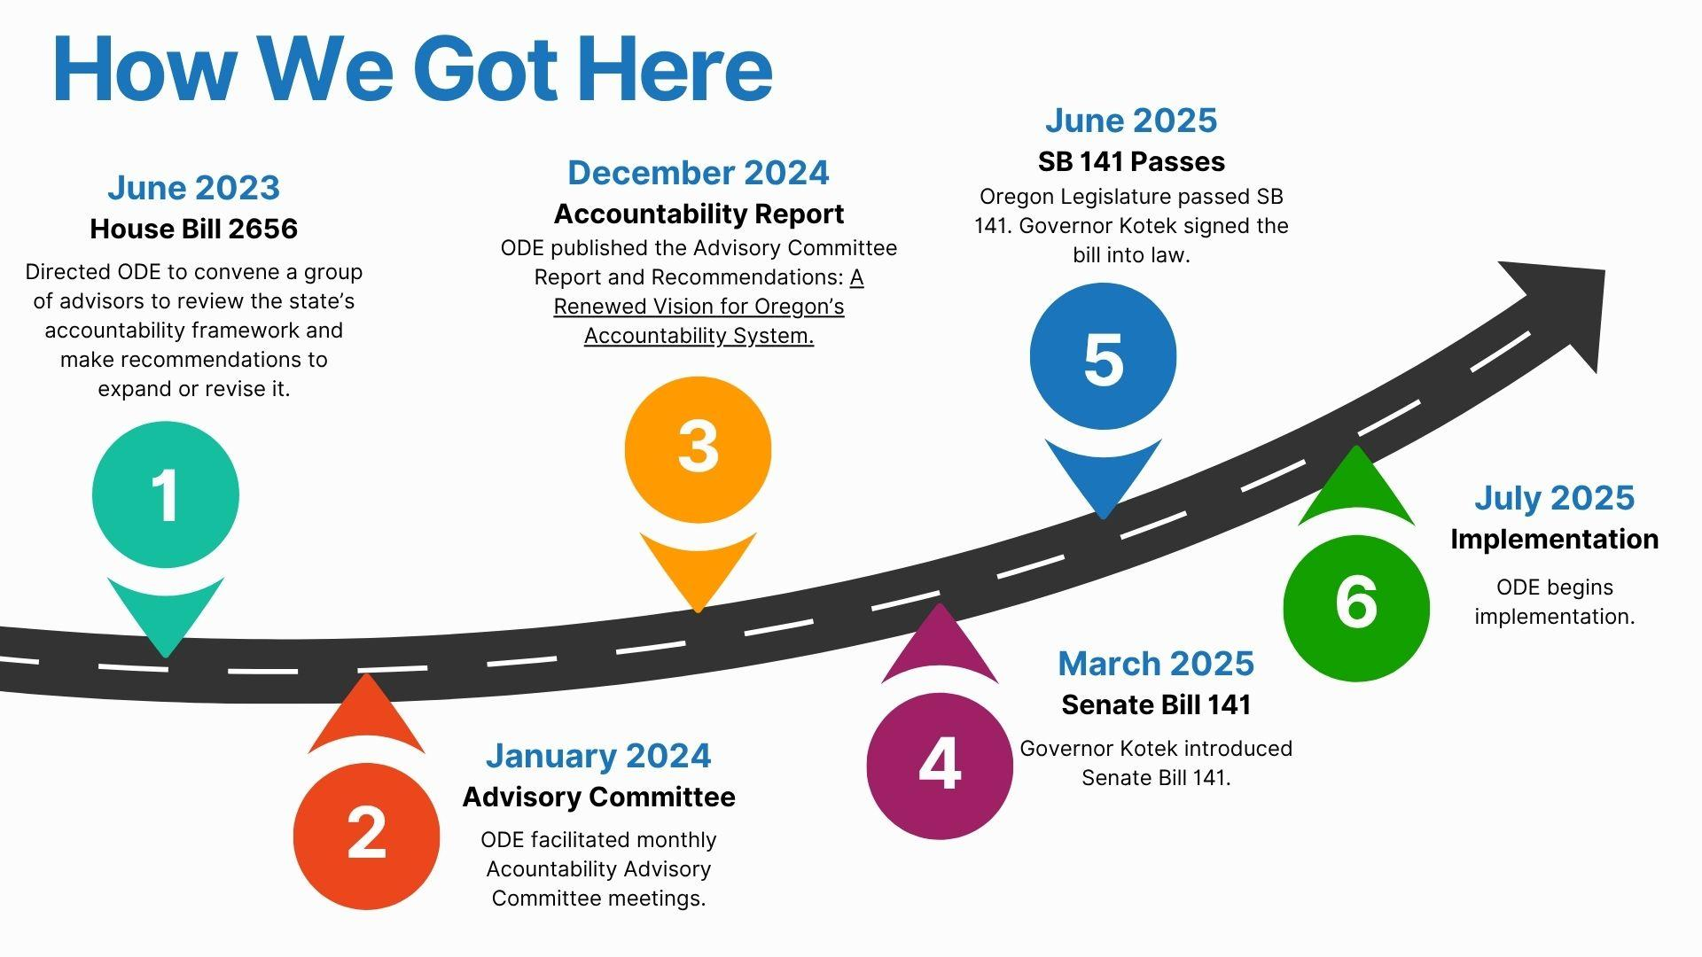
Notes:
A lot of work has been done leading up to this moment in terms of accountability. Now, we are at a turning point. The passage of SB 141 - the Education Accountability Act - reinforces the need for a stronger, more effective approach.
It reflects a significant step forward in how we ensure every Oregon student has access to meaningful learning opportunities.
This new system of accountability involves everyone across Oregon’s education landscape, including ODE, the Legislature, Education Service Districts (ESDs), school districts, educators, families, community organizations, and other partners.
For ODE, the law represents a pivot point for how we will operate in support of school districts. Instead of taking a programmatic or punitive approach—ODE will use a support-first, equity-driven framework that focuses on shared responsibility, continuous improvement, and public transparency.
School district leaders and educators, education partners, Tribal leaders, and other stakeholders will lend their expertise to inform how the state builds a system that will support the diverse needs of all Oregon’s schools - including rural, urban, charter, Tribal, and alternative programs.
This is a long-term investment in our education system; the timelines are structured to allow for piloting, engagement, and learning—not overnight change.

Slide 3

Shared Values are the Foundation for this Work
Meaningful Relationships
Shared Accountability
Systems-Level Continuous Improvement
Multiple Measures that Matter
Sufficient and Responsive Resources and Capacity
Notes:
As we move forward, it’s important that we center the shared values that were established through our previous Accountability Committee.
The first two are really the backbone of this work: relationship and reciprocal (shared) accountability.
There’s no doubt this work starts with partnership. Schools, students, families and caregivers, and community members are critical to facilitating authentic engagement and nurturing relationships between people within schools, throughout districts, and across the state.
Student success requires that schools and districts have sufficient resources to address the needs of their students.
Consistent, dedicated and clear funding mechanisms and effective spending needs to be a through line - it serves as a lever that leads to more equitable outcomes for students.
School districts need time and capacity to implement change ideas coupled with feedback from the state and community partners.

Slide 4


High-quality
learning experiences.
Aligned & focused educational systems.
Engaged partners & communities.
Safe & inclusive schools.
Committed & supported staff.
Notes:
And, there’s no doubt that we can serve students better when we prioritize our efforts. It’s important to remember our five priorities for student success, as many of the elements of SB 141 implementation align to these.
These are the five key areas we need to focus on to commit to student success.
High-quality learning experiences
Aligned & focused educational systems
Engaged partners & communities
Safe & inclusive schools
Committed & supported staff
ODE will use these Priorities as a filter to focus our efforts - including grant consolidation, reducing reporting requirements, and targeted supports for school districts.

Slide 5

Big Picture Goals
Build a stronger, equitable accountability system.
Reduce administrative burden through streamlined reporting.
Provide meaningful, timely support to districts.
Increase transparency and public trust.
Remain focused on improving student outcomes - including academic and social-emotional outcomes.
Notes:
Overall, we want to build a strong, equitable accountability system with shared responsibility. We’re going to relieve the administrative burden districts face by streamlining our reporting requirements; we’re going to provide meaningful, timely support to districts; and at the same time we will work to increase transparency and public trust. All while remaining focused on our end goal, which is i improving student outcomes.
So, what will success look like in 3–5 years?
Fewer, clearer reporting requirements for districts.
More real-time data to drive instruction.
A new statewide dashboard that shows progress transparently.
Targeted, effective support for districts based on student needs.
A culture of shared accountability—not blame.
Right now, we are organizing/prepositioning ourselves internally (as an agency) to sustain these big picture goals.

Slide 6
What’s Changing
Adds new performance metrics (K-2 attendance, 8th‑grade math, local metrics).
Requires interim assessments in math and language arts in grades K-8.
Requires the implementation of a new Continuum of Supports (coaching → directed support).
Directs ODE to streamline grant reporting.
Improves public transparency through new data dashboards with financial data, educator workforce data, and accountability details.
Directs ODE to realign internally to better support the needs of districts.
Notes:
SB 141 adds a number of new requirements. This is not an exhaustive list, but represents some of the biggest changes.
Adds new performance metrics (early attendance, 8th-grade math, one local metric) will offer a fuller picture of student success.
Requires interim assessments - these are instructional tools to guide teaching and learning, not just compliance measures.
Requires ODE to develop a new Continuum of Supports - districts will receive targeted coaching and assistance when performance targets are not met.
We are simplifying grant processes and aligning metrics to reduce reporting burdens.
We’ll launch a public dashboard to provide accessible information on school and district performance AND we’ll publish annual reports with district-level progress toward goals, supporting both transparency and action.
We’re also organizing internally to better support the needs of districts.

Slide 7
How ODE is Organizing
Four Workstreams & Desired Outcomes
Streamlining Reports & Grant Consolidation
District Performance & Continuum of Supports
Internal Operations
Public Transparency
Aligned reporting to the 5 Student Success Priorities.
Streamlined process for gathering information from school districts and other education partners.
Established continuum of supports.
Defined success indicators and systems for monitoring performance.
Standardized processes to promote collaboration and communication.
Improved customer and employee satisfaction.
Increased access to data.
Improved availability and timeliness of information.
Notes:
Internally, we’re focusing on four key areas - or workstreams. Each workstream is composed of multiple cross-office teams working toward clear goals and outcomes. The workstreams are:
1. Streamlining Reports and Grant Consolidation
2. District Performance and Continuum of Supports
3. Internal Operations
4. Public Transparency
Together, the workstreams establish the foundation for data-informed improvement efforts, equitable resource allocation, and collaborative partnerships.
Note that ODE’s full action plan is available online: Accountability Implementation Action Plan June 2025

Slide 8
Streamlining Reports & Grant Consolidation
Where We’ve Been
ODE administers 126 state and federal grants; districts must answer 250 narrative questions and 57 assurance questions:
Via 46 different submission methods,
With 93 assigned ODE contacts, and
In a submission window lasting 365 days.
Not all questions inform district support needs.
Districts are overburdened.
Where We’re Headed
Grant questions are aligned to the five Student Success Priorities.
ODE only asks for information that is legally required or that informs district support needs.
There are clear submission windows, ideally before the school year begins.
ODE provides meaningful, timely feedback.
Requirements are tailored based on district size and capacity.
Notes:
The first is Streamlining Reports & Grant Consolidation.
ODE currently administers 126 state and federal grants. Under the current reporting structure, districts must answer 250 narrative questions and complete 57 assurances:
Via 46 different submission methods,
With 93 assigned ODE contacts, and
In a submission window lasting 365 days.
This is incredibly burdensome and inefficient. School districts have consistently voiced the need for ODE to reduce this administrative burden so that more focus can be spent on student outcomes.
Our goal is to streamline the number of reports down to 5 by the start of the 2027-28 school year by using the Student Success Priorities as filters or “buckets” for organizing information. We will move away from the silo-ed, programmatic approach and begin to consolidate and streamline our efforts for increased impact and improved outcomes for students.
At the heart of this effort is a shared goal: to reduce administrative burden experienced by districts, eliminate duplicative reporting, and ensure that what ODE collects is meaningful—for both districts and ODE. This will make it easier for districts to tell their story, demonstrate impact, and spend more time on student-centered work.
ODE has enlisted the help of a consultant (Watershed) who has experience with doing this work in other states.

Slide 9
Key Dates
Streamlining Reports & Grant Consolidation
August 2025
Launched pilot development with 34 school districts.
School Year 2025-26
Develop, test and refine consolidated grant application and reduced reporting process with district partnership and perspective.
ODE submits progress report to the legislature (Dec. 2025).
School Year 2026-27
Full year of streamlined reporting for pilot districts only.
ODE submits progress report to the legislature (Dec. 2025, Dec. 2026).
School Year 2027-28
All Oregon school districts follow streamlined process.
Notes:
Here is an overview of the timeline.
We’ve selected 34 school districts to work with us to rethink and redesign state reporting and grant application processes. A kick-off meeting took place on August 28.
Together, we’re going to co-create what a streamlined process looks like. This work will happen over this next school year.
Then in 2026-27, we’ll do a full year of the consolidated grant application and reduced reporting process with the pilot districts only.
After that, we’ll roll out the process to all districts in the 2027-28 school year.

Slide 10
District Performance & Continuum of Supports
Where We’ve Been
It is not always clear which districts need support and the type of support needed.
It is not always clear which staff from ODE is providing what support.
Districts are not required to complete interim assessments.
Technical assistance is not clearly defined.
Professional development standards are not defined.
Where We’re Headed
ODE is a “one-stop shop” with a variety of supports available for school districts.
ODE’s Continuum of Supports has clearly defined entry points and exit points, informed by adopted growth targets.
ODE has cross-office regional support teams to address district needs, support progress monitoring, and deliver coaching and technical assistance as appropriate.
ODE adheres to consistent technical assistance and professional development standards.
Districts administer interim assessments in math & language arts in Grades K-8.
Notes:
Next up is the District Performance & ODE Support workstream.
This workstream focuses on developing a more responsive, equitable, and data-informed system of support and accountability for all public education entities in Oregon. Right now, based on our current reporting and information gathering processes, it’s not always clear which districts need support or what type of support they need.
It’s also not always clear who from ODE is providing what support. Meaning, we might have seven different staff from ODE working with a district on seven different things, and we don't have a systematic way of knowing that. So, it isn't just about getting clear on the support needed, but ensuring we are aligned on the delivery of the supports needed as well.
The ultimate goal is to ensure that every school district—regardless of size, type, or student population—is both supported and held accountable in ways that drive continuous, measurable improvement in student outcomes through a dynamic, data-driven Continuum of Supports.
Key agency actions include the development and implementation of a Continuum of Supports with clearly defined entry points, expectations, and aligned resources based on district needs and student outcomes. To ensure coherence and effectiveness, the agency is aligning these efforts with the Student Success Priority Framework, supporting implementation through regional teams, and strengthening progress monitoring via interim assessments and enhanced data reporting.
A lot of our efforts will be informed by the work of the the Streamlining Reports & Grant Consolidation work. For example, if we’re actually asking the right questions at the right time, we will be able to better understand the needs of districts and identify how we can best support them.

Slide 11
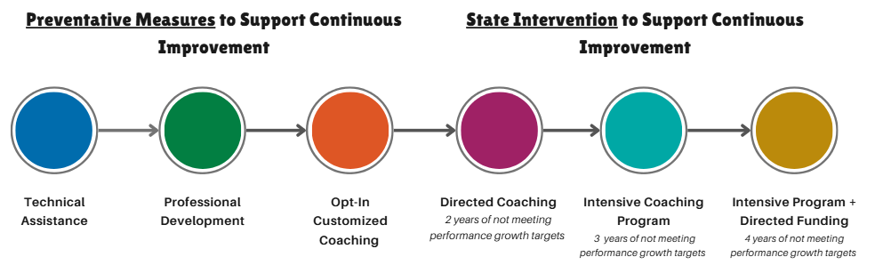
Key Dates
District Performance & Continuum of Supports
CURRENTLY AVAILABLE |  |  | 2028-29 | 2029-30 | 2030-31
Notes:
This visual helps bring to life what’s changing.
The first portion (the three circles on the left) are preventative measures, many available now through ODE and ESDs. They include technical assistance, professional development and opt-in coaching.
SB 141 adds new state interventions to the continuum (the three circles on the right). These interventions will be for districts that do not meet their performance growth targets. Beginning in 2028-29:
After two years of not meeting targets, the school district must accept coaching from ODE.
After three years of not meeting targets, the district must participate in the intensive coaching program.
After four years of not meeting targets, the district must continue participating in intensive coaching AND ODE will be able to prescribe the use of up to 25% of their State School Fund dollars.
Note that the legislation suggests the timelines listed on this slide for implementation. Many of the details will be fine-tuned during SBE rule-making.

Slide 12
Key Dates
District Performance & Continuum of Supports
During the 2025-26 School Year
Engagement and rulemaking for:
Developing a Continuum of Supports with clear entry and exit points for each stage.
Developing a list of up to five local metrics that districts may choose from.
Expanding statewide performance growth targets (to include K-2 attendance & 8th grade math).
Developing a list of up to four approved interim assessments that districts may choose from.
School districts and charters set growth targets for new metrics (they must select one local metric from the board-adopted options).
During the 2026-27 School Year
ODE begins reviewing and tracking progress towards local and statewide metrics, annually.
During the 2027-28 School Year
School districts and charter schools administer interim assessments three times per year in grades K-8 in Math and ELA and review the data during a public meeting.
Notes:
Instead of a one-size-fits-all approach, we’re working with districts to co-develop growth targets, select relevant local metrics, and focus on real-time support through coaching—not after-the-fact consequences.
Here you can see the timeline for rulemaking. In 2025-26 we will engage partners and go through the rulemaking process for:
The new Continuum of Supports
Developing a list of up to five local metrics
Expanding statewide metris to include K-2 attendance and 8th grade math
Developing a list of up to four approved interim assessments
That sets us up for the 2026-27 school year to begin tracking - on an annual basis - progress districts are making against their local metric targets and statewide targets. Remember from the previous slide, after two years of not meeting targets, districts enter the directed coaching program (starting in 2028-29).
To build a truly balanced assessment system, ODE will take a more active and supportive role in helping school districts use assessment data to improve teaching and learning—not just to report results. School districts and charter schools will administer interim assessments three times per year, starting in 2027-28, to get a snapshot of student progress that can be used by teachers to make adjustments and support real-time feedback for students, parents and families. The goal is not more testing, but better use of data to inform instruction and system-level support.
The timeline for interim assessments is:
2025-26: The State Board will adopt a list of approved Interim assessment options that districts can select from to monitor student progress throughout the school year. School districts and charter schools must select one from the board-adopted list prior to the 2026-27 school year.
2027-28: School districts will begin implementing Interim Assessments three times per year.
School districts must review the data and establish a reporting process to communicate with students and families.

Slide 13
Public Transparency
Where We’ve Been
Data are made available in Excel spreadsheets, which are not accessible to all.
Insufficient context for interpreting data visualizations is provided.
Fiscal information provided is minimal.
Data visualizations are not dynamic.
Where We’re Headed
ODE provides data that updates in real time (or near real time), making it easier for the public to access the most current information.
ODE provides data that is structured longitudinally, allowing viewers to analyze trends over time and better understand long-term impacts and outcomes.
ODE provides tailored views and insights for different audiences—whether it's a parent checking their child’s school performance, a community member exploring local outcomes, or a legislator comparing trends across districts.
Notes:
This workstream focuses on expanding access to timely, accurate, and actionable information to support shared accountability and informed decision-making across Oregon’s education system. Its ultimate goal is to foster trust, strengthen engagement, and promote transparency by ensuring that families, educators, and communities have clear, accessible insights into student outcomes, district performance, and the supports and resources available to schools and learners.
Key agency actions include publishing an annual performance report that compares district progress against growth targets, enhancing grant budget reporting systems, and developing dashboards that integrate academic and financial data.

Slide 14
Key Dates
Public Transparency
Summer 2025 - Winter 2026
Centralize and consolidate existing ODE reports and data to make them easier to locate and access.
Summer 2025 - Fall 2027
Design and implement internal policies that guide the development, publication, and use of transparent, accessible data tools and that ensure consistent, equitable communication of education data.
Summer 2025 - Fall 2027
Develop and maintain an academic and financial data dashboard that integrates key educational performance metrics and financial data.
Develop and launch a dynamic public dashboard with state and local metrics and visual indicators for progress across metrics, including disaggregated student group performance, and the status of supports provided through the Continuum of Supports.
Notes:
In terms of the timeline, there’s a lot of work that will happen leading up the publishing of a new public-facing data dashboard
We will prioritize simplicity and clarity in the initial development of the dashboard; continue to engage partners and community members along the way, checking in with people at key development milestones; and build a plan for long-term engagement.
When fully launched in 2028, the data dashboard will show progress at both state and local levels, including financial and accountability data, and the type of support districts are receiving.

Slide 15
Internal Operations
Where We’ve Been
The agency’s structure is misaligned to today’s strategic priorities.
Distribution of grant funds is not done in a timely manner.
Staff training needed to implement accountability expectations.
Customer satisfaction with ODE is under target.
Where We’re Headed
ODE’s staff, programs, and operations are aligned to improve efficiency and positioned to deliver on collective goals.
ODE position descriptions are aligned to actual duties, expectations are clear, and training meets staff and agency needs.
ODE procurement lead time is improved, and grant funds are disbursed in a timely manner.
ODE’s customer satisfaction results are at or above target.
Notes:
This workstream focuses on strengthening our internal capacity by optimizing our organizational structure, enhancing internal communication, and streamlining core functions, such as grant management, research, and program delivery. The goal is to transform ODE into a high-performing, service-oriented agency that provides equitable, coordinated, and responsive support to the field through improved collaboration and operational efficiency.
Key agency actions include completing a grant optimization project, enhancing staff training, and realigning operational and academic portfolios. The ultimate goal is to increase customer satisfaction with ODE.

Slide 16
Key Dates
Internal Operations
March - December 2025
Realign Agency Structure
Evaluate current ODE structure, align operational and academic portfolios, and align advisory committees to inform ODE action.
Enhance Staff Training Practices
Determine skill deficits and identify training needs; review and update PDs; design and deliver training for managers and staff.
April 2025 - June 2026
Increase Procurement Efficiencies
Design and deliver procurement training for ODE programs and set lead time targets for procurement.

Slide 17
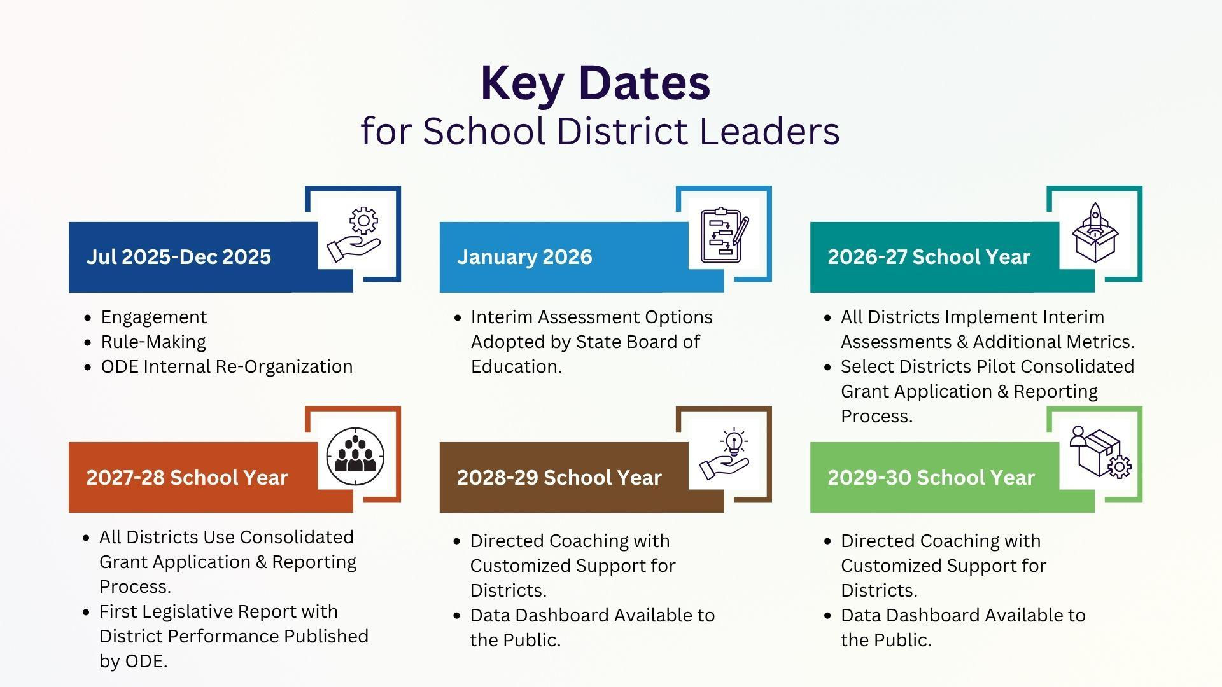
Notes:
This slides brings all the key dates together to give a comprehensive overview of what’s coming.

Slide 18
Stay Informed
ODE Accountability Website - OREducationAccountability.org
Overview of focus areas
Key dates
Communications and engagement
Full action plan
Questions? Email: ODE.ReimaginingAccountability@ode.oregon.gov

