Slide 1

Oregon Unified Grant Application (OUGA)
Statewide Launch Kickoff Call
October 7, 2026

Slide 2
Statewide Launch Kickoff Call
Objectives
Agenda
Learn about the OUGA’s purpose and goals.
Understand how the OUGA fits into ODE’s efforts to improve student outcomes.
Start preparing to undertake a district planning process.
Context and Overview
Headlines from the Pilot
District Support Structures
Selecting a Planning Lead
Next Steps

Slide 3
Context & Overview

Slide 4
Oregon’s students are ready to earn, learn, and thrive, and there is more work to do together to give every student the opportunity they deserve.
4th Grade NAEP Scores – 2024
4th Grade OSAS Scores – 2024
27%
31%
41%
37%
Of students are proficient in ELA, ranking Oregon 46th in the nation.
Of students are proficient in math, ranking Oregon 48th in the nation.
Of students are proficient in ELA.
Of students are proficient in math.

Slide 5


To improve student outcomes and support all students, ODE is focused on five priorities for student success.
High-quality learning experiences
Aligned & focused educational systems
Engaged partners & communities
Safe & inclusive schools
Committed & supported staff

Slide 6
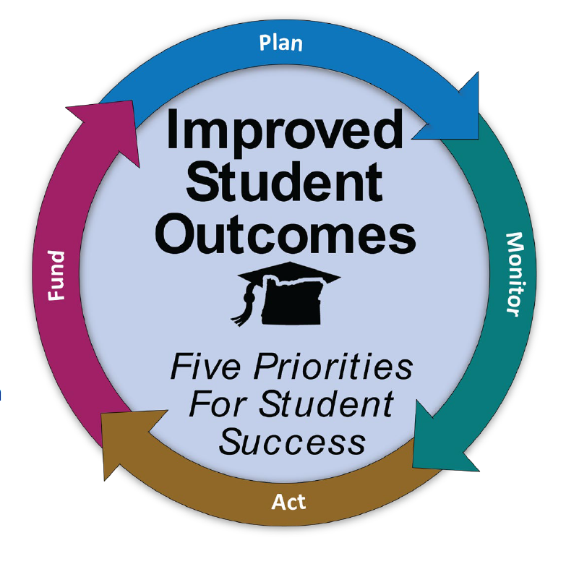
How ODE is getting there
Oregon Unified Grant Application
Performance Growth Targets
Evolving organizational structure, culture, processes, and approach
Moving from programmatic compliance to holistic district support
Aligning internal efforts, initiatives, and frameworks to support system coherence
Utilizing data to make actionable data- and evidence-based decisions
Building internal capacity
Chart of Accounts
Fiscal Transparency Dashboard
360 District Summary
Interim Tests
Continuum of Supports
Regional Support Teams

Slide 7
Oregon Unified Grant Application Statewide Launch

Slide 8

ODE is launching the Oregon Unified Grant Application (OUGA), building on the 2026 pilot with 34 districts.
During the Spring 2026 pilot, district planning leads:
Met requirements for 18 federal and state grant programs
Coordinated, streamlined responses focused on key priorities
Received direct support from ODE’s Regional Support Teams
“The movement toward integrated grants planning reflects an important long-term shift toward greater coherence across funding streams, continuous improvement efforts, and district strategy.”
Pilot District Planning Lead
“The shift away from narrative response questions toward more structured formats was a meaningful improvement. Consolidated assurances in a single place reduced significant duplication.”
Pilot District Planning Lead
“DOUBLE DOWN on this structure. THIS is what is going to make this process work. It is the HUMANS that will make this process work. Train them, empower them, listen to them."
Pilot District Planning Lead

Slide 9
The OUGA streamlines planning and applications so districts can plan around student outcomes rather than individual funding sources.
The OUGA enables districts to:
Complete a coordinated application and budget across state and federal grants.
Align implementation to the five key student success priorities.
Plan, apply, and budget on a coordinated timeline.
Receive clear, tailored support from ODE & RSTs.

Slide 10
Districts will meet requirements across state and federal grants and plans through the Oregon Unified Grant Application process.
State Grants | Federal Grants
Access to Menstrual Products Early Indicator and Intervention Systems Grants Early Literacy District Grants High School Success Fund Student Investment Grants – Formula PEEK-8 Professional Development Grants (PD) PEEK-8 Teacher Hire (TH) Grant Long-Range Facility Planning (TAP grant) Seismic Assessment Grant (TAP grant) Asbestos Hazard Assessment Grant (TAP grant) Engineered Wood Roof Systems Assessment Grant (TAP grant) Radon Hazard Assessment Grant (TAP grant) Oregon International Baccalaureate Test Fee Program | CTE Perkins - Basic Grant (Direct Recipients Only) Title I-A - School Improvement Programs IDEA (B) (611) - Grants to School Districts IDEA (B) (619) - Preschool Grants Title I-A - Grants to Local Educational Agencies Title I-C Migrant Education Title I-D - Neglected and Delinquent Program Subpart 2 Title II-A - Supporting Effective Instruction Title III - English Language Acquisition Title III - Immigrant sub-grant Title IV-A - Student Support and Academic Enrichment Title V-B - Rural and Low Income Schools (RLIS) Program
The application will meet the requirements of the following plans: (1) ESEA Consolidated Plan; (2) Federal School Improvement (1003) Plan; (3) State Student Investment Act Plan; (4) State Continuous Improvement Plan; (5) State High School Success Plan; and (6) State Early Literacy Success Plan.

Slide 11
Districts will complete distinct modules across the OUGA Platform and CIP-BN.
Application Structure Model
The state is taking the first steps to build a bespoke OUGA platform. For the Spring 2027 application cycle, this interface will include:
Priority Questions;
Grant compliance for state grants, Perkins, and IDEA;
Uploads of documents across state and federal grants;
Assurances; and
Budget for programs not in CIP-BN.
During the Spring 2027 application cycle, districts will continue to use the CIP-BN platform for legacy grants, including:
ESEA consolidated budgeting;
Equitable Services; and
Transfers.
Note that there will be guidance updates for CIP-BN to increase alignment across grant programs.
More details about the specific uploads, functionality, and expectations will be shared through information sessions in the late fall and winter of 2026-27.

Slide 12
Key Deadlines for Statewide Launch
October
Pre-Application Activities: districts begin planning activities (e.g. needs assessments and community engagement, consultations, consortia formation).
Note: More information about the pre-application activities will be shared in Fall 2026.
March 15
OUGA & CIP-BN Platforms Open: districts begin completing the planning questions and budgeting for state and federal grants.
Note: Some Federal grants (ESEA, Perkins) may be pushed to later dates if the federal release date for preliminary allocations is delayed.
April 30
OUGA Submission Due across platforms

Slide 13
District Support Structures

Slide 14







Regional Support Teams (RSTs) will provide comprehensive training and support to districts throughout the OUGA process to help strengthen district planning and improve student outcomes.
Here for Oregon Districts
How RSTs Support Districts with the OUGA
RSTs have been operating for five years and providing individualized support for districts with school improvement and cross-functional alignment, including with the OUGA.
Provide training and information
Clear, timely training before and during the OUGA application.
Answer questions and offer guidance
Help you navigate requirements, tools, and resources.
Offer personalized, ongoing support
Work with you at key milestones and when you need extra help.
Connect you to the right resources
Route complex questions to ODE experts and other specialists.
Support continuous improvement
Provide feedback loops and support after submission.

Slide 15
RSTs will provide ongoing support throughout this process by delivering the following training scope and sequence.
Module
Date
Topic
Format
Audience
Objectives
1
October 7
Launching the OUGA
Discuss the goals and timeline
District Leadership
Understand the purpose and goals of the OUGA
Preview the full year: key topics and timeline
Provide information on identifying a planning lead
Answer questions
Kickoff Webinar
2
October – November
Preparing to Complete the OUGA
Clarify planning activities
RST Introduction and Launch Information Session
(Regional)
Individualized Support with RST member
Planning Leads
(and relevant district staff)
Plan for key elements of planning that will inform application completion (e.g. needs assessment and community engagement, IDEA proportionate share, ESEA equitable services tribal consultation, consortia formation, charter school planning agreements).
Answer questions
3
November – March
Completing the OUGA
Provide module- specific training on questions and response guidance
Sessions focused on application completion
Individualized Support with RST member
ESD Liaisons
Planning Leads
(and relevant district staff)
Preview the application structure
Plan responses to the priority questions based on response guidance
Plan responses to the compliance questions based on response guidance
Plan to complete the budget based on format and description standards
Plan to submit application requirements
Answer questions and support districts in beginning to plan
4
March – Onwards
Review, Approval, and Amendments
Submission, review, feedback, and updates
Planning Leads
(and relevant district staff)
Understand the review and approval process
Receive and respond to feedback
Plan and submit amendments as needed
Answer questions
Updates & Office Hours
Individualized Support with RST member
Note: training schedule is tentative and subject to change.

Slide 16
Selecting a Planning Lead:
Coordinating Planning Across District Teams

Slide 17
Coordination across programs at the district level will make it easier to align planning and complete the OUGA.
A planning lead at the district level will facilitate the necessary coordination and the right person will vary based on district size and organizational structure. The ideal planning lead is someone who will:
  Serve as the primary point of contact with ODE regarding the application
  Oversee the completion of the Unified Application across the included grant programs and platforms
  Coordinate work with other functional areas such as instruction and finance
Districts can work with ESDs and RSTs to identify the right person and share that information with their RST contact by October 16, 2026.

Slide 18
Next Steps

Slide 19
Select your district’s planning lead by October 16 and prepare for upcoming Module 2 roadshows.
Identify a Planning Lead
Following the launch webinar, your RST will reach out to collect your planning lead’s name and contact information. Plan for your planning lead to attend the Module 2 regional information session to learn about upcoming pre-application activities and next steps.
Receive Support
An OUGA webpage is coming soon and will serve as a central location for updates, materials, and upcoming communications. Your RST will serve as your primary point of contact for OUGA support. Contact your RST with questions about the OUGA process, requirements, timelines, or next steps.

Slide 20


What’s Coming Next – Module 2 Roadshows
TIMING
REGIONAL SCHEDULING
Mid-October – Mid-November
Coordinated by RSTs and ESDs
Module 2 sessions will take place during this window.
RSTs & ESDs are working to schedule Module 2 sessions and will follow up with districts as regional details are finalized.

Slide 21

Post-Meeting Engagement
Continuous feedback will be key to success
We need to know if we’re on the right track and where/when we need to pivot
Today’s Feedback (Google Form)
  Did we achieve today's meeting objectives?
  What didn’t work for you today?
  Do you have questions or suggestions for future meetings? (Protocols, etc.)

Slide 22

Thank You

