Slide 1
Oregon Statewide Assessment System
Session 1 - Understanding A Balanced Assessment System
Office of Teaching, Learning, and Assessment
Notes:
Facilitator 1
The Oregon Department of Education has developed an Oregon Statewide Assessment System professional learning series to further support district efforts in building a balanced assessment system and their efforts in the implementation of the Oregon Statewide Assessment System: Interim Assessment System.
Welcome to Session 1 of the Oregon Statewide Summative Assessment: Interim Assessment System. This is the first of six sessions in this webinar series, and will provide an introduction to Understanding a Balanced Assessment System inclusive to the different components, assessments, and purposes of each level.
This presentation is available year-round on the Oregon Department of Education’s Interim Assessment webpage under the Interim Professional Development Materials expandable folder.

Slide 2

Purpose
The Oregon Statewide Assessment webinar series is designed to help teams of educators and administrators improve their teaching and learning systems using the tools and resources provided in a balanced assessment system.
Photo by Bekir Dönmez on Unsplash
Notes:
Facilitator 1
The purpose of this series is to help district- and school-based teams improve their systems of teaching and learning using an approach inclusive to a balanced assessment system.
All participants will build assessment literacy and connect formative assessment practices, Oregon’s Statewide Interim Assessment System, and the Oregon Statewide Summative Assessments to continually improve access and outcomes for each and every learner in their classroom, school, and district.

Slide 3

Series Outcome
Participants will build assessment literacy and improve practice by connecting formative assessment practices, interim assessments, and summative assessments to continually improve access and outcomes for each and every learner in their care.
Photo by Tomas Sobek on Unsplash
Notes:
Facilitator 1
All participants will build assessment literacy and connect formative assessment practices, Oregon’s Statewide Interim Assessment System, and the Oregon Statewide Summative Assessments to continually improve access and outcomes for each and every learner in their classroom, school, and district.

Slide 4
Session Guide
Session Guide
1 | Understanding a Balanced Assessment System
2 | Overview of the OSAS Interim Assessment System
3 | Using Interim Assessments in the Context of Instructional Practices
4 | Interim Assessment Administration: Guidance and Support
5 | Accessing Interim Assessment Data to Inform Instructional Practices
6 | Exploring Tools for Teachers and Using Formative Assessment Practices
Notes:
Facilitator 1
As a reminder this series will focus only on Session 1: Understanding a Balanced Assessment System of Oregon Statewide Assessment System: Interim Assessment System series.

Slide 5
Session Objectives
By the end of this session, educators will be able to:
Identify the different components of a balanced assessment system.
Differentiate the different use and purpose of each part of the balanced assessment system.
Make connections to local instructional practice implications.
Notes:
Facilitator 1
Specifically, by the end of the series, educators will be able to
[Click Animation]
Identify the different components of a balanced assessment system.
[Click Animation]
Differentiate the different use and purpose of each part of the balanced assessment system.
[Click Animation]
Make connections to local instructional practice implications.

Slide 6

Oregon’s Statewide Assessment System
Focusing on Equity
EQUITY through
Access
For students: access to quality learning experiences.
For educators: access to resources to improve their practice.
Transparency
All students show what they know, so we know how well our schools are serving each student.
Notes:
Facilitator 2
The Oregon Statewide Assessment System maintains ODE’s commitment to focusing on equity through both access and transparency.
ODE is committed to providing students access to a high quality of learning experiences and providing educators access to resources and tools to improve instructional practices and student outcomes.
Additionally, ODE is committed to providing all students the opportunity to demonstrate their knowledge and skills with appropriate supports as needed.

Slide 7

Our “Why” for Understanding a
Balanced Assessment System
To guarantee a high-quality, balanced assessment system to serve all students well.
… In order to do that, we must be speaking the same language and share a common foundation.
Notes:
Facilitator 2
In order to guarantee a high quality, balanced assessment system to serve all students well, it is important to understand “why” this series begins with reviewing a balanced assessment system.
As a state, it is important to build a collective background addressing assessment literacy, which shares both common language and a common foundation.

Slide 8
What is Assessment Literacy?
“Assessment literacy consists of an individual's understanding of the fundamental assessment concepts and procedures deemed likely to influence educational decisions.”
- W. James Popham (2018)
Notes:
Facilitator 2
“Assessment literacy consists of an individual's understanding of the fundamental assessment concepts and procedures deemed likely to influence educational decisions.”

Slide 9
Three Primary Pitfalls of Assessment
Pitfalls | Assessment Literacy “Bridges”
Using the wrong tests | Is this the right assessment for the right purpose?
Misusing the results of the right tests | Are there multiple data points? Are we inadvertently making this a high-stakes assessment?
Failing to employ instructionally useful tests | To be “instructionally useful”, assessments must collect evidence of student thinking.
Popham, J. (2018). Assessment literacy for educators in a hurry. ASCD: Alexandria, VA.
Notes:
Facilitator 2
James Popham, identifies multiple concerns surrounding assessment use. However, the following “bridges” can be referenced to avoid these pitfalls.
Prior to administering an assessment, first identify what is the purpose of providing an assessment and what is the right assessment to measure the desired outcome or information.
When looking at the results of an assessment, has the educator accounted for the balance of using multiple data points to triangulate information.
An additional lens to assessment administration is accounting for the students’ opportunity to fully demonstrate their thinking which can be leveraged to support instructional practices.

Slide 10
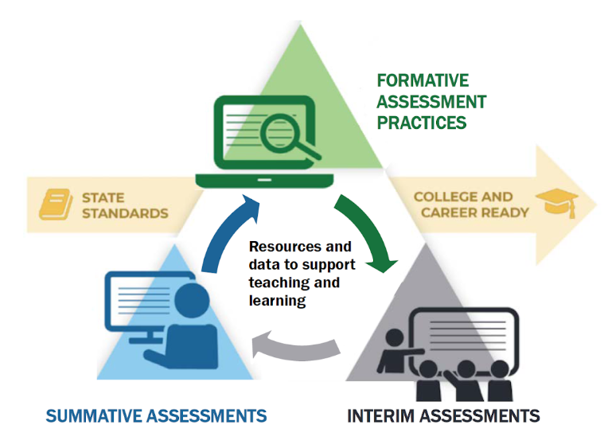
Balanced Assessment System
Notes:
Facilitator 4
The Oregon Statewide Assessment System has three components:
summative assessments, designed for program evaluation and accountability;
interim assessments, designed to support teaching and learning throughout the year; and
formative assessment practices, which support students’ learning in day-to-day instruction.

Slide 11
Moving Toward A
Balanced Assessment System
Formative Assessment Practices
Interim Assessments
Summative
Assessments
Rigorous Oregon State Standards
Notes:
Facilitator 4
As described in the Right Assessment for the Right Purpose, a balanced assessment system is fundamental to our public education system.
To date, Oregon’s statewide assessment system has been composed almost exclusively of annual summative assessments, which are administered annually and intended to provide an estimate of learning primarily across schools, districts, and the state.
While this approach allows comparison of performance across grade levels and/or schools, etc., it does not fully meet the needs of educators in the classroom.
Classroom educators need evidence of learning that they can act on within an instructional cycle (best provided by interim assessments), as well as evidence on learning that is occurring in the moment throughout classroom instruction (best from formative assessment practices).
A balanced approach to assessment can provide evidence of learning that addresses questions at different points of time within the education process and across the educational system, from student, to classroom, to school, to district, to state level determinations.

Slide 12



The Right Assessment for the Right Purpose
The Right Assessment for the Right Purpose
Summative
State, district, and school information at the end of the year.
Interim
Classroom information at the end of a unit.
Formative
Student level information, in the moment.
For additional information, please visit our guidance document
“The Right Assessment for the Right Purpose” bit.ly/ode-rarp
Notes:
Facilitator 3
(Link to RARP for facilitator’s notes: https://www.oregon.gov/ode/educator-resources/assessment/Documents/RightAssessmentRightPurpose.pdf)
As we’ve learned, the largest part of a student-centered balanced assessment system is a well-designed formative assessment process.
In our “Right Assessment for the Right Purpose” guidance document, we use the metaphor of lenses to consider each type of assessment.
A microscope best represents formative assessment practices because, when done effectively, these practices pull student learning into focus in the moment. Formative assessment practices are used throughout instruction: from planning clear learning outcomes to selecting the right tasks to engage students to providing feedback, these practices span the arc of the teaching and learning experience.
In the following slide we will take a closer look.

Slide 13
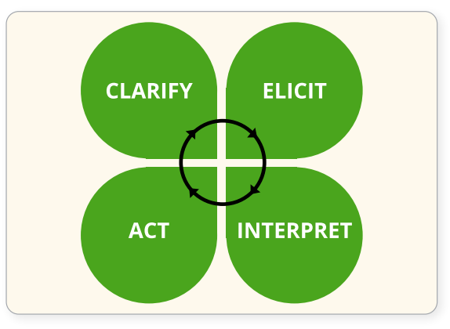
Formative Assessment Introduction
Assessment FOR Learning
Formative assessment is a planned, ongoing process used by all students and educators during learning and teaching to elicit and use evidence of student learning to improve student understanding of intended disciplinary learning outcomes and support students to become self-directed learners.
Notes:
Facilitator 3
(Citation for definition: https://ccsso.org/resource-library/revising-definition-formative-assessment)
Formative assessment is assessment for learning. Contrary to our common vernacular, formative assessment is not a “thing” nor is it accurate to talk about “formative assessments”. Rather, formative assessment is a planned, ongoing process used by all students and educators during learning and teaching to elicit and use evidence of student learning to improve student understanding of intended disciplinary learning outcomes and support students to become self-directed learners.
A high-quality formative assessment process is built on the foundation of a collaborative and respectful learning environment, and requires the ownership of both students and educators.
[Click Animation]
The clover image works well to illustrate the process:
First, learning goals and success criteria must be clarified;
Second, activities and instructional strategies must be designed or selected to elicit evidence of student thinking;
Third, this evidence is interpreted - often in the moment - to provide actionable feedback;
Finally, this feedback is acted upon and instruction is adjusted as needed.
Throughout the process, students must not only be engaged with their teacher, but also with peers and given the opportunity to self-reflect on their learning progress.

Slide 14
What Formative Assessment Is and IS NOT
Formative Assessment
Quality formative assessment has the largest positive impact of any strategy on student learning and achievement that has been documented.
Crooks, 1987; Black & William, 1998, 2001; Miesels, et al., 2003; Rodríguez, 2004
Formative Assessment IS... | Formative Assessment is NOT...
A planful, intentional process | A “thing” or test
Student-centered | Teacher-centered
Full of descriptive feedback | Evaluative feedback
Dynamic and ongoing | Static and “one-and-done”
Built on clear criteria | The same test I use every year
Full of evidence from students | Quantity over quality
Formative Assessment IS...
A planful, intentional process
Student-centered
Full of descriptive feedback
Dynamic and ongoing
Built on clear criteria
Full of evidence from students
Notes:
Facilitator 3
Over the past three decades, researchers have continually found that quality formative assessment has the largest positive impact of any strategy on student learning and achievement that has been documented.
[Click Animation]
In addition to the researchers listed here, John Hattie has identified nearly every aspect of the formative assessment process as ways as having a positive impact on, or even accelerating student achievement.
[Click Animation]
It is critical that districts, schools, and educators develop formative assessment literacy in service of student learning. To reiterate, formative assessment is a process, not a thing.
This table summarizes some of what formative assessment is, and what it is not. We’ll give you a brief moment to read for yourself.
<Pause on this screen to allow reading before moving on.>

Slide 15
The Right Assessment for the Right Purpose
Interims
The Right Assessment for the Right Purpose
Summative
State, district, and school information at the end of the year.
Interim
Classroom information at the end of a unit.
Formative
Student level information, in the moment.
For additional information, please visit our guidance document
“The Right Assessment for the Right Purpose” bit.ly/ode-rarp
Notes:
Facilitator 1
When looking at Interim Assessments, educators can make unique connections that can be used to bridge instructional practices between formative assessment practices and end of year summative assessments.
The graphic of the binoculars provides educators to stand a little farther away from the student within a wider landscape of standards and learning progressions.
However binoculars allow educators to still zoom in and focus in on details and patterns for both a classes’ performance or at the student level to still apply appropriate instruction as needed prior to end of year summative assessments.

Slide 16
Interim Assessment Introduction
Interim
Classroom information at the end of a unit.
Interim assessments are periodic standards-based assessments that target specific units of content.
Allows for a common, within-school or district view of how students are progressing toward understanding Oregon’s content standards and provides an opportunity for educator collaboration and calibration.
Notes:
Facilitator 1
Interim assessments are periodic standards-based assessments that target specific units of content.
[Click Animation]
Districts can elect to have students across an entire grade take the same interim assessment in a standardized manner at the same time. This allows for a common, within-school or district view of how students are progressing toward understanding Oregon’s content standards and provides and opportunity for education collaboration and training.
Teachers also can also leverage interims in non-standardized ways to see what scaffolds or supports students might need to aid comprehension. Therefore educators can choose to have a standardized “on-demand” administration or display items for the whole class to discuss and work through individually or in groups, print single items that are most relevant to current instructional pacing, or assign to students to be completed collectively in a group setting.

Slide 17
Interim Assessment FOR and OF Learning
Assessment FOR and OF Learning
Interim assessment systems connect student performance to instruction, outlining not just where student learning is needed, but providing classroom educators with instructional examples of what to work on next.
Data from interim assessments can help educators answer questions such as:
“Did my students understand that that concept?” and,
“What aspects do I probably need to revisit and reframe to support their learning?”
Notes:
Facilitator 1
Interim assessment systems connect student performance to instruction, outlining not just where student learning is needed, but providing classroom educators with instructional examples of what to work on next. Additionally, interim assessments provide students an opportunity to engage in learning standards at multiple stages of rigor or cognitive demands, such as Depth of Knowledge or (DOK) levels.
[Click Animation]
Robust interim assessment systems provide teachers and students with access to the questions and data to support substantial evaluation of student performance. Data from interim assessments can help educators answer questions such as: Did my students understand that concept? and What aspects do I probably need to revisit and reframe to support their learning?

Slide 18
The Right Assessment for the Right Purpose
Summative Assessment
The Right Assessment for the Right Purpose
Summative
State, district, and school information at the end of the year.
Interim
Classroom information at the end of a unit.
Formative
Student level information, in the moment.
For additional information, please visit our guidance document
“The Right Assessment for the Right Purpose” bit.ly/ode-rarp
Notes:
Facilitator 4
As we transition to understanding the Oregon Summative Assessment System, it is important to make connections to its intended design, purpose, and use.
Summative assessments, like a telescope, are useful for looking at large systems from afar and identifying patterns that might not be visible at a finer grain of observation.
They help us better understand the health of our system and are critical to increasing equity and excellence at the state, district, and school levels. It is important to remember that summative assessments cannot answer all educational questions at every level within our system and are not intended to provide data for minute-to-minute instructional decisions.
Summative data is best used to make programmatic and systems level decisions and should only be viewed as one piece of data among several when making decisions for students.

Slide 19
Summative Assessment Introduction
Summative
State, district, and school information at the end of the year.
Summative assessments are standards-based assessments of proficiency administered after instruction has occurred, generally at the end of an academic school year.
State-level summative assessments are typically used for school accountability, program evaluation, and to estimate groups of students’ achievement levels.
Notes:
Facilitator 4
Summative assessments are standards-based assessments of proficiency administered after instruction has occurred, generally at the end of an academic school year.
[Click Animation]
State level summative assessments are typically used for school accountability, program evaluation, and to estimate the achievement levels of groups of students.

Slide 20
Summative Assessment OF Learning
Assessment OF Learning
Summative assessments are reflective of the full depth, breadth, and complexity of grade level content standards to which they are aligned.
Instruments used for statewide accountability must be administered in a standardized manner in order to be comparable. Comparability is a strength of summative assessments.
Standardization is defined as “maintaining consistent testing environment and conducting tests according to detailed rules and specifications, so that testing conditions are the same for all test takers on the same and multiple occasions”.
Notes:
Facilitator 4
Summative assessments are reflective of the full depth, breadth, and complexity of grade level content standards to which they are aligned.
[Click Animation]
Instruments used for statewide accountability must be administered in a standardized manner in order to be comparable. Comparability (apples- to- apples) is a strength of summative assessments.
[Click Animation]
Standardization is defined as “maintaining consistent testing environment and conducting tests according to detailed rules and specifications, so that testing conditions are the same for all test takers on the same and multiple occasions.
Standardized summative assessments must also reflect the full range of the student population that participates in each grade level assessment, called the full performance continuum. With regard to scoring, standardization ensures that student test responses are all scored in the same manner which is predetermined and consistently applied.

Slide 21
Common Questions: Standardized Tests
Why is standardization important?
so scores can be compared “apples-to-apples”
  evaluation across all locations and students
so scores can be compared to an achievement level
  so students and educators know how “proficient” is defined
so program and investment evaluation is consistent
Standardization isn’t “one size fits all”
There are many features and accommodations that can be adjusted to match the student’s needs.
Notes:
Facilitator 4
Standardizing tests makes it possible to compare scores in an apples to apples way. Standardization happens, to varying degrees, in class tests and state tests alike.
Standardization in test development and delivery makes it so test results can be compared against the standards achievement level descriptors for all locations and students; this is important for evaluating investments and programs.
[Click Animation]
It is important to note that standardization doesn’t mean the exact same testing experience for every student—there are many features (other than the content) that can be adjusted to match the student’s needs.

Slide 22
Oregon Statewide Assessment System
Understanding A Balanced Assessment System
“Now, after a lengthy career, I am convinced that the single most cost effective way to improve our nation’s schools is to increase educator’s assessment literacy. ”
- W. James Popham (2018)
Notes:
Facilitator 2
As stated previously, the purpose of this series is to help district- and school-based teams improve their systems of teaching and learning using an approach inclusive to a balanced assessment system.
As districts, schools, and educators continue throughout the following sessions our goal is to continue building a shared assessment literacy foundation and connecting formative assessment practices, Oregon’s Statewide Interim Assessment System, and the Oregon Statewide Summative Assessments.

Slide 23

ODE Assessment Team
Dan Farley: Director of Assessment
Noelle Gorbett: Science Assessment
Andrew Byerley: Mathematics Assessment
Tony Bertrand: ELA and Social Sciences Assessment
Ben Wolcott: English Language Proficiency Assessment
Photo by Volodymyr Hryshchenko on Unsplash
Notes:
Facilitator 2
In addition to these professional development resources, the ODE Assessment team is available to support districts and schools with general or content specific assessment questions.
For contact information including email or telephone, please visit the ODE Assessment homepage and select the Assessment Contact button.
Information specific to the Interim Assessment System, including supporting resources and additional session presentations, are available on the ODE Interim Assessment webpage.
Once you have completed Session 1: Understanding a Balanced Assessment System, please navigate to Session 2: Overview of the OSAS Interim Assessment System.

