Slide 1
Oregon Statewide Assessment System
Session 2 – Oregon Interim Assessment Overview
Office of Teaching, Learning, and Assessment
Notes:
Slide 1: Title Slide (Facilitator 1)
The Oregon Department of Education has developed an Oregon Statewide Assessment System professional learning series to further support district efforts in building a balanced assessment system and their implementation of the Oregon Statewide Interim Assessment System.
Welcome to Session 2 of the Oregon Assessment Professional Learning series. This is the second of six sessions in this webinar series, and will provide an overview of the Interim Assessment System.
This presentation is available year-round on the Oregon Department of Education’s Interim Assessment webpage under the Interim Professional Development Materials expandable folder.
Resources:
The Overview PPT presentation and Session 1 Understanding a Balanced Assessment System can be included with Session 2: Interim Assessment System Overview.
(Overview Session 1 - 6) Oregon Statewide Summative Assessment: Interim Assessment Series ​​Facilitation Guide, PowerPoint​
(Session 1) Understanding a Balanced Assessment System
Facilitation Guide, PowerPoint​
Additional Resource:
ODE Interim Assessment webpage

Slide 2
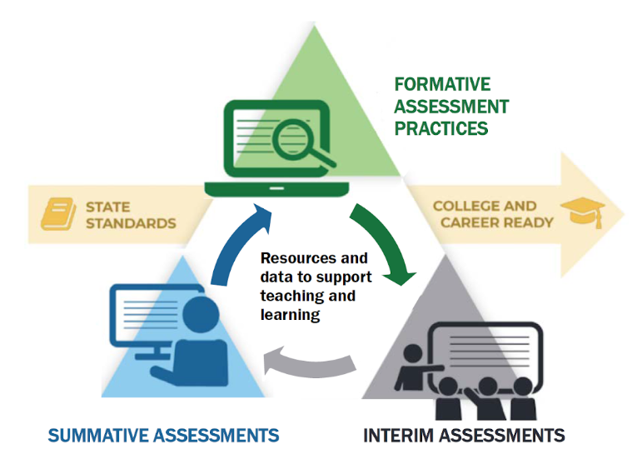
Purpose
The Oregon Statewide Assessment webinar series is designed to help teams of educators and administrators improve their teaching and learning systems using the tools and resources provided in a balanced assessment system.
Notes:
Slide 2: Purpose (Facilitator 1)
The purpose of this series is to help district and school-based teams improve their systems of teaching and learning using an approach inclusive to a balanced assessment system.
For the first time, ODE is able to provide a statewide interim assessment system aligned to both the Oregon State Standards and the Oregon Summative Assessment.

Slide 3
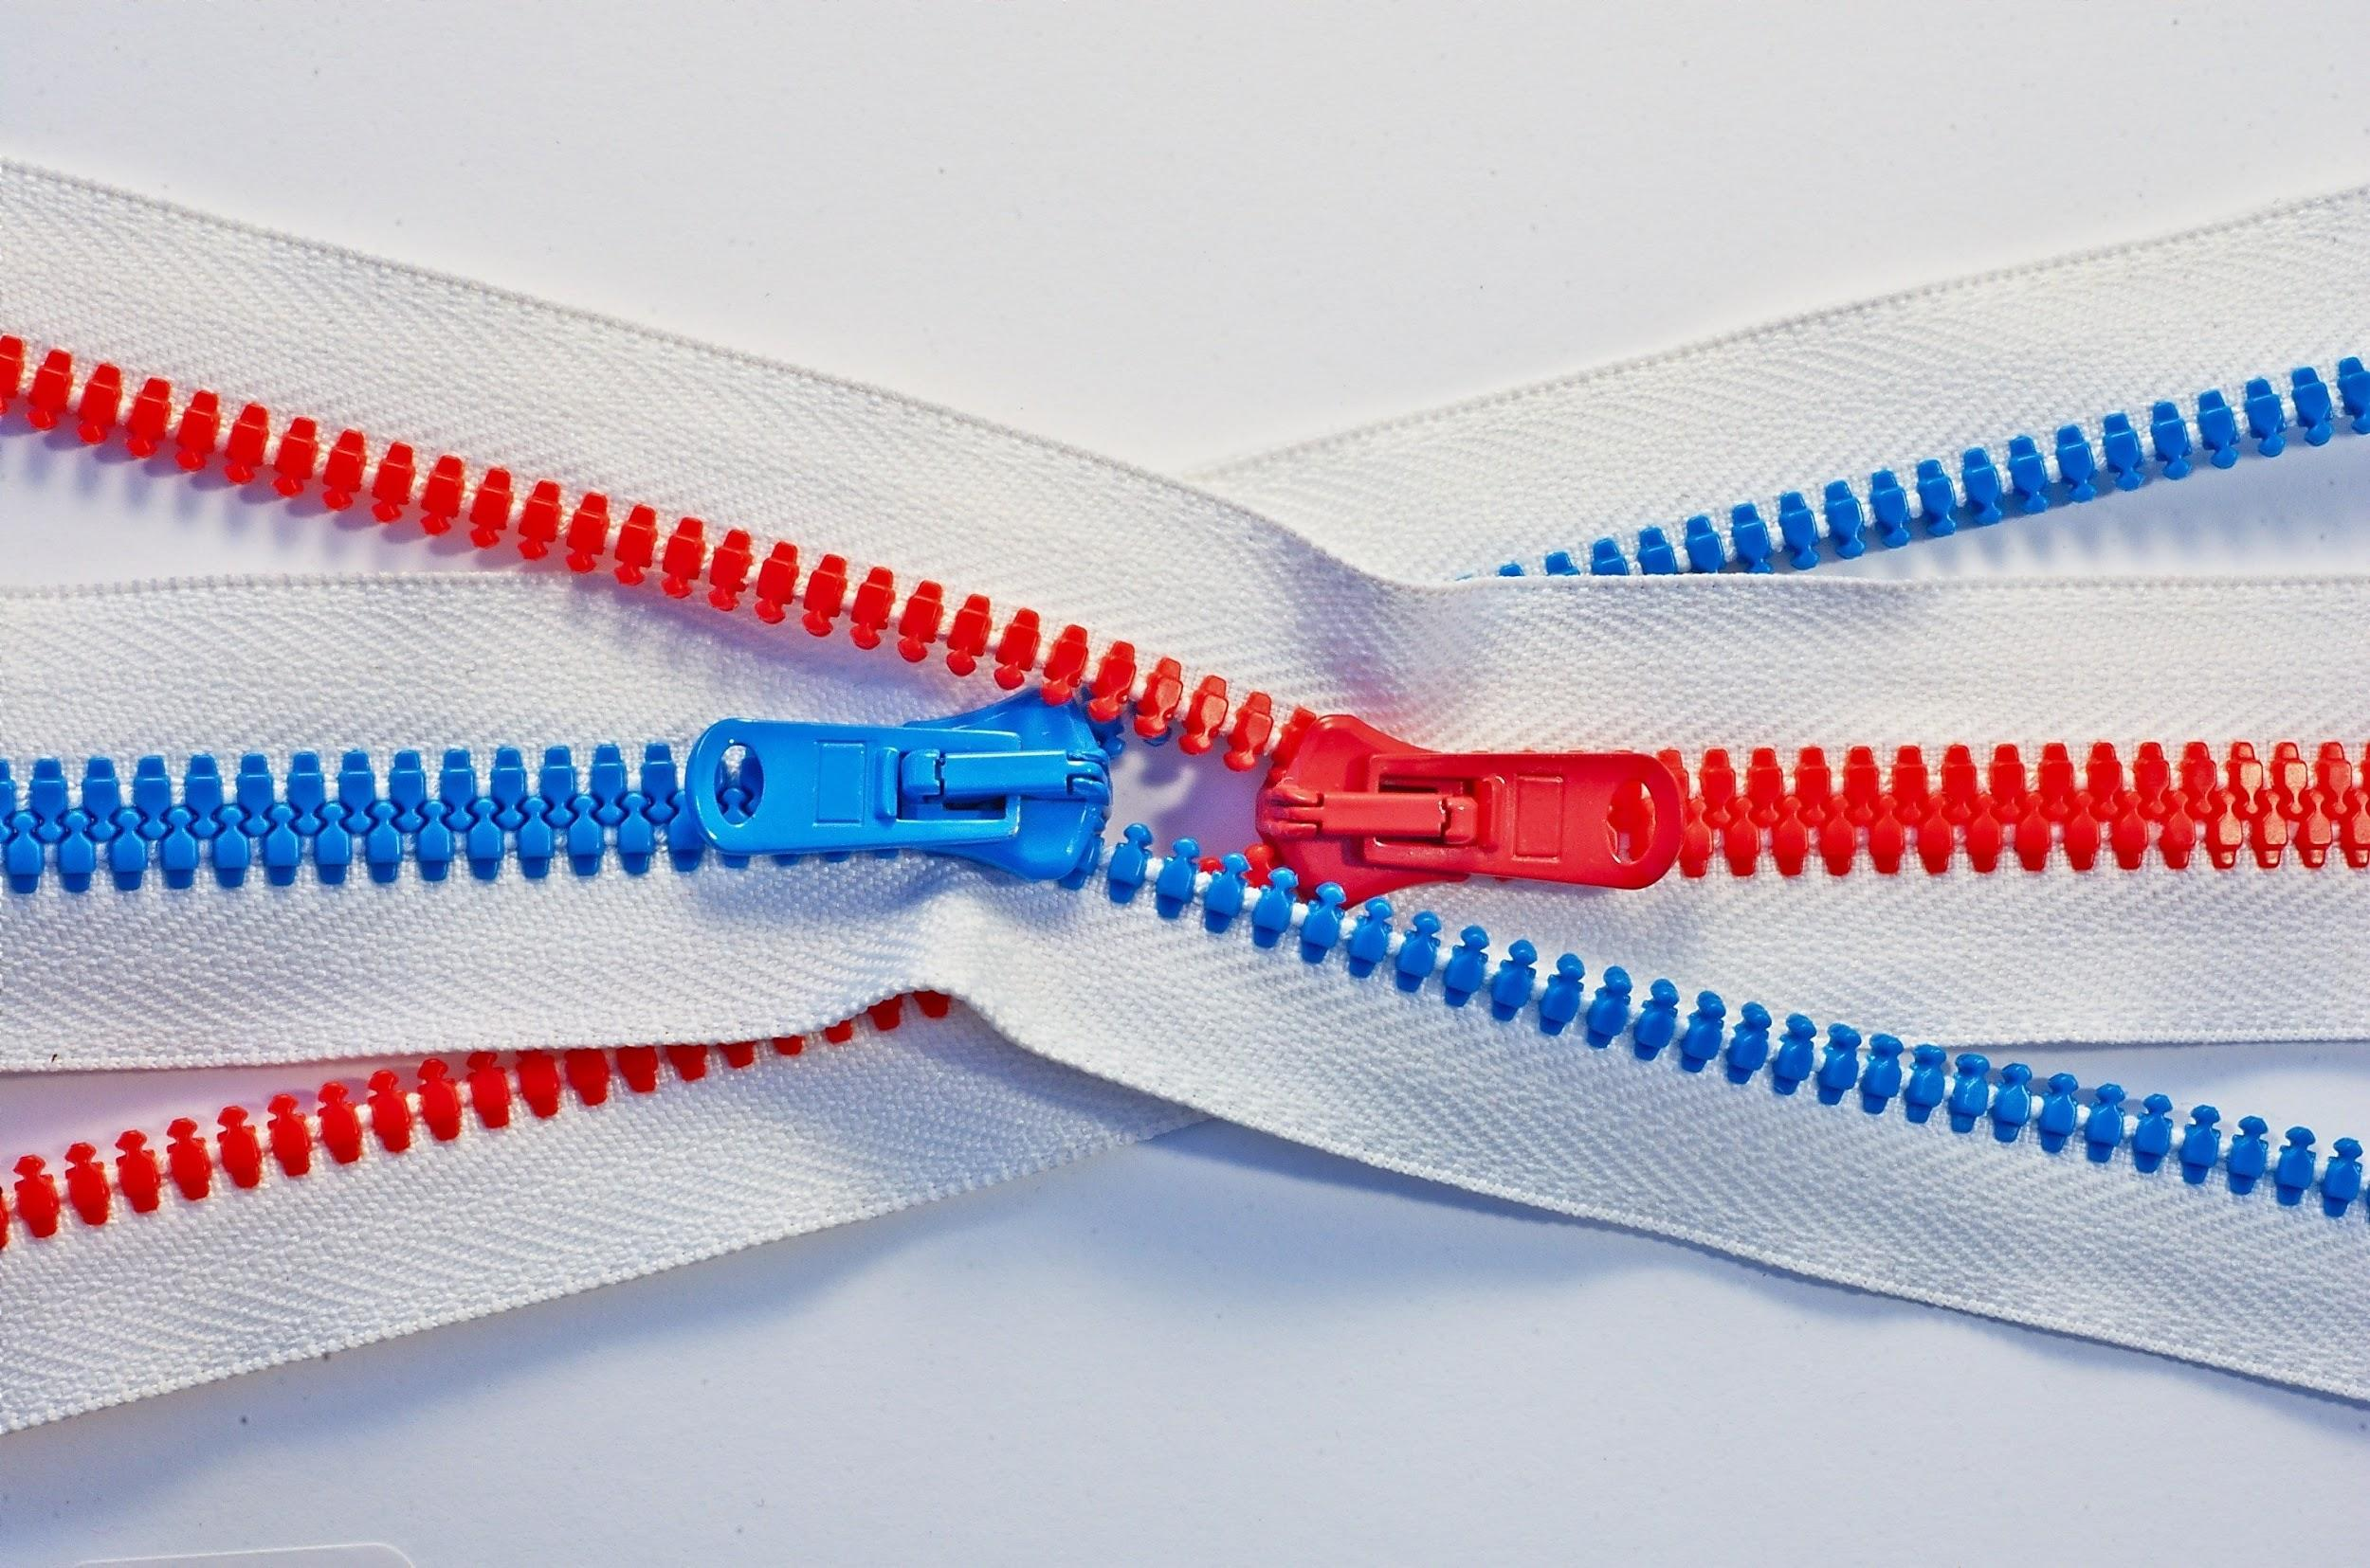
Series Outcome
Participants will build assessment literacy and improve practice by connecting formative assessment practices, interim assessments, and summative assessments to continually improve access and outcomes for each and every learner in their care.
Photo by Tomas Sobek on Unsplash
Notes:
Slide 3: Series Outcome (Facilitator 1)
Our goal is that all participants will build assessment literacy and connect formative assessment practices, Oregon’s Statewide Interim Assessment System, and the Oregon Statewide Summative Assessments to local assessment systems to continually improve access and outcomes for each and every learner in their classroom, school, and district.
Again this series will focus primarily on the new interim assessment system and other supporting resources connected to both formative assessment practices and the Oregon Summative Assessment.
Resources
Oregon Balanced Assessment Graphic (PDF)

Slide 4
Interim Assessment Series
Session Guide
1 | Understanding a Balanced Assessment System
2 | Overview of the OSAS Interim Assessment System
3 | Using Interim Assessments in the Context of Instructional Practices
4 | Interim Assessment Administration: Guidance and Support
5 | Accessing Interim Assessment Data to Inform Instructional Practices
6 | Exploring Tools for Teachers and Using Formative Assessment Practices
Notes:
Slide 4: Series and Session Overview (Facilitator 1)
Session 2 serves as the launching point to dive into the Interim Assessment System, and is just one of the six planned sessions.
Previously in session 1, participants were able to build their understanding or make further connections to the theories of a balanced assessment system.
After this session educators will have the opportunity to gain content specific information in Session 3A ELA Interims, Session 3B Math Interims, or if your district purchased the science interim assessment system, Session 3C Science interims.
Additional Sessions will cover how to navigate the OSAS Portal to Administer Interims, how to access the interim assessment data in the Central Reporting System to inform instruction, and finally how the interim assessment system interacts with the instructional resources within Tools for Teachers and how the formative assessment process can be leveraged with these resources.
Educators can register for the other future webinar sessions by accessing the Interim Assessment Professional Learning Information flyer posted on ODE’s Interim Assessment webpage.
Resources:
Interim Assessment Series Flier (PDF)

Slide 5
Session Objectives
By the end of this session, educators will be able to:
Distinguish the different types of interim assessment available in the Interim Assessment System.
Describe the difference between each type of interim assessment and explain their use and purpose.
Make connections between the interim assessment targets and the Oregon State Standards.
Notes:
Slide 5: Session Outcome (Facilitator 2)
By the end of the series, educators will be able to
[Click Animation]
Distinguish the different types of interim assessment available in the Interim Assessment System.
[Click Animation]
Describe the difference between each type of interim assessment and explain their use and purpose.
[Click Animation]
Make connections between the interim assessment targets and the Oregon State Standards.
Resources:
ELA and Mathematics Interim Assessment Overview​
​​This document describes the interim assessments, including their purpose, use, and varieties.
Assessment Resources Use Chart​
This document provides a side-by-side comparison of training tests, practice tests, and interim assessments.
Oregon State Standards

Slide 6
Interim assessments are designed to support teaching and learning throughout the year by using periodic standards-based assessments that target specific units of content.
The Interim Assessment System allows educators to connect student performance to instruction, outlining not just where student learning is needed, but providing classroom educators with instructional examples of what to work on next.
Notes:
Slide 6: Interim Assessment Overview (Facilitator 2)
During Session 1 Understanding a Balanced Assessment System, we shared how interim assessment can be used both FOR learning and serve as an assessment tool OF learning. Further, we shared how interim assessments can be used to modify instructional practices throughout the year to build students’ knowledge and skills in meeting end-of-year grade level standards and preparing them for college and career readiness.
The Interim Assessment System allows educators to connect student performance to instruction, outlining not just where student learning is needed, but providing classroom educators with instructional examples of what to work on next.
Resources:
(Session 1) Understanding a Balanced Assessment System
Facilitation Guide, PowerPoint

Slide 7


Interim Assessments:
Another Assessment? Why?
Targeted and Effective
How well are my students grasping the concepts and skills?
Who needs more challenge or enrichment? More support?
Optional and Flexible
What fits my type of instruction, pacing guide, class schedule?
Should I adjust my instruction?
Notes:
Slide 7: Another Assessment? Why? (Facilitator 2)
Whether referring to the Oregon Interim Assessment System or Local Interim Assessments, interim assessments are not just another assessment, if used appropriately, as referenced in ODE’s The Right Assessment for the Right Purpose, they provide educators and students the opportunity to monitor their instructional progress.
Additionally, the results from interim assessments, provide educators the opportunity to examine instructional pacing, modify student supports, or adjust instruction within the school year and decide which way to go next.
Resources:
Right Assessment for the Right Purpose

Slide 8
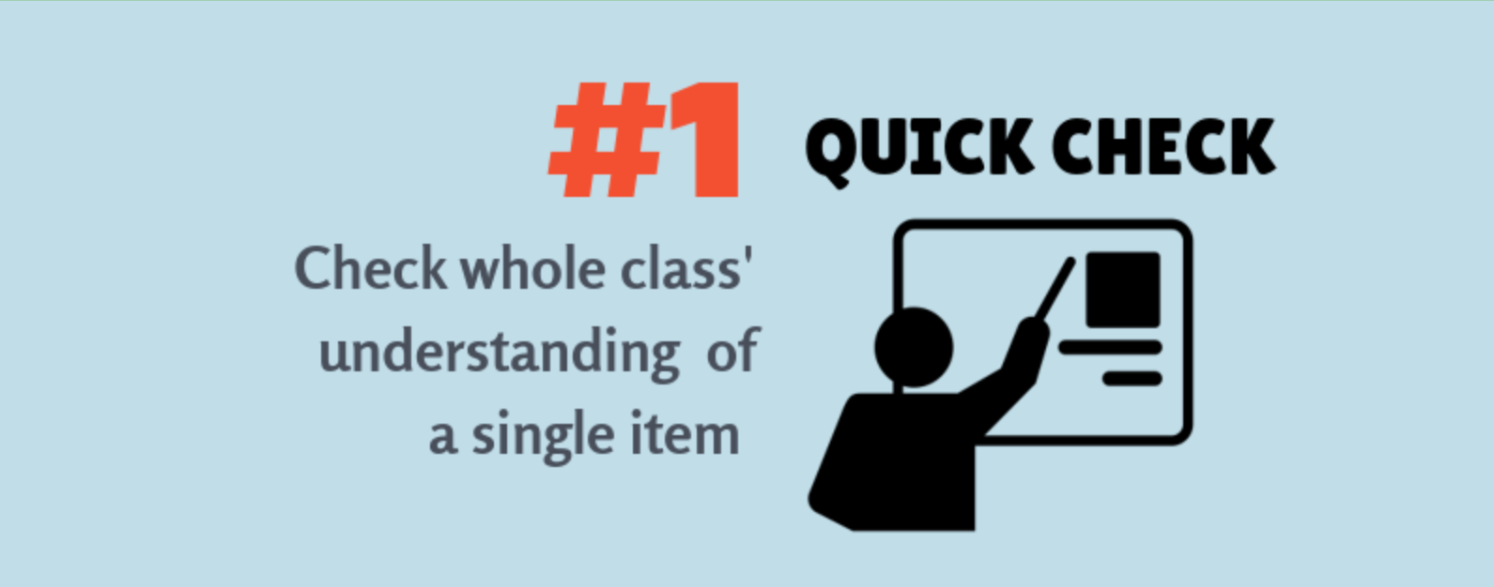
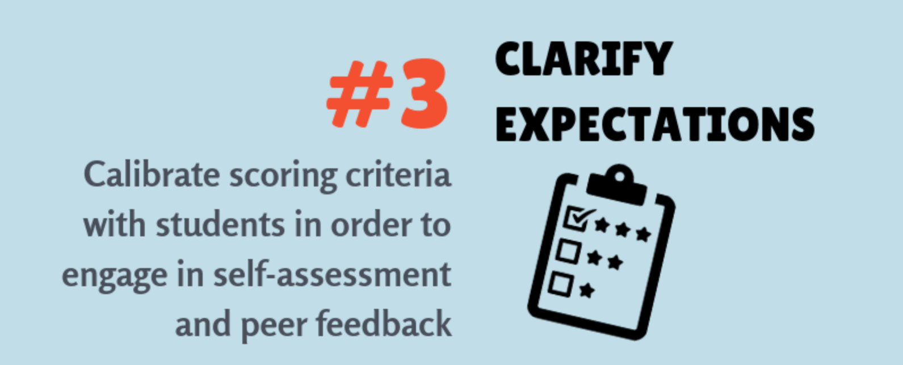
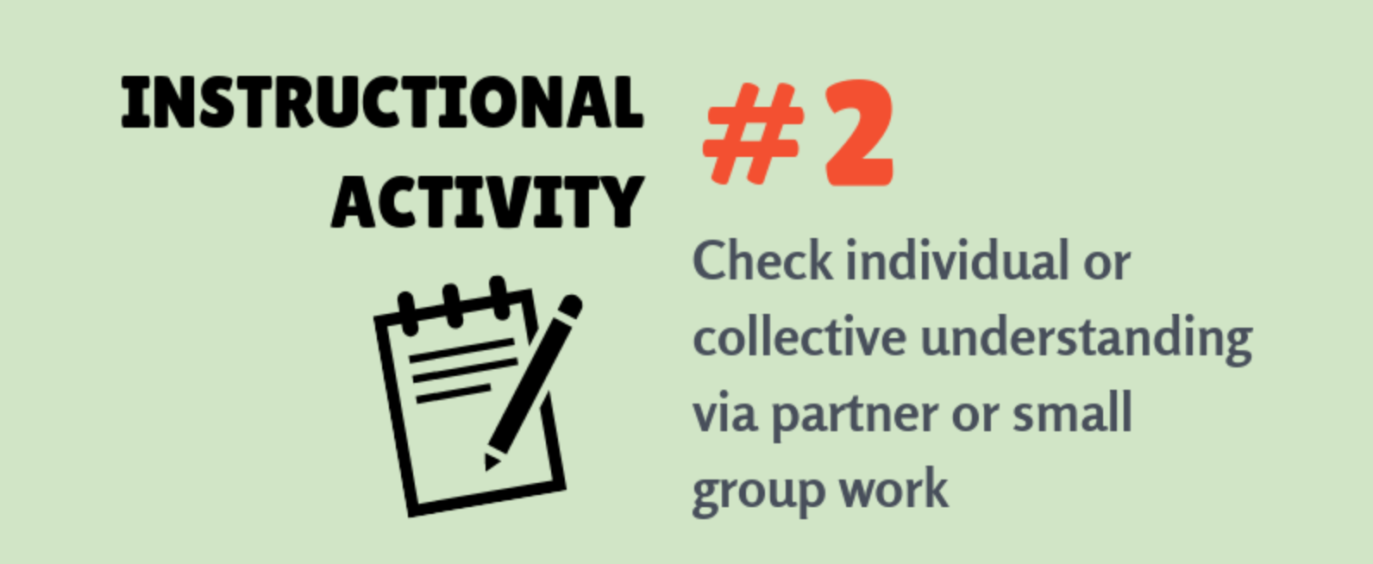
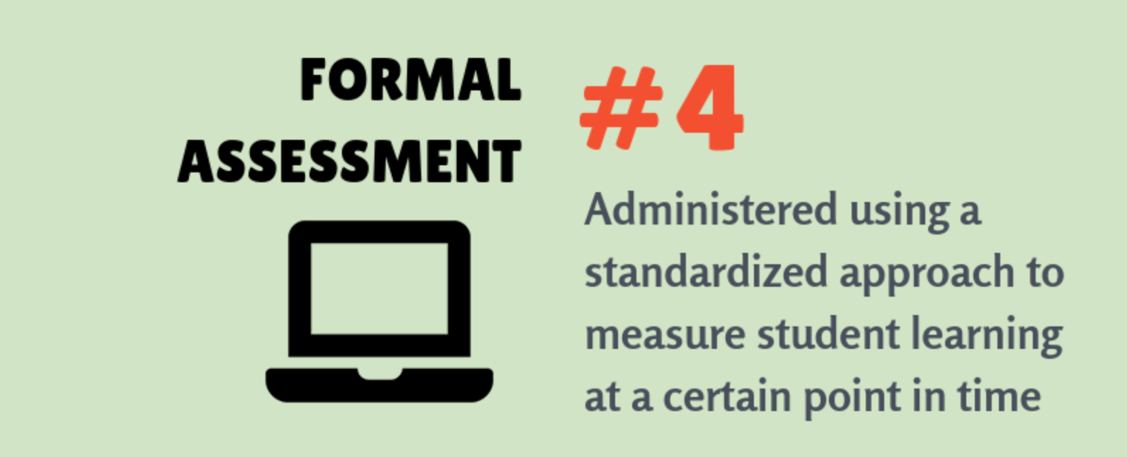
4 Ways to Use Interim Assessments
Go to www.menti.com and use the code 72 96 52 7
Notes:
Slide 8: Interim Assessment System Uses (Facilitator 2)
This slide provides different ways in which the Interim Assessment System can be utilized:
A quick check around a specific concept or standard.
A non-standardized administration as part of an instructional activity
A tool to clarify expectations around concepts, standards, specific item designs, complexities, and scoring criteria as part of formative assessment practices
Or a formal assessment to measure or collect evidence around student learning specific to taught content to determine additional instructional decisions.
Based on these examples, using the Menti Code [www.menti.com and use the code 72 96 52 7] which example most connects to your desired use for implementation?

Slide 9
Utilizing the Interim Assessment System
For most students, grade-level interim assessments, rather than tests aligned to the prior grade’s content standards, will provide the most actionable information for teachers in support of their students’ learning.
ELA Interims
Read Literary Text
Read Informational Text
Brief Writes
Revisions
Performance Tasks
Research
Math Interims
Concepts and Procedures
Problem Solving
Modeling and Data Analysis
Communicating Reasoning
Science Interims
3-D
Earth/Space
Life Science
Physical Science.
The science interims are available for $4.95 per enrolled student.
Notes:
Slide 9: Utilizing the Interim Assessment System (Facilitator 2)
The Oregon Interim Assessment System consists of 3 content areas, which is aligned to learning claims within each content.
Each Interim content areas provides learning targets and/ or standards aligned to the Oregon State Standards. Educators will be able to learn about the design of the content interims and their specific targets and/or standards further into this presentation.
A unique feature included in the Science Interims is the science items are three dimensional as aligned to the disciplinary core ideas. The Science Interim Bank is at an earlier stage of development and ODE is continuing to develop additional resources to support a wide range of items and instructional support materials. As this work continues, ODE will communicate progress with Oregon educators.
Resources:
Assessment Resources Use Chart​
This document provides a side-by-side comparison of training tests, practice tests, and interim assessments.
Science Interim Assessments Information Sheet

Slide 10
Features of Interim Assessments
Free statewide access to ELA and mathematics interim assessments and Tools for Teachers
Flexible administration options better support local purposes.
  Remote administration option for ELA, Mathematics, and Science
Items include all the accessibility resources available in the summative assessment to help provide accurate results for students.
Student performance on Interim Comprehensive Assessments (ELA and Math) is reported on the same scoring scale as the summative assessment. (Available January 5, 2021)
Notes:
Slide 10: Features of Interim Assessments (Facilitator 2)
For the first time since, ODE is able to provide a free statewide interim assessment system for ELA and Mathematics. An additional feature includes the Tools for Teachers resources. These additional resources provide instructional resources directly connected to the interim assessments and formative assessment practice resources.
[Click Animation]
ODE has worked with both Smarter Balanced and Cambium Assessment Incorporated to provide a remote administration option for educators and students. This remote administration option is further described in the ODE Assessment Module 8 Interim Training Resource and will be covered in Session 4 - Interim Assessment Administration: Guidance and Support
[Click Animation]
Additionally the interim assessments provide the same accessibility supports as those provided on the OSAS Summative Assessment. To adjust TIDE settings educators can either refer to ODE Assessment Module 3 Accessibility Training Resource or refer to the future information presented in Session 4 - Interim Assessment Administration: Guidance and Support.
[Click Animation]
Finally, for ELA and Mathematics, the interims have a comprehensive assessment option, which uses the same scoring scale as the OSAS Summative Assessment. More information about the comprehensive assessment will be covered later in this presentation. Please note the comprehensive assessment will be available for administration beginning January 5, 2021.
Resources:
Interim Administration Guide​
(Posted 08/31/20)
This Interim Assessment Guide for Administration is intended for staff who play a role in the administration of, and review of results for, the ELA and Mathematics interim assessments.
Quick Guide to Administering Interim Assessments Remotely​
This document describes how test administrators (TAs) can remotely administer the interim assessment and how students may access and participate in an interim assessment.​

Slide 11
Additional Features of Interim Assessments
May be used to measure students’ knowledge and skills in grade levels other than the students’ enrolled grades.
Cover the range of cognitive demand described in Oregon’s State Standards.
Allow educators access to view the test questions and their students’ responses to the test questions as part of educators’ instructional process to address students’ relative strengths and needs for improvement.
Notes:
Slide 11: Additional Features of Interim Assessments
(Facilitator 2)
To provide additional flexibility use of the interim assessments, interims can be administered to students using out-of-grade-level context. For example, an educator could administer the 3rd grade literary text interim assessment to a group of 5th grade students if it we deemed to be the right assessment for the right purpose.
[Click Animation]
The interim assessments are aligned to the Oregon State Standards and cover a wide range of Depth of Knowledge (DOK) levels to allow for the collection of student learning and evidence across the standards.
[Click Animation]
Teachers may also view the content of the interim assessments in the Assessment Viewing Application prior to administration to students. This allows educators to better choose the right assessment for the right purpose of administration. It also allow educators to select specific items for non-standardized administration.
We will discuss standardized and non-standardized administration further in this presentation and we will further discuss the Assessment Viewing Application in Session 4 Interim Assessment Administration: Guidance and Support

Slide 12
Interim Assessment Design
ELA | Math | Science
Interim Assessments aligned by Targets Multiple Standards contribute to Assessment Target Assessment Targets are assigned to a Content Category and/or Content Claim (Claim 2 Writing; Target 1 Narrative Writing) | Interim Assessments aligned by Targets Multiple Standards contribute to Assessment Target Assessment Targets are aligned to Priority Clusters or Supporting Clusters (Claim 1 Concepts and Procedures; Target D Perform operations with multi-digit whole numbers and with decimals to hundredths. | Interim Assessments aligned by Standards Standards are identified by their grade and disciplinary core idea Each standard is broken down into scoring assertions describing what the student should demonstrate to earn the point(s) (5-PS1-1; The student was able to __________ demonstrating their understanding of _____.)
Notes:
Slide 12: Interim Assessment Design (Facilitator 2)
Both ELA and Mathematics Interim Assessment are aligned to Assessment Targets and connect to multiple standards. In ELA targets can be further categorized into Content Categories or Claims. While Math can be further categorized into Priority Clusters or Supporting Clusters within Claim 1 Concepts and Procedures.
Within the Science Interim Assessment System, standards are identified by their grade and disciplinary core idea and can be broken down into scoring assertions describing what the student should be able to demonstrate.

Slide 13
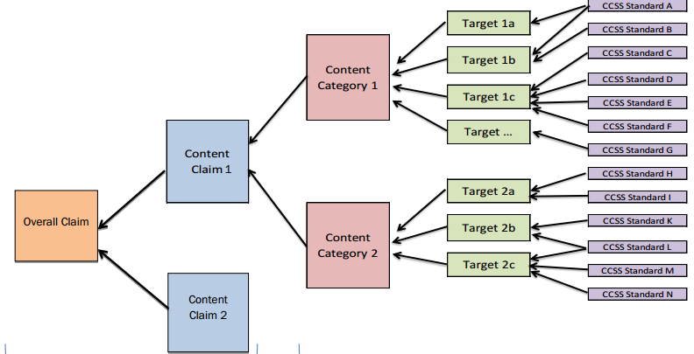
Assessment Design for Mathematics
Mathematics Claims and Targets
Priority Cluster
Concepts and Procedures
Oregon Mathematics Summative Assessment
Supporting Cluster
Problem Solving
Claim 3 Communicating and Reasoning & Claim 4 Modeling & Data Analysis
Notes:
Slide 13: Connecting Claims, Targets, and Standards (Facilitator 1)
One unique feature in the Interim Assessment System is its alignment to assessment Targets rather than individual standards. We will provide an example of how the interim assessments align and connect to standards and where they are positioned within the context of OSAS Assessment design and development.
This model provides a quick overview of assessment design relative to ELA and Mathematics; however, we will use a mathematics example for this purpose. As you can see moving from right to left, the assessment development starts with alignment to standards, that grouped into learning targets, and move towards content claims in blue and then an overall claim at the end, on track for college and career readiness.
When first thinking about the summative assessment we can easily connect to the [Click Animation] Overall Claim or composite scores.
However when we look further we can connect to data at the content claim level. In this example [Click Animation] we use Concepts and Procedures, [Click Animation] Problem Solving, and [Click Animation] both Claim 3 Communicating and Claim 4 Modeling.
Further, within the context of Mathematics, Claim 1 Concepts and Procedures can be further connected to [Click Animation] Priority Clusters/Standards, and [Click Animation] Supporting Clusters/Standards. Again, this contributes to the Overall Claim and composite score.
However, the Interim Assessments are organized into learning targets. Therefore, if an educator can identify which standards they want to assess, they can crosswalk directly to what interim assessment target they wish to administer.
ODE will provide specific examples to this process in Session 3 – Content Specific Interim Assessment Guidance for ELA, Mathematics, and Science.

Slide 14
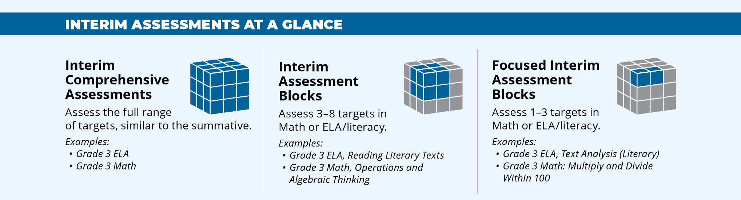
Oregon’s Interim Assessment System
The ELA/ Mathematics system offers the following interim assessments:
Interim Comprehensive Assessments (ICAs) test the same content and report scores on the same scale as the summative assessments.
Interim Assessment Blocks (IABs) provide more detailed information for instructional purposes.
Focused IABs provide educators with a finer grained understanding of student learning.
The Science Interim Assessments contain only Interim Assessment Blocks (IABs) and are available to purchasing districts.
Notes:
Slide 14: Oregon’s Interim Assessment System (Facilitator 1)
The Oregon Interim Assessment System provides flexibility in the types of assessments available for educator administration.
As previously discussed [Click Animation] the ICAs provide a complete assessment option which mirrors the summative assessment. This also means they take about the same amount of time to administer as the summative assessment, therefore their use should be evaluated prior to administration to account for the time commitment and what the data will provide to inform instruction. Again, the ICAs are available starting January 5, 2021.
The [Click Animation] Interim Assessment Blocks or IABs assess at the target level, usually 3 – 5 targets, and include a wide range of connected standards. They typically take 45 – 60 minutes to administer and provide a more detailed approach to information relative to the standards assessed which can then be used to inform instructional practices.
Finally, the [Click Animation] Focused Interim Assessment Blocks or Focused IABs measure a smaller scope of targets, usually 1 – 3 targets, and therefore provide educators with the even more detailed information of the assessed standards to inform instructional decisions. These take around the same time to administer as the IABs.
It is important to note, when referring to the Science Interim Assessments, they contain only Interim Assessment Blocks at this time and are available to purchasing districts.
Resources:
Understanding the Interim Assessment System (Video)​​

Slide 15

INTERIM ASSESSMENTS AT A GLANCE
Interim Comprehensive Assessments
(ICAs) test the same content and report scores on the same scale as the summative assessments.
One per grade, per content area
Examples:
Grade 5 ELA
Grade 5 Math
Similar to the Summative Assessment
  Same range of standards
  Scores on are on the same scale
  Assesses full range of targets
  If administered in a standardized way (secure testing environment), the approximate expected testing time length would be the same as the Summative
Notes:
Slide 15: Interim Comprehensive Assessment (Facilitator 1)
On this slide, the ICA is represented as the full cube because it covers the full targets and standards of the OSAS Summative Assessment.
In ELA it also includes brief write items from the original test blueprint used prior to 2018.
Of note, both ELA and Math Interim Assessment may require some hand-scoring items that will be required as part of the scoring process by teachers and using the appropriate scoring rubrics in the interim assessment system.
[Click Animation]
Another note is there is only one ICA per grade level for administration.
[Click Animation]
Once the hand-scored components have been entered into the Central Reporting System, a scale score will be populated and the system will produce an Individual Student Report similar to the one available for the summative assessment.

Slide 16

INTERIM ASSESSMENTS AT A GLANCE
Interim Assessment Blocks (ELA & Math)
(IABs) provide more detailed information for instructional purposes.
Over 108 IABs in total across all tested grades
Examples:
Grade 5 ELA, Reading Literary Text
Grade 5 Math, Operations and Algebraic Thinking
Assesses fewer (3-8) targets
Short item sets (6- 18 items)
Associated with a Tools for Teachers formative assessment resources Connections Playlist
If administered in a standardized way (secure testing environment), the approximate expected testing time length would be the length of a class period.
Notes:
Slide 16: ELA and Math Interim Assessment Blocks (Facilitator 1)
There are over 108 interim assessment blocks available for ELA and Mathematics which are all aligned to the Oregon state standards and assessment targets.
In this visual, the cube consists of fewer targets within each IAB compared to the comprehensive assessment. This allows educators to gather evidence and information associated with specific assessment targets and associated standards.
[Click Animation]
This allows educators to focus on assessment targets within a Claim, such as literary text from Claim 1 Reading, or Operations and Algebraic Thinking from the Mathematics Claim 1 Concepts and Procedures.
[Click Animation]
Further, these IABs are shorter in length consisting of 6 – 18 items and can be directly connected to the associated Tools for Teacher instructional resources.

Slide 17

INTERIM ASSESSMENTS AT A GLANCE
Focused Interim Assessment Blocks
(FIABs) provide more detailed information for instructional purposes.
Examples:
Grade 5 ELA, Text Analysis (Literary)
Grade 5 Math, Operations with Whole Numbers and Decimals
Assesses 1 - 3 targets
Short item sets (10 - 15 items)
Associated with a Tools for Teachers formative assessment resources Connections Playlist
If administered in a standardized way (secure testing environment), the approximate expected testing time length would be the length of a class period.
Notes:
Slide 17: Focused Interim Assessment Blocks (Facilitator 1)
The last type of interim assessments available in the ELA and Math Interim Assessment System is the Focused Interim Assessment Blocks or Focused IABs. In this image, there are even fewer assessments targets within the interim assessment and provide the most detailed information in alignment to the assessed standards.
[Click Animation]
This allows educators to dive deeper within a claim to get to very specific assessment targets within a Claim, such as Text Analysis or Operations with whole numbers and decimals.
[Click Animation]
The focused IABs also provide educators with direct connections to the Tools for Teachers instructional resources and consist of about 10 – 15 items.

Slide 18
INTERIM ASSESSMENTS AT A GLANCE
Science Interim Assessment Blocks
(IABs) provide more detailed information for instructional purposes.
Over 70 IABs in total across all tested grades
Examples:
Grade 5: ESS_EarthSys_2-5
HS: LS_StructureFunc_1-11
Aligned to 1 Standard (NGSS PE)
Cluster (4-8 Interactions)
Scoring Assertion information is provided for teachers to describe the knowledge and skills measured by the interaction.
If administered in a standardized way (secure testing environment), the approximate expected testing time length would be 10-20 minutes.
Notes:
Slide 18: Science Interim Assessment Blocks (Facilitator 2)
The Interim Assessment Blocks available for Science slightly differ in their design.
[Click Animation]
Rather than a learning target approach, they are organized and aligned direct to the Oregon State Science Standards. For example, the entire task would be aligned to a standard such as 5-PS1-1.
[Click Animation]
Further, the Science IABs are organized by Cluster items which may include up to 4 or 8 interactions to engage in the 3 dimensional design of the assessment. The science interim assessment blocks require less testing time, ranging from 10 – 20 minutes to administer, and because there is no hand scoring requirement, scores are available immediately after administration.

Slide 19
Standardized vs. Non-Standardized
Interim Assessment Administration
Standardized Administration | Non-Standardized Administration
Individual and independent testing Single administration allows for a reliable “point-in-time” spot check of student knowledge Following summative policies and procedures, such as a secure test environment (e.g., no cell phones, guiding resources, etc.) | Non-secure, non-public Working on assessment items collaboratively Students working with other students to answer items Teacher guides students through items Students use resources to help them answer questions
Notes:
Slide 19: Standardized vs. Non-Standardized Interim Assessment Administration (Facilitator 2)
Another additional flexibility component allows educators to administer the Interim Assessments in both a standardized, on-demand format similar to the summative assessment, or in a non-standardized administration allowing for flexibility of use during instruction.
However, if an educator provides the interim assessments in a non-standardized approach, they must ensure they meet the test security requirements outlined in the ODE Assessment Module 8 Interim Training Resource. ODE will further discuss remote administration requirements in Session 4 - Interim Assessment Administration: Guidance and Support.

Slide 20
Additional Interim Assessments Facts
#1
Are developed using the same process and criteria as the items on the summative assessment
#2
Can be administered through the OSAS Portal using the Test Administrator User Role
(Remote Administration Option)
#3
Can be administered up to 5 times for each assessment for both in-grade and out-of grade-level flexibility
(fixed-form tests)
#4
Scores appear in OSAS Portal using new Central Reporting System
(ICA provides Individual Score Report)
(IABs&FIABs Report Roster and Student Scores
#5
Hand scoring required for ICAs and some IABs, to promote teacher and student learning and familiarity with scoring rubrics.
#6
Each interim assessment can be previewed prior to administration in the Assessment Viewing Application.
Notes:
Slide 20: Additional Interim Assessments Facts (Facilitator 2)
The interim assessment system was designed to be used in conjunction with the state standards, the summative assessment, and local assessment systems. Items in the interim assessment system were developed using the same criteria for summative assessment items and go through a rigorous process including sensitivity, bias, and accessibility.
[Click Animation]
Interim Assessments are administered through the OSAS portal similar to the process for summative assessments and remote administration occurs in a web-based browser removing the need for districts to download the secure browser. This applies to interims only and at this time the secure browser will still be required for the summative assessment.
[Click Animation]
The interim assessments are fixed forms and are not computer adaptive like the summative, however, they can be administered multiple times and provide out-of-grade-level administration.
[Click Animation]
Scores are available in a separate Centralized Reporting System for educators to access through the OSAS portal. Therefore, it is important for educators to have their own test administration account to access information and data.
[Click Animation]
Hand scoring is required for some of the interim assessments for both ELA and Mathematics and can be identified using the Interim Assessment Overview PDF. This provides an opportunity for educators and students to become familiar with the assessment rubrics and calibrate on scoring. As a reminder, there are no hand-scoring items for Science.
[Click Animation]
As a reminder, all the interim assessments can be previewed by educators prior to administration using the Assessment Viewing Application and can be discussed with other educators to collaborate on the rigor of the standards and select the best interim assessments for administration.

Slide 21
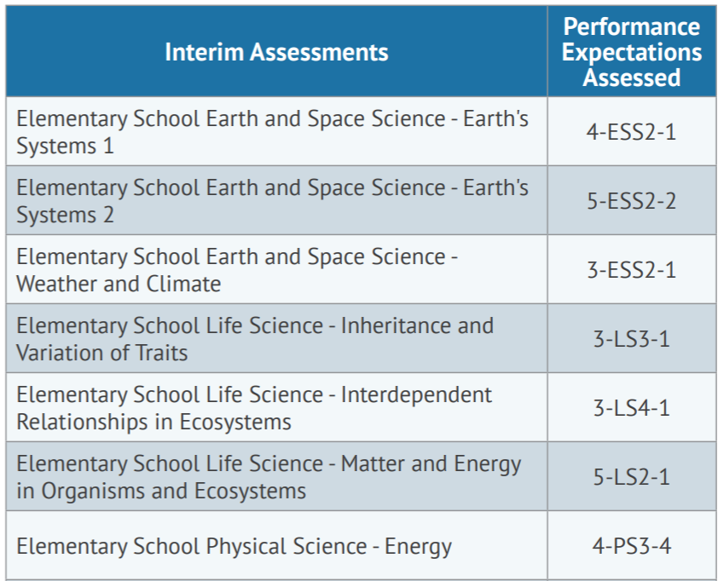

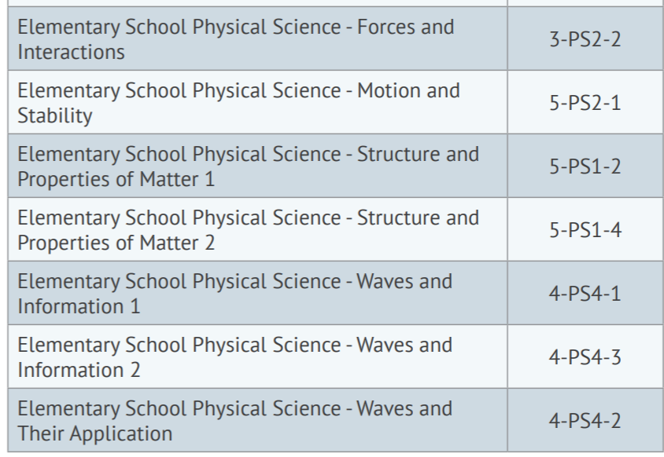
5th Grade Items*
*content is recommended for use in 3rd - 5th grades
Notes:
Slide 21: Grade 5 Science IABs (Facilitator 2)
As discussed earlier the science interim assessment system is slightly different in its design from ELA or Mathematics. The Science interim assessments are directly aligned to the Oregon Science Standards.
They can also be assigned out of grade-level and though the Science interims are available for 5th grade, 8th grade, and high school. It can be used in other grades.
In this example the first row, Earth’s System 1 is a 4th grade standards and therefore appropriate for a 4th grade educator to administer to their 4th grade students. It can also be used as an instructional resource for 5th grade students.
Resources:
Science Interim Assessments Information Sheet

Slide 22
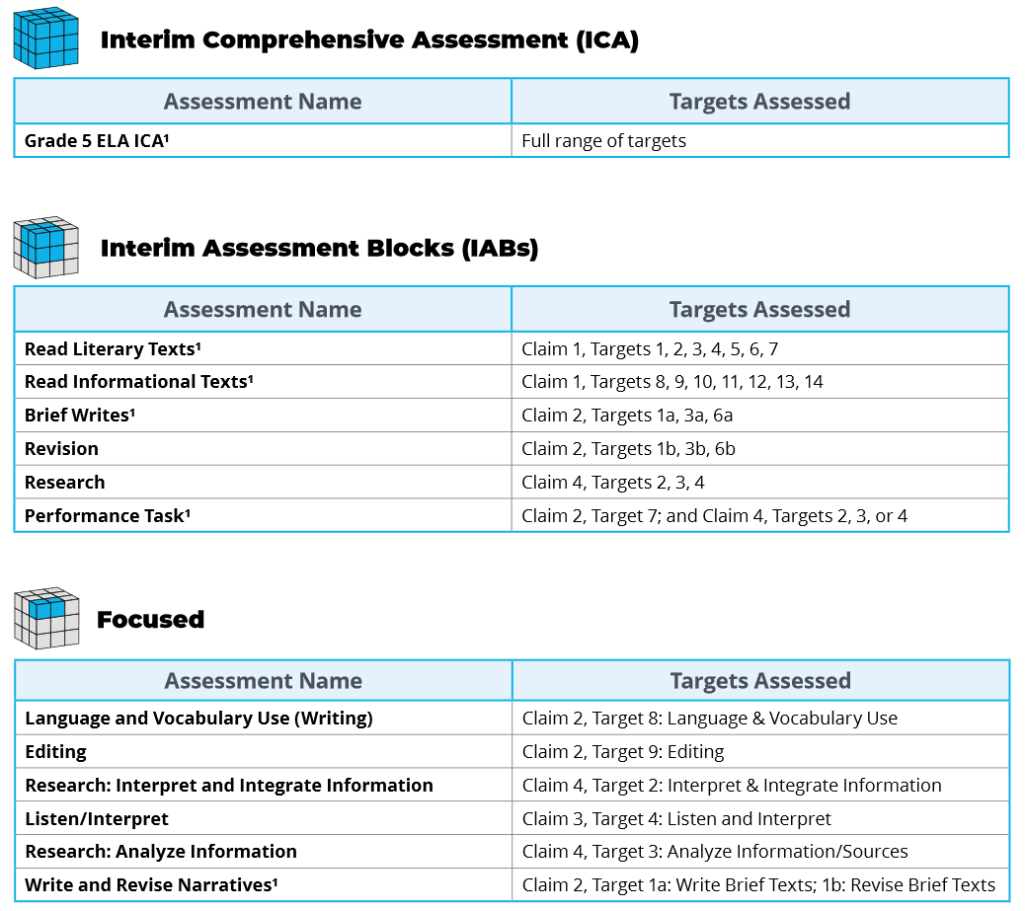
ELA Grade 5 Interims
ELA Grade 5 Interims
Notes:
Slide 22: ELA Grade 5 IABs (Facilitator 1)
The following is an example of the interim assessments included for 5th grade ELA. As you can see some of the interim assessments have a footnote 1 located next to their title indicating there are hand-scoring items within that specific ICA, IAB, or Focused IAB.
Additionally educators can quickly identify which learning targets are being assessed within the selected interim assessment.
We will further explore making connections from learning targets to standards in Session 3 for both ELA and Mathematics.
Resources:
ELA and Mathematics Interim Assessment Overview​
​​This document describes the interim assessments, including their purpose, use, and varieties.

Slide 23
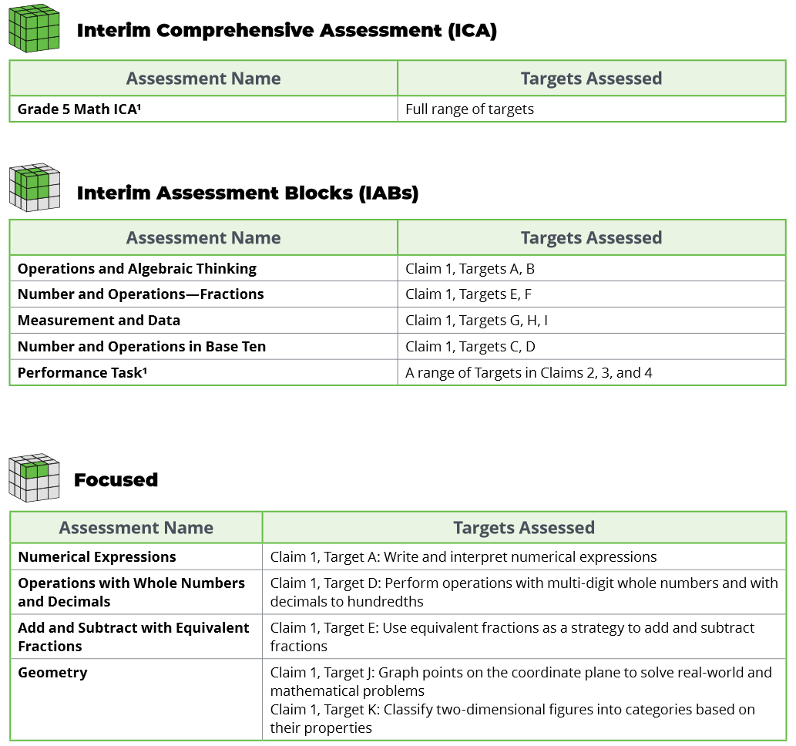
Math Grade 5 Interims
Math Grade 5 Interims
Notes:
Slide 23: Math Grade 5 IABs (Facilitator 1)
The following is an example of the interim assessments included for 5th grade Mathematics. Similar to the ELA example, educators can see some of the interim assessments that have a footnote 1 located next to their title indicating there are hand-scoring items within an interim assessment.
Again, educators can quickly identify which learning targets are being assessed within the selected interim assessment.
As a reminder, Session 3 will be broken into two separate session specific to ELA and Mathematics to help make the direct connections from learning targets to standards.
Resources:
ELA and Mathematics Interim Assessment Overview​
This document describes the interim assessments, including their purpose, use, and varieties.

Slide 24
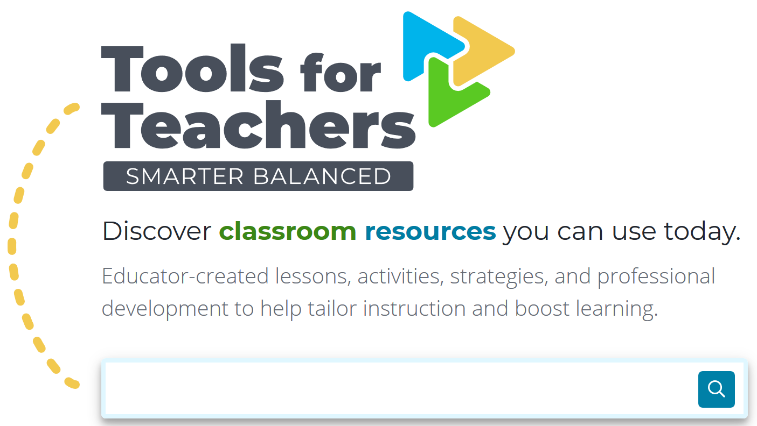
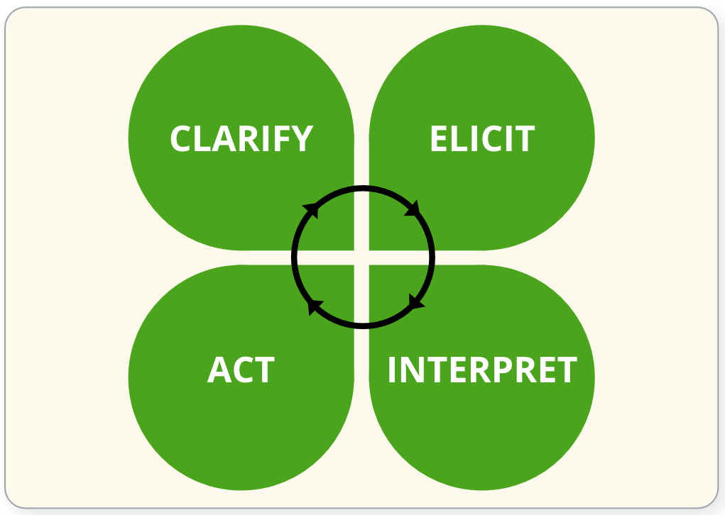
Tools for Teachers for ELA and Mathematics
To support formative assessment, Smarter Tools for Teachers is an online collection of high-quality instructional and professional learning resources contributed by educators for educators.
Notes:
Slide 24: Tools for Teachers: Formative Assessment Practices (Facilitator 1)
As mentioned, the ELA and Mathematics Interim Assessment System includes the Tools for Teachers instructional resources. These resources are aligned to college- and career-ready standards and help educators implement [Click Animation]
the formative assessment process to improve teaching and learning.
The Tools for Teachers resources are created by classroom educators from not only Oregon, but across 13 states which contribute to the Smarter Balanced Assessment Consortium. This includes educators from Washington, Hawaii, California, Vermont, Connecticut, and many other states that are part of the Consortium.
[Click Animation]
Tools for Teachers is available to all Oregon educators whether a district choose to participate or not participate in the Oregon Statewide Interim Assessment System. This includes instructional or educational assistants working directly with students. Educators will use their OSAS Portal sign-in account and credentials to access Tools for Teachers.
Therefore, it is important for district testing coordinators to review the “User role” supplemental training module to ensure access is provided for use of the Tools for Teachers resources.
Resources:
Formative Assessment Process Graphic (PDF)
Remote Use of Tools for Teachers and Formative Assessment Resources

Slide 25
Interim Training Requirements
DTCs or STCs will need to apply the “Interim” Test Group to each user that will administer the interim assessments. The decision to allow access to the Interim Assessment System is determined by the educators’ district.
  Users will not be able to administer the interim assessments if the Test Group permission is not assigned to their TA user account.
Notes:
Slide 25: Interim Training Requirements (Facilitator 1)
ODE has made this system available to all Oregon educators, however, the decision to allow educators access to the interim assessments is determined by their district. Either their District Testing Coordinator or their local School Testing Coordinator must activate the interim assessment system for educators.
Users will not be able to administer the interim assessments if the Test Group permission is not assigned to their TA user account.
Resources:
Module 8 - Interims: Remote Administration and Test Security
Facilitation Guide​​​, Powe​rPoint and PowerPoint with Audio​ ​

Slide 26
Interim Training Requirements
If the TA is a returning user from 2019-20, there are no additional requirements required to apply the “Interim” Test Group other than Module – 8.
However, if an educator does not have a 2019-20 TA user role or has transitioned to a new district, they must complete the reading requirements in Table 5 of the Test Administration Manual and the ODE-provided training modules 2 – 4 and 8 posted to the Assessment Training Materials webpage.
Notes:
Slide 26: Interim Training Requirements (Facilitator 1)
ODE has worked to reduce the work of our district testing coordinators, and this year we have implemented a roll-over process where educators from last year have already been populated in the OSAS Portal TIDE Account and will automatically have access to the Tools for Teachers resources, which launch on September 20, 2020.
Therefore, if the educators has completed the 2019-20 TA requirements they will only need to provide evidence they have completed Module 8 - Interim Assessment Remote Administration and Test Security in order for the Interim Assessment user role to be assigned to them.
[Click Animation]
However, if an educator did not have a TA user account from the 2019-20 instructional year or if the educator has transitioned to a new district which is different from last year. They must complete the reading requirements in Table 5 of the Test Administration Manual and in addition to completing Module 8, they must also complete training modules 2, 3, and 4. These training modules have already been updated for the 2020 -21 instructional year, and have been
Resources:
Module 8 - Interims: Remote Administration and Test Security
Facilitation Guide​​​, Powe​rPoint and PowerPoint with Audio​ ​
Assessment Training Materials

Slide 27
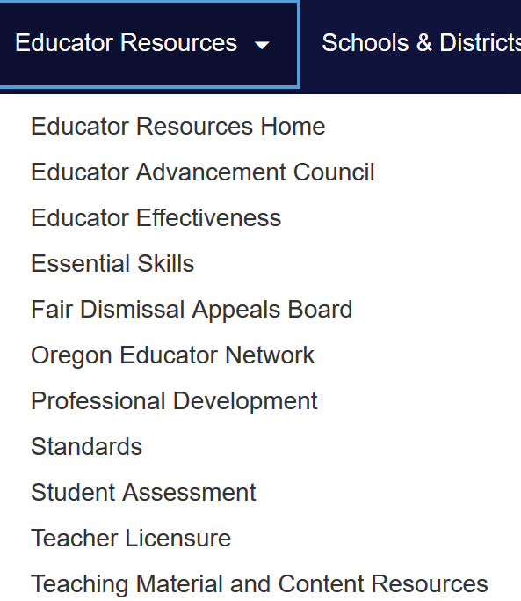

Contact Us! www.oregon.gov/ode
Dan Farley: Director of Assessment
Noelle Gorbett: Science Assessment
Andrew Byerley: Mathematics Assessment
Tony Bertrand: ELA and Social Sciences Assessment
Ben Wolcott: English Language Proficiency Assessment
Photo by Volodymyr Hryshchenko on Unsplash
Notes:
Slide 27: Contact Information and Additional Resources (Facilitator 2)
In addition to these professional development resources, the ODE Assessment team is available to support districts and schools with general or content specific assessment questions.
For contact information including email or telephone, please visit the ODE Assessment homepage and select the Assessment Contact button.
Information specific to the Interim Assessment System, including supporting resources and additional session presentations, are available on the ODE Interim Assessment webpage.
Once you have completed Session 1: Understanding a Balanced Assessment System, please navigate to Session 2: Overview of the OSAS Interim Assessment System.
Resources:
ODE Assessment Contacts

