Slide 1
Test Delivery System (TDS) Overview
ELPA Screener Training Module
Copyright © 2024 Cambium Assessment, Inc. All rights reserved.
Notes:
Welcome to the Test Delivery System (TDS) Overview training module.
In this training module, we’ll discuss the Test Delivery System, which includes the Student Interface used by students to navigate through the test, and the Test Administrator Interface used by TAs to manage test sessions and monitor student testing progress.
Please note that the example images shown in this training module may vary slightly from your state’s system.

Slide 2
Objectives
After viewing this presentation, you should be able to:
  Use the Test Administrator Interface to start and run a Screener test session
  View student test settings and accessibility resources
  Monitor the Screener testing process
  Pause and stop a test session
  Print test session information
  Exit and log out of the Test Administrator Interface
Notes:
After viewing this presentation, you should be able to:
Use the Test Administrator Interface to start and run a test session;
View student test settings and accessibility resources;
Monitor the testing process;
Pause and stop a test session;
Print test session information; and
Exit and log out of the Test Administrator Interface.
Students must use the Secure Browser to take the Screener online.

Slide 3
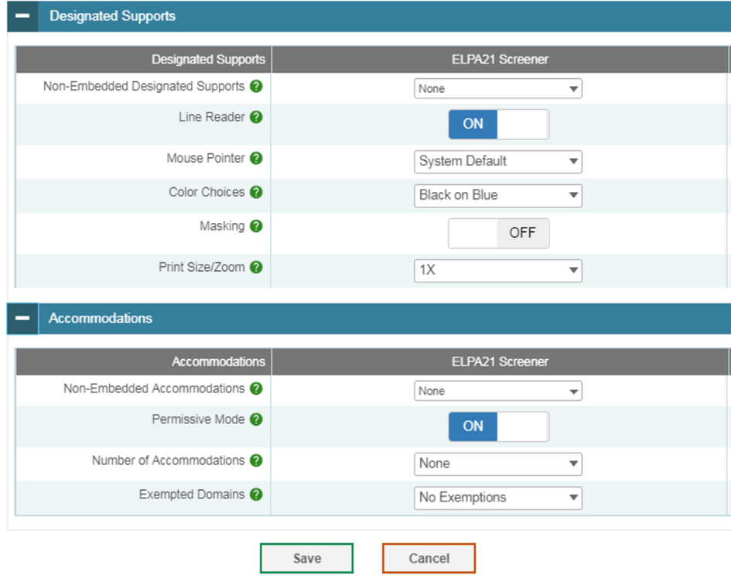
Confirming Student Settings in TIDE
  Before a student can take the Screener, that student must be entered in TIDE.
  Students without permanent SSIDs can be added to TIDE with Temporary IDs if they need to take the test right away.
  All roles may create Temp IDs.
  Domain exemptions must be marked in TIDE prior to testing.
Notes:
All students taking the Screener must be added to TIDE in advance of being administered the test. If your student is already listed with an SSID in TIDE, then they are ready to take the Screener. Otherwise, they must be added. If the student does not yet have a permanent SSID and needs to take the Screener immediately, then they must be added to TIDE manually using an automatically-assigned Temporary ID.
In Oregon, all roles have permissions to create Temp IDs.
Additionally, students who require a domain exemption must have that domain exemption recorded in TIDE prior to testing. If no domain exemption appears in TIDE, then all domains will be scored for the student, even if no questions are answered. Contact your state administrator for clarification on how to determine and record domain exemptions in TIDE in your state.
Note: Students with one or more domain exemptions programmed in TIDE will be automatically administered both Steps Two and Three of the online Screener.

Slide 4
Logging In to the TA Interface
4
Notes:
The TA Interface is used to create and manage test sessions that students join to complete online tests. We will begin with instructions on how to log in to the interface, followed by a review of the features in the TA Interface.

Slide 5
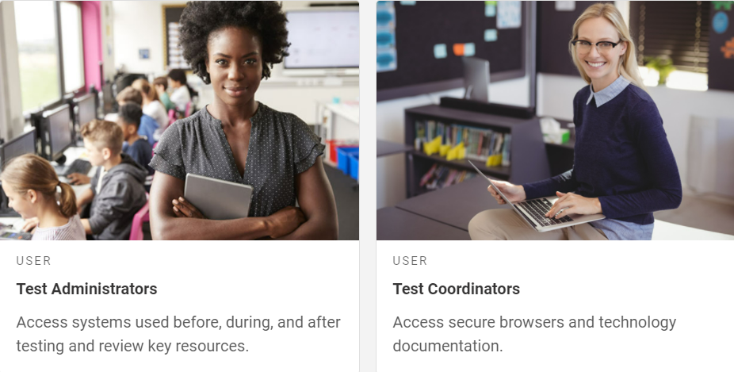
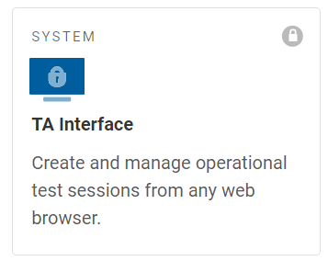
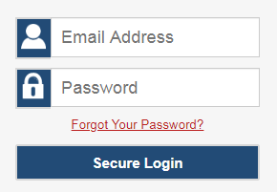
Logging in to the TA Interface
User Role Cards
Operational Test Administration Card
Login Screen
Notes:
The TA Interface is used to create and manage test sessions that students join to complete online tests.
To log in to the TA Interface, go to your state portal. Select the appropriate user role card. On the next page, click the system card used for Operational Test Administration. Enter your username and password, and then click Secure Login to continue.

Slide 6
Creating a Test Session
Notes:
The first step in administering any test is to create a test session.

Slide 7
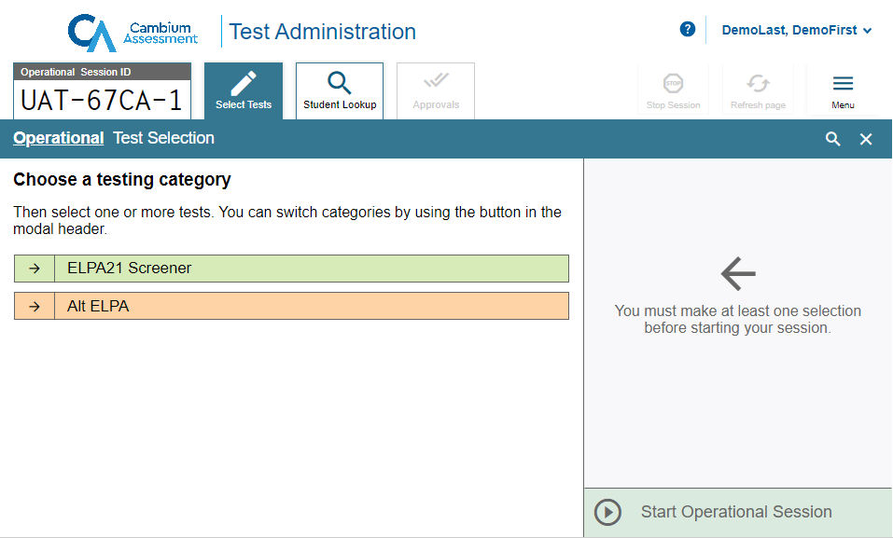
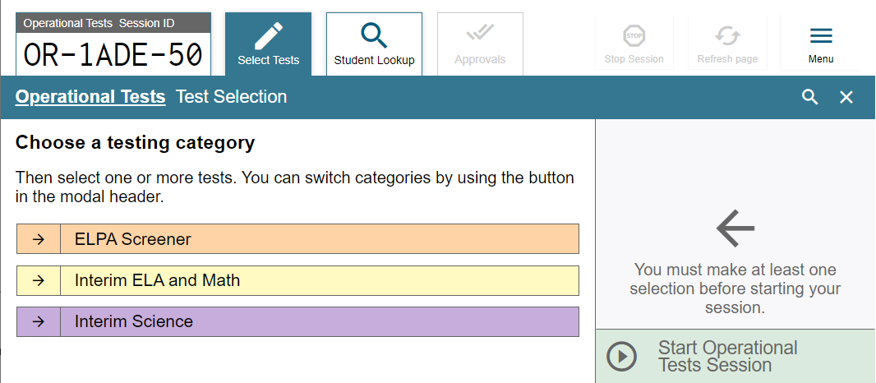
TA Interface Overview
Notes:
Once the Test Administrator has logged in, they will see the TA Interface with the Test Selection window open by default.
In the top right corner of the window, you will see your username with a dropdown menu and a Help button. Select your username to access the Logout button. Select the Help button to access the online Help Guide.
Below the Help button and username on the left side of the window, you will see an Operational Session ID tab, Select Tests tab, Student Lookup tab, and a Menu button.
The Operational Session ID tab will display the session ID and will show the test session table after students are approved to enter the test session and have logged in.
Select the Select Tests tab to add tests to a session.
Select the Student Lookup tab to search for student information using Quick Search and Advanced Search.
Select the Menu button to access the screensaver function and view any approved requests.

Slide 8
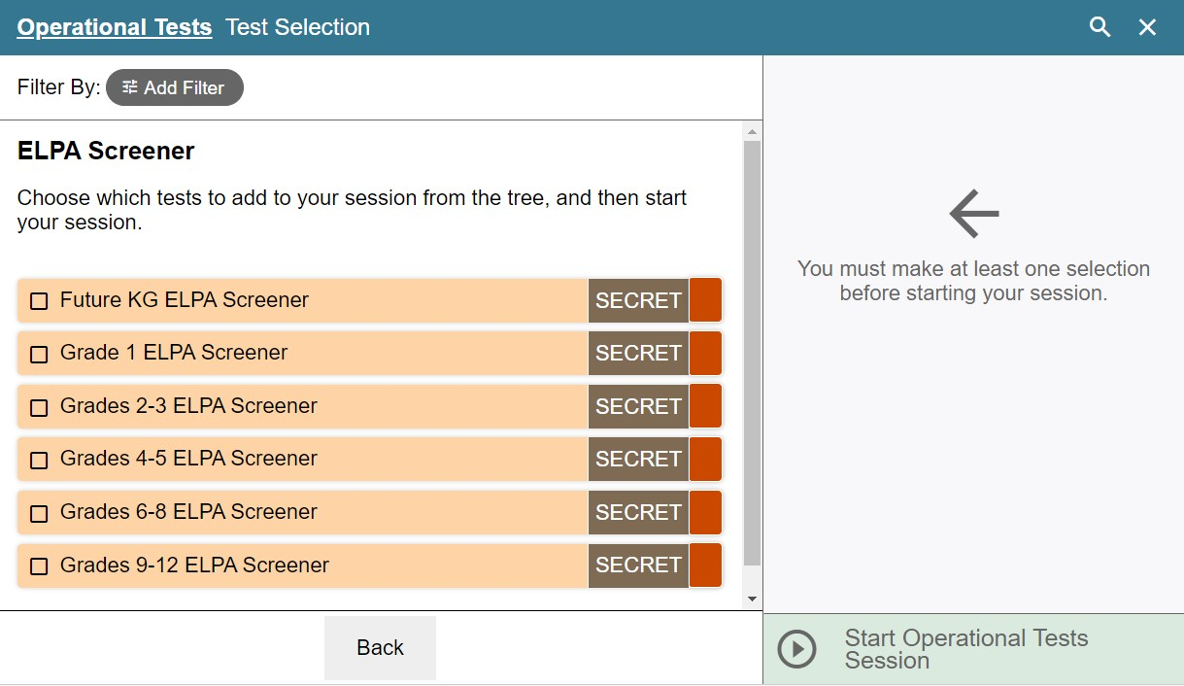
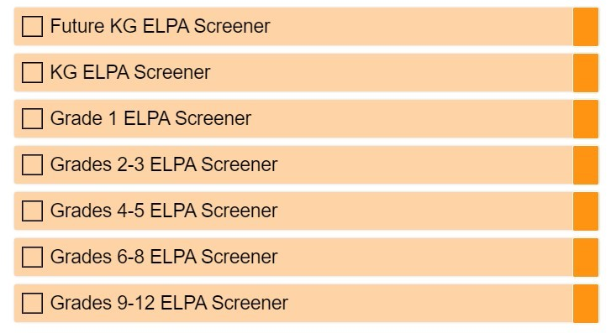
Test Selection
Notes:
To create a test session, click one or more tests to administer. This should be done less than 20 minutes prior to starting the test in order to prevent the system from timing out. You can click the Add Filter button next to Filter By to narrow down your selection.
Students will only have access to the tests you select for them that they are eligible to take. You can create a test session that includes more than one grade or grade band or includes all grade bands. If you aren’t sure which grade band you need to administer, you can select all grade bands. Selecting all grade bands will allow a newly-arrived student to take the appropriate test for their grade, based on their record in TIDE. Remember to adhere to the screener’s one-to-one test administration rules for Practice Step One and the first portion of Step 2, as found in the Screener Test Administration Manual.
Note that your state may or may not have the Future Kindergarten Screener. For states who are using it, the “Future Kindergarten” designation is an indicator that these students are entering Kindergarten. If you are unsure whether to administer a Kindergarten Screener or a Future Kindergarten Screener test to an incoming Kindergartener, contact your DTC or state administrator before testing. Your state may not participate in the Future Kindergarten screening or may have restrictions on its use.

Slide 9
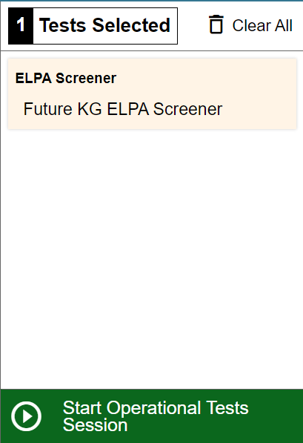
Test Selection (Continued)
Notes:
Once you select your tests, the Start Operational Session button activates. Click the Start Operational Session button. The system will automatically generate a session ID. This ID must be provided to students in order for them to log in. The Test Administrator may write it on the board or provide it to students using a printed card or similar method. If you do provide students with the information on paper, be sure to collect and destroy it when the session is complete.
You should also note the session ID for your own records. If you are involuntarily logged out of the session due to an inactivity timeout or other event, entering the session ID will allow you to resume the session. If you do not have this information when you try to resume, you will be unable to do so.

Slide 10
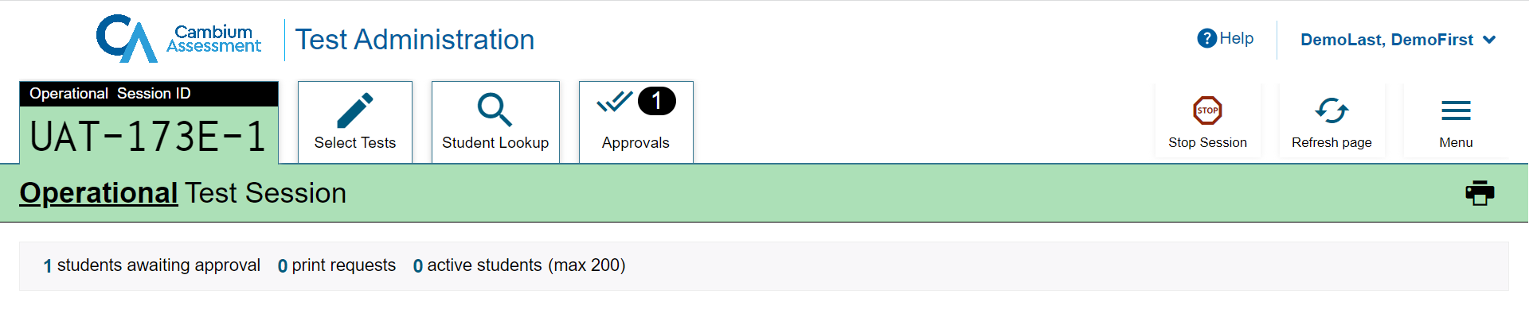
TA Interface After Testing Has Begun
Print Session Information
Notes:
Once a session has started and students are waiting for approval, the Operational Session ID tab displays the session ID and will show the test session table after students are approved to enter the test session and have logged in.
The Approvals tab will become active when any students are waiting for approval. In this example, a single student is waiting for approval. In addition, the Stop Session button will become active.
Below the Menu button, you will see a Print icon. Select the print icon to print the test session information.

Slide 11
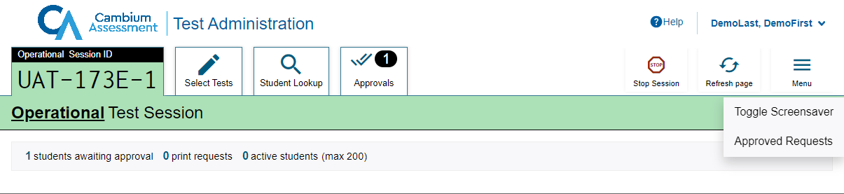
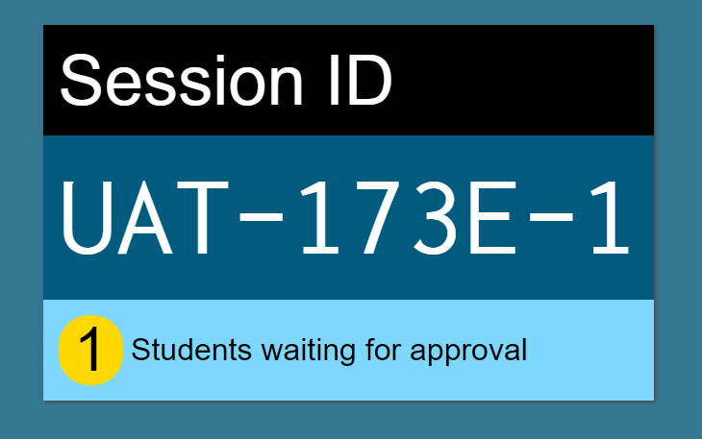
Screensaver Mode
Notes:
Since the student test progress tables in the TA Interface often contain sensitive student information, such as student IDs, the TA Interface contains a screensaver function to hide the data from view. If the screensaver mode is auto-enabled, the screensaver will automatically turn on if you are not active in the TA Site for five minutes. If the screensaver mode is not auto-enabled, it is strongly recommended that you manually turn on the screensaver mode when stepping away from your device.
To turn on screensaver mode, select Menu and then select Toggle Screensaver. The screensaver displays the Session ID. It also displays notifications if students are awaiting approval, if there are pending print requests, or if students require other interventions.
The screensaver will turn off automatically if any mouse or keyboard activity is detected. It will also turn off automatically if the test session times out due to TA or student inactivity or once the allotted time expires for a timed test.

Slide 12
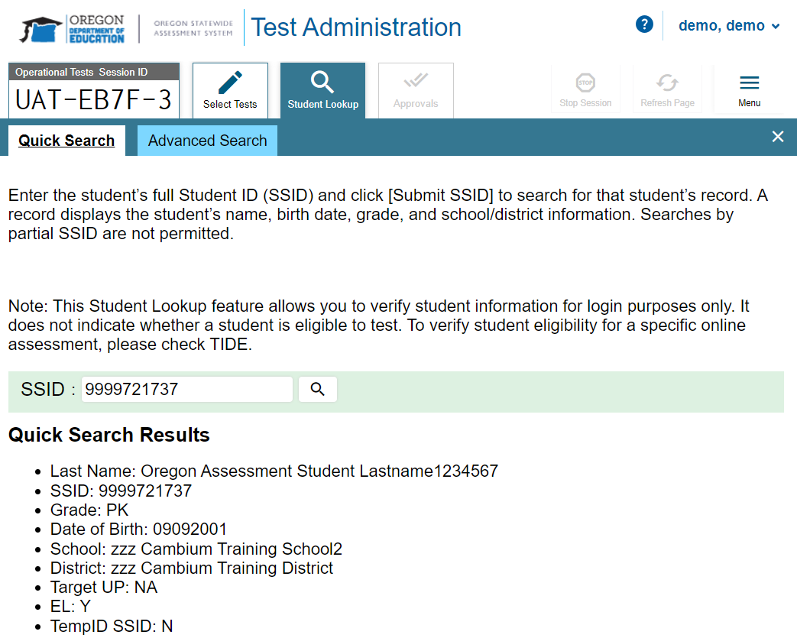
Student Lookup: Quick Search
Search
Notes:
If a student is having trouble logging in, use the Student Lookup feature to verify that the student’s login credentials are correct. You can use either the Quick Search or Advanced Search option to view the information entered for the student in TIDE.
With Quick Search, you simply enter the student’s state-assigned student ID and select the Search icon.
Results will display. If there is no match, you will see an error message.

Slide 13
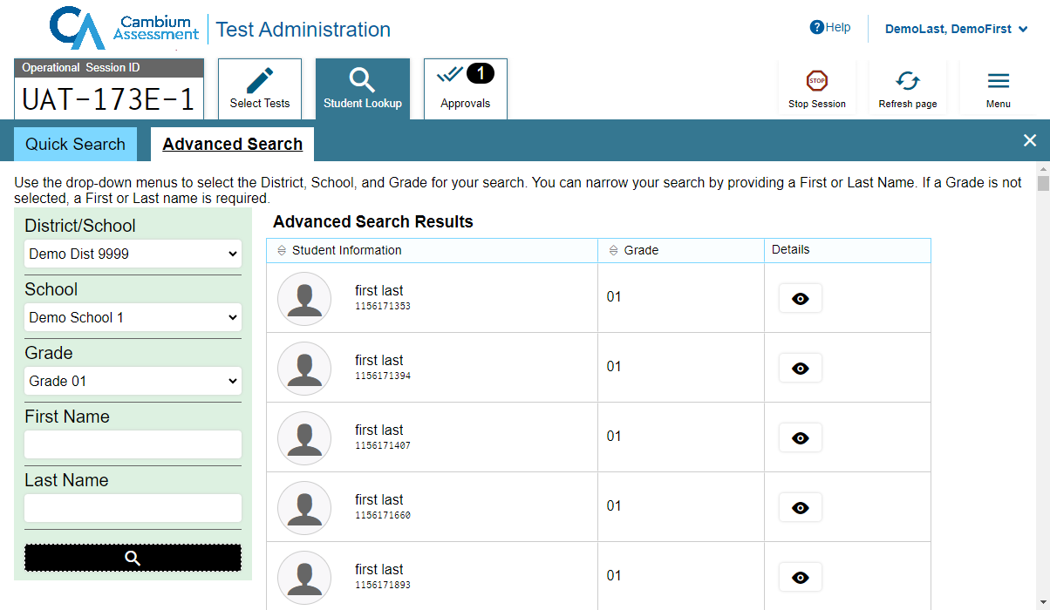
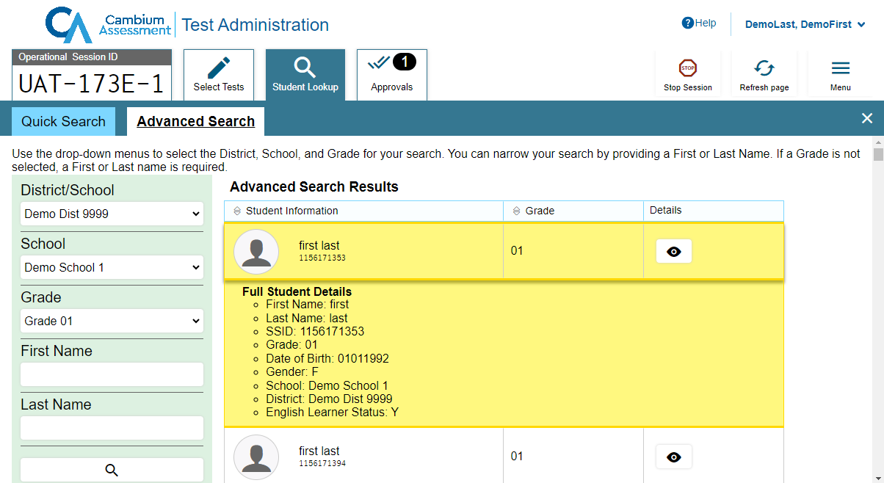
Student Lookup: Advanced Search
Search
Notes:
Advanced Search allows you to narrow your search using several filters, including District/School, Grade, First Name, and Last Name. Enter the criteria in the fields listed and select the Search icon. Results will display. If you see the student you are looking for, select the Eye button next to the student’s name. The student’s information will display below that student’s row in the table. Note that the information displayed may vary slightly from what is shown here.

Slide 14
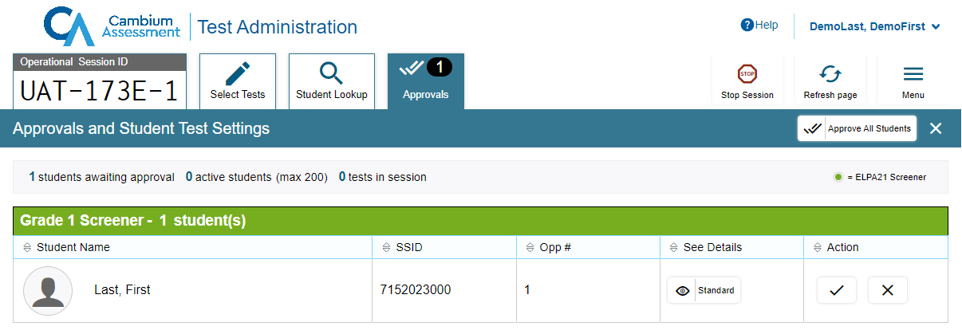
Approving Student Entry
Notes:
Once the Test Administrator starts the test session and students log in, the TA must review and approve students’ test settings before they can access their tests. It is very important to pay close attention to the test name prior to approving to be sure that students selected the appropriate test. You can do this by clicking the Approvals button. A list of students will display, organized by test name. The Test Administrator should review the list to make sure that all students chose the correct content area and test. The Test Administrator should also ensure that all student settings are correct. This is done using the Eye button in the See Details column. See the TIDE User Guide for more information about test settings.
If no changes are needed, click the check mark next to a student’s name to approve that student. Click Approve All Students to admit all students to the test session.

Slide 15
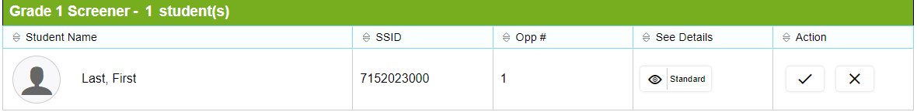
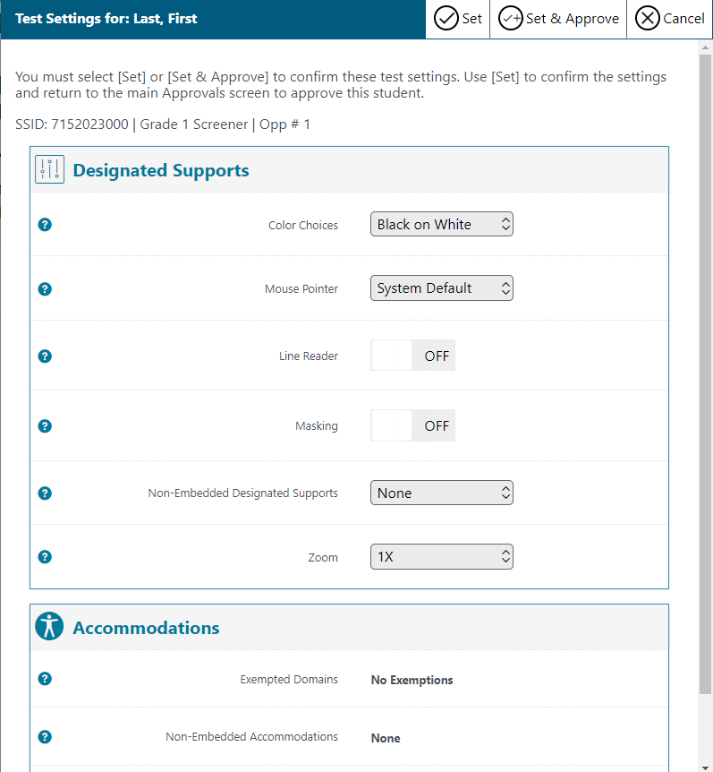
Editing Student Details: See/Edit Details
Notes:
If you need to change test settings for a student, select the Eye button in the See Details column. The Test Settings window will appear, displaying the student’s information at the top and various test settings organized by their area of need.
Some test settings can be changed in this window. After adjusting settings, select the Set button to change the settings without approving the student. To both change settings and approve the student for testing, select the Set & Approve button.
Some test settings can be viewed but not changed in this window. These test settings must be set by an authorized TIDE user prior to testing. See the TIDE User Guide for more information.
Note that the Test Settings window may not appear exactly as it is shown here, depending on your user role and permissions.
If the student’s test settings are incorrect, the settings must be updated in TIDE or the TA Interface before the student takes the test. Contact your School Test Coordinator or District Test Coordinator to have the settings updated. This will prevent resetting the test for the student later. Please note that the changes may not be immediate.
Note that no settings can be changed while the student is actively testing. The student must pause the test and log out if it is necessary to change the student’s test settings. Once the student is no longer actively testing, the student’s test settings can be updated in TIDE.

Slide 16
Denying Student Entry
Deny entry to a test session in these circumstances:
The student is not supposed to enter this session.
The student’s demographic information is incorrect.
The student’s required accommodations are incorrect.
Notes:
If a student selected an incorrect test, you must deny that student entry to the test session by selecting the X button in the Action column. Although you can approve all students at the same time, students must be individually denied entry into the test session.
You should deny students entry into the session in these circumstances:
• The student is not supposed to enter this session.
• The student’s demographic information is incorrect.
• The student’s required accommodations appear to be incorrect and the TA needs to gather more information.
Denying the student entry into the test session will not prevent other approved students from beginning their tests.

Slide 17
Logging in to the Student Interface
Notes:
Students must use the Secure Browser to take the Screener online. In the following slides, we will review how students log in to take a test.

Slide 18
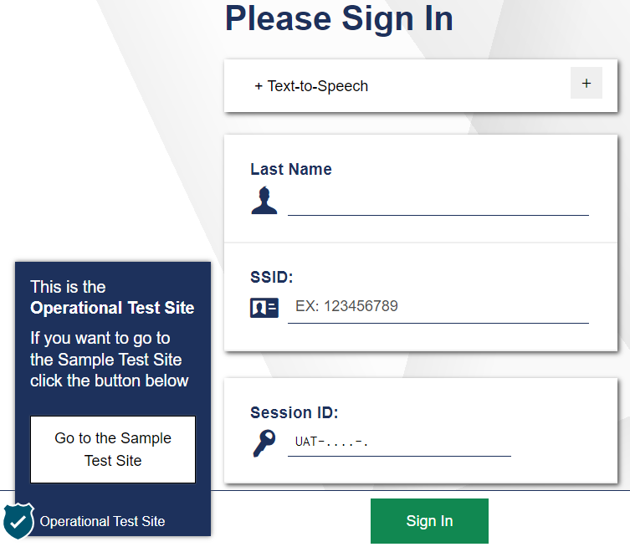

Student Login
Notes:
To log in to the online testing system using the Secure Browser, students must enter three pieces of identifying information: their last name, their SSID, and the current session ID. Only the session ID is unique for each test administration and each proctor, so this is the only information that will change through the test window.
The session ID is generated when the Test Administrator creates the test session. It needs to be given to students by the Test Administrator when it is time for them to log in to the test. Session IDs should not be generated more than 20 minutes before students are ready to log in.
After entering their information, students will click the Sign In button to log in to the test. The Test Administrator may assist students with logging in, if necessary.

Slide 19
Login Errors
Issue | Error Message | What to Do
Student last name and SSID do not exactly match what is in the system. | Please check that your information is entered correctly. If you need help, ask your Test Administrator. | Verify that the student has entered the correct last name and exact SSID. You may need to use the Student Lookup Tool, which is located in the Test Administrator Interface, to verify that the student is in the system.
Student enters the session ID incorrectly. | The session is not available for testing. | Verify that the student has entered the correct Session ID with no extra spaces or characters.
Student enters a session ID for an incorrect or expired session. | Session has expired. | Ensure that the student enters the correct Session ID for the current session. If this does not work, verify that your session is open using the Test Administrator interface.
Notes:
If a student is having difficulty logging in, an error message and code will display on the login screen. The most common errors occur when the student’s last name and SSID do not match what is in the system and when SSIDs are entered incorrectly. If the student receives an error message indicating that they have entered incorrect information in the last name or SSID fields, the TA should use the Student Lookup Tool in the TA Interface to verify the student’s information.
Another common error occurs when the students enter an incorrect session ID. If a student receives the message “The session is not available for testing,” verify that the session ID was entered correctly, with no extra spaces or characters. The session ID can be found in the TA Interface. If a student receives the error message “Session has expired,” ensure that the student has entered the correct session ID for the current session. If the student has entered the session ID correctly, use the TA Interface to verify that your session is still open.

Slide 20
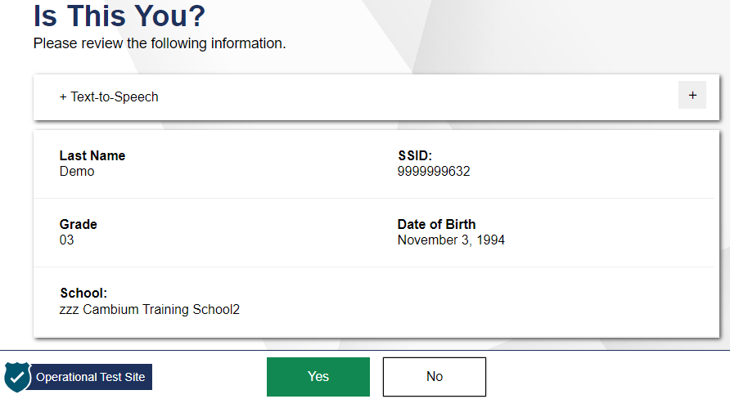
Student Verification
Notes:
After logging in, students need to complete a few more steps before they begin testing. Students will be asked to view and verify their personal information. If their information is correct, students should click Yes to proceed. If their information is incorrect, they should click No to return to the login page. Test Administrators must then contact their Building or District Test Coordinator to have the student’s information updated in TIDE before the student attempts to log in again.

Slide 21
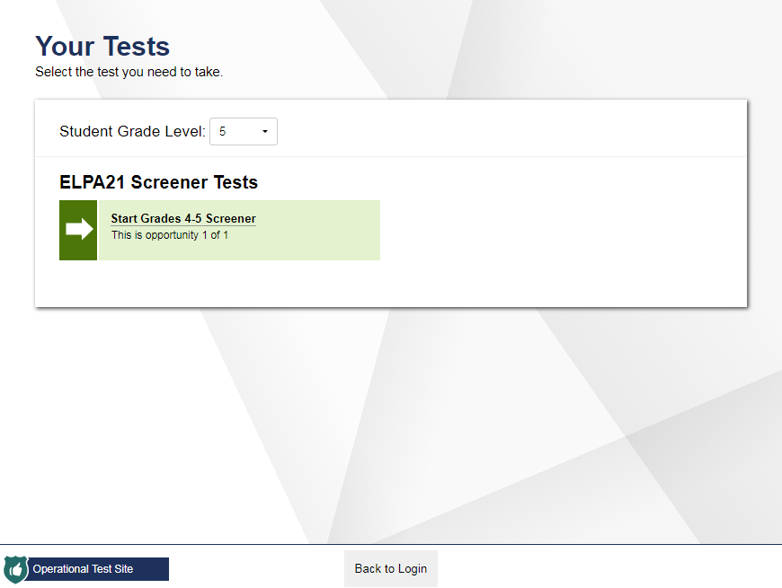
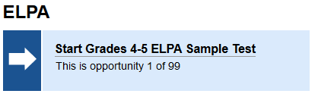
Student Test Selection
Notes:
On the “Your Tests” screen, students will see their assigned tests for this test session.
If the test displayed is incorrect, or the expected test is not listed, students should click the Back to Login button to return to the login page and consult the Test Administrator to resolve the issue. If a test has already been completed, the test selection button will be grayed out. If there are no errors, students should select the correct test and wait for Test Administrator approval to proceed.
Once students select a test to take, they must wait to be approved by their TA.
After selecting the test they need to take, students will see a Waiting for Approval screen. Once the TA approves a student’s request, the student will be taken to the next screen, the Audio/Video Checks page.

Slide 22
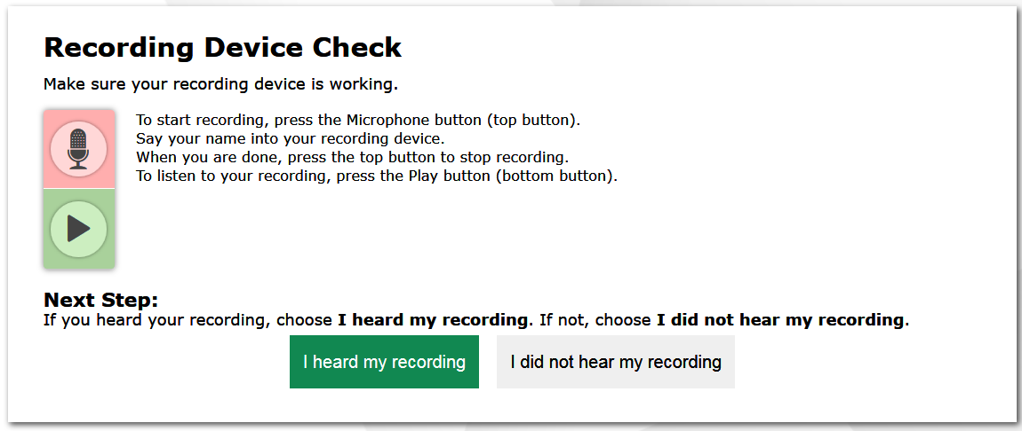
Recording Device Check
Start/Stop Recording
Start/Stop Playback
Notes:
Students taking online Screener tests will need to complete a Recording Device Check. Be sure that students are equipped with headphones and microphones. Preferably, students will be equipped with headsets that have built-in microphones.
First, students should click the microphone icon. After clicking the microphone icon, it will be replaced with a stop button. Students should say their names into their microphones, and then click the stop button.
When students click the stop button, the icon below the microphone will be replaced with a green play button. Students should click the play button to hear their recording.
If students clearly hear their names, they should click the I heard my recording button to proceed to the test.
If the audio is not clear, students should click the I did not hear my recording button and receive a message advising them to tell the TA about the microphone problem. From there, they can click Try Again to record an audio sample again, click Select New Recording Device to try recording using a different attached audio device, or click Logout to leave the test and work with the Test Administrator to adjust their microphone settings. TAs are permitted to assist students with test navigation, including these record and playback buttons, throughout the test.

Slide 23
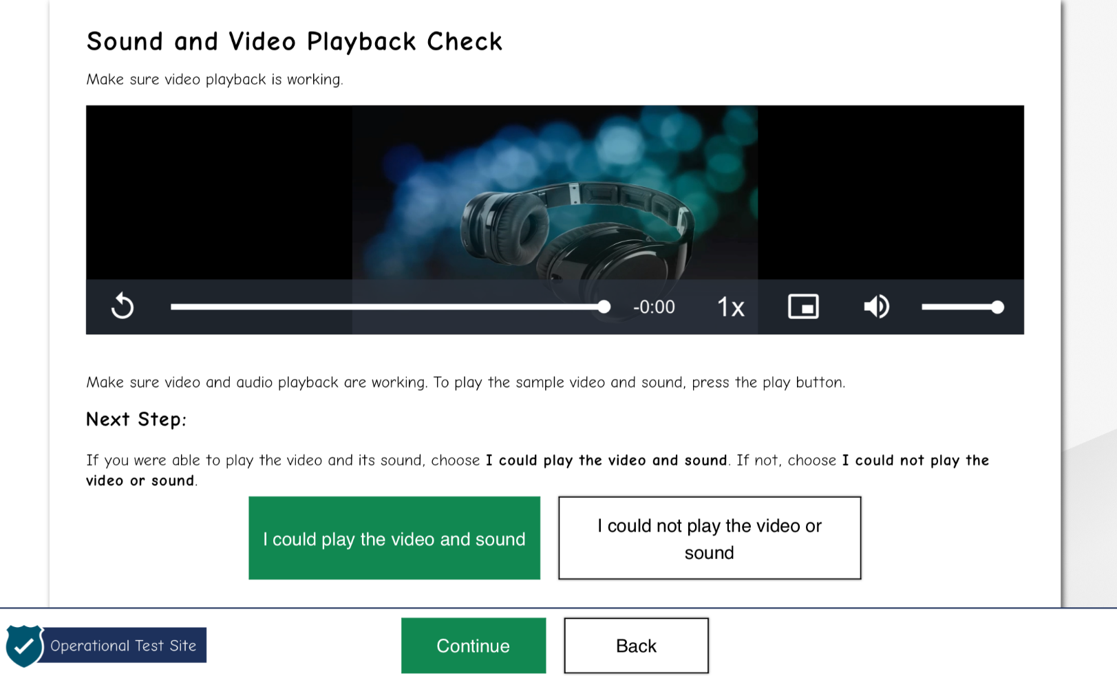
Sound and Video Playback Check
Notes:
Students will also need to complete a “Sound and Video Playback Check”.
Students will be prompted to click the play button and indicate whether the sound was audible by choosing either the I could play the video and sound or I could not play the video or sound button.
If students click I could play the video and sound, they will be able to click Continue and proceed to the next screen. If they click I could not play the video or sound, they will receive a message advising them to tell the Test Administrator that they are having an audio problem. From there, they can click Try Again to listen to the sample audio again or click Logout to leave the test and work with the Test Administrator to adjust their audio settings.

Slide 24
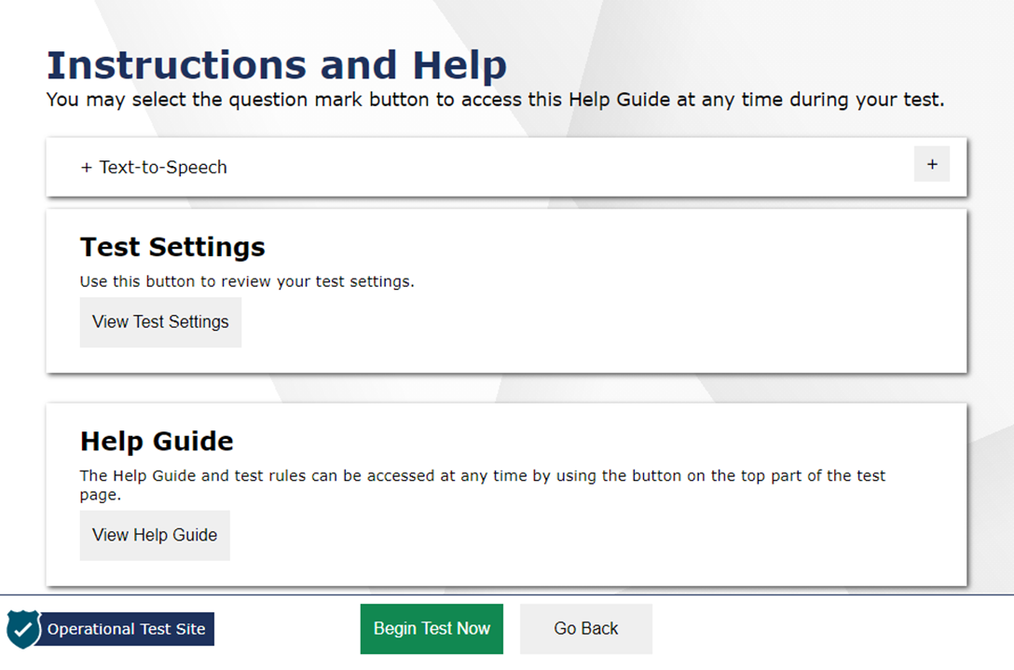
Instructions and Help Screen
Notes:
After completing the Audio/Video Checks, students will see the “Instructions and Help” screen.
The Test Settings section allows students to view their current test settings.
The Help Guide section contains an overview of the test site and test rules.
When students click Begin Test Now, they will proceed to the first question on the first part of the test.

Slide 25
Practice Step One
Notes:
Students are now presented with the first item of the Screener. The Screener is divided into 3 steps.

Slide 26
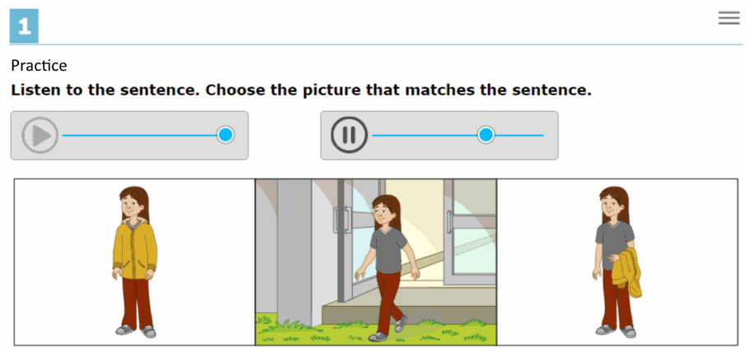
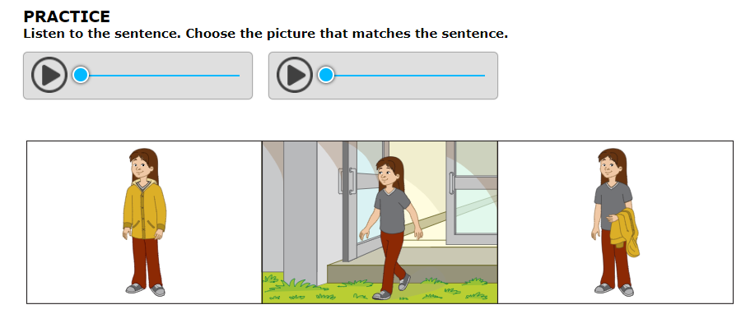
Practice Step One
Notes:
Practice Step One consists entirely of unscored items, which are marked “PRACTICE” and are intended to help students get accustomed to the format of the test.
During Practice Step One and at the start of Step Two, the TA should be seated adjacent to the student at the student’s computer. These sections of the test are administered One-to-One. No other students should be in the testing room, as this is a secure testing environment.

Slide 27
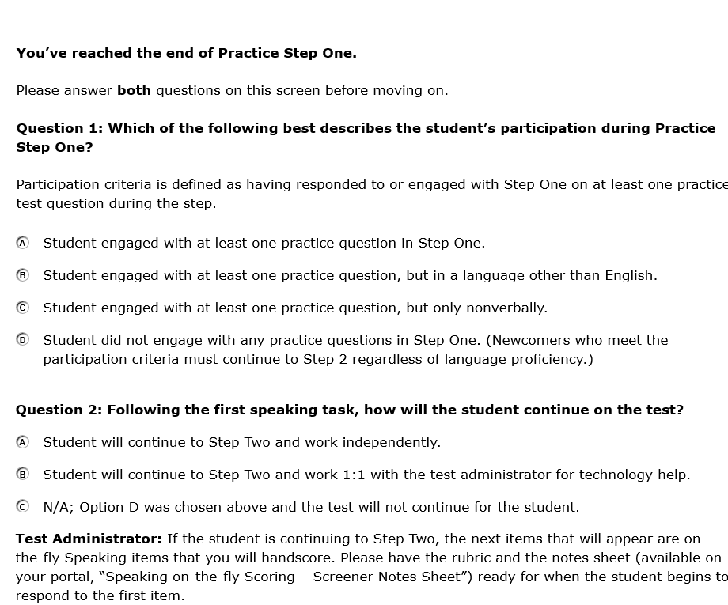
Practice Step One (Continued)
Notes:
The TA’s responses to these two questions trigger whether or not the test continues, in the case that the student was not participating with the Practice Step One items. If the student responded to at least one practice question, the test can be continued. If the student would not, or could not, participate in Practice Step One, the test can be ended using Option D in Question 1, non-participant. The TA will use the student’s testing computer to respond to these questions. A response to both questions is required.
Please refer to the guidance in your state’s Screener Test Administration Manual to help ensure that the screener opportunity is continued appropriately for students.
Participation is defined as having responded to or engaged with Step One on at least one practice test question. Response modes during this step could include verbalizing, nodding when presented with an option, pointing, or using the mouse themselves to indicate a response to at least one of the practice questions. If the TA chooses either option A, B, or C in Question 1 the student will continue on to Step Two.
Before Step Two, the TA must also respond to Question 2 to indicate if the student will require TA assistance with the technology. If the student is able to work with the technology independently, select Option A. If the student will need 1:1 assistance with the technology for the remainder of the test, select Option B. If Option D was chosen in Question 1 because the student did not engage with any practice questions in Practice Step One, select Option C.
Choosing Option D in Question 1 and Option C in Question 2 ends the test for the student. The test will not continue because the student did not participate by responding to at least one Practice Step One question. The TA will then be presented with a screen where they can provide more detail about the student’s behavior and participation during Practice Step One.
This screen also has a reminder at the bottom, because the TA will be immediately scoring the first operational task in Step Two. At this point the TA should prepare the materials for the Step Two speaking task.

Slide 28
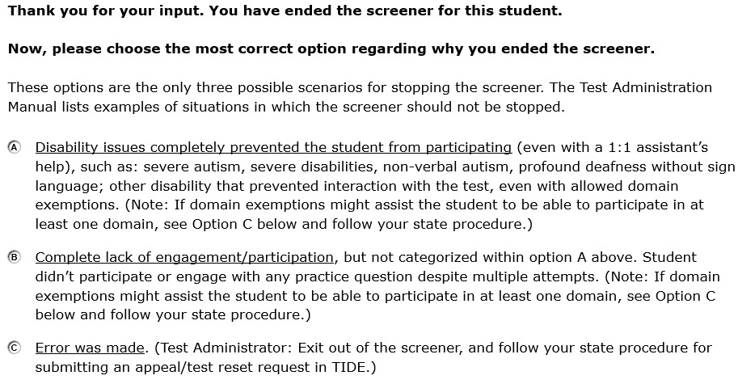

Practice Step One (Continued)
Notes:
If the TA chooses Option D in Question 1, “Student did not engage with any practice questions in Step One” and Option C in Question 2, the pictured screen will appear that will ask the TA to indicate the circumstances that ended the test for the student. The test will then end, and the student will receive a non-participant Individual Student Report.
If Option D was chosen in error in Question 1, a test reset in TIDE will be needed for the student to continue the screening session. The TA should choose option C on this screen to indicate that an error was made. If this occurs, please exit the test and follow the process for submitting an impropriety. For more information about improprieties, see the ELPA Screener Administration Manual.

Slide 29
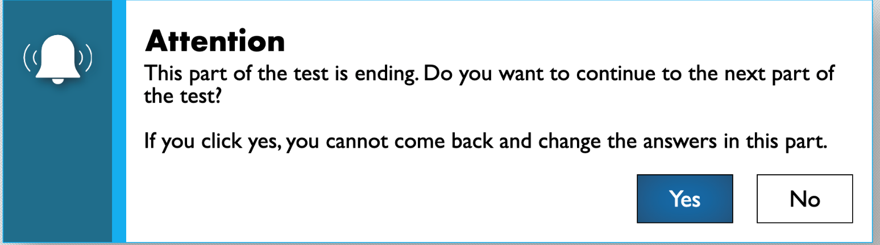
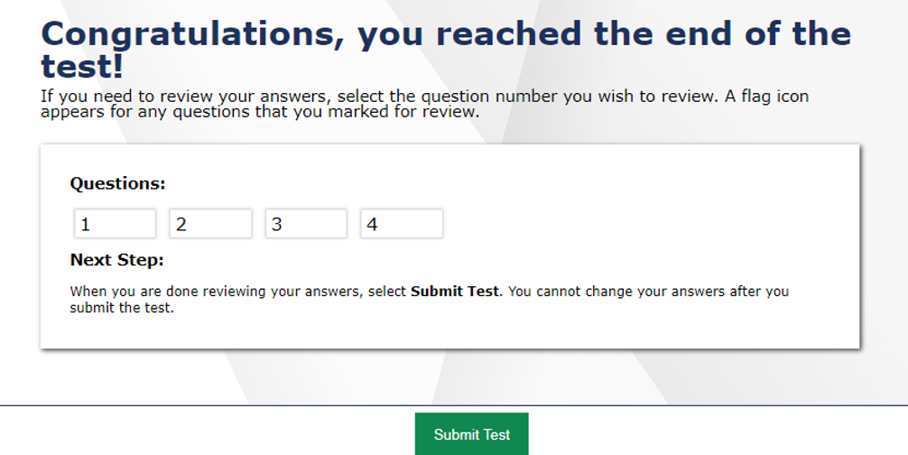
Practice Step One (Continued)
Notes:
If the TA chooses to end the student’s test after Practice Section One, they should select “Yes” when prompted whether they wish to continue to the next part of the test. After clicking the Next button, a 'Congratulations, you reached the end of the test!' screen will appear.
If the TA chooses to continue the student’s test, the student will be presented with the first question of Step Two.

Slide 30
Step Two
Notes:
Step Two is administered under secure testing conditions, with only the student choosing responses to test questions.

Slide 31
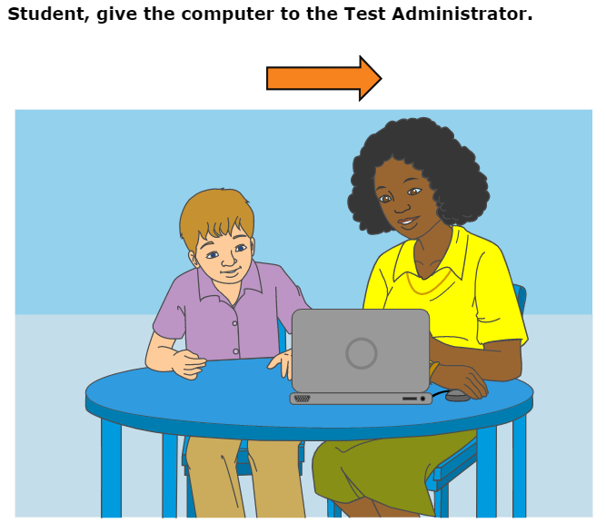
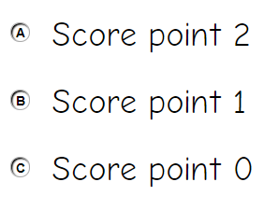
Step Two
Score Shell Example
Notes:
The first questions in Step 2 are four operational speaking items. This task is administered one-to-one, and the TA can take notes on the Notes Sheet and score “on the fly” while the student is recording.
After the four speaking items are administered, and the student has been given a chance to review their recordings, the student will be presented with a screen instructing them to give the computer to the test administrator. The TA will then provide the student with a small enrichment task and will have the student turn away from the screener. The TA will then score the four speaking items with the provided rubric, and then enter the student’s score on each item directly into the computer. The TA will score the speaking items using the scoring shell shown on this screen.
The four speaking items must be scored immediately by the TA. The computer will not move past the scoring screens until a score for each speaking item has been entered. A rubric and guidance documents will be available on your state’s testing portal for this section of the test.

Slide 32
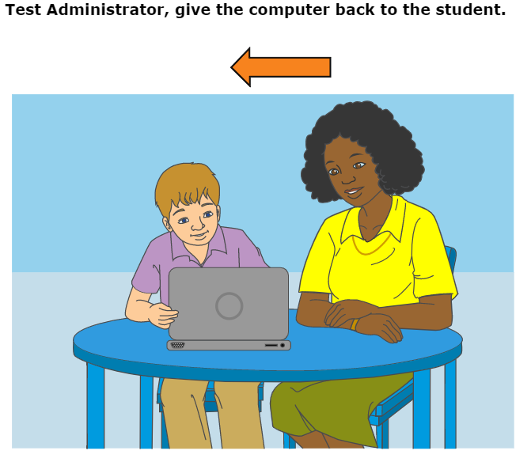
Step Two (Continued)
Notes:
Once the scores are entered and the TA clicks Next, there will be a screen instructing the TA to give the computer back to the student. Once this occurs, the responses and the scores for the four speaking items cannot be changed.
Once the TA has given the computer back to the student, the student will be presented with a question. This section of Step Two consists of machine-scored operational items from the Reading, Writing, and Listening domains. This is also the point where the student may work on their own if the TA had previously determined that the student had sufficient technology skills to work independently. If yes, the TA may step away and allow the student to continue working. If not, the TA will stay seated adjacent to the student and assist with technology.

Slide 33
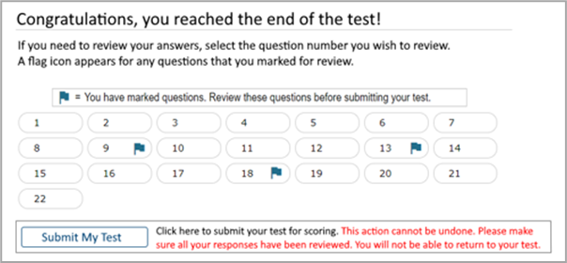
Step Two (Continued)
Students will not see this screen if they are continuing to step Three. The test engine will present a new test question.
Notes:
At the end of Step Two, after the student has been given the opportunity to review their responses to the machine-scored items, the testing system will determine if the student goes on to Step Three. The test automatically ends at Step Two if the student will not be continuing. This is determined by the number of points the student obtained in Step Two. Students who are not continuing will see a “Congratulations, you’ve reached the end of the test!” screen, and the testing session will end.
For students whom the computer has determined will continue to Step Three, the computer will present a new test question after the student has reviewed their responses to the machine-scored items in Step Two. Once this happens, the student cannot go back to Step Two to modify any responses.

Slide 34
Step Three
Notes:
Step Three consists of operational items from all four domains. There are no further stopping points prior to the end of the test.

Slide 35
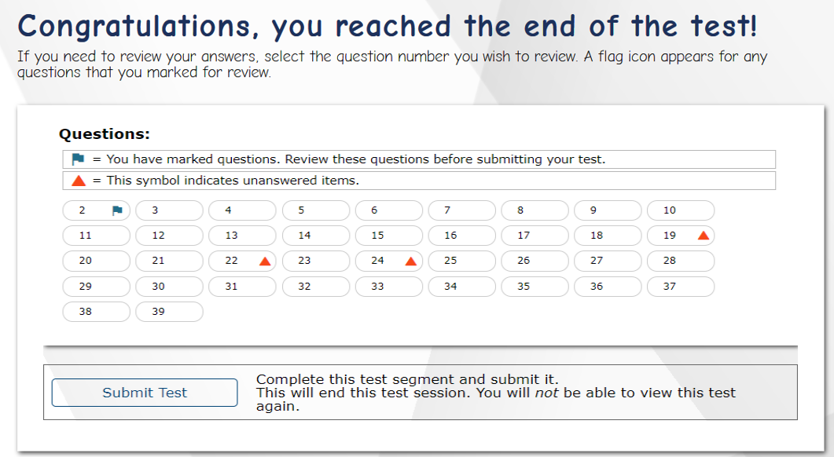
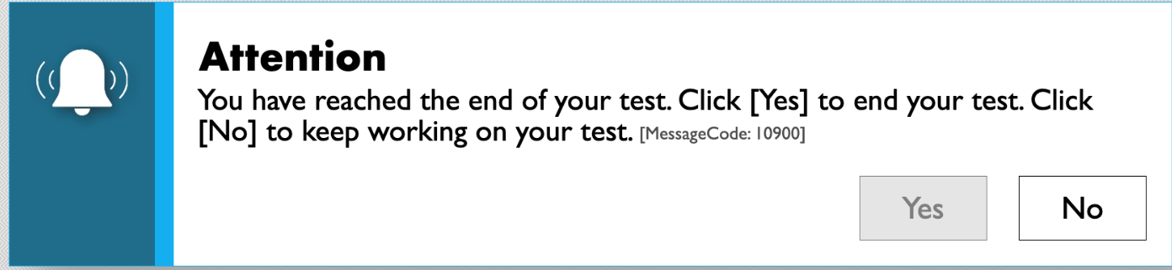
Review and End Test
Notes:
At the end of Step Three, when students click the Next button, they will see the Review and Submit Test screen. Items marked for review will appear with a blue flag next to the item number. Students should review their answers one last time before submitting their test.
When students are ready to end the test, they should select the Submit Test button. A pop-up message will appear allowing them to select Yes if they are ready to finish the test and No if they are not. If students select No, they will return to the last item of the test and can revisit previous items. If students click Yes, they will be taken to the Test Completion page, as shown on the next slide.

Slide 36
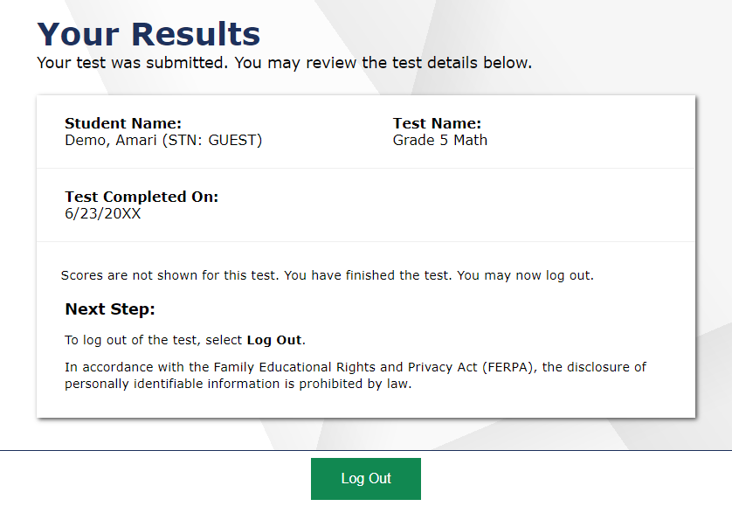

Test Completion Page
Notes:
On the Test Completion page, students will see confirmation that their test was successfully submitted. The student will click Log Out to exit the system.

Slide 37
Test Interface
Notes:
Now we will review how students navigate the student interface and use test tools.

Slide 38

Global Menu
Navigation Buttons
Test Tools
Notes:
The global menu appears at the top of the student interface. The left side of the menu contains navigation buttons that students use to advance through the test:
All students can navigate between pages using the Back and Next arrow buttons. Students can also navigate between items using the Items drop-down menu located above the navigation buttons.
The Save button ensures a response is committed to the system. However, the Save button is not required to save an item. Other actions, such as moving forward to the next question, will also save the response.
Test tools can be found on the right side of the menu:
The Masking tool, when it is available, allows students to “cover” an area of the item so that they can focus on certain item elements.
The Line Reader tool, when it is available, allows students to highlight an individual line of text in a passage or question. All content except for the line in focus is grayed out for greater emphasis.
Students use the Zoom Out and Zoom In buttons on the right side of the menu to decrease and increase the size of text and graphics on the page.
For more information on managing test settings and accessibility resources in TIDE, refer to the TIDE User Guide. For a detailed list of all available test tools and accommodations, including non-embedded accommodations, please consult the Oregon Accessibility Manual.
Finally, students can access the Help Guide page at any time by clicking the question mark in the upper-right corner of the toolbar. Students can also use the Pause button to pause a test and log out of the student interface.

Slide 39
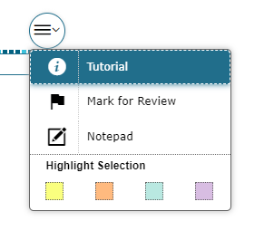
Context Menus
Context menus allow students to:
  Mark items for review
  View item tutorials
  Access additional features depending
  on test settings and item types
Notes:
Some test items and stimuli contain context menus. Students may use context menus to view item tutorials explaining how a particular item type works, mark items for review, and access additional test features.

Slide 40
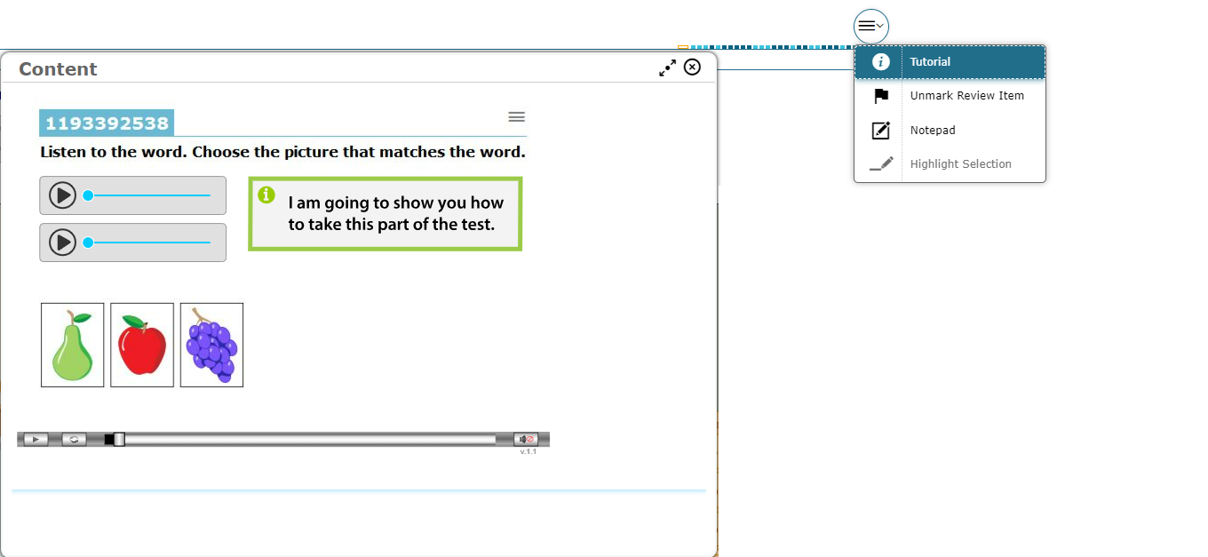
Item Tutorial
Notes:
To get more information about a particular item type, students can select Tutorial from the context menu. A pop-up message will appear that shows how that type of item works (for example: whether they should select an answer, drag-and-drop answers, or type a response in an answer space).

Slide 41
Test Items
Notes:
Next, we will discuss some types of items that students may see.

Slide 42
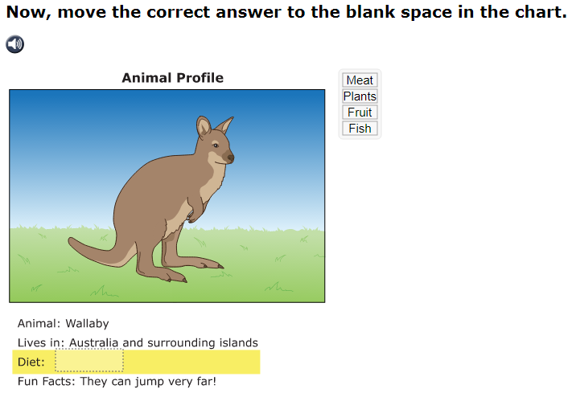
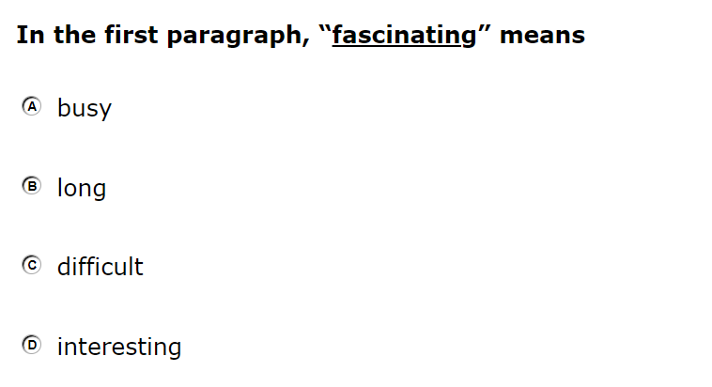
Test Items: Examples
Interactive Item
Selected-Response Item
Notes:
Students will encounter several types of items during testing.
To answer selected-response items, students must click the desired answer option so that the letter A, B, C, or D becomes shaded.
For interactive items, students need to follow the instructions given to know how to indicate their answer. For example, students may be told to click an object to identify the appropriate answer, drag pictures or words in a table, or click on a keypad. If they wish, students may click the Save button while working on interactive items to save their work. Regardless of whether they click Save or not, their answers will save automatically when they navigate to the next part of the test.
Students will click Next to move to the next item.
Be sure that the student is familiar with vertical and horizontal scrolling, as some response options may extend off the screen, and some stories extend below the screen.

Slide 43
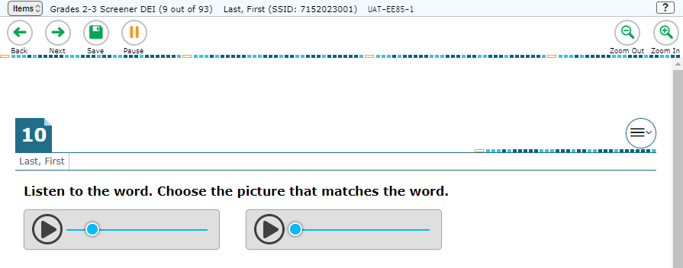
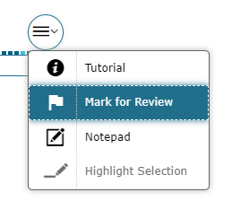
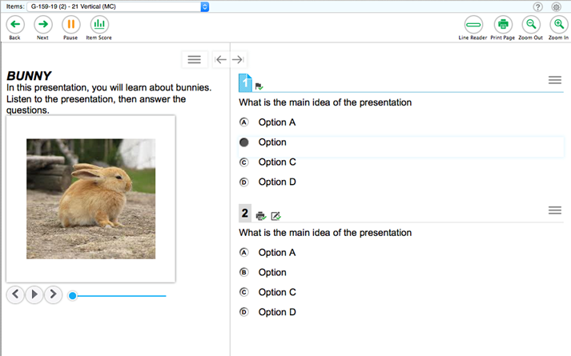
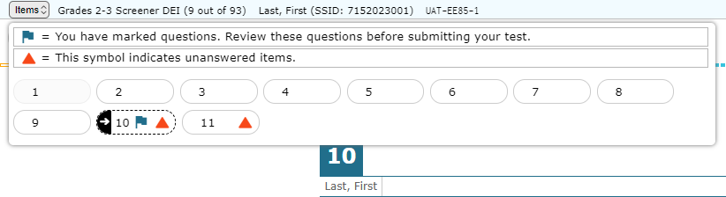
Mark Items for Review
Notes:
To flag an item for later review, students select Mark for Review in the context menu.
After marking an item for review, the item number will appear with a corner folded down. The item will also be flagged in the Items drop-down menu.

Slide 44

Test Items with Audio
Many test items contain audio clips.
Audio will automatically play once the page with the item or stimulus loads.
Students can pause or replay audio by clicking the corresponding button.
Only one audio clip can play at a time.
Notes:
Many test items contain one or more audio clips. The audio will automatically play once the page with the item or stimulus loads. Students can pause the audio or replay the audio clip by clicking the corresponding button.
Note that only one audio clip can play at a time. In order to play a different clip, students must pause the clip that is currently playing.

Slide 45

Speaking Items
The process for recording a speaking response mirrors the steps the student takes during the microphone check process.
Press the microphone to start recording.
Click the stop button when finished speaking.
Click the green play button to listen to the response.
If needed, click the microphone again to re-record the speaking response.
Notes:
The process for recording a speaking response mirrors the steps the student takes during the microphone check process.
Press the microphone to start recording.
Click the stop button when finished speaking.
Click the green play button to listen to the response.
If needed, click the microphone again to re-record the speaking response. If students rerecord, their previous recording will be deleted. It is not possible to add to a recording after the student stops recording. If the student wants to add additional information the student must start over and record the entire response from the beginning.

Slide 46
Monitoring a Test Session
Notes:
Once students log in and are approved for testing, you can monitor their status from the table(s) displayed on the TA Interface.

Slide 47
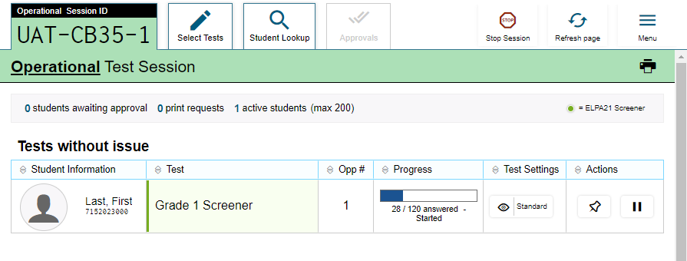
Monitoring Student Progress
Notes:
Once students log in and are approved for testing, you can monitor their status from the table(s) displayed on the TA Interface. The table shows Student Information, Test, Opportunity Number, Progress, Test Settings, and Actions options.
The Progress column displays the student’s progress through the items in the test. It may display a progress bar to indicate the student’s progress through the test or display the total number of items completed thus far and the total number of items in the test.
The Test Settings column displays either Standard or Custom. This column displays Custom when a student’s test settings are different from the default settings for that test. Select the Eye button to view a student’s test settings.
The Actions column allows you to pause a student’s test or pin a student’s information to the top of the test session table.

Slide 48
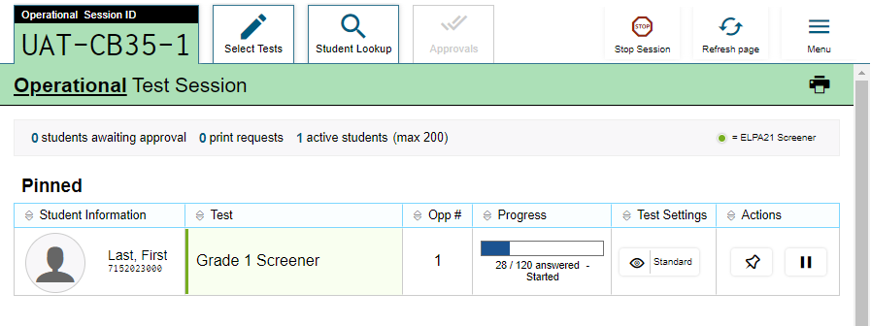
Pin Student
Unpin student
Notes:
If you want to closely follow a student, you can use the pin student function. Select the push pin icon in the Actions column of the student you want to monitor. The student’s row will appear in a separate table and move to the top of the test session tab.
To unpin a student, select the push pin icon again. The student’s row will no longer appear at the top of the Test Session tab.

Slide 49
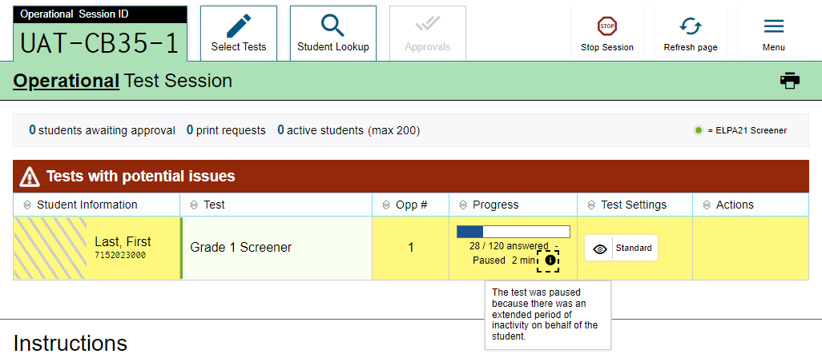
Tests with Potential Issues Table
Notes:
If the Test Delivery System (TDS) detects that a student may be having technical issues or requires assistance, a “Test with potential issues” table will appear above the “Tests without issue” table. Hovering over the “i” icon will display more information about the issue.

Slide 50
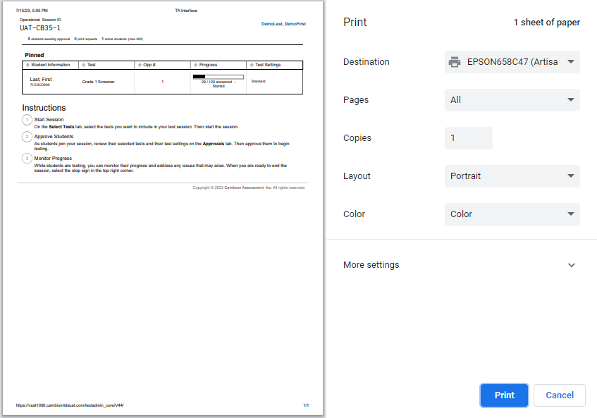
Printing Test Session Information
Notes:
If you wish to print a snapshot of the TA Interface in its current view, select the Print icon located below the Menu button. Printing a snapshot of the test session information can be useful for tracking which students did not complete their tests and may need to be scheduled for another session.
Remember that any printouts containing personally identifiable student information must be securely stored and should be destroyed after use.

Slide 51

Pausing and Stopping Sessions
Notes:
You have two options within the TA Interface to pause or stop testing once it has begun. You can pause an individual student’s test or stop the entire session, which will stop all students from testing. To pause an individual student’s test, select the Pause button in the Actions column for that student. When prompted, select OK to confirm that you want to pause the test. This option would be appropriate if a student becomes ill, for example. In the event of an emergency that requires all students to stop testing, you can pause all students’ tests by stopping the session.
If you stop the session, all in-progress tests will be paused. If a session stops, it cannot be resumed. You will have to create a new test session and give the new session ID to students so that they can resume testing. To stop the entire test session for all students, do the following:
• Select the Stop Session button. A pop-up message will appear requesting verification to end the session and log students out.
• When prompted, select OK to continue.
If you forget to log out before leaving the testing area, the session will close automatically after 20 minutes of inactivity on both the TA and student computers. You would then need to create a new session and provide the new session ID to students in order to resume testing.

Slide 52
Pausing and Stopping Sessions (Continued)
Pause Individual Student’s Test
Affects only one student
Test session continues for all other students in the session
The student whose test is paused may rejoin the test session before it ends
Stop Test Session
Affects ALL students in test session
All unsubmitted tests are automatically paused
If a session stops, it cannot be resumed. You must start a new session if students need to resume testing
Notes:
This slide lists some differences between the pause and stop functions. Note that if you stop an entire test session you will need to start a new session and students will need to log back in again in order to resume testing.

Slide 53
Pause and Test Timeout
Pausing a Test
Students can pause the test at any time and return later to finish their test, revisit any items, and change their answers.
In Oregon, paused screener tests are auto-submitted after fourteen days of inactivity.
Test Timeout Due to Inactivity
As a security measure, after 20 minutes of test inactivity, students are logged out and their tests are paused automatically.
Inactivity is determined by whether the student is interacting with the test by selecting answers or using navigation tools.
Students will receive a warning message prior to being logged out and must click OK on the pop-up message within 30 seconds in order to avoid automatic logout and pausing of their test.
Notes:
As a security measure, after 20 minutes of test inactivity, students are logged out, and their tests are paused automatically. Inactivity is determined by whether or not the student is interacting with the test by selecting answers or using navigation tools. Students will receive a warning message prior to being logged out and must click OK on the pop-up message within 30 seconds in order to avoid automatic logout and pausing of their test. If a student’s test is paused, the student can log back in at a later time to resume testing and change answers.
However, note that paused tests are automatically submitted at the end of 14 days. If a student’s test is auto-submitted before the student has finished it, then a request must be submitted using the test impropriety reporting system for that test to be reopened.

Slide 54

Logging Out of the TA Interface
Notes:
To log out of the TA Interface, select the Logout button in the upper-right corner of the page. It is preferable for you to log out only after stopping your active test session, as logging out will cause all in-progress tests to be paused. A confirmation message will appear, asking you to confirm that you want to exit the website and pause all students’ in-progress tests. This scenario also occurs when you navigate to another website from the TA Interface.
However, regardless of when or how you log out or navigate away from the TA Interface, student data will NOT be lost. If you need to access another application, we encourage you to open it in a separate browser window.
When all students have completed testing, refer to your Test Administration Manual for instructions on destroying any printed testing materials and reporting testing improprieties or irregularities.

Slide 55
Troubleshooting
Description | What to Do
What should I do if a session ends? | Log in and start a new session. Provide the students with a new session ID.
What should I do if a student gets logged out of a test while a session is still active? | If a student’s test session is interrupted, the student should log back in and rejoin the session.
What should I do if forbidden applications are running? | The Secure Browser will not allow the student to begin testing if forbidden applications are running. You will see messages advising you which applications must be closed before testing can begin.
What should I do if a student’s test freezes? | Force quit the secure browser and log back in. Force quit commands can be found in the TA User Guide. Contact your Regional ESD Partner for further assistance.
Notes:
This table presents some of the common issues that Test Administrators or students may encounter during a test session. Please take a moment to review this information. For more detailed information and additional technical tips, please refer to the Test Administration Manual.

Slide 56
Thank You!
For additional information, consult the Oregon portal, which contains:
Important announcements
TA User Guide
TIDE User Guide
Screener Test Administration Manual (TAM)
For further assistance, please consult your state’s Help Desk.
Notes:
Thank you for viewing this training module. If you need additional information, please visit your state portal, where you can find announcements and additional resources.
For further assistance, please consult your state’s Help Desk.

