Slide 1
Oregon Statewide Assessment System
Session 3A (ELA) – Using Interim Assessments During Instruction
Office of Teaching, Learning, and Assessment
Notes:
Slide 1: Title Slide (Facilitator 1)
The Oregon Department of Education has developed an Oregon Statewide Assessment System professional learning series to further support district efforts in building a balanced assessment system and their implementation of the Oregon Statewide Interim Assessment System.
Welcome to Session 3A of the Oregon Assessment Professional Learning series. This session will provide information about the interim assessment system and the ELA resources.
This presentation is available year-round on the Oregon Department of Education’s Interim Assessment webpage under the Interim Professional Development Materials expandable folder.
Resources:
ODE Interim Assessment webpage

Slide 2
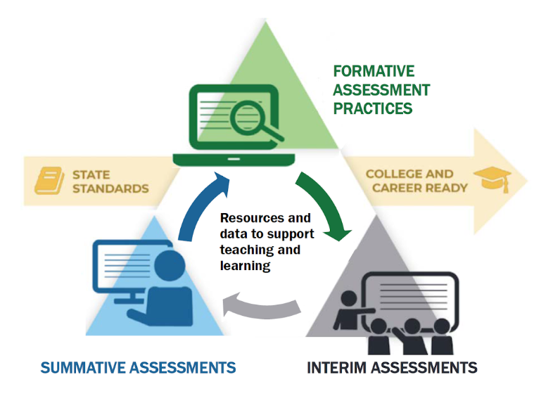
Purpose
The Oregon Statewide Assessment webinar series is designed to help teams of educators and administrators improve their teaching and learning systems using the tools and resources provided in a balanced assessment system.
Notes:
Slide 2: Purpose (Facilitator 1)
The purpose of this series is to help district and school-based teams improve their systems of teaching and learning using an approach inclusive to a balanced assessment system.
For the first time, ODE is able to provide a statewide interim assessment system aligned to both the Oregon State Standards and the Oregon Summative Assessment.

Slide 3
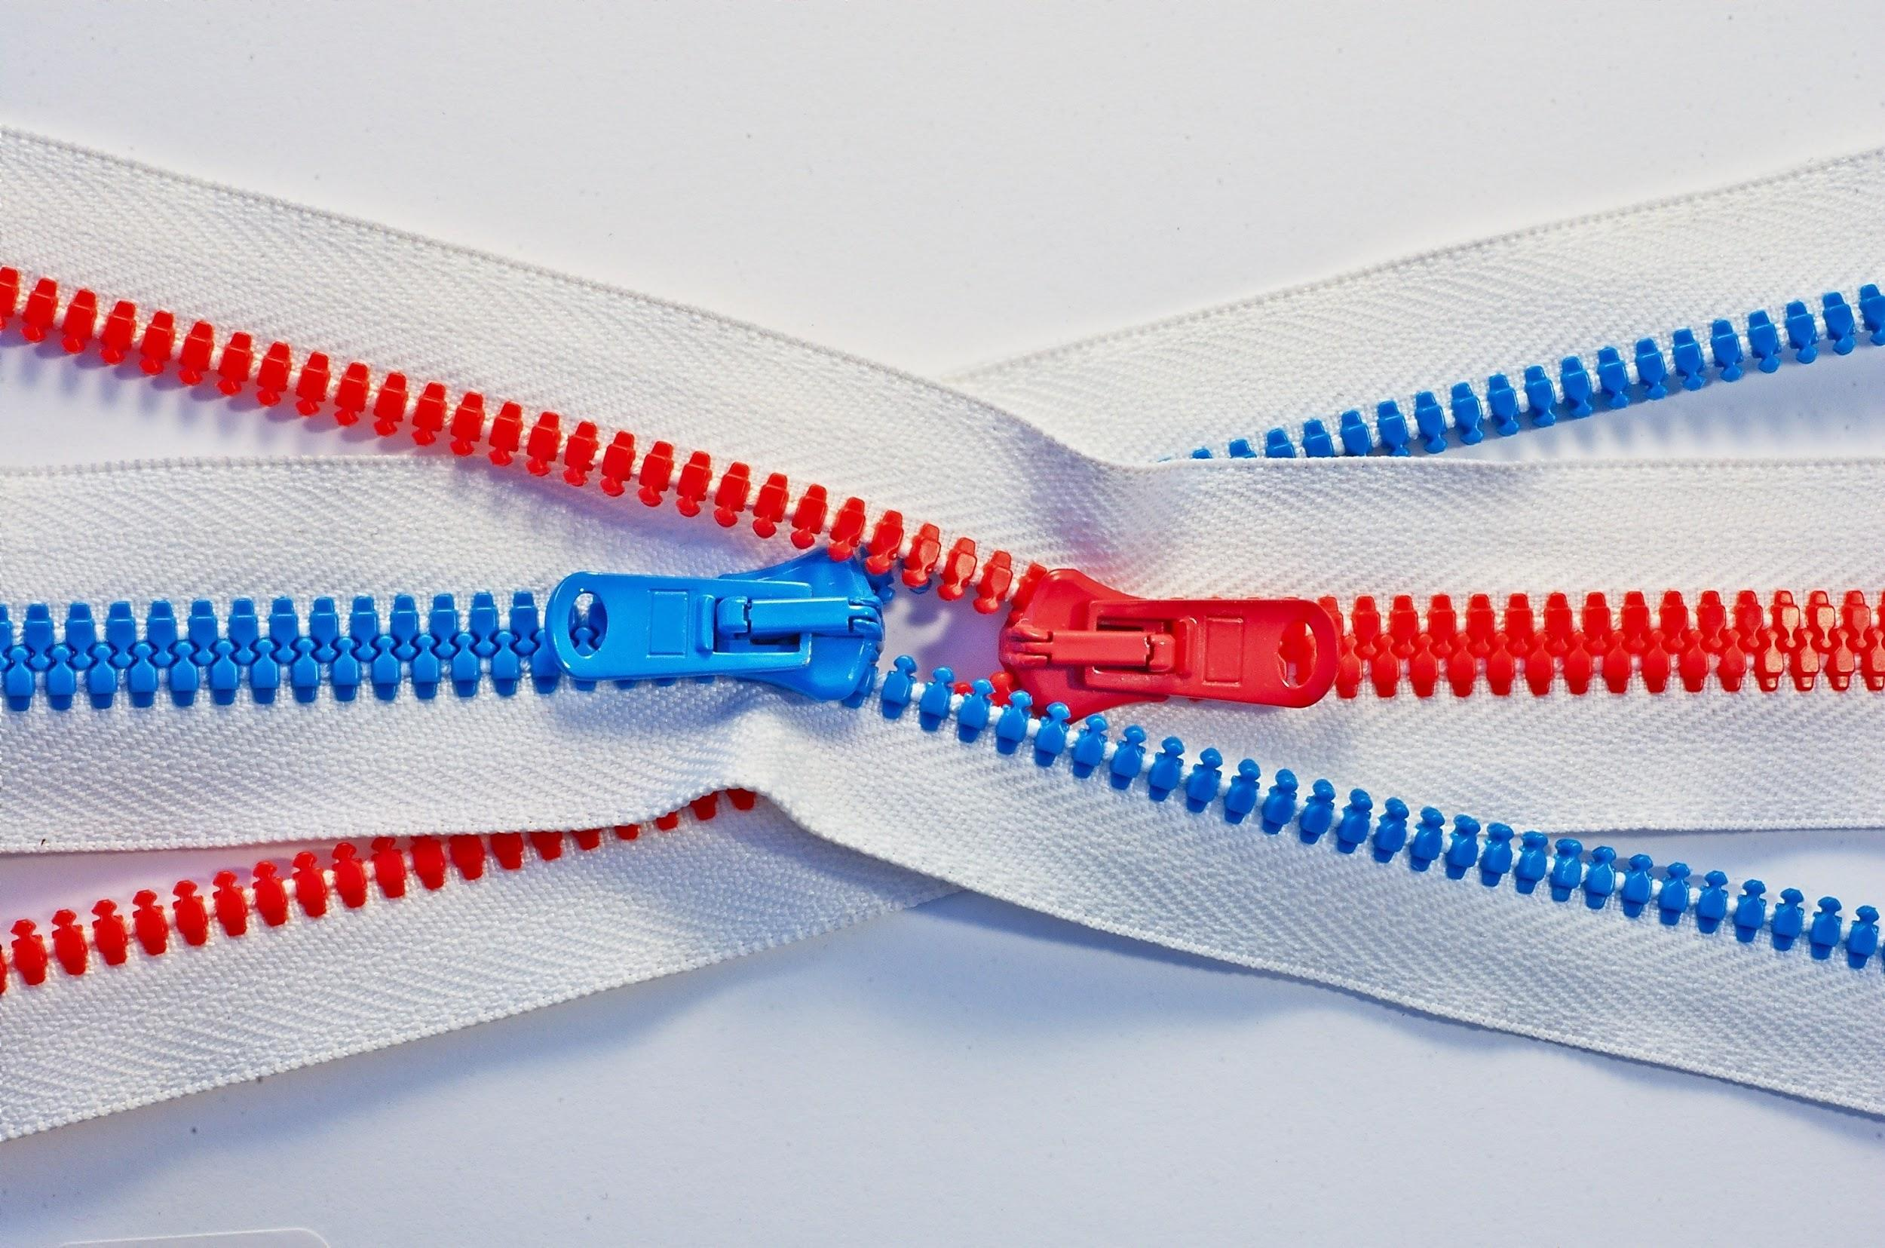
Series Outcome
Participants will build assessment literacy and improve practice by connecting formative assessment practices, interim assessments, and summative assessments to continually improve access and outcomes for each and every learner in their care.
Photo by Tomas Sobek on Unsplash
Notes:
Slide 3: Series Outcome (Facilitator 1)
Our goal is that all participants will build assessment literacy and connect formative assessment practices, Oregon’s Statewide Interim Assessment System, and the Oregon Statewide Summative Assessments to local assessment systems to continually improve access and outcomes for each and every learner in their classroom, school, and district.
Again this series will focus primarily on the new interim assessment system and other supporting resources connected to both formative assessment practices and the Oregon Summative Assessment.
Resources
Oregon Balanced Assessment Graphic (PDF)

Slide 4
Interim Assessment Series
Session Guide
1 | Understanding a Balanced Assessment System
2 | Overview of the OSAS Interim Assessment System
3 | Using Interim Assessments in the Context of Instructional Practices
4 | Interim Assessment Administration: Guidance and Support
5 | Accessing Interim Assessment Data to Inform Instructional Practices
6 | Exploring Tools for Teachers and Using Formative Assessment Practices
Notes:
Slide 4: Series and Session Overview (Facilitator 1)
Session 3A provides and deeper dive into the Interim Assessment System and focusing on the ELA components. Please refer to the Interim Assessment Series Informational Flyer for other Sessions and presentations dates.
Previously in session 1 and 2 , we provided an overview of a Balanced Assessment System and the Interim Assessment System.
After this session educators will have the opportunity to gain content specific information in Session 3B Math Interims, or if your district purchased the science interim assessment system, Session 3C Science interims.
Additional Sessions will cover how to navigate the OSAS Portal to Administer Interims, how to access the interim assessment data in the Central Reporting System to inform instruction, and finally how the interim assessment system interacts with the instructional resources within Tools for Teachers and how the formative assessment process can be leveraged with these resources.
Educators can register for these other webinar sessions using the by accessing the Interim Assessment Series Informational Flyer or by visiting the interim assessment webpage.
Resources:
Interim Assessment Series Flier (PDF)

Slide 5
Session Objectives
By the end of this session, educators will be able to:
Describe the different types of ELA interim assessments available in the Interim Assessment System and distinguish between computer adaptive and fixed forms.
Identify the different ELA interim assessments by assessment claims, content categories, and assessment targets.
Make connections between the interim assessment targets and the Oregon State Standards using the Smarter Content Explorer website.
Examine Interim Assessment use cases within instructional context.
Notes:
Slide 5: Session Outcome (Facilitator 2)
By the end of the series, educators will be able to
[Click Animation]
Describe the different types of ELA interim assessments available in the Interim Assessment System and distinguish between computer adaptive and fixed forms.
[Click Animation]
Identify the different ELA interim assessments by assessment claims, content categories, and assessment targets.
[Click Animation]
Make connections between the interim assessment targets and the Oregon State Standards using the Smarter Content Explorer website.
[Click Animation]
Examine Interim Assessment use cases within instructional context.
Resources:
ELA and Mathematics Interim Assessment Overview​
​​This document describes the interim assessments, including their purpose, use, and varieties.
Assessment Resources Use Chart​
This document provides a side-by-side comparison of training tests, practice tests, and interim assessments.
Oregon State Standards
Smarter Content Explorer

Slide 6
Interim Training Requirements
DTCs or STCs will need to apply the “Interim” Test Group to each user that will administer the interim assessments. The decision to allow access to the Interim Assessment System is determined by the educators’ district.
  Users will not be able to administer the interim assessments if the Test Group permission is not assigned to their TA user account.
Notes:
Slide 6: Interim Training Requirements (Facilitator 1)
ODE has made this system available to all Oregon educators, however, the decision to allow educators access to the interim assessments is determined by their district. Either their District Testing Coordinator or their local School Testing Coordinator must activate the interim assessment system for educators.
Users will not be able to administer the interim assessments if the Test Group permission is not assigned to their TA user account.
Resources:
Module 8 - Interims: Remote Administration and Test Security
Facilitation Guide​​​, Powe​rPoint and PowerPoint with Audio​ ​

Slide 7
Interim Training Requirements
If the TA is a returning user from 2019-20, there are no additional requirements required to apply the “Interim” Test Group other than Module – 8.
However, if an educator does not have a 2019-20 TA user role or has transitioned to a new district, they must complete the reading requirements in Table 5 of the Test Administration Manual and the ODE-provided training modules 2 – 4 and 8 posted to the Assessment Training Materials webpage.
Notes:
Slide 7: Interim Training Requirements (Facilitator 1)
ODE has worked to reduce the work of our district testing coordinators, and this year we have implemented a roll-over process where educators from last year have already been populated in the OSAS Portal TIDE Account and will automatically have access to the Tools for Teachers resources, which launch on September 20, 2020.
Therefore, if the educators has completed the 2019-20 TA requirements they will only need to provide evidence they have completed Module 8 - Interim Assessment Remote Administration and Test Security in order for the Interim Assessment user role to be assigned to them.
[Click Animation]
However, if an educator did not have a TA user account from the 2019-20 instructional year or if the educator has transitioned to a new district which is different from last year. They must complete the reading requirements in Table 5 of the Test Administration Manual and in addition to completing Module 8, they must also complete training modules 2, 3, and 4. These training modules have already been updated for the 2020 -21 instructional year, and have been
Resources:
Module 8 - Interims: Remote Administration and Test Security
Facilitation Guide​​​, Powe​rPoint and PowerPoint with Audio​ ​
Assessment Training Materials

Slide 8
Interim assessments are designed to support teaching and learning throughout the year by using periodic standards-based assessments that target specific units of content.
The Interim Assessment System allows educators to connect student performance to instruction, outlining not just where student learning is needed, but providing classroom educators with instructional examples of what to work on next.
Notes:
Slide 8: Interim Assessment Overview (Facilitator 2)
During Session 1 Understanding a Balanced Assessment System, we shared how interim assessment can be used both FOR learning and serve as an assessment tool OF learning. Further, we shared how interim assessments can be used to modify instructional practices throughout the year to build students’ knowledge and skills in meeting end-of-year grade level standards and preparing them for college and career readiness.
The Interim Assessment System allows educators to connect student performance to instruction, outlining not just where student learning is needed, but providing classroom educators with instructional examples of what to work on next.
Resources:
(Session 1) Understanding a Balanced Assessment System
Facilitation Guide, PowerPoint

Slide 9
Features of Interim Assessments
Free statewide access to ELA and mathematics interim assessments and Tools for Teachers
Flexible administration options better support local purposes.
  Remote administration option for ELA
  Items include all the accessibility resources available in the summative assessment to help provide accurate results for students.
Student performance on Interim Comprehensive Assessments (ELA and Math) is reported on the same scoring scale as the summative assessment. (Available January 5, 2021)
Notes:
Slide 9: Features of Interim Assessments (Facilitator 2)
In Session 2 we provided an overview of some of the features included in the Interim Assessment System. Available free statewide for ELA and Mathematics. Including the instructional and formative resources in Tools for Teachers.
[Click Animation]
Flexible administration for both in person and remote administration and the same accessibility supports as those provided on the OSAS Summative Assessment.
Again the remote administration option is further described in the ODE Assessment Module 8 Interim Training Resource and will be covered in Session 4 - Interim Assessment Administration: Guidance and Support
[Click Animation]
And… finally the interims have a comprehensive assessment option, which uses the same scoring scale as the OSAS Summative Assessment. However, please note the comprehensive assessment will not be available for administration until January 5, 2021.
Resources:
Interim Administration Guide​
(Posted 08/31/20)
This Interim Assessment Guide for Administration is intended for staff who play a role in the administration of, and review of results for, the ELA and Mathematics interim assessments.
Quick Guide to Administering Interim Assessments Remotely​
This document describes how test administrators (TAs) can remotely administer the interim assessment and how students may access and participate in an interim assessment.​

Slide 10
Additional Features of Interim Assessments
May be used to measure students’ knowledge and skills in grade levels other than the students’ enrolled grades.
Cover the range of cognitive demand described in Oregon’s State Standards.
Allow educators access to view the test questions and their students’ responses to the test questions as part of educators’ instructional process to address students’ relative strengths and needs for improvement.
Notes:
Slide 10: Additional Features of Interim Assessments
(Facilitator 2)
As a reminder the interims can be administered with both flexibility within and out-of-grade-level depending on student needs. For example, an educator could administer the 3rd grade literary text interim assessment to a group of 5th grade students if it we deemed to be the right assessment for the right purpose.
[Click Animation]
Importantly, the interim assessments are both aligned to the Oregon State Standards and cover the wide range of Depth of Knowledge (DOK) levels.
[Click Animation]
And finally the can be used in both standardized administration or educators can choose to select specific items for non-standardized administration.
Later we will show some examples of both approaches.

Slide 11
Interim Assessment Design
ELA Interims | Fixed Form | Computer Adaptive
Interim Assessments aligned by Targets Multiple Standards contribute to Assessment Target Assessment Targets are assigned to a Content Category and/or Content Claim Claim 2 Writing; Target 1 Narrative Writing | Interim Assessments are developed as fixed form assessments. In a fixed form test, every test taker receives the same items (aka questions). Limits the number of administrations to students due to exposure. A fixed form assessment can be delivered on paper or computer. | Summative Assessments are computer adaptive assessments. In computer adaptive, the algorithm scores each item as the test taker answers it, then based on the score of that item the algorithm adjusts the next item to the next “challenge” level. A computer adaptive assessment can only be delivered on a computer.
Notes:
Slide 11: Interim Assessment Design (Facilitator 2)
When looking at the design of the ELA interim assessment, the interims are organized by assessment targets.
Multiple standards are combined into assessment targets which contribute to the scope and complexity of the written standards.
Finally assessment targets can be further categorized into Content Categories or Claims such as reading (both literary and informational text), writing, listening, and research.
There are two fundamental test designs in language testing: Fixed Form, and Computer Adaptive.
In the middle column, we can see the interim assessments are developed as fixed form assessment, which is different than the computer adaptive approach used for summative assessments. This is primarily due to the number of individual items available between the two different systems.
In a fixed form test, every test taker receives the same items (aka questions).
This also means the same items will appear on the interim assessment if administer on multiple occasions.
Therefore it is not advised to use the interims as a pre and post test because students will see the exact same items.
Finally the interims have flexibility to be delivered in both a computer format or print option as long as the educators can ensure the item or items do not leave the classroom.
The summative assessment is not restrained in the same way due to higher number of items available which then allows the computer algorithm to score each item as the test taker answers it, and then based on the students response, the computer algorithm adjusts the level of the next item or to the next “challenge” level specific to that student.

Slide 12
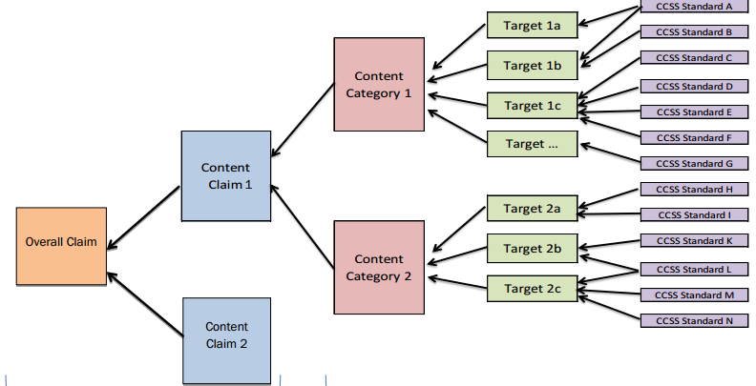
ELA Claim and Targets
English Language Arts Claims and Targets
Literary Text
Claim 1 – Reading
Oregon ELA
Summative Assessment
Informational Text
Claim 2 – Writing
Notes:
Slide 12: Connecting Claims, Targets, and Standards (Facilitator 1)
So as we said, the interim assessments are aligned to assessment targets.
[Click Animation]
This model provides a quick overview of assessment design relative to ELA. As you can see moving from right to left, the assessment development starts with alignment to standards, that grouped into assessment targets, and move towards content categories and claims, and then an overall claim at the end.
We first think about the summative assessment and can easily connect to the [Click Animation] Overall Claim or composite scores.
When we look further we can connect to data at the content claim level. In this example [Click Animation] [Click Animation] we see Claim 1 Reading and [Click Animation] Claim 2 Writing.
However, within the context of Claim 1 Reading [Click Animation] [Click Animation] we have both Literary Text, and [Click Animation] Informational Text. And these both contribute to the Claim 1 Reading scores and Overall ELA composite score.
Again, the Interim Assessments are organized into assessment targets. Therefore, if an educator can identify which standards they want to assess, they can crosswalk directly to what interim assessment target they wish to administer. One goal today is to share and show hwo to make the connections between the standards and the assessment targets using an online tool.

Slide 13
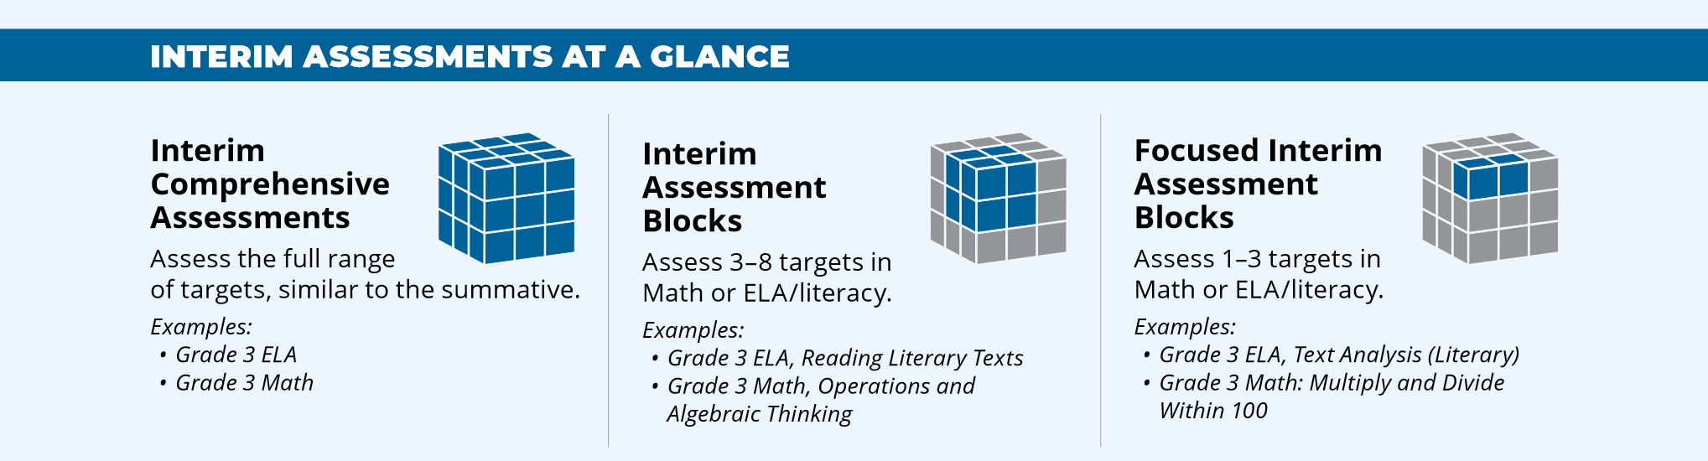
Oregon’s Interim Assessment System
The ELA Interim Assessment System offers the following interim assessments:
Interim Comprehensive Assessments (ICAs) test the same content and report scores on the same scale as the summative assessments.
Interim Assessment Blocks (IABs) provide more detailed information for instructional purposes.
Focused IABs provide educators with a finer grained understanding of student learning.
Notes:
Slide 13: Oregon’s Interim Assessment System (Facilitator 1)
We had the opportunity to dive into the different interim assessment types during Session 2 which is posted on the ODE Interim Assessment website.
As previously shared [Click Animation] the ICAs provide a complete assessment option which mirrors the summative assessment and provides educators with a complete composite score similar to the summative assessment. Note they take the same amount of instructional time to administer as the summative assessments and therefore educators should evaluate their use and purpose. As a reminder, the ICAs are available starting January 5, 2021.
The [Click Animation] Interim Assessment Blocks or IABs assess at the target level, usually 3 – 5 targets, and include a wide range of connected standards. They typically take 45 – 60 minutes to administer and provide a more detailed approach to information relative to the standards assessed which can then be used to inform instructional practices.
Finally, the [Click Animation] Focused Interim Assessment Blocks or Focused IABs measure a smaller scope of targets, usually 1 – 3 targets, and therefore provide educators with the even more detailed information of the assessed standards to inform instructional decisions. These take around the same time to administer as the IABs.
Resources:
Understanding the Interim Assessment System (Video)​​

Slide 14
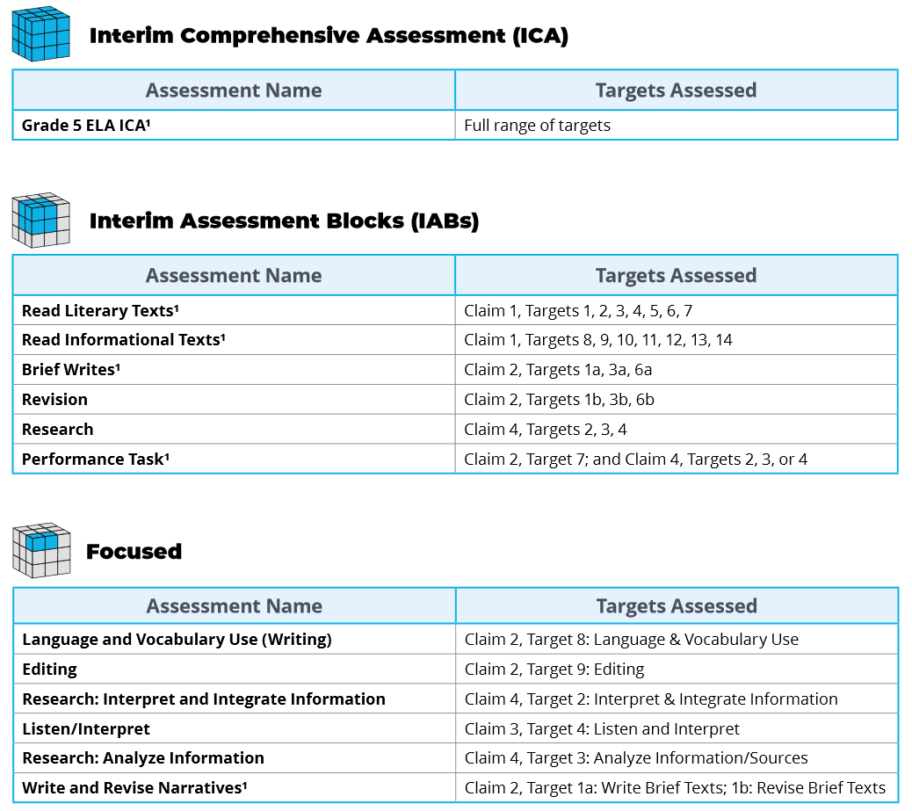
ELA Grade 5 Interims
ELA Grade 5 Interims
Notes:
Slide 14: ELA Grade 5 IABs (Facilitator 1)
The following is an example of the interim assessments included for 5th grade ELA. As you can see some of the interim assessments have a footnote 1 located next to their title indicating there are hand-scoring items within that specific ICA, IAB, or Focused IAB.
Additionally educators can quickly identify which assessment targets are connected to the selected interim assessment.
One positive with the ELA interim assessments is the assessment targets are the same across all grades, for example Claim 1 Reading Target 2 Central Ideas.
In grades 3 – 8 and high school for ELA Claim 1 Reading, Target 2 will always be Central Ideas
Resources:
ELA and Mathematics Interim Assessment Overview​
​​This document describes the interim assessments, including their purpose, use, and varieties.

Slide 15
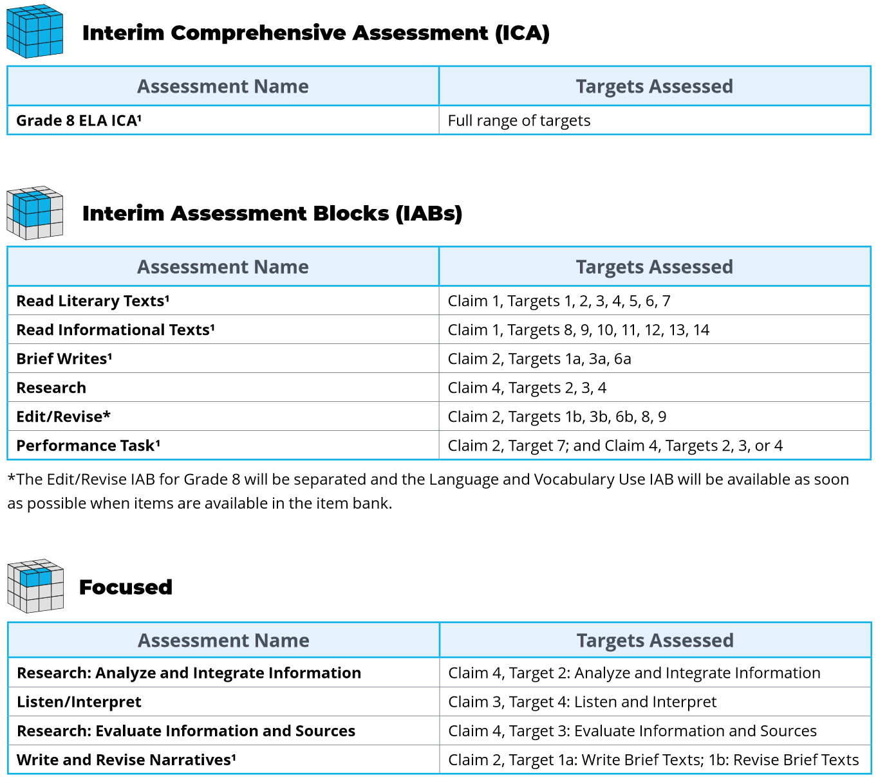
ELA Grade 5 Interims
ELA Grade 8 Interims
Notes:
Slide 15: ELA Grade 8 IABs (Facilitator 1)
So now when we look at the 8th grade example, again you can see the ELA interim assessment titles have primarily stayed the same with the one exception of the edit/revise IAB which is currently being modified with new items.
The same is true for the Focused IAB of editing and language vocabulary, but again the assessment targets included in the Interim Assessment System stay the same.
Resources:
ELA and Mathematics Interim Assessment Overview​
​​This document describes the interim assessments, including their purpose, use, and varieties.

Slide 16
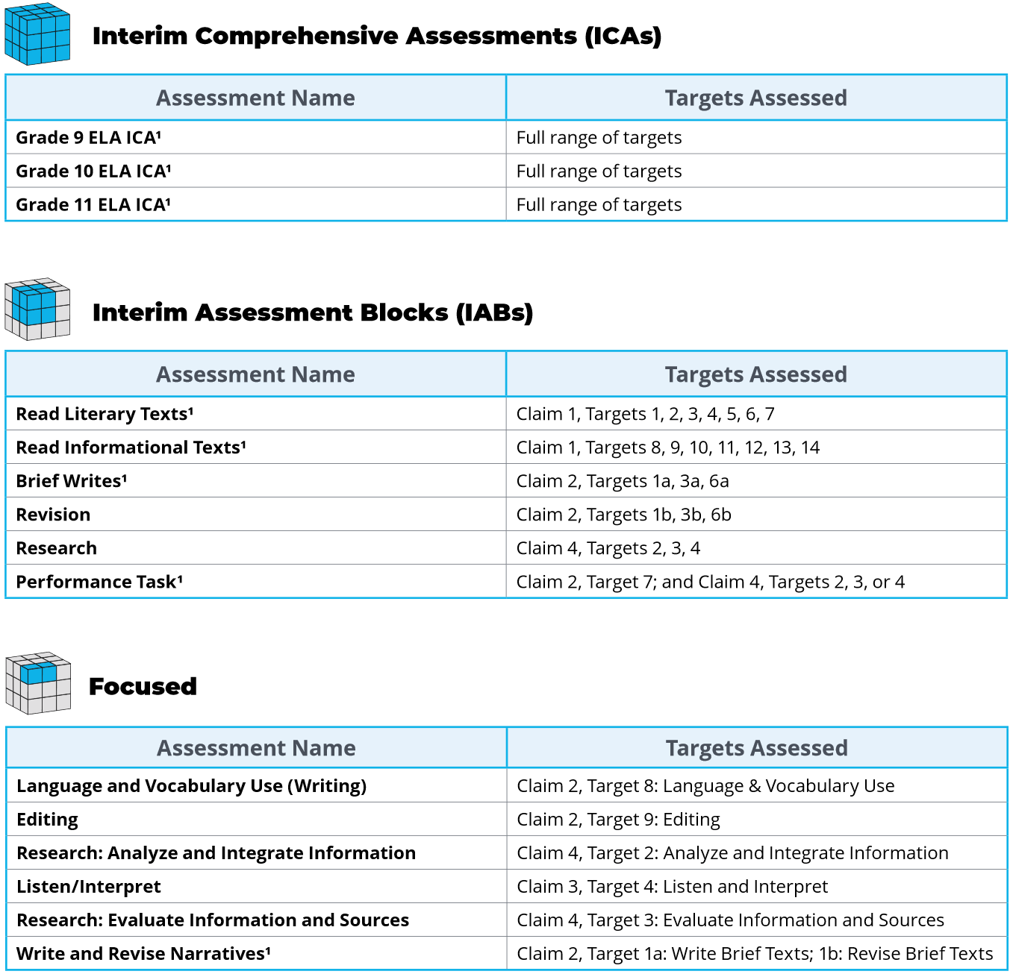
ELA Grade 5 Interims
ELA Grade HS Interims
Notes:
Slide 16: ELA Grade HS IABs (Facilitator 1)
Again, when we look at a high school example, we see the same assessment titles that were included in both the 5th and 8th grade examples. So even though the titles on the interim assessments don’t change, or the assessment targets, what IS changing is the standards associated with those assessment targets both in their developmental complexity and rigor.
But again due to the cyclical nature of the ELA standards, educators have the ability to use the interim assessments out of grade level.
It is important to note 2 aspects though.
Though the interim assessments are available to use out side of grade level context, it is not advised to target up a grade level. This is due to the fixed form nature we discussed early and that targeted up interim assessment then becomes less useful for the following year’s educator.
Though the HS ICAs have grade 9, 10, and 11, they are actually the same fixed form.
Resources:
ELA and Mathematics Interim Assessment Overview​
​​This document describes the interim assessments, including their purpose, use, and varieties.

Slide 17
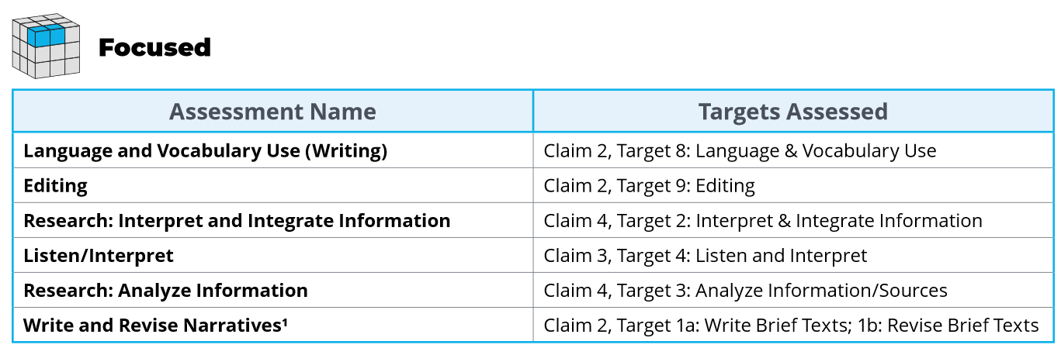
Connecting Targets and Standards
Notes:
Slide 17: ELA Grade 5 IABs – Connecting Targets and Standards (Facilitator 1)
One of our goals in this presentation is to help educators make connections between the assessment targets and the ELA standards.
For this example we are going to take a look at the 5th grade interim assessments. In particular we are going to take a look at the [Click Animation]
[Click Animation] Focused IABs.
Within the Focused IABs we are going to look at [Click Animation] Language and Vocabulary Use, which is associated with Claim 2 Writing, Target 8 Language and Vocabulary Use.
Resources:
ELA and Mathematics Interim Assessment Overview​
​​This document describes the interim assessments, including their purpose, use, and varieties.

Slide 18
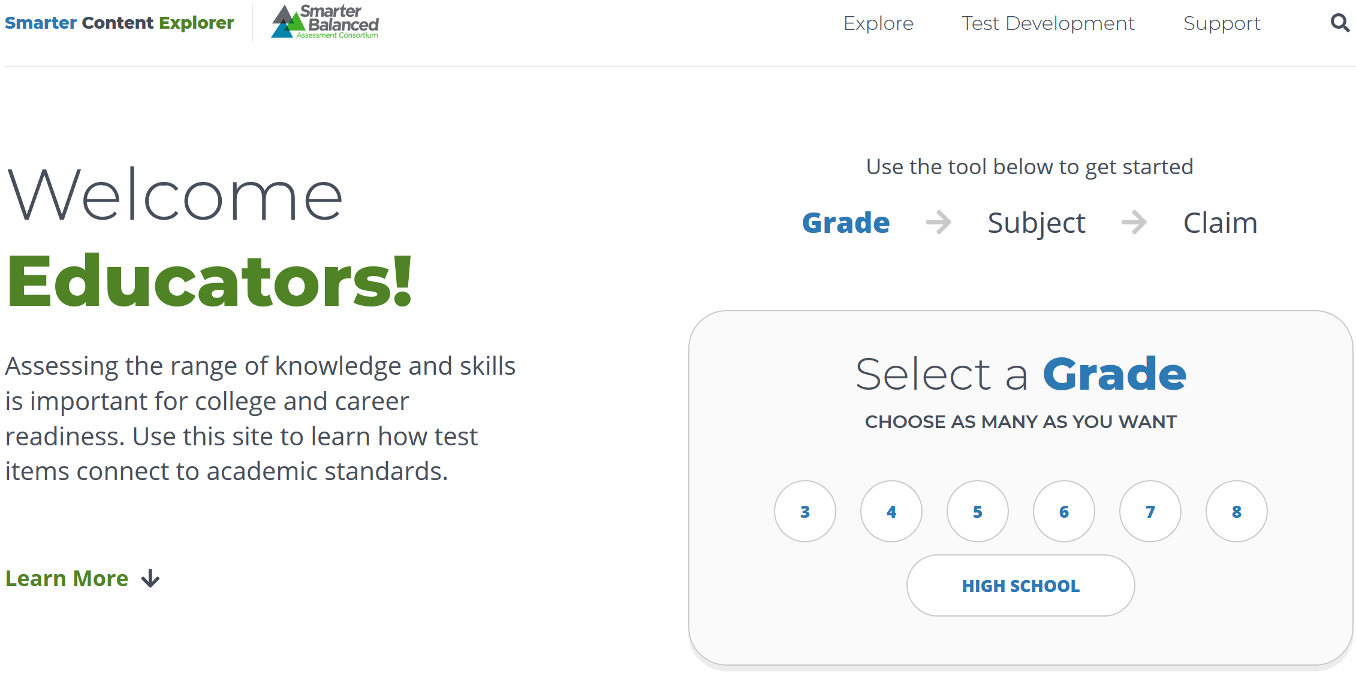
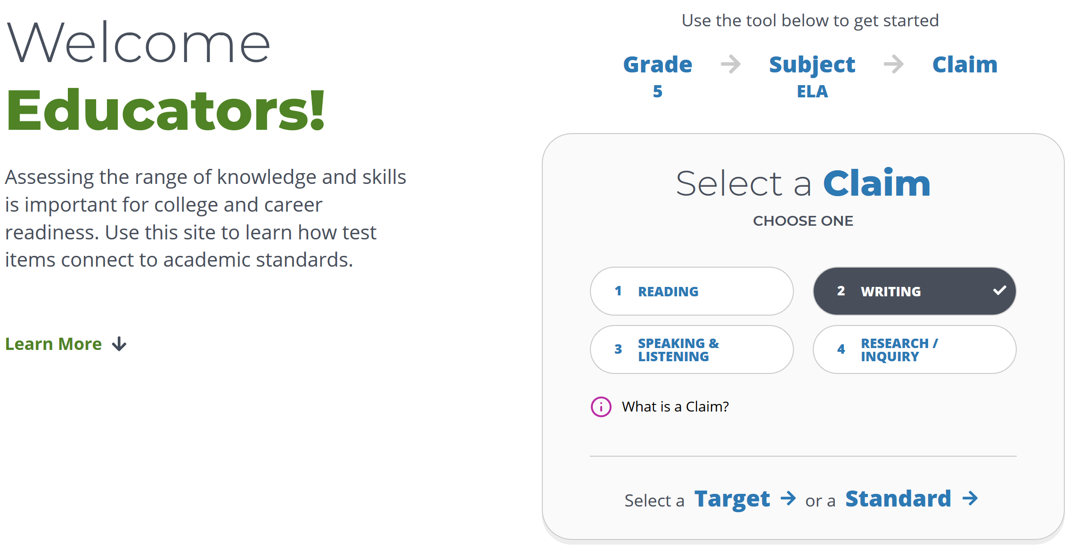
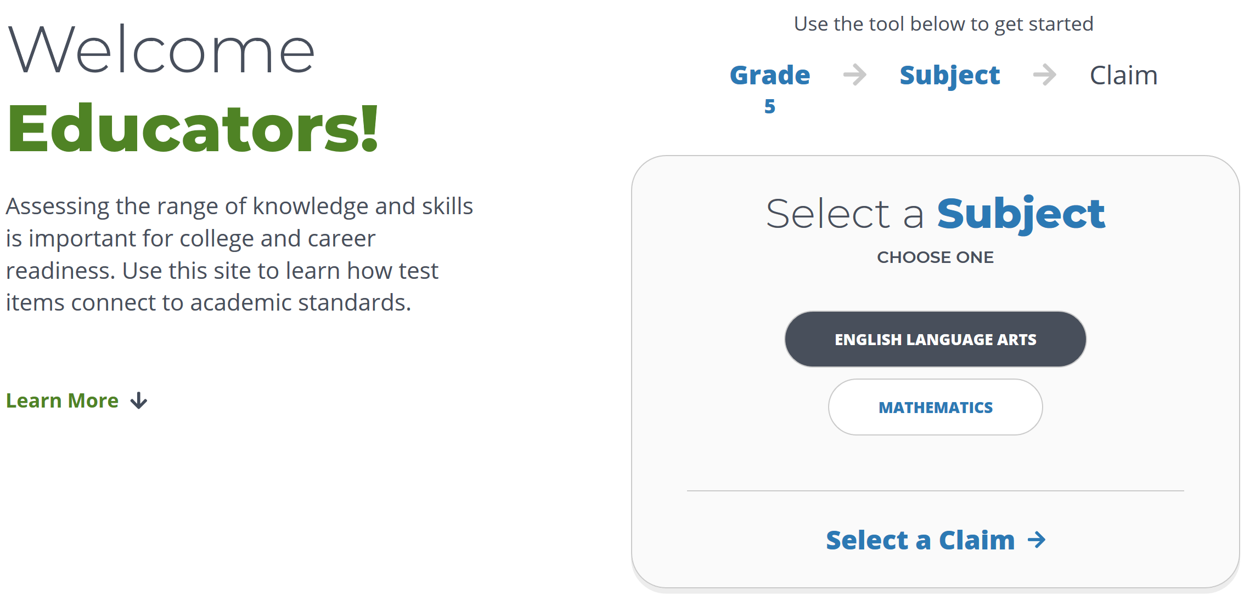
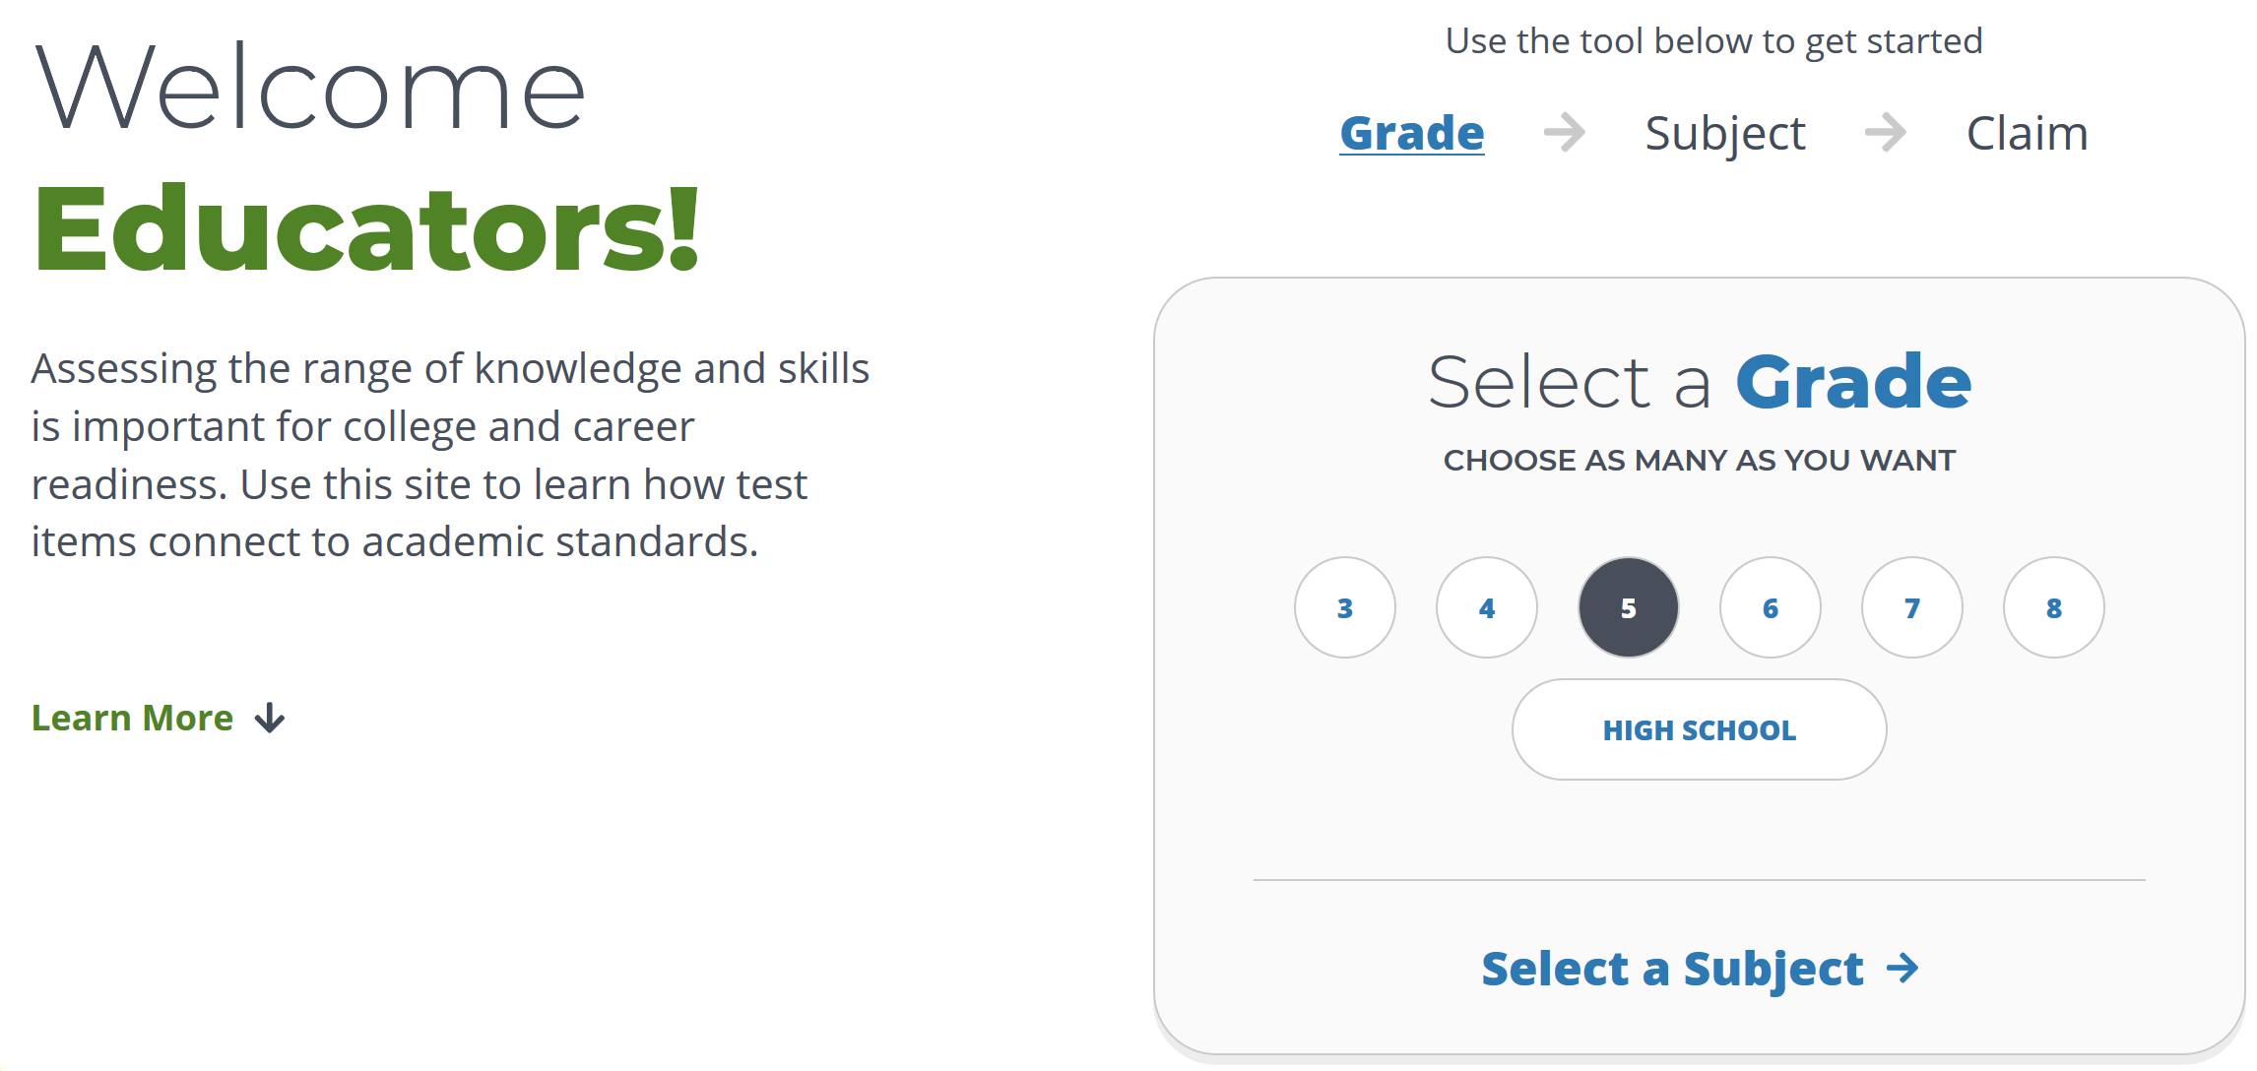
Connecting Targets and Standards
Smarter Content Explorer
Notes:
Slide 18: Smarter Content Explorer– Connecting Targets and Standards (Facilitator 1)
ODE has worked with Smarter Balanced to help create an interactive website that helps educators make connections between the assessment targets and the ELA standards.
With this online tool called the Smarter Content Explorer, Educators can drill down to into the claims and assessment targets.
[Click Animation] For instance an educator can select a specific grade, such as our 5th grade example, which then prompts the educator to select the subject area.
[Click Animation] From the subject page the educator can select English Language Arts, which then prompts the educator to select the desired claim.
[Click Animation] Using our 5th grade example, we would select Claim 2 Writing, and we would be given the option to [Click Animation] select to search by either assessment target or ELA standards.
Resource:
Smarter Content Explorer

Slide 19
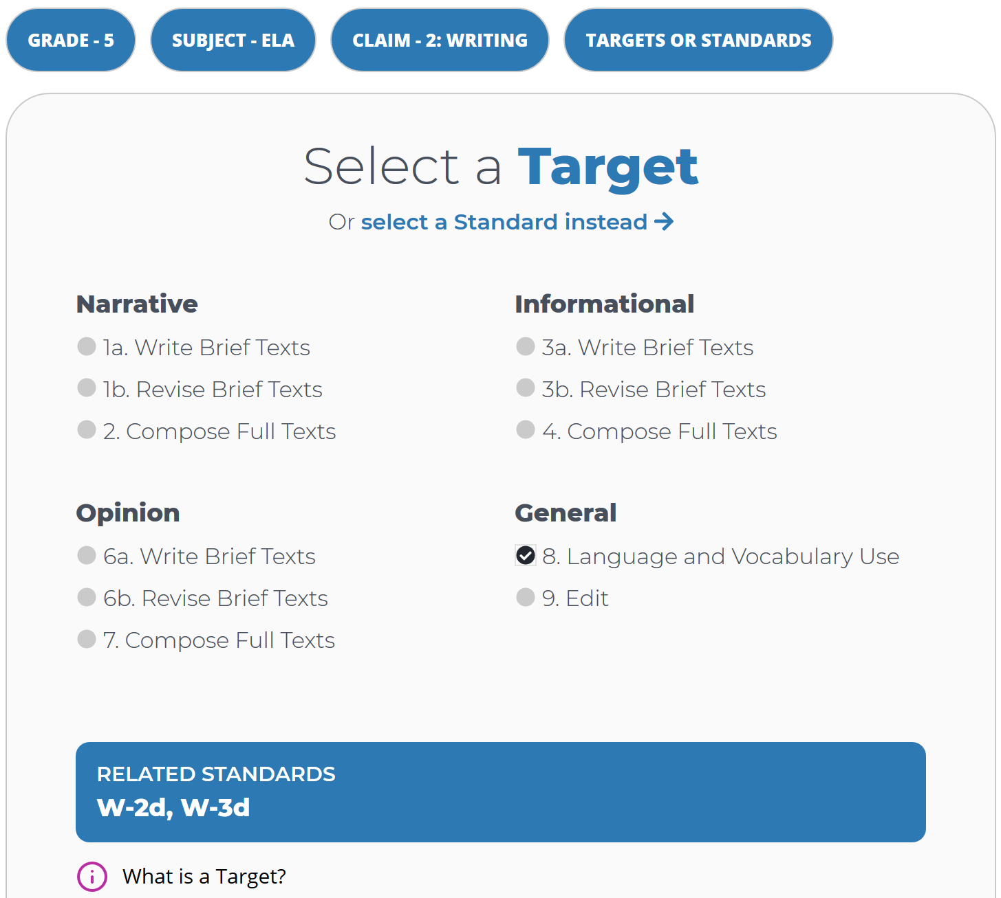
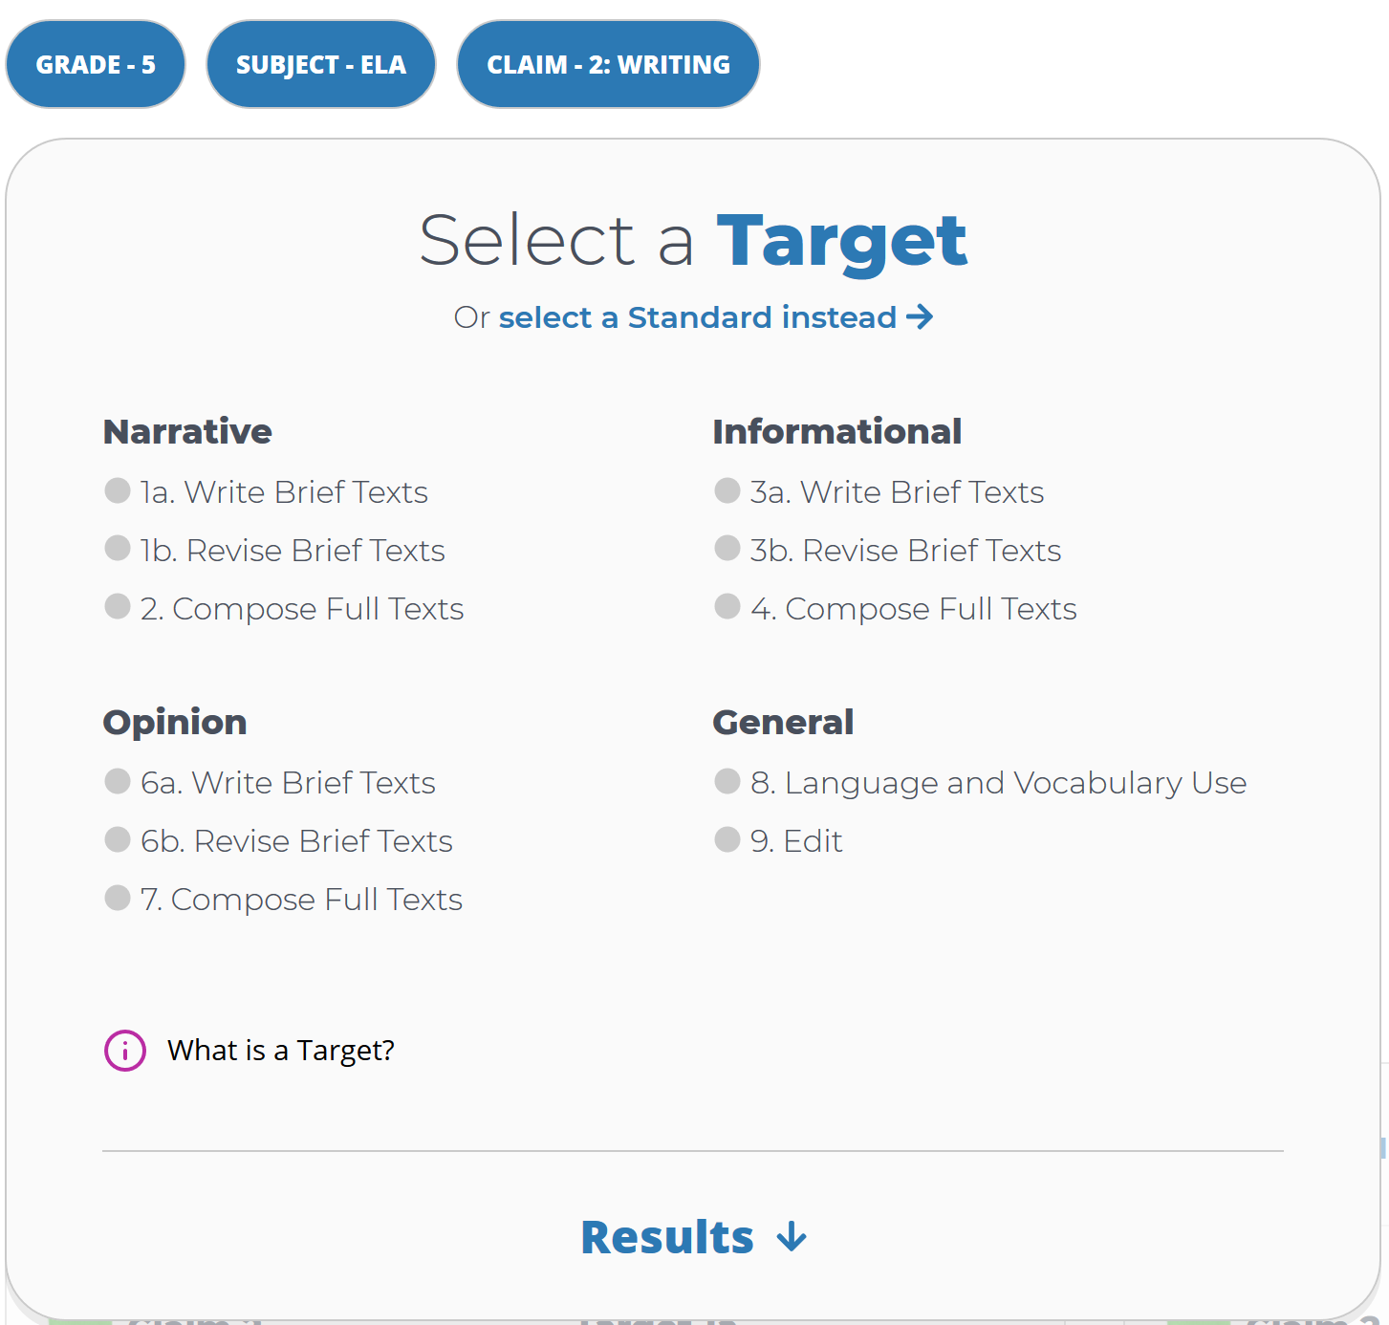
Connecting Targets and Standards
Notes:
Slide 19: Selecting Targets – Connecting Targets and Standards (Facilitator 1)
In this example we will search by the assessment target.
And as we continue to use our example [Click Animation] we will select Target 8 Language and Vocabulary Use.
[Click Animation] [Click Animation]
When we check Target 8, [Click Animation] we can see the related standards will appear at the bottom.
So we now know that the Focused IABs Language and Vocabulary associated with Claim 2 Writing, Target 8 Language and Vocabulary Use addresses writing standards Writing 2d and Writing 3d.
Therefore when an educator is teaching a unit addressing these two standards they could use the interim assessments items as part of the instructional activity, or as a quick check.
Another option would be to use the interim assessments as a formal assessment after the unit has been taught, which could then provide evidence of student learning and provide the educator feedback where more instruction made be necessary to further support students.
Resource:
Smarter Content Explorer
ELA and Mathematics Interim Assessment Overview​
​​This document describes the interim assessments, including their purpose, use, and varieties.

Slide 20
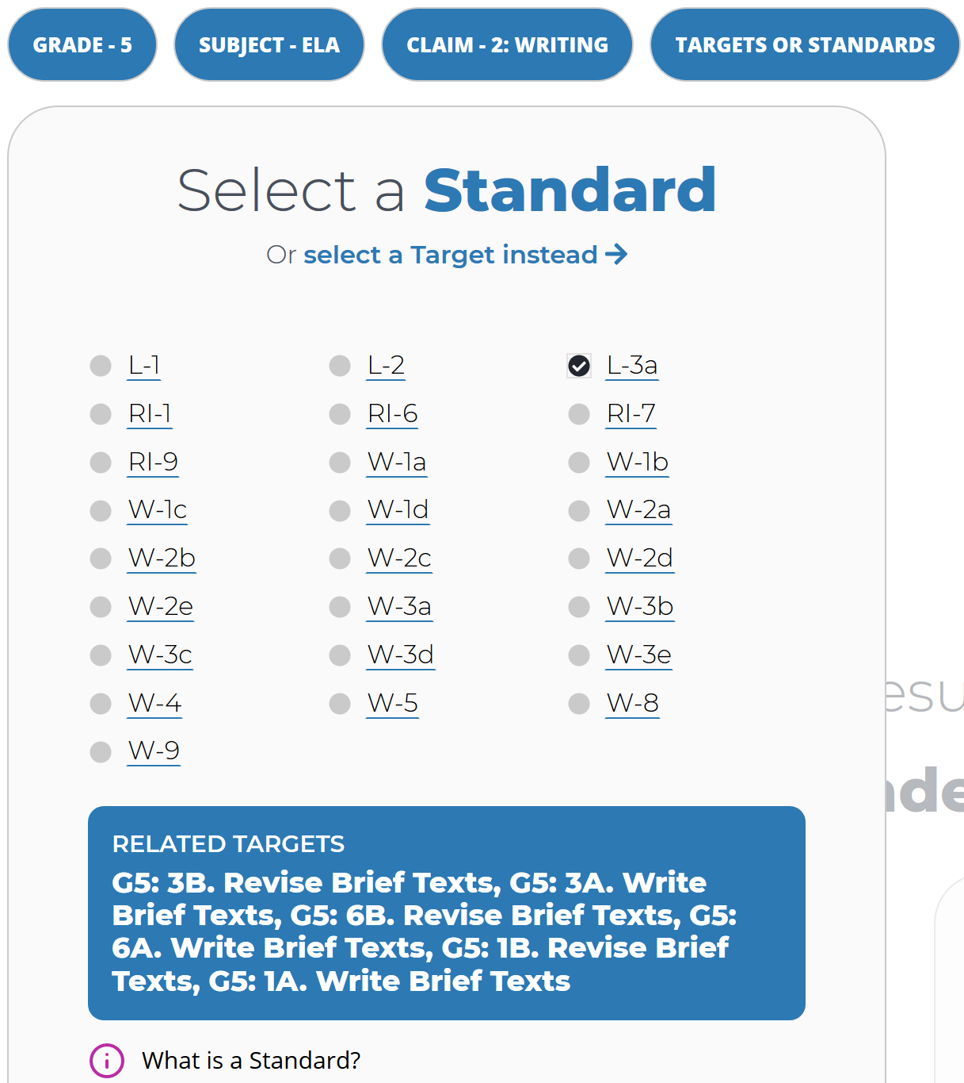
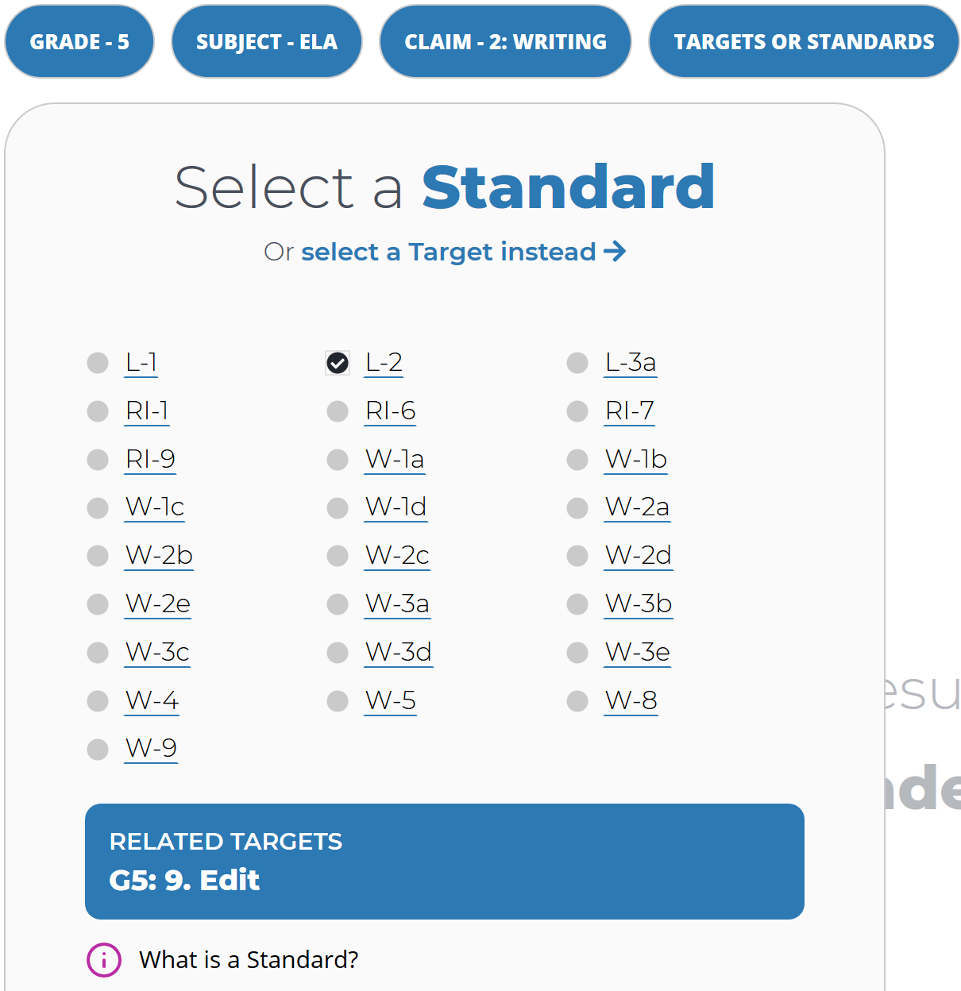
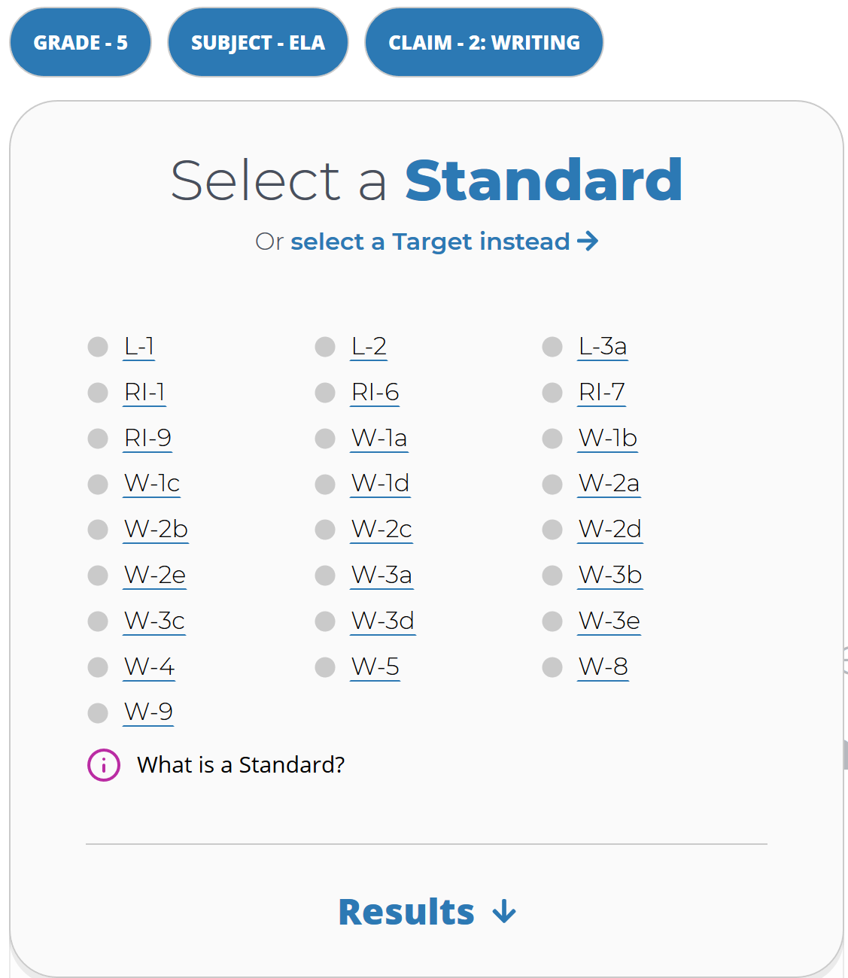
Connecting Targets and Standards
Notes:
Slide 20: Selecting Targets – Connecting Targets and Standards (Facilitator 1)
As shared, we can also use the Smarter Content Explorer to search by standards.
[Click Animation] [Click Animation]
So in this example we have selected [Click Animation] L-2 and we see that this time [Click Animation] the related Target 9 Editing has appeared as the associated assessment target.
Therefore, when an educator is teaching standard L – 2 they can refer back to the Focused IAB Editing to use for instructional activities, quick checks, or a formal assessment.
[Click Animation] [Click Animation] but sometimes as standard can be associated with multiple assessments targets. In this example [Click Animation] we select L-3A and we can see this standard [Click Animation] is associated with multiple assessment targets. Therefore an educator can refer to interim assessment overview table to find the different available interim assessment options.
Resource:
Smarter Content Explorer
ELA and Mathematics Interim Assessment Overview​
​​This document describes the interim assessments, including their purpose, use, and varieties.

Slide 21
2020 – 21 Priority Instruction
Recently, Student Achievement Partners (SAP) published 2020-2021 Priority Instructional Content in ELA.
Student Achievement Partners identified fourteen priority standards for English language arts across Grades K – 12 (and the research that supports them).
They cross the domains of reading, writing, language, and speaking and listening.
CCSS: RF.4, L.4, L.5, L.6, RI.1, RI.4, RI.9, RI.10, RL.1, RL.4, RL.10, SL.1, W.8, and W.9.
Notes:
Slide 21: Priority Instruction / Standards(Facilitator 1)
Recently, Student Achievement Partners (SAP) published 2020-2021 Priority Instructional Content in ELA.
[Click Animation] Student Achievement Partners identified fourteen priority standards for English language arts across Grades K – 12 (and the research that supports them).
[Click Animation] Additionally, they cross the domains of reading, writing, language, and speaking and listening.
[Click Animation] They identified the following CCSS: RF.4, L.4, L.5, L.6, RI.1, RI.4, RI.9, RI.10, RL.1, RL.4, RL.10, SL.1, W.8, and W.9.
ODE has taken the national guidance provide by student achievement partners, and created crosswalks with the Oregon State Standards. These resources are available in the Session 3A facilitator’s guide as well as posted on the ODE ELA Standards webpage.
Resource:
ODE Condensed Priority Standards and Learning Progression Crosswalks
These resources are a condensed version of compiled guidance and recommendations from Student Achievement Partners, the Council of Great City Schools, and the Smarter Balanced Assessment Consortium.
K-2 ODE Prioritized ELA Standards Resource
3-5 ODE Prioritized ELA Standards Resource
6-8 ODE Prioritized ELA Standards Resource
9-12 ODE Prioritized ELA Standards Resource

Slide 22
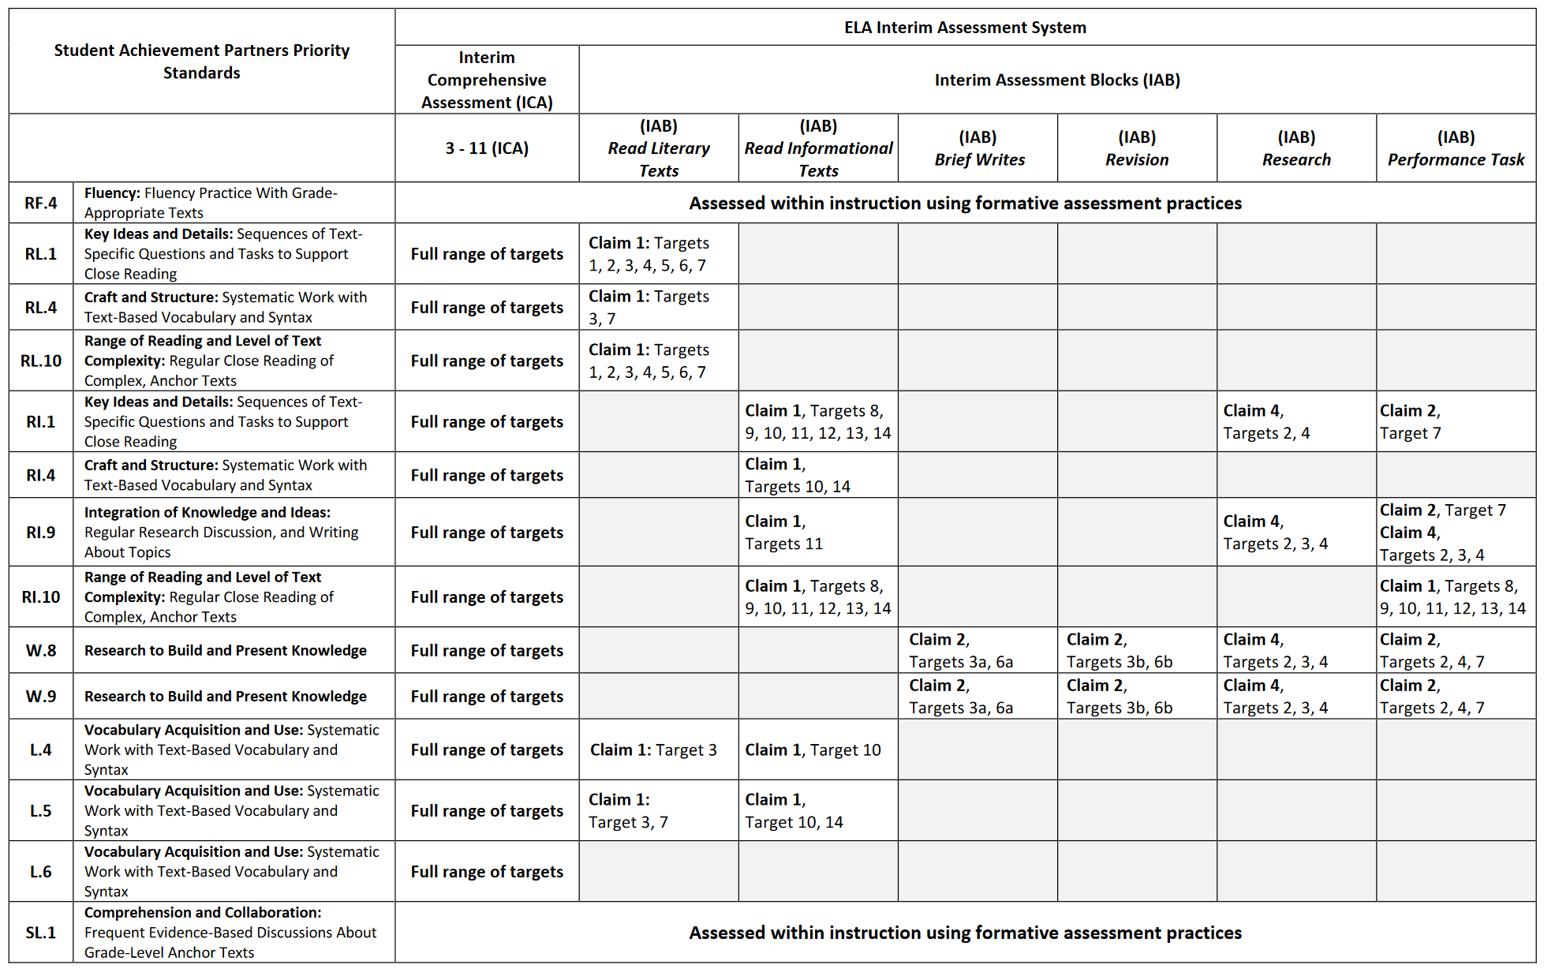
Aligning Priority Standards to the
Interim Assessment System
Notes:
Slide 22: Alignment of the IABs and the Priority Standards(Facilitator 1)
So to further support educators in the implementation of the ELA interim assessments, ODE has created this crosswalk table.
[Click Animation] In the far left column we have placed the Student Achievement Partners Priority Standards
[Click Animation] [Click Animation] Across the top we have identified the ICA and at this time only the IABs.
[Click Animation] [Click Animation] If we focus on the Writing 8 and 9 [Click Animation] we can quickly identify the associated IABs [Click Animation] in which these two standards are associated or found in the interim assessments, which then provides educators a quick reference.
Though ODE has supported national guidance on priority standards, selecting priority standards is a local decision set by districts and may include additional standards beyond those recommended by SAP. Therefore if a districts has selected additional or different priority standards for the 2020 -21 school year, aligning those district priority standards with the interim assessments might be a good first step.
We have placed the direct link to this resources in the Facilitator’s guide.
Resource:
ODE 3-12 Prioritized ELA Standards and Oregon ELA Interim Assessment Block Crosswalk

Slide 23
Using Interim Assessments within the
Academic Calendar
The IABs are short, fixed-form assessments that focus on a subset of the grade-level standards.
The IABs are a critical component of the system because they can align coherently with a district’s curriculum and assessment practices and be administered off-grade.
Notes:
Slide 23: Interim Assessment and the Academic Calendar (Facilitator 1)
So throughout the session we have discussed how the ELA interim assessments are fixed form assessments that reflect a sub-set of differing grade-level standards.
[Click Animation] However the interim assessment are designed to align to not only the ELA standards, but can be further aligned or embedded with a district’s curriculum maps and local assessments. And as needed be administered out –of grade level.
[Click Animation]
As educators move throughout the year it is not expected that students will be proficient or showing mastery of all the ELA standards, however when they interim assessments are embedded within the academic years they can provide the additional evidence OF learning to adjust lessons FOR learning and ultimately support students towards mastery of grade level standards by the end of the academic year.
Resource:

Slide 24
Using Interim Assessments within the
Academic Calendar
The IABs can support educators in identifying strengths/ or additional supports for students and have the potential to directly inform what a teacher should teach next, and to whom.
In addition to administering the entire IAB as a stop-and-test event, the IABs can also be used in non-standard ways.
For instance, a teacher may use test items from an IAB to illustrate the expectation of the standard, as a do-now exercise in the classroom, or as an exit ticket to check for understanding.
Notes:
Slide 24: Interim Assessment and the Academic Calendar (Facilitator 1)
So throughout the session we have discussed how the ELA interim assessments are fixed form assessments that reflect a sub-set of differing grade-level standards.
[Click Animation] In addition to administering the entire IAB as a stop-and-test event, the IABs can also be used in non-standard ways.
[Click Animation]
For instance, a teacher may use test items from an IAB to illustrate the expectation of the standard, as a do-now exercise in the classroom, or as an exit ticket to check for understanding.
We explore a few other use cases or examples in the coming slides.

Slide 25
Standardized vs. Non-Standardized
Interim Assessment Administration
Standardized Administration | Non-Standardized Administration
Individual and independent testing Single administration allows for a reliable “point-in-time” spot check of student knowledge Following summative policies and procedures, such as a secure test environment (e.g., no cell phones, guiding resources, etc.) | Non-secure, non-public Working on assessment items collaboratively Students working with other students to answer items Teacher guides students through items Students use resources to help them answer questions
Notes:
Slide 25: Standardized vs. Non-Standardized Interim Assessment Administration (Facilitator 2)
As mentioned earlier, the interim assessments allow flexibility in both a standardized, on-demand format similar to the summative assessment, or in a non-standardized administration allowing for flexibility of use during instruction.
When using the interim assessments in a non-standardized manner please refer to the guidance in ODE Training Module 8 for test security and remote guidance.

Slide 26
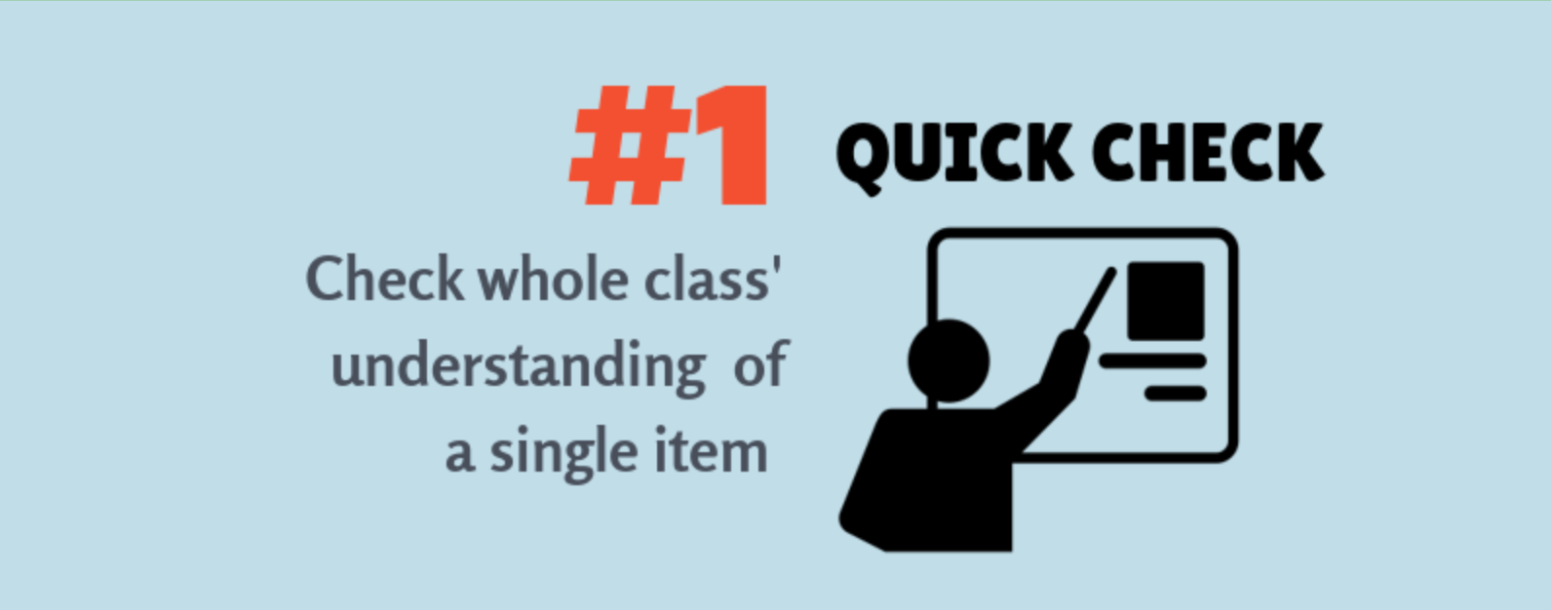
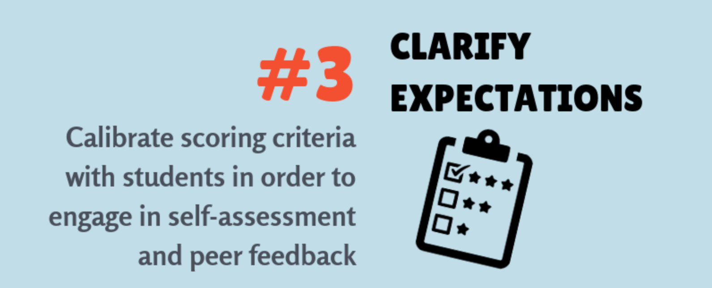
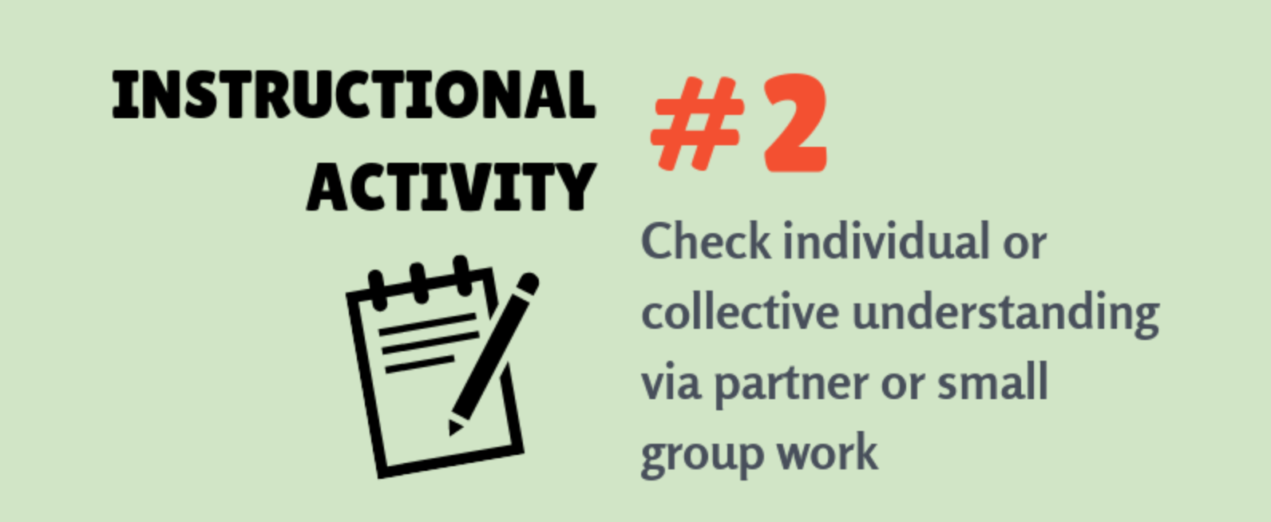
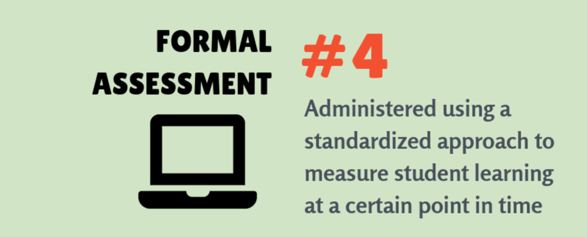
4 Ways to Use
Interim Assessments
Notes:
Slide 26: Interim Assessment System Summary (Facilitator 2)
As mentioned in Session 2 these are just a few ways the interim assessments can be used .
A quick check around a specific concept or standard.
A non-standardized administration as part of an instructional activity
A tool to clarify expectations around concepts, standards, specific item designs, complexities, and scoring criteria as part of formative assessment practices
Or a formal assessment to measure or collect evidence around student learning specific to taught content to determine additional instructional decisions.

Slide 27
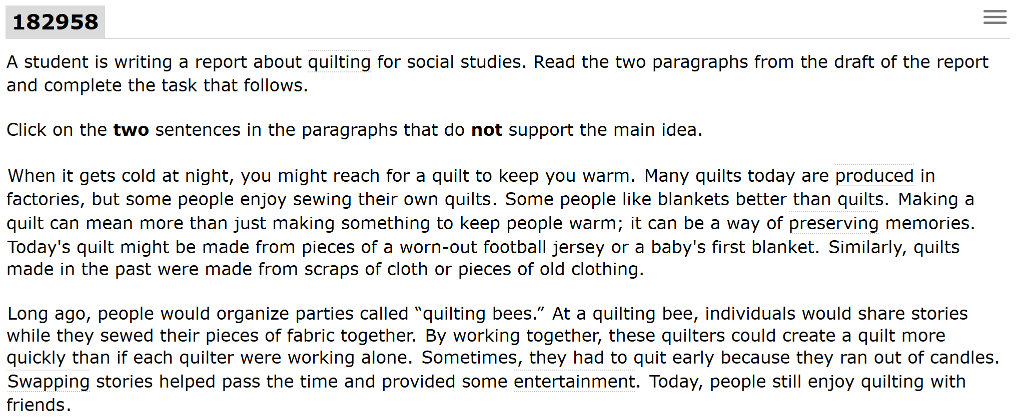
# 1 Quick Check
Interim Assessment Block (IAB)
or Focused (IAB)
Grade 5 - Claim 2 Writing: Target: 3 (Write/revise Brief Texts), Hot Text Item
Notes:
Slide 27: Quick Check Use Case (Facilitator 2)
When we look at a Grade 5 Claim 2 Writing item, we have an item that aligns to Target 3 Write and Revise Brief Writes. [Click Animation]
In this example a teacher has just finished a writing lesson on supporting details and this item asks the students to edit the paragraph by identifying the two sentence that DO NOT support the main idea.
Because this item is a multiple select item is asking student a more complex response (DOK 2) in that they should be able to identify both sentences, but it also requires students to be able to understand main idea and identify what the main idea is within the context of writing using the other supporting sentences.

Slide 28
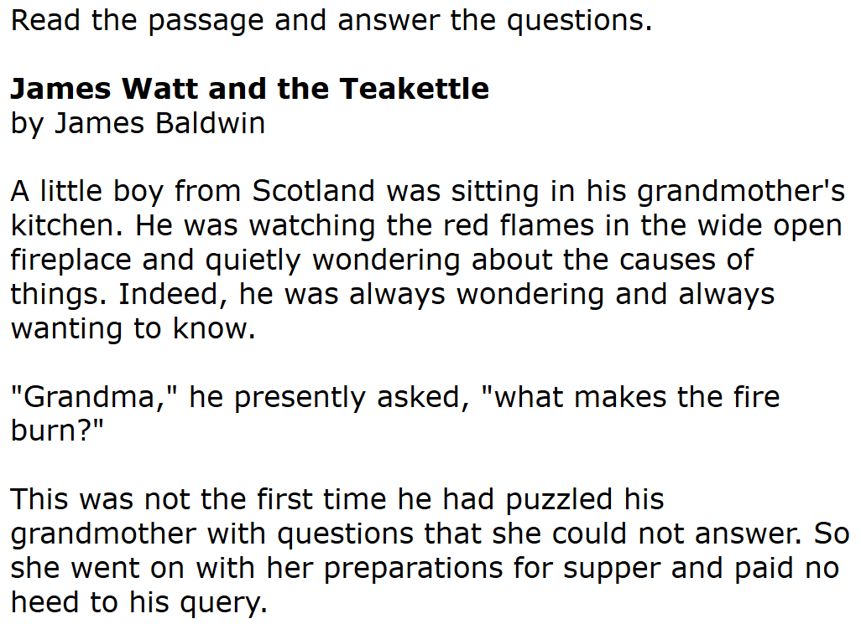
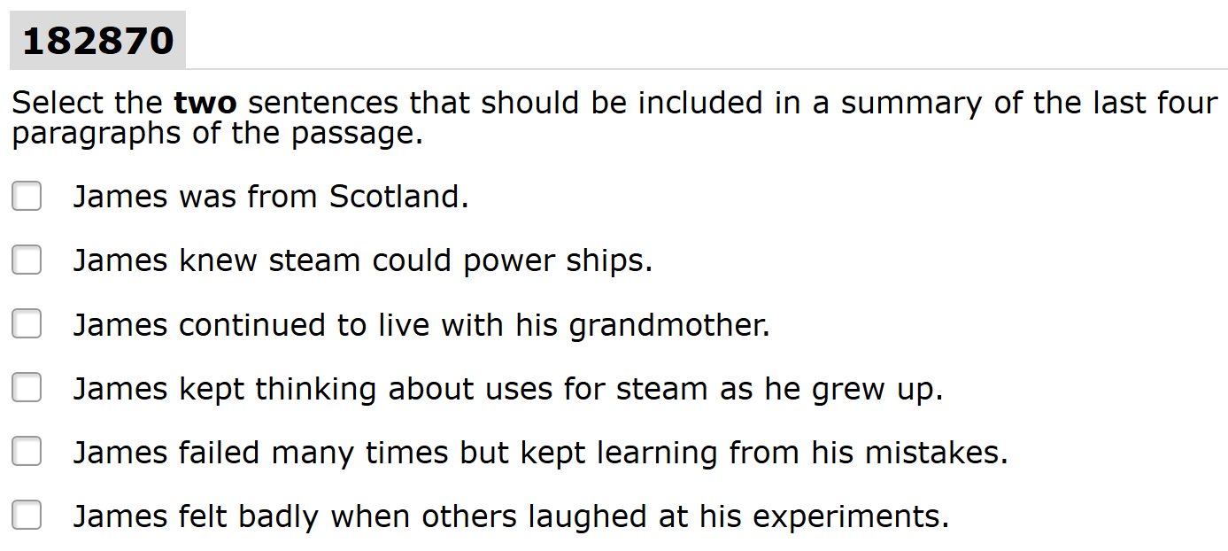
# 1 Quick Check
Interim Assessment Block (IAB)
or Focused (IAB)
Grade 5 - Claim 1 Reading: Target: 2 (Central Ideas: Identify or summarize central ideas/ key events), Multiple Select Item
Notes:
Slide 28: Instructional Activity Use Case (Facilitator 2)
In this Claim 1 Reading item, aligned to Target 2 Central Ideas, [Click Animation]
Students must first read an informational passage and identify the central idea. After reading the passage [Click Animation] [Click Animation]
An educator could have students independently answer the following question or collaborate in small groups to collectively decide on additional details that further support the identified central idea.
Additionally, if done in small groups the educator could facilitate students to identify pieces within the text that support their reasoning for selecting from the different options which provides a deeper collection of evidence than a simple selected response, thus further enhancing the use of this item.

Slide 29
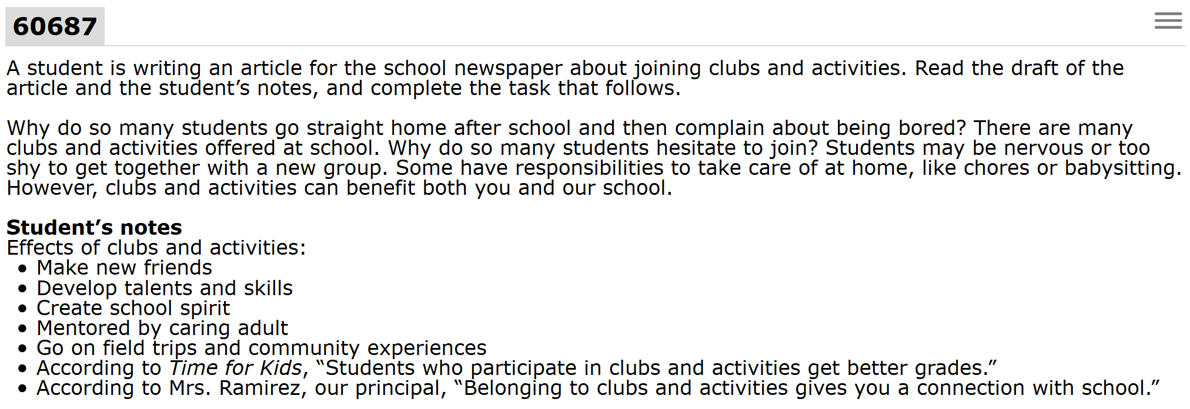
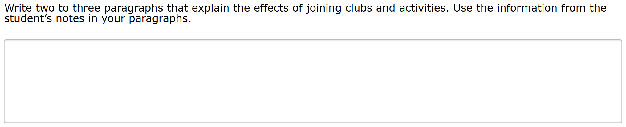
# 1 Quick Check
Interim Assessment Block (IAB)
or Focused (IAB)
Grade 8 - Claim 2 Writing:
Target: 3 (Write/revise Brief Texts), Short Answer/ Constructed Response Item
Notes:
Slide 29 Instructional Activity Use Case (Facilitator 2)
In this use case example, an educator has provided a grade 8 writing activity which can be used to clarify expectations in which a student is being asked to attend to a Target 3 Write and Revise Brief Write.
[Click Animation] The student is first being asked to use the beginning of another student’s draft and use their notes to not only edit the provided draft but also improve upon the draft using the additional notes. This is a DOK 3 task. Additionally because this is in the interim assessment system, an educator is able to provide additional context and support so that the student can not only build their skills but get any additional context or clarification on the topic.
[Click Animation] As the student engages in the writing activity the student can apply their own editing skills or the educator could ask the student to share their first draft with others to compare how each student approached the same task differently and thus providing additional collaboration support.
Or the educator could use this opportunity to use the brief writes scoring rubric to provide the student feedback so they can revise their work.
In both cases the teacher is able to not only capture evidence OF student learning, but immediately provide additional instruction in the moment FOR additional learning supports.

Slide 30
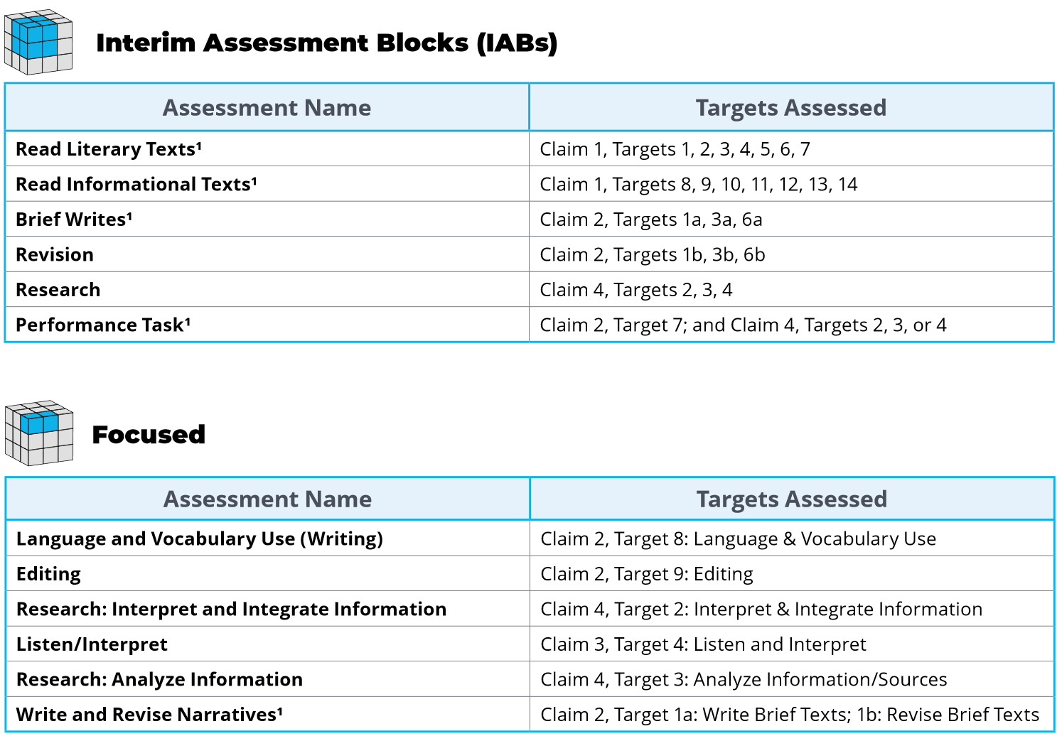
Additional Use Cases
Scenario 1:
Educator is wanting to increase proficiency in student writing using the Interim Assessments
4
3
6
1
2
5
Notes:
Slide 30: Scenario 1 (Facilitator 2)
Here is an additional example of how the interims might be combined in to a larger context. [Click Animation] In this scenario an educator is wanting to increase proficiency in student writing using the Interim Assessments.
[Click Animation] One starting place might be working on Language and Vocabulary Use either with items or as a more formal assessment.
[Click Animation] A teacher could then review editing skills with students before transitioning to an interim assessment where students can apply their skills
[Click Animation] and start by working through different items that require feedback or revisions
Before finally [Click Animation] being asked to create their own brief writes or constructed responses and apply their own skills in language use and editing to their writing.
If students need additional support the educator can choose to focus on a specific writing purpose [Click Animation] such as writing or revising narratives.
With the final activity of [Click Animation] students being asked to create a full writing response with a performance task.

Slide 31
Additional Use Cases
Scenario 2:
Educator is wanting to increase proficiency within the standards of informational text and applying research using the Interim Assessments
1
4
5
3
2
An educator might choose to use out of grade level interims assessments as part of the instructional process based on student needs.
Notes:
Slide 31: Scenario 1 (Facilitator 2)
In this scenario the educator is wanting to increase proficiency within the standards of informational text and applying research skills.
[Click Animation]
A likely starting place might be working on informational text and comprehension.
[Click Animation] A potential next step might be working with students on how to analyze information and sources or
[Click Animation] working with students on how to interpret information and integrate information into the context of differing tasks.
[Click Animation] After working with students on these skills an educator could potentially administer a formal assessment related to research to decide if additional instruction is necessary and again this could build towards.
[Click Animation] students being asked to use the informational sources in the performance task and create a full writing response.
Resources:

Slide 32
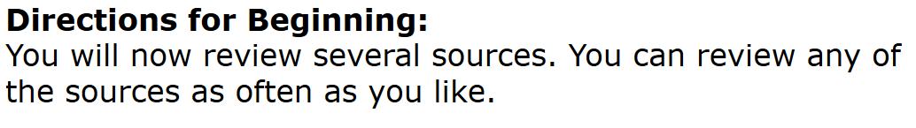
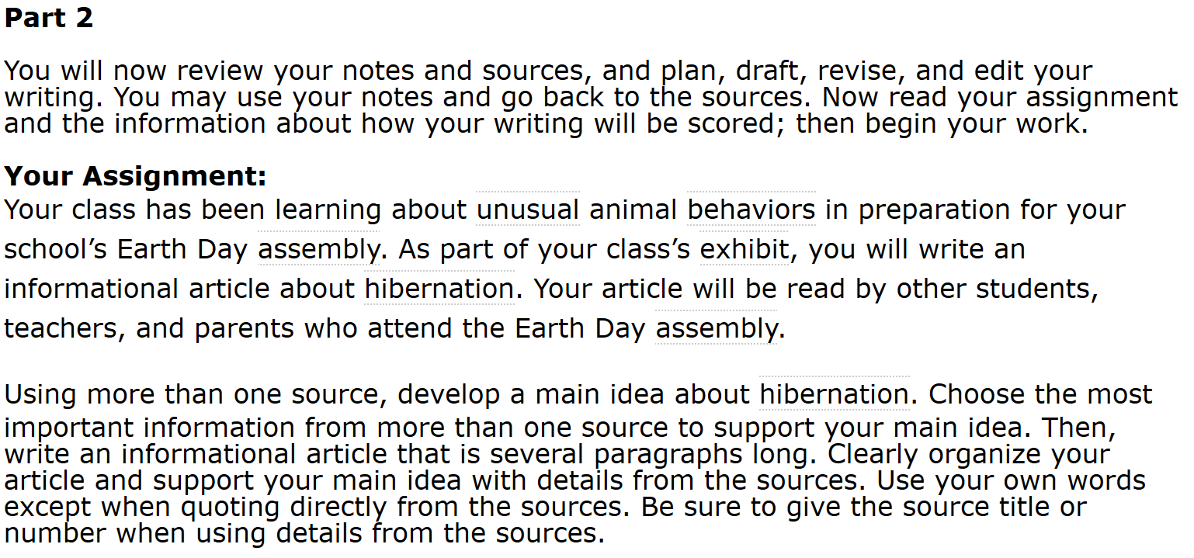

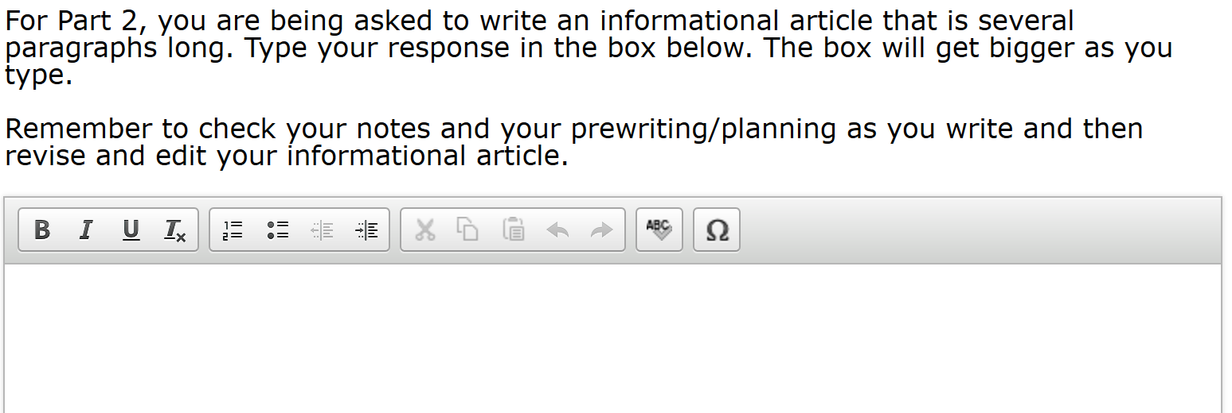
# 1 Quick Check
Hand-scoring item provides opportunity for educators to engage in writing scoring calibration and provide feedback to students.
Interim Comprehensive Assessment (ICA),
Interim Assessment Block (IAB),
or Focused (IAB)
Grade 5 - Claim 2 Writing:
Target: 4 (Full Informational/explanatory), Writing Extended Response Item
Notes:
Slide 32 Formal Assessment Use Case (Facilitator 2)
Building off the two scenarios we have combined a final formal assessment which allows an educator to combine multiple skills and standards into one activity.
In this final use case, an educator has provided the performance task [Click Animation] [Click Animation]
The students are provided multiple informational sources to read through and identify central ideas, and analyze relevant information from the sources. Keep in mind educators can provide text to speech support for the reading passage
[Click Animation] In part 2 they are asked to interpret and integrate information into a full composition writing response.
[Click Animation] Finally student are given the support tools to complete their writing assessment.
Additionally, [Click Animation] the performance task provide not only students a chance to demonstrate their writing skills, but it provide educators an opportunity to collaborate and calibrate scoring expectations.

Slide 33
Right Assessment for the Right Purpose
The interim assessments can serve as a tool which allows educators to collect evidence FOR and OF learning.
As a first step, educators should evaluate their pacing guides, priority standards, and instructional resources.
Notes:
Slide 33: ELA Interim Assessment Summary (Facilitator 2)
The interim assessments can serve as a tool which allows educators to collect evidence FOR and OF learning.
[Click Animation]
As a first step, educators should evaluate their pacing guides, priority standards, and instructional resources.

Slide 34
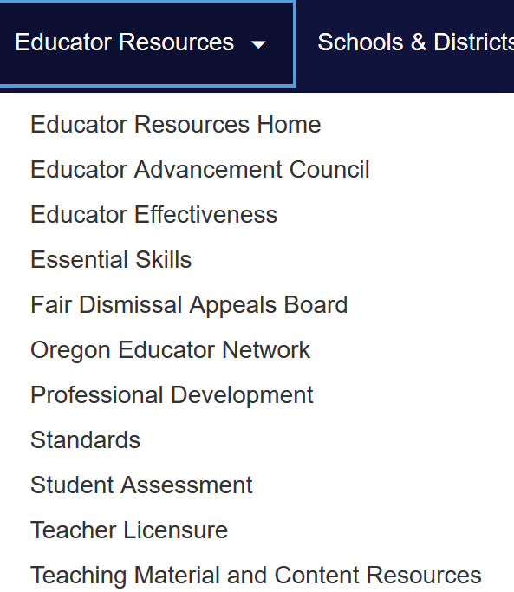

Contact Us! www.oregon.gov/ode
Dan Farley: Director of Assessment
Tony Bertrand: ELA and Social Sciences Assessment
Tina Roberts: ELA Standards and Instruction Specialist
Photo by Volodymyr Hryshchenko on Unsplash
Notes:
Slide 34: Contact Information and Additional Resources (Facilitator 2)
In addition to these professional development resources, the ODE team is available to support districts and schools with general or content specific questions.
For contact information including email or telephone, please visit the ODE Standards or Assessment homepage and select the Contact button.
Information specific to either the Oregon ELA Standards or the Interim Assessment System, including supporting resources and additional session presentations, are available on the ODE webpage.
Thank you, and as a reminder in Session 4 we will be presenting information for in-person or remote administration within the OSAS Portal.
Resources:
ODE Assessment Contacts

