Slide 1
Oregon Statewide Assessment System
Session 3C (Science) – Using Interim Assessments During Instruction
NEW! Updated for 2021-2022 School Year!
Office of Teaching Learning & Assessment
Notes:
Welcome to Session 3C of the OSAS Interim Assessment System Professional Learning Series, Using Science Interim Assessments During Instruction
Introductions:

Slide 2

Oregon Statewide Assessment System
Guiding Principles
A balanced assessment system is vital to achieve an equitable,
high-quality education for all students.
Center Equity
Cultivate Connections & Relationships
Use the Right Assessment for the Right Purpose
Be Transparent
Notes:
We all know the extraordinary challenges communities, families, students, and educators are continuing to face this academic year and we are navigating conversations and emotions around the wildfires that have impacted many communities across Oregon, and COVID-19 pandemic. We’re also aware that the families and students most affected by COVID-19 pandemic are often those who are historically underserved by our systems. Today, we join you in thinking deeply about how we can adapt to this year.
On the screen are the guiding principles of our statewide assessment system. These are grounded in the same principles as ODE’s Ready Schools, Safe Learners Resiliency Framework.
Namely, we are centering in equity. We’ve worked hard to provide an interim assessment system that can help in understanding student learning.
Cultivating connections to and relationships with our students is vital for any learning environment, It’s also vital that we stay connected to our professional community and colleagues who can support and encourage us.
The Office of Teaching Learning and Assessment utilizing the document “The Right Assessment for the Right Purpose,” and this principle drives our work and frames our conversations. We’ll go into a few more detail on this document later in this presentation.
And finally, being transparent. We support an assessment system that is designed to provide evidence of student thinking all the way up to data on system-level indicators, and a set of tools that can demystify the process of assessment and enhance student learning.

Slide 3
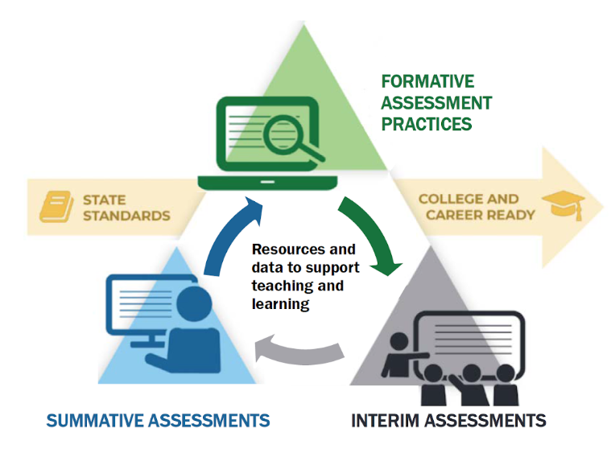
Purpose
Notes:
The purpose of this series is to help district and school-based teams improve their systems of teaching and learning using an approach inclusive to a balanced assessment system. This image should have a picture of students at the center as this balance assessment system is truly student-centered.
Here we see a diagram of the balanced assessment system with students at the center through teaching and learning.
Today, we will help you build assessment literacy by connecting formative assessment practices (green triangle), Oregon’s Statewide Interim Assessment System (grey triangle), and the Oregon Statewide Summative Assessments (blue triangle) as a means to continually improve access and outcomes for each and every learner in their classroom, school, and district.

Slide 4
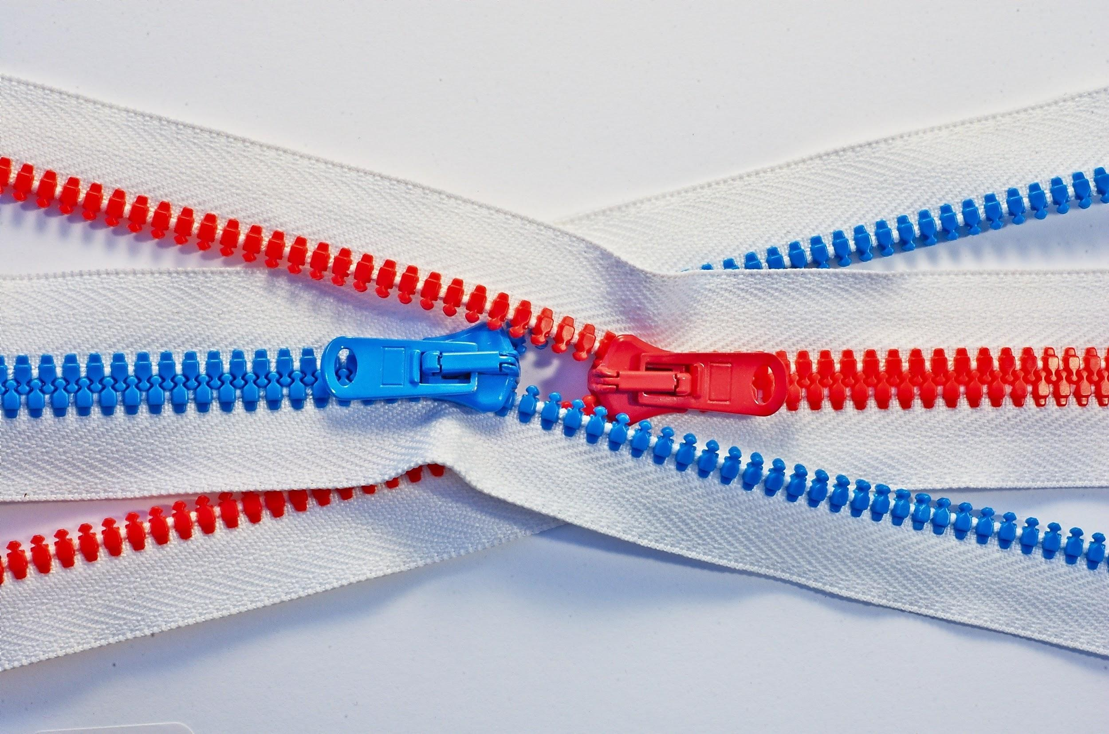
Series Outcome
Build Assessment Literacy
Connecting:
formative assessment practices
interim assessments,
summative assessments
For continuous improvement
Photo by Tomas Sobek on Unsplash
Notes:
Our goal for this professional learning series is that all participants will build assessment literacy and connect the three components of a balance assessment system through formative assessment practices, Oregon’s Statewide Interim Assessment System, and the Oregon Statewide Summative Assessments to continually improve access and outcomes for each and every learner in their classroom, school, and district.
Today, we will be focusing primarily on the new interim assessment system for science and other supporting resources connected to both formative assessment practices and the Oregon Summative Assessment.
.

Slide 5
Interim Assessment Series
Session Guide
1 | Understanding a Balanced Assessment System
2 | Overview of the OSAS Interim Assessment System
3 | Using Interim Assessments in the Context of Instructional Practices
4 | Interim Assessment Administration: Guidance and Support
5 | Accessing Interim Assessment Data to Inform Instructional Practices
6 | Exploring Tools for Teachers and Using Formative Assessment Practices
Notes:
This session is one of several learning sessions being provided this Fall by the Oregon Department of Education. Today we are taking a deeper dive into the Interim Assessment System; focusing on the Science components. Sessions 1 and 2 provided an overview of a Balanced Assessment System and the Interim Assessment System. This is Session 3C, focusing on the Science Interim assessment bank. Sessions 3A and B focus on ELA and Math. Session 4 provided Interim Assessment Administration guidance, session 5, provided information about the centralized reporting system and session six focuses on the tools for teachers resource available for ELA and Math.
Please refer to the Interim Assessment webpage for facilitator notes and powerpoint presentations from those sessions.

Slide 6

Interim Professional Session 3C - Learning Goals
By the end of this session, educators will be able to:
Describe how to use interim assessments instructionally
Describe the content and structure of Science Interims in the OSAS Interim Assessment System
Know how to use the Assessment Viewing Application, Test Administration Interface, and the Centralized Reporting System
Notes:
By the end of this session, educators will be able to:
Describe how to use interim assessments instructionally
Describe the content and structure of Science Interims in the OSAS Interim Assessment System
Know how to use the Assessment Viewing Application, and Test Administration Interface to administer assessments through the secure or online browser and view the results in the Centralized Reporting System

Slide 7



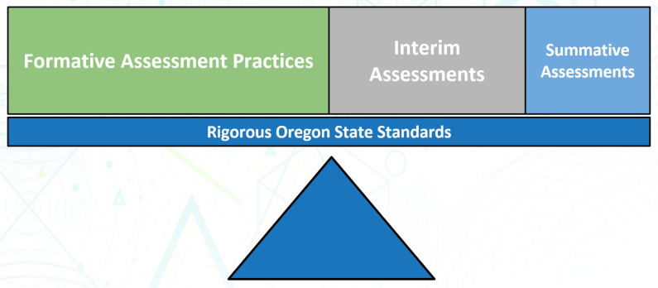
Balanced Assessment System
Assessment FOR Learning
OF & FOR
Assessment OF Learning
Does this assessment best help us understand student learning or
system health?
Notes:
The Oregon Statewide Assessment System has three components:
summative assessments, designed for program evaluation and accountability;
interim assessments, designed to support teaching and learning throughout the year; and
formative assessment practices, which support students’ learning in day-to-day instruction.
(click)
Our system is balanced and note that each type of assessment provides a different lens.
(Click)
The microscope represents the close look at student learning, the binoculars look at a larger group of students, and the telescope can look at an even larger group.
(click)
We can use interims as assessments for learning to help us with instructional decision making, or of learning.
(click)
When we select an assessment, we must ask ourselves, does this assessment help us understand student learning or system health in the way we are using it ?
More information about balanced assessment can be found in the document “The Right Assessment for the Right Purpose” on the ODE webpage. The link is in your resource document provided in the chat.

Slide 8
Standardized vs. Non-Standardized
Interim Assessment Administration
Standardized Administration | Non-Standardized Administration
Individual and independent testing Single administration allows for a reliable “point-in-time” spot check of student knowledge Following summative policies and procedures, such as a secure test environment (e.g., no cell phones, guiding resources, etc.) | Non-secure, non-public (not through browser) Working on assessment items collaboratively Students working with other students to answer items Teacher guides students through items Students use resources to help them answer questions
Notes:
In session 2 we talked about standardized and non-standardized instruction. Educators may administer the Interim Assessments in both a standardized, on-demand format similar to the summative assessment, or in a non-standardized administration allowing for flexibility of use during instruction.
In a standardized approach, the assessments are used within the test delivery browser by individual students as a spot check of student learning at a point in time in a secure environment.
In a non-standardized approach, the assessments can be used more creatively. The items can be used outside of the test delivery browser during instruction in whole group or small group with students working through the items together. Students can use resources to help them answer questions and the environment is not expected to be secure in the same manner that it would be for a summative assessment.
It is important to note that if an educator provides the interim assessments in a non-standardized approach, they must ensure they meet the test security requirements outlined in the ODE Assessment Module 8 Interim Training Resource. ODE further discusses remote administration requirements in Interim Professional Learning Session 4 - Interim Assessment Administration: Guidance and Support. These items are semi-secure which means that they may be shared for classroom discussion and teacher professional learning and discussion, but they may not be publicly posted on social media or other public platform.

Slide 9

Identifying Essential Learning
bit.ly/ODEDL2021
Designing Learning
Content Specific Considerations
Keep care and connection at the forefront.
Design Learning to include students experiencing disability and who are learning English, as they are first and foremost general education students.
Focus on essential grade-level learning.
Build on student’s academic background, life experiences, culture and language to support culturally relevant learning.
Notes:
We wanted to call attention to the “Designing Learning for 2020-21” documents that were published in response to the needs of the 20-21 school year. We collaboratively worked with our national partners and utilized national guidance, resources from other states, and received input from educators to put forth our best current thinking on how to design learning this year The link on the screen will take you to the webpage where you’ll see a link to download the document in its entirety, as well as supplements for each content area.
[to paste in chat: bit.ly/ODEDL2021]

Slide 10
Identifying Essential Learning
What is essential learning?
Development of Scientific Literacy
Help students build on and revise their knowledge and abilities, starting with curiosity
Keep science teaching and learning coherent by bundling standards and story-lining.
Address requisite skills and knowledge in ways that are focused on grade level learning.
Leverage student interests and identity.
Notes:
The Framework for K–12 Science Education laid the foundation for a vision of science for all students, with a goal of developing a scientifically literate society and preparing students with the skills, habits and understanding to be college, community, and career ready.
The Oregon Science Standards are built on the notion of learning as a developmental progression. They are designed to help students continually build on and revise their knowledge through phenomena driven instruction.
Consider bundling standards and creating storylines, so science teaching and learning can be coherent as student make sense of the world around them.
Focus on delivering grade-level learning to address skills and knowledge
Finally, in Chapter 11 of the Framework for K–12 Science Education, it highlights how "all science learning can be understood as a cultural accomplishment." Cultural perspectives can transform learning experiences to make science more engaging and meaningful for learners by leveraging agency, interest and identity.

Slide 11
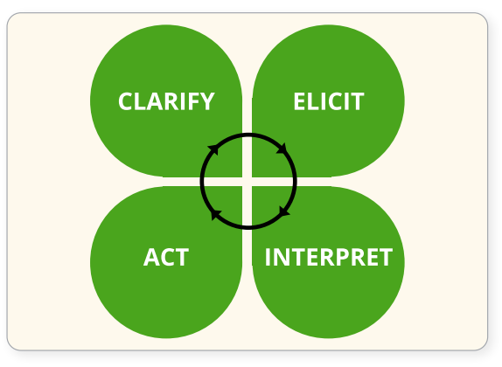
Assessment FOR Learning
Formative assessment is an active and intentional learning process that partners the teacher and the students to continuously and systematically gather evidence of learning with the express goal of improving student achievement.
HIGH-QUALITY
INSTRUCTIONAL
PRACTICES
COLLABORATION
Notes:
So when we incorporate essential learning with the concept of assessment for learning we are challenging the common vernacular, that formative assessment is not a “thing” nor is it accurate to talk about “formative assessments” (as a plural)
Rather, formative assessment is a planned, ongoing process. This is used by all students and educators during learning and teaching to elicit and use evidence of student knowledge. With the intended outcomes to support students to deepen their understandings and become self-directed learners.
A high-quality formative assessment process is built on the foundation of a collaborative and respectful learning environment. This requires the ownership of both students and educators.
[Click Animation]
The clover image works well to illustrate the process:
Starting in the upper left corner of the clover, first learning goals and success criteria must be clarified; (moving clockwise)
Second, activities and instructional strategies must be designed or selected to elicit evidence of student thinking;
Third, this evidence is interpreted - often in the moment - to provide actionable feedback;
Finally, this feedback is acted upon and instruction is adjusted as needed.
Throughout the process, students must not only be engaged with their teacher, but also with peers and given the opportunity to self-reflect on their learning progress.

Slide 12
Using Interim Assessments
Notes:
Slide 14: Using Interim Assessments –
And now we’ll talk a little bit about ways you can use interim assessments.

Slide 13
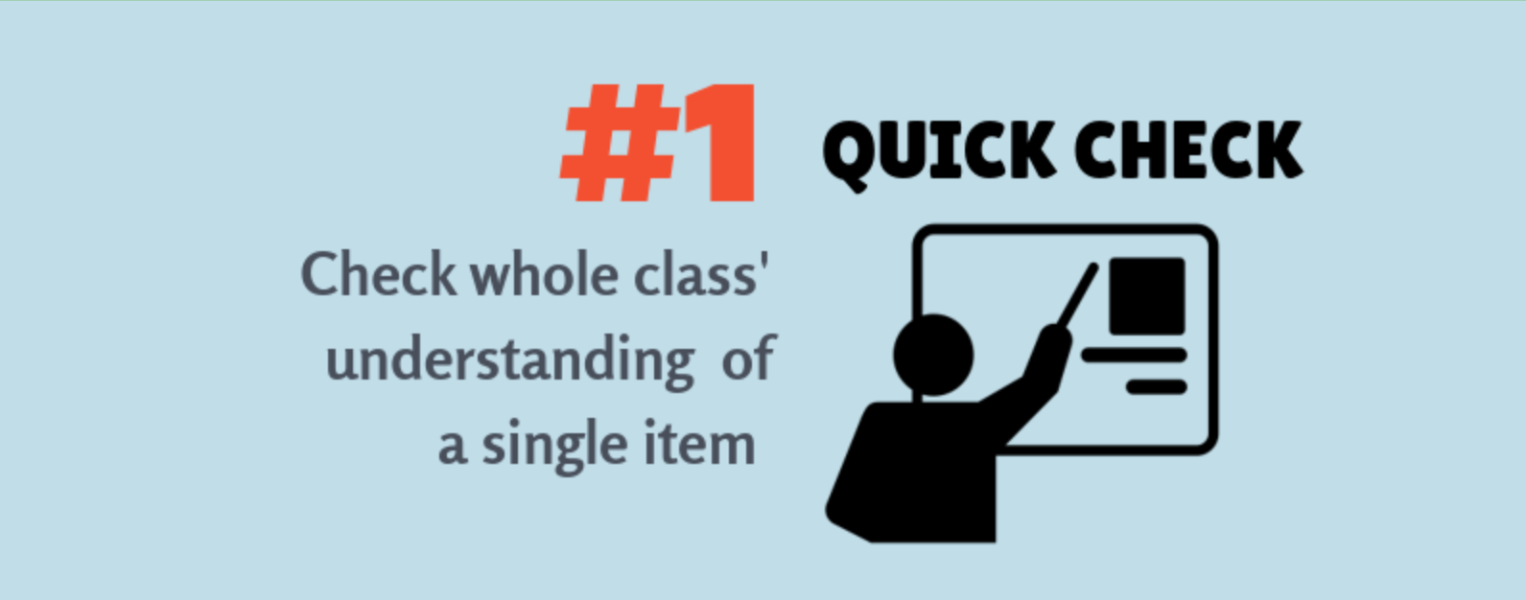
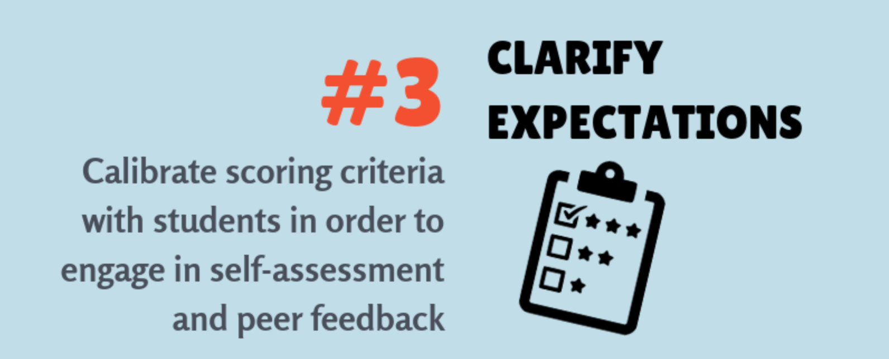
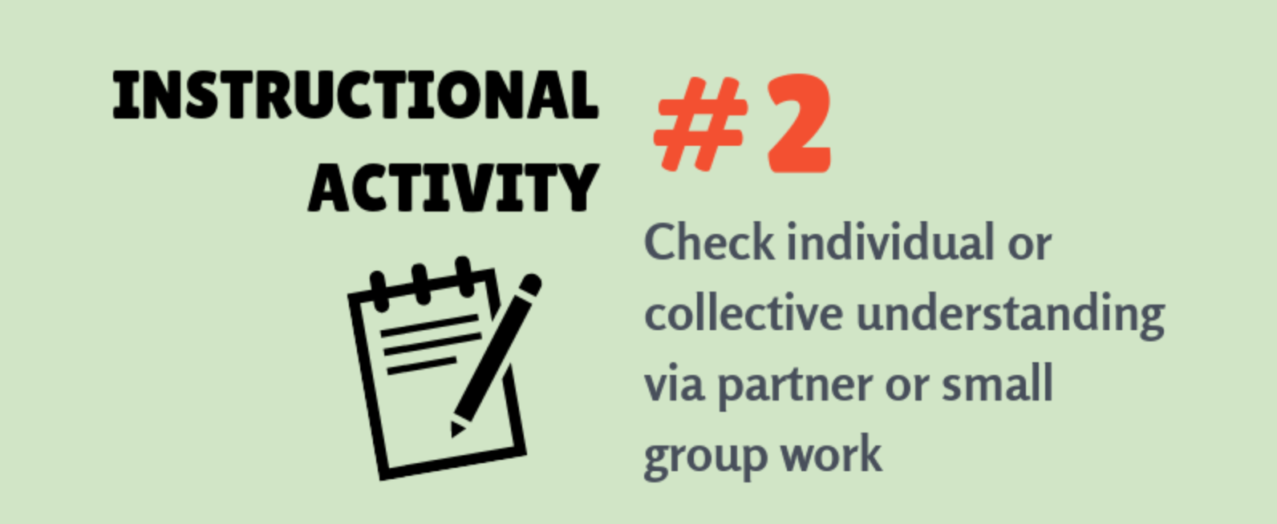
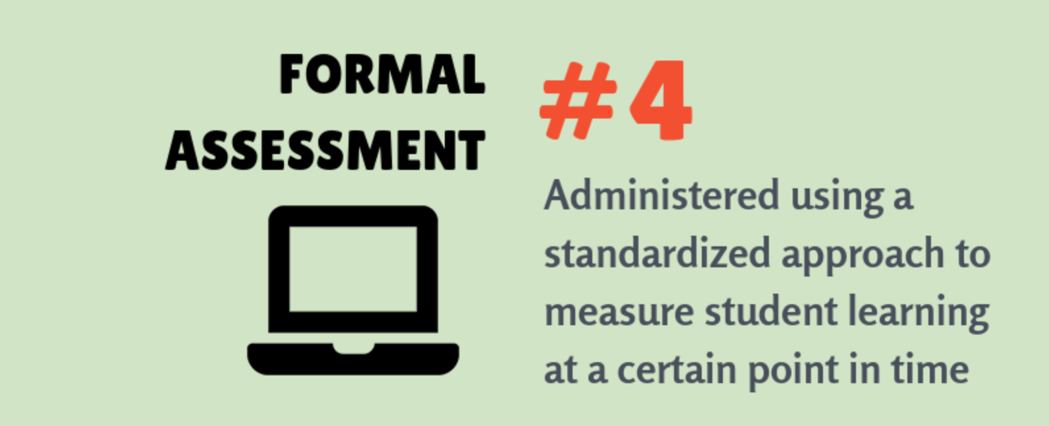
4 Ways to Use
Interim Assessments
Notes:
This slide provides different ways in which the Interim Assessment System can be utilized:
#1A quick check around a specific concept or standard.
Example: The teacher logs into the Assessment Viewing Application platform and projects the stimulus to ask for student response to one of the interactions (perhaps Part A) to gather evidence of what student understand about that concept in a informal way to guide instructional decisions about what their next teacher move will be in the lesson.
#2 A non-standardized administration as part of an instructional activity
Example: The teacher prints or projects an item including the stimulus and interactions and allows students to work together to complete all of the interactions. The teacher analyzes student responses to guide their next teaching move.
#3 A tool to clarify expectations around concepts, standards, specific item designs, complexities, and scoring criteria as part of formative assessment practices.
Example: After students complete an item either alone or in groups, the teacher reviews the interaction prompts and correct respons(es) with students (in large or small groups). Students can reflect on their performance and identify what they know and are able to do. In this way they better understand expectations for the standard being assessed.
Or a #4 a formal assessment to measure or collect evidence around student learning specific to taught content to determine additional instructional decisions.
Example: The teacher assigns appropriate tests to students at the end of instruction. This provides feedback to students as well as the teacher and may provide insight for instructional improvement.
Remember that you are still able to review the item with students and provide feedback even if the assessment is delivered in a standardized, secure manner.

Slide 14
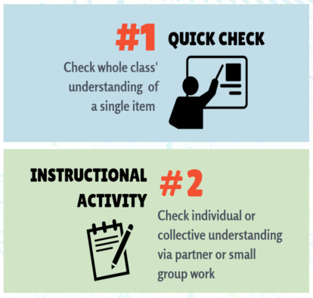
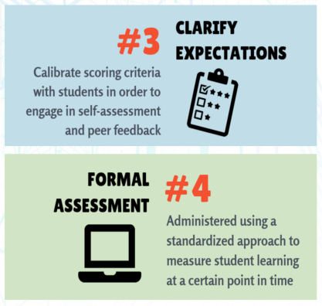
For and Of Learning
Determine whether each use of
Interim Assessments is an
example of
Assessment FOR Learning
-or-
Assessment OF Learning
(HINT: ignore the colors)
Notes:
So quick check, looking at the different ways of using the Science Interim Assessment bank,
(click)
which use is an assessment for learning and which is an assessment of learning?
This scale shows an estimate of the amount of each type of assessment in a school year. It’s important to think about this scale in your instructional planning.

Slide 15
Science Interim Bank Content and Structure
Notes:
Now we’re going to talk about the content and structure of the science interim bank.

Slide 16
Overview of the NGSS Interim Assessment Bank
Each cluster/task item is aligned to only 1 Oregon Science Standard
Items are arranged within the bank by disciplinary core idea.
14 Elementary School Science Standards addressed
20 Middle School Science Standards addressed
20 High School Science Standards addressed
*For 2021-2022, ODE has purchased the science interim bank for use free of charge.
** There is an anticipated mid-year update in 2021-2022 school year
Notes:
Within the bank, each cluster/task item is aligned to only 1 Oregon Science Standard (NGSS).
Items are arranged within the bank by disciplinary core idea.
Currently there are 14 elementary school science standards, 20 middle school standards, and 20 high school science standards for which there are items provided in the science interim assessment system.
Item development for the Science Interim Assessment Bank is ongoing; we expect an update sometime during the 21-22 school year. For a complete list of item bank standards, please see the science interim interim assessment information sheet on the ODE Interim Assessment web page.
https://www.oregon.gov/ode/educator-resources/assessment/Pages/Interim_Assessments.aspx
For this year, the Oregon Department of Education has purchased the science interim bank. All Oregon school may use it free of charge.

Slide 17

Structure
  All items are machined-scored and results are reported in the Centralized Reporting System.
  All the accommodations and designated supports offered on the OSAS Science Statewide Assessments are available on the Interim Assessment, including Text-to-Speech.
  Teachers can securely log into the Assessment Viewing Application (AVA) to preview the items without having to take the test using the secure browser.
Notes:
All items in the Science Interim Assessment bank are machine scored after the student has submitted their assessment; meaning that teachers will not need to hand score any of the items.
All of the same embedded supports that are available in the state-wide summative science assessment are available in the online test delivery system for the science interim assessment.
Teachers can securely log into the Assessment Viewing Application to preview the items without having to take the test using the test delivery system browser.
Links to the Assessment Viewing Application, Test Administration Application, Remote Interim Testing Site, and Centralized Reporting System are all located on the OSASPortal Interim Assessments page.
The Science Interim Assessments Quick Guide and Remote Administration Guide can be found on the OSASportal Interim Resources webpage

Slide 18
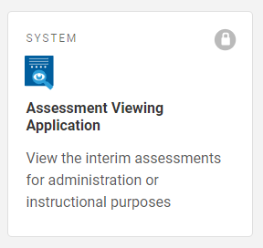
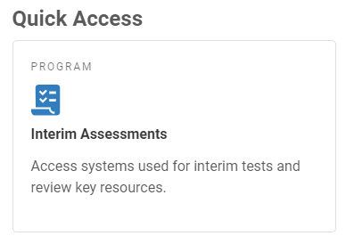
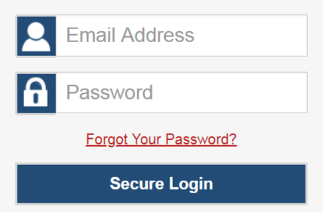
Assessment Viewing Application
Note: OSASPortal.org has been reformatted with a new look and feel.
Notes:
The Assessment Viewing Application, also known as AVA, allows educators to view the science interim assessment items without opening a test session.
To log in to AVA, you must have an authorized email address and password, which are the same as the ones you use for the Test Information Distribution Engine (TIDE) and the Test Administrator (TA) Interface. Contact your District Test Coordinator if you do not have an account.
To log in to AVA and go to the OSAS Portal, click the Interim Assessments card. On the next page, click the Assessment Viewing Application card. Enter your email address and password, and then click Secure Login.
If it is your first time logging in (ever or for the year), you log into AVA from a new device, or you have cleared the cache on your computer, you may be asked to enter a code which will be sent to you via email. Under circumstances other than those we have just listed you should not be asked for a code and the available tests page will appear.
An Assessment Viewing Application User Guide and training module can be found on the OSASPortal in the Interim Assessment Resources This guide is more detailed than the Science Quick Guide AVA information.

Slide 19
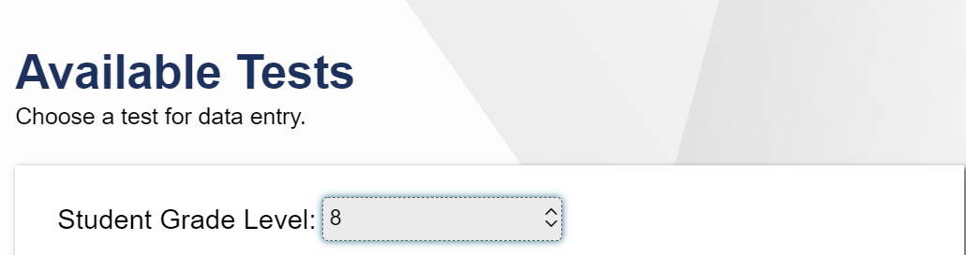
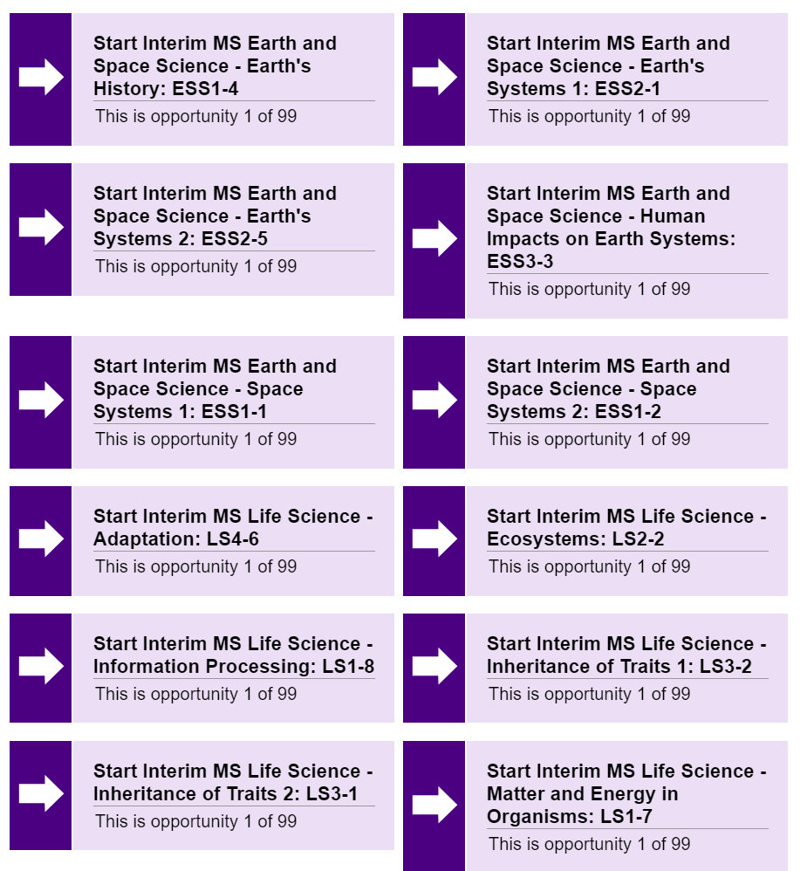
Items selected by
Oregon Science Standard (NGSS)
Notes:
After logging in to the Assessment Viewing Application you will see the Available Tests Screen. All available science interim tests will be listed on the screen by standard. By clicking on the name of the test you will be able to see the contents of the item.
Remember that the Oregon Science standards are 3-dimensional. By referring to the text of the Oregon Science Standards found on the Oregon Department of Education standards page or on the NGSS website, teachers can identify the specific dimensions found within the standard.
By clicking on the test that you want, you will be able to see and interact with the item the same way the student would.

Slide 20
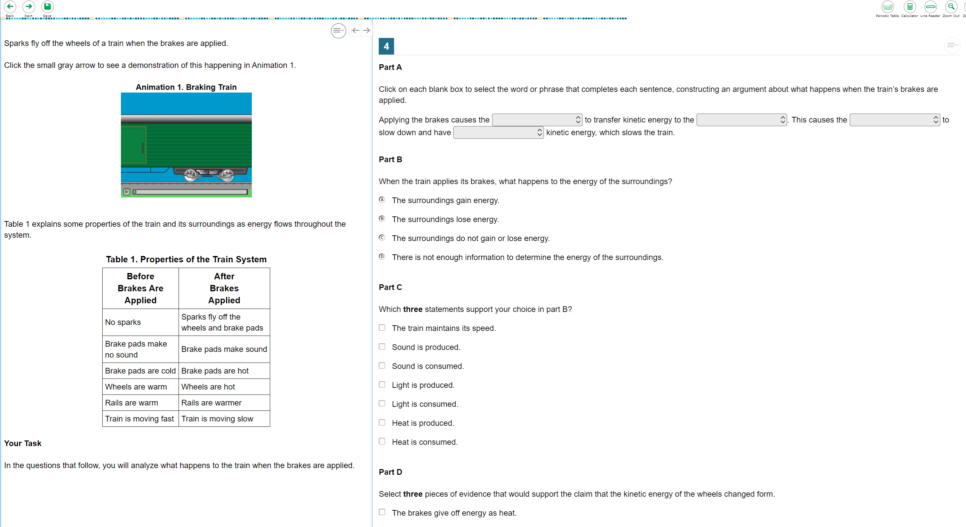
Interim Test Item Example
Notes:
Each test in the science interim bank contains a task item. The tasks were developed with the same specifications as the cluster/task items developed for the OSAS Science Assessment. Unlike the state-wide summative assessment, there are no independent/stand-alone items in the interim science assessment bank.
The tasks in the interim bank are comprised of a stimulus section on the left and a scored student interaction section on the right. In the stimulus, students are presented with a phenomena, background information, and a task statement. The student interactions assess the combined disciplinary core ideas, science and engineering practices and cross-cutting concepts. You will notice that the tasks are somewhat scaffolded and contain the same interaction types as the state-wide summative OSAS Science Assessment.
As we stated previously, you will notice that the interim assessment tests contain the same accessibility features that are present in the state-wide summative OSAS Science Assessment. Students should consistently use the same accessibility supports throughout instruction and assessment.

Slide 21
How to use the Test Administration Interface

Slide 22
Interim Training Requirements
Were you a Test Administrator in
2019-20?
Complete Module 8
DTC assigns “Interim” test group in TIDE
YES
Yes, but in a different district/state
NO
1. Reading requirements from Table 5 of Oregon’s
Test Administration Manual (TAM)
2. Complete Modules 2, 3, and 4 as posted to the
  Assessment Training Materials webpage
Notes:
ODE has worked to reduce the work of our district testing coordinators. We have implemented a roll-over process where educators from last year have already been populated in the OSAS Portal TIDE Account and will automatically have access to the ELA and Math Tools for Teachers resources.
Therefore, [Click Animation] if you were an educators who completed previous school year TA requirements, you would only need to provide evidence you have completed Module 8 - Interim Assessment Remote Administration and Test Security in order for the Interim Assessment test group to be assigned.
However, [Click Animation] if an educator did not have a TA user account in that district during the previous instructional year
[Click Animation] they must complete the reading requirements in Table 5 of the Test Administration Manual and also complete training modules 2, 3, and 4 on the Assessment Training Materials Webpage.
Once these requirements had been fulfilled [Click Animation] the final step would be completing Module 8 to have the interim assessment test group assigned.
Note These training modules have been posted to the ODE Training web page.
Resources:
Module 8 - Interims: Remote Administration and Test Security
Facilitation Guide​​​, Powe​rPoint and PowerPoint with Audio​ ​
Assessment Training Materials

Slide 23
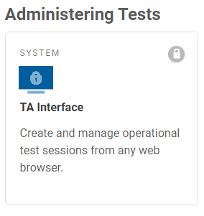
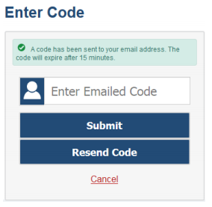
Assigning a Test in TA Interface
Note: OSASPortal.org has been reformatted with a new look and feel.
Will appear if logging in for first time or with cleared cache
Notes:
Test administration for interim assessments looks very similar to test administration for summative assessments.
By clicking on the Test Administration link on the OSAS Portal Interim Assessment webpage, the teacher will be prompted to log into the test administration or TA interface. Again, If it is your first time logging in (ever or for the year), you log into the TA interface from a new device, or you have cleared the cache on your computer, you may be asked to enter a code which will be sent to you via email. Under circumstances other than those we have just listed you should not be asked for a code and test selection window in the TA interface will appear.

Slide 24
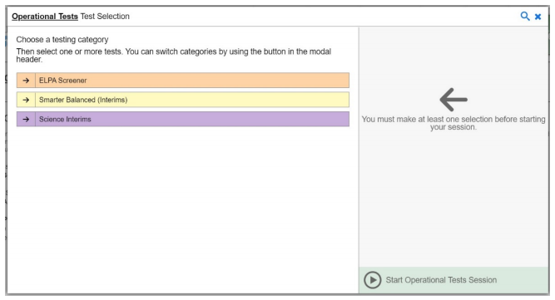
Test Selection Window
Notes:
Once you are logged into the TA Interface, you will be able to select an interim assessment from those available to you. Science Interim assessments are only available to districts who have purchased the science interim assessment bank.

Slide 25
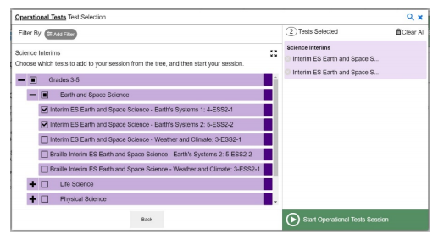
Test Selection Window
Notes:
To select a Science Interim Assessment, click on the Science Interims test category. This will display the grade band groups available for the Science Interim assessments.
To select a test, click on the plus sign to expand the grade band group and then the Science discipline test group. Select the test you want to administer. You may select more than one assessment to include in a test session.

Slide 26
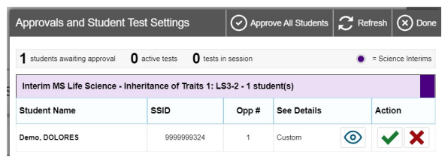
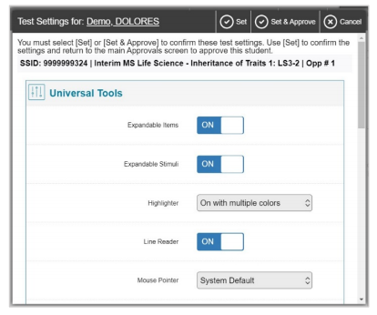
Review Test Settings
Notes:
Once you have started the test session and students have logged in, you must approve their test settings before they can access their tests. A list of students awaiting approval will display, organized by test name.
If you are administering multiple tests, it is very important that you pay close attention to the test name prior to approving to be sure that students have selected the appropriate test. If a student has selected an incorrect test, you must deny that student entry to the test session by clicking on the red x.
You should also ensure that all the settings the student should have are correct. You can review and confirm a student’s test settings and accommodations by clicking on the eye icon under the See Details section for that student. Verify that all test settings are correct before the test begins. If the test settings are not correct, please have the school test coordinator or district test coordinator update the student settings in TIDE before proceeding with the test.
To confirm the selected test settings and return to the list of students awaiting approval click set. To confirm the settings and approve the student for testing click set and approve. Once you click set and approve the student is permitted into the test session and no longer appears in the approvals and student test settings window.
If no changes are need to student test settings or test selections, click approve all students to admit all students to the session.

Slide 27
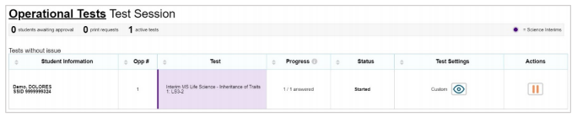
Monitoring a Test Session
Notes:
Once students have been approved for entry into the test session, you can monitor each student’s test progress in the Test Session table.
Please note that if there should be a need for a student to take the same test over again, that students may only take each test 1 time per day. They would have to wait at least until the next day before they could retake it.
More information about interim assessment administration, including secure and remote browser information will be provided in Interim Assessment Series Session 4: How to Administer Interim Assessments and can be found in the Quick Guide to Administering Science Interim Assessments and the Quick Guide to Administering Interim Assessments Remotely

Slide 28
How to Use the
Centralized Reporting System

Slide 29
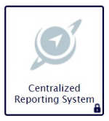
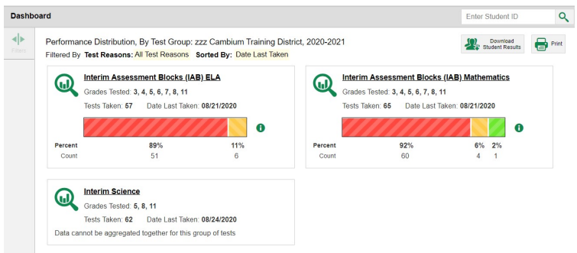
Centralized Reporting System
Notes:
Using the Centralized Reporting System on the OSASportal Interim Assessment page, teachers will be able to securely log in to see the Centralized Reporting System Dashboard. Within the dashboard, select interim science

Slide 30
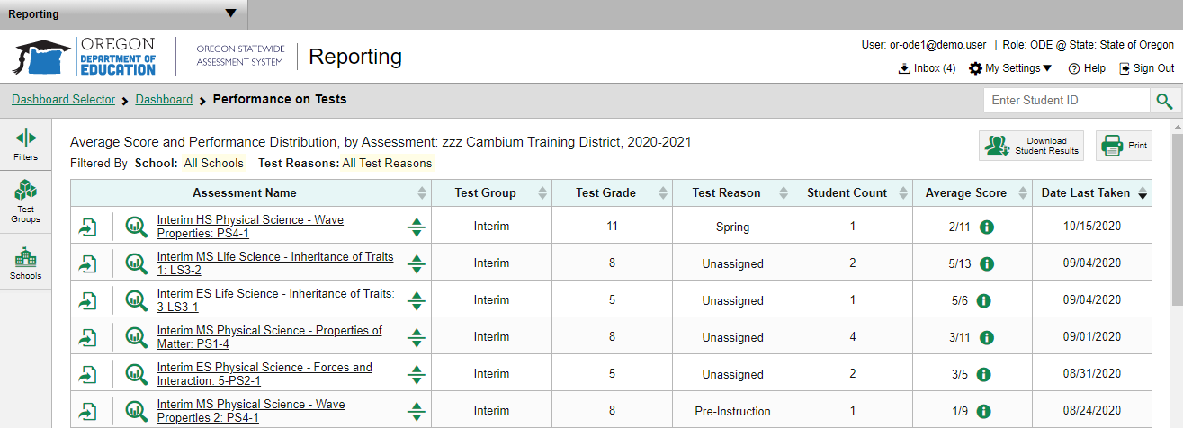
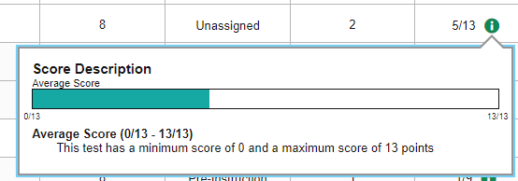
Centralized Reporting System
Notes:
On the Performance on Tests screen, educators will be able to select from a list of assessments they have given to see student performance. Teachers may use the buttons on the left hand side of the screen to filter and narrow the assessment data to populate.
Within the table educators can
-Export a report
-compare data with state and district level data
-see a score description for average score
Or look more closely at the test and data
Please note that science provides an average score rather than performance distribution. Science Interim items provide raw scores rather than scaled scores, therefore a performance distribution is not yet available.
Because no hand scoring is required for the Science Interim Assessments, results of the assessments will be available in real time in the Centralized Reporting System as soon as the student submits the test. Teachers can view scores for the students who were included in a test session that they proctored or for students that they are associated with by a roster. Raw scores for the item cluster/task are reported. It is possible that scale scores may be made available for interim science assessments at some point in the future.

Slide 31
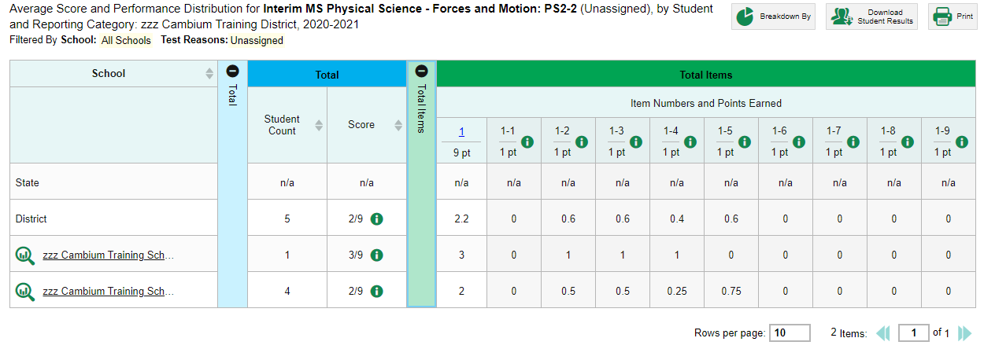
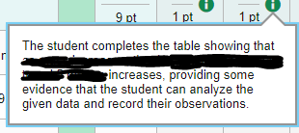
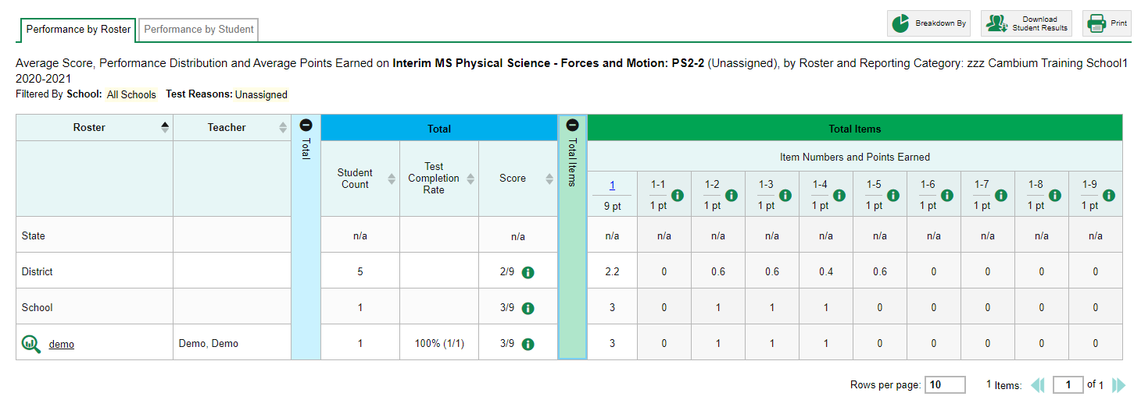
Performance on a Test
Notes:
In the District Performance on Test Screen educators can see data for state, district, and school level such as the number of students who took the test, the average score, the number of interactions on the test and average points earned for each interaction.
By clicking on their school name, they can drill down further to roster level data (please note that rosters must be set up in TIDE, otherwise all students will be grouped by school). Teachers can
In addition to raw scores, teachers are able to access the scoring rubrics for each item cluster/task to see how the item was scored. Teachers can view the scoring assertion for each student response and the outcome of the student response.
By clicking on the name of the roster or Performance by student, educators will drill down to student level data.

Slide 32
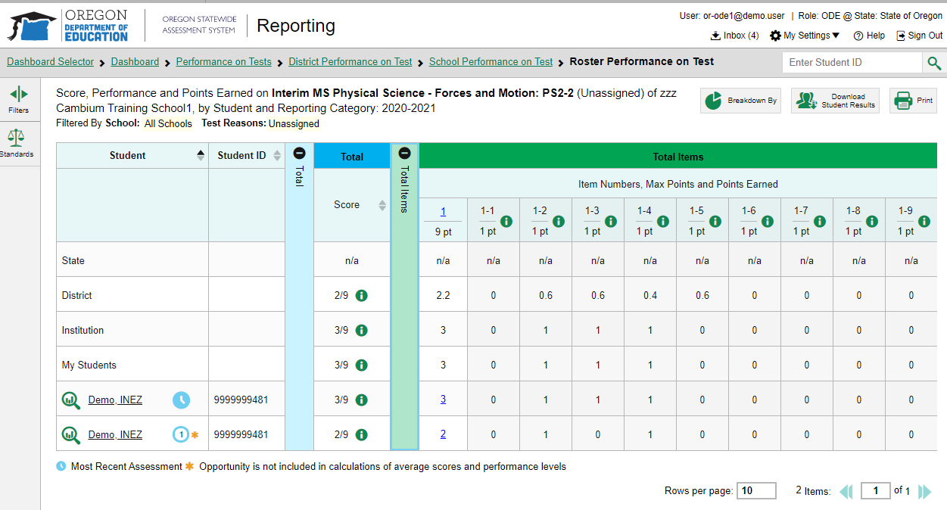
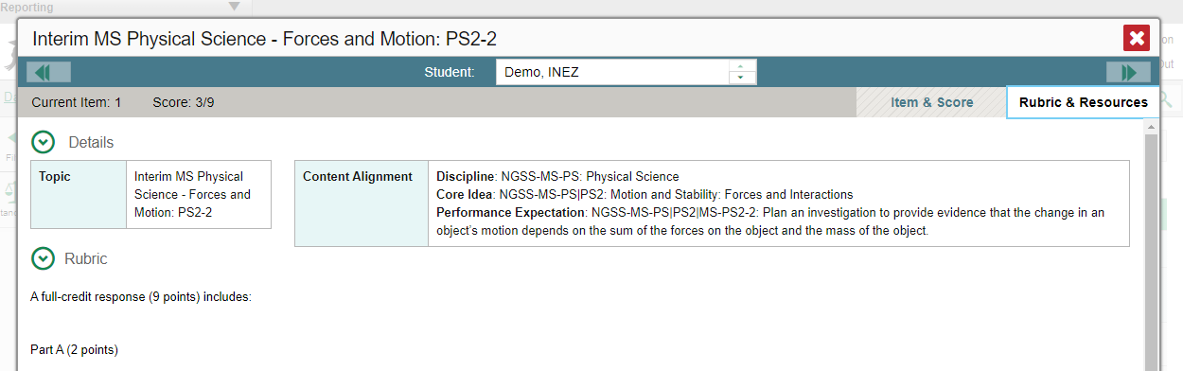
Student Interim Assessment Data
Notes:
Within each roster you will find individual student scores for this assessment. By clicking on the breakdown button, teachers can filter the list by student grade and/or race/ethnicity. Educators can download reports, including individual student reports. The downloaded reports will appear in the account inbox
We can see here that Inez has taken this assessment twice, the clock indicating with assessment is more recent. If we click on the number of points earned in the entire task, the item information will appear. Within the item and score tab an image of the interim assessment, the accompanying scoring assertions and Inez’s answers can be found. We’re not showing this information here, but we can show you the rubric and resources tab which provides educators with information about the standard being assessed and how points are earned.

Slide 33
How can this data inform science instruction for students?
Notes:
So now that you have the student data from the interim assessment, how can this inform your instruction?

Slide 34

Resources to Inform High Quality Instruction
Framework for K–12 Science Education
NGSS Evidence Statements
STEM Teaching Tools
Notes:
The Framework for K–12 Science Education establishes a vision of science for all students, with a goal of developing a scientifically literate society and preparing students with the skills, habits and understanding to be college, community, and career ready.
The NGSS Evidence Statements provide educators with additional detail on what students should know and be able to do at each level and each standard/performance expectations. These are statements of observable and measureable components that, if met, will satisfy NGSS performance expectations.
The STEM Teaching Tool site has targeted resources that help implement high quality instruction and the implementation of NGSS. Each tool focuses on a specific issue and leverages the best knowledge from the collaboration between practitioner and research.

Slide 35
Quality Examples of Lessons and Units
Oregon Open Learning Hub - OER Commons
Next Generation Science Storylines
Open Sci Ed
Next Gen Science
Going 3D with GRC
Notes:
The OOL Hub is a newly launched platform that hosts a collection of NGSS supported materials and can be searched by grade band and often specific standards
The NGSS Storylines, Open Sci Ed, NEXT Gen Sci and Going 3d with GRC are developed in collaboration with specific resources that provide specific examples of units/lessons that are sometimes stand alone or an integration of standards.

Slide 36
Professional Learning Resources
Tools for Ambitious Science Teaching
STEM Teaching Tools – PD
NGSS Video Hub
Notes:
Here are a few resources of professional learning that may help elevate your science instruction and provide some videos of difference approaches to implementing NGSS.

Slide 37
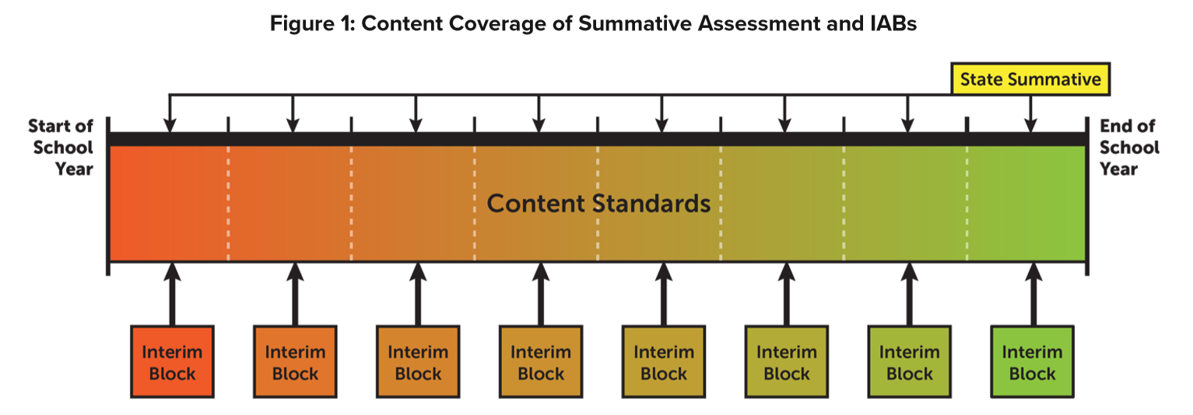
Using Interim Assessment Throughout the School Year
Notes:
Interim assessments should be used periodically throughout the school year as students engage with content standards. This interim assessment bank can be used in a formatively in a non-standardized way, or as a true interim benchmark assessment. Interim assessment helps students and teachers better understand state content standards and can help support students in their preparation toward college and career readiness.

Slide 38
Learning Goals
Describe how to use interim assessments instructionally
Describe the content and structure of Science Interims in the OSAS Interim Assessment System
Know how to use the Assessment Viewing Application, Test Administration Interface, and the Centralized Reporting System
Notes:
We just went through a lot of information very quickly and I want to revisit our learning goals.
What have you learned about the interim system? What are you still wondering?

Slide 39
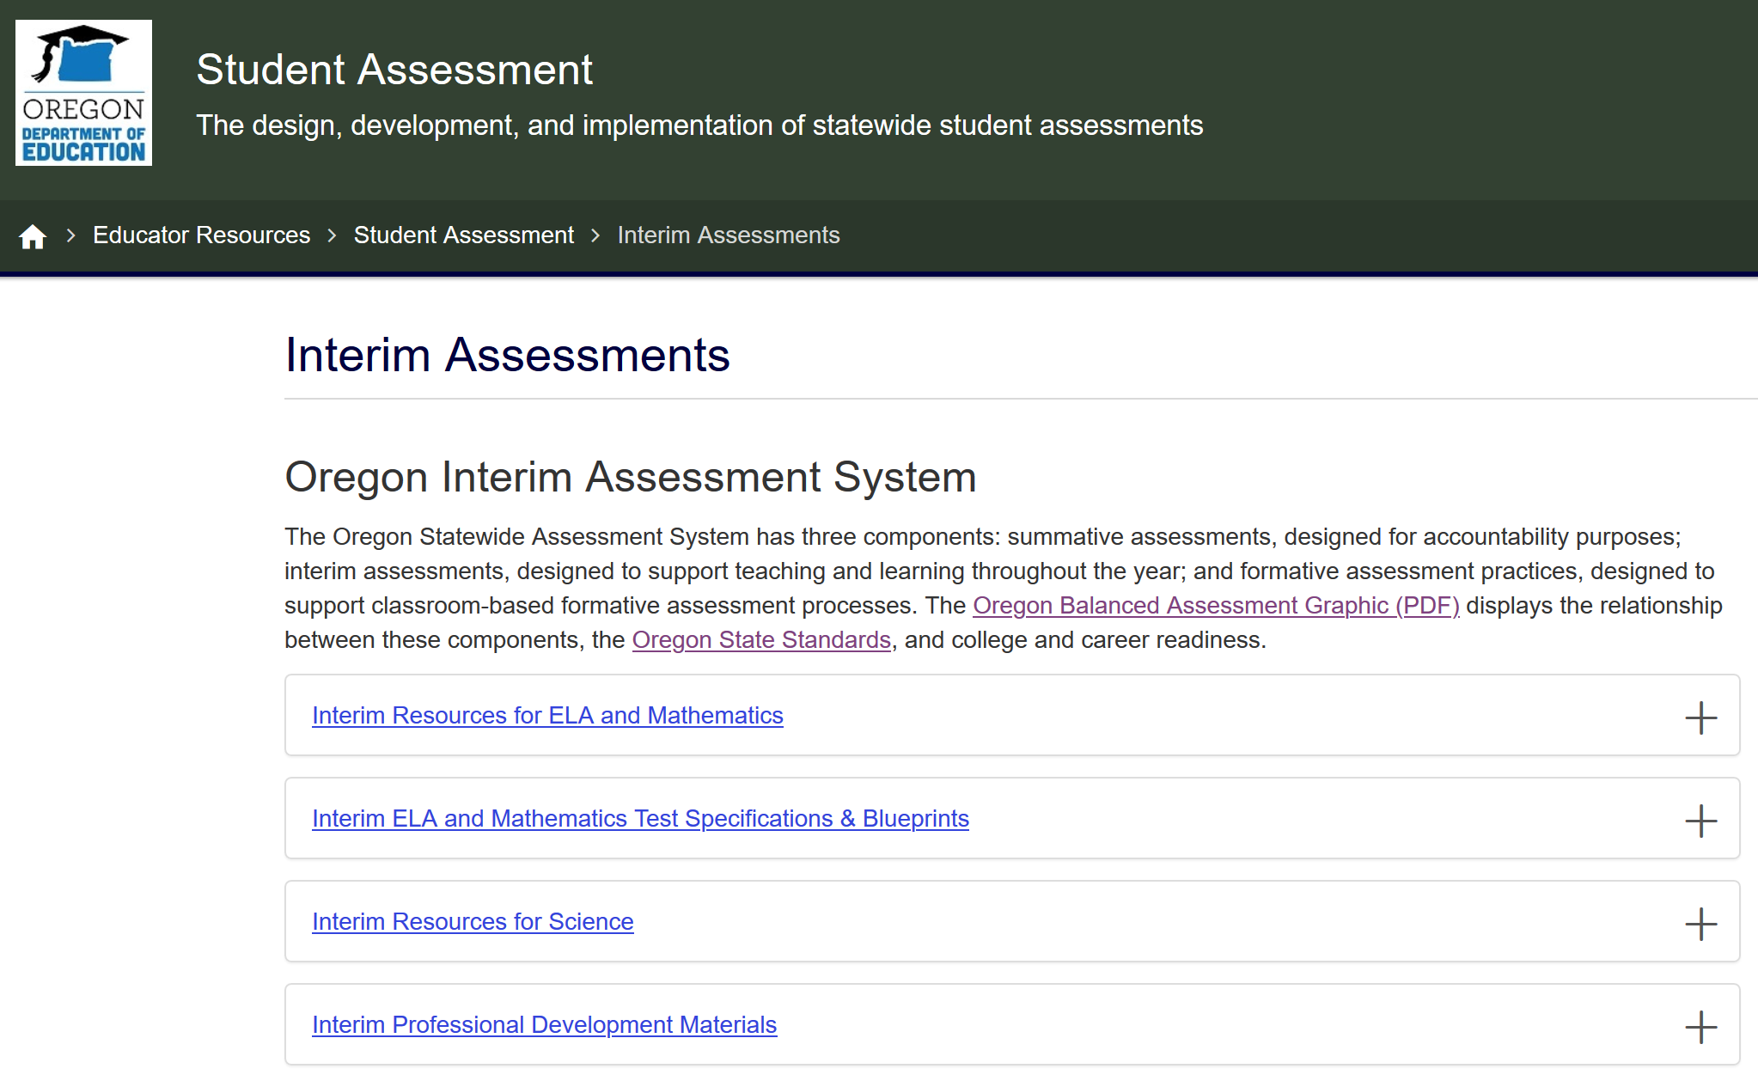
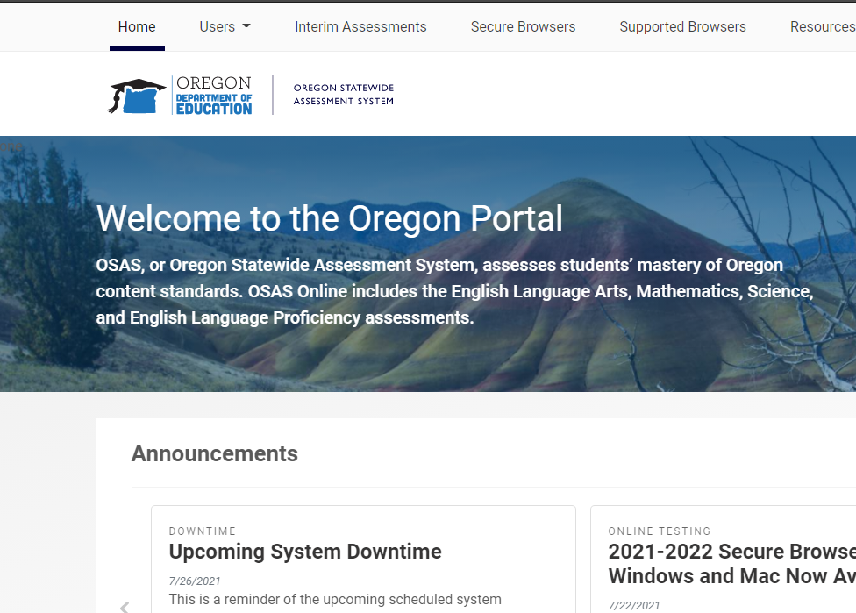
Interim Test Administration Resources
ODE Interim Assessment webpage
OSAS Portal
Note: OSASPortal.org has been reformatted with a new look and feel.
Notes:
For access to any of the interim assessment resources discussed in this session or past sessions, please navigate to ODE Interim Assessment webpage or the Resources section of the OSAS Portal webpage.

Slide 40

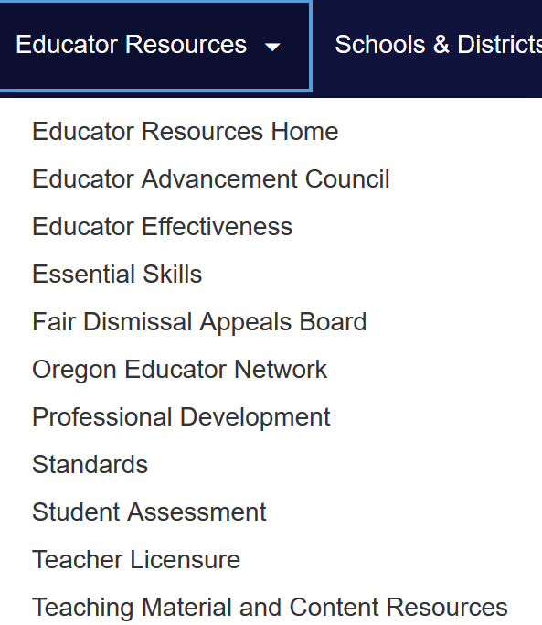
Contact Us!
Dan Farley: Director of Assessment
Noelle Gorbett: Science Assessment
Jamie Rumage: Science Education Specialist
www.oregon.gov/ode
Photo by Volodymyr Hryshchenko on Unsplash
Notes:
In addition to this slide deck and the resources we have provided today, please feel free to reach out to me and Jamie with any instructional or technical questions you have.
the ODE team is available to support districts and schools with general or content specific assessment questions.
To find additional contact information for other members of our team, please visit the ODE Assessment homepage and select the Assessment Contact button.

