Slide 1
Oregon Statewide Assessment System Session 4 – Interim Assessment Administration: Guidance and Support Office of Teaching, Learning, and Assessment
Notes:
Slide 1: Title Slide (Facilitator 1)
The Oregon Department of Education has developed an Oregon Statewide Assessment System professional learning series to further support district efforts in building a balanced assessment system and their implementation of the Oregon Statewide Interim Assessment System.
Welcome to Session 4 of the Oregon Assessment Professional Learning series. This is the fourth of six sessions in this webinar series, and will provide an overview of the Interim Assessment System- Test Administration and Assessment Viewing Application.
This presentation is available year-round on the Oregon Department of Education’s Interim Assessment webpage under the Interim Professional Development Materials expandable folder.
Resources:
ODE Interim Assessment webpage

Slide 2
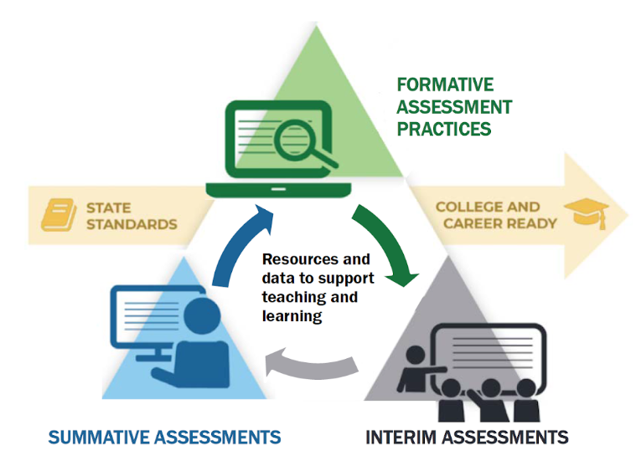
Purpose
The Oregon Statewide Assessment webinar series is designed to help teams of educators and administrators improve their teaching and learning systems using the tools and resources provided in a balanced assessment system.
Notes:
Slide 3: Purpose (Facilitator 1)
The purpose of this series is to help district and school-based teams improve their systems of teaching and learning using an approach inclusive to a balanced assessment system.
For the first time, ODE is able to provide a statewide interim assessment system aligned to both the Oregon State Standards and the Oregon Summative Assessment.

Slide 3
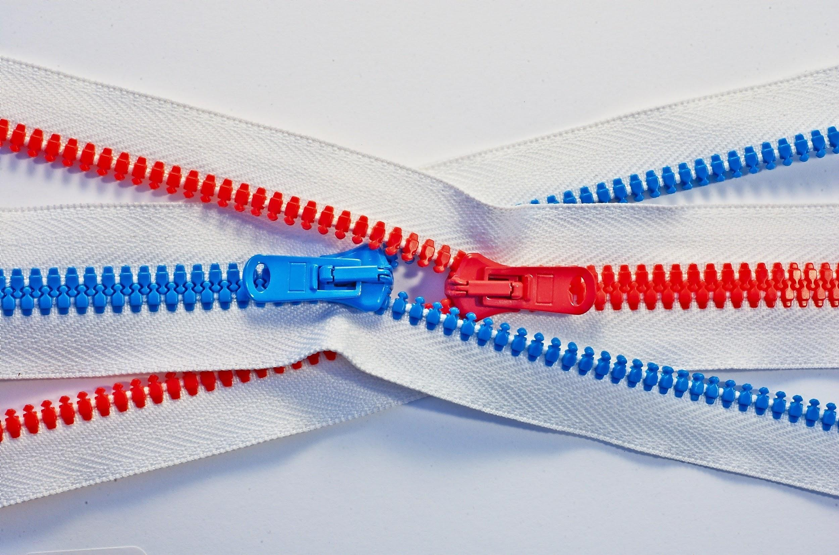
Series Outcome
Participants will build assessment literacy and improve practice by connecting formative assessment practices, interim assessments, and summative assessments to continually improve access and outcomes for each and every learner in their care.
Photo by Tomas Sobek on Unsplash
Notes:
Slide 4: Series Outcome (Facilitator 1)
Our goal is that all participants will build assessment literacy and connect formative assessment practices, Oregon’s Statewide Interim Assessment System, and the Oregon Statewide Summative Assessments to local assessment systems to continually improve access and outcomes for each and every learner in their classroom, school, and district.
Again this series will focus primarily on the new interim assessment system and other supporting resources connected to both formative assessment practices and the Oregon Summative Assessment.
Resources
Oregon Balanced Assessment Graphic (PDF)

Slide 4
Interim Assessment Series
Session Guide
1 | Understanding a Balanced Assessment System
2 | Overview of the OSAS Interim Assessment System
3 | Using Interim Assessments in the Context of Instructional Practices
4 | Interim Assessment Administration: Guidance and Support
5 | Accessing Interim Assessment Data to Inform Instructional Practices
6 | Exploring Tools for Teachers and Using Formative Assessment Practices
Notes:
Slide 5: Series and Session Overview (Facilitator 1)
Session 4 serves as a technical support for districts, schools and educators for the the administration and use of the interim assessments. Again this is just one of the six sessions.
The remaining sessions will cover how to access the interim assessment data in the Central Reporting System to inform instruction, and finally how the interim assessment system interacts with the instructional resources within Tools for Teachers and how the formative assessment process can be leveraged with these resources.
Educators can register for the other future webinar sessions by accessing the Interim Assessment Professional Learning Information flyer posted on ODE’s Interim Assessment webpage.
Resources:
Interim Assessment Series Flier (PDF)

Slide 5
Session Objectives
By the end of this session, educators will be able to:
Review the training requirements and test security required for administering the interim assessments.
Identify the resources available for both in-person and remote administration.
Navigate the OSAS Portal to identify, select, and administer the interim assessments.
Investigate how the Assessment Viewing Application can be used to better select the right interim assessment.
Notes:
Slide 6: Session Outcome (Facilitator 2)
By the end of the series, educators will be able to
[Click Animation]
Review the training requirements and test security required for administering the interim assessments.
[Click Animation]
Identify the resources available for both in-person and remote administration.
[Click Animation]
Navigate the OSAS Portal to identify, select, and administer the interim assessments.
[Click Animation]
Investigate how the Assessment Viewing Application can be used to better select the right interim assessment.
Resources:
ELA and Mathematics Interim Assessment Overview​
​​This document describes the interim assessments, including their purpose, use, and varieties.
Interim Administration Guide​ (Posted 08/31/20)
This Interim Assessment Guide for Administration is intended for staff who play a role in the administration of, and review of results for, the ELA and Mathematics interim assessments.
Quick Guide to Administering Interim Assessments Remotely​
This document describes how test administrators (TAs) can remotely administer the interim assessment and how students may accessand participate in an interim assessment.​
Science Interim Assessment Information Sheet​
This document provides Science Interim Assessment content details and purchase information.
Quick Guide to Administering Science Interim Assessments
This document provides information for administering the OSAS Science Interim Assessment including: Assessment Viewing Application, Secure Browser, TA Interface, and Centralized Reporting System.

Slide 6
Interim Assessment Training Requirements
Notes:
Slide 7: Interim Training Requirements (Facilitator 1)
Interim Assessment Training Requirements

Slide 7
Interim Training Requirements
DTCs or STCs will need to apply the “Interim” Test Group to each user that will administer the interim assessments. The decision to allow access to the Interim Assessment System is determined by the educators’ district.
Users will not be able to administer the interim assessments if the Test Group permission is not assigned to their TA user account.
Notes:
Slide 8: Interim Training Requirements (Facilitator 1)
ODE has made this system available to all Oregon educators, however, the decision to allow educators access to the interim assessments is determined by their district. Either their District Testing Coordinator or their local School Testing Coordinator must activate the interim assessment system for educators.
Users will not be able to administer the interim assessments if the Test Group permission is not assigned to their TA user account.
Resources:
Module 8 - Interims: Remote Administration and Test Security
Facilitation Guide​​​, Powe​rPoint and PowerPoint with Audio​ ​

Slide 8
Interim Training Requirements
Were you a Test Administrator in
2019-20?
Complete Module 8
DTC assigns “Interim” test group in TIDE
YES
Yes, but in a different district/state
NO
1. Reading requirements from Table 5 of Oregon’s
Test Administration Manual (TAM)
2. Complete Modules 2, 3, and 4 as posted to the
Assessment Training Materials webpage
Notes:
Slide 9: Interim Training Requirements (Facilitator 1)
ODE has worked to reduce the work of our district testing coordinators, and this year we have implemented a roll-over process where educators from last year have already been populated in the OSAS Portal TIDE Account and will automatically have access to the Tools for Teachers resources, which launch on September 20, 2020.
Therefore, [Click Animation] if you were an educators who completed the 2019-20 TA requirements, you would only need to provide evidence they have completed Module 8 - Interim Assessment Remote Administration and Test Security in order for the Interim Assessment test group to be assigned.
However, [Click Animation] if an educator did not have a TA user account from the 2019-20 instructional year or if the educator has transitioned to a new district which is different from last year.
[Click Animation] They must complete the reading requirements in Table 5 of the Test Administration Manual and also complete training modules 2, 3, and 4.
Once these requirements had been fulfilled [Click Animation] the final step would be completing Module 8 to have the interim assessment test group assigned.
Note These training modules have already been updated for the 2020 -21 instructional year, and have been beed posted to the ODE Training web page.
Resources:
Module 8 - Interims: Remote Administration and Test Security
Facilitation Guide​​​, Powe​rPoint and PowerPoint with Audio​ ​
Assessment Training Materials

Slide 9
Remote Administration Features and Interim Assessment Test Security
Remote administration option for ELA, Mathematics, and Science
Notes:
Slide 10: Remote Administration Features and Interim Assessment Test Security (Facilitator 1)
Remote Administration Features and Interim Assessment Test Security

Slide 10
Standardized vs. Non-Standardized Interim Assessment Administration
Standardized Administration (Inside the OSAS Portal)
Individual & independent Single administration allows for a reliable “point-in-time” spot check of student knowledge Following summative policies and procedures, such as a secure test environment (e.g., no cell phones, guiding resources, etc.) Student data available immediately
Non-Standardized Administration (Outside the OSAS Portal)
Non-secure, non-public Use within the arc of instruction Collaborative tasks Guided & independent practice Students use resources to help them answer questions Must be scored, analyzed, and interpreted
Notes:
Slide 11: Remote Administration Features and Interim Assessment Test Security (Facilitator 1)
As a reminder the Interim Assessment provide additional flexibility that allows educators to administer the Interim Assessments in both a standardized, on-demand format similar to the summative assessment, or in a non-standardized administration allowing for flexibility of use during instruction.
In a standardized approach students use the interims independently within the OSAS Portal and scores are available immediately. Note interims assessments that have hand-scoring items will not be available until hand-scoring items have been entered into the Central Reporting System, which is covered in Session 5.
[Click Animation]
In non-standardized administration interim assessments can be used as part of the instructional process, students can discuss and collaborate, educators can provide student support. However, interim assessments and items must be scored, analyzed, and interpreted at the local level by the educator.
Educators should discuss and plan the best use of the interims assessments within the local context of instruction. Please refer to information from the Session 3 presentations which focused on examples using the interim assessments in the different content areas of ELA, Math, and Science.
Resources:
Smarter Balanced Remote Teaching and Learning
https://remote.smartertoolsforteachers.org/

Slide 11
How Test Administrators Administer Interim Assessments Remotely
How Test Administrators Administer
Interim Assessments Remotely
Remotely During the 2020 – 21 instructional year, teachers may administer, and students may take, interim assessments under the following conditions:
An authorized employee (e.g., teacher, test administrator) in a district administers the test consistent with the district or school policies for in-person interim assessment administration.
The test administrator monitors the test activity such that tests are open only for the minimum amount of time necessary for students to complete and submit their responses.
The test administrator uses established test administration practices to support students accessing the interim assessments; this may be a phone call or chat with a parent in advance of starting the test.
Remotely During the 2020 – 21 instructional year, teachers may administer, and students may take, interim assessments under the following conditions:
An authorized employee (e.g., teacher, test administrator) in a district administers the test consistent with the district or school policies for in-person interim assessment administration. | The test administrator maintains student data privacy with student SSID and other personally identifiable information (PII), which are required to take an interim. Do not send PII over email, chat or text, or other non-secure transmission methods. Please refer to local policies regarding communicating PII.
The test administrator monitors the test activity such that tests are open only for the minimum amount of time necessary for students to complete and submit their responses.
The test administrator uses established test administration practices to support students accessing the interim assessments; this may be a phone call or chat with a parent in advance of starting the test. | The test administrator follows state and local policies regarding test security and immediately escalates to the test coordinator any suspected item security issue (e.g. posting on social media).
Notes:
Slide 12: Remote Administration and Test Security (Facilitator 1)
In order to administer the interim assessments in a remote setting educators meet the following conditions.
The interims must be administer by an authorized employee who has completed the required trainings.
The TA must monitor test activity and student access to limit the amount of time any test is open in a remote setting.
Provide information to parents and students on administration practices to support students’ access and use of the interim assessment tool.
[Click Animation]
Educators must follow FERPA guidelines including a student’s SSID or other personally identifiable information
Provide a secure method for students to gain access to the SSID numbers required to log into the interim assessment system.
If the TA suspects an item has been shared on social media, they should immediately contact their district testing coordinator to report the issue to ODE.

Slide 12
Similarities in the assessment process between remote and in-person instruction
Know the purpose for administering the interim assessment
Choose which interim assessment will provide the best information
Match the conditions with the purpose:
student’s environment
accessibility resources,
timing based on when instruction was provided.
Use the results to inform next steps in instruction.
Do not post the test items on the internet or a public page
Do not email interim test items
Do not email or text students’ personal or confidential information – even to parents. Use a secure method provided by your district.
Notes:
Slide 13: In-person vs. remote administration (Facilitator 1)
Additionally Test Administrators should follow the following guidance when administering interim assessments whether in person or in a remote setting.
[Click Animation]
Know the purpose for administering the interim assessments, choose the interim assessment that will provide the best information, provide necessary supports and considerations in order for students to demonstrate their knowledge and skills, use information to guide next steps or additional support within instruction.
[Click Animation]
The following provide examples of what should not be done within the context of interim assessment administration.
Do not post items on the internet or on any public page. Do not email interim assessment test items, do not email or text personal or confidential information as previously discussed on the previous slide. This includes directly to parents. Please use a secure method as outlined by your district.
Please note use within your online teaching platform is considered acceptable use. Similar to ODE’s approach if a presentation is being recorded or posted on a public facing website, interim items should not be displayed as part of the presentation.
Resources:
Smarter Balanced Remote Teaching and Learning
https://remote.smartertoolsforteachers.org/

Slide 13
In-person and Remote Administration for Students
Using the OSAS Portal
Notes:
Slide 14: In-person and Remote Administration for Students (Facilitator 1)
In-person and Remote Administration for Students – Using the OSAS Portal
Resources:
Quick Guide to Administering Interim Assessments Remotely​
This document describes how test administrators (TAs) can remotely administer the interim assessment and how students may accessand participate in an interim assessment.​

Slide 14
Student Access to the Interim Assessments
In-person use is one option for using either interim assessment items or interim assessments blocks including the ICAs.
However, students can also participate using the Remote Interim Assessment Testing Site.
The Remote Interim Assessment Testing Site is available on the OSAS Portal
Notes:
Slide 15: Student Access to the Interim Assessments (Facilitator 2)
In-person use is one option for using either interim assessment items or interim assessments blocks including the ICAs.
[Click Animation]
However, students can also participate using the Remote Interim Assessment Testing Site.
[Click Animation]
The Remote Interim Assessment Testing Site is available on the OSAS Portal
Whether In-person or remotely, students will need to access the OSAS Portal
Resources:
Student and Families OSAS Portal

Slide 15
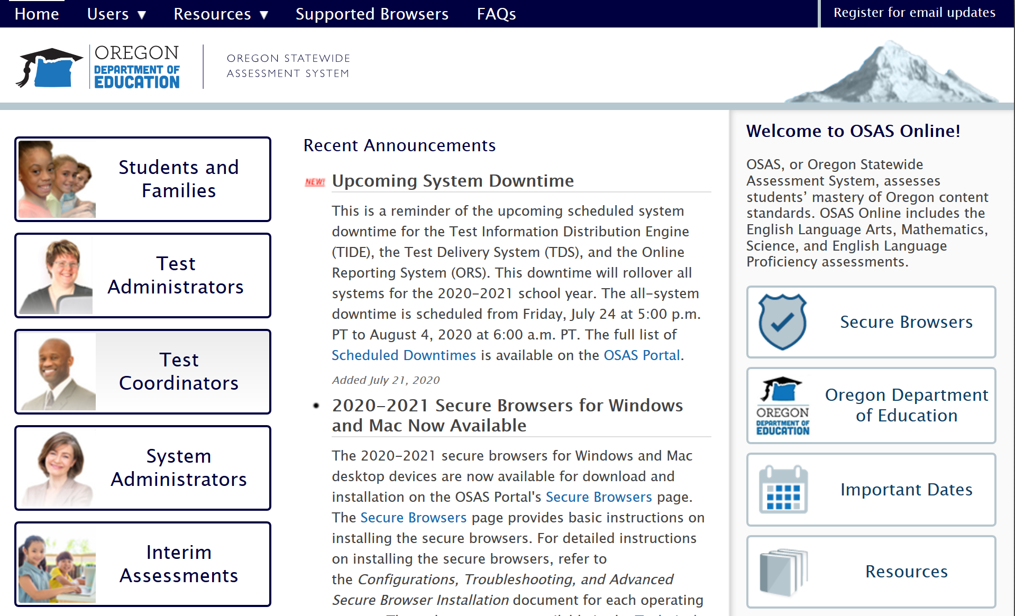


Student Access to the Interim Assessment System for In-person
Notes:
Slide 16: Remote Administration for In-Person Use (Facilitator 1)
In this first example of In-Person administration, a district, school, or educator could have students access the interim assessment system through the same secure browser used for the summative assessments.
Following the same steps as accessing the summative assessments, a district, school, or the individual responsible for site based technology would navigate to the [Click Animation] Secure Browser tile.
The individual would be prompted to [Click Animation] download the Secure Browser to the desired device.
Once the browser has been downloaded [Click Animation] the Secure Browser icon would be used to access the testing platform for the interim assessments.
Again this is the same process used for the summative assessment in year’s past.

Slide 16
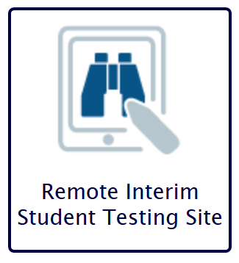
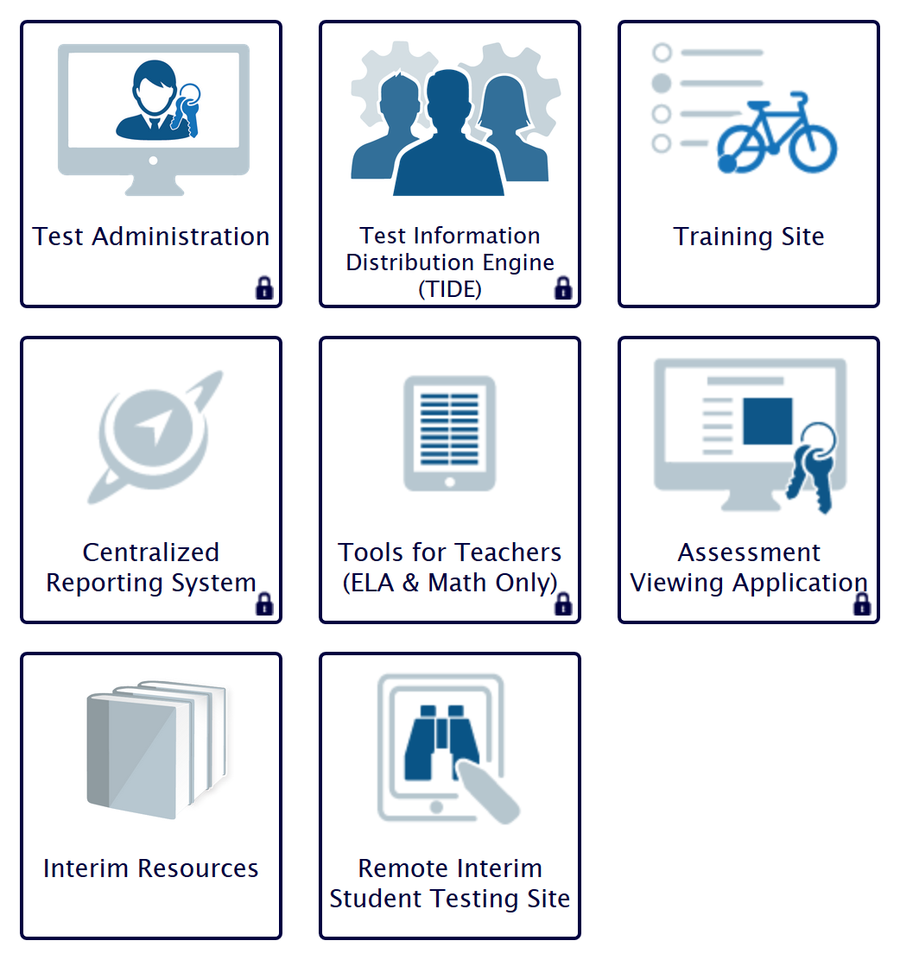
Student Access to the Interim Assessment System for Remote Use
Notes:
Slide 17: Remote Administration for Remote Use (Facilitator 1)
There are two options for students to access the interim assessments via the Remote Interim Assessment Testing Site. Additionally, if districts or schools have not yet downloaded the secure browser, this option is available all year for the 2020 – 21 academic year. This applies ONLY to the interim assessments.
The primary way students will access the remote testing site is through the [Click Animation] Student and Families button. They will be taken to the Student and Families web page and will [Click Animation] select the Remote Interim Assessment Testing Site icon-tile.
If a student should click on [Click Animation] the Interim Assessments button by accident. The following [Click Animation] [Click Animation] following buttons will appear, and the student would [Click Animation] still be able to select the Remote Interim Assessment Testing Site icon-tile.

Slide 17
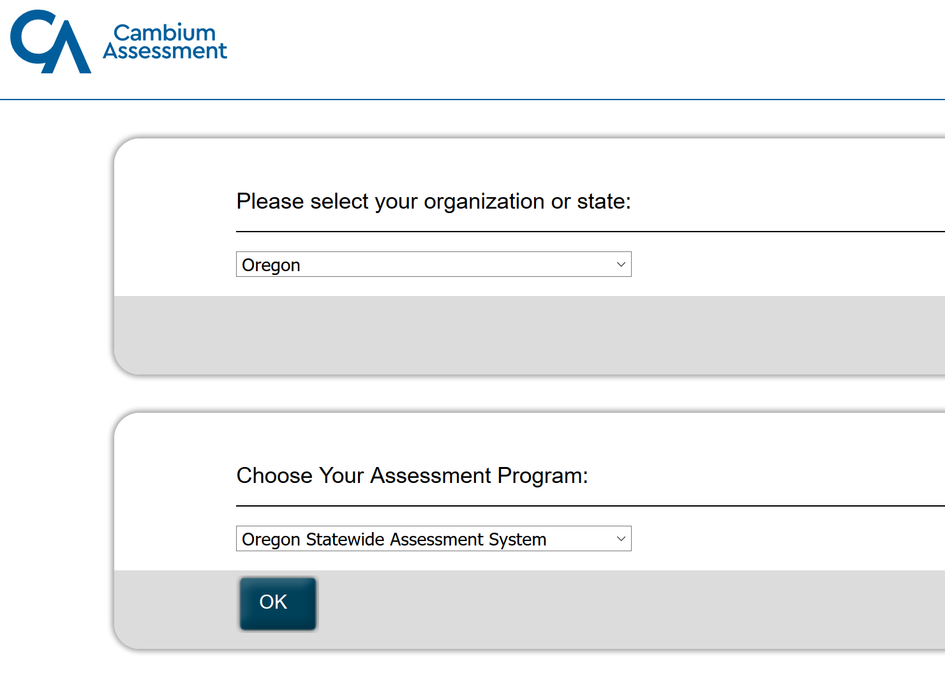
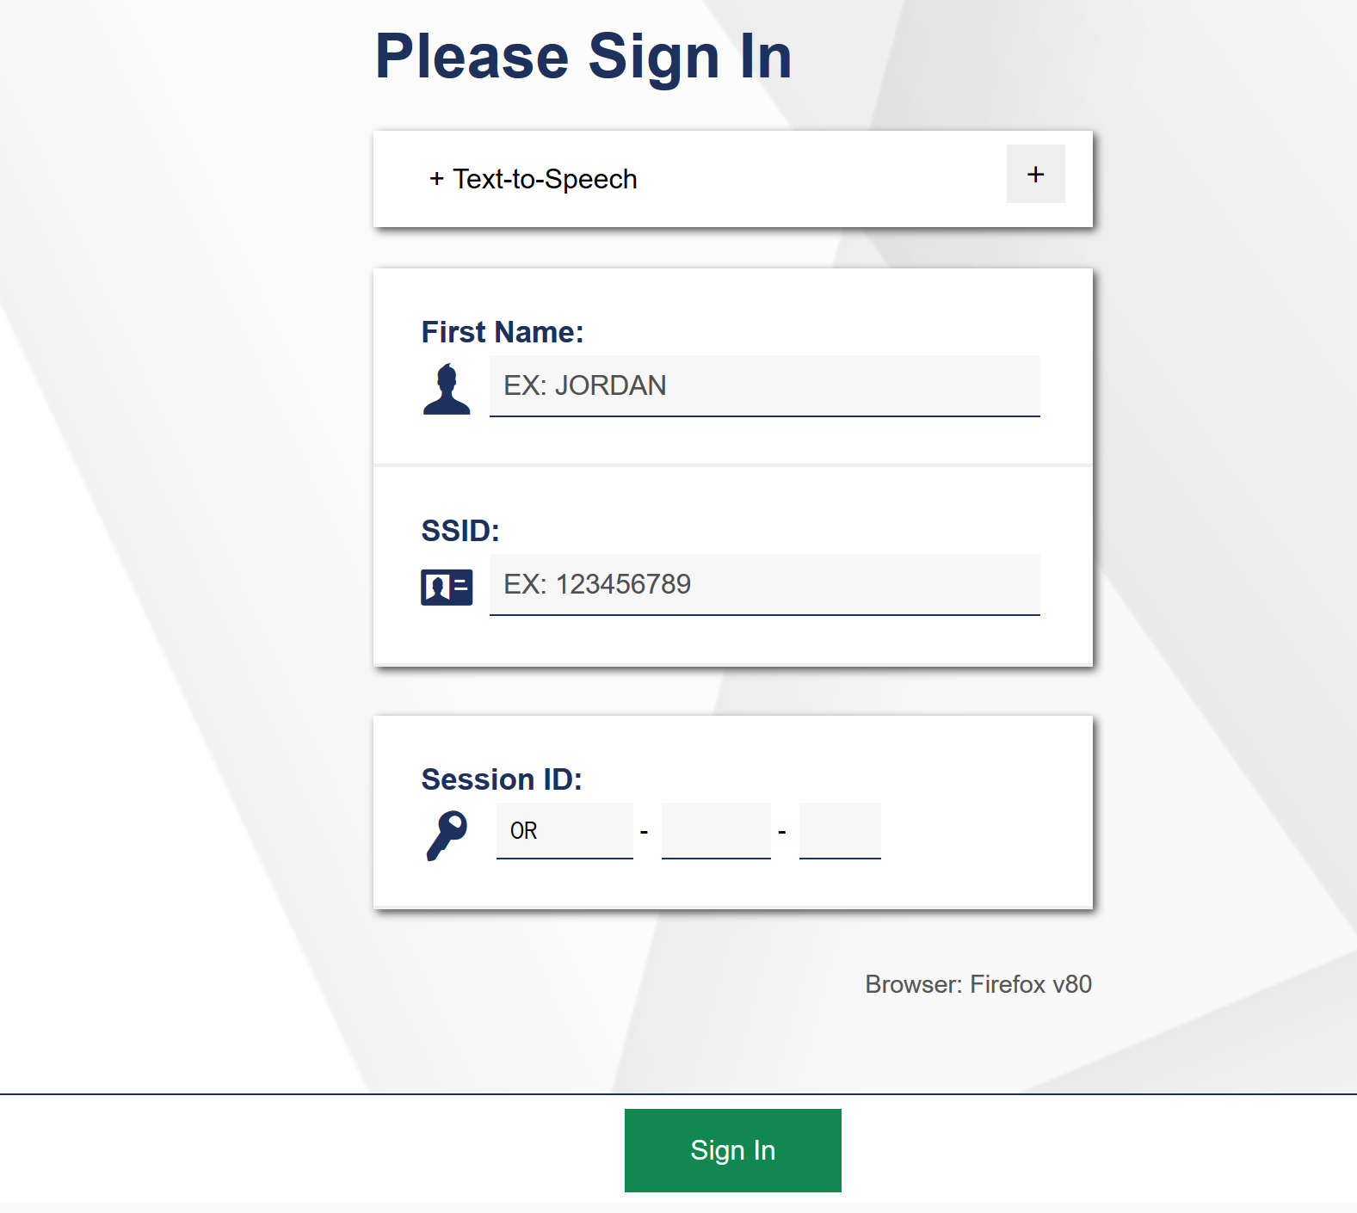
Using the Remote Interim Student Testing Site
Notes:
Slide 18: Remote Interim Student Testing Site (Facilitator 1)
The Remote Interim Assessment Testing Site icon-tile will take students to the Remote Student Sign on website. This site functions and is similar to the one used for the summative assessments.
Therefore students will sign in using the same process as they would for the summative. In addition to students entering their official first name.
[Click Animation]
Student will need to either know or have access to their SSID number. As a reminder educators should follow the guidance provided by their local districts for communicating personally identifiable information.
[Click Animation]
Additionally, educators will need to have an interim session ID to share with students. The Session ID can be shared with students via chat or email. Please note if no students log into the Session ID number within the first 15 minutes the system will automatically end the session.
[Click Animation]
Once all the information has been entered students will use the Sign-In button.
.

Slide 18
How Educators Administer the Interim Assessments for Students
Using the OSAS Portal
Notes:
Slide 19: How Educators Administer the Interim Assessments (Facilitator 1)
How Educators Administer the Interim Assessments – Using the OSAS Portal
Resources:
Quick Guide to Administering Interim Assessments Remotely​
This document describes how test administrators (TAs) can remotely administer the interim assessment and how students may accessand participate in an interim assessment.​

Slide 19
Administration of Interim Assessments
Notes:
Slide 20: Administration of the Interim (Facilitator 1)
The process of administering the Interim Assessment via the OSAS Portal is the same as the summative assessment. This applies to both an in-person or remote administration.
As previously stated students can access a remote interim assessment site by navigating to the Students and Families Button and selecting the (animation) Remote Interim Student Testing System.
Educators will navigate to the [Click Animation] Interim Assessments button. This will take educators to a new screen [Click Animation] where all of the tile options are available.
Educators will [Click Animation] [Click Animation] select the Test Administration tile to access the available interim assessments.
using their TA login credentials. For specific information on navigating the TA portal, please refer to training Module 2.
Once logged into the system educators will select the (animation) Interim Assessment the wish to assign for student access.
As shown a teacher can choose the content area they would like to administer, they can further select (animation) the grade level they would like to access and again the Interim Assessment System allows for flexible administration both in and out of grade level.
Finally the educators can select the (animation) type of interim assessment, whether a IAB, ICA, or FIAB and the (animation) instructional content of the selected interim type.

Slide 20
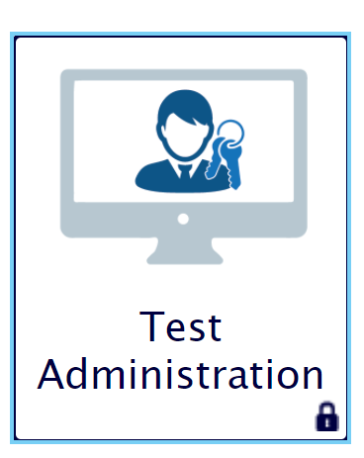
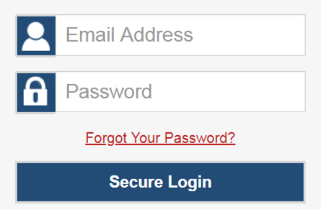
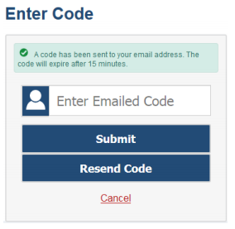
Assigning an Interim Assessment Test in Interim TA Interface
Will appear if logging in for first time or with cleared cache
Notes:
Slide 21: Accessing the Interim Assessments (Facilitator 1)
By clicking on the [Click Animation] Test Administration link on the OSAS Portal Interim Assessment webpage, [Click Animation] the teacher will be prompted to log into the test administration or TA interface.
Note, If it is your first time logging in (ever or for the year), you log into the TA interface from a new device, or you have cleared the cache on your computer, [Click Animation] you may be asked to enter a code which will be sent to you via email. Under circumstances other than those we have just listed you should not be asked for a code and test selection window in the TA interface will appear.

Slide 21
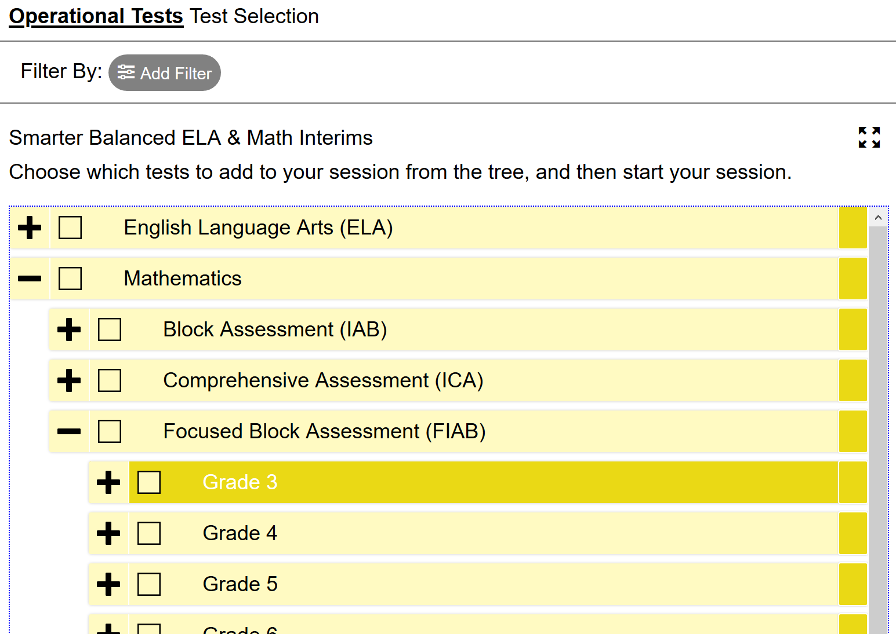
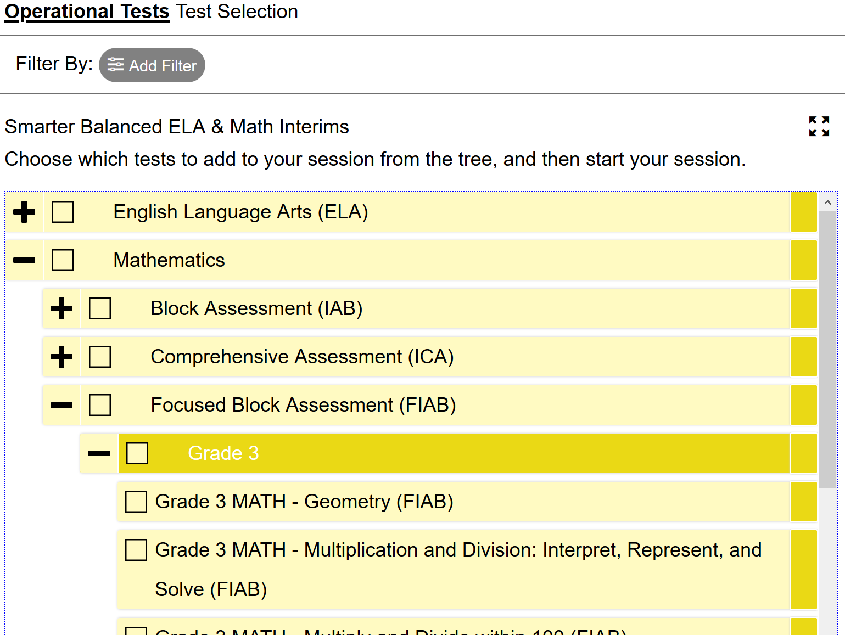
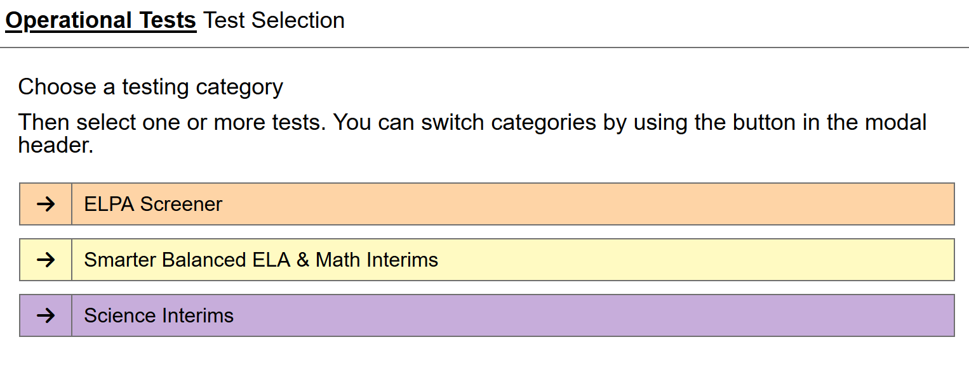
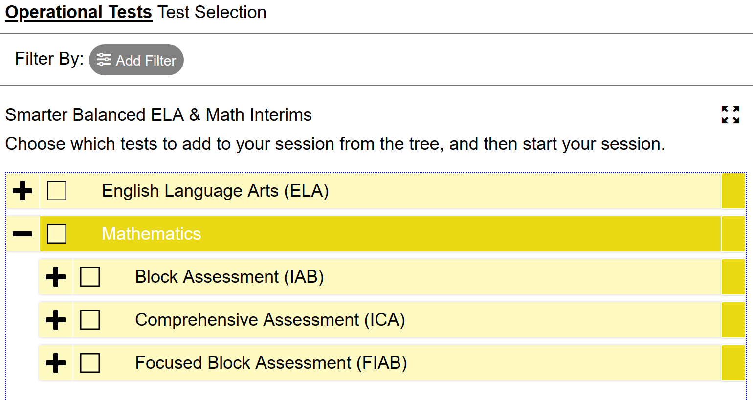
Selecting the Right Interim Assessment
Notes:
Slide 22: Selecting Interim Assessments (Facilitator 1)
Once logged into the system educators will select the [Click Animation] Interim Assessment the wish to assign for student access. This can either be the ELA and Mathematics Interim Assessments, or the Science Interim Assessments for purchasing districts
[Click Animation] In this example we have selected the Mathematics Interim Assessments and now the educator has the Option of selecting which type of interim assessment they would like IAB, ICA, or Focused IAB.
[Click Animation] By selecting the interim type, such as the Focused IAB in this example, they can further select the grade level they would like to access and choose from. As a reminder, the Interim Assessment System allows for flexible administration both in and out of grade level.
[Click Animation] Finally within the grade level the educator can select the appropriate interim assessment by the desired instructional concepts or standards.

Slide 22
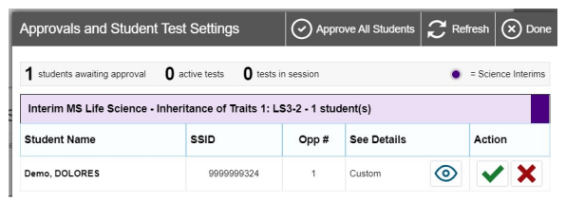
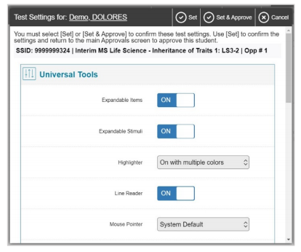
Approving the Interim Assessment and Reviewing Test Settings
Use the Check Box to Approve Students
Notes:
Slide 23: Approving and Review Test Settings (Facilitator 1)
Once you have started the test session and students have logged in, you must approve their test settings before they can access their tests. A list of students awaiting approval will display, organized by test name. [Click Animation]
If you are administering multiple tests, it is very important that you pay close attention to the test name prior to approving to be sure that students have selected the appropriate test. If a student has selected an incorrect test, you must deny that student entry to the test session by clicking on the red x.
[Click Animation] You should also ensure that all the settings the student should have are correct. You can review and confirm a student’s test settings and accommodations [Click Animation] by clicking on the eye icon under the See Details section for that student.
[Click Animation] Educators can verify that all test settings are correct before the test begins. If the test settings are not correct, please update the student settings in TIDE before proceeding with the test. In some cases this may require additional support from a school test coordinator or district test coordinator.
To confirm the selected test settings and return to the list of students awaiting approval click set.
However, to confirm the settings and approve the student for testing click set and approve. Both appear at the top of the test setting pop-up.
Once you click set and approve the student is permitted into the test session and no longer appears in the approvals and student test settings window.
If no changes are need to student test settings or test selections, the educator can choose to click approve all students to admit all students to the interim assessment session.

Slide 23
Previewing Interim Assessments or Interim Assessment Items
Using the Assessment Viewing Application (AVA)
Notes:
Slide 19: Previewing Interim Assessments or Interim Assessment Items (Facilitator 3)
Previewing Interim Assessments or Interim Assessment Items– Using the Using the Assessment Viewing Application (AVA)
Resources:
Assessment Viewing Application (AVA) Training Module [pptx]

Slide 24
Previewing Interim Assessments and Items
Notes:
Slide 25: Administration of the Interim (Facilitator 3)
As previously stated by navigating to [Click Animation] the interim assessment button educators can access numerous resources within the OSAS portal. [Click Animation]
One feature available for educators is [Click Animation] the Assessment Viewing Application, which allows educators to preview items included in the different types of interim assessments available for use.
As reminder from the test security guidance, educators can use this function as part of their non-standardized use to enhance classroom instructional practices.

Slide 25
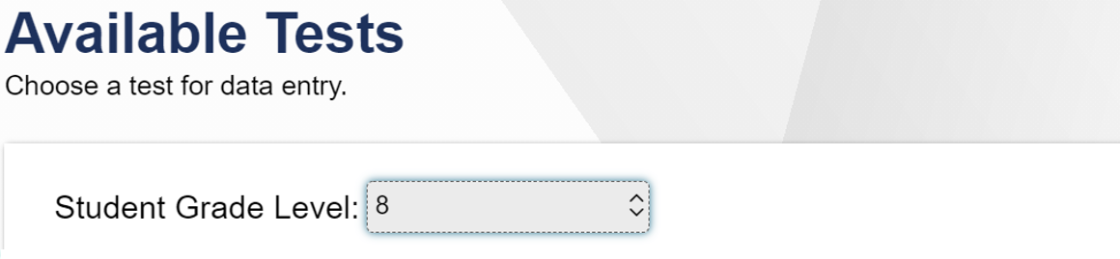
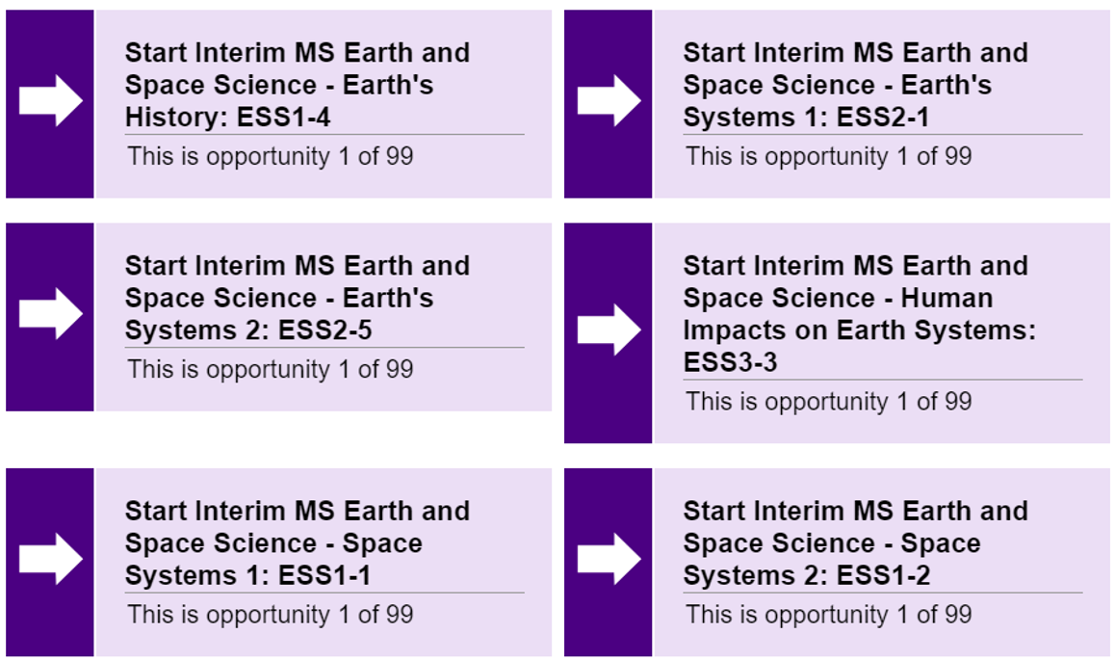
Previewing Science Interim Assessments and Interim Assessment Items
Notes:
Slide 26: Previewing Items selected by Oregon Science Standard (NGSS) (Facilitator 3)
In this slide we have provided a Science Interim Assessment example.
After logging in to the Assessment Viewing Application you will see the Available Tests Screen. All available science interim tests will be listed on the screen by standard. By clicking on the name of the test you will be able to see the contents of the item.
Remember that the Oregon Science standards are 3-dimensional. By referring to the text of the Oregon Science Standards found on the Oregon Department of Education standards page or on the NGSS website, teachers can identify the specific dimensions found within the standard.
By clicking on the test that you want, you will be able to see and interact with the item the same way the student would.
Resources:
ODE Science Standards webpage:
https://www.oregon.gov/ode/educator-resources/standards/science/Pages/Science-Standards.aspx
NGSS Evidence Statements:
https://www.nextgenscience.org/evidence-statements

Slide 26
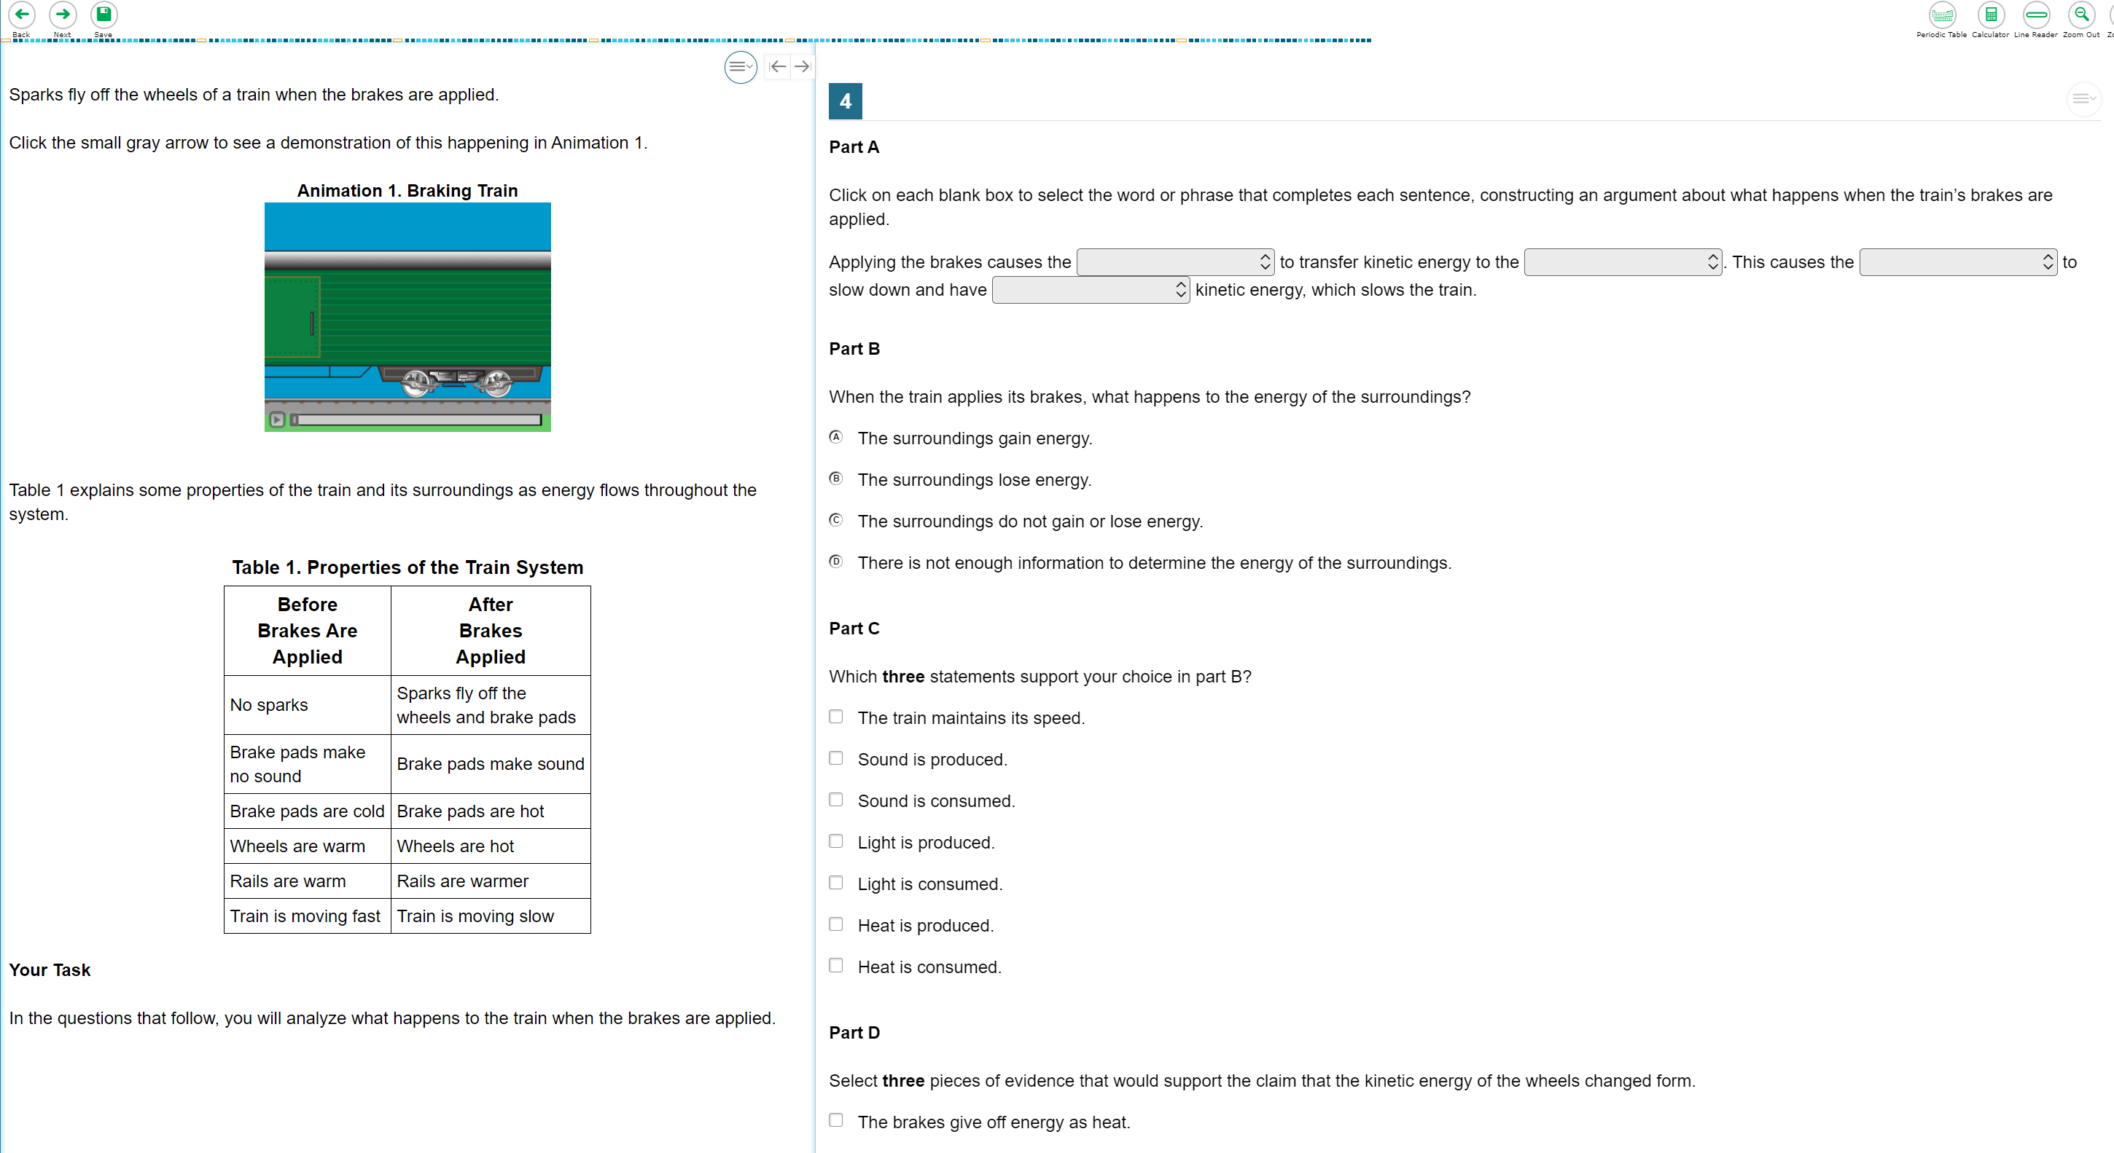
Science Interim Test Item Example
Notes:
Slide 27: Science Interim Assessment Item Example (Facilitator 3)
Each test in the Science Interim bank contains a task item. The tasks were developed with the same specifications as the cluster/task items developed for the OSAS Science Assessment. Unlike the state-wide summative assessment, there are no independent/stand-alone items in the science interim assessment bank.
The tasks in the science interim bank are comprised of a stimulus section on the left and a scored student interaction section on the right. In the stimulus, students are presented with a phenomena, background information, and a task statement. The student interactions assess the combined disciplinary core ideas, science and engineering practices and cross-cutting concepts. You will notice that the tasks are somewhat scaffolded and contain the same interaction types as the state-wide summative OSAS Science Assessment.
As we stated previously, you will notice that the interim assessment tests contain the same accessibility features that are present in the state-wide summative OSAS Science Assessment. Students should consistently use the same accessibility supports throughout instruction and assessment.

Slide 27
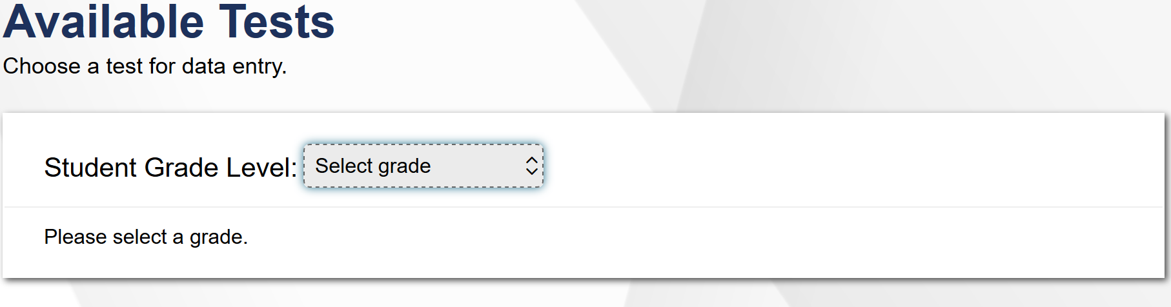
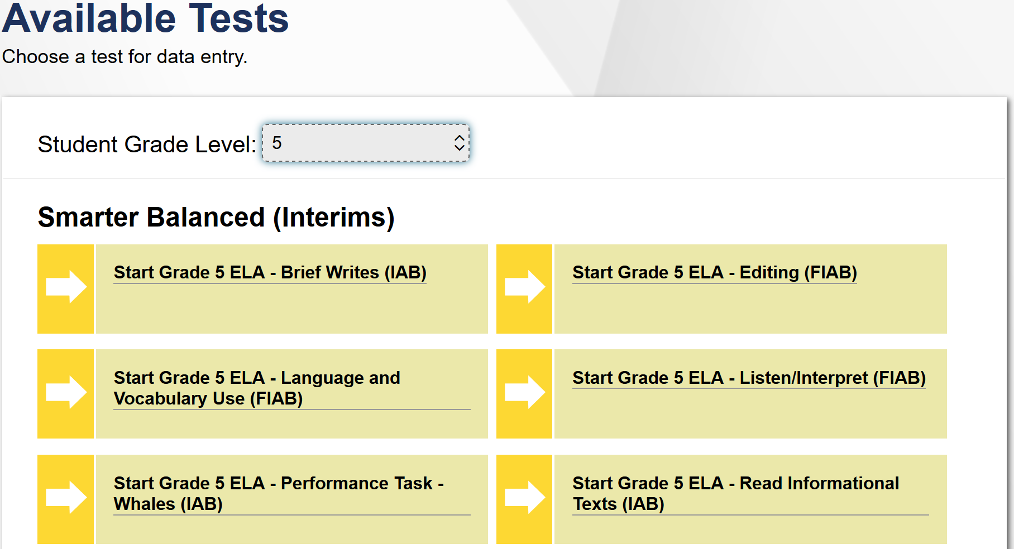
Previewing ELA Interim Assessments and Interim Assessment Items
Notes:
Slide 27: Previewing ELA Interim Assessments and Interim Assessment Items (Facilitator 3)
In this ELA example, we have selected the grade 5 ELA Interim Assessments.
After logging in to the Assessment Viewing Application you will see the Available Tests Screen. All available ELA interim tests will be listed on the screen by their assessment targets.
Again the ELA and Mathematics Interim Assessment are organized by assessment targets, therefore we recommend revisiting the Session 3 ELA and Mathematics materials to support educators in making the connections between assessment targets and standards.
Additionally the ELA and Mathematics Interim Assessment will have either [Click Animation] the interim type such IAB, [Click Animation] or Focused IAB in the title. This also applies to the ICAs not shown in the image.
Similar to the Science example, by clicking on the name of the test you will be able to see the contents of the item.

Slide 28
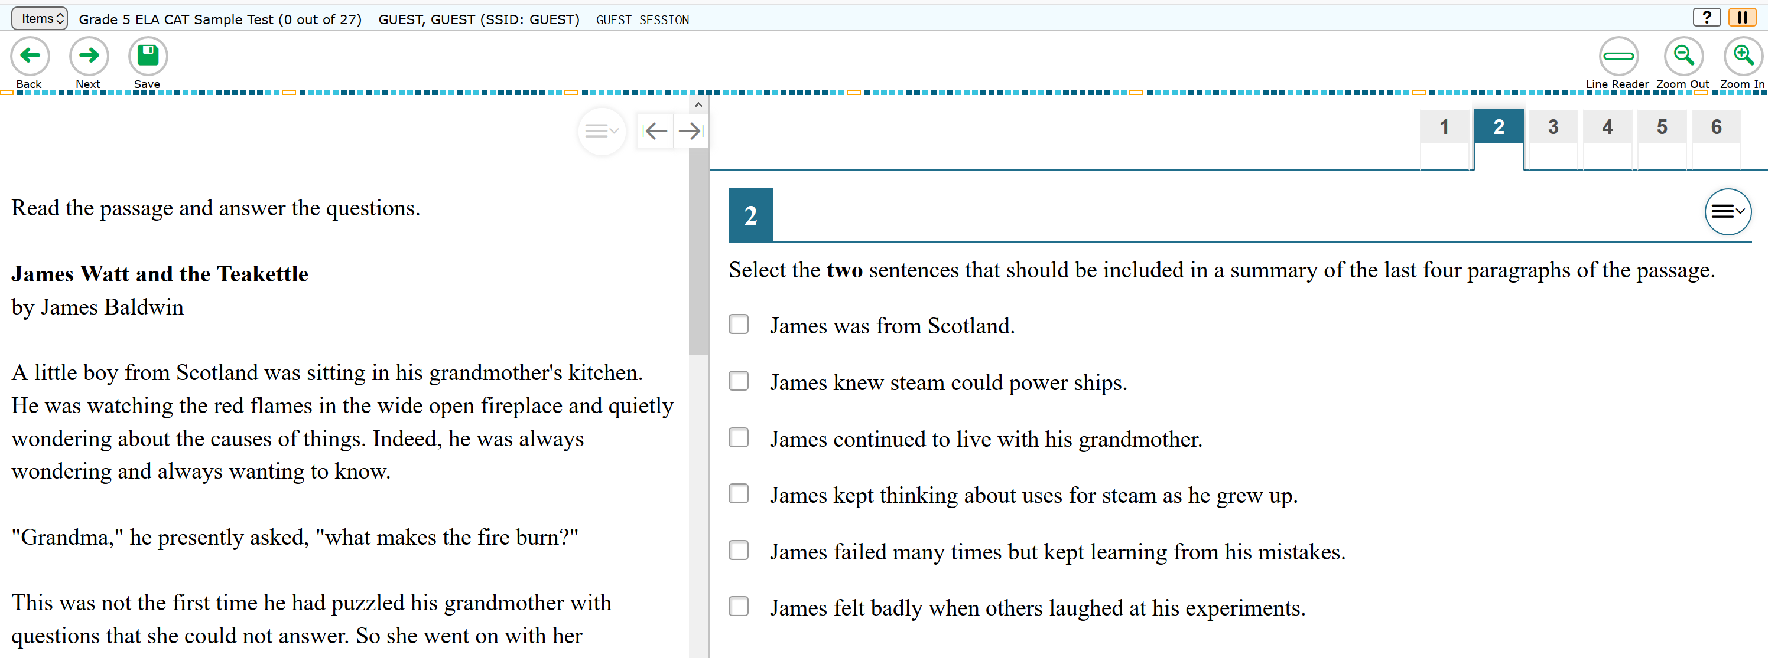
ELA Interim Test Item Example
Notes:
Slide 29: ELA Interim Assessment Item Example (Facilitator 3)
In this grade 5 example, educators can preview the reading passage and items associated with the items.
Similar to the science example the interim assessment tests contain the same accessibility features that are present in the state-wide summative assessment.
Again in the interim assessment system educators can provide additional supports depending on whether they use the interim assessment in a standardized model or a non-standardized model.
The interim assessment are intended to support both resources FOR learning and OF learning.

Slide 29
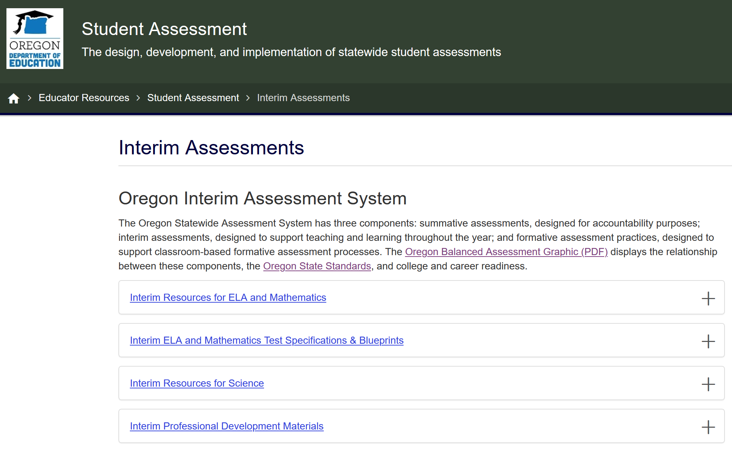
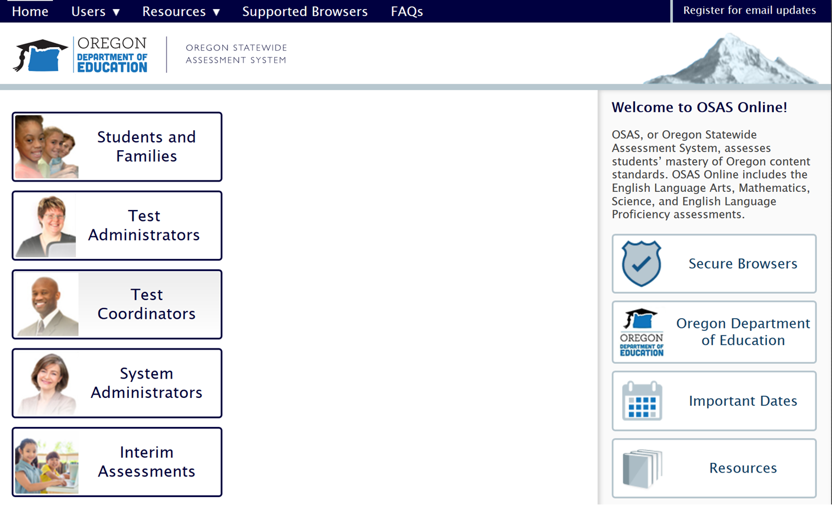
Interim Test Administration Resources
ODE Interim Assessment webpage
OSAS Portal
Notes:
Slide 30: Interim Test Administration Resources (Facilitator 3)
For access to any of the interim assessment resources discussed in this session or past sessions, please navigate to ODE Interim Assessment webpage or the Resources section of the OSAS Portal webpage.

Slide 30
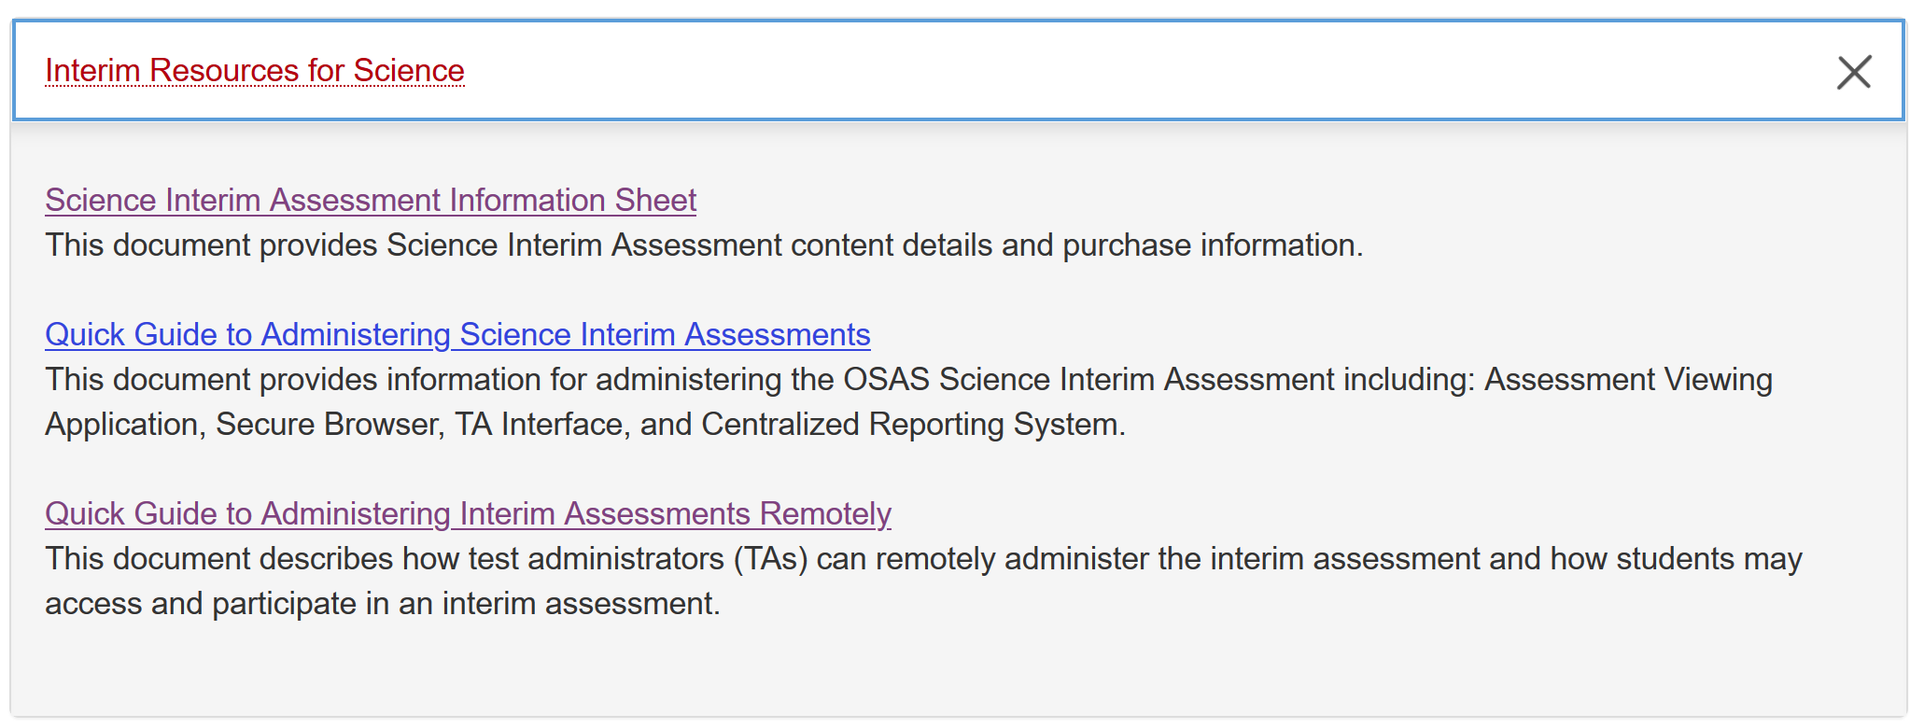
Interim Resources for Science
Notes:
Slide 31: Interim Test Administration Resources (Facilitator 3)
On the ODE - Interim Assessment web page, educators can find additional Interim Science Resources.
[Click Animation] The Science Interim Assessment Information Sheet​ provides an overview of the different Science Interim Assessment available and purchasing information.
[Click Animation]
[Click Animation] The Quick Guide to Administering Science Interim Assessments provides information for administering the OSAS Science Interim Assessment including: Assessment Viewing Application, Secure Browser, TA Interface, and Centralized Reporting System.
[Click Animation]
[Click Animation] The Quick Guide to Administering Interim Assessments Remotely​ describes how test administrators (TAs) can remotely administer the interim assessment and how students may access and participate in an interim assessment.

Slide 31
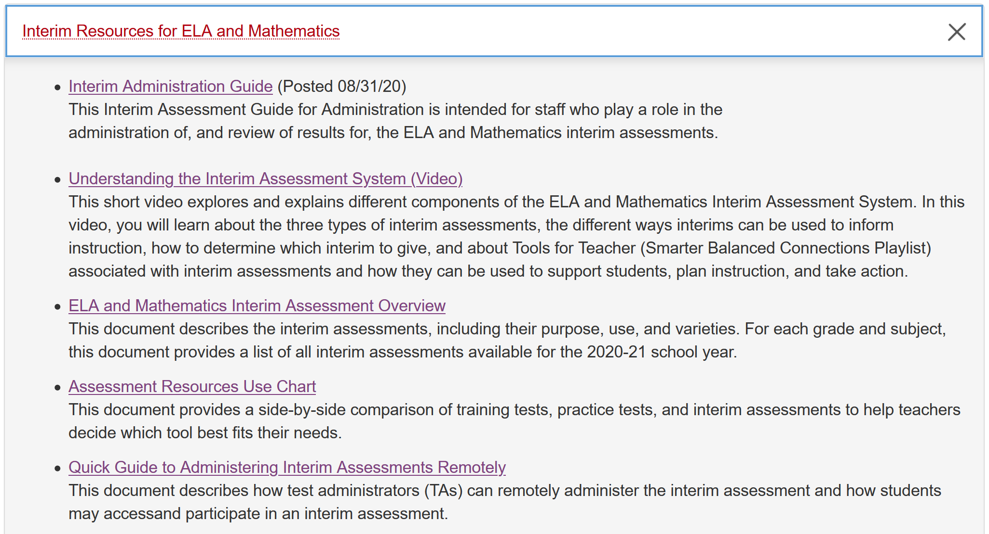
Interim Resources for ELA and Mathematics
Notes:
Slide 32: Interim Test Administration Resources (Facilitator 3)
On the ODE - Interim Assessment web page, educators can find additional Interim Science Resources.
[Click Animation] The Understanding the Interim Assessment System (Video)​​ ​​explains different components of the ELA and Mathematics Interim Assessment System.
[Click Animation]
[Click Animation] The ELA and Mathematics Interim Assessment Overview​ ​​describes the interim assessments, including their purpose and use for each grade and subject, this document also provides a list of all interim assessments available for the 2020-21 school year.​
[Click Animation]
[Click Animation] [Click Animation] Both the Interim Administration Guide​ and the Quick Guide to Administering Interim Assessments Remotely​ describes how test administrators (TAs) can remotely administer the interim assessment and how students may access and participate in an interim assessment.

Slide 32
How DTCs Assign Test Groups for Educators in TIDE
Using OSAS Portal and TIDE
Notes:
Slide 33: How DTCs Assign Test Groups for Educators in TIDE (Facilitator 2)
Thislast section is specific to those who are either a Districts Testing Coordinator or School Testing Coordinator.
Resources:
Granting Permission to Administer Tests using Test Groups in TIDE (PPT)​ (Updated 08/06/20) This presentation explains how 2019-2020 user accounts in TIDE roll over in TIDE for 2020-2021. It explains how DTCs will manage user permission for users in their district to administer tests by Test Group (ELPA Screener, Summative, and/or Interim tests) using a new feature in TIDE.

Slide 33
Assigning Test Groups to OSAS Portal User Accounts
Notes:
Slide 34: Assigning Test Groups to OSAS Portal User Accounts (Facilitator 2)
The PowerPoint presentation describing how to assign test groups is available on the ODE Assessment web page under the Test Administrator User Guide materials.
The following is a quick example to assign test groups for educators in the OSAS Portal.
The DTC or STC can [Click Animation] select the Test Coordinators and System Administrators buttons to navigate into the TIDE Settings. [Click Animation]
[Click Animation] From the icon-tiles select the [Click Animation] TIDE icon-tile. This will requires users to sign in using the authorized credentials.
[Click Animation] [Click Animation] Once in the TIDE System select the User information expanding folder and [Click Animation] select, View/Edit/Export Users.

Slide 34
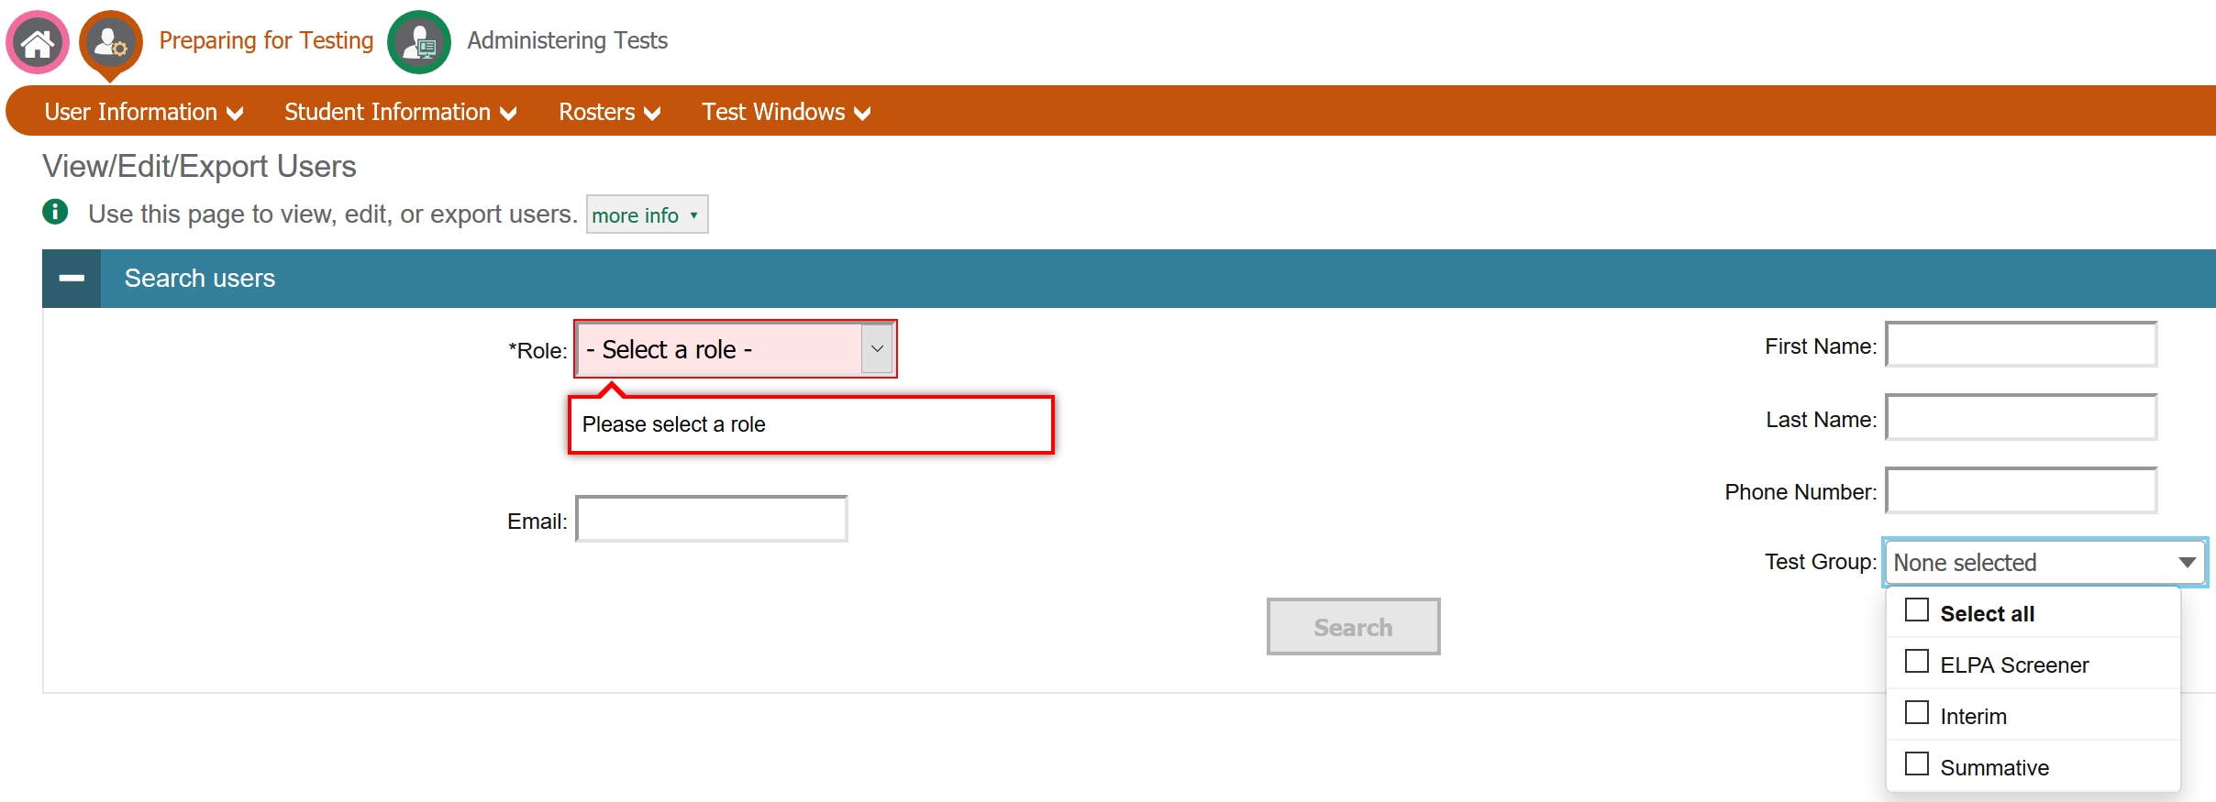
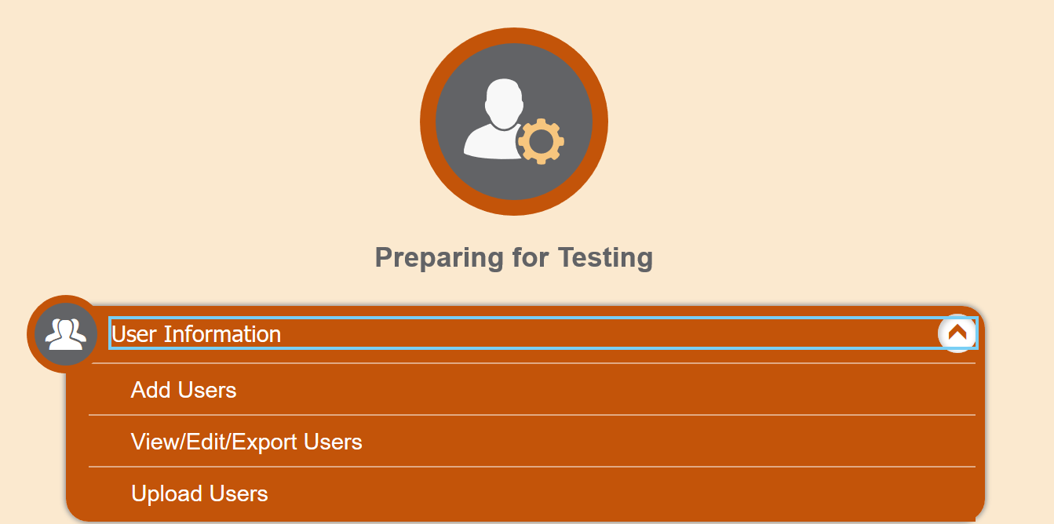
Assigning Test Groups to OSAS Portal User Accounts
Notes:
Slide 34: Assigning Test Groups to OSAS Portal User Accounts (Facilitator 2)
Once in the TIDE System select the User information expanding folder and [Click Animation] select, View/Edit/Export Users.
[Click Animation] A new window will open and DTCs or STCs can search by User role [Click Animation]
[Click Animation] or search by Name.
In either case the DTC or STC will need to activate the Interim Assessments [Click Animation] by selecting the interim assessment check box.
Again the detailed PowerPoint explaining the process is available on the ODE Test Administration web page under the User Guides folder.

Slide 35
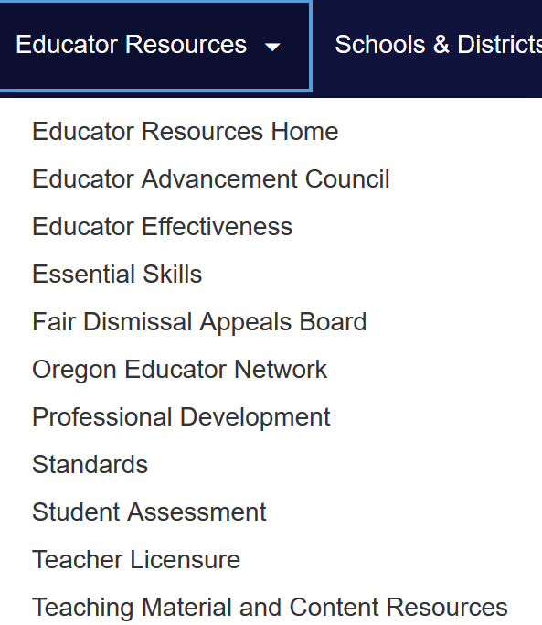

Contact Us! www.oregon.gov/ode
Dan Farley: Director of Assessment
Noelle Gorbett: Science Assessment
Andrew Byerley: Mathematics Assessment
Tony Bertrand: ELA and Social Sciences Assessment
Ben Wolcott: English Language Proficiency Assessment
Photo by Volodymyr Hryshchenko on Unsplash
Notes:
Slide 36: Contact Information and Additional Resources (Facilitator 2)
In addition to these professional development resources, the ODE Assessment team is available to support districts and schools with general or content specific assessment questions.
For contact information including email or telephone, please visit the ODE Assessment homepage and select the Assessment Contact button.
Information specific to the Interim Assessment System, including supporting resources and additional session presentations, are available on the ODE Interim Assessment webpage.
Resources:
ODE Assessment Contacts

