Slide 1
WELCOME
Notes:
Total time for Session 1: 60 min.

Slide 2
Session 1: Assessment Literacy Introduction
Notes:
Total time for Session 1: 60 min.

Slide 3
Session 1.A: Orientation and Purpose Setting
Notes:
Total time for Session 1.A: 15 min.

Slide 4
Purposes of This Training
Session 1.A: Orientation and Purpose Setting
Learn about performance assessments, how they provide robust evidence of student learning, and how they can support a balanced assessment system.
Collaboratively score student work from a Smarter Balanced performance task to build a common understanding of what student proficiency looks like.
Review student work as the basis for reflecting on and responding to the evidence of learning that performance tasks can generate.
Notes:
Facilitator’s Guide 1.A
Read through the purposes of the training.

Slide 5
Who Is in the Room?
Session 1.A: Orientation and Purpose Setting
Stand up if you are:
A classroom teacher
An instructional coach
A school-based administrator
A district administrator
Other
Notes:
Facilitator’s Guide 1.A
This slide is animated. Click through the list and ask people to stand if they fall into the category listed on the slide. This is an opportunity to get a quick idea of who is in the audience in order to inform the professional development over the course of the day. Facilitators can feel free to change the categories on this slide.

Slide 6
Note-Taking Guide
Session 1.A: Orientation and Purpose Setting
Separate handout
Session titles and objectives
Topics or activities
Space to write your comments and questions
Notes:
Facilitator’s Guide 1.A
Once you have reviewed the purpose and goals of this training, introduce participants to the note-taking guide. This is a separate handout and should be given to participants at this time. Give them a minute to look over the different session titles and objectives.

Slide 7
Getting to Know You . . .
Session 1.A: Orientation and Purpose Setting
Choose one word or phrase that comes to mind when you think of student assessment.
Share your word with your table group, including why you selected it.
Write your word/phrase on a sticky note and bring your sticky note to the presenter.
Now discuss in pairs:
In what ways do you use assessment both for learning and of learning?
Notes:
Facilitator’s Guide 1.A
This is an opportunity for participants to introduce themselves to their table group and share a bit about their feelings about student assessment. This activity will also give facilitators a chance to “read” patterns in participants’ feelings and experiences with student assessment.
Pass out sticky note pads. Ask participants to write their word on a sticky note and bring it up to the presenter. Ask an assistant to help place the submitted sticky notes on a wall into groups of similar words/phrases (or the facilitator can do this on his or her own). This could be as simple as placing generally positive words in one cluster and generally negative words in another cluster, or you could let patterns emerge naturally.
While the sticky notes are being placed on the wall, instruct participants to discuss prompt number two in pairs or table groups.
To conclude this activity, point out interesting patterns that emerged from the sticky note clusters. Invite participants to look at the wall throughout the day.
NOTE: If you have the means to complete this activity electronically by using a word cloud app such as AnswerGarden, feel free to adjust the activity. Any tool that will make the word patterns visible is a good idea.

Slide 8
Session 1.B: Types of Assessment
Notes:
Total time for Session 1.B: 25 min.

Slide 9
Session 1.B and 1.C Objectives
Session 1.B: Types of Assessment
Develop a shared understanding of the intended purposes of different types of assessment within a balanced assessment system
Understand the role of performance assessment in providing robust evidence of student learning
Understand the role of performance assessment within the design of the Smarter Balanced Assessment System
Notes:
Facilitator’s Guide 1.B
Discuss the objectives for Session 1 (B and C) as presented on the slide. Note that 1.C focuses on performance assessment.

Slide 10
Types of Assessment
Session 1.B: Types of Assessment
As we discuss three different types of assessment – formative, interim, and summative – use Handout 1.1 to capture your notes.
Think about how these different types of assessment work together to inform teaching and learning.
Notes:
Facilitator’s Guide 1B
Ask participants to find Handout 1.1, Types of Assessment Note-Taker. Let them know that we will be reviewing three types of assessment: Formative, Interim, and Summative.
Suggest that they take notes on the top two boxes (Purpose and Examples in My Context) for each of the assessment types we discuss. We will return to this handout later in this session, addressing the bottom two boxes for each assessment type then.
You may want to let participants know that this is not an exhaustive list of types of assessment. For example, we will not be focusing on diagnostic assessment, although there is detailed information about diagnostic assessment in Handout 1.4.

Slide 11
Formative Assessment
Session 1.B: Types of Assessment
Description:
“A process that takes place continuously during the course of teaching and learning to provide teachers and students with feedback to close the gap between current learning and desired goals.” — Margaret Heritage, Formative Assessment: Making It Happen in the Classroom. P.10
Not a tool or an event, but a process
Purposes:
Provide immediate or very rapid feedback to teachers and students
Provide evidence that can be used to adapt teaching and learning
Notes:
Facilitator’s Guide 1.B
The next several slides address purposes and examples of different forms of assessment.

Slide 12
Key Features of Formative Assessment:
Session 1.B: Types of Assessment
Clear lesson-learning goals and success criteria, so students understand what they are aiming for;
Evidence of learning gathered during lessons to determine where students are relative to goals;
A pedagogical response to evidence, including descriptive feedback, that supports learning by helping students answer: Where am I going? Where am I now? What are my next steps?
Peer- and self-assessment to strengthen students’ learning, efficacy, confidence, and autonomy;
A collaborative classroom culture where students and teachers are partners in learning.
(Linquanti, 2014)
From the CA ELA/ELD Framework
Notes:
Facilitator’s Guide 1.B
Take a few moments to review each component individually, giving examples where necessary.
Source: Linquanti, R. (2014). Supporting Formative Assessment for Deeper Learning: A Primer for Policymakers. Paper prepared for the Formative Assessment for Students and Teachers/State Collaborative on Assessment and Student Standards, 2. Washington, DC: Council of Chief State School Officers. Taken from the California ELA/ELD Framework, p. 823.

Slide 13
Formative Assessment
Session 1.B: Types of Assessment
Some ways to elicit evidence for formative assessment:
Observation of academic dialogue
Questioning discussions
Analysis of student work
Peer- and self-assessment strategies
What does formative assessment look like in your context?
Notes:
Facilitator’s Guide 1.B
Discuss some of these strategies as ways to gather evidence of student learning for formative assessment.
Ask participants to share out examples of what formative assessment looks like in their context. If participants don’t jump in immediately, you can provide an example to spur their thinking and provide a model.
Note that the source for this slide is the Formative Assessment Insights course, Activity 3.7: Five Evidence Gathering Routines. Further details are available on the ODE website. Resource/source for eliciting evidence: http://www.ode.state.or.us/wma/teachlearn/testing/resources/five_evidence_gathering_routines.pdf.
For other examples, please see CCSSO’s “Formative Assessment: Examples of Practice” document: http://www.csai-online.org/resources/formative-assessment-examples-practice.

Slide 14
Interim Assessment
Session 1.B: Types of Assessment
Description:
Compares student understanding or performance against a set of learning standards or objectives
May be administered at specified intervals over the course of an academic year
May be common across classes or schools
Purposes:
Monitor students’ academic progress toward longer-term goals
Inform school improvement planning
May predict a student’s end-of-year performance
Notes:
Facilitator’s Guide 1.B

Slide 15
Interim Assessment
Session 1.B: Types of Assessment
Examples of interim assessment:
Common interim assessments
Common performance tasks
Mid-term examinations
Trimester examinations
May include item banks
Notes:
Facilitator’s Guide 1.B
It may be worth noting that “Common Formative Assessments,” or CFAs, are interim assessments. They are described as “periodic or interim assessments collaboratively designed by grade-level or course teams of teachers.” Source: Larry Ainsworth & Donald Viegut, Common Formative Assessments: How to Connect Standards-based Instruction and Assessment (Corwin Press, 2006). (retrieved from: http://www.doe.in.gov/sites/default/files/turnaround-principles/2fdtcommonformassess.pdf)
For more information about interim assessment, please see CRESST’s “District Adoption and Implementation of Interim and Benchmark Assessments” report: http://www.csai-online.org/resource/68.

Slide 16
Summative Assessment
Session 1.B: Types of Assessment
Description:
May be referred to as a “culminating assessment”
Provides information on students’ knowledge and skills relative to learning standards
May be “high-stakes”
Purposes:
Provide an overall description of students’ learning status
Monitor and evaluate student achievement at the group level
Inform program-level and school-improvement planning
Notes:
Facilitator’s Guide 1.B

Slide 17
Summative Assessment
Session 1.B: Types of Assessment
Examples of large-scale summative assessment:
National Assessment of Educational Progress (NAEP)
Smarter Balanced Summative Assessments
Partnership for Assessment of Readiness for College and Careers (PARCC) Assessments
Specific statewide examinations
A summative assessment may also be given at the school or classroom level
End-of-unit assessment
End-of-course assessment
Notes:
Facilitator’s Guide 1.B
For more information on state summative assessments, visit the CSAI site: http://www.csai-online.org/sos?t=assessment&m=.

Slide 18
Balanced Assessment Systems
Session 1.B: Types of Assessment
“A comprehensive, coherent, and continuous system of assessment provides mutually complementary views of student learning, ensures that assessment within each cycle is focused on the same ultimate goal—achievement of standards—and pushes instruction and learning in a common direction (Herman, 2010).”
California ELA/ELD Framework, P. 827
What do you think are key features of a balanced assessment system?
Notes:
Facilitator’s Guide 1.B
This quotation is featured in the California ELA/ELD Framework. Read the quotation on the slide to participants and facilitate a short discussion of what most resonates with them. Ask participants to share what they think are the key features of a balanced assessment system.

Slide 19
Balanced and Coherent Assessment System
Session 1.B: Types of Assessment
Importance for teaching and learning
Formative practices (teacher & student)
Summative
Interim
(Abedi & Linquanti, 2012; Linquanti, 2014)
Notes:
Facilitator’s Guide 1.B
Say, “Another way to consider the assessment system is to look at each cycle’s impact on teaching and learning, and how the results of the assessment practices and tools are being used. Each of these three types of assessment provide important information that should be informing teaching and learning in different ways.
Formative: for use by teachers and students to continuously inform teaching and learning in the classroom;
Interim or benchmark: for use by teachers and school or district administrators to gauge student progress at a point in time;
Summative: for use at the school, district, state, or national level to gauge student progress at the end of the year and to inform program and school improvement planning.”

Slide 20
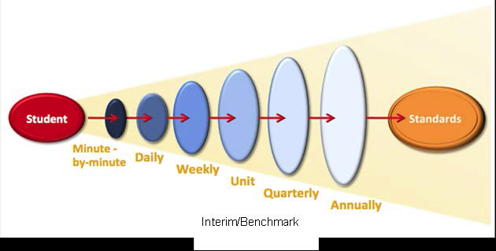
Assessment Cycles and Levels
Session 1.B: Types of Assessment
Formative assessment
Interim/Benchmark assessment
Summative assessment
(CDE ELA/ELD Curriculum Framework, 2014 p. 826. Adapted from Herman & Heritage, 2007)
Notes:
Facilitator’s Guide 1.B
Say, “Assessment is not just a test—more generally, it is a way of determining where students are on their way to goals set for where they need to get to. We can think of cycles of assessment that happen in different time frames for different purposes: short, medium, and long. Short cycles, minute-by-minute, daily, and weekly inform ongoing teaching and learning as it is happening. Assessments administered at the end of the year are long-cycle because they cover a much longer period of learning—the Smarter Balanced summative assessments are long-cycle. Medium-cycle assessments, such as end-of-unit or quarterly assessments, may serve formative or summative purposes, depending on how they are used. If they are used to inform future teaching and learning, they are formative. If they are used to evaluate what students have learned by a certain time point, they are summative.”
The source of this graphic is the California ELA/ELD Curriculum Framework, 2014, p.826.

Slide 21

How Does Assessment Support Teaching and Learning?
Session 1.B: Types of Assessment
Blank title
Take a moment to capture your thinking about how different assessments inform teaching and learning in Handout 1.1: Types of Assessment Organizer.
For reference, consider Handout 1.2: Types and Uses of Assessments within Assessment Cycles, and Handout 1.3: Overview of Major Assessment Types in Standards-Based Instruction.
Notes:
Facilitator’s Guide 1.B
Give participants a few minutes to individually review the two reference handouts (1.2 and 1.3). Allow them to work individually or in pairs to complete the graphic organizer. Ask participants to share out the questions about student learning they develop.

Slide 22
Session 1.C: Performance Assessment
Notes:
Total time for Session 1.C: 20 min.

Slide 23
Item Types
Session 1.C: Performance Assessment
Different item types elicit different information about student learning from students and can be used for different purposes:
Selected response
Constructed response
Standardized performance tasks
Curriculum-embedded performance tasks
Notes:
Facilitator’s Guide 1.C
Performance assessments are one item type that can be used for different assessment purposes (formative, interim, summative).
There are different types of items that elicit different information about student learning. Item types can be used for formative, interim/benchmark, and summative assessment, although some are more suited for specific assessment purposes.

Slide 24
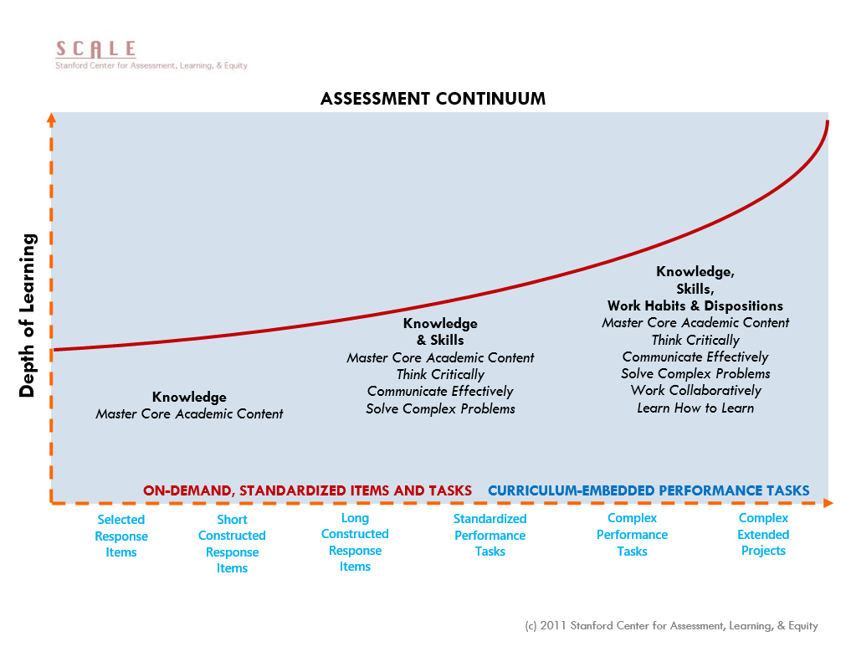
Blank title
Notes:
Facilitator’s Guide 1.C
This slide shows a continuum of assessment, with different assessment item types along the horizontal axis, and DOK represented on the vertical axis. There are a lot of item types indicated along the bottom, but what’s important to notice is that on-demand, standardized items and tasks end right HERE (point to end of red text along horizontal axis), near the middle of the graph. And curriculum-embedded performance tasks BEGIN right HERE (point to left edge of blue text along horizontal axis). During our time together, we are starting right in the middle, and moving up the DOK curve to the right. And there’s a lot of space there to move into.

Slide 25
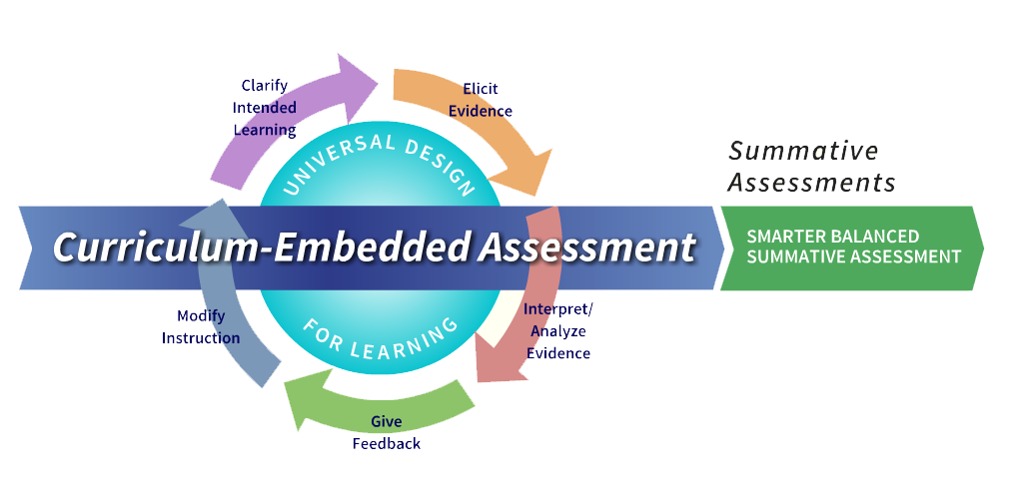
The Smarter Balanced Assessment System
Notes:
Facilitator’s Guide 1.C 20 min.
Play the video, BEAL Assessment Overview – Short - Narrated. Make sure you download the media files ahead of time and check that they work. The video is not linked through the slide. You may have to minimize the PPT and play directly from your desktop.
Play the video and answer questions, as described in the Facilitator’s Guide.
Please note that while this video reflects the entire Smarter Balanced assessment system, including the digital library and the interim assessment system, Oregon does not use these two optional tools, and formative and interim assessment is done at the school and district level.

Slide 26

Why Performance Tasks?
Session 1.C: Performance Assessment
READ: “Role of Smarter Balanced Performance Tasks” (Handout 1.4 in your booklet).
DO: Mark 2–3 most important words and/or phrases in the handout (highlight, underline, or circle).
Notes:
Facilitator’s Guide 1.C
Transition from the video by saying something like: “Performance assessment can take many forms. Smarter Balanced performance tasks are one iteration of performance assessment. They are on-demand, standardized performance tasks. Let’s think now about the role of those tasks within the Smarter Balanced summative assessments. We know that performance tasks are more complex, harder to score, and more demanding of task designers, students, and teachers alike. So we want to consider the question of WHY Smarter Balanced has chosen to use performance tasks in its summative assessments. We will try to answer that question with evidence from a text.”
Direct participants to Handout 1.4, entitled “Role of Smarter Balanced Performance Tasks.” Give them up to five minutes to quickly read the document and select the most important words and phrases. Monitor the room so you can move on to sharing out as quickly as possible (in less than five minutes if many participants are done reading).
Invite a few participants to share their selections. Encourage other audience members to raise their hands if they selected the same word/phrase (this will give the room a sense of what words or phrases were commonly identified as important).

Slide 27
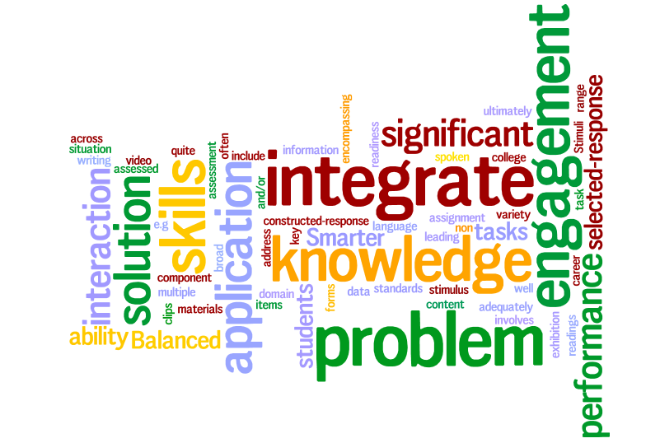
Session 1.C: Performance Assessment

Slide 28
Key Phrases
Session 1.C: Performance Assessment
Interaction with varied, rich stimuli
Engages students in a scenario
Solve a problem
Create a product with a specific purpose
Application of knowledge and skills
Integration . . . across multiple standards
Assesses what selected- and constructed-response items cannot
Notes:
Facilitator’s Guide 1.C
Note: This slide is animated.
Click through the list, explaining that this bullet-point version represents what we believe to be the key phrases from the document. These phrases distill the importance of performance tasks in the Smarter Balanced Assessment System and in education more broadly.

Slide 29
Reflect . . .
Session 1.C: Performance Assessment
Based on your analysis of the “Role of Smarter Balanced Performance Tasks” document, why is Smarter Balanced using performance tasks in its summative and interim assessments?
Notes:
Facilitator’s Guide 1.C
Pose this question to participants. Rather than allowing time for table-talk, simply give a few moments for individual quiet thought; then solicit 2–3 answers from the audience.

Slide 30




Four Principles of Performance Assessment
Session 1.C: Performance Assessment
. . . targets skills and knowledge that matter
. . . is assessment for and as learning
. . . is learning by doing
. . . links curriculum, instruction, and assessment
Notes:
Facilitator’s Guide 1.C
Review the four principles of performance assessment represented on the slide. This is for performance assessment in general, not only for performance assessment in the summative context.

Slide 31
Session 2: Deep Dive into a Smarter Balanced Performance Task
Notes:
Total time for Session 2: 150 min.

Slide 32
Session 2 Objectives
Session 2: Deep Dive into a Smarter Balanced Performance Task
Experience a Smarter Balanced performance task from the perspective of a student, and unpack what the task requires students to know and be able to do
Understand Smarter Balanced performance task design and scoring tools
Collaboratively score student work from a Smarter Balanced performance task to build a common understanding of what student proficiency looks like
Analyze student work and consider the implications for teaching and learning
Notes:
Briefly review the objectives for this session.

Slide 33
Session 2.A: Experiencing and Unpacking a Task
Notes:
Total time for Session 2.A: 45 min.

Slide 34
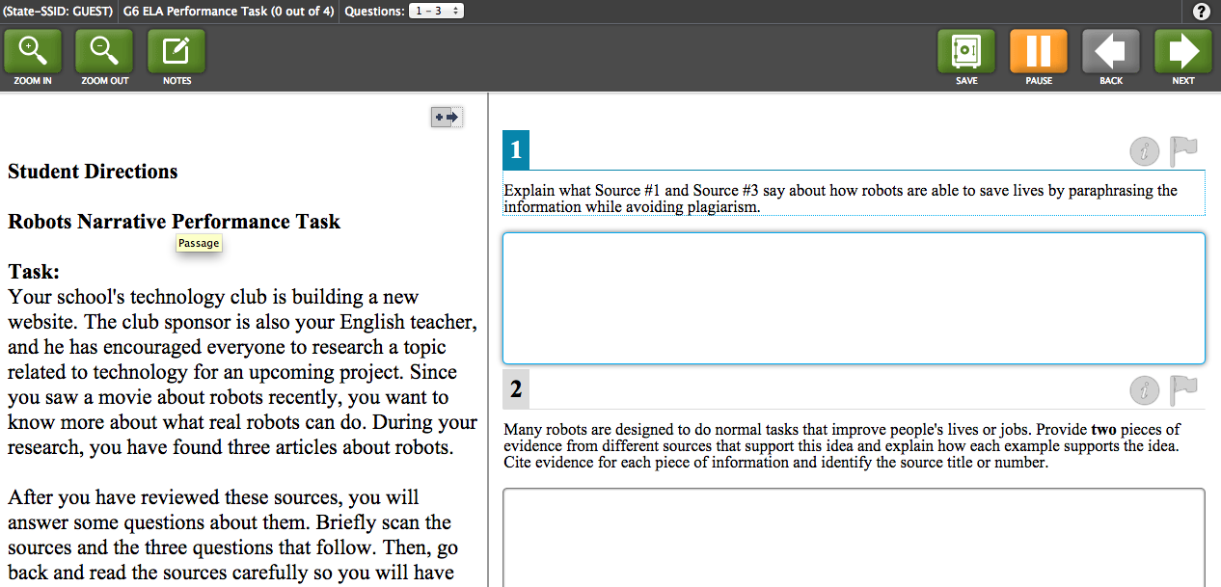
What Does a Smarter Balanced Performance Task Look Like?
Session 2.A: Experiencing and Unpacking a Task
Notes:
Facilitator’s Guide 2.A
Use this slide as an opportunity to remind participants that while we will be encountering the performance tasks on paper, students will take them online. This is a screenshot of the test interface. If participants have not yet done so, they should take the Smarter Balanced online Practice Test.

Slide 35
Experience a Task
Session 2.A: Experiencing and Unpacking a Task
Work your way through all parts of the task, following instructions and responding to prompts as though you were a student.
When you reach the full write, develop a thesis statement and an outline for writing, rather than a full response.
Elementary group:
Handout 2.1—Grade 5 ELA Performance Task
Secondary group:
Handout 2.2—Grade 8 ELA Performance Task
Notes:
Facilitator’s Guide 2.A
Allow 25 minutes.
Read the instructions on the slide to participants. Make sure they know that they will have 25 minutes to complete the task. Inform them that the task content was adapted for the session from Smarter Balanced practice tests. The content is available through the online version of the practice test on the Smarter Balanced website and is posted on the Understanding Proficiency website (under Scoring Guides). The task can be shared publicly.
Keep time carefully and nudge participants along as necessary; they only get 25 minutes, and you want to ensure that they complete all of the constructed- and selected-response items and at least have time to outline/seriously think about the full-write response.

Slide 36

Table Discussion and Activity
Session 2.A: Experiencing and Unpacking a Task
What do students need to know and be able to do to successfully complete this task?
With your table group, use chart paper to brainstorm a list.
Notes:
Facilitator’s Guide 2.A
Allow 10 minutes.
Instruct participants to chart their impressions of what students need to know and be able to do to successfully complete this task. Make sure that participants are writing as they discuss their impressions.

Slide 37
Whole-Group Discussion
Session 2.A: Experiencing and Unpacking a Task
Prompts:
What are the knowledge and skill demands of this task for students?
What are the potential barriers for special populations and other students?
What strategies did you use to work your way through the task in the limited time we had?
Notes:
Facilitator’s Guide 2.A
Allow 5 to 10 minutes (depending on how much time is left).
Rather than having each table share out its entire list, walk around while they work and then pull out some common threads in the discussion. Center the discussion around the knowledge and skill demands listed by the tables, but also include the other two questions as appropriate.

Slide 38
Session 2.B: Claims and Targets
Notes:
Total time for Session 2.B: 15 min.

Slide 39


Claims and Targets Resource
Session 2.B: Claims and Targets
ELA Content Specifications, Appendix B
Notes:
Facilitator’s Guide 2.B
Orient participants to the resource that the content of this session comes from (Appendix B of the ELA/Literacy Content Specifications). Let participants know that later in the session, they will have an opportunity to review an excerpt from this resource.

Slide 40
What Are Claims and Targets?
Session 2.B: Claims and Targets
“Claims are the broad statements of the assessment system’s learning outcomes.”
“For each Claim, a set of Assessment Targets are provided. . . . the assessment targets describe the expectations of what will be assessed by the items and tasks within each claim.”
Smarter Balanced General Item Specifications
Notes:
Facilitator’s Guide 2.B
Emphasize that one of the primary purposes of claims and targets is to group or cluster multiple standards in meaningful ways, which is a key feature of performance tasks.

Slide 41
Blank title
Session 2.B: Claims and Targets
The overall claim for grades 3–8:
“Students can demonstrate progress toward college and career readiness in English language arts and literacy.”
The overall claim for grade 11:
“Students can demonstrate college and career readiness in English language arts and literacy.”
Notes:
Facilitator’s Guide 2.B
Say, “There is one overall claim for the assessments at grades 3–8 and one overall claim for the assessments at grade 11. You will notice a common theme.”

Slide 42
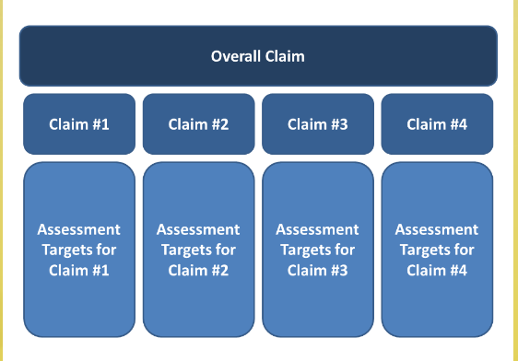
Claims, Targets, and Standards
Session 2.B: Claims and Targets
Notes:
Facilitator’s Guide 2.B
Explain that this graphic represents the structure of the overall claim, the four specific ELA claims, and the assessment targets that align with each claim.

Slide 43
ELA Claim #1 (Reading)
Session 2.B: Claims and Targets
Students can read closely and analytically to comprehend a range of increasingly complex literary and informational texts.
Notes:
Facilitator’s Guide 2.B
Say, “The first claim is about reading.”
Read Claim 1.

Slide 44
ELA Claim #2 (Writing)
Session 2.B: Claims and Targets
Students can produce effective and well-grounded writing for a range of purposes and audiences.
Notes:
Facilitator’s Guide 2.B
Say, “The second claim is about writing.”
Read Claim 2.

Slide 45
ELA Claim #3 (Speaking and Listening)
Session 2.B: Claims and Targets
Students can employ effective speaking and listening skills for a range of purposes and audiences.
Notes:
Facilitator’s Guide 2.B
Say, “The third claim is about speaking and listening. This claim is not currently assessed on the Smarter Balanced summative assessments.”
Read Claim 3.

Slide 46
ELA Claim #4 (Research/Inquiry)
Session 2.B: Claims and Targets
Students can engage in research and inquiry to investigate topics, and to analyze, integrate, and present information.
Notes:
Facilitator’s Guide 2.B
Say, “The fourth claim is about research and inquiry.”
Read Claim 4.
Note that the first three claims are directly tied to a strand of standards, while the Research claim pulls from both the reading and writing standards. Participants may wish to discuss why this claim exists. See the Facilitator’s Guide for more discussion of this issue.

Slide 47
Important Things to Note
Session 2.B: Claims and Targets
There is only one claim and one assessment target associated with each item.
For SBAC Performance Tasks:
Research claim and targets are assessed in the constructed- and selected-response items.
Writing claim and targets are assessed in the full write (different targets are associated with different writing prompts).
Reading targets are not assessed.
Notes:
Facilitator’s Guide 2.B
Walk through the slide and answer questions as they arise.

Slide 48
Review Excerpt from Appendix B
Session 2.B: Claims and Targets
Elementary Group:
Handout 2.3—Elementary Excerpt from Appendix B
Focus on Grade 5, Writing Claim 2, Target 7
Secondary Group:
Handout 2.4—Secondary Excerpt from Appendix B
Focus on Grade 8, Writing Claim 2, Target 7
Notes:
Facilitator’s Guide 2.B
Allow 5 minutes.
Give participants time to review the content of the handout and discuss in partners/table groups.

Slide 49
What do you notice?
Session 2.B: Claims and Targets
Consider the relationship between the claim, target, standards, and the full-write item on the performance task.
How effectively does the full-write item measure the claim, target, and standards?
How do you currently teach and assess these standards in your context?
Notes:
Facilitator’s Guide 2.B
Allow 5 minutes.
Give participants three minutes to discuss in table groups/pairs; then invite them to share out.

Slide 50
Questions about Claims and Targets?
Session 2.B: Claims and Targets
Notes:
Facilitator’s Guide 2.B
Field any lingering questions.

Slide 51
Session 2.C: Introduction to the Writing Rubric
Notes:
Total time for Session 2.C: 15 min.
Explain that this session focuses on helping participants better understand the scoring requirements for the full-write portion of the performance task. Later on, they will have a chance to review the full scoring guides (Handouts 2.16 and 2.17), including the scoring requirements for other constructed response items.

Slide 52
Context
Session 2.C: Introduction to the Writing Rubric
Smarter Balanced performance task writing rubrics have instructional implications for teachers at all grade levels (not just those listed on the individual rubrics).
We will focus on one of the Smarter Balanced performance task writing rubrics in this session.
The complete set is included in your Materials Booklet (Handout 2.18).
Notes:
Facilitator’s Guide 2.C
Inform participants that, although this training is for K–12 teachers, rubrics have only been written for grades 3–11, with different grade spans focusing on different writing purposes. Instructional implications, however, apply to teachers at all grade levels. The focus rubric for this training is just one of five rubrics. The complete set (5 total) is included in the Materials Booklet (Handout 2.18).

Slide 53
Rubric Review 1
Session 2.C: Introduction to the Writing Rubric
Individually, review the rubric associated with the performance task you experienced and unpacked in Session 2.A.
Elementary group:
Handout 2.5—Grades 3–5 Opinion Writing Rubric
Secondary group:
Handout 2.6—Grades 6–11 Argumentative Writing Rubric
Before you begin, please share: How familiar are you with this rubric already?
Notes:
Facilitator’s Guide 2.C
Gauge group’s familiarity with the writing rubric.
Say, “Please spend the next five minutes examining the rubric. Make notes about what you observe, and be prepared to share with your small group.”
Allow 5 minutes.

Slide 54
Rubric Review 2
Session 2.C: Introduction to the Writing Rubric
In your table groups, discuss your collective observations about:
Features of writing that are assessed
Structure of the rubric
Score levels
Rubric language
Notes:
Facilitator’s Guide 2.C
Allow 5 minutes.
Say, “Within your table groups, please share what you observed about the rubric. Discuss your collective observations about:
Features of writing that are assessed,
The structure of the rubric,
The score levels in the rubric, and
Specific rubric language.
You have five minutes.”

Slide 55
Key Features of the Rubric
Session 2.C: Introduction to the Writing Rubric
Analytic—three dimensions
Organization/Purpose
Evidence/Elaboration
Conventions
Four score levels + NS (Not Scorable)
Conventions excluded
Total point value: 10
Notes:
Facilitator’s Guide 2.C
Say, “Thank you for spending some time focusing on understanding the rubric. Now, we’ll spend a little time going over the key features of the rubric.
First, this rubric is an analytic rubric—meaning that it evaluates the quality of students’ writing along multiple dimensions and produces a set of scores that provides more fine-grained information than a holistic score. In this case, there are three dimensions of scoring.
Two of the dimensions—Organization/Purpose and Evidence/Elaboration, are scored along four score levels, from Level 1 to Level 4. Conventions is scored along only three score levels—Levels 0, 1, and 2. All three dimensions have a Not Scorable score level, in which case the response is scored NS, rather than Level 0.
Last, the sum of scores across these three dimensions of scoring totals a maximum of 10 points. These ten points contribute to the scoring of Writing (Claim 4).”

Slide 56
Key Attributes of Writing That Are Assessed
Session 2.C: Introduction to the Writing Rubric
Organization/Purpose
Clear opinion/argument, focus
Use of transitional strategies to clarify relationships among ideas
Introduction and conclusion
Progression of ideas and connections among ideas
Sense of unity/completeness (Level 4)
Completeness/coherence (Level 3)
Loosely connected/somewhat sustained (Level 2)
Notes:
Facilitator’s Guide 2.C
Say, “Within each of the scoring dimensions, multiple indicators are used as criteria to make a judgment about the overall dimension score. We’ll go into more detail on how to use these different criteria to make a decision about the overall dimension score in the next segment of this module.
The key attributes of writing that are evaluated in the Organization/Purpose dimension are whether the opinion/argument is clear and focused; whether the student uses transitional strategies to clarify relationships among ideas; whether the essay includes an introduction and conclusion that contribute to the focus of the essay; and whether there is a progression of ideas and connections among ideas.
Note also the summative descriptors at the top of each score level in the rubric. Level 4 responses are characterized as having a sense of unity and completeness, while Level 3 is said to have completeness and coherence, and Level 2 has loosely connected ideas, and a somewhat sustained organization.”

Slide 57
Key Attributes of Writing That Are Assessed
Session 2.C: Introduction to the Writing Rubric
Evidence/Elaboration
Integration of relevant evidence from sources (facts, details)
Citation or attribution of sources
Elaborative techniques (e.g., specific examples, definitions, explanations, personal experiences)
Appropriate vocabulary/style
Thorough elaboration; effective development (Level 4)
Adequate elaboration and development (Level 3)
Uneven, cursory elaboration and development (Level 2)
Notes:
Facilitator’s Guide 2.C
Say, “The key attributes of writing that are evaluated in the Evidence/Elaboration dimension are whether the writing integrates relevant facts and details from the sources; whether the writing cites or attributes the sources; whether the student uses elaborative techniques, such as specific examples, definitions, explanations, or personal experiences; and whether the student uses appropriate vocabulary and style for the purpose and audience.
Note also the summative descriptors at the top of each score level on the rubric. A Level 4 response provides thorough elaboration of support or evidence for the controlling idea and effective use of source materials, effectively and clearly developing ideas. A Level 3 response provides adequate elaboration of support or evidence for the controlling idea through the use of source material, and adequately develops ideas. And a Level 2 response provides uneven, cursory elaboration with uneven or limited use of source materials, and uneven development.”

Slide 58
Key Attributes of Writing That Are Assessed
Session 2.C: Introduction to the Writing Rubric
Conventions
Sentence formation
Punctuation
Capitalization
Grammar usage
Spelling
Three score levels (2, 1, 0)
Adequate command
Partial command
Little or no command
Notes:
Facilitator’s Guide 2.C
Say, “The key attributes of writing that are evaluated in the Conventions dimension include sentence structure, punctuation, capitalization, grammar usage, and spelling. As noted earlier, Conventions are scored at three levels. To achieve a Level 2 score, the writing should demonstrate adequate command of conventions; to achieve a Level 1 score, the writing should demonstrate partial command of conventions; and to warrant a Level 0 score, the writing should demonstrate little or no command of conventions.
A note about holistic scoring of this dimension indicates that the score depends on three factors:
The variety of errors: in sentence formation, punctuation, capitalization, grammar usage, and spelling.
The severity of errors: with basic errors being more heavily weighted than higher-level errors.
The density of errors: meaning the proportion of errors to the amount of writing done well and the total length of the writing.”

Slide 59
Rubric Adjectives Refer to Handout 2.7
Session 2.C: Introduction to the Writing Rubric
4
3
2
1
Clear,
Consistent,
Effective,
Logical,
Strong,
Appropriate, Comprehensive,
Specific
Clear,
Adequate,
General,
Generally appropriate
Somewhat unclear, Insufficient, Inconsistent, Weak,
Uneven, Somewhat ineffective, Imprecise,
Vague,
Repetitive
Confusing, Ambiguous,
Brief,
Few or no, Missing, Extraneous, Unclear,
Minimal, Irrelevant, Absent,
Incorrect,
Copied, Ineffective, Limited, Infrequent
Notes:
Facilitator’s Guide 2.C
Note: This slide is animated.
Say, “For the two dimensions that are scored on a continuum of four score levels, you may have noticed a pattern in the kinds of adjectives that are used to describe the work at each level.
[ADVANCE TO NEXT ANIMATION]
At Level 4, the writing is described as clear, consistent, effective, logical, strong, appropriate, comprehensive, and specific.
[ADVANCE TO NEXT ANIMATION]
At Level 3, the writing is described as clear, adequate, general, and generally appropriate.
[ADVANCE TO NEXT ANIMATION]
At Level 2, the writing is described as somewhat unclear, insufficient, inconsistent, weak, uneven, somewhat ineffective, imprecise, vague, or repetitive.
[ADVANCE TO NEXT ANIMATION]
At Level 1, the writing is described as confusing, ambiguous, brief or lacking, extraneous, unclear, minimal, irrelevant, incorrect, copied, ineffective, limited, infrequent.
These adjectives are good reminders of the quality of work that we should generally associate with each level.”

Slide 60
NS—Not Scorable
Session 2.C: Introduction to the Writing Rubric
Insufficient (includes copied text)
In a language other than English
Off-topic
Off-purpose
Notes:
Facilitator’s Guide 2.C
Say, “Last, there is an ‘NS’ score designation for each scoring dimension. You would make a note that the response is not scorable for four possible reasons:
1) The response is insufficient—meaning that the student has written almost nothing, OR has directly copied large amounts of text from the sources.
2) The response is in a language other than English.
3) The response does not address the topic of the prompt.
Or 4) The response is off-purpose—this means that the student has not met the request for a particular kind of writing, e.g., in this case, opinion writing. Instead, the student has written a narrative, a poem, or some other form of writing than the type of writing that has been requested. It is possible for a student to include explanation in an opinion writing piece, and vice versa (opinion in an informational piece). This is the one grey area where there is some wiggle room between two purposes of writing. Students are not penalized in these last two cases.”

Slide 61
Questions about the writing rubric?
Session 2.C: Introduction to the Writing Rubric
Notes:
Facilitator’s Guide 2.C
Field any lingering questions.

Slide 62
Session 2.D: Gathering Evidence and Scoring
Notes:
Total time for Session 2.D: 20 min.

Slide 63
Video
Session 2.D: Gathering Evidence and Scoring
Elementary group:
Video 2.1: ELA Hand Scoring – Elementary
Secondary group:
Video 2.2: ELA Hand Scoring – Secondary
Note: The video references a different task than the one you experienced/unpacked and a different writing rubric. Focus on the video’s description of the process for gathering evidence and scoring.
Notes:
Facilitator’s Guide 2.D
Introduce Video

Slide 64
Step 1
Session 2.D: Gathering Evidence and Scoring
Review the Full-Write Prompt
Elementary group:
Handout 2.1—Grade 5 ELA Performance Task
Secondary group:
Handout 2.2—Grade 8 ELA Performance Task
Notes:
Facilitator’s Guide 2.D
Help participants locate the full-write prompt for the performance task in their grade span. Allow a couple of minutes for them to re-read the prompt/highlight key phrases.

Slide 65
Step 2
Session 2.D: Gathering Evidence and Scoring
Review the Writing Rubric
Elementary group:
Handout 2.5—Grades 3–5 Opinion Writing Rubric
Secondary group:
Handout 2.6—Grades 6–11 Argumentative Writing Rubric
Notes:
Facilitator’s Guide 2.D
Help participants locate the writing rubric associated with the full-write prompt for the performance task in their grade span. Allow a couple of minutes for them to review key features of the rubric.

Slide 66
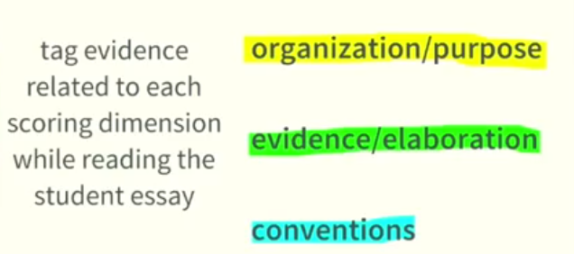
Step 3
Session 2.D: Gathering Evidence and Scoring
Individually Read and Score
Notes:
Facilitator’s Guide 2.D
Let participants know that they will receive highlighters to review some anchor papers and practice hand scoring.
Say, “You can choose to focus on one dimension at a time, but you can also tag pieces of evidence as you notice them by marking them with different colors AS you read through the student samples.”

Slide 67
Step 3, continued…
Session 2.D: Gathering Evidence and Scoring
After you tag pieces of evidence in student essays (or as you do so), mark the indicators within the rubric that are supported by the evidence.
Look for a preponderance of evidence.
Notes:
Facilitator’s Guide 2.D

Slide 68
Questions about the scoring process?
Session 2.D: Gathering Evidence and Scoring
Notes:
Facilitator’s Guide 2.D
Field any lingering questions.

Slide 69
Session 2.E: Review of the Scoring Process with Anchor Papers
Notes:
Total time for Session 2.E: 15 min.
Say, “At this point, we want to give you time to review the scoring process using real examples of student work.”

Slide 70
Anchor Papers
Session 2.E: Review of the Scoring Process with Anchor Papers
Examples of student work that exemplify the attributes of a certain score level and that serve as a standard against which other papers or performances can be judged
Notes:
Facilitator’s Guide 2.E
Say, “One important resource that can help teachers become more calibrated with each other as well as with an external standard of performance is the use of anchor papers. Anchor papers are examples of student work that exemplify the attributes of a certain score level and that serve as a standard against which other papers or performances can be judged. These are also commonly known as benchmarks.
By their very nature, common rubrics (and especially those that span several grade levels) are written in a way that is inherently general so that they can be applied across different performance tasks and grade levels. This often makes them difficult to understand and apply. It feels very subjective. But when common rubrics are accompanied by anchor papers that provide concrete examples of what a rubric indicator means at a particular grade level, the rubric score levels can be understood more easily.”

Slide 71
Sample A
Session 2.E: Review of the Scoring Process with Anchor Papers
Elementary group:
Handout 2.8—Elementary Student Sample A
Secondary group:
Handout 2.9—Secondary Student Sample A
Read the Student Response
Review the scoring rationales and highlighted rubric for each dimension
Notes:
Facilitator’s Guide 2.E
Allow 5 minutes to read/review.
Inform participants that all student samples used in this session are posted on the Understanding Proficiency website (http://understandingproficiency.wested.org/). They can be shared publicly. Additional samples can be found on the website.

Slide 72
Discuss with your table group:
Session 2.E: Review of the Scoring Process with Anchor Papers
What seem to be the criteria for the dimensional scores associated with this response?
How does reviewing this sample help clarify your understanding of the rubric language?
How does reviewing this sample help anchor your understanding of the score levels for this rubric?
Notes:
Facilitator’s Guide 2.E
Allow 3 minutes to discuss and an additional 2 minutes for a share-out.

Slide 73
Sample B
Session 2.E: Review of the Scoring Process with Anchor Papers
Elementary group:
Handout 2.10—Elementary Student Sample B
Secondary group:
Handout 2.11—Secondary Student Sample B
Read the Student Response
Review the scoring rationales and highlighted rubric for each dimension
Notes:
Facilitator’s Guide 2.E
Allow 5 minutes to read/review.
Explain that we won’t be spending a lot of time analyzing and discussing the Level 1 anchor, but we want them to know what a Level 1 looks like.

Slide 74
Session 2.F: Score and Discuss Two Samples
Notes:
Total time for Session 2.F: 40 min.

Slide 75
Individual Practice and Discussion
Session 2.F: Score and Discuss Two Samples
First, you’ll read and score Samples C and D individually.
Then each table will…
Chart their scores.
Discuss with the goal of coming to consensus on the scores.
Notes:
Facilitator’s Guide 2.F
Say, “Now it’s time to apply the evidence-based scoring method that was modeled in the video. We’ll ask you to look at and score two more samples—Samples C and D. After you have scored, chart your scores, and then discuss and try to come to consensus with your group on the scores.”

Slide 76

Write Your Scores on Sticky Notes
Session 2.F: Score and Discuss Two Samples
e.g.,
“Gr3 Opinion B”
2
3
1
Notes:
Facilitator’s Guide 2.F
Say, “This is how you should note your scores on sticky notes.”

Slide 77
How Do You Chart Your Scores?
Session 2.F: Score and Discuss Two Samples
Charting Paper for
Sample
___
Dimension/
4
3
2
1
0
Score
Organization/
///
///
Purpose
Evidence/
////
/
/
Elaboration
Conventions
//////
Notes:
Facilitator’s Guide 2.F
Say, “At each table are blank pieces of chart paper for each sample that you will score in common today. Write your scores on a sticky note and hand it to your table leader, who will chart your scores.”

Slide 78
Elect a Table Leader
Session 2.F: Score and Discuss Two Samples
Responsibilities:
Keep the group on track and focused.
Chart scores.
Ensure that all voices are heard.
Help bring the group to consensus.
Notes:
Facilitator’s Guide 2.F
Say, “Please elect a table leader. The responsibilities of the table leader are to keep the group on task; chart scores; make sure all voices are heard during the discussion of the scores and rationale for each sample; and help bring the group to consensus on the scores.”
Allow 30 seconds to select a table leader.

Slide 79
Individual Scoring
Session 2.F: Score and Discuss Two Samples
Elementary group:
Handout 2.12—Elementary Student Samples C and D
Secondary group:
Handout 2.13—Secondary Student Samples C and D
Use the evidence-gathering and scoring process that was just modeled, using highlighters and blank rubrics provided.
Please respect your fellow participants–keep it quiet until the time is up!
Notes:
Facilitator’s Guide 2.F
Allow 20 minutes.
Say, “Now, we’ll give you about 20 minutes to individually score two more papers (Samples C and D). Please use the evidence tagging and scoring process that was just modeled, using the highlighting markers. Then record your scores and evidence on the blank rubrics provided. Remember to make your judgments based on evidence, and be prepared to explain why you selected a particular score. Last, please do not discuss your scores or begin talking before the time is up. Let’s keep it quiet for the next 20 minutes so that your fellow participants can concentrate without distractions.”

Slide 80
Chart Your Scores
Session 2.F: Score and Discuss Two Samples
Dimension/ Score | 4 | 3 | 2 | 1 | 0
Organization/ Purpose
Evidence/ Elaboration
Conventions
Notes:
Facilitator’s Guide 2.F
Circulate to make sure that the table leader is charting everyone’s scores on the chart paper for each sample.

Slide 81
Discuss Your Scores
Session 2.F: Score and Discuss Two Samples
Focusing on the samples and score dimensions in which there were more discrepancies within your group, try to come to consensus on each dimension score.
When explaining your scores, provide evidence and examples from the paper that support your selected score.
Remember: consensus may not be 100% agreement.
Sometimes it is okay to agree to disagree!
Don’t get stuck—discuss both samples.
Notes:
Facilitator’s Guide 2.F
Allow 10 minutes.
Say, “Now, you will have 10 minutes to discuss the samples. Let’s focus on the samples and score dimensions that have the most discrepancy within your group. Make observations where there is agreement and disagreement. Then try to come to consensus on each dimension score. Explain your scores to each other, providing evidence and examples from the paper that support your selected score.
Remember that consensus is not 100% agreement, and that sometimes it is okay to disagree. We don’t want you to get stuck on one sample. Please pace yourselves so that you are able to discuss at least two samples. You have 10 minutes.”

Slide 82
Master Scores and Rationales
Session 2.F: Score and Discuss Two Samples
Elementary group:
Handout 2.14—Elementary Student Samples C and D with Rationales and Highlighted Rubrics
Secondary group:
Handout 2.15—Secondary Student Samples C and D with Rationales and Highlighted Rubrics
Compare your group’s consensus scores with the master scores
Notes:
Facilitator’s Guide 2.F
Allow 5 minutes.
Say, “Now that you have had an opportunity to discuss your scores among your table members, we will share the master scores, which were determined based on the “baseline” anchor papers that were provided in the Smarter Balanced Interim Assessment training papers.”
Note: Participants will likely not have time to read through all rationales—indicate that they can do this on their own time, but the resource will remain available to them.

Slide 83
Questions about the master scores and rationales?
Session 2.F: Score and Discuss Two Samples
Notes:
Facilitator’s Guide 2.F
Field any lingering questions from this session.

Slide 84
Session 2.G: Review of Full Scoring Guides and Other Writing Rubrics
Notes:
This session will only be included in the event that Session 2 overall is running ahead of schedule; otherwise facilitators should simply orient participants to the additional resources.
Total time for Session 2.G: 10 min.

Slide 85
Quick Review/Prime for Future Study
Session 2.G: Review of Full Scoring Guides and Other Writing Rubrics
Scan Two Resources
Full Scoring Guide for the Performance Task
Take note of scoring criteria for research questions.
Full Set of SBAC Performance Task Writing Rubrics
Take note of key similarities/differences.
Notes:
Facilitator’s Guide 2.G
Say, “Now that you have had an opportunity to deep dive into the full-write item, you will review the full scoring guides and consider the scoring criteria for the research questions/other parts of the performance task. You will also have a chance to briefly review the full set of Smarter Balanced writing rubrics, note key similarities/differences, and ask any burning questions before we break for lunch.
Note: Participants will likely not have time to read through all parts of the handouts—indicate that they can do this on their own time.

Slide 86
Note: Three Research Question Formats
Session 2.G: Review of Full Scoring Guides and Other Writing Rubrics
Short text (2 points)
Multiple choice (1 point)
Matching table (1 point)
Notes:
Facilitator’s Guide 2.G
Say, “There are three main question formats used for the research questions: (1) short text responses, which can range from a few sentences to a short paragraph; (2) multiple-choice questions (which often require that multiple correct responses be selected to earn one point); and (3) matching tables (which also often require multiple responses to be selected correctly to earn one point).”

Slide 87
Note: Writing Purposes for Grade Spans
Session 2.G: Review of Full Scoring Guides and Other Writing Rubrics
Opinion (Grades 3–5)
Informational (Grades 3–5)
Narrative (Grades 3–8)
Argumentative (Grades 6–11)
Explanatory (Grades 6–11)
Notes:
Facilitator’s Guide 2.G
Say, “There are five performance task writing rubrics. It is helpful to look at them together, noticing key similarities and differences. Pay close attention to the writing purpose that is assessed at each grade span.”

Slide 88
Scoring Guide
Session 2.G: Review of Full Scoring Guides and Other Writing Rubrics
Elementary group:
Handout 2.16—Full Scoring Guide for the Grade 5 ELA Performance Task
Secondary group:
Handout 2.17—Full Scoring Guide for the Grade 8 ELA Performance Task
Notes:
Facilitator’s Guide 2.G
Move directly to next slide.

Slide 89
Writing Rubrics
Session 2.G: Review of Full Scoring Guides and Other Writing Rubrics
Both groups:
Handout 2.18—Smarter Balanced Performance Task Writing Rubrics
Notes:
Facilitator’s Guide 2.G
Allow 5–7 minutes for participants to review resources.

Slide 90
Questions about the scoring guides or rubrics? Any burning questions from Session 2 overall?
Session 2.G: Score and Discuss Two Samples
Notes:
Facilitator’s Guide 2.G
Field any questions.

Slide 91
Session 3: Learning from Student Work on Performance Tasks
Notes:
Total time for Session 3: 145 min.

Slide 92
Session 3 Objectives
Session 3: Learning from Student Work on Performance Tasks
Deepen understanding of the formative assessment process
Analyze evidence of student learning elicited by a rigorous performance task
Explore meaningful ways of responding to evidence of student learning
Plan for modifying instruction based on evidence of student learning
Notes:
Briefly review the objectives for this session.

Slide 93
Session 3.A: Introduction
Notes:
Total time for Session 3.A: 15 min.

Slide 94
Reflect on the Task and Student Work
Session 3.A: Introduction
Consider the task and student work you reviewed earlier today:
If the responses you reviewed had been from your own students, where would you want to go in your own instruction?
What kinds of learning experiences and formative assessment opportunities would support students in being successful on tasks like this?
How are the student responses similar to evidence you are accustomed to seeing in student work in your context?
Notes:
Facilitator’s Guide 3.A
Post three pieces of chart paper around the room, each with one of these questions on them. Ask participants to reflect on these questions and walk around to the three pieces of chart paper, writing their reflections on each one. After participants have populated the charts, circulate and quickly provide a summary of themes that emerge on each question. As an alternative, these discussion questions could be managed in table groups.

Slide 95
Assessment in the Classroom
Session 3.A: Introduction
Notes:
Facilitator’s Guide 3.A
Remind participants that we saw this graphic at the beginning of the training in the video from Session 1. Explain that in this session, we will be focusing on the dark blue area of this graphic, “curriculum-embedded assessment.” We will review student work elicited from the Smarter Balanced performance task we reviewed earlier, this time through a formative assessment lens as opposed to through the lens of scoring the student work for summative purposes. Specifically, we will focus on interpreting and analyzing evidence, giving feedback, and modifying instruction in order to improve teaching and learning. Point out these phases of the formative assessment cycle in the graphic.

Slide 96
Session 3.B: Analyzing Student Work
Notes:
Total time for Session 3.B: 35 min.

Slide 97
Session 3.B Objectives
Session 3.B: Analyzing Evidence
Deepen understanding of formative assessment by analyzing and interpreting student work elicited by a performance task.
Find and read additional student work samples:
Elementary: Handout 3.1
Secondary: Handout 3.2
Notes:
Facilitator’s Guide 3.B
Remind participants that we will now focus on the formative assessment cycle, interpreting and analyzing evidence of student thinking. For this activity, we will analyze and interpret additional student work elicited from the same task participants reviewed this morning--this time, with a formative assessment lens, not a focus on scoring for summative purposes.
We have provided 4 additional samples, and participants can read any number that makes sense given the time and mental energy of the group. Alternatively, participants can return the the four samples they reviewed in the morning.

Slide 98
Review student work for formative purposes
Session 3.B: Analyzing Evidence
Use Handout 3.3: Student Work Analysis Organizer to help guide your review.
What strengths and challenges can you identify?
What gaps in skills or content knowledge might cause these challenges?
How might these challenges be addressed?
Notes:
Facilitator’s Guide 3.B
Ask participants to individually read the new student samples and to complete the organizer with a partner or table group for about 20 to 25 minutes. Let them know that we will use these samples throughout the afternoon to guide our discussion and activities related to feedback and instructional adaptation. Encourage them to write notes on the student samples that will allow them to remember their reactions to them. Participants should use their rubrics to guide their analysis, but should not invest time in arriving at a score.
Allow participants to share their captured thinking with their table mates, and then ask for whole group share-outs of primary challenges they would want to address with each student as well as patterns they have seen across the samples they reviewed.

Slide 99
Session 3.C: Giving Feedback
Notes:
Total time for Session 3.C: 50 min.

Slide 100
Session 3.C Objective
Session 3.C: Giving Feedback
Deepen understanding of formative assessment by planning and providing feedback that can move student learning forward
Notes:
Facilitator’s Guide 3.C
Inform participants that we will now shift our attention from analyzing student work to using that analysis to plan and provide feedback that moves student thinking forward. We will continue to review their notes about the specific areas of strength and challenges that we identified in the student work we reviewed.

Slide 101
A Thought Experiment on Feedback
Session 3.C: Giving Feedback
Find Handout 3.4: Receiving Feedback and turn to the page with your assigned number.
Imagine this is your own essay as you read through the feedback.
How does this feedback on your paper make you feel?
How motivated are you to improve this essay?
What does the feedback tell you about how to improve your writing?
What questions do you have for the teacher?
Notes:
Facilitator’s Guide 3.C
Count off participants, assigning a number from 1 to 11. Ask participants to turn to the page of Handout 3.4 with their assigned number on the top. Ask participants to write their name neatly on the essay as if it were their own.
Ask participants to take a moment to thoughtfully consider any feedback provided on the cover page for “their” essay. Ask participants to jot down their reactions: how does this feedback make you feel physically, emotionally, or otherwise? What does it tell you about your performance and how to improve? What questions do you have?
Finally, on a scale of 1-4 rate your motivation to improve your writing and your clarity about how to do so, with 4 being extremely motivated to rework it to make it better and 1 being completely disinterested/prefer to move on to next task.
Ask participants to discuss their feedback and reactions with their table group for 3-5 minutes. Ask for any participants who would like to share their reactions.

Slide 102
Effective Feedback
Session 3.C: Giving Feedback
Where am I going?
Where am I now?
Where to next?
(Heritage, 2010)
Notes:
Facilitator’s Guide 3.C
Tell participants that effective feedback helps students answer these three simple questions.
Source: Heritage, M., & Stigler, J. W. (2010). Formative assessment: Making it happen in the classroom. Thousand Oaks, Calif: Corwin. P. 80.

Slide 103
Focus of Formative Feedback:
Session 3.C: Giving Feedback
Providing information to the student with the goal of closing the gap between current learning and learning goals
Guiding the student to adjust and revise their thinking and to understand their own next steps
Providing criterion-based, clear and motivational information
Notes:
Facilitator’s Guide 3.C

Slide 104
Qualities of Effective Feedback
Session 3.C: Giving Feedback
What adjectives would you use to describe effective formative feedback in your context?
Individually, write three descriptive words on a sticky note.
Share your words with your table group.
Notes:
Facilitator’s Guide 3.C
Give participants two minutes to write their descriptive words on a sticky note and allow 5 minutes for table talk. Ask for each table to report out, with each table adding only new words. Collect responses on chart paper and keep posted around the room. Some important descriptions are below and should be added to the list if participants do not generate them:
Timely
Relevant
Actionable
Practical
Specific
Non-evaluative
Goal-referenced/related to learning goals
Transparent
Collaborative
Reciprocal
User-friendly
Clear
Ongoing
Consistent
Motivational
Objective

Slide 105
Modes of Feedback
Session 3.C: Giving Feedback
What strategies or structures do you use to give students feedback?
Notes:
Facilitator’s Guide 3.C
Record participants’ responses on chart paper and post alongside the “Qualities of Feedback” chart you just completed. If participants need help generating ideas, share some from the list below.
Private conference
Whole group demonstration
Teachable moment
Peer review
Written feedback
Small group conference

Slide 106
Practice – Planning Feedback Strategies
Session 3.C: Giving Feedback
Return to your notes in Handout 3.3. With a partner, consider these questions:
Keeping in mind the qualities and modes of feedback we just discussed, how would you provide feedback to support these student(s) in moving their own learning forward?
Why did you make these choices?
Notes:
Facilitator’s Guide 3.C
Ask participants to work together to plan feedback for Student Samples A-D.
Ask participants to work with partners or small groups to discuss feedback strategies they would consider for each student. How would they help this student move their thinking forward? Facilitator can briefly model this process using Student Sample A, directing participants to work on Samples B-D.
Participants should consider what feedback strategy they would choose for this student, and briefly explain the pedagogical rationales for their choices.
Ask groups to share their response for one student. Ask groups to share their thoughts, and make sure that participants hear reactions to all student samples.

Slide 107
Practice – Planning Feedback Conversations
Session 3.C: Giving Feedback
With a partner, identify one student sample or a pattern seen across the samples to which you would like to respond.
Plan a student conference (for individual sample) or a group discussion (for a pattern) that could help move student learning forward.
Plan an evidence-based discussion you would have with the student.
Develop three good questions you would ask the student.
You will enact and debrief your feedback with a partner.
Notes:
Facilitator’s Guide 3.C
Give participants 10 minutes to plan their feedback conversation.

Slide 108
Enacting Feedback
Session 3.C: Giving Feedback
Find a new partner and enact your conversation as a teacher, with your partner playing the role of the student. (5 minutes)
Debrief your conversation – What worked well? What questions and suggestions do you have? (2 minutes)
Switch partners and enact and debrief a second conversation.
Notes:
Facilitator’s Guide 3.C

Slide 109
Feedback
Session 3.C: Giving Feedback
What worked well?
What was challenging?
What are your takeaways about feedback?
Notes:
Facilitator’s Guide 3.C
Ask a few participants to share out their experiences with this feedback exercise.

Slide 110
Session 3.D: Modifying Instruction
Notes:
Total time for Session 3.D: 50 min.

Slide 111
Session 3.D Objectives
Session 3.D: Modifying Instruction
Develop a shared definition of curriculum-embedded performance assessment
Based on your analysis of student samples, and the needs of students in your context, consider adaptations to the task you could make to support student learning in a classroom setting.
Notes:
Facilitator’s Guide 3.D

Slide 112
Defining “Curriculum-Embedded”
Session 3.D: Modifying Instruction
A curriculum-embedded performance task is fully integrated into a unit of study and provides students with ample instructional support.
Ideally, curriculum-embedded tasks require students to do and produce authentic work with the skills and knowledge contained in a given unit.
Notes:
Facilitator’s Guide 3.D
Unpack this definition with participants, emphasizing that in a classroom setting, we have opportunities for formative assessment and scaffolding learning that are not available in an on-demand, summative performance assessment. Explain that in our next activity, we will brainstorm how we could adapt the performance task we reviewed today, providing ample opportunity for formative assessment.

Slide 113
Blank title
Notes:
Facilitator’s Guide 3.D
This is a repeat of a slide that we saw in Session 1. Remind participants that as we consider performance tasks in a classroom setting, we have the opportunity for more complex evidence of student learning and to offer more opportunities for formative assessment and student learning. Tell participants that we will spend our remaining time considering how we could modify the standardized performance task we saw earlier today in a classroom setting to make it a richer assessment opportunity.

Slide 114
Adapting a Task for the Classroom
Session 3.D: Modifying Instruction
Return to your analysis of student work in Handout 3.3.
In your evaluation of student work samples from this earlier task, what skills and concepts were identified as the biggest challenges for students?
Are there other challenges that you anticipate for students in your own context?
Notes:
Facilitator’s Guide 3.D

Slide 115
Adapting a Task for the Classroom
Session 3.D: Modifying Instruction
Based on your analysis of student work, create a poster with your ideas for adapting this task to a classroom setting.
How could you scaffold student learning?
What opportunities for formative assessment could you plan?
How would you make the task more engaging
Notes:
Facilitator’s Guide 3.D
Ask participants to work in pairs to consider how to adapt this task to a classroom setting.
They can write on poster paper their ideas to scaffold learning, build in formative assessment, and make the task more engaging.
Give participants 10 minutes to plan their adaptations and remind them that their adaptations should be grounded in what they see in the student work (and their speculations about their own students’ needs). Ask them to write their ideas on chart paper.
Assure participants that they do not need to develop a full performance task, but simply think about how to they could provide more scaffolding, formative assessment, and promote student engagement in a classroom setting.

Slide 116
Gallery Walk
Session 3.D: Modifying Instruction
Circulate around the room, viewing the posters created by your colleagues.
Add sticky notes if you have any feedback or ideas.
Notes:
Facilitator’s Guide 3.D

Slide 117
Performance Assessment Resource Bank (PARB)
Session 3.D: Modifying Instruction
This website offers free, vetted K-12 curriculum-embedded performance tasks in math, English/language arts, science, and history/social studies:
Visit: www.performanceassessmentresourcebank.org
Notes:
Facilitator’s Guide 3.D
Make sure that you have set up a personal account to the PARB and that you have oriented yourself to this resource, including understanding the search functions and knowledge of the kinds of tasks you can find there.
The PARB was developed by Understanding Language-Stanford Center for Assessment, Learning, and Equity (UL-SCALE) and the Stanford Center for Opportunity Policy in Education (SCOPE) in collaboration with the Council of Chief State School Officers' (CCSSO) Innovation Lab Network.
Log into the PARB and quickly introduce participants to this as a resource for vetted classroom-ready performance tasks. Demonstrate the search function and let participants know that while you need an account to access the PARB, accounts are free and take only a moment to set up.

Slide 118
Session 3.D: Modifying Instruction
See Handout 3.5: Additional Resources for Performance Assessment for more information.
Notes:
Facilitator’s Guide 3.D

Slide 119
Closing Reflections
Session 3.D: Modifying Instruction
How has today’s experience impacted your thinking about performance assessment?
Notes:
Facilitator’s Guide 3.D

