Slide 1
DTC Webinar
February 12, 2020
Welcome! Thank you for joining us. We will begin shortly.
Notes:
Good morning and welcome to our February DTC webinar. My name is Renee and in the room I am joined by ____
We also have our Science Specialist Noelle Gorbett, Math Specialist Andy Byerley, and ELA and Social Sciences Specialist Tony Bertrand remotely participating today.

Slide 2
Quick Reminders
Kindergarten Assessment Report for 2019-20 posted on the ODE website 2/6
ODE closed for the Presidents Day 2/17
Notes:
The Kindergarten Assessment Report for 2019-20 was posted on the ODE website Thursday, February 6th
ODE will be closed for Presidents Day Monday, February 17th

Slide 3
ODE Mandatory Reporting
Can we discuss the crisis alert/ODE's mandatory reporting change in more detail? We're wondering how this will be communicated to principals. Will principals be fielding calls from DHS? Our district hasn't started testing yet, but we wanted to know what might happen so that we can effectively communicate the change with principals.
Notes:
As of January 1, 2020 staff at ODE have become mandatory reporters, pursuant to Senate Bill 415. This impacts the process for reporting crisis alerts, which occur when a student writes about critical issues in their lives during their statewide or interim assessment. ODE is working with the Department of Human Services to create a systematic process for reporting these crisis alerts. While this process is being finalized, all crisis alerts that ODE receives will be reported to DHS. ODE will also continue to alert the school Principal and District Test Coordinator through secure file transfer and call the Principal to inform them they have just been sent an alert, as it has done in previous years. We are simply adding a call to DHS as an additional step to our existing protocol. This is the most conservative approach that can be taken until we have clearer guidance in effect. Currently ODE has received five alerts as of January 1, one of which DHS provided a case number for to elevate while the other did not rise to that need. For alerts that are assigned a case number, the school will likely be contacted for further information.

Slide 4
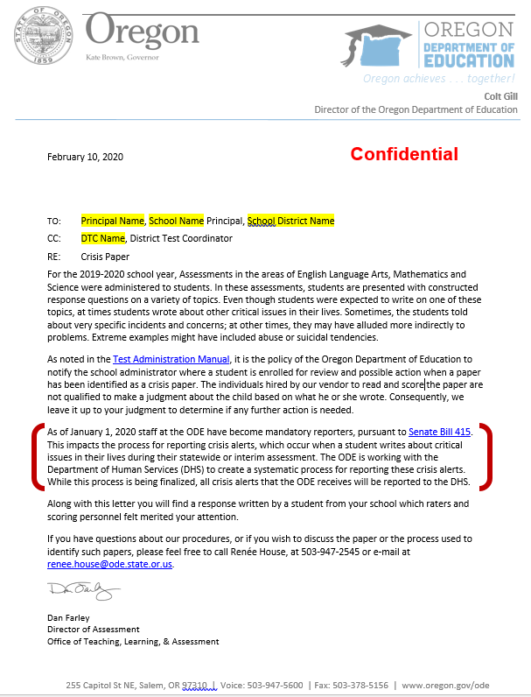
Updated Cover Letter
Notes:
The cover letter that is sent to the School Principal and DTC with the student’s writing that explains the alert has been updated to include ODE’s new role reporting to DHS, which has red brackets around it in the image in this slide.

Slide 5
Science
Do we have the new Science Assessment results and will we be administering it or the OAKS for Science this year?
Will there be any Science score interpretation webinars or documents?
Notes:
The achievement cut scores and descriptors are being presented to the State Board of Education for approval on February 20, 2020. This presentation was delayed by the cancelation of the January 16, 2020 State Board meeting due to anticipated inclement weather.
With approval by the state board, it is anticipated that scores will be available to districts in mid-March.
The OSAS Science Assessment administration window is currently open until June 5, 2020. A communication toolkit containing 1-page communication documents and powerpoints will also be made available to districts on our website following board approval. A webinar will be scheduled to provide basic information about the communication toolkit and data availability. Please be looking for notification of board approval, toolkit availability, webinar data and time, and district data availability announcements in the AA Update.

Slide 6
ELPA
If a student completes only part of the ELPA summative before it expires, will they get an overall proficiency level and domain scores? If yes, how many questions do they need to finish in order to get scores?
Notes:
At the end of the last day of the testing window, open ELPA Summative tests are “force completed.”
If the student has answered every item on the test, it is scored and reported (just as if the student had submitted it themselves).
If the student has not answered every item, the test is not scored or reported. Its data are retained for counting and recordkeeping purposes only.

Slide 7
Illustration Glossary (bit.ly/sb-ig)
Current Status: the IG is not yet in the operational assessment as ODE is still gathering evidence to inform a student-centered decision
  Accessibility Panel input
  Psychometric analysis
Option 1: Implement in 2020, later in the testing window
Option 2: Implement in 2021
Notes:
In January, ODE shared that due to its development cycle at Smarter Balanced, the Illustration Glossary would “go live” after Oregon’s testing window opened. This generated some questions and concerns from districts, so we have been gathering evidence to inform the most student-centered decision possible. Just a quick reminder that the Illustration Glossary is an embedded designated support available to students in the summative math assessment who would benefit from having non-construct-relevant words and phrases rendered as an image. You can use the Bitly URL on this screen to access the informational flier from Smarter Balanced which includes a video of what the IG looks like in action. In the flier, you will notice that two of the primary student groups for whom the accessibilty feature was designed are English Learners and students who have varying levels of proficiency in other text-based glossaries. If enabled for a student, the IG would be available in a fixed-form on the summative assessment. It is currently available on the practice and interim assessments.
The biggest concern of our team is whether a student would have a comparable testing experience using the IG as they would without it. To gather evidence on this, we reached out to our Accessibility Panel for their feedback, as well as Cambium Assessment’s psychometric team for a more detailed analysis of the fixed-forms. The Accessibility Panel was unanimously supportive of implementing the IG this year, citing that (a) it’s not a complicated support for students and teachers to learn and (b) visual elements are commonly used in universal design frameworks such as GLAD. The Cambium Assessment team has shared some simulation data with us that suggest the fixed-forms will not be a markedly different testing experience; however, ODE’s psychometricians have some follow-up questions that are not yet answered.
So, we had hoped to bring a decision to you today, but until we have gathered and reviewed all the evidence, two options remain:
Option 1 is to implement the IG this year, making it available later in the testing window to give students and teachers ample time to practice. Barring any substantially different information from Cambium Assessment, this is likely what will happen.
Option 2 would be to hold off until next year.
ODE will bring you a final decision as soon as we are able. In the meantime, we recommend circulating the flier around to STCs, teachers of English Learners, and others who may benefit from knowing, and introducing students to the IG in the practice tests. Any questions on the Illustration Glossary?

Slide 8
Essential Skills
How do you access/locate support and training for work samples?
Scoring and training resources are on ODE’s Essential Skills webpage.
Ask ESDs about workshops in your region.
Notes:
Recently, ODE has fielded several questions regarding professional learning resources and trainings for scoring Essential Skills work samples. We want to remind DTCs that scoring guides, feedback forms, anchor papers, and other helpful resources are available on ODE’s Essential Skills webpage. ODE is limited in our capacity to facilitate trainings in individual districts, however we can more easily accommodate regional workshops at ESDs. Please reach out to your ESD’s professional learning coordinator or director of teaching and learning to ask about workshop opportunities in your area.

Slide 9
Question & Answer
*Intentionally left blank*

Slide 10
Next Steps & Adjourn
A Q/A document will be posted to the Testing Resources page

