Slide 1
DTC Webinar
December 11, 2019
Welcome! Thank you for joining us. We will begin shortly.
Notes:
Good morning and welcome to our first monthly DTC webinar for the 19-20 school year. My name is Renee and in the room I am joined by ____
We also have Assessment Director Dan Farley remotely participating today.

Slide 2
Intro to the Format
Overview
  ODE-provided Quick Reminders + Topics (~5-25 minutes depending on the amount of content)
  ODE & DTC Question/Answer Session + Sharespace (~25 minutes depending on the amount of questions)
All questions will be addressed during the Q/A section.
  The meeting is recorded to facilitate the creation of a Q&A document after each meeting
  We will provide each Webinar PowerPoint on the Test Administration Resources webpage along with a Q&A document
Notes:
As a reminder for returning DTCs and to give an introduction to anyone that is new to the role this year, this webinar will consist of two sections. In the first section ODE will provide some quick reminders for upcoming events or due dates and have responses to any topics that were submitted from DTCs prior to this webinar. This can take anywhere from 5-25 minutes depending on the amount of content to share or how many topics were submitted. The second portion of the webinar will be the facilitation of a Q&A session where DTCs may ask staff from ODE that are present any follow up questions. There is also a Sharespace for DTCs to provide questions of best practice that they would like to hear from other DTCs. This is not always requested by DTCs so we may not always have a Sharespace slide to go over. Again, depending on the amount of questions submitted this can take about 25 minutes or longer. ODE will try to address all questions during the Q&A session, however if the person with the content knowledge to respond is not available we will respond offline. During the Q&A session ODE will mute the phone to be able to speak amongst ourselves and the knowledge in the room to compile a succinct response. Once the phone is unmuted the question will be read and the response will be provided. Within a week of the webinar the PowerPoint and a document with all of the questions and answers will be posted to the Test Administration Resources webpage.

Slide 3
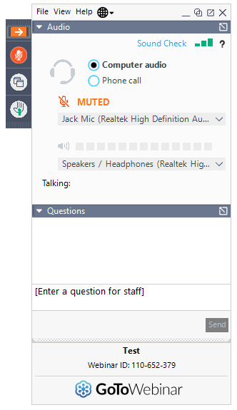
Before We Begin
To ask questions:
use the question box and your question will be read aloud and answered by ODE staff.
select the “raise hand” icon and you will be unmuted and able to ask your question.
Notes:
When we do get to the Q&A portion of the webinar there are two ways that you may participate. You can use the question feature and the presenter will see your question, read it aloud, and answer it. You may also use the raise hand feature and the presenter will unmute you so that you can ask your question.

Slide 4
Quick Reminders
Oregon Accessibility Manual Update 12/10/19
Online Test Delivery System (including Practice Tests), TIDE, and Online Reporting System (ORS) offline for scheduled maintenance 12/13/19-12/15/19
Online Reporting System (ORS) offline for scheduled maintenance 12/20/19-1/6/20
ODE is closed 12/25/19
ODE is closed 1/1/20
ELA, ELPA, Math, and Science test windows open 1/7/20
Notes:
The Oregon Accessibility Manual was updated yesterday. Guidance and clarification around enabling the Text-to-Speech (TTS) tracking feature has been updated on pages 16, 24 and 35. This change was made to reflect that this feature is located in the Test Administrator (TA) interface prior to approving individual students for test administration. The tracking feature highlights words as they are being read aloud by TTS. Students with attention difficulties or reading disabilities may need assistance with tracking when they are reading.
Online Test Delivery System, Online Reporting System are scheduled to be offline for maintenance December 13-15
Online Reporting System will be offline schedule maintenance again December 20-January 6
ODE will be closed December 25 and January 1
ELA, ELPA, Math, and Science test windows open January 7

Slide 5
Accessibility Supports
Are there any other accessibilities supports coming our way other than current text to speech/scribes?
Notes:
There are no additional accessibility supports that we plan to implement in 2020. We do have a system for users to request specific supports, so that process may result in some unanticipated supports. Of course, we have long-term efforts underway that will continue to improve the accessibility of our statewide assessment system.

Slide 6
SIA Plan
What measures are to be used, what's required for the grant applications, how will they be evaluated, what on-going measurements should we be working on?
Also, any regular reporting needs to board/community and what might be the impact of ODE embargoes on our ability to fulfill these reporting needs?
Notes:
In terms of the measure to be used, the reading proficiency component has already been shared in terms of what measure is to be used. It will be our statewide 3rd grade ELA summative assessment composite score. In terms of the first bullet point I think this is in regards to the optional local assessment or local metrics that might be used in addition to the 4 required components. We are in the process of working with Scott Nine’s team to elaborate a process for districts to follow in that arena. Of course there are a few options; developing lists of assessments that might be used specific to constructs that are pressing or relevant is one approach. I believe that the approach I will recommend is not that one but rather developing a list of criteria that should be used for districts to help guide districts making decisions about what local metrics might be possible to use in those context. It depends on the purpose for which the assessments are being used and the stakes associated with the decisions. Most of that work is still to be done and we’ll be working on that within the next 3 weeks with Scott Nine’s team and we’ll update you once we have more information.
In terms of reporting needs, we will reach out to Scott and his team and our accountability colleagues to make sure that we are giving you the information that you need in connecting those dots for you. I don’t have anything in addition to share. We understand the question and we’ll try to be responsive as we develop more of this process.

Slide 7
TIDE Setting for TTS for the ELA PT
Will the new test settings be updated in the training materials/guides?
Notes:
Progress to the following 3 slides for the answer and break down of this question.

Slide 8
Updated Designated Support
Text-to-Speech
The Oregon Department of Education has expanded the use of Text-to-Speech for the English language arts – Performance Task as a designated support.
Test Administrators will be able to set Text-to-Speech settings for ELA CAT and ELA PT tests differently.
Student Test Settings in TIDE will be broken out into two columns for the ELA CAT and ELA PT tests.
Notes:
The following changes have occurred…
The Oregon Department of Education has expanded the use of Text-to-Speech for the English language arts – Performance Task as a designated support.
Test Administrators will be able to set Text-to-Speech settings for ELA CAT and ELA PT tests differently.
Student Test Settings in TIDE will be broken out into two columns for the ELA CAT and ELA PT tests.

Slide 9
Differences Between the ELA CAT and ELA PT for Text-to-Speech
ELA CAT
ELA PT
Text-to-Speech in the ELA CAT for stimuli refers to the reading passages associated with Claim 1 Reading.
This support is only selectable as an accommodation for students whose need is documented in an IEP or 504 plan.
Text-to-Speech in the ELA PT for stimuli refers to the reading sources embedded in the ELA PT associated with Claim 4 Research and Claim 2 Writing (full write/writing extended response).
This support is now selectable as a designated support.
See Table 2.5 of the
Oregon Accessibility Manual
See Table 2.3 of the
Oregon Accessibility Manual
Notes:
For the ELA CAT:
Text-to-Speech in the ELA CAT for stimuli refers to the reading passages associated with Claim 1 Reading.
This support is only selectable as an accommodation for students whose need is (Animation) documented in an IEP or 504 plan.
For more information please See Table 2.5 of the Oregon Accessibility Manual.
For the ELA PT
Text-to-Speech in the ELA PT for stimuli refers to the reading sources embedded in the ELA PT associated with Claim 4 Research and Claim 2 Writing (full write/writing extended response).
This support is now selectable as a designated support.
For more information please See Table 2.3 of the Oregon Accessibility Manual.

Slide 10
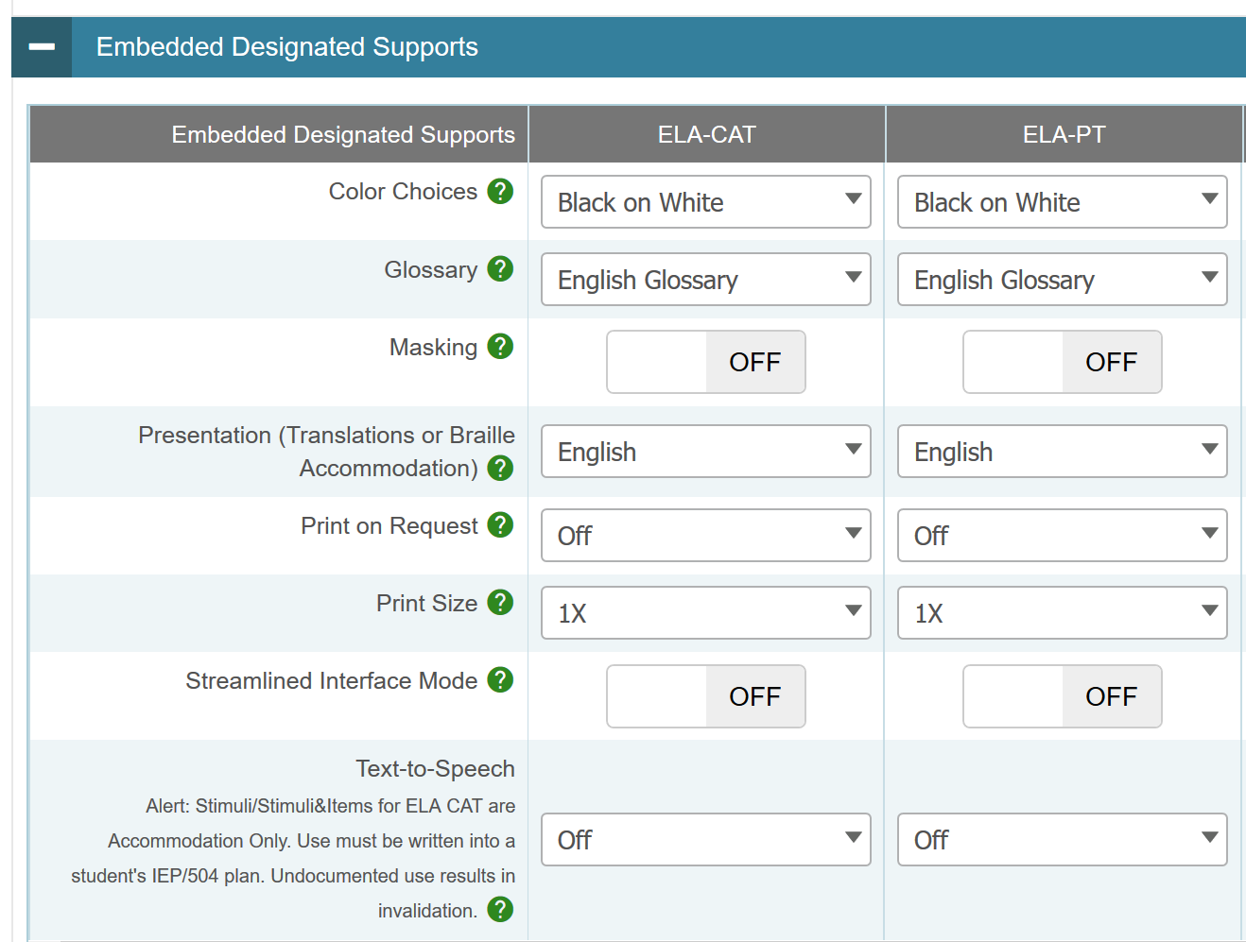
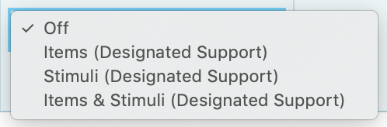
Changing Text-to-Speech
Supports in TIDE
Notes:
Text-to-Speech support settings are located under the (Animation - Appear) Embedded Designated Supports Section for both the ELA CAT and ELA PT.
Again (Animation - Disappear) (Animation - Appear)
Text-to-Speech in the ELA CAT for stimuli refers to the reading passages associated with Claim 1 Reading. This support is only selectable as an accommodation for students whose need is documented in an IEP or 504 plan.
(Animation - Disappear) (Animation - Appear) Use must be written into a student’s IEP/504 Plan. Undocumented use of Text-to-Speech for reading passages associated with Claim 1 Reading result in an invalidation.
The new expansion of text-to speech use for reading sources applies to only the ELA PT.
To activate the designated support for the ELA PT reading sources (Animation - Disappear) (Animation - Appear) select the text-to-speech drop-down menu under the ELA-PT tab.
Once selected (Animation - Appear) the user may change the setting to items; stimuli; or items and stimuli.
More information is posted on this has been posted to the Assessment Training Materials webpage under the 2019-20 Training Modules dropdown. Please watch Module 5A – Text-to-speech PowerPiont with audio. Please reach out to Tony Bertrand for additional support if you have questions after watching the video and reading the OAM.

Slide 11
Designated Support: Transcribe
I think it means that if a student uses Google speech to text during class to write essays then they can use it during the state test and a TA (test administrator) will then type it from the student’s computer to the secure browser. Is this accurate? If not, could you explain how it will work? Also how do we keep Google secure while the student is "typing"?
Notes:
The intent of this feature is to try to support student accessibility within our state assessment system in areas where specific assistive technology is insufficient or not connected to the secure browser directly. This question speaks to google speech which conveys the assumption that it’s an online format. We’re not able to ensure test security using any online resources. The transcribe feature is really intended to be used for local assistive technology devices where students speech is being transcribed into a local computer and there is no internet connectivity. That being said, we are and have been working on a google like solution for our secure browser so that students experience and instruction matches to the degree that we can make it match what they experience within the testing environment. We’re working with AIR on a pilot of that this year and you can reach out to Dan Farley (dan.farley@state.or.us) directly if you would like to be engaged in that pilot. The pilot will not be conducted in an operational context this year. We’re still developing those tools. AIR has been brokering conversations with google regarding security of student responses. In the meantime, the transcribe function is not intended to be used for any online platforms.

Slide 12
Long-Term Vision/Planning
Supporting districts in implementing balanced approaches to assessment, including formative practices, interim systems, and appropriate uses of summative assessment results (via Target Reports)
Parent Assessment Literacy Training Modules are being developed; we are completing the Spanish version, adding closed captioning, and conducting parent impact panels to ensure that the materials match parent needs.

Slide 13
Question & Answer
*Intentionally left blank*

Slide 14
Next Steps & Adjourn
A Q/A document will be posted to the Testing Resources page
Have a great holiday!

