Slide 1
DTC Webinar
December 12, 2018
Welcome! Thank you for joining us. We will begin shortly.

Slide 2
Intro to the Format
Overview
ODE-provided Quick Reminders + Topics (~5-25 minutes depending on the amount of content)
ODE & DTC Question/Answer Session + Sharespace (~25 minutes depending on the amount of questions)
All questions will be addressed during the Q/A section.
The meeting is recorded to facilitate the creation of a Q&A document after each meeting
We will provide each Webinar PowerPoint on the Test Administration Resources webpage along with a Q&A

Slide 3
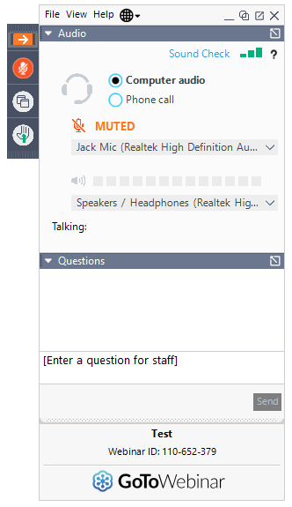
Before We Begin
To ask questions:
use the question box and your question will be read aloud and answered by ODE staff.
select the “raise hand” icon and you will be unmuted and able to ask your question.

Slide 4
DTC Feedback from 2017-18
No longer calling these discussions informal (they are recorded)
Won’t host the meetings live unless there is sufficient content to discuss (will leverage AA Update and/or DTC listserv instead in these cases)
Will try to discuss events we anticipate for the coming year, so DTCs are aware of our long-term vision/planning
Meetings will end with next steps and then adjourn

Slide 5
Quick Reminders
Online Test Delivery System (including Practice Tests), TIDE, and Online Reporting System (ORS) offline for scheduled maintenance 12/14-12/16/18
Online Reporting System (ORS) offline for scheduled maintenance 12/21-1/7/19
ODE is closed for the Christmas holiday 12/25/18
ODE is closed for the New Year’s Day holiday 1/1/19
ELA, ELPA, Math, Science and Social Sciences test windows open 1/8/19

Slide 6
Accessibility Supports
I would like some clarification around accessibility supports, specifically read aloud and separate setting. Can a student refuse these types of supports at the time of the test? Or do we have to read the test aloud if it is on the IEP?
Per the IEP, the support needs to be available to the student. However, the student can refuse to avail themselves of it. Documentation of the student’s refusal ought to be made and relayed to the student’s IEP team prior to its annual review of the student’s IEP and, specifically, the team’s deliberations related to the statewide assessment accessibility supports section of it.

Slide 7
ELPA Screener
How are scores sent to the district/schools?
Student scores are distributed via the Online Reporting System (ORS) in Individual Score Report format or Excel spreadsheet format. These reports are displayed and retrieved in the same manner as summative reports.
How did the schools that gave it this year determine who gives it? Teachers? Classified staff?
Which screening tool to administer this year, to which students, was decided by districts, who did not report their decision-making process to ODE.
For kindergartners, how did districts determine what supports would be needed if the student did not have an IEP?
Again, ODE was not privy to the district decision-making process. Allowable supports not requiring an IEP fall under the categories of Universal Tools (which can are available to all students based on student preference and selection) and Designated Supports (which are available to any student for whom the need has been indicated by an educator).
What's the estimated time to administer the screener, including scoring time?
We will supply you with a chart of estimated testing times.

Slide 8
Long-Term Vision/Planning
Working on interim/benchmark pilot this year in three districts (North Santiam, Eugene 4J, and Grants Pass)
Governor’s budget includes funding support for a Year 2 statewide implementation, now on to the Legislature
Governor’s budget also supports our goal of disseminating and supporting teachers in implementing formative assessment practices

Slide 9
Sharespace Topics
I would appreciate hearing from experienced DTC the most effective way they have found to train school TAs? I am worried about the length of the training and covering the necessary content and the amount of time it takes. It would be helpful for me to see what others have used for these trainings.
I would also like some clarification around what students can do when they have finished testing but other students are still testing. We do a lot of testing in classrooms, so "sending them back to class" doesn't work.

Slide 10
Question & Answer
*Intentionally left blank*

Slide 11
Next Steps & Adjourn
As mentioned, this video and Q/A document will be posted to the Testing Resources page.
Check for a small update to the TAM in the coming days
Have a great holiday!

