Slide 1
DTC Webinar
August 26, 2020
Welcome! Thank you for joining us. We will begin shortly.

Slide 2
Intro to the Format
Overview
  ODE-provided Introductions and Quick Reminders + Topics
  ODE & DTC Question/Answer Session + Sharespace
All questions will be addressed during the Q/A section.
  The meeting is recorded to facilitate the creation of a Q&A document after each meeting
  We will provide each Webinar PowerPoint on the Test Administration Resources webpage along with a Q&A document

Slide 3
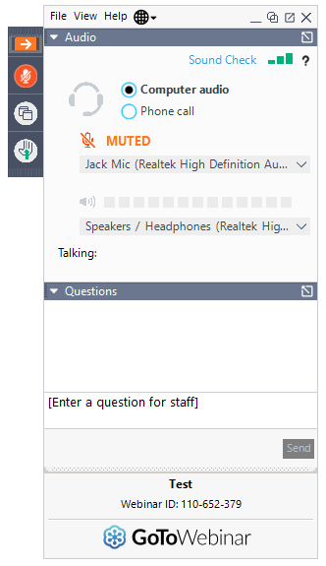
Before We Begin
To ask questions:
use the question box and your question will be read aloud and answered by ODE staff.
select the “raise hand” icon and you will be unmuted and able to ask your question.
Please navigate to www.menti.com for a quick survey. Enter CODE: XXXXXXXX

Slide 4
2020-21 Oregon Statewide Assessment System (OSAS) Update
If our summative assessment system is feasible...
Performance Tasks have been removed from Oregon’s summative assessment blueprints (ELA and Math) for 2020-21 (this decision will be revisited thereafter).
  Substantial reduction in testing time (graph on following slide)
  Essential Skills requirements in this area are under consideration.

Slide 5
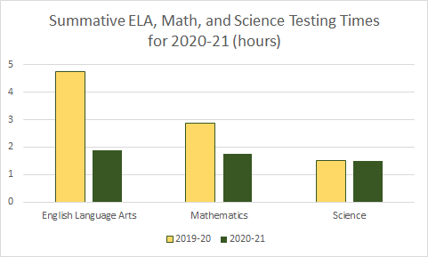
Anticipated Testing Time
Reductions
Comparisons based on 80th %-ile

Slide 6
2020-21 OSAS Update, cont.
ODE is providing statewide access to our Interim Assessments and Tools for Teachers resources, developed by Smarter Balanced, at no additional cost
  Additionally, ODE has collaborated with Cambium Assessment, Inc. to provide a remote administration option for students and educators.
Science interims now available for purchase ($4.95/student in G5, G8, & G11).
Summative assessment window for Grades 3-8 ELA, Math, and Science opens March 4, 2021.

Slide 7
2020-21 OSAS Update, cont.
Kindergarten Assessment is suspended for 2020-21.
10th grade students who have completed advanced coursework in ELA, math, and/or science will be allowed to “target up” to participate in respective 11th grade summative assessments.
  12th graders who desire to participate
  Early testing in science below 10th grade is no longer supported.
ODE plans to publish a Request for Proposals for our nationally-normed, practice college entrance examination for 10th graders.

Slide 8
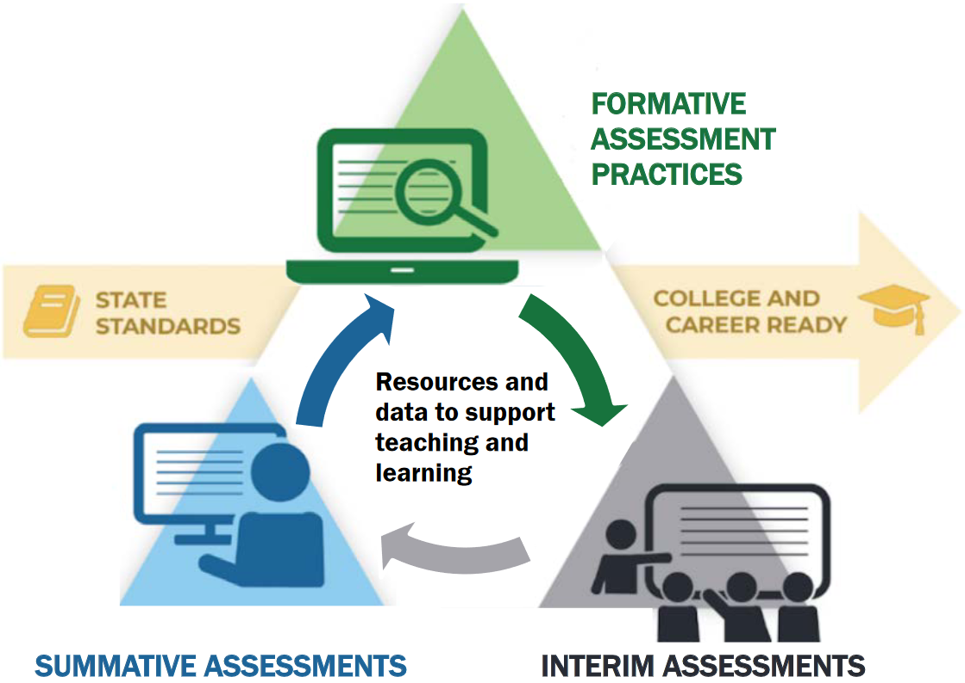
Balanced Assessment System
The Oregon Statewide Assessment System consists of three components: end-of-year summative assessments designed for accountability purposes, interim assessments designed to support teaching and learning throughout the year, and formative assessment practices. For ELA and Mathematics, we now have a suite of tools and resources in Tools for Teachers that support classroom-based formative assessment practices.
Notes:
The interim assessment bank and accompanying tools for teachers in ELA and Math are powerful tools for supporting teaching and learning.

Slide 9
Session Guide
Session | Title | Outcome
1 | Understanding a Balanced Assessment System | Gain familiarity with the difference in assessments within the Oregon Statewide Assessment System
2 | Overview of the OSAS Interim Assessment System | Identify the different components and types of interim assessments available within the Interim Assessment System.
3 | Using Interim Assessments in the Context of Instructional Practices | Explore how interim assessments can be utilized across the different content areas of ELA, Math, and Science
4 | Interim Assessment Administration: Guidance and Support | Identify how to access the Interim Assessment System through the OSAS Portal and administer tests.
5 | Accessing Interim Assessment Data to Inform Instructional Practices | Identify how to access the interim assessment data in the OSAS Portal and interpret the different available reports available.
6 | Exploring Tools for Teachers and Using Formative Assessment Practices | Connect the Interim Assessment System with playlists of instructional resources in Tools for Teachers, while supporting the formative assessment process.
Notes:
This series consists of six videos that will guide participants through each aspect of Oregon Statewide Assessment System: Interim Assessment System
Session 1 - Understanding a Balanced Assessment System – participants will gain familiarity with the difference in assessments within the Oregon Statewide Assessment System
In Session 2 - Overview of the OSAS Interim Assessment System – individuals will gain further knowledge about the Interim Assessment System and be able to identify the different components and types of interim assessments available within the Interim Assessment System.
For Session 3 - Using Interim Assessments in the Context of Instructional Practices – educators will engage and explore how interim assessments can be utilized across the different content areas of ELA, Math, and Science. It is important to note Session 3 will be broken out into content specific topics to allow educators to take a deeper look into the interim assessments including use cases.
Session 4 - Interim Assessment Administration: Guidance and Support – addresses the technical aspect of identifying Identify how to access the Interim Assessment System through the OSAS Portal and administer tests.
In Session 5 - Accessing Interim Assessment Data to Inform Instructional Practices – educators will learn how to navigate and to access the interim assessment data in the OSAS Portal and interpret the different available reports available to improve instructional practices for students.
Finally Session 6 - Exploring Tools for Teachers and Using Formative Assessment Practices – teachers will make connections to the Interim Assessment System with playlists of instructional resources in Tools for Teachers, while supporting the formative assessment process.

Slide 10
Purpose
The Oregon Statewide Assessment webinar series is designed to help teams of educators and administrators improve their teaching and learning systems using the tools and resources provided in a balanced assessment system.
Participants will build assessment literacy by connecting formative assessment practices, interim assessments, and summative assessments to continually improve access and outcomes for each and every learner in their care.
Notes:
The purpose of this series is to help district- and school-based teams improve their systems of teaching and learning using the tools and resources provided in a balanced assessment system.
[Click for animation]
All participants will build assessment literacy and connect formative assessment practices, interim assessments, and summative assessments to continually improve access and outcomes for each and every learner in their classroom, school, and district.

Slide 11
Overview TIDE User Roll-Over Accounts
When TIDE rolls over from the 2019-2020 to 2020-2021 school year, all users will remain in TIDE with the same user role.
Since Oregon now has an Interim Assessment system statewide, there exists a need to grant access to different aspects of the Oregon Statewide Assessment System:
  The new “Test Group” field accounts for this
No users will have the ability to start a test session until this Test Group field is assigned. (This includes the Interim Assessment System)

Slide 12
“Test Group” Field
DTCs, DLUs and/or STCs must update user accounts to add permission to administer tests by Test Group.
Test Group permissions may be added via Upload Users or individually by opening an account in the View/Edit Users module.
DTCs must contact their Regional ESD Partner to request that Test Group permissions be assigned for their own DTC account.

Slide 13
“Test Group” Field
The Test Group field is organized into three categories with permissions to the following tests:
ELPA Screener | Interim | Summative
ELPA Screener | ELA Interims | ELA
 | Math Interims | Math
 | Science Interims (if purchased) | Science
 |  | ELPA Summative

Slide 14
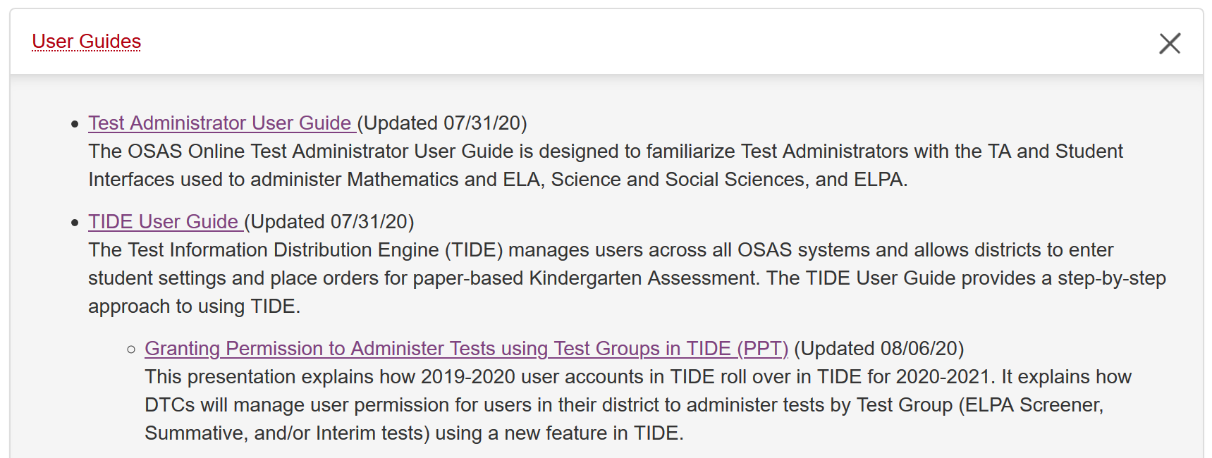
User Roles and Setting Up Test Administrator Accounts

Slide 15
Interim Training Requirements
DTCs need to apply the “Interim” Test Group to each user that will administer the interim assessments. This user permission must be set in TIDE via the View/Edit User interface or the User Upload module.
  Users will not be able to administer the interim assessments if the Test Group permission is not assigned to their user account.
If the TA is a returning user from 2019-20, there are no additional requirements required to apply the “Interim” Test Group.
However, if an educator does not have a 2019-20 TA user role, they must complete the reading requirements in Table 5 of the Test Administration Manual and the ODE-provided training modules 2 - 4 posted to the Assessment Training Materials webpage.

Slide 16
Utilizing the Interim Assessment System
For most students, grade-level interim assessments, rather than tests aligned to the prior grade’s content standards, will provide the most actionable information for teachers in support of their students’ learning.
ELA Interims
Read Literary Text
Read Informational Text
Brief Writes
Revisions
Performance Tasks
Research
Math Interims
Concepts and Procedures
Problem Solving
Modeling and Data Analysis
Communicating Reasoning
Science Interims
3-D
Earth/Space
Life Science
Physical Science.
The science interims are available for $4.95 per enrolled student.
Notes:
Science Items are three dimensional aligned to the disciplinary core ideas. It is important to note that the Science Interim Bank is at an earlier stage of development and does not have the number of items or robust tools for teachers component at this time.
I’m going to handoff to Tony who will share more detailed information with you regarding the contents of the ELA and Math Interims.

Slide 17
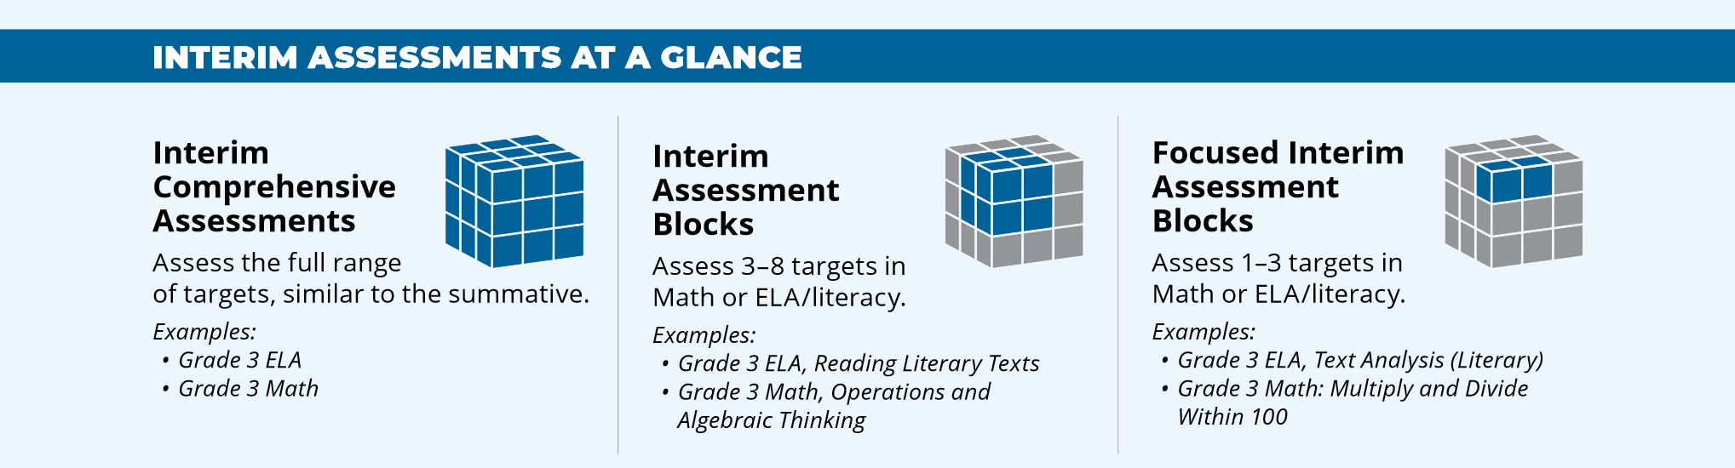
Oregon’s ELA and Math Interim Assessment System
Smarter Balanced offers the following interim assessments:
Interim Comprehensive Assessments (ICAs) test the same content and report scores on the same scale as the summative assessments.
Interim Assessment Blocks (IABs) provide more detailed information for instructional purposes.
Focused IABs provide educators with a finer grained understanding of student learning.
Notes:
Provide context to the different IABs available for the Smarter Balanced Interim Assessment System
Clarify Science Interims are IAB level only at this time.
Share 2020 - 2021 Interim Assessment Overview PDF in chat: https://portal.smarterbalanced.org/library/en/interim-assessments-overview.pdf
Share Interim Assessment Overview Video link in chat: https://youtu.be/Im-thuZCp4c

Slide 18
Features of Interim Assessments
Free statewide access to ELA and mathematics interim assessments and Tools for Teachers
Flexible administration options better support local purposes.
  Remote administration option for ELA, Mathematics, and Science
Items include all the accessibility resources available in the summative assessment to help provide accurate results for students.
Student performance on Interim Comprehensive Assessments (ELA and Math) is reported on the same scoring scale as the summative assessment. (Available beginning January 5, 2021)
Notes:
Flexible administration options: Teachers may utilize interim assessments in a variety of ways that Tony will share with you in a few moments.

Slide 19
Features of Interim Assessments
May be used to measure students’ knowledge and skills in grade levels other than the students’ enrolled grades.
Cover the range of cognitive demand described in Oregon’s State Standards.
Allow educators access to use Standardized and Non-standardized administration. (view the test questions and their students’ responses to the test questions as part of educators’ instructional process).
Identifies students’ relative strengths and needs for improvement.
Notes:
Flexible administration options: Teachers may utilize interim assessments in a variety of ways that Tony will share with you in a few moments.

Slide 20
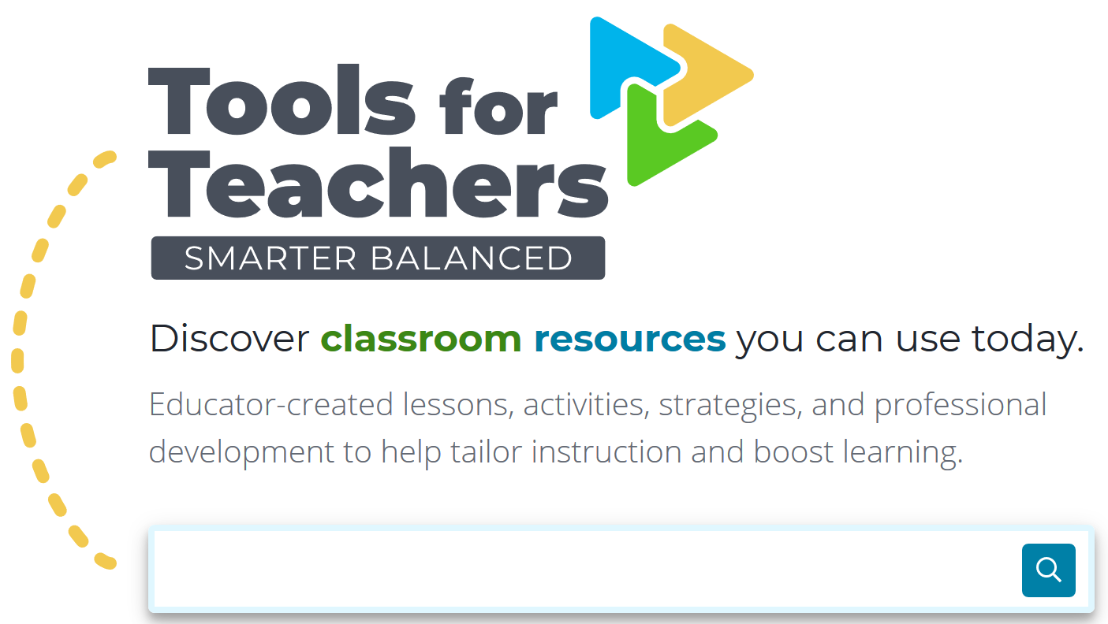
Tools for Teachers
To support formative assessment, Smarter Tools for Teachers is an online collection of high-quality instructional and professional learning resources contributed by educators for educators.
Notes:
These resources are aligned to college- and career-ready standards and help educators implement the formative assessment process to improve teaching and learning.

Slide 21


Tools for Teachers
Replaces Digital Library
“Connections Playlists” connect interim assessments with instruction
Instructional resources are differentiated
Embedded formative assessment strategies
Supports bookmarks & annotations
Connects intelligently to Content Explorer and Sample Items
Notes:
Reminder about “by teachers, for teachers”.

Slide 22
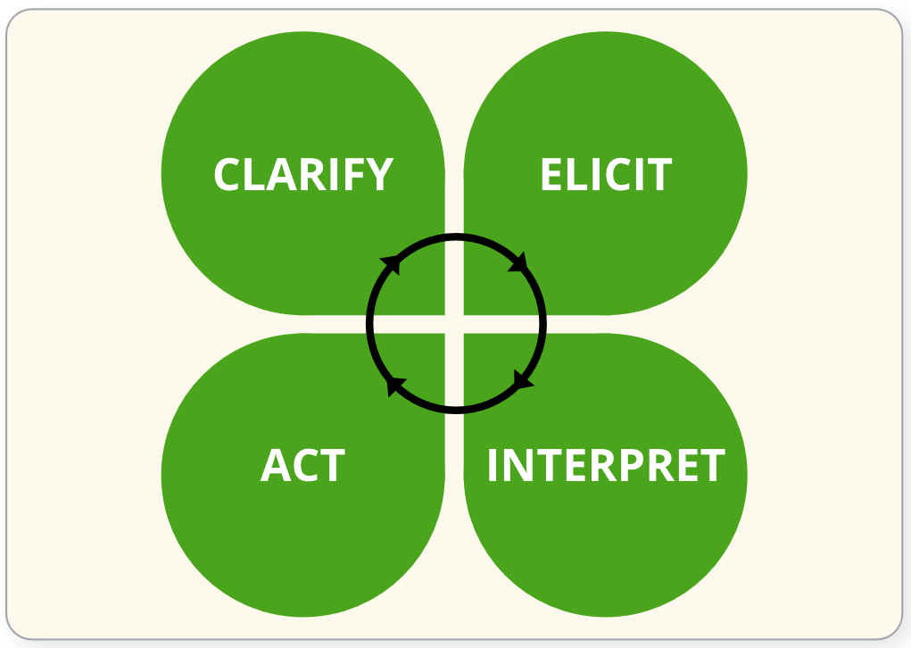
Tools for Teachers and Connecting the Formative Assessment Process
Formative Assessment is a deliberate process used by educators and students during instruction that provides actionable feedback that is used to adjust ongoing instructional strategies to improve student learning.
Notes:
To share in chat: https://portal.smarterbalanced.org/library/en/formative-assessment-process.pdf

Slide 23
Quick Reminders
These are placeholders at this time from past DTC WEBINARS and need to be updated.
Oregon Test Administration Manual DATE
Oregon Accessibility Manual DATE
Online Test Delivery System (including Practice Tests), TIDE, and Online Reporting System (ORS) offline for scheduled maintenance 12/13/19-12/15/19
Online Reporting System (ORS) offline for scheduled maintenance 12/20/19-1/6/20
ODE is closed 12/25/19
ELA, Math, and Science (general and alternate) and ELPA Summative test windows open 1/5/2021
Notes:
The Oregon Accessibility Manual was updated yesterday. Guidance and clarification around enabling the Text-to-Speech (TTS) tracking feature has been updated on pages 16, 24 and 35. This change was made to reflect that this feature is located in the Test Administrator (TA) interface prior to approving individual students for test administration. The tracking feature highlights words as they are being read aloud by TTS. Students with attention difficulties or reading disabilities may need assistance with tracking when they are reading.
Online Test Delivery System, Online Reporting System are scheduled to be offline for maintenance December 13-15
Online Reporting System will be offline schedule maintenance again December 20-January 6
ODE will be closed December 25 and January 1
ELA, ELPA, Math, and Science test windows open January 7

Slide 24
Question & Answer
*Intentionally left blank*

Slide 25
Next Steps & Adjourn
A Q/A document will be posted to the Testing Resources page
Thank you again for joining us today!

