Slide 1
English Language Proficiency Assessment (ELPA) Screener
Informational Slides
Notes:
These are the English Language Proficiency Assessment Screener Informational Slides, which contain introductory information about the ELPA Screener. These slides are suitable for people who are new to the ELPA Screener or who would like to be refreshed on basic functions and policies related to the Screener. To learn more about updates that are relevant to the coming school year, consult the yearly ELPA Informational Webinar.

Slide 2
Purpose and Use
  The ELPA Screener measures proficiency in reading, writing, speaking and listening English based on Oregon’s English Language Proficiency Standards.
  Determines eligibility for English Language Development (ELD) services.
  Administered mostly when Language Use Survey indicates a primary home language other than English (however, remember that Native American/Alaska Native students can also have EL status).
Introduction
Notes:
The principal purpose of the ELPA Screener is to confirm possible English learner status, as defined by the US Department of Education. The USDoE specifies that a valid and reliable English language proficiency screening instrument must measure student English proficiency in four domains. While many students taking the Screener come from environments with high use of languages other than English, remember that under the federal definition of an English learner, Native American or Alaska Native students who indicate English as their primary home language can still be identified as English learners.

Slide 3
Screener and Summative
ELPA Screener
Year-round
Determines eligibility for ELD services
Taken once
Single test
ELPA Summative
Specific testing window
Determines readiness to exit ELD program
Taken yearly
Four individual domain tests
Similarities
Online administration
Fixed form
Design, scoring, interface, report
Accommodations and supports
Introduction
Notes:
The ELPA Screener and ELPA Summative differ in purpose and availability. Notably, the Screener is a one-time event, which determines student eligibility for English language services, while the Summative is an annual expectation, taken by all students who have EL status.
The format, scoring, and appearance of the Summative and Screener are very similar. Both the Screener and the Summative are “fixed form”, which means that at a given grade level, students always see the same items. Note that all accommodations and supports available for Summative testing are also available for the ELPA Screener.

Slide 4
Language Use Survey
The Oregon Language Use Survey (LUS) determines who to screen
  A “screener for the screener”
  Remember the federal definition of “English Learner” (included in slide notes)
Use as is—do not modify
Question? Comments? Contact your district’s Title III Specialist.
Introduction
Notes:
The Language Use Survey is a preliminary instrument that helps identify students who need screening because they may meet the federal definition of an English learner. There is one statewide Language Use Survey, which must be used unaltered. The full federal definition of an English learner can be found in the notes to this slide.
English learner – The term “English learner,” when used with respect to an individual, means an individual —
who is aged 3 through 21;
(B) who is enrolled or preparing to enroll in an elementary school or secondary school;
(C)(i) who was not born in the United States or whose native language is a language other than English; (ii)(I) who is a Native American or Alaska Native, or a native resident of the outlying areas; and (II) who comes from an environment where a language other than English has had a significant impact on the individual's level of English language proficiency; or (iii) who is migratory, whose native language is a language other than English, and who comes from an environment where a language other than English is dominant; and
(D) whose difficulties in speaking, reading, writing, or understanding the English language may be sufficient to deny the individual — (i) the ability to meet the challenging State academic standards; (ii) the ability to successfully achieve in classrooms where the language of instruction is English; or (iii) the opportunity to participate fully in society. (ESEA Section 8101(20))

Slide 5
Reflection #1
How would you respond to the following misuses of the Language Use Survey?
“The family’s last name is XXX, so we should screen the student.”
“We should ask the student a few questions to better gauge their English capacity.”
“We should ask the student’s parent/guardian to rate the child’s expertise in academic English.”
Note: The orange Reflection slides are written primarily for users who are not yet familiar with the ELPA Screener. Experienced users may skim or skip the Reflection slides, unless their district requires review.
Introduction
Notes:
This and future Reflection slides may be a good place to pause the presentation and think, or have a short discussion with someone who may be watching the presentation with you. What concerns might be raised by the quotations on this slide? Some possible concerns related to these questions are listed in the notes for this slide.
1. We do not screen based on last name, appearance, or suspected ethnic category—all of these, and factors like them, are potential civil rights violations. We screen solely on information directly concerning the student’s experience with English.
2. The Language Use Survey does not replace the Screener and should not be used to try to figure out the student’s English proficiency. Parents or guardians should supply information about the home language environment and the student’s history with language.
3. Again, the Language Use Survey does not replace the Screener. The Language Use Survey tells us about the student’s history with language, not their current proficiency. It might also be beneficial to phrase our questions more in terms of “how often” or “in what situations” or “when and under what conditions did the student learn this language.” Parents don’t automatically know what we mean when we say “academic English.”

Slide 6
Before Screening
Notes:
Now we will follow the screening process from beginning to end, starting with Test Administrator training prior to screening and ending with the score reporting and proficiency determination.

Slide 7
Test Administrator (TA) Requirements
TA required training (listed on ODE website):
  Read ELPA Screener Administration Manual
  ELPA Screener Administration Module or ELPA Screener Informational Slides (i.e. these slides)
    If district does not require one module over the other, TA may choose which to complete
  ELPA Screener Speaking Scoring Document
  “Base” TA training: modules 2-4, assurance of test security form, TAM and OAM readings
New TAs will complete Screener training before administering first Screener and again at time of annual ODE-required training
Before screening
Notes:
The materials listed on this slide form a baseline of required training materials. If special circumstances require ODE to add or modify training materials mid year, Test Administrators and District Test Coordinators should review the new material, but they do not need to review all training materials from scratch.
Test Administrators who join a district mid-year need to complete training before administering the ELPA Screener to students. If the district has an annual season for completing ODE-required trainings, the newly arriving Test Administrator should renew their training at that time. Otherwise, their training is good for a full calendar year (although they will of course need to review any relevant updates over the course of that year).
Further optional training materials are available on the ODE website, such as reporting system training slides, speaking scoring slides, and the ELPA informational webinar.

Slide 8
Practice for TAs
Screener and Summative formats are virtually identical. To preview test layout and task types, see:
  ELPA sample test
  Elementary and Middle and High School​​ Speaking Scoring Practice Slides
    Speak these rather than reading them for a more authentic replication of the scoring experience.
Also, at the beginning of each session there is a short practice section that the TA and student do together (more detail in following slides).
Before screening
Notes:
Both for test security and maximizing reliability of state data, districts should not create “demo” students so that Test Administrators can explore the ELPA Screener. Although ELPA21 has not developed a dedicated “training version” of the Screener, available training materials should be sufficient to help new Test Administrators get a feel for the Screener.
The existing Sample test is a good starting point. The only feature of the Screener not represented on the Sample test is the TA-scored Speaking items; to help Test Administrators build an understanding of how this part of the test will function, we recommend both the required training materials dealing with speaking scoring, and one or both sets of Speaking scoring practice slides linked here. The scoring practice slides can be used to calibrate scoring and inter-rater reliability among your staff.
Finally, note that each testing session begins with a series of practice items, which can serve a secondary purpose of reorienting the TA to the Screener each time a new test is proctored.

Slide 9
Testing Environment
Should resemble summative testing environment:
  Quiet, secure testing environment
  Space for TA to work 1-to-1 with student
  Enrichment materials nearby (for TA scoring step)
  Appropriate sound/recording equipment
  Accommodation decisions already made
    Recommend entering exemptions in TIDE at least 24 hours before testing
  Necessary manuals on hand (Screener Manual, Oregon Accessibility Manual)
Before screening
Notes:
Just as with the Summative, the Screener must be administered in a secure, distraction-free, prepared environment.
It is a good idea to set accommodations and supports, such as domain exemptions, at least 24 hours prior to testing.

Slide 10
Reflection #2
Suggested TA turn and talk*:
(If you have the luxury of choice,) To what kind of student will you administer your first Screener?
Name three ways you can practice to familiarize yourself with the Screener. [Have TAs read scripts aloud to each other]
How will you prepare the testing environment to minimize stress when it comes time to screen?
*activity could take several forms
Before screening
Notes:
It may be useful for new TAs to think through their first experience with the Screener ahead of time. If multiple students are scheduled for screening, consider beginning with students who appear to have the greatest initial English proficiency or the most experience with technology, so the TA can focus on Screener administration rather than navigating a complicated interaction with the student.
Review and get comfortable with all materials before a first experience with the Screener.
Make preparations and ready materials prior to testing so the TA’s full attention is available for test administration.

Slide 11
Student IDs
Students may test under a Temporary ID or SSID.
Districts should test using an SSID when possible
Districts can attach a Temp ID test score to an SSID via “merging” (more later)
Before screening
Notes:
Students may be screened using either their state-assigned SSID or a system-generated Temporary ID. Each ID has a single screening opportunity. When possible, it is preferable to screen students using their SSID; however, sometimes screening must be completed before an SSID becomes available (for example, meeting federally required identification timelines). Temporary IDs ensure that there will always be an ID available for any student who needs screening. Districts can perform a “merge” following screening to permanently associate a score with the student’s SSID.

Slide 12
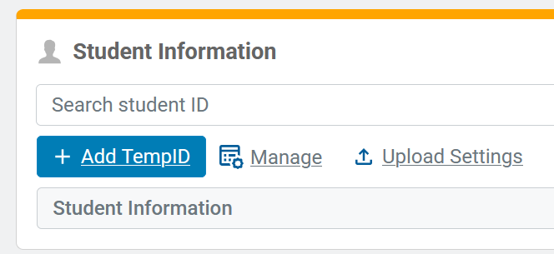
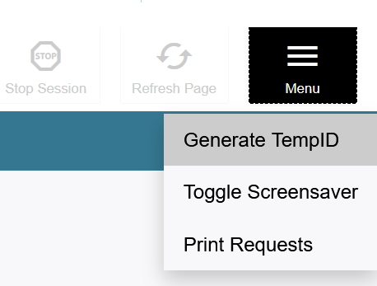
Temporary IDs
Created two ways:
  TIDE
  During login
Format “ORT-#”
Can be merged with SSID (recommended but not required)
  Birthdate must match exactly, name can be “close”
Name and birthdate are editable fields, institution is not
Before screening
Notes:
Temporary IDs may be created in advance, through the Test Information Distribution Engine, or as needed through the testing interface. Temporary IDs are always created one at a time. Temporary IDs are not the same thing as a local or district-issued ID; all Temporary IDs begin with the three-letter prefix ORT. To preserve information about a student’s testing history, districts are encouraged, though not required, to later merge Temporary IDs with students’ permanent SSIDs. This can be performed using a batch process. The system uses a “fuzzy matching” algorithm to help find records where the student’s name is close but not identical; however, a student’s birthdate must match exactly. It is preferable to minimize data entry errors when creating Temporary IDs.

Slide 13
Accommodations for Students Without a 504 or IEP
Test Administrator may select accommodations for which there is “good evidence,” e.g.:
  information from parents/caregivers
  clearly observable evidence of a disability
  medical documentation
District must store documentation of evidence supporting selected accommodations in student’s permanent file
In some cases, the district may feel it is in the best interests of the student with a suspected disability to delay screening. Contact your district’s Title III Specialist for more information.
Before screening
Notes:
A district may believe that a student slated for English language proficiency (ELPA) screening may qualify for services under a Section 504 or Individualized Education Program (IEP), but typical documentation, such as a comprehensive evaluation report, may not be available to support such a determination. In such cases, if screening timelines preclude the convening of an effective 504 or IEP team, the test administrator (TA) may select any accommodations on the ELPA Screener for which there is good evidence of student need (e.g., information provided by parents or caregivers, clearly observable evidence of a disability which impedes access to one or more domains, relevant medical documentation).
Districts who pursue this course of action must record and store evidence used to select accommodations, along with other screener documentation, in the student’s permanent file. Information on accommodations and accessibility supports is given in the Test Administration Manual and the Oregon Accessibility Manual found on ODE’s Test Administration page.
There are also cases where a district may believe there are good reasons to delay screening for students with a suspected disability. Please contact your district’s Title III Specialist for more details.

Slide 14
Reflection #3
Suggested TA turn and talk:
Explain how to create a Temp ID for a new student.
When choosing accommodations for a student who might qualify as having a disability, explain what “good evidence” means to you.
Before screening
Notes:
TAs who are new to the ELPA Screener may find it useful to summarize the procedures for creating a Temporary ID, and what counts as “good evidence” for implementation decisions based on the suspected presence of a disability. In addition, your district may have specific policies or procedures for selecting and recording evidence used to justify implementation of accommodations for a student who may have a disability.

Slide 15
Future/Early K or K?
Future/Early K test form:
  Available from March 1 until the opening of the Grade K form
  Identical to Grade K test form
  Has a different scoring profile (3+ on non-exempt domains)
Be sure to enter the appropriate grade code so that students entering Kindergarten do not accidentally “roll up” into Grade 1.
Before screening
Notes:
Students screening in Grade K may see two different test forms on the test selection screen: Grade K and Grade Future/Early K. These forms are the same test, meaning they have the same items in the same order. However, the two forms apply different scoring rules, which will be outlined later in the presentation.

Slide 16
Future/Early K Test Selection
On the test selection screen…
“Future/Early K” students (enrolled in Grade Pre-K) can see the Future/Early K test only.
Kindergarten students (enrolled in grade K) can see both the K and Future/Early K test. Enrollment date determines which form to use for testing students.
Before screening
Notes:
From August through February, only one kindergarten form is visible on test selection screens. From March through July, kindergarten students may be able to see both forms available on their test selection screen. The TA should be ready to help them choose the correct form.

Slide 17
Future/Early K or K Test Forms
Use the Future/Early K form for:
Students who will enter Grade K in the coming school year
Grade K students who test on or prior to the opening of the Grade K Screener
Use the Grade K form for:
Grade K students who test on or after the opening of the Grade K window (the same day as the ELPA Summative window)
Usually, only one form is selectable. Both forms are selectable March through July. If you choose the wrong form, your DTC should report as a test impropriety.
Before screening
Notes:
Students who have not yet begun their kindergarten year always use the Future/Early K form. Students who have begun their kindergarten year and who test prior to the opening of the Grade K Screener window also use the Future/Early K form, even if they are already receiving instruction in a kindergarten classroom. Students who test during the Grade K window of their kindergarten year use the Grade K form. Districts should only need to make a choice about which form to select in the months of March through July, when late-arriving kindergarten students test on the Grade K form, and students who have not yet begun their kindergarten year test on the Future/Early K form.

Slide 18
During Screening
Notes:
Now let’s move on to the test itself.

Slide 19
Screener Steps
  Step 1 (“Practice Step”): unscored practice items
  Step 2 (up to the early stop rule): scored items
    Speaking first, scored by TA
    Other three domains follow, machine-scored
  Step 3 (full screener): more scored items
    All domains, mixed machine-scored and constructed response items
During screening
Notes:
The ELPA Screener is divided into three steps. Each time the test advances beyond a step, the student can no longer return to items in the previous step.

Slide 20
Screener Structure
Step 1
(Practice)
Practice Items
Determine Participation
Step 2
(Scored Items)
TA-scored speaking items
Early Stop Rule
Step 3
(Refining the Score)
No TA-scored items
Full Screener
During screening
Notes:
Practice step 1 previews the test. This helps the student become comfortable with test operation and allows the TA to determine the student’s facility with testing technology, as well as the student’s level of participation.
Step 2 includes an initial set of scored items from all four domains. The beginning of this step includes TA scoring responsibilities. At the end of this step, the test performs a quick calculation to see if the student could possibly be proficient, or if the test needs to end.
Step 3 includes more items from all four domains. This step is administered only to students who could possibly score Proficient. The TA has no scoring responsibilities during this step.

Slide 21
Step 1 (“Practice Step One”)
  Purpose: familiarize student with interface, help TA determine student comfort level with technology and test
  A limited set of unscored items
  1-to-1 with TA
  Last couple of items are Speaking
    Review “too soft” warning
  At end, TA (not student!) indicates student participation and familiarity with technology.
    A student may proceed independently or one-to-one with technology assistance from TA
    Practice Step One must be finished for a usable Screener score
During screening
Notes:
Just as the name indicates, the items in Practice Step 1 are for practice purposes only. They help preview required interactions for the student, such as operating the record and playback functions for the Speaking portion of the test. During this step, the TA will observe student interaction with the test. At the end of this step, the TA will indicate the student’s participation level and whether the TA will be providing any technology assistance going forward. If the test is stopped before the TA indicates the student’s participation level, it will be scored as Not Attempted. A student with a Not Attempted score is considered not to have been screened and a Not Attempted score cannot be used to make EL status decisions.

Slide 22
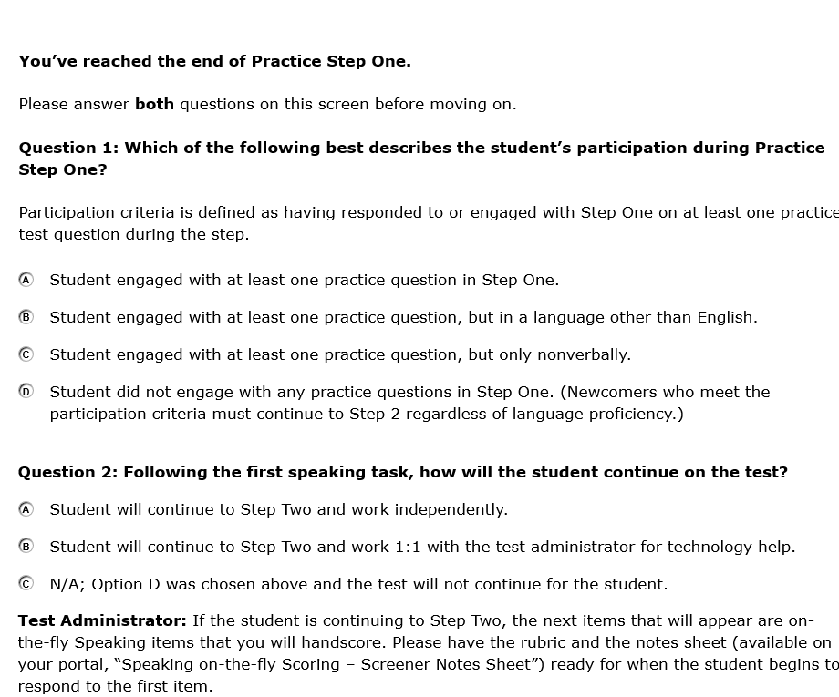
Step 1 Screenshot (1/2)
Insufficient supervision during this step is a frequent cause of ELPA Screener improprieties.
During screening
Notes:
This screen will appear at the end of Practice Step 1. The TA answers these questions, not the student. Unsupervised students may choose an inappropriate answer, which could lead to a testing impropriety.

Slide 23
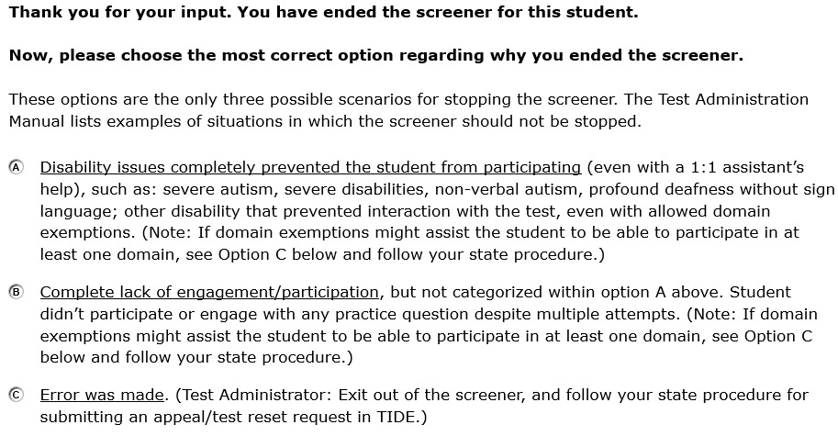
Step 1 Screenshot (2/2)
If you see this screen and select option C, the next step is for your DTC to submit a test impropriety report and request that the test be Reset. If the student is designated as a non-participant, a Reopen will not solve the issue.
During screening
Notes:
Should the TA indicate that the student is a non-participant, they will see a follow-up question asking them to indicate their reason for the choice. The answer choices also include appropriate next steps, as well as what to do if the option was selected in error. Once again, responding to this screen is the TA’s responsibility, not the student’s.

Slide 24
Who is a Participant?
Participant examples
Responds in a language other than English
“Clicks through” to finish as fast as possible
Engages nonverbally (e.g. pointing)
All responses “I don’t know”
“Plays” with test
Non-participant examples
Complete refusal
Unable to interact with interface (such as pointing at items on screen)
Totally withdrawn
During screening
Notes:
Any student who meaningfully interacts with the test is considered a participant. This slide contains a non-exhaustive list of examples illustrating participation and non-participation. The definition of meaningful interaction is broad. Newcomers with no knowledge of English still count as participants, even if their response to the test is a variation of “I don’t know” or “I don’t understand.” The goal of the Screener is to measure a student’s English language proficiency, and responses such as “I don’t know” are still supplying the test with important information about the student’s level of proficiency.

Slide 25
Reflection #4
  Suggested TA turn and talk:
  What will you see when you first log into the Screener? How is this different from the Sample Test? [“Sample Test” in tiny letters in the top bar vs. “Practice” in large letters under item number]
  Generate at least three “what if” questions you will ask students (or ask about students) to verify that they can successfully use the technology.
  Explain the difference between a participant and a non-participant.
During screening
Notes:
Some districts have reported that TAs see the word “practice” and incorrectly assume that they have accidentally logged into the Sample test. It may be a good idea to clarify with TAs what they can expect to see upon entering the Screener and how it differs from the Sample test. Also, we have seen numerous reports from TAs which demonstrate inaccurate understandings of participation vs. non-participation.

Slide 26
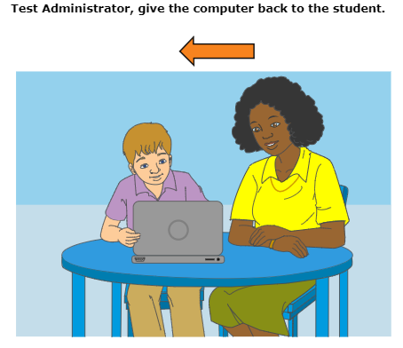
Step 2
  Begins with set of speaking items
    TA hand-scores on 2-point rubric (never the student!)
    Have enrichment materials nearby in case they are needed
  Continues with mixed items from other three domains
    All machine-scored
  “Early stop rule”
    No chance to score Proficient in all domains: test ends
    Otherwise, student continues to Step 3
During screening
Notes:
Step 2 of the Screener consists of scored items from all four domains. Practice Step 1 ended with a set of Speaking items; Step 2 begins with Speaking items, so that the recording procedure is still fresh in the student’s mind. After recording responses to this set of items, the student will surrender their computer to the TA, who will score the student responses. An unsupervised student may accidentally score their own Speaking responses, thus leading to an inaccurate Screener result and a testing impropriety.
At the end of Step 2, the test calculates the student’s performance thus far. If there is no chance that a student can score Proficient, even if they complete all the remaining items on the Screener, then the test stops here and the student receives a confirmation message that they have completed the test. If there is a chance the student could score Proficient, the test proceeds to Step 3.

Slide 27
Reflection #5
  (Tailor activity to the needs of the training group)
  Read the Speaking Scoring Document
  Quiz yourselves (pair or group probably better than solo if possible) using the Speaking Scoring Slides.
  Discuss where your answers varied from the suggestions and why they varied. If you disagree with the suggested score, what is your reasoning?
During screening
Notes:
The required Speaking Scoring training document includes sample student responses with associated score points. TAs may also wish to use one or both sets of Speaking Scoring Slides to create a more realistic scoring scenario. These slides include an ELPA-like question with a range of student responses on one slide, and suggested score points with rationales on the next.

Slide 28
Step 3
  For students who may be Proficient
  Mix of items from all non-exempt domains
    No TA scoring
    Speaking and Writing items scored by vendor
  Takes a little less time than the ELPA Summative
During screening
Notes:
As stated before, students who may possibly be Proficient advance to Step 3 of the Screener and are administered additional items from all non-exempt domains. TAs have no scoring responsibilities during this step, but it does include human-scored items. Specifically, there are Speaking Constructed Response items in all grades, and there are Writing Constructed Response items in grades 2-12 (not K-1). Scoring on these items is performed by our handscoring vendor.

Slide 29
Estimated Testing Times (Minutes)
Grade Band | Step 2 | Step 3 | Total Time for Steps 2 and 3
K | 8 | +10 | 18
G1 | 11 | +17 | 28
G2-3 | 11 | +36 | 47
G4-5 | 15 | +31 | 46
G6-8 | 14 | +37 | 51
G9-12 | 19 | +42 | 61
Data source: 80th percentile, 2024-25 student testing in OR.
During screening
Notes:
This chart summarizes the total expected testing time for the 80th percentile of students in Oregon.

Slide 30
Pause and Auto-Submit
  If the student is inactive more than 20 minutes, the test will be paused and the student logged out.
  After fourteen full calendar days, an incomplete test will be automatically submitted for scoring.
  Accidental auto-submit or other screening difficulty? Submit a test impropriety via the ODE website.
During screening
Notes:
The ELPA Screener can be paused and resumed like Oregon’s other tests. However, once a test opportunity has been opened, it must be completed within 14 calendar days. At the end of the 14th day, the test will be automatically submitted for scoring.
The ELPA Screener can be reopened and reset, like Oregon’s other tests. In the case of an undesired auto-submit or other difficulty, it is better to request that the partially completed test be reopened rather than opening a new test. Such requests are made by the District Testing Coordinator, using ODE’s testing impropriety form.

Slide 31
After Screening
Notes:
Now let’s talk about scoring and proficiency.

Slide 32
Proficiency Profiles (1/2)
  Purpose of “overall” labels: determine eligibility for ELD services (Screener) / criteria for exiting ELD services (Summative)
  Note that Future/Early K has a different Proficient profile (see future slide)
Profile label | Qualifying score | Eligible for EL status?
Proficiency Not Determined | No score; test ended during Practice Step 1 | Yes
Emerging | All tested domains 2 or 1 | Yes
Progressing | At least one tested domain 3 or higher (but not Proficient) | Yes
Proficient | All tested domains 4 or 5 | No
After screening
Notes:
Like the Summative, the Screener yields results in all non-exempt domains. This domain profile is then consulted to generate an overall proficiency level. In grades K-12, a student must score 4 or higher on all non-exempt domains to score Proficient.

Slide 33
Proficiency Profiles (2/2)
  “Overall proficiency levels” of 1, 2, and 3 used for some data entry purposes do not provide sufficient information to make refined placement or instructional decisions
  Students marked as non-participants receive a score of Proficiency Not Determined and should be reported as if the student had scored 1 in all non-exempt domains. The student is eligible for ELD services.
After screening
Notes:
While some data systems require overall Proficiency designations to be expressed numerically, the individual domain scores form a more accurate picture of the student’s English proficiency and are more useful for instruction and placement decisions. Note that the Progressing category is quite wide.
Non-participating students qualify for EL services and should be reported in relevant data collections as having scored a 1 in all non-exempt domains.

Slide 34
K and Future/Early K Profile
  Grade K
    Proficient: Level 4 or higher in all non-exempt domains
    Test and scoring profile available year-round
  Future/Early K
    Proficient: Level 3 or higher in all non-exempt domains
    Scoring profile available March 1 until the opening of the Grade K Screener
After screening
Notes:
The Future/Early K screener is scored differently from grades K-12. A student testing on the Future/Early K form is Proficient if they score a 3 or higher in all non-exempt domains. All other grades require a 4 or higher in non-exempt domains for a Proficient result.

Slide 35
Score Reporting
  Individual Student Reports (ISR) virtually identical to for both Screener and Summative
  Retrieved from Centralized Reporting System
  Turnaround:
    Step 1 (non-participants): within 2 hours of submission
    Step 2 (early stop): several hours
    Step 3 (full screener): average turnaround less than 3 calendar days
After screening
Notes:
The Individual Score Reports for the ELPA Screener and Summative are nearly identical. The Summative version includes a numeric scale score with the domain proficiency level, while the Screener ISR does not.
Summative scores are retrieved from dedicated ODE applications such as Secure Assessment Reports. Screener results are retrieved from the Centralized Reporting System. Scores for Steps 1 and 2, which require no off-site scoring, should arrive the same day. Step 3, which requires hand scoring through an off-site vendor, should arrive within 7 calendar days maximum.

Slide 36
Wrap-Up
Notes:
As we finish the presentation, a few important reminders.

Slide 37
Important Points
  Reminder: ELP testing is a federal requirement. There are no provisions for four-domain exemptions or opt-out.
    Exception: religious or disability exemptions under OAR 581-021-0009
    If such an exemption is requested after the student has begun or even completed testing, submit a test impropriety report.
  Oregon does not offer a paper/pencil version of the screener (except for braille, ordered on the Test Administration page).
  Full, step-by-step instructions for administering the ELPA Screener can be found in the ELPA Screener Administration Module (required for Test Coordinators and Test Administrators).
Wrap-up
Notes:
It’s important to remember that “opt out” provisions are a legislatively defined concept that apply exclusively to the Math and English Language Arts test. There is no federal provision for exemption from English language proficiency testing, although Oregon does have an administrative rule that permits parent-requested exemptions from state-mandated learning activities, for religious or disability reasons. You can find more information on parent-requested exemptions in the Test Administration Manual.
The braille screener is ordered using the same form as the braille summative. There is no ordering deadline for the braille Screener.

Slide 38
Resources
  ELPA21 Webpage
  Test Administration Page (TAM and OAM)
  Promising Practices
  Testing Portal and Sample Tests
  Training Materials Page (required and optional training materials)
  Regional ESD Partners
Wrap-up
Notes:
This concludes the ELPA Screener Informational Slides. This final slide contains links to additional resources related to the ELPA Screener and test administration.

