Slide 1
English Language Proficiency Assessment Screener Informational Webinar
Important information for all roles
Introduction
Notes:
Although DTCs are the primary audience envisioned for this presentation, I will cover information useful to all roles.

Slide 2
Introduction

Slide 3
Presentation Goals
Increase knowledge of, and comfort level with, ELPA Screener
Provide suggestions to help stimulate thinking on TA training
Provide updates for 2020-21
Introduction
Notes:
There will be a few suggestions on how to organize training sprinkled throughout this webinar. These are meant to help generate ideas or refine processes; districts may already have effective training programs in place and should follow procedures that they have found to be successful with their staff.

Slide 4
Purpose and Use
The ELPA Screener measures proficiency in reading, writing, speaking and listening English based on Oregon’s English Language Proficiency Standards.
Determines eligibility for English Language Development (ELD) services.
Administered mostly when Language Use Survey indicates a primary home language other than English (however, remember that Native American/Alaska Native students can also be ELs).
Introduction
Notes:
However, remember that Native American or Alaska Native students who indicate English as their primary home language can still be identified as English learners if they come from an environment where a language other than English has had a significant impact on the student’s level of English language proficiency.

Slide 5
Screener and Summative
Screener
Year-round
Determines eligibility for ELD services
Taken once
Fixed form
Summative
Specific testing window
Determines readiness to exit ELD program
Taken yearly
Semi-adaptive
Similarities
Online administration
Design, scoring, interface, report
Accommodations and supports
Introduction
Notes:
It is natural to be nervous about the new. Our job is to give staff the tools they need to feel confident an secure during the transition to the new Screener.

Slide 6
Language Use Survey
The Language Use Survey determines who to screen
A “screener for the screener”
Remember the federal definition of “English Learner”
Two versions available: Bridge and Legacy
Districts are free to use either version
Question? Comments? Contact Susy Mekarksi.
Introduction
Notes:
This is a rigorous screener, so we want to be sure we’re screening the right students.
Fed guidance around removing EL status from students misidentified as ELs:
Erroneous identification may also occur when a parent misunderstands the home language survey and indicates that languages other than English are spoken at home because there is occasional use of a language other than English, even though English is the dominant language used at home and the student does not speak or understand any language other than English. In that case, the LEA could remove the EL designation since the student should not have been identified as an EL in the first place. (Title iii addendum 2016).
English learner – The term “English learner,” when used with respect to an individual, means an individual —
who is aged 3 through 21;
(B) who is enrolled or preparing to enroll in an elementary school or secondary school;
(C)(i) who was not born in the United States or whose native language is a language other than English; (ii)(I) who is a Native American or Alaska Native, or a native resident of the outlying areas; and (II) who comes from an environment where a language other than English has had a significant impact on the individual's level of English language proficiency; or (iii) who is migratory, whose native language is a language other than English, and who comes from an environment where a language other than English is dominant; and
(D) whose difficulties in speaking, reading, writing, or understanding the English language may be sufficient to deny the individual — (i) the ability to meet the challenging State academic standards; (ii) the ability to successfully achieve in classrooms where the language of instruction is English; or (iii) the opportunity to participate fully in society. (ESEA Section 8101(20))

Slide 7
Reflection
How would you respond to the following misuses of the Language Use Survey?
“The family’s last name is Abramovic, so we should screen the student.”
“We should ask the student a few questions to better gauge their English capacity.”
“We should ask the student’s parent/guardian to rate the child’s expertise in academic English.”
Introduction
Notes:
A turn-and-talk is hard to do well in a webinar format, but these are the kinds of “let’s pretend” situations that may help TAs or other district staff gain confidence with a new instrument.
1. No, we don’t screen based on last name, appearance, or suspected ethnic category—all of these, and factors like them, are potential civil rights violations. We screen solely on information directly concerning the student’s experience with English.
2. We can get better and more relevant information from parents or guardians, who will have a more in-depth knowledge of the student’s history with language.
3. We should phrase our questions more in terms of “how often” or “in what situations” or “when and under what conditions did the student learn this language.” Parents won’t automatically know what we mean when we say “academic English.”

Slide 8
Before Screening

Slide 9
TA requirements
TA required training (listed on ODE website):
Read ELPA Screener Administration Manual
ELPA Screener Administration Module
ELPA Screener Speaking Scoring Document
“Base” TA training: modules 2-4, assurance of test security form, TAM and OAM readings
New TAs will complete Screener training before administering first Screener and again at time of annual ODE-required training
Before screening
Notes:
Also optional materials available on ODE website: participation reports and ORS training PPTs, speaking scoring slides, and informational webinars (very much like the presentation you are in now!)

Slide 10
Practice for TAs
Screener and Summative formats are virtually identical. To preview test layout and task types, see:
ELPA sample test
Speaking scoring practice slides
Speak these rather than reading them for a more authentic replication of the scoring experience.
Also, at the beginning of each session there is a short practice section that the TA and student do together (more detail in following slides).
Before screening
Notes:
The scoring practice slides are a great way to calibrate scoring/inter-rater reliability among your staff.

Slide 11
Testing environment
Should mimic summative testing environment:
Quiet, secure testing environment
Space for TA to work 1-to-1 with student
Enrichment materials nearby (for TA scoring step)
Headphones and microphone
Accommodation decisions already made
Recommend entering exemptions in TIDE 24h before testing
Necessary manuals on hand (Screener Manual, Oregon Accessibility Manual)
Before screening

Slide 12
Reflection
Suggested TA turn and talk*:
(If you have the luxury of choice,) To what kind of student will you administer your first Screener?
Name three ways you can practice to familiarize yourself with the Screener. [Have TAs read scripts aloud to each other]
How will you prepare the testing environment to minimize stress when it comes time to screen?
*activity could take several forms
Before screening
Notes:
If possible, choose an “easy” student for your first administration.
View all materials before administering your first screener. You don’t want to see anything for the first time on the day of administration.
Make a plan. What are you afraid will happen? What will you do if that terrible thing happens?

Slide 13
Student IDs
Students may test under a Temporary ID or SSID.
It is recommended that districts test under an SSID when possible.
Districts can attach a Temp ID test score to an SSID via “merging” (more later).
Before screening

Slide 14
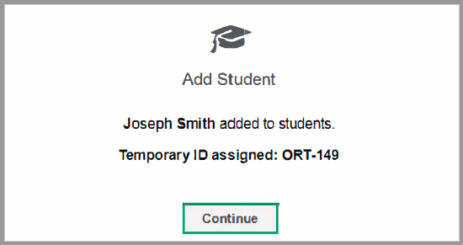
Temporary IDs
Created two ways:
TIDE
During login
Format “ORT-#”
Can be merged with SSID (recommended but not required)
Birthdate must match exactly, name can be “close”
Name and birthdate are editable fields, institution is not
Before screening
Notes:
After the TIDE rollover, districts will be merging Temp IDs with SSIDs. Districts will want to keep data entry errors to a minimum.

Slide 15
Accommodations for students without a 504 or IEP
Test Administrator may select accommodations for which there is “good evidence,” e.g.:
information from parents/caregivers
clearly observable evidence of a disability
medical documentation
District must store documentation of evidence supporting selected accommodations in student’s permanent file
In some cases, the district may feel it is in the best interests of the student with a suspected disability to delay screening. Contact Kim Miller for more information.
Before screening
Notes:
The full text of this guidance will be found in the screener TAM and the OAM. It is quoted below for reference:
A district may believe that a student slated for English language proficiency (ELPA) screening may qualify for services under a Section 504 or Individualized Education Program (IEP), but typical documentation, such as a comprehensive evaluation report, may not be available to support such a determination. In such cases, if screening timelines preclude the convening of an effective 504 or IEP team, the test administrator (TA) may select any accommodations on the ELPA Screener for which there is good evidence of student need (e.g., information provided by parents or caregivers, clearly observable evidence of a disability which impedes access to one or more domains, relevant medical documentation).
Districts who pursue this course of action must record and store evidence used to select accommodations, along with other screener documentation, in the student’s permanent file. Information on accommodations and accessibility supports is given in the Test Administration Manual and the Oregon Accessibility Manual found on ODE’s Test Administration page.

Slide 16
Reflection
Suggested TA turn and talk:
Explain how to create a Temp ID for a new student.
When choosing accommodations for a student who might qualify as having a disability, explain what “good evidence” means to you.
Before screening

Slide 17
Future K or K?
A student about to enter, or entering the first semester of, Kindergarten should take the “Future Kindergarten” screener
Open from March 1 to December 31*, inclusive
Identical test form
Future K has a different scoring profile (more later)
For students entering Kindergarten in the coming fall, enter grade level code “grade 00” in TIDE between March 1 and the rollover date.
*New for 2020-21
Before screening
Notes:
Grade 00 makes sure that a student doesn’t accidentally become a first grader when the school year rolls over. This also helps distinguish future Kinders from current Kinders.
Deployment timelines are posted on the state testing portal; also, watch AA Update.

Slide 18
During Screening

Slide 19
Screener steps
Step 1 (“Practice Step”): unscored practice items
Step 2 (up to the early stop rule): scored items
Speaking first, scored by TA
Other three domains follow, machine-scored
Step 3 (full screener): more scored items
All domains, mixed machine-scored and constructed response items
During screening

Slide 20
Screener Structure
Step 1 (Practice)
Practice items
Determine Participation
Step 2 (Scored Items)
TA-scored speaking items
Early Stop Rule
Step 3 (Refining the Score)
No TA-scored items
Full screener
During screening

Slide 21
Step 1 (“Practice Step One”)
Purpose: familiarize student with interface, help TA determine student comfort level with technology and test
A limited set of unscored items
1-to-1 with TA
Last couple of items are Speaking
Review “too soft” warning
At end, TA (not student!) indicates student participation and familiarity with technology.
A student may proceed independently or one-to-one with technology assistance from TA
During screening
Notes:
There are no limits on re-recording. If a student receives the “too soft” warning, best practice is that the student play back the recording. If the student is satisfied with their response as captured by the system, there is no reason to re-record.
There will be a chance for the TA to explain the circumstances informing their evaluation of student participation. After the participation selection, there will be a screen where the TA indicates whether the student will proceed independently or one-to-one.

Slide 22
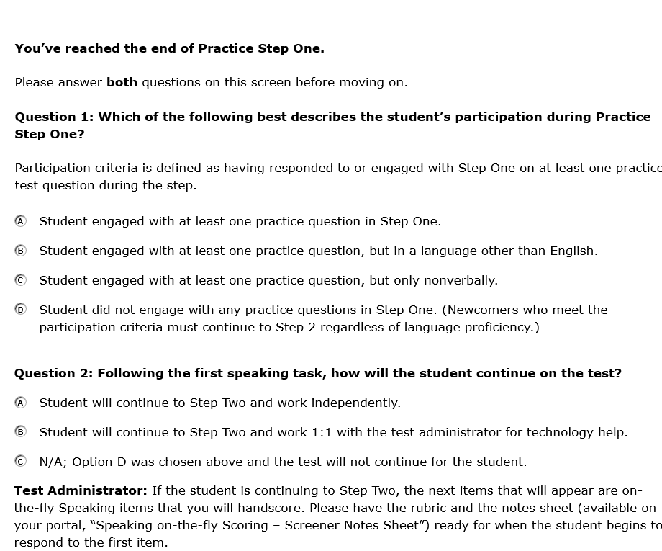
Step 1 Screenshot
During screening

Slide 23
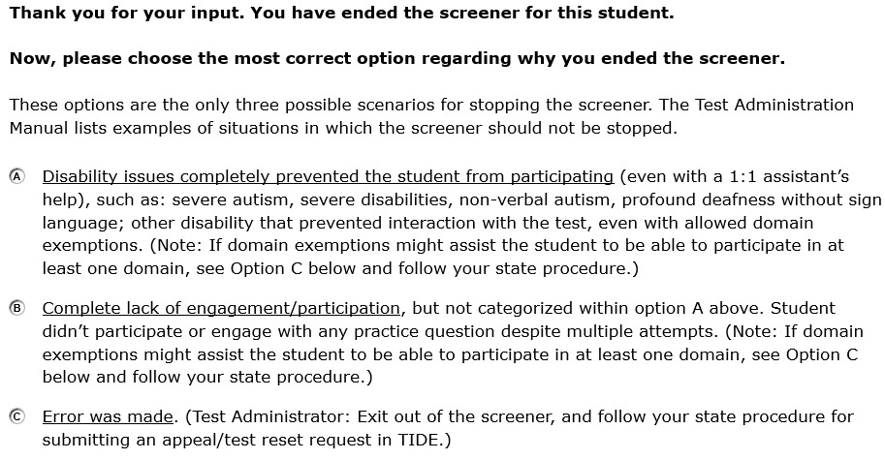
Step 1 Screenshot (cont.)
During screening

Slide 24
Who is a participant?
Participant examples
Responds in a language other than English
“Clicks through” to finish as fast as possible
Engages nonverbally (e.g. pointing)
All responses “I don’t know”
“Plays” with test
Non-participant examples
Complete refusal
Unable to interact with interface (such as pointing at items on screen)
Totally withdrawn
During screening
Notes:
A participant is a student who meaningfully interacts with the test. These examples help illustrate “meaningful interaction” but they are not exhaustive.

Slide 25
Reflection
Suggested TA turn and talk:
What will you see when you first log into the Screener? How is this different from the Sample Test? [“Sample Test” in tiny letters in the top bar vs. “Practice” in large letters under item number]
Generate at least three “what if” questions you will ask students (or ask about students) to verify that they can successfully use the technology.
Explain the difference between a participant and a non-participant.
During screening
Notes:
There are no limits on re-recording. If a student receives the “too soft” warning, best practice is that the student play back the recording. If the student is satisfied with his/her response as captured by the system, there is no reason to re-record.

Slide 26
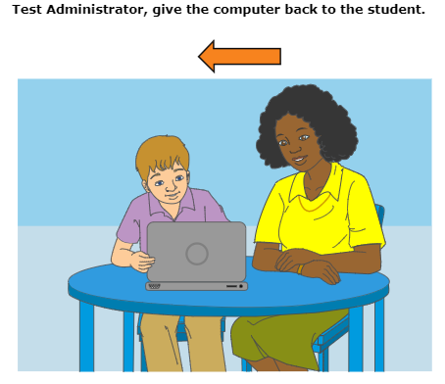
Step 2
Begins with set of speaking items
TA hand-scores on 2-point rubric
(never the student!)
Have enrichment materials nearby in case they are needed
Continues with mixed items from other three domains
All machine-scored
“Early stop rule”
No chance to score Proficient in all domains: test ends
Otherwise student continues to Step 3
During screening
Notes:
Reports from implementing districts indicate that the enrichment materials are almost never needed. Teachers report that scoring the speaking items is intuitive, fast, and easy.
This picture may change. It sort of looks like an 8th grader working with a 5th grader.

Slide 27
Reflection
(Tailor activity to the needs of the training group)
Read the Speaking Scoring Document
Quiz yourselves (pair or group probably better than solo if possible) using the Speaking Scoring Slides.
Discuss where your answers varied from the suggestions and why they varied. If you disagree with the suggested score, what is your reasoning?
During screening

Slide 28
Step 3
For students who may be Proficient in all domains
Mix of items from all domains
No TA scoring
Speaking and Writing items scored by vendor
Takes a little less time than the summative
During screening
Notes:
Speaking Constructed Response items in all grades K-12
Writing Constructed Response items in grades 2-12 (not K-1)

Slide 29
Estimated testing times
Grade Band | Step 2 (in minutes) | Step 2 and 3 (in minutes)
K | 6-8 | 15-21
G1 | 8-11 | 20-29
G2-3 | 8-12 | 30-43
G4-5 | 10-17 | 32-50
G6-8 | 9-16 | 34-52
G9-12 | 12-20 | 37-58
Taken from 25-75th percentile, 2019-20 student testing in OR.
The above represent roughly a 25% decrease in total testing time from 18-19.
During screening
Notes:
Do not add these columns together. The Step 2 and 3 column already includes testing time from Step 2.

Slide 30
Pause and auto-submit
If the student is inactive more than 20 minutes, the test will be paused and the student logged out.
After seven full calendar days, an incomplete test will be automatically submitted for scoring.
Accidental auto-submit or other screening difficulty? Submit a test impropriety via the ODE website.
During screening

Slide 31
After Screening

Slide 32
Proficiency profiles
Purpose of “overall” labels: determine eligibility for ELD services (Screener) / criteria for exiting ELD services (Summative)
Emerging: all tested domains 2 or 1
Progressing: at least one tested domain 3 or higher (but not Proficient)
Proficient: all tested domains 4 or 5
After screening
Notes:
Progressing is a very broad category.
Whenever possible, use domain scores to inform placement and instructional decisions.

Slide 33
Proficiency profiles
“Overall proficiency levels” of 1, 2, and 3 used by some individuals are a data entry fiction and do not provide sufficient information to make refined placement or instructional decisions
The “Non-Participant” profile (0-0-0-0) should be reported as if the student had scored 1-1-1-1. The student is eligible for ELD services.
After screening
Notes:
It’s a good idea to avoid using the 1, 2, 3 labels except when absolutely necessary to communicate data entry needs. This causes confusion with domain achievement levels and masks the wide range in the Progressing determination (3-1-1-1 and 5-5-5-3 are both Progressing).

Slide 34
K and Future K profile
Grade K
Proficient: all 4s or higher
Test and scoring profile available year-round
Future K
Proficient: Level 3 in R/W, Level 4 in L/S
Scoring profile available March 1 through December 31*
For students tested under wrong profile: do not retest. Disregard ISR proficiency designation printed on student report and manually enter correct proficiency designation.
*New for 2020-21
After screening

Slide 35
Score reporting
Individual Student Reports (ISR) virtually identical to for both Screener and Summative
Retrieved from Online Reporting System
Turnaround:
Step 1 (non-participants): within 2 hours of submission
Step 2 (early stop): several hours
Step 3 (full screener): average turnaround less than 3 calendar days
After screening
Notes:
Step 3 turnarounds based on May 2019 conversation with ELPA21.

Slide 36
New for 2020-21

Slide 37
Vendor name change
Our test delivery vendor, American Institutes for Research (AIR), is now known as Cambium Assessment, Incorporated (CAI, or just “Cambium”).
No impact to district experience
Same Helpdesk contact information
Same personnel
One or two minor name changes
New for 2020-21
Notes:
There will be a couple of other name changes but this is the one that matters for the Screener.
Also, ODE staff may occasionally reference “Cambium” where they would previously have referenced “AIR.”

Slide 38
Impacts of Distance Learning for All
The following updates assume limited or small group contact with students (i.e. in-person screening). Guidance will be updated if this changes.
We expect to reopen the Screener on or before the summer TIDE rollover (Aug. 4). Until that time, districts should refer to guidance for identifying possible English learners under Distance Learning for All.
New for 2020-21
Notes:
There’s not room in this webinar to provide possible courses of action for every combination of on-site and remote schooling, nor would that approach be productive.

Slide 39
Impacts of Distance Learning for All, cont.
According to May 18 guidance from the US Department of Education, there are no changes to identification timelines identification for COVID-impacted environments.
30 days from date of enrollment
After the beginning of the school year, notify parents within two weeks of placement in a language instruction educational program
New for 2020-21

Slide 40
Impacts of Distance Learning for All, cont.
Some students could not be screened under Distance Learning for All and were offered services based solely on Language Use Survey responses
These students need to be screened to determine their official English learner status
Families should be involved in these discussions
Family decisions to accept or waive services during Distance Learning for All have no bearing on this proficiency determination; “start fresh”
New for 2020-21

Slide 41
Impacts of Distance Learning for All, cont.
On 6/2 DCC call, ODE indicated that students with English learner status who did not complete the ELPA Summative in spring of 2020 would be tested on the ELPA Screener in fall 2020 to determine if they still require English language supports.
Further information regarding this policy will be included with guidance in development for statewide testing for school year 2020-21.
New for 2020-21

Slide 42
Domain Exemption Guidance
Guidance on Domain Exemptions was updated in 2020. A link will be added to this slide when available.
Document also available in webinar handouts.
Central criterion:
The student’s IEP or 504 team determines that the student’s disability prevents the student from accurately demonstrating what the student knows and can do in English, taking into consideration all other allowable supports and accommodations available on the assessment.
New for 2020-21

Slide 43
Domain Exemption Guidance, cont.
Q: Why is there repeated text in district-submitted questions?
A: For a yes/no domain exemption decision, the central question is always the same.
However, questions about how to serve a student or what kind of accommodations could be useful will have varying answers.
New for 2020-21
Notes:
Or, What’s the point of answering district-submitted questions if the response is always the same?

Slide 44
New Accommodations
Two targeted accommodations were added in spring 2020:
Transfer Student Responses
Read Aloud for Students with Reading Exemption
Districts requested one new accommodation:
Comforting Presence
Text formally presented to ELPA21 on May 29.
New for 2020-21

Slide 45
Alt-ELPA Update
An Alt-ELPA is in development for students with the most significant cognitive disabilities. This would be the ELPA equivalent of the Oregon Extended Assessment.
Timeline below applies to Summative development; Screener consideration to follow.
Administration pilot 2021-22
Field test 2022-23
Operational 2023-24
New for 2020-21

Slide 46
Future K and K Screening
Future K window extended:
Was March 1 through August 14, inclusive
Extended to March 1 through December 31, inclusive
(Note that Screener was not available for part of this extended window due to impacts from COVID)
Also a focus of ELPA21 research (following slides)
New for 2020-21

Slide 47
ELPA21 Research: Areas of Investigation
Comparison of student performance on Screener and Summative
Analysis of teachers’ ratings of K student proficiency for students screened
Analysis of student proficiency and growth by time of year when screened
New for 2020-21

Slide 48
ELPA21 Research: Conclusions
Students who register early for Kindergarten and achieve 3s or higher on tested domains
Are more likely to be classified as Proficient on the ELPA Summative
Perform well on other state measures, such as early literacy assessments
Writing performance should not be ignored
New for 2020-21

Slide 49
ELPA21 Research: Conclusions, cont.
Students with performance levels 1 or 2 in any domain should not be considered Proficient
Attention should be paid to when the test is administered (before school year, in the fall, during or after annual Summative)
New for 2020-21

Slide 50
States to Decide
Two recommended options
Option 1: “3333” Enhancement
Students entering Kindergarten would be considered Proficient with results of 3 or more in all tested domains.
States would determine “window” for this scoring profile.
New for 2020-21

Slide 51
States to Decide, cont.
Option 2: “Add a category” Enhancement
Create a new intermediate category between current Progressing and Proficient.
Students entering Kindergarten would fall into this category if they obtain 3 or more in all tested domains.
States determine if this new category is equivalent to Proficient or if it requires monitoring.
New for 2020-21

Slide 52
States to Decide, Timeline
2020
Summer: gather feedback for ELPA21
October/November: official decision making
November 2: deadline for final decision
2021
August 2: Screener “go live” with changes implemented
New for 2020-21

Slide 53
Enhancement: “Entering Kinder” Items
New task types:
Based on states’ Early Learning/Early Literacy standards
Targeted for students arriving in Kindergarten
Letter/number recognition and knowledge of basic CVC (consonant-vowel-consonant) words
To be field tested on Screener
New for 2020-21

Slide 54
Other Screener Enhancements
2020-21
Revised Practice Step 1 / Step 2 transition screens (screenshots in During Screening section of this presentation)
2021-22 and beyond
“Screener 3.0”—no further detail at this time
New for 2020-21

Slide 55
Wrap-up

Slide 56
Important Points
Reminder: ELP testing is a federal requirement. There are no provisions for four-domain exemptions or opt-out.
Exception: religious or disability exemptions under OAR 581-021-0009
Oregon does not offer a paper/pencil version of the screener (except for Braille, ordered on the Test Administration page).
Full, step-by-step instructions for administering the ELPA Screener can be found in the ELPA Screener Administration Module (required for Test Coordinators and Test Administrators).
Wrap-up
Notes:
The Braille screener is ordered using the same form as the Braille summative.

Slide 57
Online Resources
ELPA21 Webpage
Test Administration Page (TAM and OAM)
Promising Practices
Testing Portal and Sample Tests
Training Materials Page (training modules; ELPA Screener Administration Manual; practice Speaking scoring slides)
Wrap-up
Notes:
The TDS module is required for Test Administrators. The ORS and Participation Reports modules are optional for Test Coordinators. The practice Speaking scoring slides are optional for Test Administrators.
The practice slides were developed and generously shared by the Washington Office of Superintendent of Public Instruction.

Slide 58

Q and A

Slide 59
Further Questions or Concerns:
Ben Wolcott
English Language Proficiency Assessment Specialist
Oregon Department of Education
ben.wolcott@ode.state.or.us
503.947.5835
Wrap-up
Notes:
I am interested in feedback on how this presentation: what you found most useful, what might be improved. Immediately following the conclusion of the webinar a short 3-question survey will launch, which should take only 1 or 2 minutes of your time. Some of you may have feedback beyond that requested from this mini-survey, and I want to hear it, whether by phone or email.
Thank you for participating!

