Slide 1

Online Reporting System (ORS)
Screener Training Module
Notes:
Welcome to the online training module for the Online Reporting System, also known as ORS. This training module is designed to help you navigate ORS and understand its features.
This training module includes many examples of ORS features. The Online Reporting System User Guide located on your state’s portal contains additional information about features of ORS that are specific to your state.
Please note that images in this presentation are for demonstration purposes, and the appearance of your state’s ORS may vary slightly.

Slide 2
Objectives
After viewing this presentation, you should understand
how to:
Navigate the system
View and print individual student reports
Generate and export student results and summary statistics
Search for specific students
Notes:
After viewing this presentation, you should understand how to:
Navigate the system
View and print individual student reports
Generate and export summary statistics and student results
Search for specific students

Slide 3
Purpose
Provide timely, relevant reports and guide educators to make valid, actionable interpretations of individual screener results
Interactive data
Near real-time reporting (upon completion of scoring for hand-scored responses in Step Three)
Provide access to data
Results for assessments in one system
Notes:
The ORS is designed to provide you with assessment data and tools you need to understand the performance of your students on the screener. Because ORS can aggregate results in real-time, the system is able to rapidly provide student scores immediately after submission and scoring. Note that hand-scoring for a student who must complete Step 3 of the screener may take up to seven calendar days.
Student data can be securely viewed and downloaded for districts, schools, and teachers. However, note that students must be registered in the Test Information Distribution Engine, or TIDE, in order for them to be included in the ORS. For more detailed information, consult the TIDE User Guide.

Slide 4
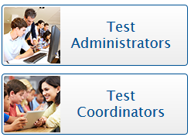
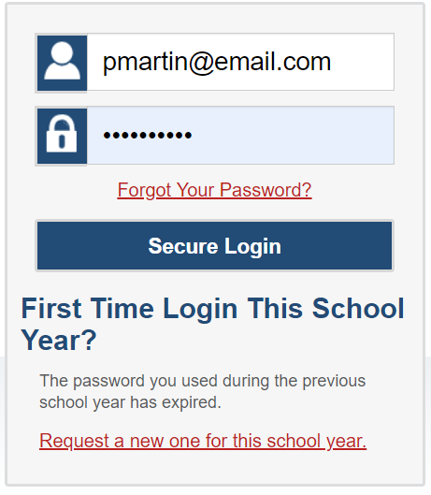
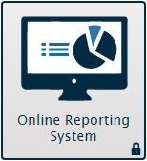
Logging in to ORS
Notes:
To log in to ORS, you must have an authorized email address and password, which is the same as the one you use for TIDE and the TA Interface. Contact your School Administrator if you do not have a TIDE account.
The ORS is a secure, role-based system. Your access to reports and data in the system depends on your user role and your district and school associations. For a detailed list of user roles and associated permissions, see your TIDE User Guide.
To log in to ORS, go to your portal. Click on the appropriate user role card. On the next page, click the ORS system card. Enter your username and password, and then click Secure Login.

Slide 5
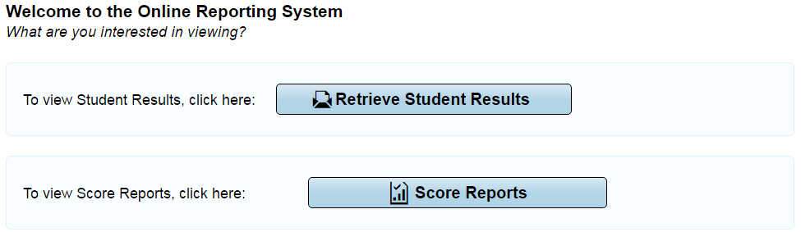
ORS Interface: Welcome Page
Notes:
The Welcome page appears when you first log in to the ORS and asks you to select the type of report you want to view. Note that you can navigate to a different report at any time within ORS.
Retrieve Student Results allows you to download student data for a district, school, teacher, or roster. The data includes students’ personal information and their performance on the selected test and administration.
Score Reports provide test score data.

Slide 6
ORS Interface: Global Tools
Notes:
The ORS banner that is displayed near the top of each page consists of buttons or “Global Tools” for accessing the different reports and performing different tasks.
The Score Reports button takes you to the Home Page Dashboard that provides overall score data for your district, school, or students.
The Reports & Files button provides access to test summary statistics and the Retrieve Student Results page where you can download large files of student results.
Inbox takes you to the Inbox section of the Retrieve Student Results page that lists the student data files you have requested.
Search Students lets you search for student information by using the student’s name or SSID number.
Upload Rosters allows you to upload a roster from your computer
Add Roster allows you to create custom rosters of your students for data analysis
View/Edit Rosters allows you to view existing rosters and add or remove students from them as desired.
The Help button is where users may find useful information and step-by-step instructions for performing tasks in ORS.
Print provides options to print the data displayed on the page.
Export exports the data displayed on the page as an Excel file.
Definitions provides definitions for terms specific to the report you are viewing. This tool only appears on some pages.

Slide 7
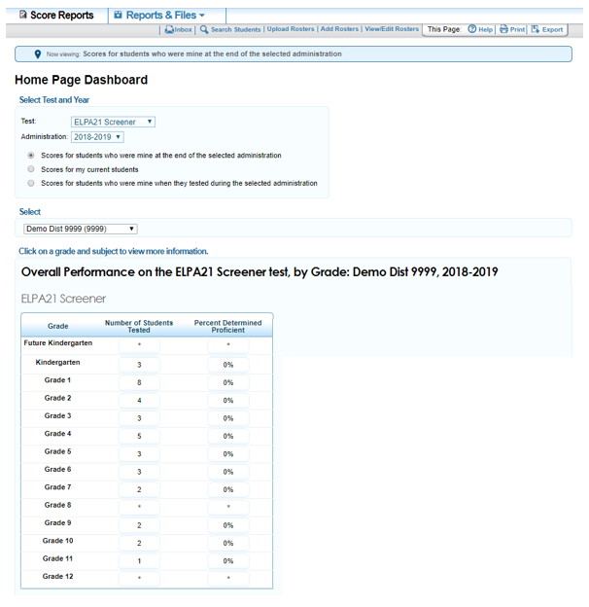
Home Page Dashboard
Notes:
When you click Score Reports on the Welcome Page or from the banner, the Home Page Dashboard appears. We will discuss this page in more detail later in the presentation.

Slide 8
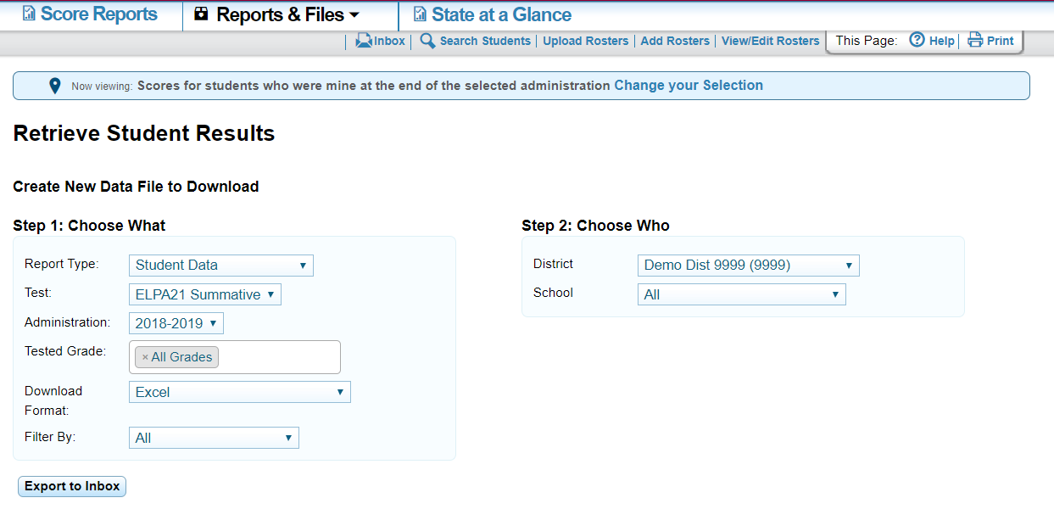
Retrieve Student Results
Reports are available for 30 days.
If you don’t download the report before it expires after 30 days, you will need to generate the report again and download it.
Notes:
When you click Reports and Files and hover over it, you will be directed to the Retrieve Student Results page. On this page, you can export individual student reports for your students or a spreadsheet containing detailed student score data. A report will be sent to your Inbox. This is the fastest and easiest way to download screener results for multiple students at one time.
You can also export a student data file for the screener by district, school, teacher, or roster. The data file contains students’ personal information, including enrolled school and grade level, as well as their screener scores and domain scores. You can export the data file in Excel or CSV format.
To export a report:
First, select a report from the Report Type drop-down list. You may download either Student Data or PDFs of Student Reports.
Then, select the parameters for your file from the available drop-down lists and click Download. You will be informed via email once the file is ready.
You can Filter By specific categories. They are English Learner Status, Enrolled Grade, Ethnicity, Gender, IDEA Indicator, and ALL.
Finally, when your file is ready, click Export to Inbox below Step #1. Your file will be in the Inbox.

Slide 9
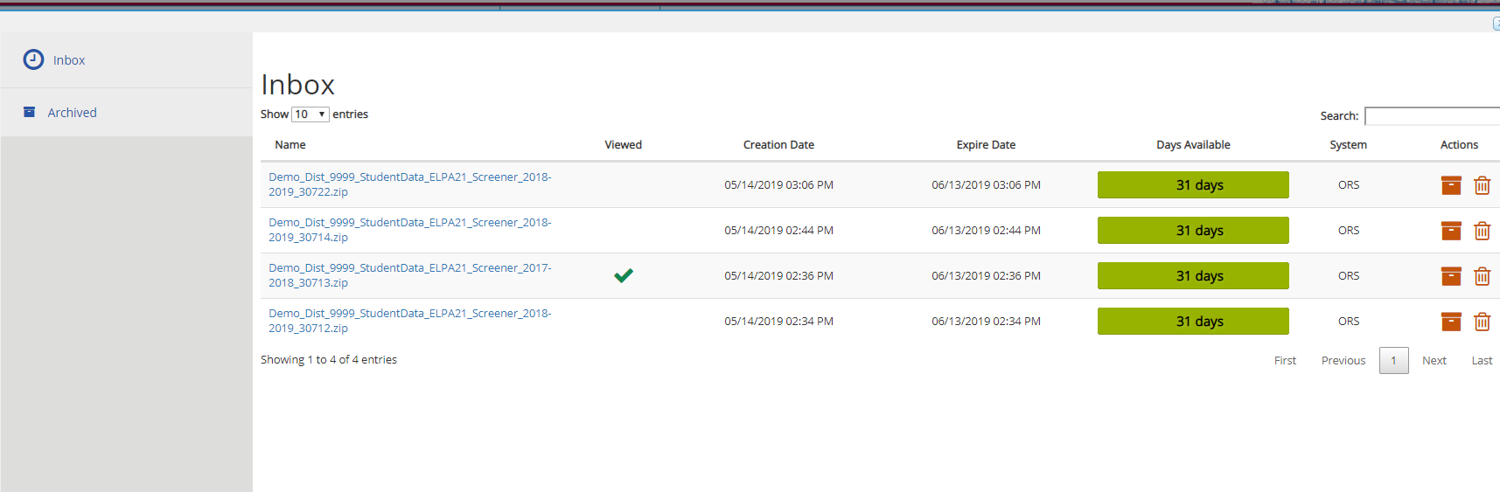
Inbox
Notes:
From your Inbox click the file Name to save the file to your computer. Your file will continue to be available for 30 days in ORS.
If you download a ZIP file containing Individual Student Reports for your students, the ZIP file will include a CSV manifest that lists all the PDF reports included in the ZIP file.
If you are unable to download your report within 30 days, it will become unavailable. However, you may always generate the report by following these steps again.

Slide 10
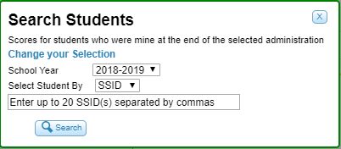
Search Students
Notes:
You can search for a student’s score reports by student ID or Temp ID. This is especially useful if you need to find a student’s score report, but do not know the student’s grade or school. This feature searches for score report results for students, not participation data.
To search for up to 20 students at once, you can enter multiple SSID numbers separated by commas in the search field. To view or download score reports for more than 20 students, use the Retrieve Student Results page.
Note that a user may only view data that is permitted by their user role. A district-level user can only view data for students in his or her district, and a school-level user can only view data for students in his or her school.

Slide 11
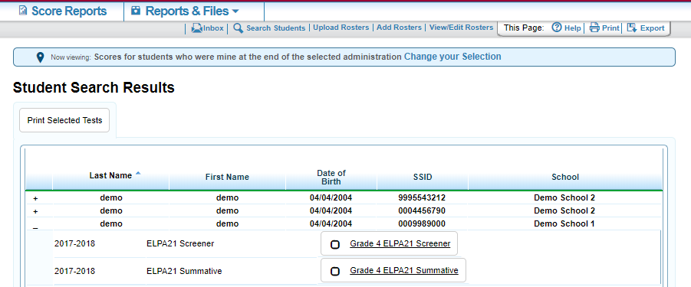
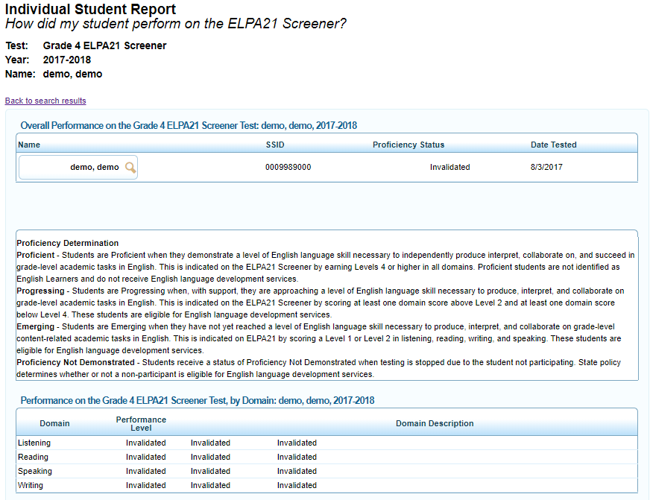
Student Search Results
Notes:
The Student Search Results page will show a list of students who match your search.
To view tests taken by a student, click the plus sign to the left of the student’s name.
To view a student’s score report for a particular test, double-click the test name. To print the Individual Student Report, select the test by checking the box and click Print Selected Test.

Slide 12
Home Page Dashboard
Notes:
When you click Score Reports on the Welcome Page or from the banner, the Home Page Dashboard appears.
This page provides data about your students, the number of students tested, and the percentage proficient for the selected test and administration. District personnel see district summaries, school personnel see school summaries, and teachers see summaries of their students.
If your state refers to Screener tests by some other name, then that name will be used in ORS.

Slide 13
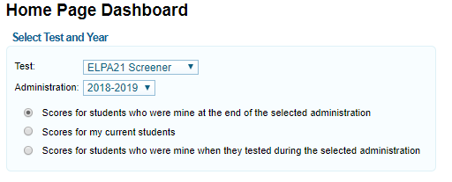
Home Page Dashboard: Select Test and Administration
You can select the test and administration for which you want to view score data.
Notes:
From the Home Page Dashboard, you can select the test and administration for which you want to view score data, the Screener or the Summative. These two assessments are reported separately.
You can also specify the students whose data you wish to view using the available radio buttons.
If you currently have a student who did not test in the selected test and administration, no data will be displayed for that student. An example may be students who moved to your school from out of state.
Note that additional scores are added to ORS with each new administration.

Slide 14
Home Page Dashboard: Defining the Student Population
Scores for students who were mine at the end of the selected administration | Scores for my current students | Scores for students who were mine when they tested during the selected administration
Allows you to see score data for those students who tested in the selected test and administration | Allows you to immediately view score data for those students who are associated to your current rosters, even if they were previously enrolled in a different school or district | Allows you to see score data for those students who were associated with your school, district, or roster when they were tested in the selected test and administration
Notes:
Scores for students who were mine at the end of the selected administration allows you to see score data for those students who tested in the selected test and administration and were associated with your school or district at the end of the selected test and administration.
Scores for my current students allows you to immediately view score data for those students who are associated to your current rosters, even if they were previously enrolled in a different school or district. This view enables you to see your current students’ previous strengths and weaknesses before they begin testing this year.
Scores for students who were mine when they tested during the selected administration allows you to see score data for those students who were associated with your school, district, or roster when they were tested in the selected test and administration.

Slide 15
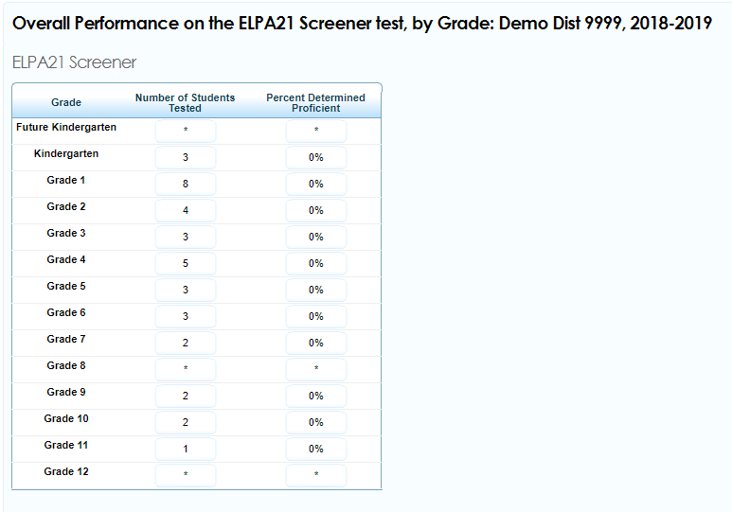
Home Page Dashboard: Report Tables
Notes:
After defining which students you wish to view, look at the table near the bottom of the Home Page Dashboard. This table displays aggregate data for the test.
Number of Students Tested displays the number of students to date who have completed and submitted their tests for scoring.
Percent Determined Proficient displays the percentage of students to date who have scored proficient on each test.
To access score reports for a particular grade-based test, click a cell for the selected grade. You will only see the tests administered by the selected district or school. When you click a cell, a Subject Detail Report will load for the corresponding grade.

Slide 16
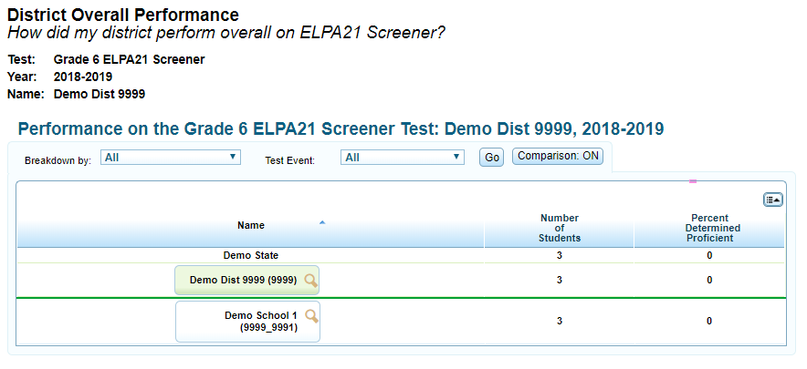
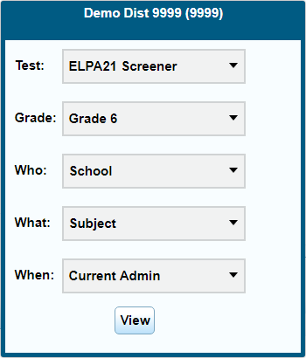
Subject Detail Report
Notes:
To view more information about a student, roster, teacher, school, or district, click the magnifying glass icon that appears next to its name. An exploration menu will appear with the name of the entity you clicked in the title. The exploration menu is for moving between reports and deciding which type of data you would like to view.

Slide 17
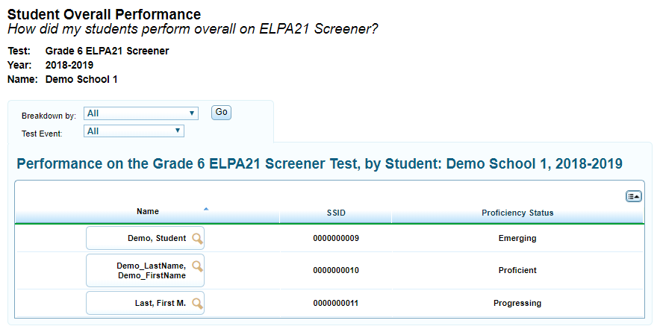
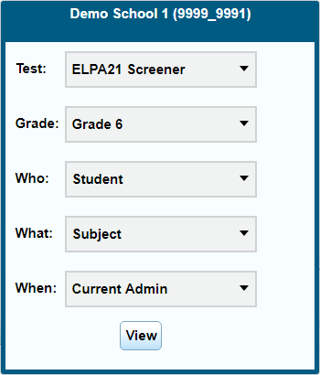
Student Listing Report
Notes:
For example, you can access the student listing report by clicking the magnifying glass next to a school, teacher, or roster, and then selecting Student in the exploration menu’s “Who” drop-down list. Click View to load the report.
The student listing report shows students’ overall proficiency on the screener. To view domain-specific proficiency, you can also select Domain in the exploration menu’s “What” drop-down list.

Slide 18
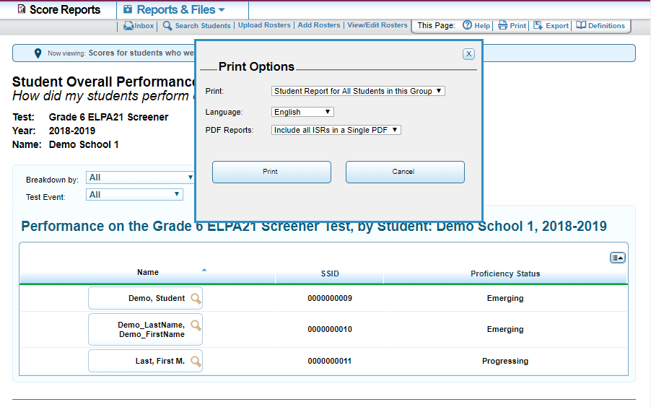
Student Listing Report: Printing
Notes:
On most pages in ORS, using the Print tool simply prints the currently displayed information. However, printing from the student listing report works a bit differently.
When using the Print tool on the student listing report, a print pop-up window will appear, giving you the following options:
You can print “Just this Page,” or “Student Report for All Students in this Group.”
You can select a language to print the report in that language. Available home languages vary by state.
You can select a PDF Report to print: Include all ISRs in a Single PDF or One PDF per ISR in a zip file.
A message is displayed to inform you that you will be notified via email once the report has been generated. When the PDF file or ZIP file is ready, you can download your file by clicking Inbox in the ORS banner.
Please remember that student information may only be downloaded to district-issued computers, not to personal computers.

Slide 19
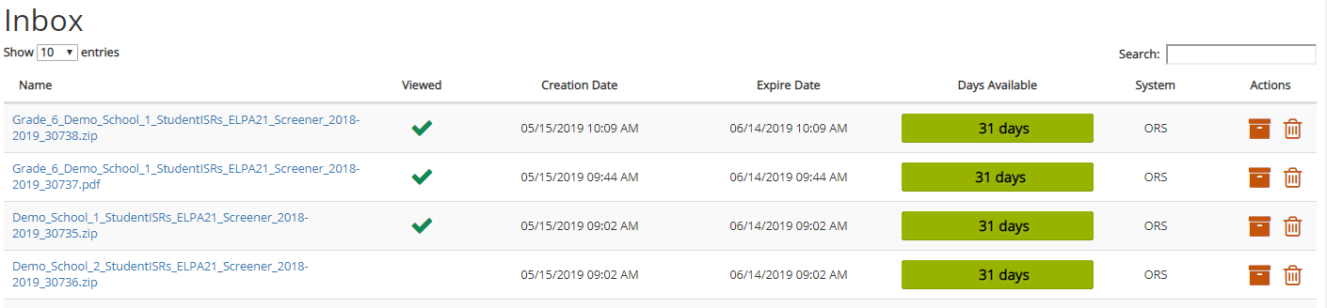
Print from the Inbox
Notes:
After receiving the email, go to the Inbox. If the file is a PDF (.pdf) click on it to download it to your computer. Open the document and the ISR will print.
If the file is a zip file (.zip) click on it to open up a compressed file on your computer. You can then extract all the PDF files or just the ISRs you want. Print as you would any PDF.

Slide 20
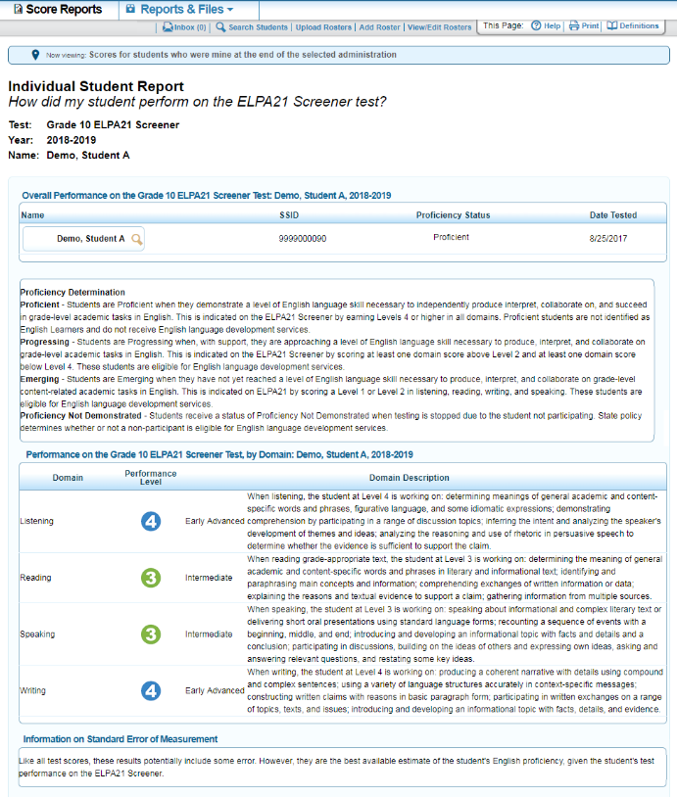
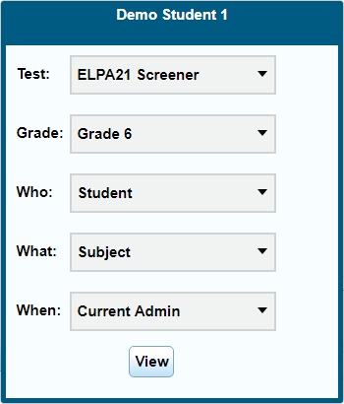
Individual Student Report
Notes:
An Individual Student Report presents a graphic representation of proficiency. It includes more detailed information on overall performance and proficiency status of the student on the screener test, along with a description of the student’s performance level in each domain.
We have already covered viewing ISRs from the Retrieve Student Results page, and by using the Search Students tool.
You can also access a student’s ISR in the Score Reports section by clicking the magnifying glass next to any student’s name, and selecting Student in the exploration menu’s “Who” drop-down list.

Slide 21
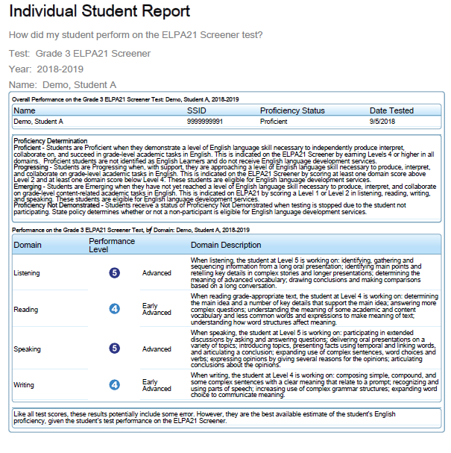

Individual Student Report: Printing
Notes:
While viewing an individual student report, you can click the Print tool to generate a PDF version to download or print out.

Slide 22
Things to Remember
The ORS helps educators answer questions regarding the assessment data in order to improve teaching and learning.
The magnifying glass icon displays the exploration menu, which is used to explore the different dimensions and levels of score data.
All reports can be printed and exported.
The Help (User Guide) button is available on every page.
You can use ORS to generate individual student reports to share with parents. ISRs are available in other languages, in addition to English.
Notes:
Here are a few things to remember:
The Online Reporting System helps educators answer questions regarding the assessment data in order to improve teaching and learning;
The magnifying glass icon displays the exploration menu, which is used to explore the different dimensions and levels of score data;
All reports can be printed and exported;
The Help button is available on every page of ORS; and
You can use ORS to generate individual student reports to share with parents in any of the other available languages, in addition to English.

Slide 23
Thank You!
For additional information, consult your portal’s Resources page, which contains:
Important Announcements
ORS User Guide
For further assistance, please consult your Help Desk.
Notes:
Thank you for viewing this training module. If you need additional information, please visit your state portal, where you can find announcements and copies of the ORS User Guide. For further assistance, please consult your Help Desk.

