Slide 1
Speaking Scoring Practice Slides
Secondary level
Developed by Oregon Department of Education,with support from Corvallis School District

Slide 2
Recommended Use
To simulate an authentic scoring environment, and if local context permits multiple TAs to train simultaneously:
Provide TAs with copies of the Speaking Scoring document
Display picture and prompt only
Read a sample student response aloud; TAs discuss possible score points
Read recommended score and scoring rationale aloud; TAs discuss
Proceed to next student sample response
Participants may also generate possible student responses to these prompts and discuss score points/rationales for these locally generated responses

Slide 3
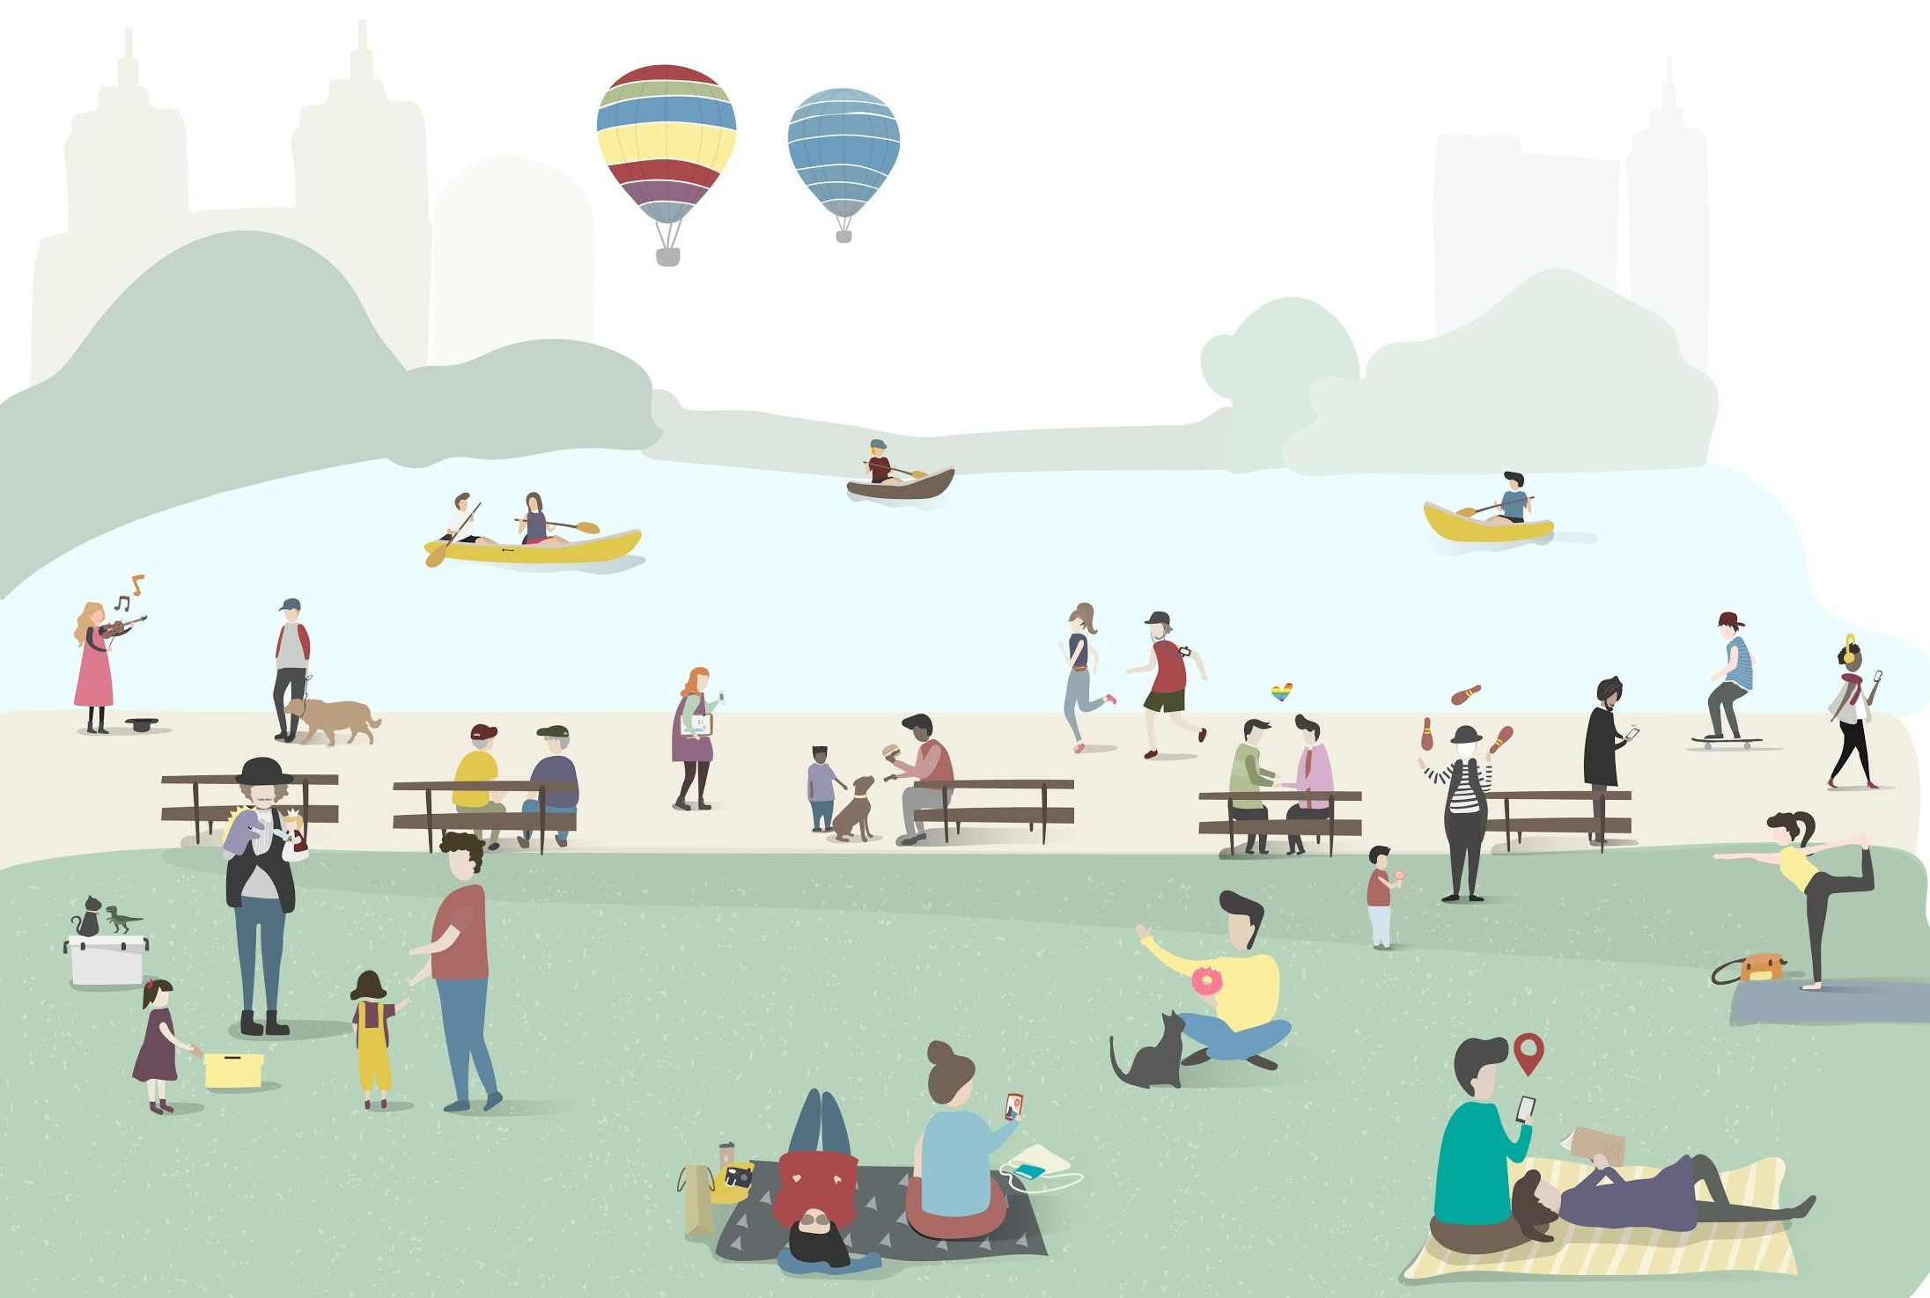
“On the fly” Speaking Scoring: Example 1
Image: freepik.com
What is this place used for?

Slide 4
“On the fly” Speaking Scoring: Example 1
Image: freepik.com
What is this place used for?
Relax.
People go here to play.
A day at the park.
El parque.
Park.
Water.
It is city.
Dog walk.

Slide 5
“On the fly” Speaking Scoring: Example 1
Image: freepik.com
What is this place used for?
Relax. (2)
People go here to play. (2)
A day at the park. (2)
El parque. (0)
Park. (1)
Water. (1)
It is city. (1)
Dog walk. (2)
Notes:
“Relax” is an appropriate activity for the setting and meets all criteria at the 2 level. Note that any accurate and full description of something people are doing in this scene, even if rare for parks in general (for example, “Ride in a balloon”), would score a 2. The test is measuring the student’s ability to communicate in English, not their cultural knowledge.
This complete sentence is appropriate to the stimulus and meets all criteria at the 2 level.
While technically a sentence fragment, this is an appropriate response and meets all criteria at the 2 level.
“El parque” is Spanish. Responses in languages other than English score a 0.
“Park” partially addresses the prompt, and therefore scores a 1.
“Water” is clearly related to the prompt but does not meet the criteria necessary to score a 2. “Water” scores a 1.
Like the above, “It is city” accurately describes the scene but does not fully address the prompt, since it conveys no information about activity or use proper to this picture. It scores a 1.
This response may sound awkward, but it fully addresses the prompt and meets all criteria necessary to score a 2.

Slide 6
“On the fly” Speaking Scoring: Example 2
Image: freepik.com
What is person C doing?
A
C
B

Slide 7
“On the fly” Speaking Scoring: Example 2
Image: freepik.com
What is person C doing?
Music.
Fun.
She is standing up.
Exercise.
The woman is doing yoga.
I’m hungry.
Ejercicio.
Pointing at something.
A
C
B

Slide 8
“On the fly” Speaking Scoring: Example 2
Image: freepik.com
What is person C doing?
Music. (1)
Fun. (1)
She is standing up. (2)
Exercise. (2)
The woman is doing yoga. (2)
I’m hungry. (0)
Ejercicio. (0)
Pointing at something. (1)
A
C
B
Notes:
“Music” could indicate that the student is mistakenly describing person A rather than person C. The student might also mean person C is listening to music as part of an exercise routine. Either way, the response is related to the stimulus/partially addresses the prompt and scores a 1.
“Fun” partially addresses the prompt and scores a 1.
This complete sentence accurately describes person C and meets all the criteria for a score of 2. The student does not need specialty terms or knowledge of outdoor activities that may be uncommon in their home culture to score a 2 on this question.
“Exercise” directly and fully addresses the prompt, scoring a 2.
This complete sentence describes person C accurately and specifically, meeting all the criteria for a score of 2.
“I’m hungry” is a complete sentence, but is unrelated to the prompt (off task/off topic) and therefore scores a 0.
This response is in Spanish. Responses in a language other than English score a 0.
The body posture of person C does somewhat resemble pointing, so even if the student is mistaken about the primary purpose of the activity, the response still partially addresses the prompt and scores a 1. However, at least one other person in the scene looks like they might be pointing at something, so to score a 2, the student would need to differentiate person C from others in the illustration. “She’s pointing at that little girl” or “Standing and pointing” or “She points at the juggler/clown” are all sufficient levels of detail to score a 2. Remember that the goal of the test is not to find out what the student knows about various leisure activities, but to measure their ability to communicate in English.

Slide 9
“On the fly” Speaking Scoring: Example 3
What is this place used for?
Image: freepik.com

Slide 10
“On the fly” Speaking Scoring: Example 3
What is this place used for?
I don’t like it.
Eat or Food.
Hang out.
Buy.
Make.
Sports.
I don’t know.
It’s a food truck. People eat there.
Image: freepik.com

Slide 11
“On the fly” Speaking Scoring: Example 3
What is this place used for?
I don’t like it. (0)
Eat or Food. (2)
Hang out. (2)
Buy. (1)
Make. (1)
Sports. (0)
I don’t know. (0)
It’s a food truck. People eat there. (2)
Image: freepik.com
Notes:
As phrased, this response is not related to the prompt, and scores a 0. If the student more specifically indicated that they don’t like food trucks, or that this particular food truck doesn’t appeal to them, they would meet the criteria for a higher score point.
This response directly addresses the prompt and meets all the criteria for a score of 2.
“Hang out” may not be considered the primary purpose of a food truck, but this response accurately addresses the prompt and meets all the criteria for a score of 2.
“Buy” is insufficiently specific and therefore only partially addresses the prompt, for a score of 1. The student might mean, “Buy food,” but the TA cannot assume information that is not given by the student.
Likewise, “make” is not specific enough and only partially addresses the prompt, scoring a 1. As above, the student may mean, “Make food,” but that would be an assumption on the part of the TA. Evidence for a given score point must come from the student, not the TA.
“Sports” is seemingly unrelated to the prompt and scores 0. However, if a student may be able to establish a relationship by providing more detail. For example, the response, “I see these at soccer games,” would be partially related to the prompt and would score a 1, because it does not directly address the question (“What is this place used for?”). A response such us, “Buy food at soccer games” would address the question directly and would score a 2.
Responses of “yes”, “no”, or “I don’t know” always score 0, even if they are true.
This set of complete sentences directly addresses the prompt and meets all the criteria for a score of 2.

Slide 12
“On the fly” Speaking Scoring: Example 4
What are the people at the table doing?
Image: freepik.com

Slide 13
“On the fly” Speaking Scoring: Example 4
What are the people at the table doing?
Sit.
Two.
He’s looking at his phone.
Loud.
Not have and.
Eating.
Wait.
Man or Woman.
Image: freepik.com

Slide 14
“On the fly” Speaking Scoring: Example 4
What are the people at the table doing?
Sit. (2)
Two. (1)
He’s looking at his phone. (2)
Loud. (0)
Not have and. (0)
Eating. (2)
Wait. (1)
Man or Woman. (1)
Image: freepik.com
Notes:
“Sit” accurately describes the activity of the people at the table and meets all the criteria for a score of 2. “Sitting” would be the preferable form, but the grammatical error does not obscure the student’s meaning.
“Two” partially addresses the prompt, as there are two people at the table, for a score of 1.
This complete sentence fully addresses the prompt and meets all the criteria for a score of 2.
“Loud” is unrelated to the prompt; nothing in this scene looks particularly loud. Off topic or off task responses score 0. If the student provided more detail (“Phone make loud noise”), they would meet the criteria for a higher score point.
The severity of grammatical errors in this response make it nonsensical, so it scores 0.
“Eating” fully addresses the prompt and meets all the criteria for a score of 2.
If it is clear the student means “Wait, I’m thinking,” but does not add anything further to address the prompt, this would be an off topic response and would score a 0. Otherwise, the student could mean that the people at the table are waiting (for someone to join them, maybe) and would partially address the prompt for a score of 1. It would be inappropriate for the TA to “supply” the rest of the sentence for the student and assign a score point of 2, but for responses like “Wait” where student intention may be ambiguous, it is appropriate for the TA to assume that the student’s responses are related to the task.
Either “Man” or “Woman” partially addresses the prompt, for a score of 1. The student would need to provide more information for this response to meet the criteria for a score of 2.

