Slide 1
Module 3 Presentation
Margaret Heritage
This content is offered by the Oregon Department of Education under a Creative Commons Attribution Non-Commercial Share Alike 4.0 license
Notes:
Welcome to Module 3’s presentation.

Slide 2
Section 1
High-leverage Feature: Sophistication of Topic Vocabulary in the DLLP
This content is offered by the Oregon Department of Education under a Creative Commons Attribution Non-Commercial Share Alike 4.0 license
Notes:
The focus of this module is on the high-leverage language feature – sophistication of topic vocabulary.

Slide 3
Section 1
High-leverage Feature: Sophistication of Topic Vocabulary in the DLLP
This content is offered by the Oregon Department of Education under a Creative Commons Attribution Non-Commercial Share Alike 4.0 license
Notes:
The focus of this module is on the high-leverage language feature – sophistication of topic vocabulary.

Slide 4
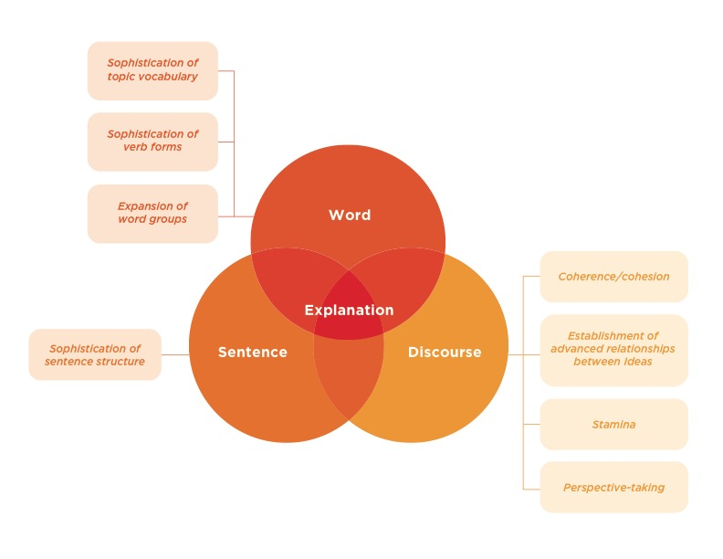
DLLP Diagram
This content is offered by the Oregon Department of Education under a Creative Commons Attribution Non-Commercial Share Alike 4.0 license
Notes:
Recall that the dynamic language learning progression is organized around three key language features – word, sentence and discourse and eight high-leverage features. Remember that all three dimensions work in tandem in students’ language production; we are just treating them individually so that you can become familiar with their progression.
In this module we are going to address the word dimension, taking a closer look a one of the three word dimension high-leverage features: sophistication of topic vocabulary. Before we go into detail about this feature, we are going to review what we mean by “words”

Slide 5
Words and Language
A word is a unit of language that carries meaning
According to the Oxford English Dictionary (2018), a word is “A single, distinct, meaningful element of speech or writing.”
Much of what you know when you say that you know a language are the words of that language
Knowing words, or collectively the vocabulary of a language, is a critical foundation for both effective oral language and literacy
This content is offered by the Oregon Department of Education under a Creative Commons Attribution Non-Commercial Share Alike 4.0 license
Notes:
A word is a unit of language that carries meaning. According to the Oxford English Dictionary (2018), a word is “A single, distinct, meaningful element of speech or writing.”
Much of what you know when you say that you know a language are the words of that language. Knowing words, or collectively the vocabulary of a language, is a critical foundation for both effective oral language and literacy.

Slide 6
Words and Language
A word can be used on its own or combined with other words to form larger multi-word units of meaning (i.e., a phrase or idiom, a sentence).
Imperatives (i.e., commands such as Go! Clean!), a single word – as a verb – also constitutes an entire sentence.
This content is offered by the Oregon Department of Education under a Creative Commons Attribution Non-Commercial Share Alike 4.0 license
Notes:
A word can be used on its own or combined with other words to form larger multi-word units of meaning (a phrase or idiom, a sentence)
Imperatives (commands such as Go! Clean!), a single word – as a verb – also constitutes an entire sentence.

Slide 7
Vocabulary
Correct
Penguins
Protractor
Green
Contagious
Listen!
Good job!
Repeated addition
Tornado formation
Yesterday’s English lesson
Sitting on the edge of the canyon
The heart of the matter
This content is offered by the Oregon Department of Education under a Creative Commons Attribution Non-Commercial Share Alike 4.0 license
Notes:
On this slide you can see single words used to affirm, name, describe, request or command, and combinations of words into two-word or longer phrases used to label, describe objects, events, or actions and, in the case of the last phrase, used figuratively (a non-literal meaning).
A person’s collective knowledge of words is their lexicon, or as it is more commonly called - their vocabulary.

Slide 8
Sophistication of Topic Vocabulary
Four sub-feature components:
Essential topic vocabulary
Brush, toothpaste, water (used in a personal routine such as teeth cleaning)
Count, blocks, numbers (used in a mathematics task)
Related topic vocabulary
Dentist, floss, cup
Group, stacks, connect
Technical topic vocabulary
Crown, dentures, enamel
Prime number, remainder, subtract
Vivid vocabulary
Swirl, gurgle, fuzzy
Spread, array
This content is offered by the Oregon Department of Education under a Creative Commons Attribution Non-Commercial Share Alike 4.0 license
Notes:
The Sophistication of Topic Vocabulary DLLP comprises four sub-feature components: Essential topic vocabulary: the relatively small, core set of topic vocabulary words most speakers or writers are likely to rely on in order for the listener or reader to understand the topic being explained; Related topic vocabulary: words that would be typically used to explain in detail about the topic; Technical topic vocabulary: words not likely to be encountered outside a discipline or sub-discipline context; and Vivid vocabulary: words that evoke imagery. You will use these sub-features for an activity in section 2 of this presentation.
By tracing the progression for Sophistication of Topic Vocabulary teachers can monitor how students are increasing the breadth and depth of their word knowledge in different academic content areas.

Slide 9
Deciding on Topic Vocabulary
Learning topic vocabulary in the context of authentic language use
Teachers need to decide which words :
students need to learn content and convey content learning
are optional words in a given activity
This content is offered by the Oregon Department of Education under a Creative Commons Attribution Non-Commercial Share Alike 4.0 license
Notes:
The DLLP puts the focus on students learning topic vocabulary in the context of authentic language use (for example, words used to solve the calculation of angles of a triangle with a peer, or to describe the motivations of the character Zero in Holes) and not simply words learned as discrete entities from a weekly vocabulary or spelling test list.
Deciding which vocabulary should be considered essential or merely related is where teachers need to use their knowledge of the content area they are teaching and assessing for both language and content learning. Content teachers are best positioned to make the choice between the words students need to convey their content learning, and the words that may be optional in a given activity and that students can either omit, or use from their everyday lexicon without loss of content meaning making.
Support for acquiring the wide range of topic related vocabulary that, while not essential but still highly relevant for a well-crafted explanation of a task, will of course be necessary as students move along the DLLP for Sophistication of Topic Vocabulary.

Slide 10
Section 2
The Phases of the Dynamic Language Learning Progression
This content is offered by the Oregon Department of Education under a Creative Commons Attribution Non-Commercial Share Alike 4.0 license
Notes:
In this section we are going to look in more detail at the dynamic language learning progression phases of sophistication of topic vocabulary.

Slide 11
Finding the Best Fit on the DLLP
Emerging Best fit?
Developing Best fit?
Controlled Best fit?
Not (Yet)
Evident
This content is offered by the Oregon Department of Education under a Creative Commons Attribution Non-Commercial Share Alike 4.0 license
Notes:
Recall from previous modules that the DLLP helps you identify students on pathways of the different language features.
This involves finding the ‘best fit’ on the progression for a student’s explanation. Determining the ‘best fit’ does not mean that students get a score or a grade.
The best fit is a low or no-stakes judgment of where the student’s language feature of interest, in this case, sophistication of topic vocabulary, should be placed on the progression so that a you can effectively target instruction to those identified elements of a feature that still need support for getting a student’s language to the next phase of the DLLP.

Slide 12
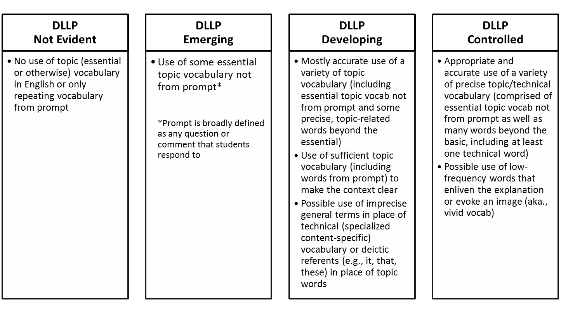
Phases of Sophistication of Topic Vocabulary
Decide on the student’s ’best fit’ then ask: In what ways does this student need to grow in topic vocabulary
to show a more sophisticated performance?
This content is offered by the Oregon Department of Education under a Creative Commons Attribution Non-Commercial Share Alike 4.0 license
Notes:
As you focus on sophistication of topic vocabulary, you will be listening to students’ oral explanations or reading their written explanations to make a determination about the level of topic vocabulary sophistication related to one of these phases. You have these phases on Handout 1 from Module 2.
Not Evident – if…. [read text in slide].
Emerging - if…. [read text in slide].
Developing – if…. [read text in slide].
Controlled – if…. [read text in slide].
We call this determining the ‘best fit’ – which, as previously mentioned, does not mean that students get a score or a grade. The ‘best fit’ is your judgment about where the student’s sophistication of topic vocabulary lies on this progression.
Once you have determined a student’s ‘best fit,’ you then need to consider the question with reference to the DLLP: In what ways does this student need to grow in the sophistication of topic vocabulary language feature to show a more sophisticated performance? When you have answered this question, you will know what to plan next for the student’s language learning.

Slide 13
Section 3
Determining the ‘best fit’ for sophistication of topic vocabulary
This content is offered by the Oregon Department of Education under a Creative Commons Attribution Non-Commercial Share Alike 4.0 license
Notes:
In the next section, you will see several examples of topic vocabulary in explanations and where we placed them on the DLLP. These are all oral language samples that were transcribed.

Slide 14
Student language example
Because his teeth need to be clean. And the bottom too, and his tongue. And he needs to clean in the sides. And then he needs to brush them every day. Then he has to clean the other side.
This content is offered by the Oregon Department of Education under a Creative Commons Attribution Non-Commercial Share Alike 4.0 license
Notes:
The prompt to elicit students’ explanations was “Pretend you’re talking to a friend who doesn’t know how to clean his/her teeth. When you’re ready, tell him/her how to do it and why he/she should do it. ” [Read example on slide]. Think about where you might place this sample on the DLLP [ Pause to give them time to think]. The best fit for this sample is Developing Vocabulary Sophistication
Some topic vocabulary is used (bottom, tongue, sides) beyond just core or essential vocabulary (brush)
Note clean and teeth are repeated from the prompt and not, therefore, counted as “productive” language - that is, the child did not have to come up with these specific words without assistance–they were given to him.

Slide 15
Student language example
She should do it so her teeth don't get ugly. And she has to do it. And how she do it is because up and down. And side.
This content is offered by the Oregon Department of Education under a Creative Commons Attribution Non-Commercial Share Alike 4.0 license
Notes:
The prompt to elicit students’ explanations was also “Pretend you’re talking to a friend who doesn’t know how to clean his/her teeth. When you’re ready, tell him/her how to do it and why he/she should do it. ” [Read example on slide]. Think about where you might place this sample on the DLLP [ Pause to give them time to think]. The best fit for this sample is No Evidence of Vocabulary Sophistication.
Topic vocabulary is repeated from the prompt (teeth) and not counted as “productive.”
While side is additional topic vocabulary and ugly is vivid vocabulary, these are not effective in the absence of essential vocabulary to comprehend the explanation.

Slide 16
Student language example
You could use it so you don't get- so they're separated right? So then you have to put them in groups so that you wouldn't be confused. So that's why you use this.
This content is offered by the Oregon Department of Education under a Creative Commons Attribution Non-Commercial Share Alike 4.0 license
Notes:
The prompt to elicit this student’s explanations was “Pretend you are talking to a classmate who has never done this activity. When you're ready, tell him how to use the cubes to find out how many there are and why using the cubes this way helps him.” [Read example on slide]. Think about where you might place this sample on the DLLP [ Pause to give them time to think]. The best fit for this sample is Emerging Vocabulary Sophistication:
The student does not use essential topic vocabulary to make the context clear.
The student uses some additional topic vocabulary (separated, groups)

Slide 17
Student language example
Put them how you think you can multiply them, like by twos or fives or tens or six or however you think. And if they're equal, if each group has the same amount of cubes then you just count them. You don't count them but you multiply them or just add them however you want. And then when you're done counting them, after that that's your answer about how many cubes you got. So it is important to have it this way, so then it's easier instead of you going one by one and counting them one by one.
This content is offered by the Oregon Department of Education under a Creative Commons Attribution Non-Commercial Share Alike 4.0 license
Notes:
The prompt to elicit this explanation was “Pretend you are talking to a classmate who has never done this activity. When you're ready, tell her how to use the cubes to find out how many there are and why using the cubes this way helps her.” [Read example on slide]. Think about where you might place this sample on the DLLP [ Pause to give them time to think]. The best fit for this sample is Controlled Vocabulary Sophistication:
There is use of topic vocabulary beyond the essential (count, twos, fives, etc.), including technical vocabulary (multiply, equal, add), and additional topic vocabulary (amount, answer)

Slide 18
This content is offered by the Oregon Department of Education under a Creative Commons Attribution Non-Commercial Share Alike 4.0 license
Notes:
This is the end of Module 3s presentation. Module 4 will focus on the language feature, sophistication of sentence structure.

Slide 19
Student Audio Files for Activity Sheet 1
OR Mod 3 Example A - https://youtu.be/gVvpzaLF-tQ
OR Mod 3 Example B - https://youtu.be/GnysQTGYuhk
OR Mod 3 Example C - https://youtu.be/lB20XO65E6U
OR Mod 3 Example D - https://youtu.be/KcBeaPFaxnc
This content is offered by the Oregon Department of Education under a Creative Commons Attribution Non-Commercial Share Alike 4.0 license

