Slide 1
Local Performance Assessment Writing Work Samples Scoring and Calibration
https://tinyurl.com/3ywbd23v
Notes:
This training session addresses scoring calibration for writing work samples as part of the local performance assessment requirements. All of the resources, including training materials, can be located in a centralized folder online using the tiny url link or by visiting the ODE English language arts assessment webpage.
https://tinyurl.com/3ywbd23v

Slide 2

Workshop Goals
Review the guidelines for administering Writing Work Samples for the purpose of the Local Performance Assessment requirements.
Build background and identify language within the ODE Official and Student Language Writing Scoring Guide.
Collaboratively score a writing work sample to build a common understanding of proficiency.
Notes:
The training goals address the following topics:
Review the guidelines for administering Writing Work Samples for the purpose of the Local Performance Assessment requirements.
Build background and identify language within the ODE Official and Student Language Writing Scoring Guide.
Collaboratively score a writing work sample to build a common understanding of proficiency.

Slide 3
Partners and Peers
Elementary, MS, and HS school ELA educators
Elementary, MS, and HS school social studies educators
Special Education or Title I educators
Instructional coaches
Administrators and Educational Assistants
Notes:
Note: Teachers should be partnered at the beginning of greeting attendees and placed in tables or groups with like-peers. Depending upon group make-up, you may need to change categories. It is recommended when working with multiple grade level to group teachers by those bands to collaboratively work with peers on the writing scoring guides and work sample calibration activity. Allow SPED teachers flexibility in choosing the group they work most closely with in supporting students. Coaches should be placed with the grade level content band that caters to their strength to contribute to the accuracy of calibration

Slide 4
Collaborative Work Norms
Equity of voice
Active listening
Respect for all perspectives
Confidential and safe
Self-monitor use of electronics/distractions
Notes:
On this slide we provide an opportunity to review collective group norms to ground the professional development. Facilitators can add specific language and norms adopted by the school district if they are not included in the following list.

Slide 5

Goal 1: Review the guidelines for administering Writing Work Samples for the purpose of the Local Performance Assessment requirements.
Notes:
During this portion, educators will Review the guidelines for administering Writing Work Samples for the purpose of the Local Performance Assessment requirements.

Slide 6
2021 Update on Essential Skills and Local Performance Assessment Requirements
In 2021, the Oregon Legislative Assembly passed SB 744 which directs the Oregon Department of Education to review state requirements for high school diploma options, as well as to review state requirements related to demonstrations of proficiency in Essential Skills. Allowing for this review, students will not be required to show proficiency in Essential Skills as a condition of receiving a high school diploma during the 2021-2022, 2022-2023, and 2023-2024 school years.
Note: SB 744 applies only to the suspension of the assessment of Essential Skills requirements for receiving a Regular or Modified Diploma and does not suspend the local performance assessment requirements for students in grades 3 through 8 and at least once in high school.
Notes:
As a reminder… In 2021, the Oregon Legislative Assembly passed SB 744 which directs the Oregon Department of Education to review state requirements for high school diploma options, as well as to review state requirements related to demonstrations of proficiency in Essential Skills. Allowing for this review, students will not be required to show proficiency in Essential Skills as a condition of receiving a high school diploma during the 2021-2022, 2022-2023, and 2023-2024 school years.
Note: SB 744 applies only to the suspension of the assessment of Essential Skills requirements for receiving a Regular or Modified Diploma and does not suspend the local performance assessment requirements for students in grades 3 through 8 and at least once in high school.

Slide 7
LPA Requirement Summary
The Local Performance Assessment must evaluate the application of students’ knowledge and skills.
Districts must annually administer a Local Performance Assessment for students in grades 3 through 8 and at least once in high school in the following skill areas:
Mathematics
Scientific Inquiry
Speaking
Writing
Local Performance Assessment development should emphasize building activities, exercises, or problems that get at higher depth of knowledge and cognitive complexity rather than just recall or demonstrate.
Notes:
The Local Performance Assessment must evaluate the application of students’ knowledge and skills and districts must annually administer a Local Performance Assessment for students in grades 3 through 8 and at least once in high school in the following skill areas: Mathematics, Scientific Inquiry, Speaking, and Writing. Once again, for this presentation we will be focusing on the writing LPA requirements.
Most importantly and indicated in the box in the bottom right of this slide, LPAs should emphasize building activities, exercises, or problems that get at higher depth of knowledge and cognitive complexity rather than just recall or demonstrate.
This is one reason why the Interim ELA Performance Tasks are viewed as a potential option for districts and schools because they are designed to engage students in both DOK 3 or higher and align to the full complexity of the standards as they were written by bundling multiple standards into the anchor standards or learning targets.

Slide 8
2019 English Language Arts and Literacy Standards
College and Career Readiness Anchor Standards for Writing
Text Types and Purposes:
Write arguments to support claims in an analysis of substantive topics or texts, using valid reasoning and relevant and sufficient evidence.
Write informative/explanatory texts to examine and convey complex ideas and information clearly and accurately through the effective selection, organization, and analysis of content.
Write narratives to develop real or imagined experiences or events using effective technique, well-chosen details, and well-structured event sequences.
Notes:
Local Performance Assessments should align to the 2019 Oregon English Language Arts and Literacy Standards. On this slide we can see the three writing text types and purposes which include opinion/argumentative, informational/expository, and narrative writing

Slide 9
LPA Requirement Summary Cont.
The Local Performance Assessment must be a standardized measure (e.g., activity, exercise, problem, or Work Sample scored by a common scoring instrument).
Work Samples, which are performance assessments scored using an official state scoring guide, are one way that districts can satisfy the Local Performance Assessment requirement.
Districts are encouraged, though not required, to use official state scoring guides to score local performance assessments.
Notes:
When administering a local performance assessment within the classroom, educators must ensure the assessment is standardized. The assessment maybe a common activity or an activity in which the scoring guide is consistent. The scoring guide makes the performance assessment standardized even if the task content is different. Districts are encouraged, though not required, to use official state scoring guides to score local performance assessments.
Work Samples, which are performance assessments are one way that districts can satisfy the Local Performance Assessment requirement.

Slide 10

Questions or Clarifications?
Photo: Pixabay
Notes:
We will stop here for a moment to check if there are any questions before preceding to address any local concerns.

Slide 11

Goal 2: Build background and identify language within the ODE Official and Student Language Writing Scoring Guide.
Notes:
In this section, we will address our second goal as we collectively build background knowledge and identify language within the ODE Official and Student Language Writing Scoring Guide.

Slide 12




Four Corners Activity
4 Corners or Survey Activity
How comfortable are you feeling about the different scoring guides and your scoring accuracy?
Row boat – just beginning, slow going, lots of work
Motor boat – moving a little faster and navigating from place to place
Speed boat – moving quickly through the landscape
Yacht – can travel long distances with ease, amenities make it easy to handle various conditions
Notes:
In this activity we’d like to gauge how comfortable educators are feeling about the different scoring guides and your scoring accuracy. If in person this can be done within in the room or if presenting online this can be completed using a chat waterfall, or an online survey or poll. Please take a moment to read through the descriptors and select which description reflects your position.
Row boat – just beginning, slow going, lots of work
Motor boat – moving a little faster and navigating from place to place
Speed boat – moving quickly through the landscape
Yacht – can travel long distances with ease, amenities make it easy to handle various conditions

Slide 13
Writing Scoring Guides: Descriptors & Definitions
Official Writing Scoring Guides – refers to the updated scoring guides aligned to the language within the Common Core State Standards for implementation beginning Fall 2017.
Note that there are two versions of the Official Scoring Guide to be used depending on writing purpose: one for narrative writing (personal or fictional narratives) and the other for explanatory or argumentative writing.
Student Language Scoring Guides – refers to both a 6th – 8th detailed version and 3rd – 5th & 6th – 8th condensed versions aligned to the Official Writing Scoring Guides
Updates to the OWSG – In 2019, ODE adopted the Position Statement guidance from the National Council of Teachers of English, “Statement on Gender and Language” October 25, 2018.
Use of gender-neutral language is permissible in student work.
Notes:
Oregon has two different scoring guides posted on the ODE website.
Official Writing Scoring Guides – refers to the updated scoring guides aligned to the language within the Common Core State Standards for implementation beginning Fall 2017.
Note that there are two versions of the Official Scoring Guide to be used depending on writing purpose: one for narrative writing (personal or fictional narratives) and the other for explanatory or argumentative writing.
Student Language Scoring Guides – refers to both a 6th – 8th detailed version and 3rd – 5th & 6th – 8th condensed versions aligned to the Official Writing Scoring Guides
Please note… In 2019, ODE adopted the Position Statement guidance from the National Council of Teachers of English, “Statement on Gender and Language” October 25, 2018 and intentional use of gender-neutral language is permissible in student work and should not impact a students convention trait score.

Slide 14
Guiding Questions
Scoring guide structure?
Scoring guide language?
Score levels differences?
Features of assessed writing?
Notes:
Before launching into the next slides, please take a moment to internally reflect on these questions as it applies to the scoring guides and student work.

Slide 15
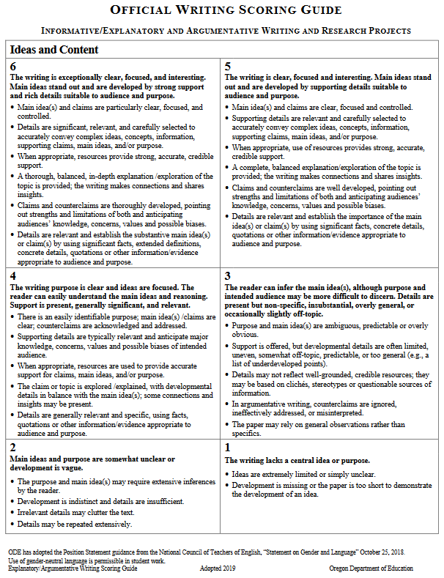
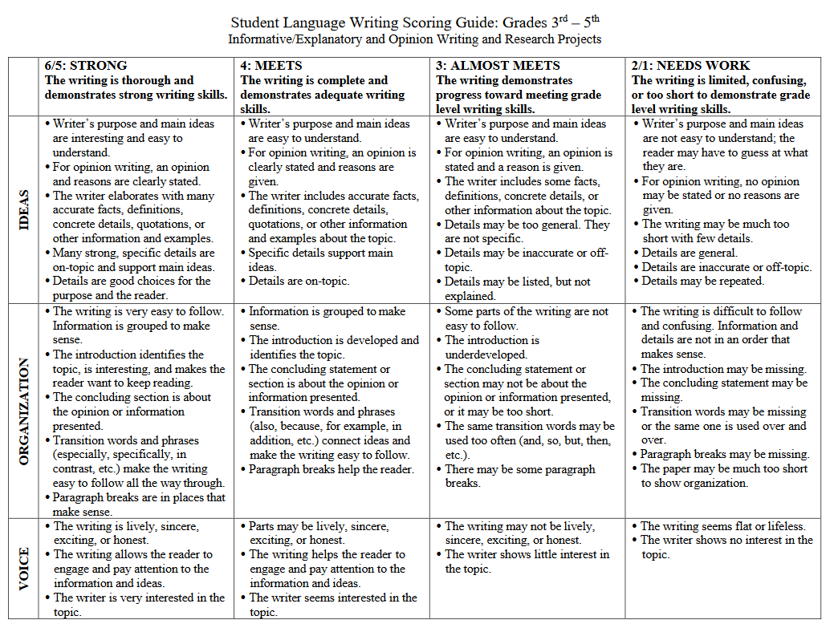
Writing Rubrics for LPAs
Official Writing Scoring Guide
Student Language Scoring Guide
Notes:
As previously stated ODE posts two different scoring guides on the website.
The Official Writing Scoring guide is one option available for scoring writing work samples. It is primarily used at the high school level but can be used at other grades as determined to be appropriate by the educator. The Official Writing Scoring guide is based on the full complexity of the standards.
The other scoring guides posted include student language scoring guides. These scoring guides are based on the Official Writing Scoring Guide, but have been developed to reflect appropriate grade level academic language and as you’ll notice the higher and lower ends of the 6 point scale on the student language versions have been combined. Additionally we have made these available by the grade bands described in the previous slides.
A common question is can high school educators use the 6 – 8 student language scoring guides. Since the suspension of Essential Skills is in place this type of decision should be answered by the district’s requirements for scoring LPAs in high school.

Slide 16
6 +1 Writing Traits for Informative / Explanatory & Argumentative
Use of Sources were added to the Informative/Explanatory & Argumentative SG and align to the Social Science Analysis Standards
Is there evidence multiple sources were consulted to support the arguments?
Are there attributions present to acknowledge the source material?
How effectively was source material integrated into the paper?
Was the student successful at avoiding plagiarism by paraphrasing or using quotation marks?
Notes:
As a reminder to the Informative / Explanatory & Opinion/Argumentative scoring guides , Use of Sources has been added as a plus one trait. This change also aligns to the align to the Social Science Analysis Standards. The social science analysis scoring guides posted on the website provides a deeper analysis into those social science analysis standards.

Slide 17
Key Features:
Six – point scale
Domain Traits (6 + 1)
Ideas and Content
Organization
Voice
Word Choice
Sentence Fluency
Conventions
Use of Sources
Notes:
As briefly mentioned in the prior slides, the official writing scoring guide is based on a 6 point scale. Score point four describes the minimum grade level proficiency expectations for students. The score point four applies to all grade levels including 3rd grade and up.
The list provides a quick list of the 6 traits included plus the use of sources previously mentioned for the opinion/argumentative and informational/expository scoring guide. In a few moments participants will engage in an activity to become more familiar with the specific language included within each scoring assertion, and in the meantime in the coming slides we provide a quick overview or theme of each writing trait.

Slide 18
Writing Trait Themes
Notes:
Now we will look the writing trait themes.

Slide 19

Ideas and Content
Purpose, main ideas
Stated opinion and reasons
Supporting details
Photo: Pixabay
Notes:
Ideas and Content focuses on main ideas and supporting details

Slide 20

Organization
Order and structure
Use of transitional strategies
Introduction and conclusion
Sequencing
Paragraph breaks
Photo: Pixabay
Notes:
The major themes of organization are order, structure and sequencing, but also include introduction and concluding transitions

Slide 21

Voice
Engages reader
Interest in the topic
Liveliness, sincerity, honesty, excitement
Photo: Pixabay
Notes:
Voice is inclusion of how the author engages the reader and provides their own expressive interest in the topic.

Slide 22
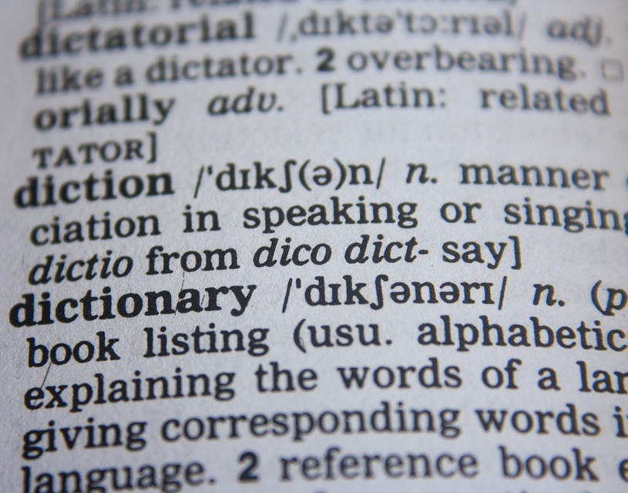
Word Choice
Accuracy and precision of word use
Content vocabulary
Variety
Photo: Pixabay
Notes:
Word choice is about how the author uses not only a variety of vocabulary in the writing, but also includes accuracy of both descriptive and content or academic language based on the topic

Slide 23

Sentence Fluency
Ease in reading out loud
Diversity of sentence beginnings
Assortment of sentence lengths
Variation in sentence patterns
Photo: Pixabay
Notes:
Sentence fluency addresses the flow of the paper and how the writer uses a variety of sentence patterns and length

Slide 24
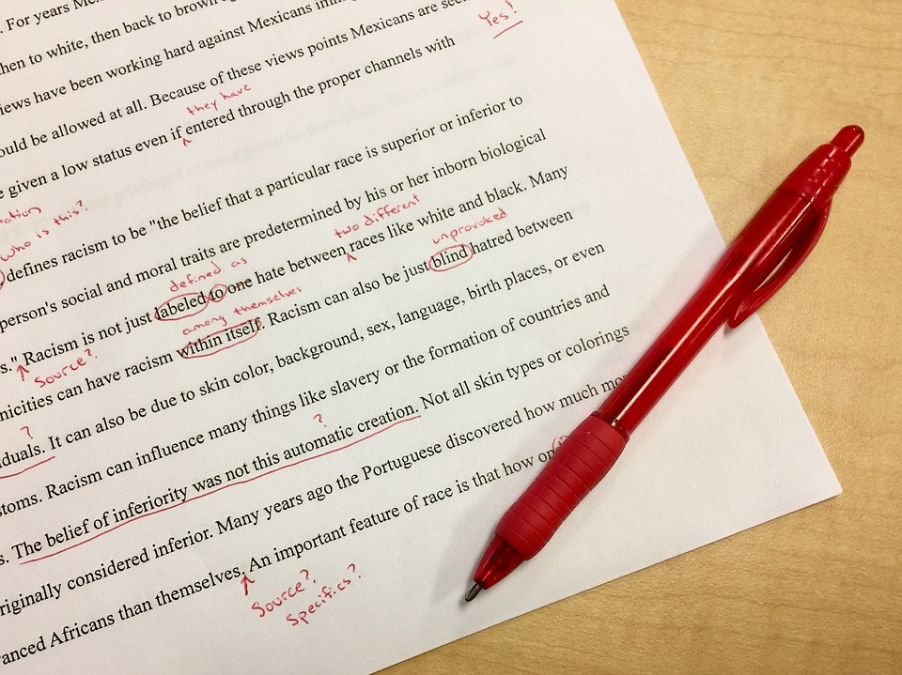
Conventions
Punctuation
Spelling
Capitalization
Grammar and usage
Photo: Pixabay
Notes:
And conventions includes many of the language standards surrounding grammar and use within the context of writing.

Slide 25

Use of Sources
Accuracy
Mix of different sources
Quantity and quality of information
List of sources
Photo: Pixabay
Notes:
As we mentioned earlier there is a plus one trait for opinion/argumentative and informational/expository, use of sources. The theme aligns to not only the use of multiple sources back the writer’s accuracy in using the sources in providing supporting details or facts.

Slide 26
Activity: Examining Language within the Traits of Informative/Expository (10 minute + 5 minute discussion)
In teams of two or more divide up the 6 writing traits to scan.
Starting at score level four: highlight, underline, or circle key descriptive words that describe “look for” of student evidence in writing.
Repeat this process for score level five and three.
Discussion: What were some key specifics or language you saw either between scoring assertions within a trait or something that was new learning?
Notes:
Activity: Highlighting Key Feature: In teams of two or more divide up the 6 writing traits to scan.
Starting at score level four: highlight, underline, or circle key descriptive words that describe “look for” of student evidence in writing.
Repeat this process for score level five and three.
Discussion: What were some key specifics or language you saw either between scoring assertions within a trait or something that was new learning?

Slide 27
Writing Trait Key Language
Notes:
In the next few slides we will review some the different adjectives and phrases used for a score point value of four minimum proficiency, three approaching proficiency expectations of the standards, and five above the minimum proficiency of the standards.

Slide 28
Ideas and Content
5 – Interesting and thorough details / accurate / strong and specific
4 – Adequate details / clear / easy to understand
3 – Some details / too general / inaccurate or not specific
Photo: Pixabay
Notes:
Within Ideas and Content the focus is on details being easy to understand and adequate details provided. In looking at core point three details may be too vague, general or inaccurate, and at score point five details are specific to the content and provide an additional layer of interest and knowledge

Slide 29
Organization
5 – Thorough and strengthen/ very easy to follow / interesting
4 – Developed and clear / makes sense
3 – Some clarity / underdeveloped / same
Photo: Pixabay
Notes:
Organization is focused on clarity and where details are situated in an order that makes the author’s message clear. At score point three their might be evidence of organization and an attempt to sequence information, but it is underdeveloped or details are situated in a way that they seem to repeat the same points. At score level five the details are organized in a clear manner and the flow of the details does not detract from the author’s message and some of the author’s plot or points are strengthened by the way they are organized within the writing piece.

Slide 30
Voice
5 – Lively / sincere / exciting / honest / very interested
4 – Parts are expressive / helps reader engage / seems interested
3 – Not consistent/ little interest
Photo: Pixabay
Notes:
Voice is often associated with word choice and focuses on the author’s purpose behind the writing. The author is asked to write in a manner that is engaging to the reader, and therefore students at a score point four are asked to use expressive language that invites the reader into the writing piece. At a score level three the author may attempt to invite the reader into the story but the message is inconsistent to hold the reader captivated. Of course at a score level five the author is expressive and writes with a voice that captivates the reader regardless of the topic.

Slide 31
Word Choice
5 – Interesting and precise / many rich content vocabulary words
4 – Variety of words / many content vocabulary words
3 – Little variety / repetition / some content vocabulary words
Photo: Pixabay
Notes:
As mentioned in the last trait, word choice is key is helping the author to be expressive, however, word choice also touches on the writer’s accuracy in using content specific language as described in the language standards. Additional, it builds on the diversity of vocabulary used within the author’s writing. Therefore, we see the use of variety and the difference between content and academic language to be the biggest distinguishing factor across the proficiency scoring levels.

Slide 32
Sentence Fluency
5 – Smooth / very easy to read out loud / many different variations
4 – Easy to read out loud / some variation or difference
3 – Some parts are easy to read out loud / some awkwardness
Photo: Pixabay
Notes:
Though Sentence fluency can often be confused with conventions, they primary focus is one the use of short simple sentences in combination with compound sentences and prepositional phrases that add to the students control of expressive writing. The example of reading a student response aloud is often the best gauge and the writing reads smoothly like a meandering stream versus choppy like rapids in a river. Though some parts maybe easy to read, if the fluency of the writing causes the reader to pause or be compelled to reread a section, it is most likely a score level three rather than a score level four or higher.

Slide 33
Conventions
5 – Higher-level / correct / little need for editing
4 – Usually correct / requires some editing
3 – Some errors / distract reader / much editing needed
Photo: Pixabay
Notes:
Conventions address grammar in the most traditional sense: spelling, capitalization, or ending and internal punctuation. A key factor to remember with spelling is that a single spelling mistake should not be compounded every time it is misspelled, unless the misspelling is different than the previous attempt. Of significant importance is taking a closer look at score level five which does state “little need for editing” is acceptable. Therefore even a student who has some editing needed they may still be using a high level of grammatical use: internal punctuation that deems them a level five rather than a level four. The bigger difference between a level four and three is when grammatical mistakes are numerous enough to distract the reader from the author’s intended writing purpose.

Slide 34
Use of Sources
5 – Specific information / several sources / accurately cited /uses quotations or paraphrases
4 – Uses information / several sources / accurately identified / summarizes or paraphrases
3 – Some information / mainly one source / may be incorrectly identified / may include copied text
Photo: Pixabay
Notes:
Finally, use of sources connects to a students writing style that incorporates reading and social science analysis standards within the context of the writing standards. Does the author use information from multiple sources to convey their opinion or argument or to enhance the informational/ expository writing piece. Are they performing at a level three where summarizing or paraphrasing information is missing and they are only copying the text, or are they performing at a level five where they are accurately using multiple sources and specific information to strengthen their writing.
In some cross content writing pieces, educators may wish to use both the writing scoring guide and the social science analysis scoring guides to capture multiple standards in one activity.

Slide 35

Questions or Clarifications?
https://tinyurl.com/2p8eryem
Photo: Pixabay
Notes:
In addition to the highlighted scoring guide you just created, we have created a Writing Scoring Guide Adjective document that might be helpful to use within instruction and share with students. The workshop facilitator will either post a link to these document and share this document with you now as we transition to our next goal.
Link to document: https://tinyurl.com/2p8eryem

Slide 36

Goal 3: Collaboratively score a writing work sample to build a common understanding of proficiency.
Notes:
In this final section we will address Goal 3: Collaboratively score a writing work sample to build a common understanding of proficiency.

Slide 37
Activity: Providing a Task
While the Standards delineate specific expectations in reading, writing, speaking, listening, and language, each standard need not be a separate focus for instruction and assessment.
Often, several standards can be (bundled) addressed by a single rich task (learning target).
Activity: We will pause her for a moment and provide approximately 7 – 8 minutes to read the task and sources so that you are familiar with the context shared with students. Please read the task materials.
https://tinyurl.com/4phvekym
Notes:
Prior to starting the calibration process, we will become familiar with the task associated with the provided anchor papers.
While the Standards delineate specific expectations in reading, writing, speaking, listening, and language, each standard need not be a separate focus for instruction and assessment.
Often, several standards can be (bundled) addressed by a single rich task (learning target) such as a performance task.
In this activity, we will share the different tasks and sources provided to students. We will provide approximately 7 – 8 minutes to read the task and sources so that you are familiar with the context shared with students. We will pause her for a moment. When participants are ready we will continue by navigating to the next slide.
For elementary educators, we have provided 3rd and 5th grade anchor papers, our recommendation is for our 4th grade educators to use the 5th grade anchor papers as they provide a forward looking perspective of student writing expectations. Middle school educators will be looking at a sample set from 7th grade and high school educators will be looking at a sample set from 11th grade
If you are the facilitator you may wish to pause the presentation or video now.
Share link or documents: https://tinyurl.com/4phvekym

Slide 38
Scoring Calibration
Notes:
Now that you are familiar with the task we will begin the process of working together on scoring calibration.

Slide 39

Anchor Papers
Examples of student work that exemplify the attributes of a certain score level and that serve as a standard against which other papers or performances can be judged.
Notes:
The purpose of the anchor papers that will be shared with you is to provide examples of student work that exemplify the attributes of a certain score level and that serve as a standard against which other papers or performances can be judged.
This is just one small activity and with time teams can create their own library of anchor papers to use for future calibration sessions. The protocols shared and presented can be used for multiple content areas with other anchor papers.
The scoring justifications and commentary that are used are from a group of teachers based on their calibration levels at the time. Please be aware you might not be I full agreement with the scores and you will be asked to look beyond the score and read the narrative evidence that was used

Slide 40

Gathering Evidence and Scoring
Preponderance of evidence - the greater weight of the evidence to decide in favor of one side or the other.
Photo: Pixabay
Notes:
The scoring justifications and commentary that are used are from a group of teachers based on their calibration levels at the time. Please be aware you might not be I full agreement with the scores and you will be asked to look beyond the score and read the narrative evidence that was used and cited in the justifications and commentary.
There might be circumstances where you have identified evidence from multiple soring level descriptors and you will be asked to determine a score based on the preponderance of evidence or the greater weight of the evidence to decide in favor of one side or the other.
In the coming slides, we will briefly walk through the scoring calibration process. Our focus will be on opinion/argumentative and informational/expository to allow us to practice the plus one use of sources trait.

Slide 41
Gathering Evidence and Scoring
Step 1: Individually Read and Identify Evidence
Identify evidence related to each trait while reading the student writing
Refer to the key words you identified and writing trait themes
Ideas and Content
Organization
Voice
Word Choice
Sentence Fluency
Conventions
Use of Sources
Notes:
Now that you have had a chance to become familiar with the task, you will now read through the student samples. As you read through the anchor papers identify evidence related to each trait while reading the student writing response and refer to the key words you identified and writing trait themes this part of the task will take approximately 5-7 minutes per paper to read, however we will read and discuss one paper at a time.

Slide 42
Gathering Evidence and Scoring
Step 2: Record Key Features from the Scoring Guide
After you identify pieces of evidence in student essays, record any key vocabulary in the scoring guide as evidence
Look for a preponderance of evidence to determine a score
Notes:
After reading through the student response and using your highlighted scoring guides and key vocabulary document, identify pieces of evidence in student essays while looking at the preponderance of evidence to determine a score. As we transition the Step 3 we will discuss recording your scores.

Slide 43

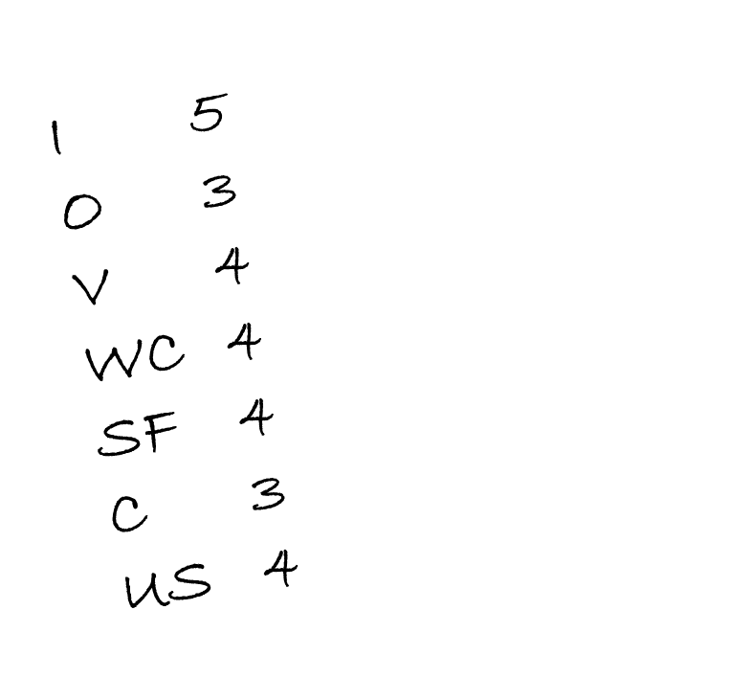
Gathering Evidence and Scoring
Step 3: Write Your Scores on a Sticky Note
Record your score based on the evidence and your interpretation of the language in the scoring guide
It is important to not yet share scores during this part to avoid placing an impartial bias on others in your group who are determining their scores
Notes:
The facilitator will ask you to determine your score and write it down of a sticky note or other piece of paper, however, it is important to not yet share scores during this part to avoid placing an impartial bias on others in your group who are determining their scores.
At this time approximately 10-12 minutes should have passed from first starting the reading process, identify evidence, and recording your score.

Slide 44
Gathering Evidence and Scoring
Step 4: Chart Your Scores and Discuss in Collaborative Group
Trait | 6 | 5 | 4 | 3 | 2 | 1
Ideas & Content |  | // | /// | /
Organization |  | // | ////
Voice |  | /// | ///
Word Choice |  | // | // | /
Sentence Fluency |  |  | /// | ///
Conventions |  |  | // | ////
Use of Sources |  | / | // | ///
Notes:
Teams will share out their scores within their group and a designated recorder will chart the teams scores. Consensus may not be 100% agreement. Sometimes it is okay to agree to disagree. After scores have been shared for each trait, take a moment to briefly discuss any traits where there is wide variety.
In the example chart presented on this slide, the first four traits seem to be in agreement that the student scored proficient or higher. However the team is in wider disagreement in the last 3 traits and may choose these traits to focus on and discuss the evidence and try to come to a consensus. Therefore, each participant should be prepared to support scores using both language from the scoring guide and evidence from the student writing
The facilitator will allow the group 5 – 7 minutes to discuss and will share the justifications and commentary in a moment.

Slide 45

Gathering Evidence and Scoring
Step 5: Compare Your Results With Scores and Commentary
Notes:
The scores, justifications, and commentary are a snapshot of time from a group of educators who were calibrated together. The should provide not only the trait scores but should also be supported with the evidence from that group that completed the justifications.
This is a moment to look at your scores from each trait and compare not only the score, but the evidence cited to justify the score provided in the justification and commentary papers.
We will provide about 3 – 5 minutes for self-reflection before moving on to another student sample.

Slide 46

Any Questions
Photo: Pixabay
Notes:
We will pause here to clarify any questions before beginning the process and in a moment we will post the complete steps on the next slide.

Slide 47
Writing Scoring Calibration Protocols (18 – 20 min.)
Individually, Read and Identify Evidence (5 – 7 min.)
Record Key Features from the Scoring Guide (4 min.)
Write Your Scores on a Sticky Note (1 min.)
Chart Scores and Justify (5 – 7 min.)
Compare Your Results With Scores and Commentary (3 – 5 min.)
After group discussions, wait for the next direction before you look at the next student samples
Notes:
Again we have posted the steps including approximate time for each step to help both the facilitator and participants to monitor the activity. If there is time permitting, we would recommend elementary educators to take a look at the other sample task and papers from the opposing grade you previously discussed. For instance 3rd grade educators might gain additional insight be looking at the 5th grade provided task and reading at least the 5th grade sample A student response and scoring justification and commentary. Equally 4th and 5th grade teachers may benefit in looking at the 3rd grade materials.

Slide 48

Contact Information
ODE Contact Information and Support
ODE ELA Assessment Resources
https://tinyurl.com/2p8wwb3y
Notes:
The intended goal of this professional development topic was to put the numerous puzzle pieces together and strengthen our collective understanding of the local performance assessment requirements, the different published ODE scoring guide resources, and taking a moment to look and discuss some sample anchor papers to calibrate our understanding of the scoring process and how evidence is used to determine and support trait scores.
In addition to this resource, ODE makes other resources available to educators. These resources can provide additional insight into assessment practices that support instructional practices. Contact information for English language arts and other content areas is also available to educators by visiting the ODE website.

