Slide 1
Remote Testing
Students and Families Training Module
Notes:
Welcome to the remote testing training module for students and families for this year's spring Oregon Statewide Summative assessments.

Slide 2
Course Objectives
This video will show you how to do the following:
Check to make sure you have the proper hardware and that it functions
Log in to the remote testing system
Communicate with your proctor during the remote testing session
Take and submit a remote test
Notes:
This video will show you how to do the following:
Check to make sure you have the proper hardware and that it functions
Log in to the remote testing system
Communicate with your proctor during the remote testing session
Take and submit a remote test

Slide 3
Security and Privacy
The option to test students remotely is built into the existing online testing system.
This is the same online testing system that students use to complete their tests for in-person testing at school.
Students will not be asked to share any additional personal- identifiable information.
Notes:
The option to test students remotely is built into the existing online testing system. This is the same online testing system that students used to complete their tests in person at school. Students will not be asked to share any additional personal- identifiable information.

Slide 4
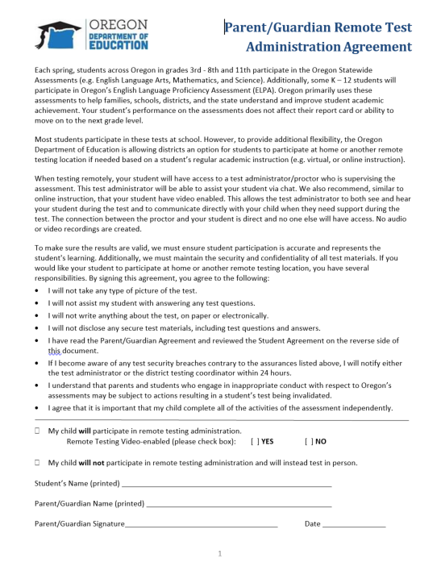
Providing Consent
Parent/Guardian consent is required for students to participate in a remotely proctored test session.
Your district may also require you to provide consent for your student to use a webcam, microphone, and speaker during the test session
This will allow the test proctor to monitor and communicate with a student during the test session
Notes:
Parent/Guardian consent is required for students to participate in a remotely proctored test session. So your district needs to contact you before testing to get your signed agreement if your student will be testing remotely.
Your district may also require you to provide for your student to use a webcam, microphone, and speaker during the test session to be able to participate in remote testing. Video helps the test proctor monitor the test session and communicate with students during the assessment.

Slide 5
Before Testing Day
Notes:
Let's review some of the steps you will want to go through before testing day.

Slide 6

Ensure You Have the Proper Hardware and Software
Before taking a remote test, make sure that you have the necessary hardware and software and that it functions properly
Ensure that you testing device meets the following hardware and software requirements:
Your testing device has the Secure Browser installed
  Your school or district may have already installed the Secure Browser on your device
  If your device does not have the Secure Browser installed, your school or district may work with you to install it. If this is not possible, you will not be able to participate in remote testing.
Notes:
Before taking a remote test, make sure that you have the necessary hardware and software and that it functions properly.
Ensure your testing device meets the following hardware and software requirements:
Your testing device has the Secure Browser installed. Your school district may have already installed this application. If they have not, and they are not able to assist you in installing the Secure Browser, you will not be able to participate in remote testing.

Slide 7
Ensure You Have the Proper Hardware and Software
Students will have access to real-time video communication between the student and the proctor or teacher during the test.
For students with video permission on file with the district, your testing device will require a built-in or plug-in webcam, microphone, and speaker.
Students in need of assistive technology such as text-to-speech software or screen readers, will need to be checked.
Notes:
The remote testing setting also allows for real-time video communication between the student and the proctor or teacher during the test.
If you allow real-time video communication between your student and the proctor during the test, your testing device will require a built-in or plug-in webcam, microphone, and speaker.
Students in need of assistive technology will also need to ensure access to specific features such as text-to-speech software, screen readers, or other forms of assistive technology have been checked for functionality.

Slide 8
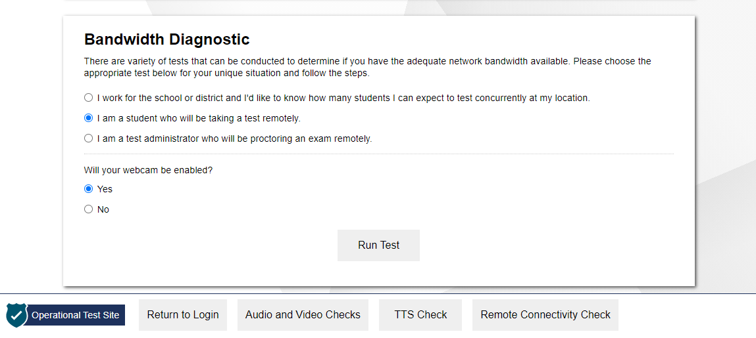
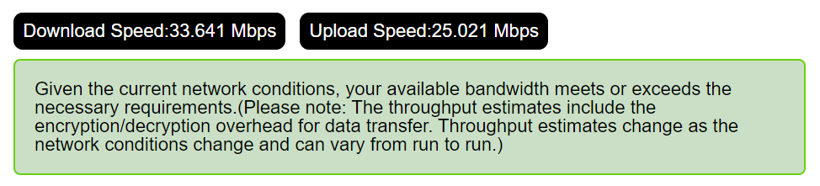
How to Test Your Internet Speed
https://bit.ly/Check_My_Speed
Notes:
Before the day of the test, you should make sure your internet speed is fast enough to take a test at home. The recommended minimum speed is 1.8 megabytes per second.
To test your internet speed, go to the diagnostic checker at the link on this slide (https://bit.ly/Check_My_Speed).
Under Network Diagnostics, select the appropriate test from the drop-down menu. Then enter “1” in the box for the total number of students you would like to test at one time and select Run Network Diagnostics Tests.
When the test is complete, you will see a Bandwidth Summary box letting you know if your internet speed is fast enough.
If the diagnostic summary indicates that your internet speed is not fast enough, let your school know.

Slide 9
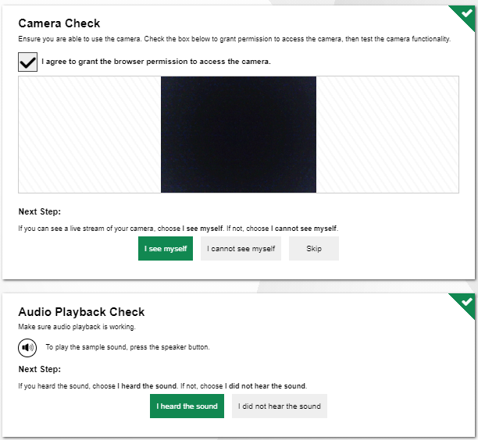
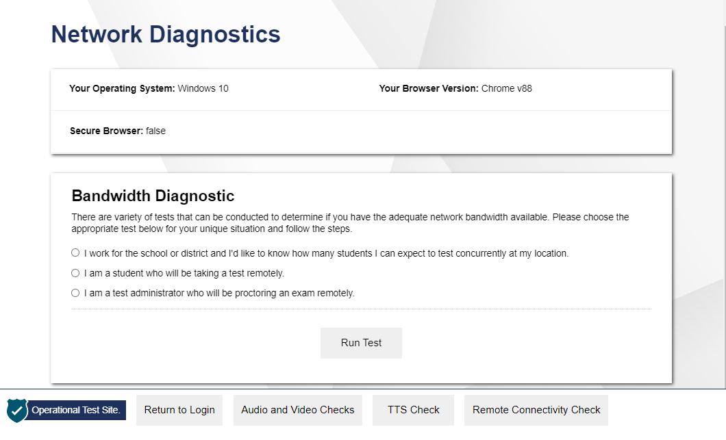
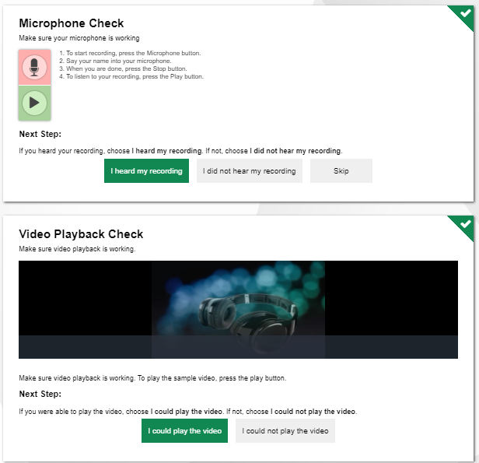
How to Check Your Hardware
https://bit.ly/Check_My_Speed
Notes:
In addition to ensuring you have the necessary hardware and checking your internet speed, you must also make sure that your hardware is functioning correctly prior to the day you take the remote test. You should work with your teacher and/or technology coordinator to test the functioning of each piece of hardware prior to remote testing.
Additionally, you can use the diagnostic checker that will walk you through a series of audio, video and microphone checks to ensure your hardware is working correctly. To access a diagnostic checker, go to https://bit.ly/Check_My_Speed
Note that this is the same link you use to access the internet speed checker. From here, select the Audio and Video Checks button. A series of audio and video checks will appear. To run the checks, follow the instructions for each individual check to determine if your hardware is functioning correctly.
If you encounter any problems during the diagnostic checks, contact your teacher to help troubleshoot the problem. You will need to use the same communication method you use during remote learning to contact your teacher.

Slide 10
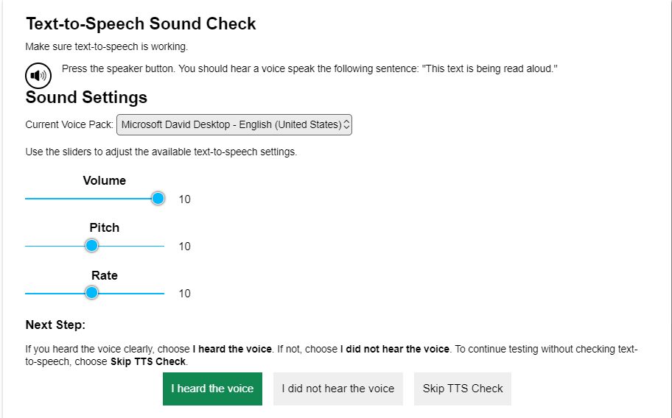
How to Check Your Hardware (Cont.)
Notes:
Additionally, from the diagnostic checker screen, you can test your device’s text-to-speech capabilities.
From here, select the TTS Check button. The Text-to-Speech Check page will appear. To run the check, select the speaker icon. If you do not hear the voice, try changing the Sound Settings and selecting the speaker icon again.
If you still cannot hear the voice, contact your teacher to help troubleshoot the problem. You will need to use the same communication method you use during remote learning to contact your teacher.

Slide 11
How to Obtain Necessary Assistive Technologies
Students who use assistive technologies during instruction need access to the same assistive technologies when they take a test remotely
Parents and students should work with their district or school’s technology coordinator to set up any necessary assistive technologies
If access to necessary technologies cannot be provided to students at home, parents and students should work with their teacher to determine other options for taking the test
Notes:
Students who use assistive technologies during instruction need access to the same assistive technologies when they take a test remotely
Parents and students should work with their teacher and their school’s technology coordinator to set up any necessary assistive technologies the student may need.
If access to any necessary assistive technologies cannot be provided to the student at home, parents and students should work with the school to determine other options for taking the test.

Slide 12
During Testing
Notes:
Now let's turn to what to do during testing.

Slide 13
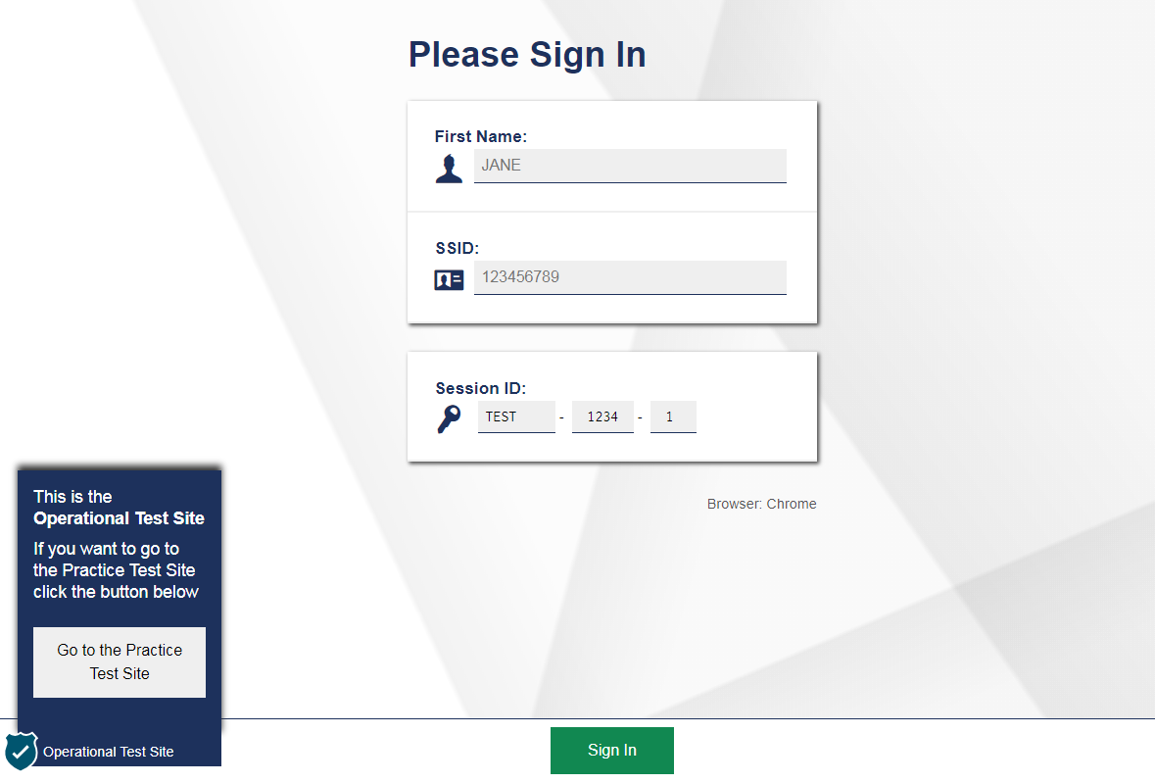
How to Sign Into the Remote Session
To sign into a remote session:
Sign in using the Secure Browser
Sign in using a Session ID provided by the testing administrator/proctor
Notes:
Before taking a test, you will need to sign into the testing site for the remote session.
First, if you have the Secure Browser, you can click on the Secure Browser icon on the device you are using for remote testing and see the login page. This screen is exactly the same as the screen you see when taking a test in the classroom.
If you do not have the Secure Browser loaded on your device you will need to do some prior to beginning your test. Additionally, you will need a test session ID provided by your teacher to log into the remote testing session.
In both options, you will need to do the following:
login using your first name; this will be your official name registered with the school
enter your student SSID number; and,
enter the session ID that the proctor provides.
Then select Sign In to continue.

Slide 14
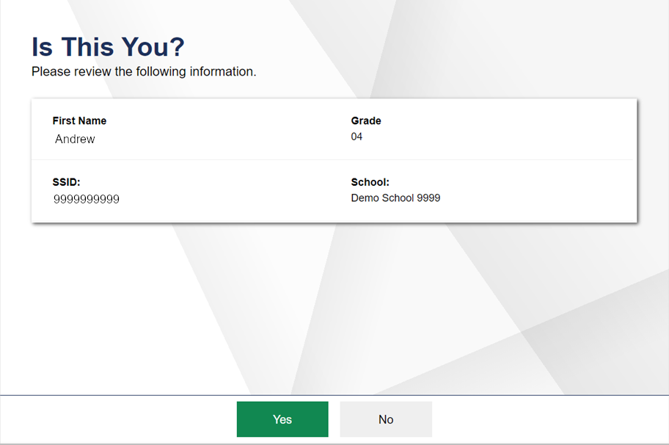
How to Confirm Your Information
Notes:
After signing in, you will see a screen asking you to confirm your demographic information. This screen is the same as the screen you would see when signing into the online testing system to take a test while present in the classroom.
You should carefully review your information to make sure it is accurate. If the information is correct, select Yes. If your information is incorrect, you will need to contact your proctor.

Slide 15
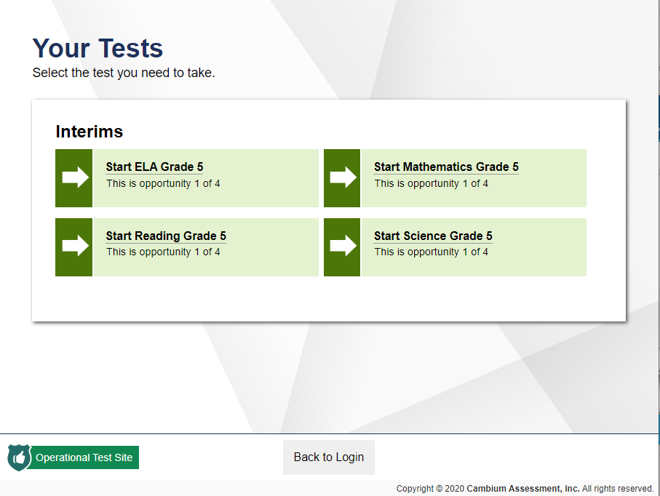
How to Select Your Remote Test
Notes:
On the next screen, you will select the test you need to take. This screen is the same screen you see when taking a test in the classroom. Once you select the test you need to take, you will be presented with a few more steps before you can begin remote testing.

Slide 16
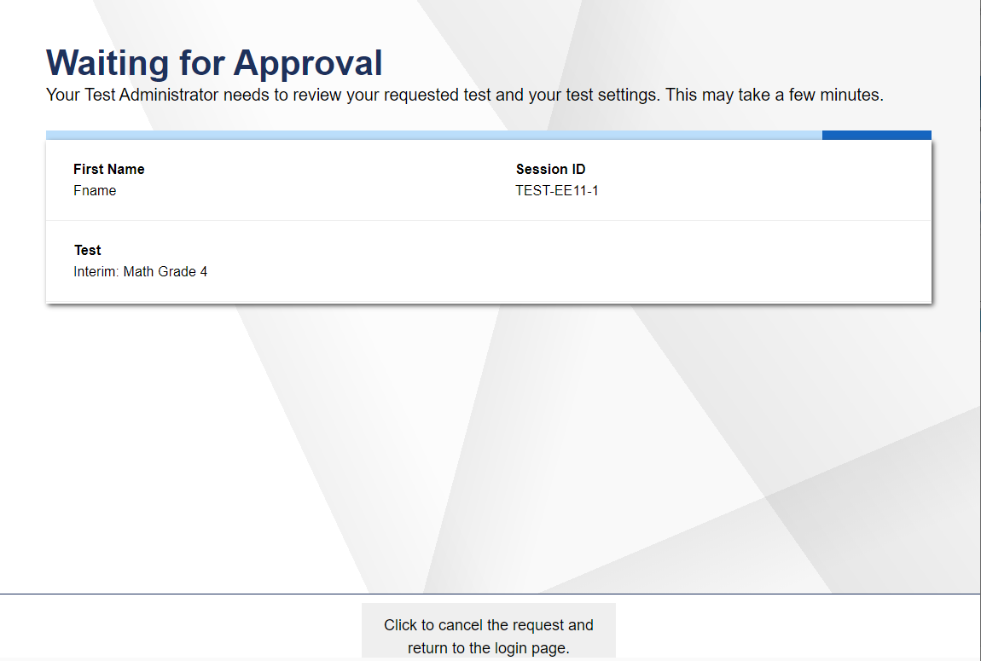
What You Will See When Waiting for Approval
Notes:
After selecting the test you need to take, you will see a Waiting for Approval screen. This screen is the same screen you see when taking a test in the classroom.
The proctor will automatically be notified that you are waiting to be approved. The proctor must approve you to enter the session before you can continue. Once the proctor approves your request to enter the test, you will see a few more screens before starting the test.

Slide 17
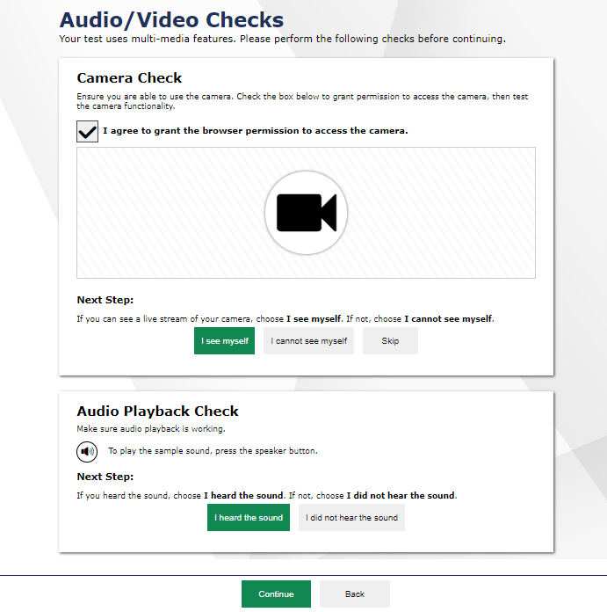
How to Complete Audio/Video Checks
Notes:
Next, you will see an Audio/Video Checks screen with one or more Audio/Video check panels. These checks are similar to what you would see when taking a test in the classroom with the addition of the camera check, if your parent or guardian has indicated to the district they will allow remote video. If remote video is not enabled, you will not see the camera check.
The next few screens will explain how to perform each audio/video check.

Slide 18
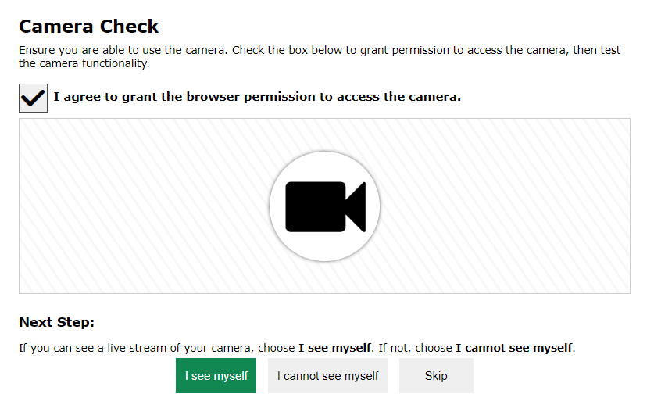
How to Check Your Webcam
Notes:
If your parent or guardian has given permission to the school district for video enabled, on the camera check page and next to the “I agree to grant the browser permission to access the camera,” you must mark the checkbox before you can proceed.
You will then see a pop-up window that requests permission for the browser to access your device’s camera and microphone. If you do not select Allow, the online testing system will be unable to access the web camera. Depending on the permission from your parent or guardian you may not be able to continue to the test. If you are unsure if your parent or guardian gave permissions contact your teacher.
After allowing the browser access to your device’s webcam, live video should appear. If video appears, select I see myself. A checkmark will appear in the upper right corner of the Camera Check field. If video doesn’t appear, select I cannot see myself and contact your proctor to help troubleshoot the problem.

Slide 19
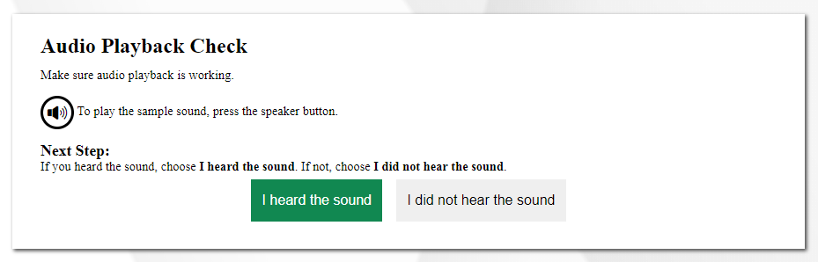
How to Check Your Audio
Notes:
To ensure your speaker is working properly, follow the steps below.
Select the speaker icon to play the sound. If you hear the sound from the speaker, select I heard the sound. A checkmark will appear in the upper right corner of the audio playback field.
If you do not hear the sound, you will need to click I did not hear the sound and contact your proctor to help troubleshoot the problem.

Slide 20
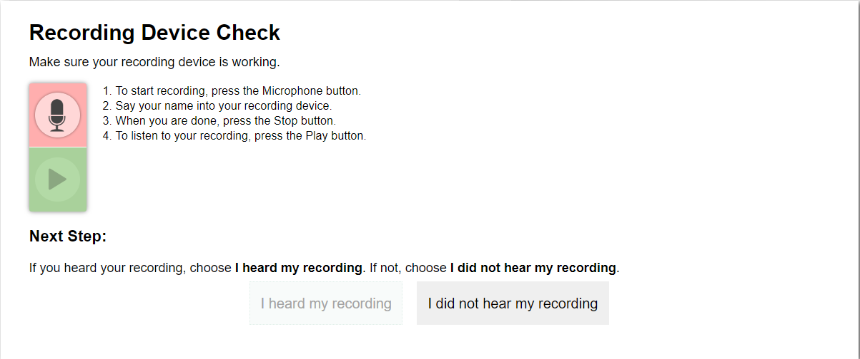
How to Check Your Microphone
Notes:
To ensure your microphone is working properly, follow the steps below.
First, click the microphone icon. Next, speak into the microphone.
When you are done speaking, select the stop sign to stop recording.
To listen to your recording, select the play button.
If you hear the audio you recorded play from your speaker, select I heard my recording. A checkmark will appear in the upper right corner of the recording device check field.
If you do not hear your recording play, click I did not hear my recording. You should contact your proctor to help troubleshoot the problem.
After all audio/video checks are completed, select Continue.
If you encounter a problem during a hardware check, the you should contact their proctor using the same method of communication used prior to this.

Slide 21
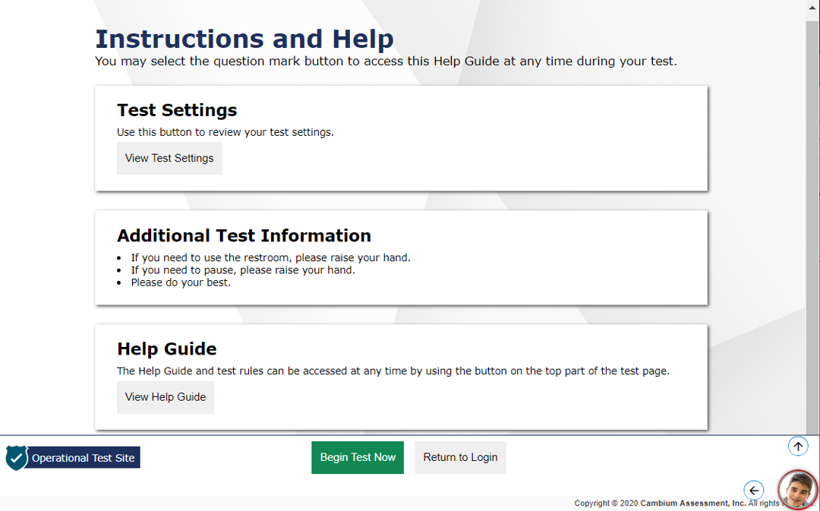
How to Access Test Instructions and a Help Guide
Notes:
Now that you have completed the Audio/Video checks, you will see the same Instructions and Help screen you would see when taking a test in the classroom. This page will display a Test Settings section and a Help Guide section. An Additional Test Information section may also appear if it is available on the test students are taking.
To view your test settings, select View Test Settings.
To access a help guide, select View Help Guide.
If available on the test you are taking, an Additional Test Information panel will contain any additional information you need to know in order to complete the remote test.
If your parent or guardian has approved remote video, you will see a live feed from your webcam at the bottom right corner of your screen. The image can be moved by clicking the arrows that appear when hovering over the image. Clicking on the image will allow you to communicate with your proctor. We will talk more about how to communicate with your teacher later in this module.
When you are ready to begin the test, select Begin Test Now.

Slide 22
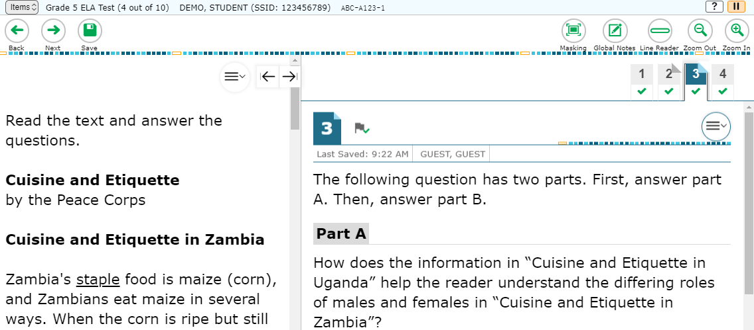

What You See After Entering a Remote Test
Notes:
After selecting Begin Test Now from the previous Instructions and Help screen, you will see the first question on the test. You will navigate through the test the same way you would when taking a test in the classroom.
If you lose your internet connection during a test, the test is paused, and your proctor is notified. Your responses will automatically be saved up to the point you lost the internet connection. When the connection resumes, you will need to sign into the test again using the same steps you did when you initially signed in to continue taking the test.

Slide 23
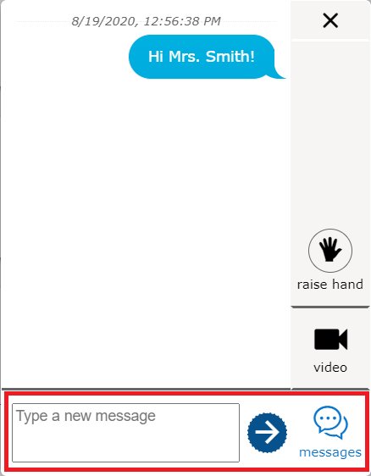
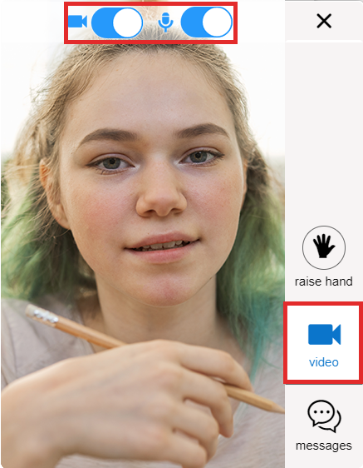
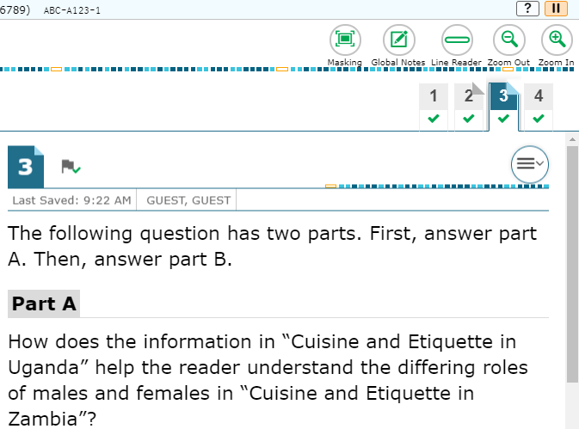

How to Communicate with Your Teacher During a Session
Toggle Buttons to Activate the Camera and Audio
Video Conference Button
Student Video Icon
Chat Box
Live Video Feed
Notes:
You can communicate with your teacher at any time during a remote testing session. To communicate with your teacher, click on the student video icon that appears by default in the bottom right corner of your screen. As mentioned earlier, you can move the icon by clicking on the arrows that appear when holding it over the icon.
In the chat box that appears, type a brief message and then select the arrow button to send the message to your teacher. You can also select the Raise Hand icon to “virtually raise your hand”. Your teacher will receive a notification on the test administration site that you need assistance and can respond to your request via chat message. Teachers can respond to raised hands by chat, video (when video is enabled), or a screen sharing session.
When you select the student video icon, you can turn your camera and microphone on and off. If you turn off your microphone and/or camera, your teacher will be unable to see or hear you. The teacher can respond to your message for assistance either through a chat message, one-to-one video conference, or on-to-one screen sharing session.

Slide 24
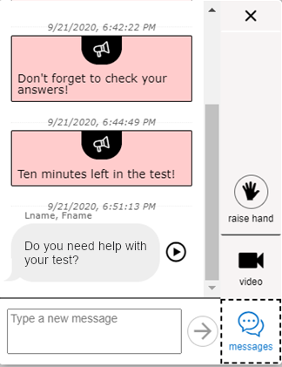

How Your Proctor can Communicate with You During a Test
Broadcast message to all students
Message to only you
Chat with your proctor
Notes:
Proctors can send broadcasted messages to all students in the session at one time or can send messages to individual students.
If your proctor sends you a message, the message appears automatically on your screen. You can respond to your proctor by typing a message in the chat window. Note that broadcast messages sent to all students appear differently than messages sent to an individual student.
If enabled, you will need to click the Video icon after clicking the student video icon in the test if you want to see yourself or turn your video/audio off/on.

Slide 25
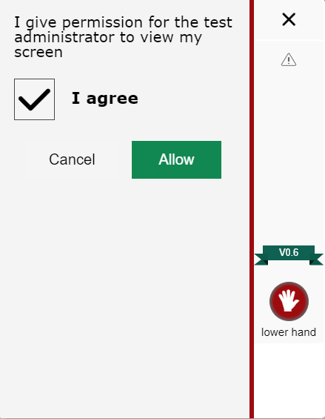
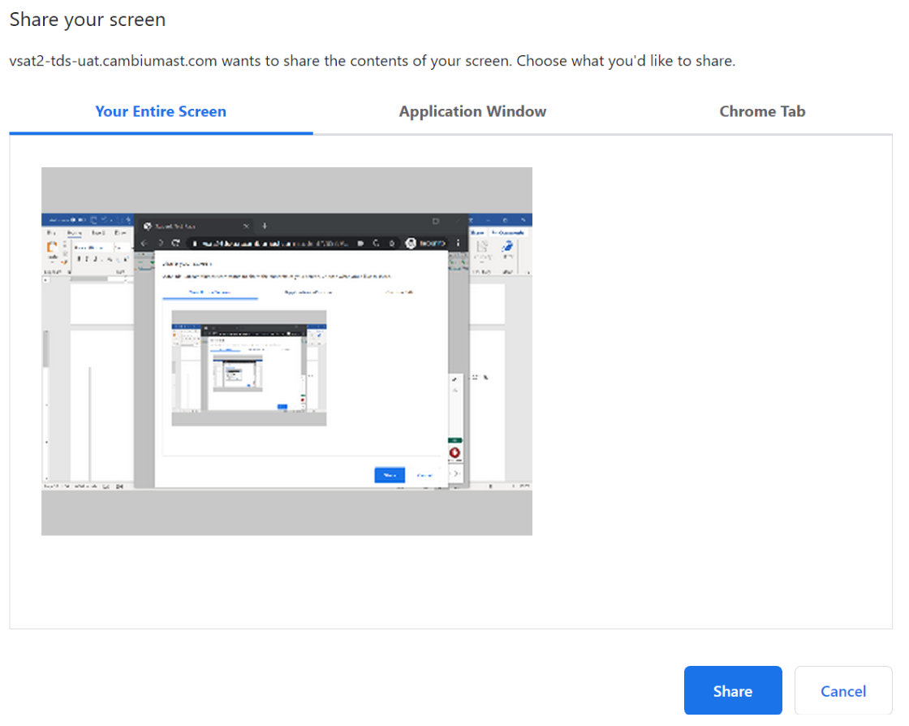
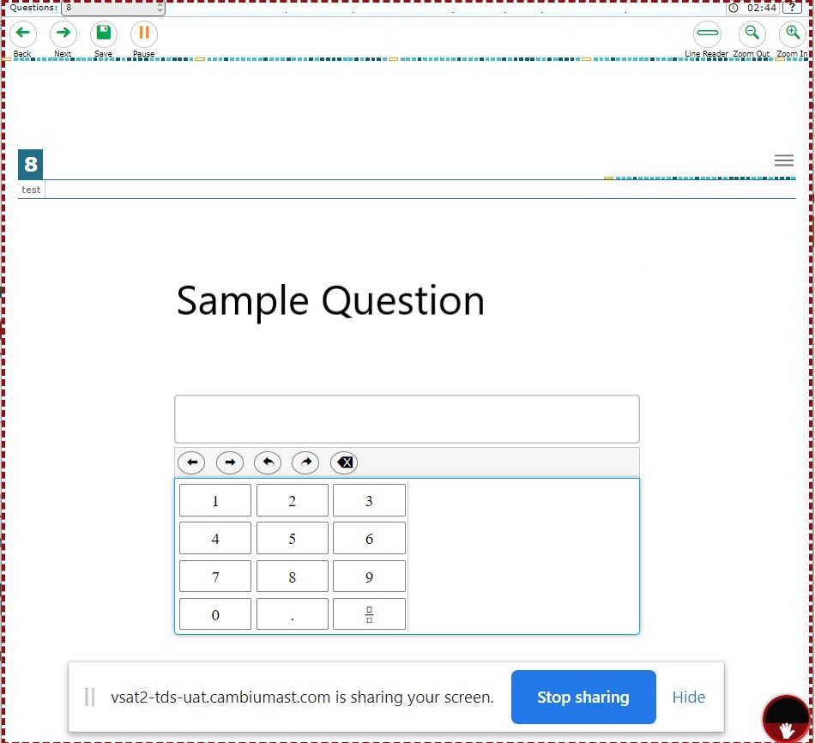
How Your Teacher can Communicate with You During a Test (Cont.)
Notes:
If your teacher initiates a screen sharing session, a pop-up window will appear in the student interface, requesting permission to view your screen. You must mark the I agree checkbox and then select Allow. If you do not select Allow, screen sharing will not work.
After selecting Allow, a pop-up window will appear in the student interface asking you which screen you would like to share with your teacher. You should select the screen with the open test and select Share.
Once you select Share, your teacher will see a mirror image of your screen and will be able to assist you accordingly.
To stop sharing your screen, select Stop Sharing.

Slide 26


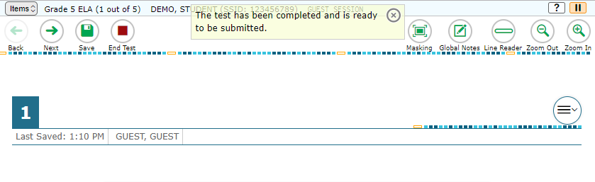
How to End a Remote Test
Notes:
When you answer the last question on the remote test, the End Test button will appear in the upper-left section of the screen, along with a message letting you know that the test has been completed and is ready to be submitted. Select the End Test button to end the remote test.

Slide 27
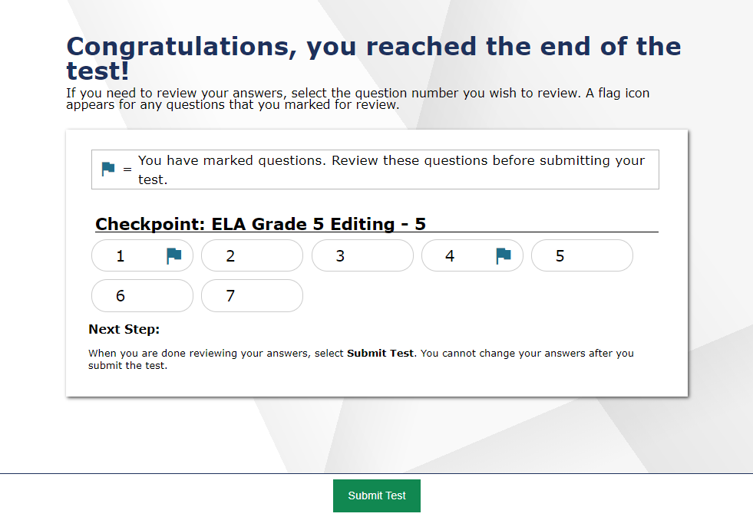
How to Submit a Remote Test
Notes:
On the next screen, you will be prompted to review your answers before submitting their test. This screen is exactly the same as you would see when taking a test in the classroom. To review your answers, you can click on the question number to be taken back to that item on the test and review your answer.
Once you have reviewed your answers, select the Submit Test button.

Slide 28
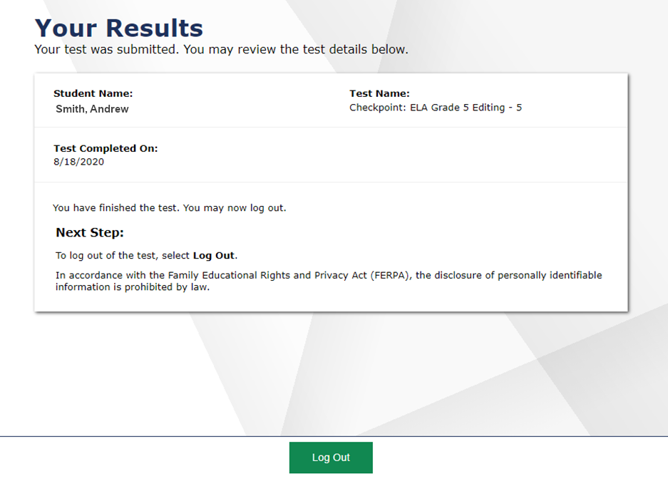
How to Confirm Your Test was Submitted
Notes:
Immediately after you confirm you want to submit your test you will see the same test confirmation screen you would see when taking a test in the classroom. This screen lets you know that your test was successfully submitted. To log out and exit the remote test session, select the Log Out button. Once you log out of the test session, you will no longer be able to communicate with your proctor through the system.

Slide 29
Thank You!
Thank you for viewing this training module.
If you need additional information or have questions, please consult the resources posted at
https://www.oregon.gov/ode/educator-resources/assessment/Pages/Assessment-Administration.aspx
You can also contact your teacher or school if you require additional assistance.
Notes:
Thank you for viewing this training module.
For additional information, refer to resources posted ODE Test Administration web page under Remote Testing Resources or visit the URL listed on this slide.
You can also contact your teacher or school if you require additional assistance.
This concludes the Families and Students training module

