Slide 1
Oregon Science Assessment 2018-2019 School Year

Slide 2
Purpose
This presentation will provide teachers with information about the 2018-2019 Oregon Science Assessment.
Enhancements since 2017-2018
Same as 2017-2018
New
No Change

Slide 3
Requirements and Blueprint

Slide 4
Science Assessment Requirements
No Change
The Science Assessment is required to be given to every student in grades 5, 8, and 11.
High School students may bank a passing HS Science Assessment Score in 8th*, 9th or 10th grade, fulfilling the 11th grade requirement.
*When 8th grade students pass the High School Science Assessment
TAM, Section 5.1: Testing Time and Recommended Order of Administration
TAM, Appendix B: Student Inclusion

Slide 5
2018-2019 Oregon Science Assessment
Test window: February 6 - June 7, 2019,
Students will have one annual test opportunity
Scores will not be available to students immediately upon completion of the assessment. Scores will be available in the Fall of 2019 after State Board Approval
Test opportunities are subject to a 45-calendar day expiration period.
New
New
New
No Change
TAM, Appendix A
Section 6.4: Pause Rules and Test Expirations

Slide 6
2018-2019 Oregon Science Assessment
Assessing the 2014 Oregon Science Standards (Next Generation Science Standards)
5th Grade Science Assessment contains items aligned to 3rd-5th grade Oregon Science Standards
8th Grade Science Assessment contains items aligned to 6th-8th grade Oregon Science Standards
High School Science Assessment contains items aligned to all high school science Oregon Science Standards
New

Slide 7
Blueprint: 5th Grade
New
Three-Dimensional Reporting Categories | # Operational Cluster/Task Items Average 8-10 interactions | # Operational Stand-Alone/ Independent Items
3-D Physical Science | 1 to 2 | 4 to 5
3-D Life Science | 1 to 2 | 4 to 5
3-D Earth Science | 1 to 2 | 4 to 5
 | *Total = 4 | *Total = 13 to 14
*Represents the total number of operational items of that item type to appear from all reporting categories.

Slide 8
Blueprint: 8th Grade
New
Three-Dimensional Reporting Categories | # Operational Cluster/Task Items Average 8-10 interactions | # Operational Stand-Alone/ Independent Items
3-D Physical Science | 1 to 2 | 4 to 5
3-D Life Science | 1 to 2 | 4 to 5
3-D Earth Science | 1 to 2 | 4 to 5
 | *Total = 5 | *Total = 12 to 13
*Represents the total number of operational items of that item type to appear from all reporting categories.

Slide 9
Blueprint: High School
New
Three-Dimensional Reporting Categories | # Operational Cluster/Task Items Average 8-10 interactions | # Operational Stand-Alone/ Independent Items
3-D Physical Science | 2 | 4
3-D Life Science | 2 | 4
3-D Earth Science | 2 | 4
 | *Total = 6 | *Total = 12
*Represents the total number of operational items of that item type to appear from all reporting categories.

Slide 10
Constraints for all Science Assessments
New
Each cluster/task will be from a different Disciplinary Core Idea (DCI)-
Example of a DCI: PS1: Structures and Properties of Matter
No more than three stand-alone/independent items on a student’s assessment will be from the same DCI
No more than one cluster/task or stand-alone/independent item will be from the same standard/performance expectation.
Example: MS-PS1-1, MS-PS1-2, MS-PS1-3,

Slide 11
Constraints for all Science Assessments (continued)
New
All items will appear in random order regardless of reporting category or type of item.
Field test items [either one cluster/task or five stand-alone/independent item(s)] will be placed in a random position within each student assessment in addition to the operational items listed in the blueprint summary.*
*Field test items do not count
toward the student’s final score.
New
No Change

Slide 12
2018-2019 Science Assessment Scoring
New
Individual Students will receive a composite science score in Fall 2019
Individual students may* also receive category scores
Group level scores may* consist of DCI relative performance (strength and weakness).
In the future (beyond 2018-19) group level scores may contain relative performance by standard (performance expectation).
*Availability of scores TBD for 2018-2019 school year
Notes:
The availability of category (Life Science, Physical Science, Earth and Space Science) and group level scores has not yet been determined for the 2018-2019 Science Assessment (implementation).
We strive to provided group (classroom and disaggregated student group reports) performance by standard/performance expectation at in the future.

Slide 13
Reporting Categories- Student Level*
New
3-Dimensional Physical Science
3-Dimensional Life Science
3-Dimensional Earth Science
Embedded within each category:
Disciplinary Core Ideas
Science and Engineering Practices
Cross-Cutting Concepts
* It has yet TBD whether students will receive category scores for the 2018-2019 assessment.
Notes:
Unlike previous score reporting categories, the new reporting categories are three dimensional and scores represent not only student understanding of science content, but also their knowledge and skills with science and engineering practices and cross-cutting concepts.

Slide 14
Reporting Categories: Institution Level*
New
LS: Life Science
LS1: From Molecules to Organisms: Structures and Processes
LS2: Ecosystems: Interactions, Energy, and Dynamics
LS3: Heredity: Inheritance and Variation of Traits
LS4: Biological Evolution: Unity and Diversity
ESS: Earth and Space Science
ESS1: Earth’s Place in the Universe
ESS2: Earth’s Systems
ESS3: Earth and Human Activity
PS: Physical Science
PS1: Matter and Its Interactions
PS2: Motion and Stability: Forces and Interactions
PS3: Energy
PS4: Waves and Their Applications in Technologies for Information Transfer
*It has yet TBD whether students will receive category scores for the 2018-2019 science assessment.
Notes:
Within the Oregon Reporting System, teachers will be able to see additional information on group performance. This information will be relative to the specific DCI and the associated Science and Engineering Practices and Cross Cutting Concepts associated with that DCI. Reports will show areas of strength or weakness in a DCI category compared to the student groups performance relative to proficiency and relative to the test as a whole.
Please consider the three dimensionality of the standards when observing this information.
Performance within a DCI is not limited to content knowledge, but also reflects student knowledge and skills with the Science and Engineering Processes and Cross-Cutting Concepts within the Performance Expectations associated with the DCI.
We are not able to report on specific Science and Engineering Practices or Cross Cutting Concepts at this time.

Slide 15
Oregon Science Assessment Item Examples

Slide 16
Item Development Process
No Change
Items are developed collaboratively between Oregon Department of Education, Oregon educators, ODE’s test vendor (American Institute for Research –AIR), and ODE’s collaborative state partners.
Oregon Department of Education has signed a memorandum of understanding with several other states to share items.
ALL items are reviewed by Oregon educators for recommendation of acceptance into the operational pool.

Slide 17
Cluster/Tasks & Stand-Alone/Independent Items
New
designed to engage the student in grade-appropriate, meaningful scientific activity aligned to a specific standard.
begins with a phenomenon or design problem that engages student interest and can be explained, modeled, investigated, or designed using the knowledge and skill(s) described by the standard.
Stand-Alone items are brief with 1-2 interactions whereas Cluster/tasks are longer and more complex with an average of 8-10 interactions.
For more information on Item Specifications, please see the Item Specification documents available on the ODE Science Assessment Webpage.
Notes:
The NGSS standards have been written as performance expectations. Performance expectations simply clarify the expectations of what students will know and be able to do by the end of the grade.
Phenomena for the Next Generation Science Standards are how we engage students in academic content, for example Spinner Direction, Humpback Whale Feeding Bubble, or Looking Through Water.

Slide 18
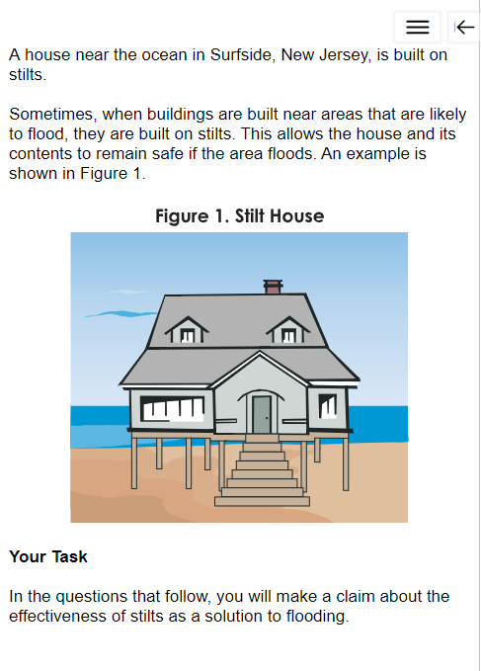
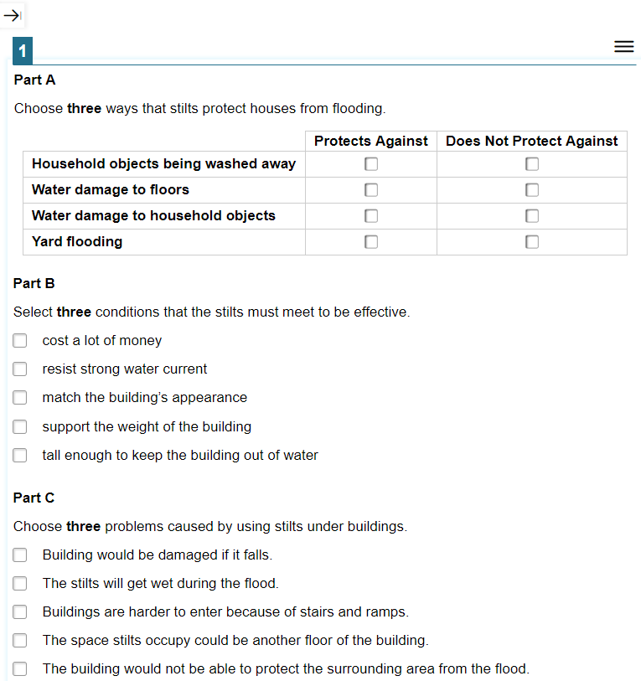
Cluster/Task Items (Grade 5 Example)
New
Notes:
Grade 5
Cluster example.
Each cluster has a stimulus to introduce the phenomenon or design problem and inform students of their task. The task is structured into multiple parts which walk the student through the process of gathering information about the phenomena or design problem, reasoning with that information and communicating their response to the task.
The student may expand either side of the page using the arrow buttons at the top of the screen. this will allow them to concentrate more fully on that side of the page and/or allow them to see larger data sets such as tables without have to scroll from left to right.
The context menus (hamburger menus) allow students to use features such as mark for review, tutorials, highlighting functions, etc. from a dropdown menu. These same features are also available through a right mouse click anywhere within the item or stimulus.

Slide 19
Stand-Alone/Independent Items (Gr. 5 Ex.)
New
Oaksportal.org
Notes:
Stand-Alone example –

Slide 20
Spanish Toggle Feature
New
Allows the student to switch back and forth between Spanish and English.
The student may answer in either language. Their responses are saved to both languages automatically.
Highlighting, masking and similar features may be lost or only persist for the language where it was used.
When the student scrolls down the page in one language, their approximate location will be retained when the switch to the other language.
Notes:
Spanish is presented to the student first and the toggle allows them to switch to an English presentation.

Slide 21
Spanish Toggle Feature
New
Notes:
The Spanish toggle will be located in the upper right hand tool menu.

Slide 22
Accessibility Supports
No Change
For a complete list of all embedded and non-embedded universal supports, designated supports, and accommodations, please see the Oregon Accessibility Manual.

Slide 23
Scratch Paper
New
Scratch paper is a non-embedded universal tool available to all students.
PLEASE NOTE: Scratch paper used for notes on the Science assessment can be retained and securely stored between test sessions.
TAM, Section 2.4: Secure Handling of Printed Test Materials and Note Paper: Printing, Storage, and Disposal
Notes:
Scratch paper continues to be a non-embedded universal tool, however, please note that starting this year, scratch paper may be retained and securely stored for the Science test so that students may access their notes for Science cluster tasks in progress.
To retain scratch paper, TAs must direct students to write their names (or some appropriate identifying information) on their scratch paper, and then collect and inventory the scratch paper at the end of each test session. Retained scratch paper must be kept in a securely locked room or cabinet that can only be opened by authorized staff. Upon completion of the test, paper must be securely destroyed.

Slide 24
Estimated Time
New
Assessment Grade-Level | Estimated Time in hr: minutes*
5th Grade | 1:30
8th Grade | 1:30
High School | 1:35
*These estimates are based on 2017-2018 field test data for most students (80% percentile) and do not account for any time needed to start computers, load secure browsers, and log in students.
TAM, Section 5.1: Testing Time and Recommended Order of Administration

Slide 25
Resources

Slide 26
Preparation: Sample Test
New Sample items and Formats
No Sample Test Policy Change
Students should practice with the sample test to allow them to become more familiar with the structures of the items and the features of the online assessment platform.
Sample tests are not to be used in an evaluative way. These items are not designed to give the student or teacher feedback on student performance.

Slide 27
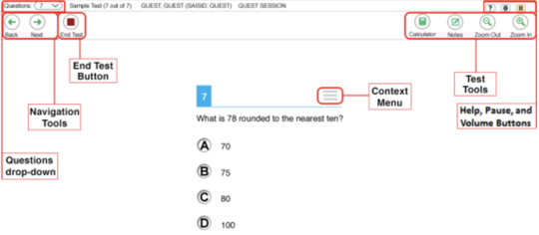
Science Sample Test: Help
A list of available features can be found on the Sample Test Help section for Science.
Please point out the features of the Science Assessments to students using the practice test.
Overview of the Student Interface below is not specific for science. Notes for example is only used for the English Language Arts assessment.
Notes:
Features of the 2018-2019 Science Sample Test Include:
Available Test Tools
Science The following tools are available for Science Tool: Notes, Calculator Science 5, 8, and HS
Comments
Expand/Collapse Passage
Help [?] Highlighter Line Reader Mark for Review Masking Pause
Periodic Table is only available for the following tests: Science 8 and HS
Print on Request Strikethrough System Settings Text-to-Speech Text-to-Speech Tracking Tutorial Zoom buttons

Slide 28
Preparation-Scoring Guides
New
Scoring Guides were created to allow teachers to see how items are scored to inform classroom practice.
Sample test scoring guides are available on the ODE Science Assessment webpage.

Slide 29
Helpful resources available on the ODE Science Assessment webpage:
New
Grade Band Item Specifications- item writer information such as assessment boundaries and clarifications
Blueprint Summary- number and type of items on the test
Science Sample Tests (link) & Scoring Guides- Sample scoring assertions and rubrics for sample tests (not to be used for student achievement evaluation)
Item Type Tutorials List- links to video examples of assessment interaction types
Video link to a simulation example

Slide 30
Additional Resources on the ODE Assessment Website
New
Oregon Accessibility Manual – Guides the selection and administration of universal tools, designated supports, and accommodations for Oregon’s Statewide Assessment System (OSAS)
Test Assessment Manual – Guides the administration of the science assessment.

Slide 31
FAQ
New
Q: What happens if the student needs to pause the test for more than 20 minutes when they are in the middle of working through a cluster/task?
A: The student will be allowed to resume working on the cluster when they return to the test. All answer selections within the cluster are unlocked and can be changed. All answers for previously completed clusters and stand-alone items will be locked.
If students pause for less than 20 minutes, they may review/change answers from any item already completed.
Notes:
If students pause for less than 20 minutes, they have the ability to review and change answers for any item already completed. When possible it is recommended that test administrators give students ample notice of the end of the test session so they are able to complete the cluster they are working on before ending the test session.

Slide 32
Very Important Reminder
No Change
Please remove or cover instructional visual stimuli/posters (including content related information and questions on the board) in the testing environment prior to testing to prevent testing improprieties.

Slide 33
Thank you!
Noelle Gorbett
Science Assessment Specialist
Oregon Department of Education
noelle.gorbett@state.or.us

