Slide 1
OSAS Science Assessment Reporting
Updated 01/01/2022
Notes:
Hello, This is Noelle Gorbett, Science Assessment Specialist at the Oregon Department of Education.
This is the OSAS Science Assessment Reporting presentation.

Slide 2

Goals for this session
Describe OSAS Science Assessment Development
Identify available data
Identify the appropriate uses of OSAS Science Assessment data
Notes:
During this session we will describe the OSAS Science Assessment’s development, identify the data available to you in various assessment data systems, and identify the appropriate uses of OSAS Science Assessment data.

Slide 3

Oregon Statewide Assessment System
Science Assessment
Assessment Development
Oregon adopted new science standards in 2014*
Items aligned to the new standards were field tested within the OAKS assessment in 2018
The first operational assessment aligned to these standards was given in 2019.
Notes:
A standards adoption committee made up of educators and community partners unanimously recommended the Next Generation Science Standards to the Oregon State Board of Education for adoption as the 2014 Oregon Science Standards. The State Board of Education adopted the standards on March 6, 2014. A plan was developed and guidance given to districts on the implementation of standards including a timeline the implementation of the new statewide assessment aligned to these standards.
Items aligned to these new standards were first field tested with the OAKS assessment in the 2017-2018 test administration. The first operational assessment completely aligned to these new standards was given in the 2018-2019 test administration.
*Please note: Oregon Science Standards are under review in 2021-2022 as a part of the regular review cycle that occurs every 7 years. This will not impact assessment in the 2021-2022 school year. Any changes in the standards requiring changes to the assessment will be implemented on a timeline to be determined by ODE in collaboration with the Science Standards Review Advisory and the Assessment Advisory.

Slide 4
Significant Changes to the Standards
2009 Oregon Science Standard | 2014 Oregon Science Standard (Next Generation Science Standard)
3.4D.1 Identify a problem that can be addressed through engineering design, propose a potential solution, and design a prototype. | 3-ESS3-1 Make a claim about the merit of a design solution that reduces the impacts of a weather related hazard.
Notes:
Here are examples of the old and new standards for comparison. Note the specificity of the new standard and the increased level of rigor in asking the student to make a claim about the merit of a design solution rather than just identifying a problem

Slide 5
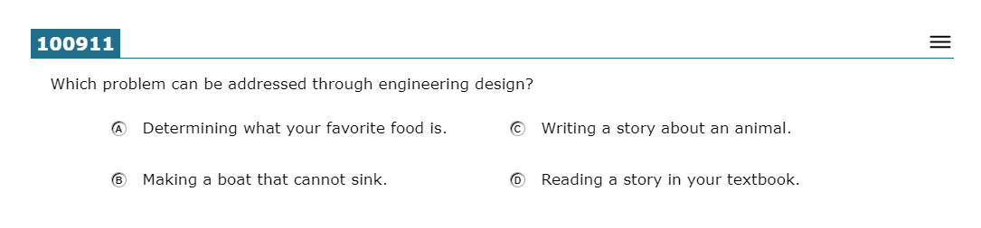
(Retired) OAKS Science Item
Notes:
This is an example of an item from the retired OAKS Science Assessment. Note the brevity and the classical multiple choice. This type of item allows for minimal collection of evidence about what the student knows and is able to do.

Slide 6
(New) OSAS Science Item
Notes:
This is an example item from the OSAS Science Assessment Sample Test. The item includes a phenomena/scenario on the left-hand side of the screen and several interactions on the right hand side of the screen. The student is given a task to complete through the interactions on the right hand side of the screen. The interactions types vary. A complete list of interaction types can be found on the OSASportal.org under ‘resources’.

Slide 7
Oregon Statewide Assessment System
Science Assessment (cont’d)
Standard Setting and Presentation to the State Board
Achievement cut scores were selected by a panel of educators in August 2019.
Affinity groups were engaged due to the lack of diversity on the panel.
Affinity groups supported the recommendations of the panel.
Achievement cut scores and descriptors were first presented to the board in December of 2019 and were adopted in February of 2020.
Notes:
After completion of the first operational administration of the OSAS Science Assessment, cut scores needed to be identified. Achievement cut scores were selected by a panel of educators in August 2019. It was pointed out during the meeting of the panel that the panel was almost entirely white and did not represent the diversity of the student population in our state. Affinity groups were engaged to discuss the cut scores identified by the standard setting panel as well as the resulting percentage of students proficient across the state. Affinity groups supported the recommendations of the panel and gave additional feedback on ways we can work together to better support all students in our state, particularly historically marginalized students.
Achievement cut scores and achievement level descriptors for the OSAS Science Assessment were first presented to the state board of education in December of 2019 and were adopted by the board in February of 2020.

Slide 8
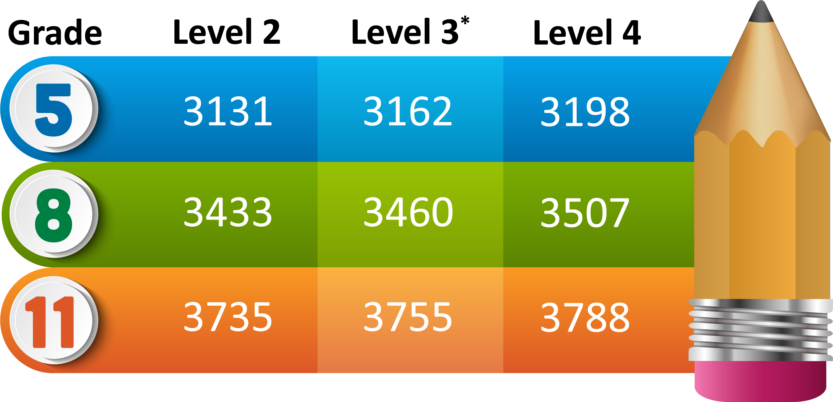
Achievement Level Cut Scores
*Students achieving level 3 or 4 are considered proficient.
Notes:
Here are the achievement level cut scores for the OSAS Science Assessment.

Slide 9
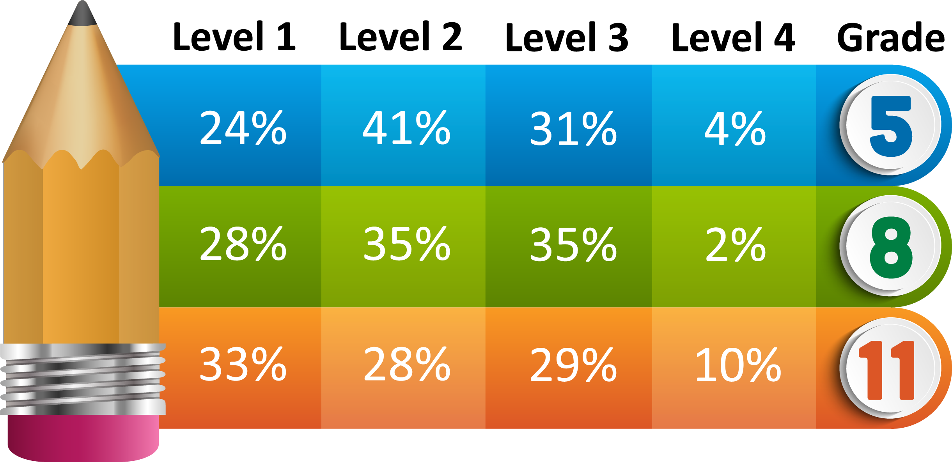
2018-19 State Level Achievement*
*Based on unofficial 2018-19 OSAS Science Assessment Data.
Achievement of a level 3 score or higher indicates proficiency.
Notes:
2018-2019 State Level Achievement.
Here we see the percentage of students across our state at each level of achievement once the cut scores have been applied.
Please note that achievement of a level 3 score or higher indicates proficiency

Slide 10
Available Data
Available Data Student score data for Science is available in Student Centered Staging, Accountability Warehouse Extract (AWE), and OSAS Centralized Reporting System (CRS).
Student scores for the current year will continue to load into these systems through June as tests are completed and scored.
Notes:
The science scores are available in Student Centered Staging and Accountability Warehouse Extract, as well as in the Centralized Reporting System . The records for the current year are typically open for editing in early spring through the end of May to allow district staff to verify students and apply administration codes where appropriate.
The current year science test records are going to be loaded daily, and those come into ODE’s systems about one to two days after the tests are completed. The unofficial scores in CRS are typically available within 24 hours of test submission.

Slide 11
Data Available in Centralized Reporting System (CRS)
The Oregon Statewide Assessment System (OSAS) Centralized Reporting System (CRS) contains ‘unofficial’ data that has not been validated by districts.
CRS can be accessed through the OSAS Portal website under the ‘Reporting’ button found within the Test Administrators and Test Coordinators menus.
Training on using the CRS is available on the ODE web page.
You can download student results and view score reports.
Aggregate reports include percent of students tested and percent of students proficient.
NOTE: these percentages will not exactly match ODE reports, since accountable students are not identified in CRS.
Notes:
The OSAS Centralized Reporting System, or CRS, contains ‘unofficial’ data – unofficial because it has not been validated by districts.
You can navigate to the OSAS Portal with the link in the second bullet of this slide to access CRS.
The CRS has a User Guide, and there is also a CRS training webinar available on the ODE website.
In the CRS, you can look up individual student results, and you can also generate some aggregate score reports. For these reports, you can drill down from the district to the school, as well as the personnel and roster level, and you can also get some aggregate counts and percentages for performance.

Slide 12
Data Available in Centralized Reporting System (CRS)
Data can be seen at the state, district, school, group, and individual student levels.
Individual
  Individual Scores – Individual Student Reports (ISRs) may be downloaded. ISRs contain:
    Composite Score
    Claim score ranges for 3-Dimensional Earth and Space Science, 3-Dimensional Life Science, and 3-Dimensional Physical Science
Aggregate (state, district, school, group roster)
  Data arranged by state, district, school or group roster for 3-Dimensional Science Claims, SEP/CCC Claims includes performance distribution, performance relative to the test as a whole, and areas of weakness and strength.
For more OSAS Science Reporting information, please see the OSAS Science Assessment Reporting document on the ODE Science Assessment web page.
Notes:
Depending on your current role as assigned in TIDE, you will be able to see state, district, school, group and individual student level data in the Centralized Reporting System.
At the individual level you will be able to see individual student data as well as be able to download individual student reports. Individual student reports contain a composite score as well as claim score ranges for 3-Dimensional Earth and Space Science, 3-Dimensional Life Science and 3-Dimensional Physical Science
Depending on your role you will be able to see aggregate or (group) data at the state, district, school, or group roster level for 3-Dimensional Earth and Space Science, 3-Dimensional Life Science, and 3 Dimensional Physical Science as well as
SEP/CCC claims including:
Gathering Data and Investigating Scientific Questions
Developing and Using Models to Describe the Natural World
Using Mathematical Thinking to Analyze and Interpret Patterns in Data
Use Scientific Reasoning to Construct Explanations and Arguments and to Design Solutions
Aggregate level data is shown as performance distribution, performance relative to the test as a whole, and relative areas of strength and weakness
For detailed science reporting information, please see the OSAS Science Assessment Reporting document on the Oregon Department of Education Science Assessment web page.

Slide 13
Data Available in ODE’s Systems
The Oregon Department of Education (ODE)’s systems (Student Centered Staging, Accountability Warehouse Extract, and Secure Assessment Reports) contain ‘official’ data that can be edited and validated by districts.
Training on how to access test records and student reports via Student Centered Staging, Accountability Warehouse Extract, and Secure Assessment Reports is available online on the ODE district website.
Preview of summary reports will be through the Achievement Data Insight (ADI) application on the ODE district website.
Notes:
The Oregon Department of Education (ODE)’s systems (Student Centered Staging, Accountability Warehouse Extract, and Secure Assessment Reports) contain ‘official’ data that can be edited and validated by districts.
The science test records will be editable in the Student Centered Staging application on ODE’s district website. Districts can download the records to load into local systems from the Accountability Warehouse Extract application.
There is a webinar training on how to access assessment data in those ODE applications available on the district video training website, linked in the second bullet here.
The summary reports, meaning performance aggregated to school & district and state levels, will be available in the Achievement Data Insight or ADI application, also on the ODE district website.

Slide 14
Achievement Data Insight Validation
The Achievement Data Insight is an application on the ODE district secure website. Permissions must be granted by your district security administrator. You need to request permission to both the application and the Science Student Performance tile.
Please see the ODE Key Dates for Accountability and Reporting web page for specific dates during which to validate student test information on test records.
Notes:
The Achievement Data Insight is an application on the ODE district secure website. Permissions must be granted by your district security administrator. You need to request permission to both the application and the Science Student Performance tile.
If you don’t see it on your list of applications, after you login to the ODE district website, you’ll need to request permission from your district security administrator, to both the application and the Science Student Performance validation tile within the application.
Please see the ODE Key Dates for Accountability and Reporting web page for specific dates during which to validate student test information on test records.

Slide 15
Accountability Reporting
Science Results
  Elementary and Middle School Performance will appear on the At-A-Glance School Profiles.
  Participation and Performance reports for all grades will appear on the Assessment Group Reports webpage.
Notes:
Science Results will appear in elementary and middle school at a glance profiles and participation and performance reports for all grades will appear on the Assessment Group Reports webpage.

Slide 16



Oregon’s Statewide Assessment System
The Right Assessment for the Right Purpose
Summative
State, district, and school information at the end of the year.
Interim
Classroom information at the end of a unit.
Formative
Student level information, in the moment.
Notes:
Now that we know where to find data let’s talk about using the right assessment for the right purpose.
Formative assessment practices are feedback discussions between teachers and students, and students and peers in the moment. As the graphic conveys, they offer a very close, discrete look at student learning that highlights important details at the student level, much like a microscope. Formative assessment offers the greatest power for improving student learning. Formative assessment is a planned, ongoing process used by all students and educators during learning and teaching to elicit and use evidence of student learning to improve student understanding of intended disciplinary learning outcomes and support students to become self-directed learners.
Interim assessments may be selected by classroom educators to meet several instructional purposes. Interim assessments are typically used to determine whether students are on track, if they have mastered shorter units or lessons within the school year that have been the focus of a period of instruction. They are likened here to binoculars, as the results are a little farther away from the student, but landscape details and patterns are still noticeable. Summative assessments, like a telescope, are useful for looking at large systems from afar and identifying patterns that might not be visible at a finer grain of observation.
Summative assessments are administered at the end of the year and designed to provide systems-level information for annual state, district, and school-level decision-making. It is easy to see why a telescope cannot be used to see cells, nor can a microscope be used to determine how many moons Saturn has. We would not use binoculars for either of those purposes. Similarly, each assessment serves a specific purpose and should be used only for that purpose.
Please see the ODE publication ‘The Right Assessment for the Right Purpose” Guidance Document on the ODE Assessment website for more information.

Slide 17
Appropriate Use of Assessment Results
From Right Assessment for the Right Purpose:
Assessments are typically developed for a singular purpose and should only be used for that purpose.
Assessments should generally not be used for any purposes for which the test developer or user does not have sufficient validity evidence.
No single assessment result should be used in isolation to make high-stakes decisions at the individual (i.e., student) level.
Statewide Summative Content Assessment results are useful for guiding state policy decisions and making systems-level decisions at the state, district, and school levels. Districts use state assessment results to inform improvement planning and to assist with systems questions, such as efficacy of a new district curriculum, new professional development plan, allocation of resources, etc.

Slide 18
Communication Toolkit
Available on the ODE Science Assessment webpage:
OSAS Science Information for Teachers
English OSAS Science Information for Families
Spanish OSAS Science Information for Families
2021-2022 Oregon Science Assessment Information Presentation
Notes:
ODE has developed a communication toolkit for the OSAS Science Assessment. These resources can be found on the ODE Science Assessment webpage.

Slide 19
Additional Resources
Also available on the ODE Science Assessment Webpage:
OSAS Science Assessment FAQ
Achievement Standards
Achievement Level Descriptors (by grade band)
OSAS Science Assessment Blueprint Summary
OSAS Science Assessment Reporting
For more information about Oregon Science Standards, please see the Oregon Department of Education Science Standards Webpage.
Notes:
Noelle

Slide 20

Here to Help
Please Contact Us
Noelle Gorbett
Noelle.Gorbett@ODE.Oregon.gov

