Slide 1
2018-2019 Science Assessment Reporting
Noelle Gorbett, Science Assessment Specialist
Jamie Rumage, Science Education Specialist
Cindy Barrick, Research Analyst
Elyse Bean, Research Analyst
Oregon Department of Education
03/05/2020
Notes:
Noelle: Welcome to the 2018-2019 Science Assessment Reporting webinar
I am Noelle Gorbett, Science Assessment Specialist and in the room we have:

Slide 2
Goals for this session
Describe OSAS Science Assessment Development
Identify available data
Describe future data availability
Identify the appropriate uses of OSAS Science Assessment data
Notes:
Noelle: During this session we will describe the OSAS Science Assessment’s development, identify the data available to you this spring, describe future data availability and identify the appropriate uses of OSAS Science Assessment data.

Slide 3
Oregon Statewide Assessment System Science Assessment
Assessment Development
Oregon adopted new science standards in 2014
Items aligned to the new standards were field tested within the OAKS assessment in 2018
The first operational assessment aligned to these standards was given in 2019.
Notes:
Jamie: A standards adoption committee made up of educators and community partners unanimously recommended the Next Generation Science Standards to the Oregon State Board of Education for adoption as the 2014 Oregon Science Standards. The State Board of Education adopted the standards on March 6, 2014. A plan was developed and guidance given to districts on the implementation of standards including a timeline the implementation of the new statewide assessment aligned to these standards.
Items aligned to these new standards were first field tested with the OAKS assessment in the 2017-2018 test administration. The first operational assessment completely aligned to these new standards was given in the 2018-2019 test administration.

Slide 4
Significant Changes to the Standards
2009 Oregon Science Standard | 2014 Oregon Science Standard (Next Generation Science Standard)
3.4D.1 Identify a problem that can be addressed through engineering design, propose a potential solution, and design a prototype. | 3-ESS3-1 Make a claim about the merit of a design solution that reduces the impacts of a weather related hazard.
Notes:
Here are examples of the old and new standards for comparison. Note the specificity of the new standard and the increased level of rigor in asking the student to make a claim about the merit of a design solution rather than just identifying a problem

Slide 5
(Retired) OAKS Science Item
Notes:
This is an example of an item from the retired OAKS Science Assessment. Note the brevity and the classical multiple choice. This type of item allows for minimal collection of evidence about what the student knows and is able to do.

Slide 6
(New) OSAS Science Item
Notes:
This is an example item from the OSAS Science Assessment Sample Test. The item includes a phenomena/scenario on the left-hand side of the screen and several interactions on the right hand side of the screen. The student is given a task to complete through the interactions on the right hand side of the screen. The interactions types vary. A complete list of interaction types can be found on the OSASportal.org under ‘resources’.

Slide 7
Oregon Statewide Assessment System Science Assessment (cont’d)
Standard Setting and Presentation to the State Board
Achievement cut scores were selected by a panel of educators in August 2019.
Affinity groups were engaged due to the lack of diversity on the panel.
Affinity groups supported the recommendations of the panel.
Achievement cut scores and descriptors were first presented to the board in December of 2019 and were adopted in February of 2020.
Notes:
Noelle-
After completion of the first operational administration of the OSAS Science Assessment, cut scores needed to be identified. Achievement cut scores were selected by a panel of educators in August 2019. It was pointed out during the meeting of the panel that the panel was almost entirely white and did not represent the diversity of the student population in our state. Affinity groups were engaged to discuss the cut scores identified by the standard setting panel as well as the resulting percentage of students proficient across the state. Affinity groups supported the recommendations of the panel and gave additional feedback on ways we can work together to better support all students in our state, particularly historically marginalized students.
Achievement cut scores and achievement level descriptors for the OSAS Science Assessment were first presented to the state board of education in December of 2019 and were adopted by the board in February of 2020.

Slide 8
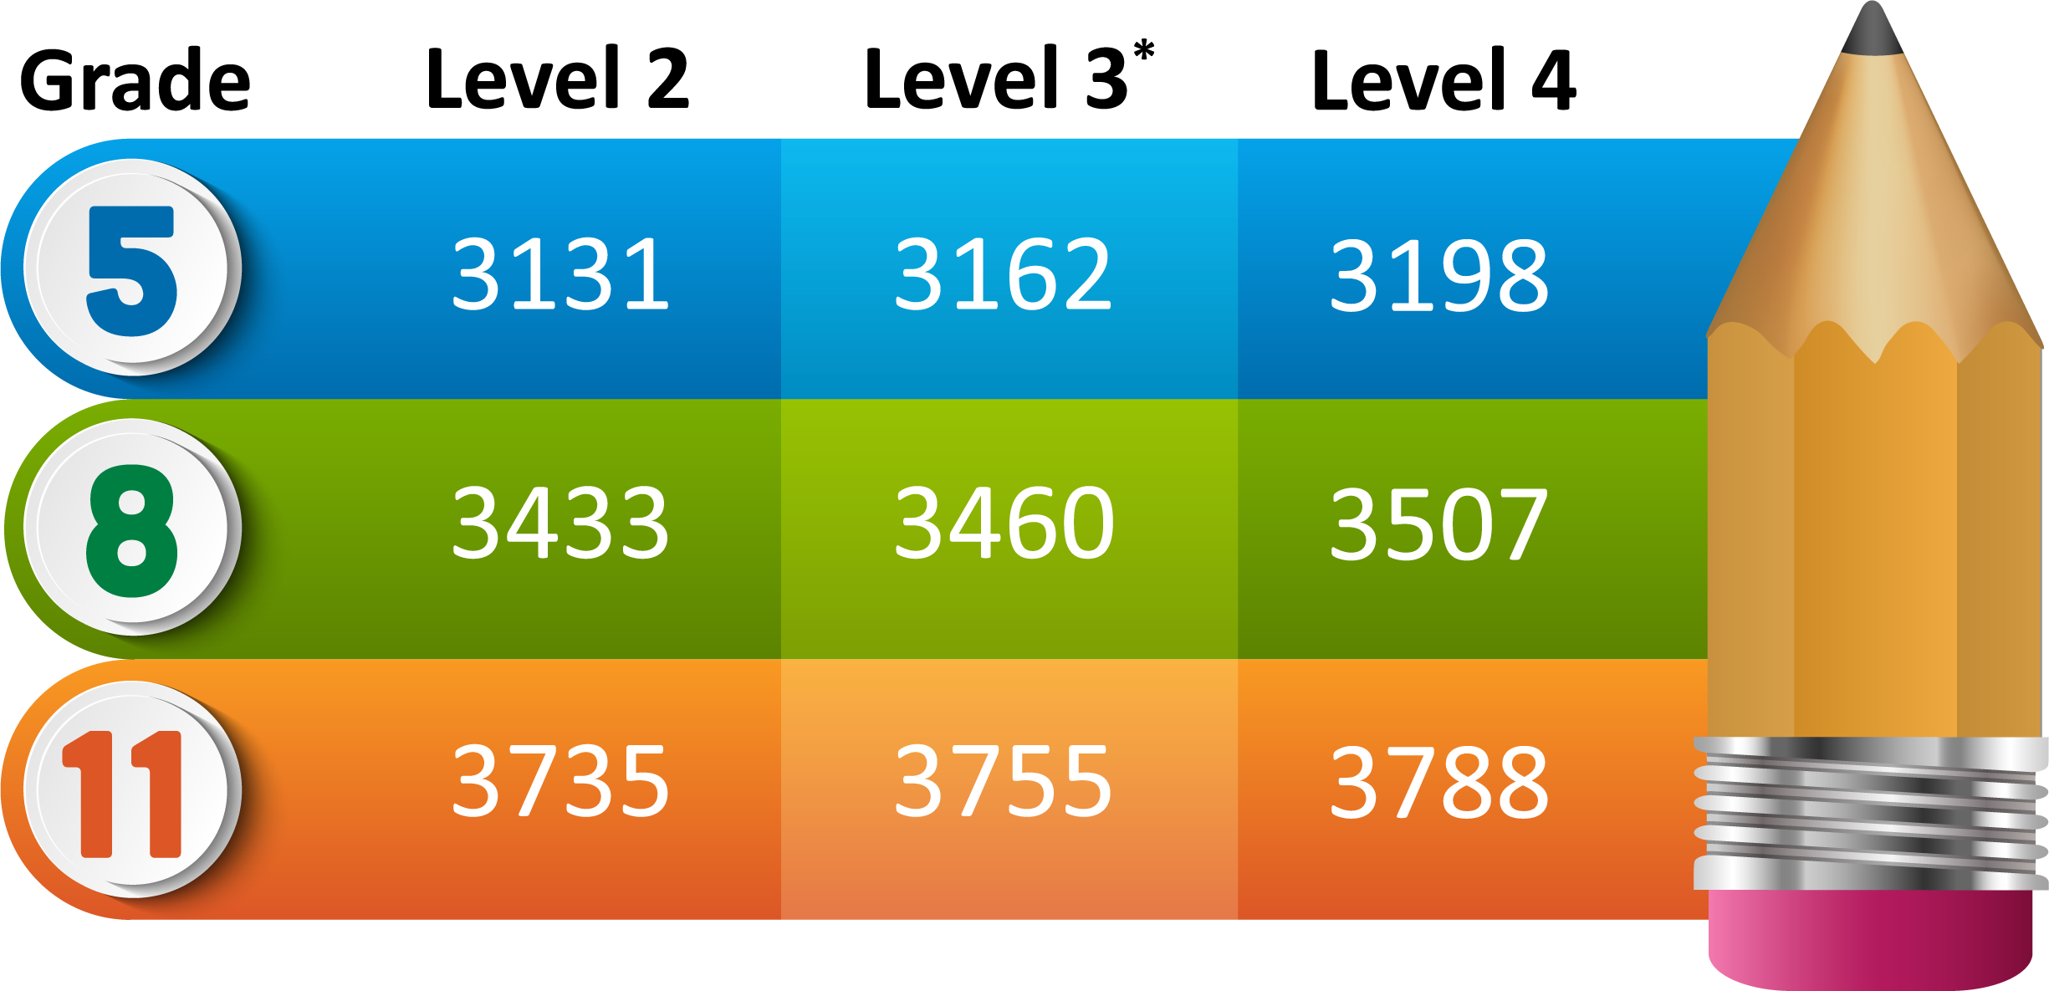
Achievement Level Cut Scores
*Students achieving level 3 or 4 are considered proficient.
Notes:
Noelle-
Here are the achievement level cut scores for the OSAS Science Assessment.

Slide 9
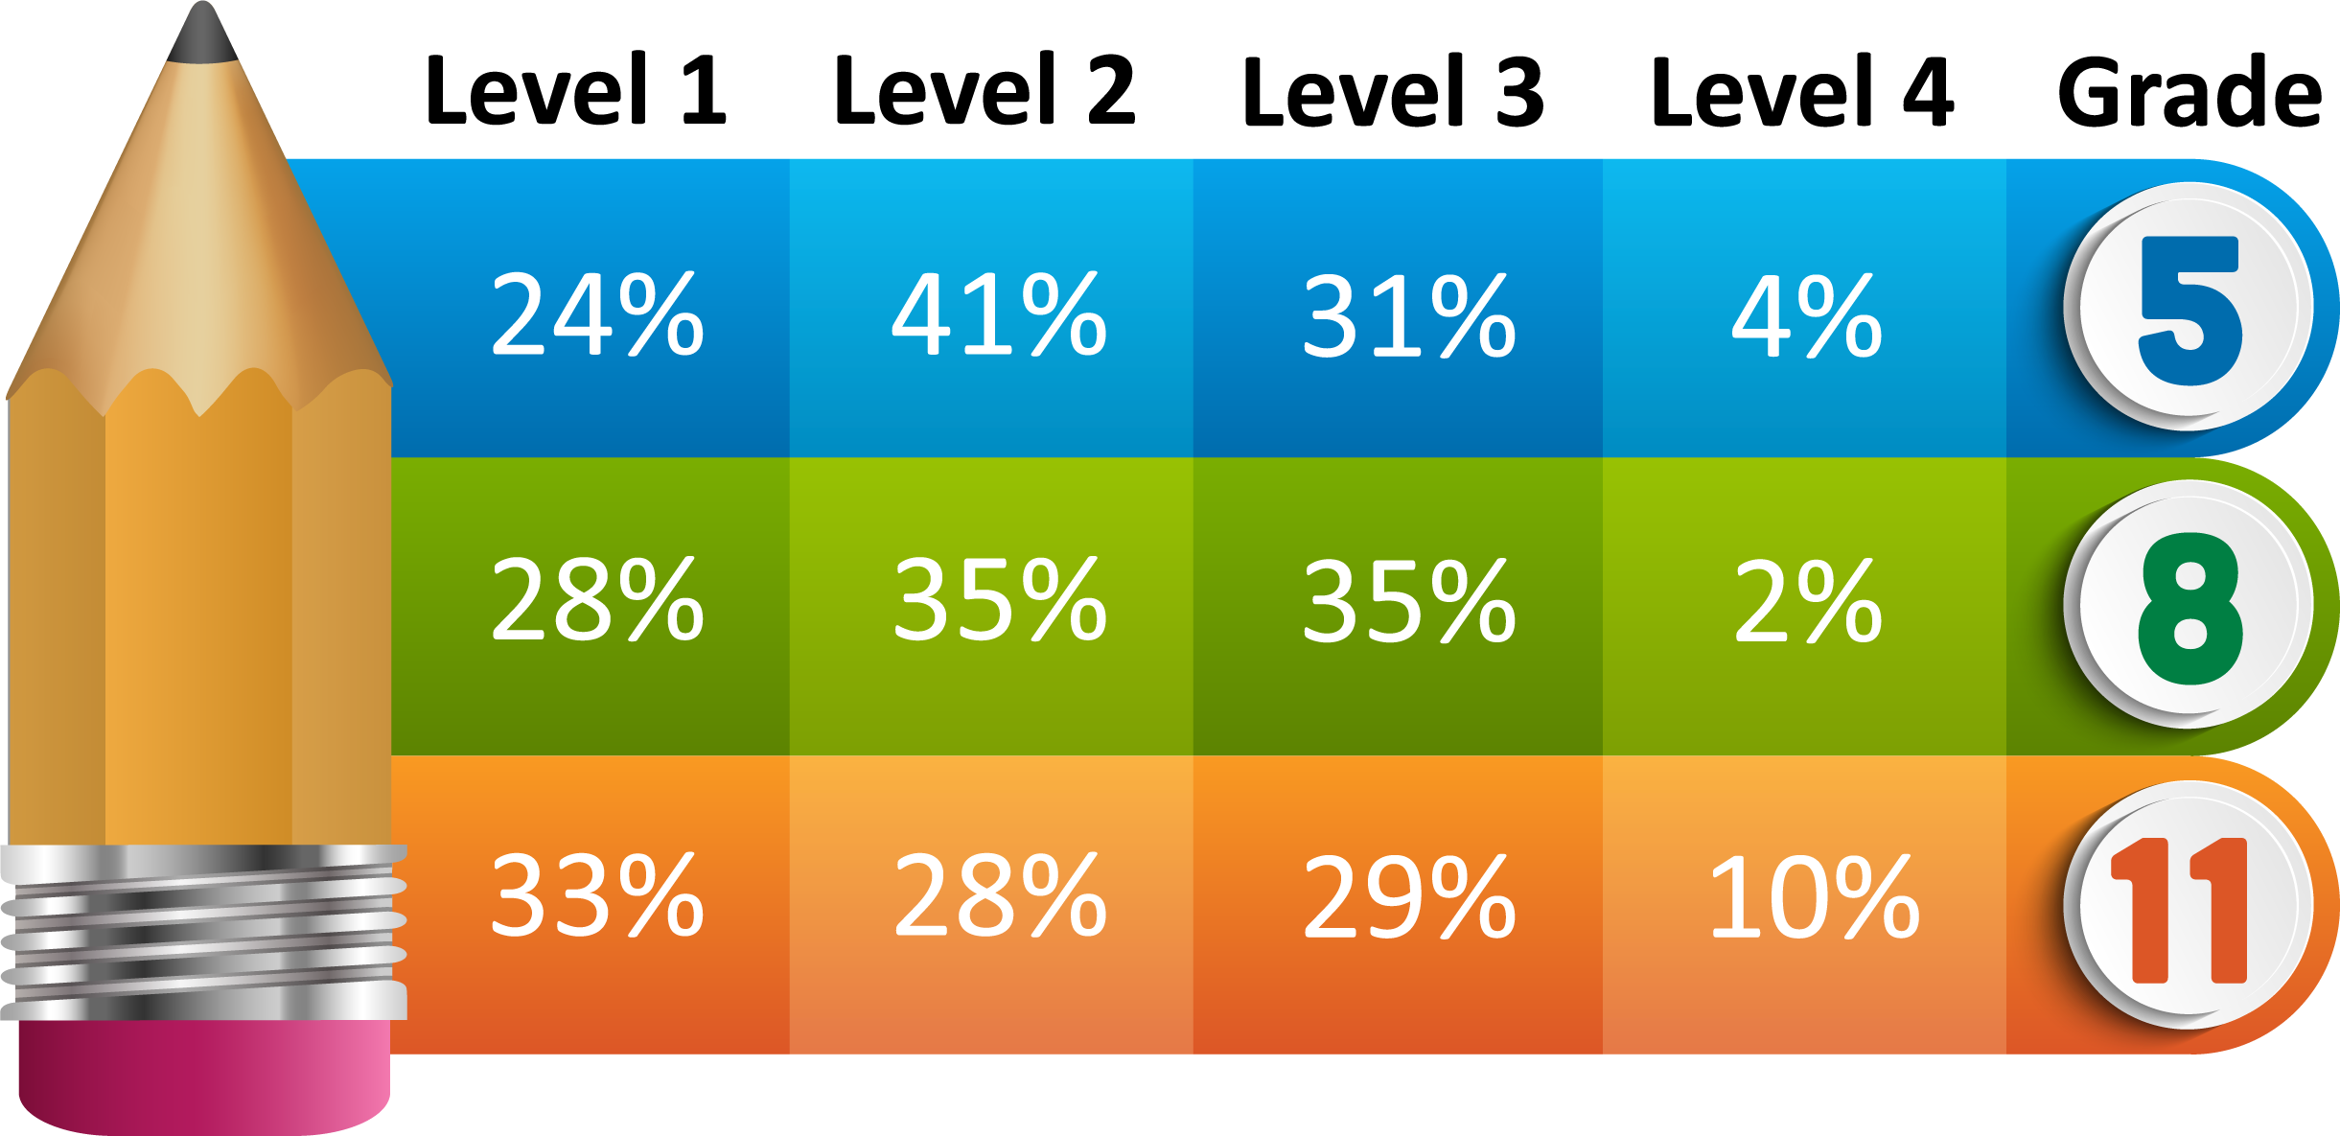
2018-19 State Level Achievement*
*Based on unofficial 2018-19 OSAS Science Assessment Data.
Achievement of a level 3 score or higher indicates proficiency.
Notes:
Noelle
2018-2019 State Level Achievement.
Here we see the percentage of students across our state at each level of achievement once the cut scores have been applied.
Please note that achievement of a level 3 score or higher indicates proficiency

Slide 10
Data Available in Online Reporting System (ORS)
The Oregon Statewide Assessment System (OSAS) Online Reporting System (ORS) contains ‘unofficial’ data that has not been validated by districts.
ORS can be accessed through the OSAS Portal website under the ‘Online Reporting’ button found within the Test Administrators, Test Coordinators, and System Administrators menus.
Training on using the ORS is available on the ODE website.
You can download student results and view score reports.
Aggregate reports include percent of students tested and percent of students proficient. NOTE: these percentages will not exactly match ODE reports, since accountable students are not identified in ORS.
Notes:
Cindy: The OSAS Online Reporting System, or ORS, contains ‘unofficial’ data – unofficial because it has not been validated by districts.
You can navigate to the OSAS Portal with the link in the second bullet of this slide.
The ORS has a User Guide, and there is also an ORS training webinar available on the ODE website.
In the ORS, you can look up individual student results, and you can also generate some aggregate score reports. For these reports, you can drill down from the district to the school, as well as the personnel and roster level, and you can also get some aggregate counts and percentages for performance.

Slide 11
Available Data
Available Data in Spring 2020
Student score data for Science 2018-19 and 2019-20 (to date) will be available in Student Centered Staging, Accountability Warehouse Extract (AWE), and OSAS Online Reporting System (ORS) on March 10, 2020.
Student scores for 2019-20 will continue to load into these systems through June 2020 as tests are completed and scored.
Notes:
Cindy: The science 2019 scores will be available in Student Centered Staging and Accountability Warehouse Extract, as well as in ORS, on Tuesday, March 10 by 6 AM. The 2019 records will be open for editing from March 10 through May 29, to allow district staff to verify students and apply administration codes where appropriate.
The current year (2020) science test records are going to be loaded daily, starting on March 10, and those come into ODE’s systems about one to two days after the tests are completed.

Slide 12
Data Available in ODE’s Systems
The Oregon Department of Education (ODE)’s systems (Student Centered Staging, Accountability Warehouse Extract, and Secure Assessment Reports) contain ‘official’ data that can be edited and validated by districts.
Training on how to access test records and student reports via Student Centered Staging, Accountability Warehouse Extract, and Secure Assessment Reports is available online on the ODE district website.
Preview of summary reports will be through the Achievement Data Insight (ADI) application on the ODE district website.
Notes:
Cindy: The science 1819 and 1920 test records will be editable in the Student Centered Staging application on ODE’s district website. Districts can download the records to load into local systems from the Accountability Warehouse Extract application.
There is a webinar training on how to access assessment data in those ODE applications available on the district video training website, linked in the second bullet here.
The summary reports, meaning performance aggregated to school & district and state levels, will be available in the Achievement Data Insight or ADI application, also on the ODE district website.

Slide 13
Achievement Data Insight Validation
The Achievement Data Insight is an application on the ODE district secure website. Permissions must be granted by your district security administrator. You need to request permission to both the application and the Science Student Performance tile.
District Test Coordinators will have from April 30 through May 29, 2020 to validate student test information on 2018-19 Science test records.
District Test Coordinators will have from June 11 through August 21, 2020 to validate student test information on 2019-20 ELA, Math, and Science test records.
Notes:
Cindy: If you don’t see it on your list of applications, after you login to the ODE district website, you’ll need to request permission from your district security administrator, to both the application and the Science Student Performance validation tile within the application.
We will open the 2018-19 science validation on April 30, and district staff will have through May 29 to make edits to the 1819 science records. We will refresh the 1819 reports during that time as changes are made.
The validation for 2019-20 science, along with ELA and Math, will open on June 11, and district staff have through August 21 to make edits to their 1920 records.

Slide 14
Accountability Reporting
2018-19 Science Results
Elementary and Middle School Performance will not appear on the 2018-19 At-A-Glance School Profiles.
Participation and Performance reports for all grades will appear on the Assessment Group Reports webpage by the end of June 2020.
2019-20 Science Results
Elementary and Middle School Performance will appear on the 2019-20 At-A-Glance School Profiles. There will be no change arrows comparing performance to the previous year.
Participation and Performance reports for all grades will appear on the Assessment Group Reports webpage by mid-September 2020.
Notes:
Cindy: As far as reporting is concerned, for science 2018-19, in the science ADI validation, on the “RC Summary” tab, you will be able to see the performance data that would normally be displayed on the elementary and middle school At-A-Glance profiles. However, the 1819 science results will NOT be displayed on the 1819 At-A-Glance profiles.
We will post the school, state, and district level reports for 1819 science on the Assessment Group Reports webpage on the ODE public website before the end of June. (The data for these reports is displayed on the “AGR Summary” tab in the science ADI validation.)
The 2019-20 science performance results (which will be available in the science ADI validation, on the “RC Summary” tab for the 2019-2020 school year) will be displayed on the elementary and middle school At-A-Glance profiles. Remember, the 1920 results will be available in the ADI validations on June 11th. The At-A-Glance Profiles for 1920 will be available within the ADI application on July 30. The AGR Summary tab in the ADI validations for 1920 will appear on August 13, and the 1920 validations are open through August 21.
Questions???

Slide 15
Oregon’s Statewide Assessment System
The Right Assessment for the Right Purpose
Summative
State, district, and school information at the end of the year.
Interim
Classroom information at the end of a unit.
Formative
Student level information, in the moment.
Notes:
Noelle: Formative assessment practices are feedback discussions between teachers and students, and students and peers in the moment. As the graphic conveys, they offer a very close, discrete look at student learning that highlights important details at the student level, much like a microscope. Formative assessment offers the greatest power for improving student learning. Formative assessment is a planned, ongoing process used by all students and educators during learning and teaching to elicit and use evidence of student learning to improve student understanding of intended disciplinary learning outcomes and support students to become self-directed learners.
Interim assessments may be selected by classroom educators to meet several instructional purposes. Interim assessments are typically used to determine whether students are on track, if they have mastered shorter units or lessons within the school year that have been the focus of a period of instruction. They are likened here to binoculars, as the results are a little farther away from the student, but landscape details and patterns are still noticeable. Summative assessments, like a telescope, are useful for looking at large systems from afar and identifying patterns that might not be visible at a finer grain of observation.
Summative assessments are administered at the end of the year and designed to provide systems-level information for annual state, district, and school-level decision-making. It is easy to see why a telescope cannot be used to see cells, nor can a microscope be used to determine how many moons Saturn has. We would not use binoculars for either of those purposes. Similarly, each assessment serves a specific purpose and should be used only for that purpose.
Please see the ODE publication ‘The Right Assessment for the Right Purpose” Guidance Document on the ODE Assessment website for more information.

Slide 16
Appropriate Use of Assessment Results
From Right Assessment for the Right Purpose:
Assessments are typically developed for a singular purpose and should only be used for that purpose.
Assessments should generally not be used for any purposes for which the test developer or user does not have sufficient validity evidence.
No single assessment result should be used in isolation to make high-stakes decisions at the individual (i.e., student) level.
Statewide Summative Content Assessment results are useful for guiding state policy decisions and making systems-level decisions at the state, district, and school levels. Districts use state assessment results to inform improvement planning and to assist with systems questions, such as efficacy of a new district curriculum, new professional development plan, allocation of resources, etc.
Notes:
Noelle-

Slide 17
Communication Toolkit
Available on the ODE Science Assessment webpage:
OSAS Science Information for Districts
OSAS Science Information for Teachers
English OSAS Science Information for Families
Spanish OSAS Science Information for Families
Coming Soon:
OSAS Information Presentation for Families (PowerPoint with facilitator notes)
Notes:
Noelle-
ODE has developed a communication toolkit for the OSAS Science Assessment. These resources can be found on the ODE Science Assessment webpage.

Slide 18
Additional Resources
Also available on the ODE Science Assessment Webpage:
Achievement Standards
Achievement Level Descriptors (by grade band)
OSAS Science Assessment Blueprint Summary
For more information about Oregon Science Standards, please see the Oregon Department of Education Science Standards Webpage.
Notes:
Noelle

Slide 19
Here to Help Please Contact Us
Noelle Gorbett
Noelle.Gorbett@state.or.us
Cindy Barrick
Cindy.Barrick@state.or.us
Elyse Bean
Elyse.Bean@state.or.us
Jamie Rumage
Jamie.Rumage@state.or.us
Notes:
At this time we will take any questions you have. Please type your question in the chat box.
-answer questions-
Thank you for your time this afternoon. Please feel free to contact us if you need additional support.
Have a great evening.

