Slide 1
Oregon Statewide Assessment System
Session 5 – Accessing Interim Assessment Data to Inform Instructional Practices
Office of Teaching, Learning, and Assessment
Notes:
Slide 1: Title Slide (Facilitator 1)
The Oregon Department of Education has developed an Oregon Statewide Assessment System professional learning series to further support district efforts in building a balanced assessment system and their implementation of the Oregon Statewide Interim Assessment System.
Welcome to Session 5 of the Oregon Assessment Professional Learning series. This is the fourth of six sessions in this webinar series, and will provide an overview of the Interim Assessment System- Test Administration and Assessment Viewing Application.
This presentation is available year-round on the Oregon Department of Education’s Interim Assessment webpage under the Interim Professional Development Materials expandable folder.
Resources:
ODE Interim Assessment webpage

Slide 2
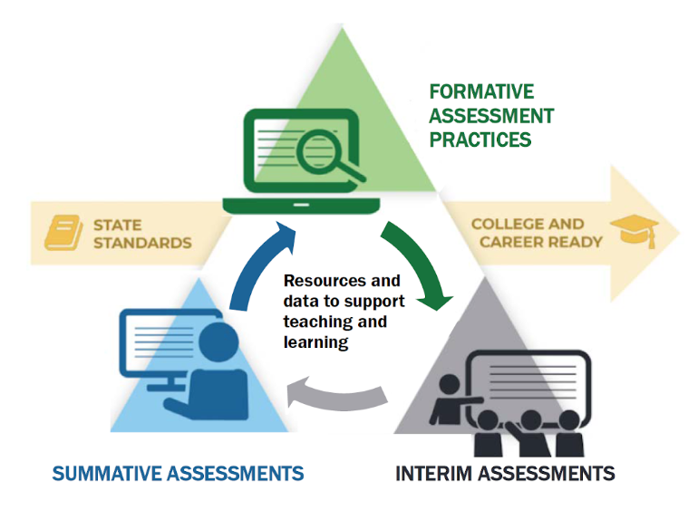
Purpose
The Oregon Statewide Assessment webinar series is designed to help teams of educators and administrators improve their teaching and learning systems using the tools and resources provided in a balanced assessment system.
Notes:
Slide 2: Purpose (Facilitator 1)
The purpose of this series is to help district and school-based teams improve their systems of teaching and learning using an approach inclusive to a balanced assessment system.
For the first time, ODE is able to provide a statewide interim assessment system aligned to both the Oregon State Standards and the Oregon Summative Assessment.

Slide 3
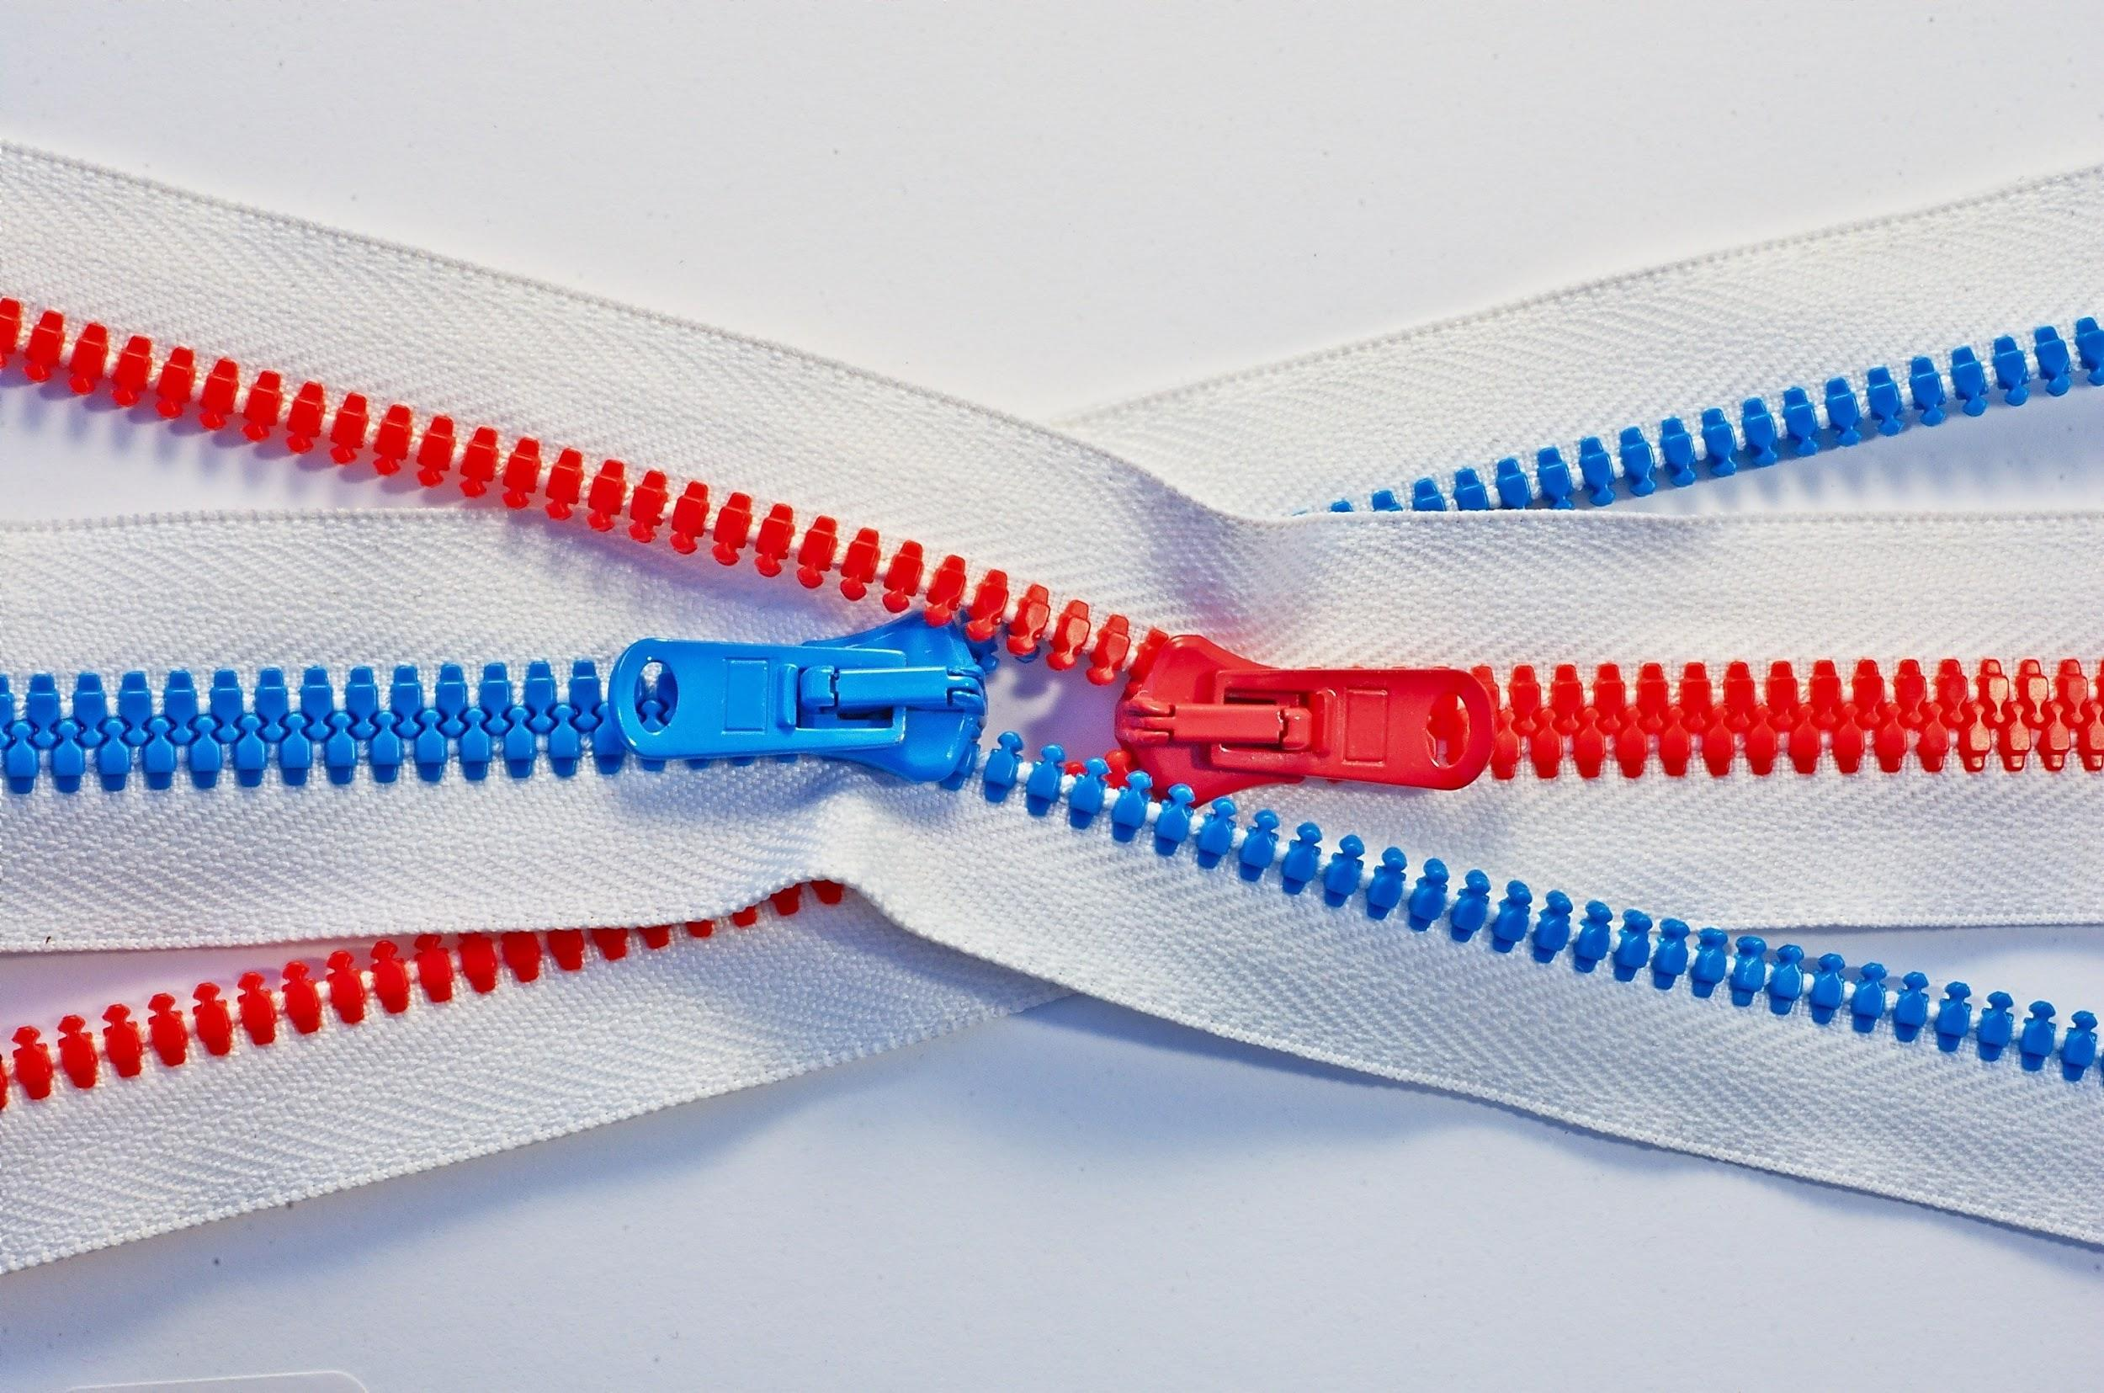
Series Outcome
Participants will build assessment literacy and improve practice by connecting formative assessment practices, interim assessments, and summative assessments to continually improve access and outcomes for each and every learner in their care.
Photo by Tomas Sobek on Unsplash
Notes:
Slide 3: Series Outcome (Facilitator 1)
Our goal is that all participants will build assessment literacy and connect formative assessment practices, Oregon’s Statewide Interim Assessment System, and the Oregon Statewide Summative Assessments to local assessment systems to continually improve access and outcomes for each and every learner in their classroom, school, and district.
Again this series will focus primarily on the new interim assessment system and other supporting resources connected to both formative assessment practices and the Oregon Summative Assessment.
Resources
Oregon Balanced Assessment Graphic (PDF)

Slide 4
Interim Assessment Series
Session Guide
1 | Understanding a Balanced Assessment System
2 | Overview of the OSAS Interim Assessment System
3 | Using Interim Assessments in the Context of Instructional Practices
4 | Interim Assessment Administration: Guidance and Support
5 | Accessing Interim Assessment Data to Inform Instructional Practices
6 | Exploring Tools for Teachers and Using Formative Assessment Practices
Notes:
Slide 4: Series and Session Overview (Facilitator 1)
Session 5 serves as a technical support for districts, schools and educators for accessing data from the interim assessment system. Again this is just one of the six sessions.
The remaining sessions will cover how to access the interim assessment data in the Central Reporting System to inform instruction, and finally how the interim assessment system interacts with the instructional resources within Tools for Teachers and how the formative assessment process can be leveraged with these resources.
Educators can register for the other future webinar sessions by accessing the Interim Assessment Professional Learning Information flyer posted on ODE’s Interim Assessment webpage.
Resources:
Interim Assessment Series Flier (PDF)

Slide 5
Session Objectives
By the end of this session, educators will be able to:
Navigate the OSAS Portal to access interim assessment data from the Central Reporting System
  Understand the importance of student rosters
Identify the different interim assessment reports based on roles within the education system
Drill down into the interim assessment blocks to identify specific instructional “next – steps”
Review the hand-scoring requirements for the interim assessment blocks
Notes:
Slide 5: Session Outcome (Facilitator 2)
By the end of the series, educators will be able to
[Click Animation]
Review the training requirements and test security required for administering the interim assessments.
[Click Animation]
Identify the resources available for both in-person and remote administration.
[Click Animation]
Navigate the OSAS Portal to identify, select, and administer the interim assessments.
[Click Animation]
Investigate how the Assessment Viewing Application can be used to better select the right interim assessment.
Resources:
ELA and Mathematics Interim Assessment Overview​
​​This document describes the interim assessments, including their purpose, use, and varieties.
Interim Administration Guide​ (Posted 08/31/20)
This Interim Assessment Guide for Administration is intended for staff who play a role in the administration of, and review of results for, the ELA and Mathematics interim assessments.
Quick Guide to Administering Interim Assessments Remotely​
This document describes how test administrators (TAs) can remotely administer the interim assessment and how students may accessand participate in an interim assessment.​
Science Interim Assessment Information Sheet​
This document provides Science Interim Assessment content details and purchase information.
Quick Guide to Administering Science Interim Assessments
This document provides information for administering the OSAS Science Interim Assessment including: Assessment Viewing Application, Secure Browser, TA Interface, and Centralized Reporting System.

Slide 6
Interim Assessment
Training Requirements and Creating Student Rosters
Notes:
Slide 6: Interim Training Requirements (Facilitator 1)
Interim Assessment Training Requirements

Slide 7
Interim Training Requirements
DTCs or STCs will need to apply the “Interim” Test Group to each user that will administer the interim assessments. The decision to allow access to the Interim Assessment System is determined by the educators’ district.
  Users will not be able to administer the interim assessments if the Test Group permission is not assigned to their TA user account.
Notes:
Slide 7: Interim Training Requirements (Facilitator 1)
ODE has made this system available to all Oregon educators, however, the decision to allow educators access to the interim assessments is determined by their district. Either their District Testing Coordinator or their local School Testing Coordinator must activate the interim assessment system for educators.
Users will not be able to administer the interim assessments if the Test Group permission is not assigned to their TA user account.
Resources:
Module 8 - Interims: Remote Administration and Test Security
Facilitation Guide​​​, Powe​rPoint and PowerPoint with Audio​ ​

Slide 8
Interim Training Requirements
Were you a Test Administrator in
2019-20?
Complete Module 8
DTC assigns “Interim” test group in TIDE
YES
Yes, but in a different district/state
NO
    1. Reading requirements from Table 5 of Oregon’s
    Test Administration Manual (TAM)
      2. Complete Modules 2, 3, and 4 as posted to the
      Assessment Training Materials webpage
Notes:
Slide 8: Interim Training Requirements (Facilitator 1)
ODE has worked to reduce the work of our district testing coordinators, and this year we have implemented a roll-over process where educators from last year have already been populated in the OSAS Portal TIDE Account and will automatically have access to the Tools for Teachers resources, which launched on September 30, 2020.
Therefore, [Click Animation] if you were an educators who completed the 2019-20 TA requirements, you would only need to provide evidence they have completed Module 8 - Interim Assessment Remote Administration and Test Security in order for the Interim Assessment test group to be assigned.
However, [Click Animation] if an educator did not have a TA user account from the 2019-20 instructional year or if the educator has transitioned to a new district which is different from last year.
[Click Animation] They must complete the reading requirements in Table 5 of the Test Administration Manual and also complete training modules 2, 3, and 4.
Once these requirements had been fulfilled [Click Animation] the final step would be completing Module 8 to have the interim assessment test group assigned.
Note These training modules have already been updated for the 2020 -21 instructional year, and have been beed posted to the ODE Training web page.
Resources:
Module 8 - Interims: Remote Administration and Test Security
Facilitation Guide​​​, Powe​rPoint and PowerPoint with Audio​ ​
Test Administr​ation Manual ​(Updated 10/06/20)
Assessment Training Materials

Slide 9
Educator Access to
Interim Assessment Data
As a reminder, educators must have their own OSAS Portal user account to access interim assessments and data.
Additionally, educators must create student rosters in the OSAS Portal to see interim assessment data associated with their user account.
Notes:
Slide 9: Student Access to the Interim Assessments (Facilitator 1)
As a reminder, educators must have their own OSAS Portal user account to access interim assessments and data.
We recognize some schools have historically had a single test administrator who has administered summative assessments, the interim assessments are meant to empower teachers to modify instruction as needed based on the needs of the students. Therefore individual user accounts are the best approach to empower classroom educators.
[Click Animation]
The use of rosters provide further support and flexibility in the interim assessment system. As you will see in some upcoming slides, rosters provide educators an additional layer in the central reporting system to view additional school/roster reports. Again this will be addressed in the coming slides.

Slide 10
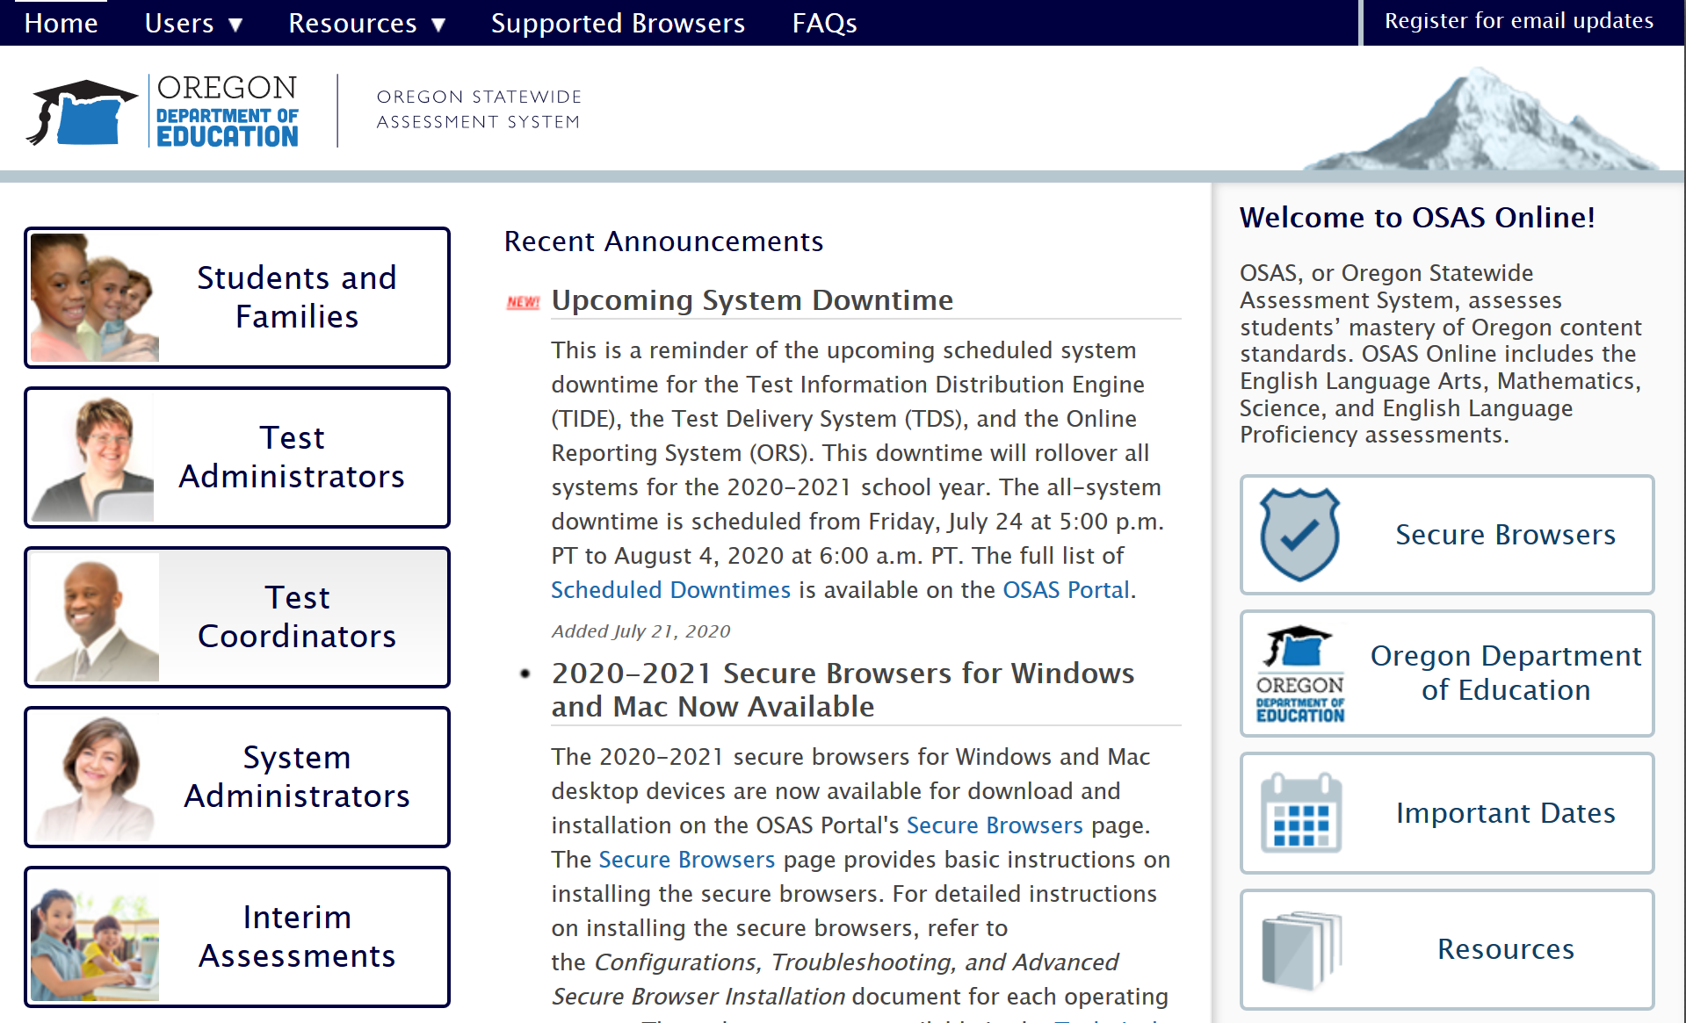
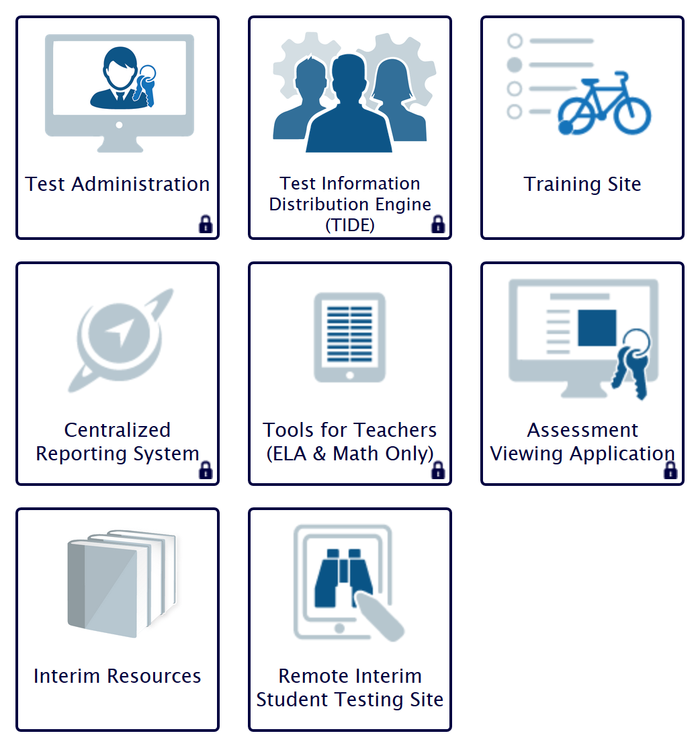
Creating Rosters in the OSAS Portal
Notes:
Slide 10: Creating Rosters in TIDE (Facilitator 1)
Here we will provide a brief overview on creating a teacher/student roster in TIDE. For detailed step by step direction please refer to the TIDE User Guide posted on the ODE Test Administration web page.
[Click Animation] User will log-in using the appropriate access button.
[Click Animation] [Click Animation] From the icon-tiles select the [Click Animation] TIDE icon-tile.
As a reminder each tile that has the lock image on the tile [Click Animation] will requires users to sign in using the authorized credentials.
Resources:
Test Administration web page: https://www.oregon.gov/ode/educator-resources/assessment/Pages/Assessment-Administration.aspx
TIDE Us​er Guide ​(Updated 08/31/20)

Slide 11
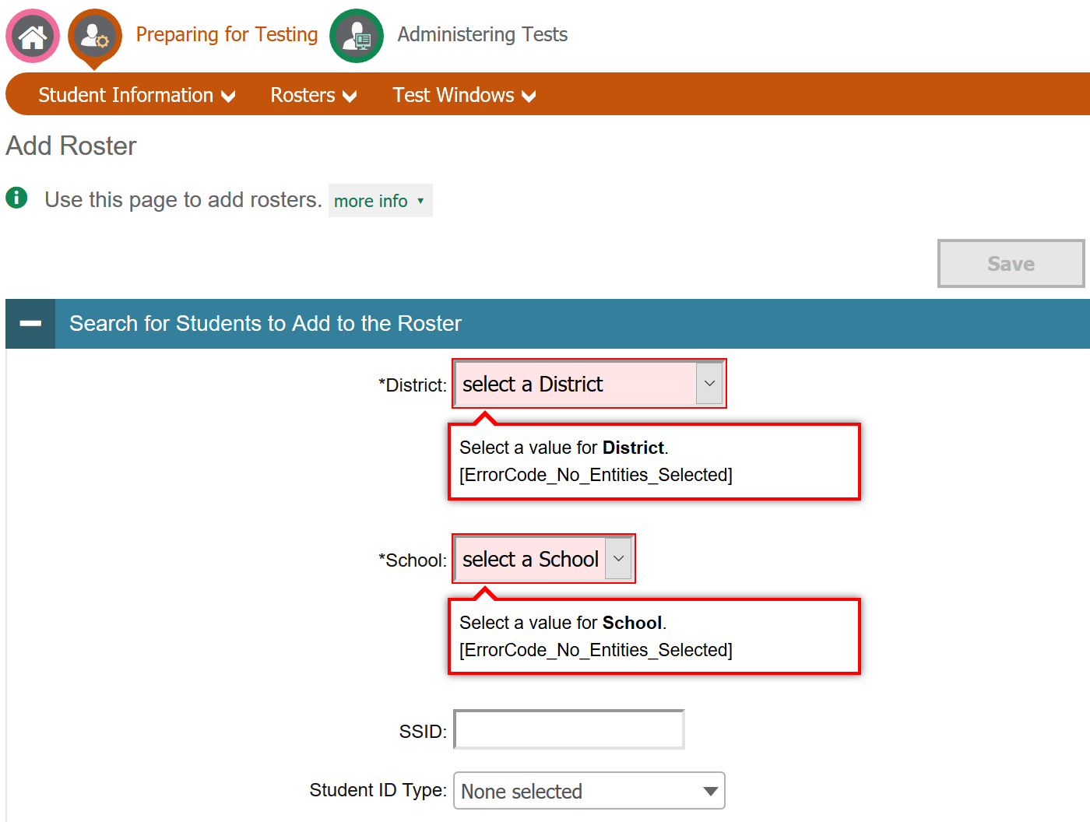
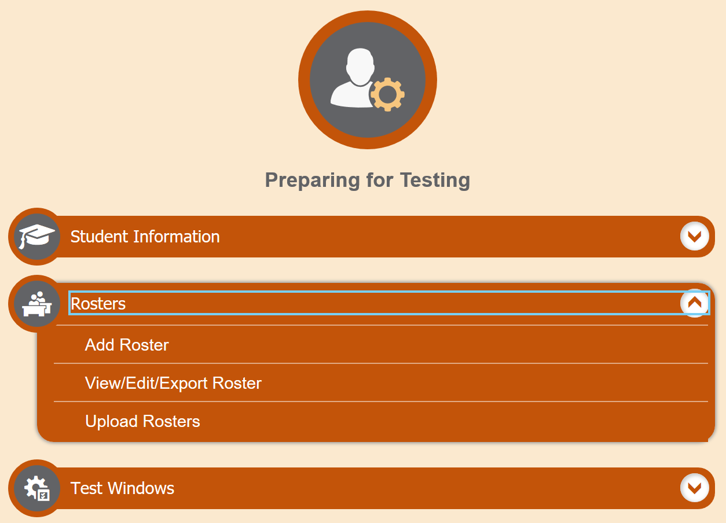
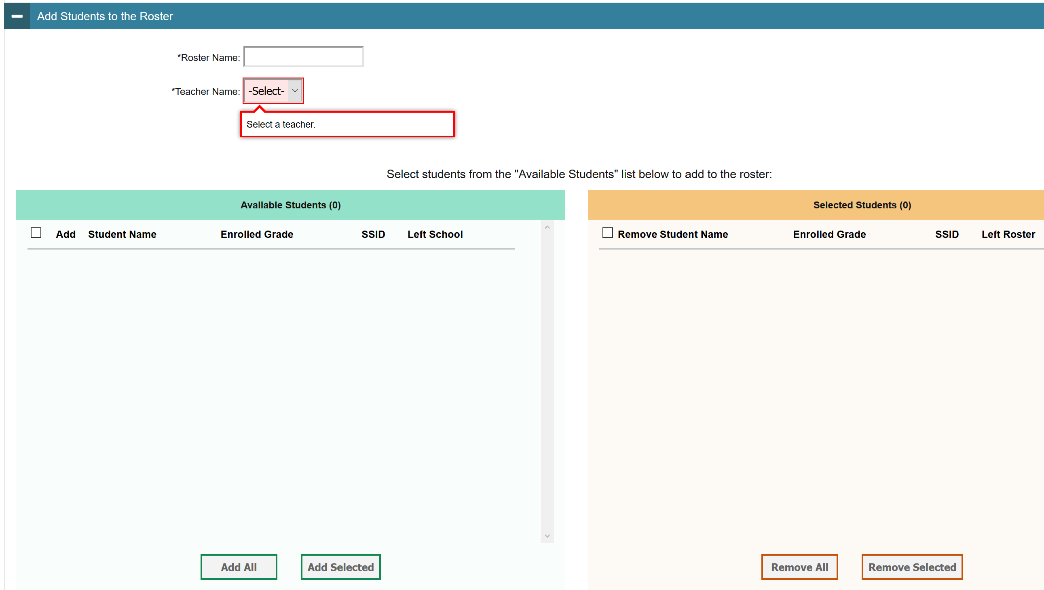
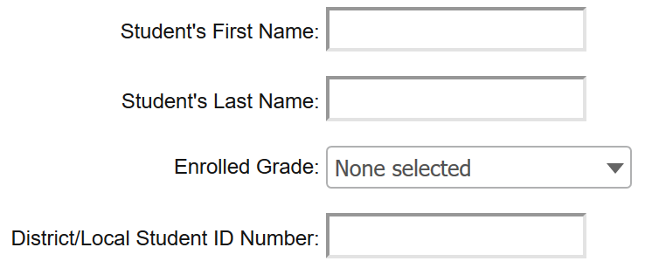
Creating Rosters in the OSAS Portal
Notes:
Slide 11: Assigning Test Groups to OSAS Portal User Accounts (Facilitator 2)
Once in the TIDE System select the Roster expanding folder and [Click Animation] select, add roster.
[Click Animation] A new window will open and user will be prompted to select their district and their assigned school.
Once those have been selected [Click Animation] users can also further filter available students by [Click Animation] their enrolled grade level.
[Click Animation] In the bottom half of the screen educators will be prompted [Click Animation] to create a roster name and assign their name to the roster by using the Teacher Name drop down menu.
[Click Animation] [Click Animation] Educators will select from the Available Student listed in the bottom left table.
[Click Animation] [Click Animation] At this point educators will either[Click Animation] Add all students or select specific students for the created roster.
Selected [Click Animation] [Click Animation] students will appear in the bottom right table. Please note if needed students can be removed from a roster using the Remove All or Remove Selected Students.
In either case the DTC or STC will need to activate the Interim Assessments [Click Animation] by selecting the interim assessment check box.
Detailed directions explaining the process are available in the TIDE User Guide available on the ODE Test Administration web page under the User Guides folder.

Slide 12
Accessing the Interim Assessment Centralized Reporting System (CRS) for ELA and Mathematics
Accessing the Interim Assessment Centralized Reporting System (CRS) for ELA and Mathematics
Notes:
Slide 12: Accessing the Interim Assessment Centralized Reporting System (CRS) for ELA and Mathematics
(Facilitator 1)
Accessing the Interim Assessment Centralized Reporting System (CRS) for ELA and Mathematics
Resources:
Centralized Reporting System User Guide [pdf]

Slide 13
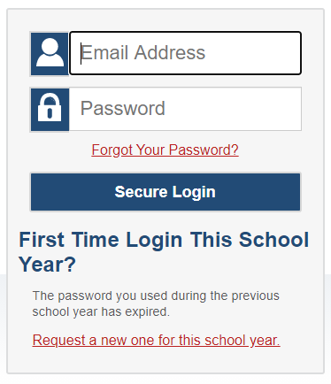
Accessing the Interim Assessment Centralized Reporting System (CRS)
Notes:
Slide 13: Accessing the Interim Assessment Centralized Reporting System (CRS) (Facilitator 1)
To access the Centralized Reporting System [Click Animation] Select the Interim Assessment button. [Click Animation] This will navigate to the [Click Animation] Interim Assessment Tiles.
[Click Animation] Educators will select the Centralized Reporting System tile. As a reminder any tile which has the lock pad within the tile [Click Animation] requires users to log in using the credentials assigned to them by their DTC or STC.

Slide 14
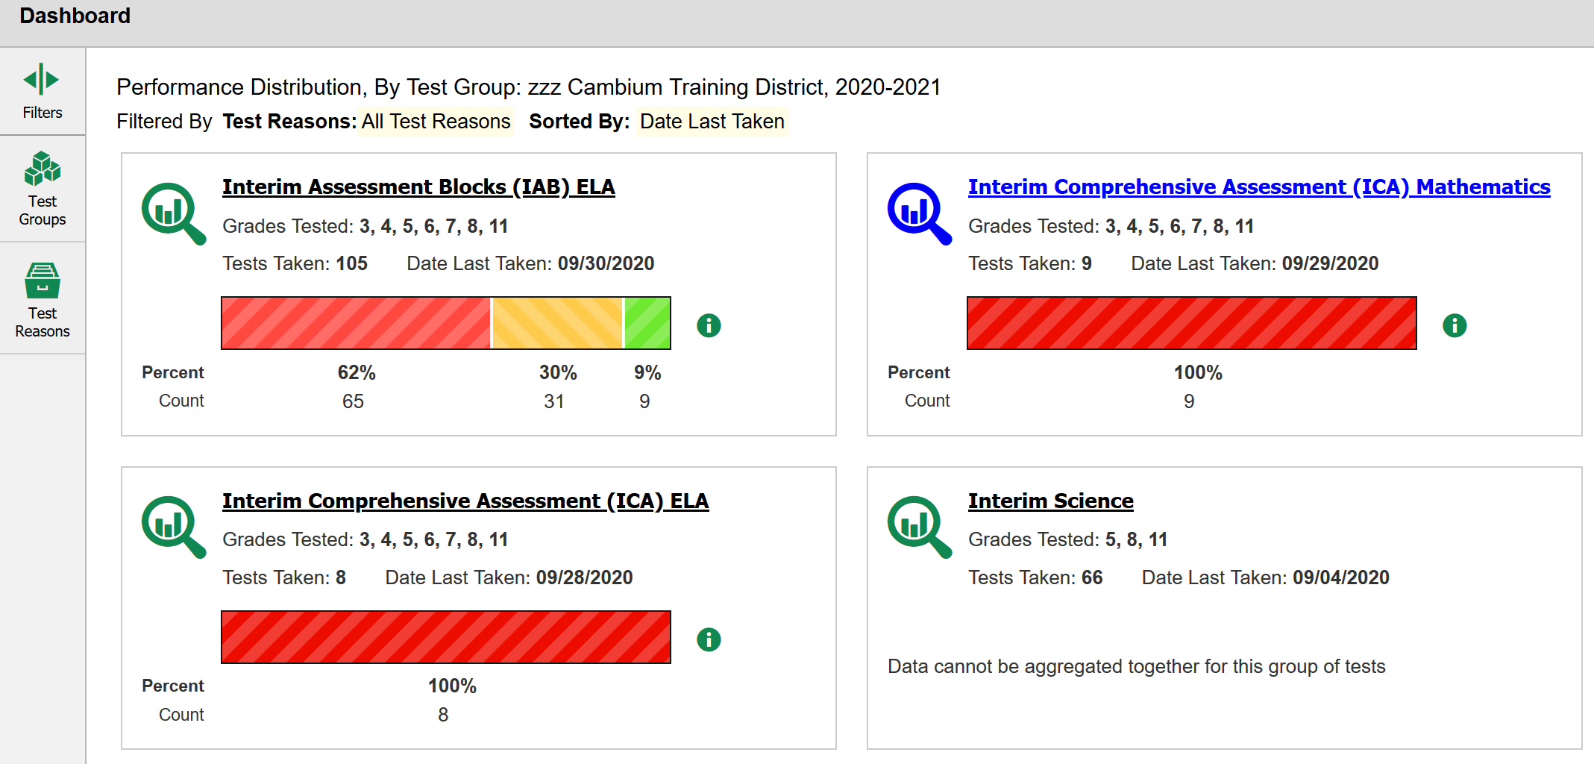
ELA and Math CRS District Reports for Staff and Coaches
Notes:
Slide 14: ELA and Math CRS District Reports for Staff and Coaches (Facilitator 1)
Centralized Reporting System
After logging in to the Reporting System, teachers and school- and district-level users see the dashboard. Test information and results are displayed for the students assigned to you based on your role.
Teachers are able to view data for all students in their rosters who have completed assessments. They can also view data for students to whom they have administered assessments in the current school year.
School and district level users are able to view data for all students in their schools who have completed assessments.
In this example of a district report [Click Animation] a card displays for each test, by subject, with the grades tested and the total tests taken.
[Click Animation] [Click Animation] The graphic objects shown on the dashboard and on the report pages allow you to further filter ICAs and IABs by grade levels for both ELA and Math.
Another option to see which grades have been administered is simply selecting [Click Animation] ELA IABs.
This can also be done for [Click Animation] [Click Animation] Interim Comprehensive Assessments for Math or [Click Animation] [Click Animation] ELA ICAs.

Slide 15
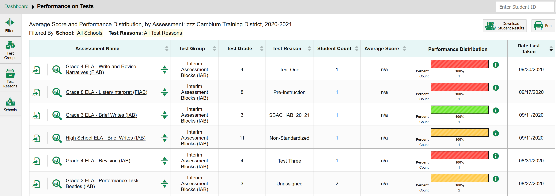
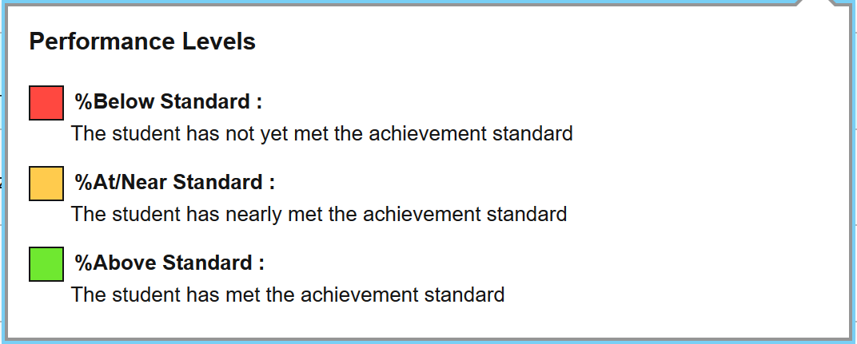
ELA Example of CRS District Reports for Staff and Coaches
Notes:
Slide 15: ELA Example of CRS District Reports for Staff and Coaches (Facilitator 1)
In this slide we take a closer look at the ELA IAB Performance list.
[Click Animation] Educators are able to sort information quickly by using the navigation tools at the top of the list.
[Click Animation] [Click Animation] Additionally, similar filter buttons appear in the top left, however now district personnel can further filter by school.
[Click Animation] [Click Animation] Finally educators can quickly view the performance distribution for any of the administered IAB examples shown.
[Click Animation] [Click Animation] It is important to note the performance distribution is comprised of 3 levels of either below the measured, at or near the standards, or above the measured standard.
It is important to understand the at/ near indicator accounts for the standard error of measurement. Therefore students in this category could be slight below or slightly above the achievement standard. Please utilize and trigulated with additional data.

Slide 16
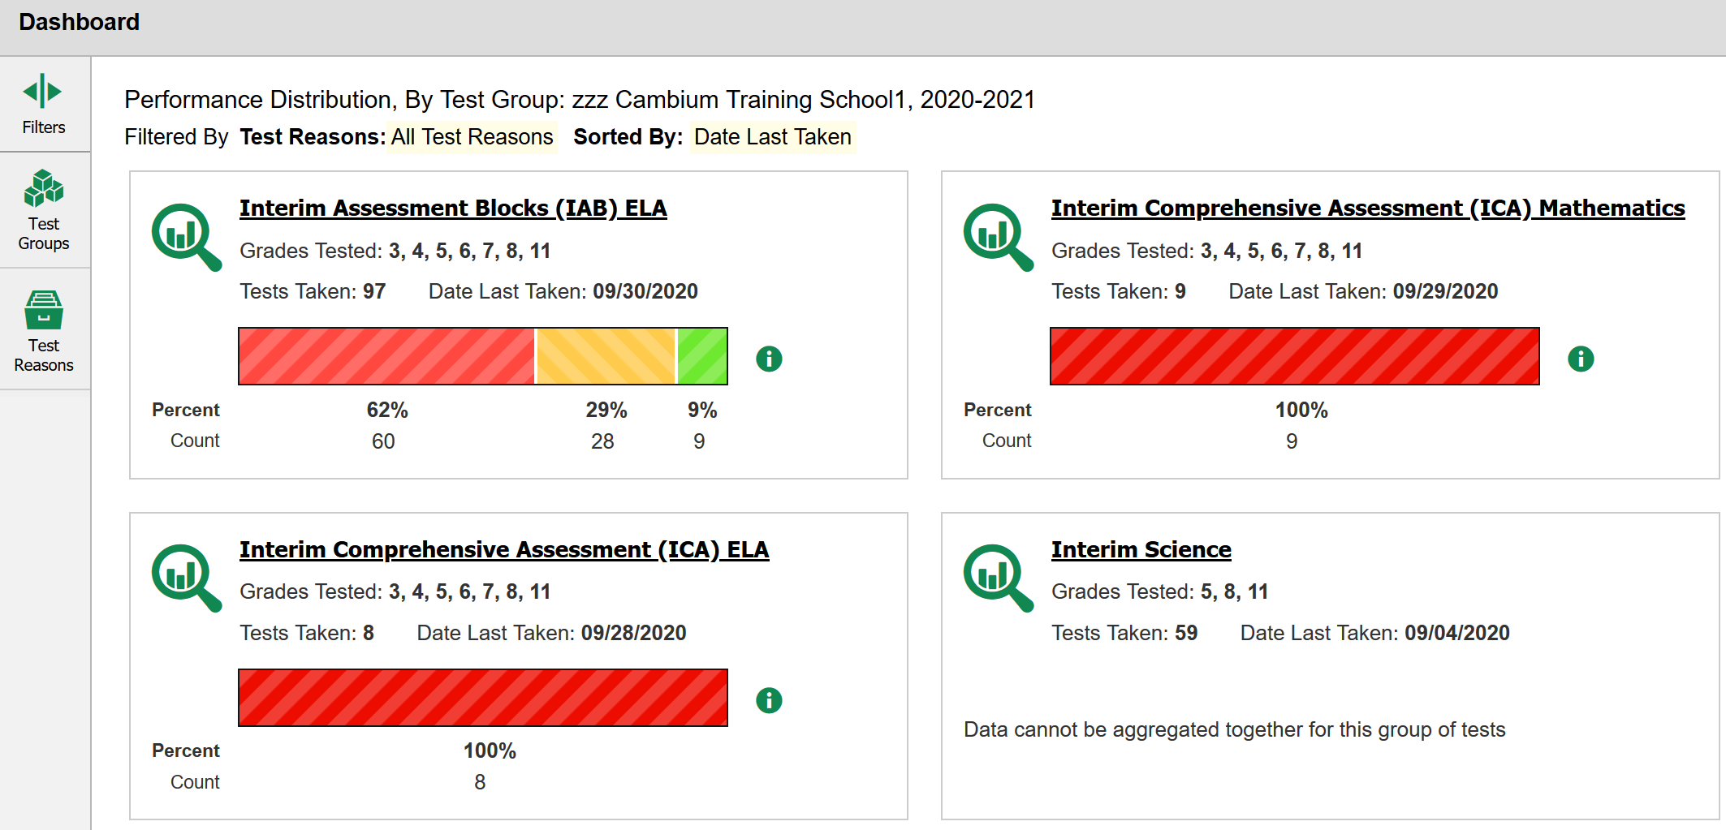
CRS School Reports for
Staff and Coaches
Notes:
Slide 16: CRS School Reports for Staff and Coaches (Facilitator 1)
When accessing the school reports, educators [Click Animation] will see a similar layout as the district report.
However, [Click Animation] [Click Animation] one difference is that educators will see their school name listed at the table of the dashboard.
[Click Animation] [Click Animation] The same graphic object allows educators to further filter by test groups and test reasons like the district reports.
[Click Animation] [Click Animation]
[Click Animation] [Click Animation] Assessment cards will appear within the dashboard for each test, by subject, with the grades tested and the total tests taken. Again these are now specific to the school level.
Similarly in the example educators will be able to access [Click Animation] ELA IABs [Click Animation] [Click Animation] Interim Comprehensive Assessments for Math or [Click Animation] [Click Animation] ELA ICAs.
Again educators can select a card on the dashboard to “drill down” and view specific interim assessments.

Slide 17
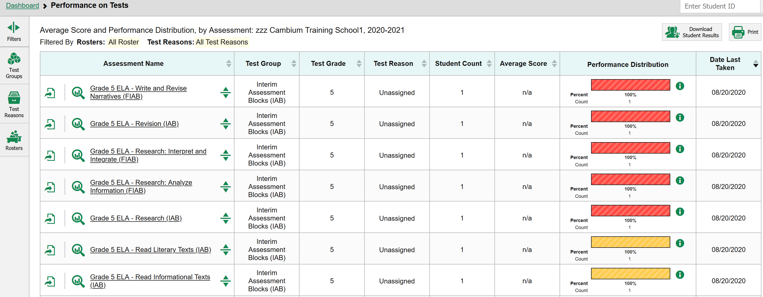
ELA Example of CRS School Reports for Staff and Coaches
Notes:
Slide 17: ELA Example of CRS School Reports for Staff and Coaches (Facilitator 1)
In this slide we take a closer look at the ELA IAB Performance list at the school level.
[Click Animation] Again, Educators are able to sort information quickly by using the navigation tools at the top of the list.
[Click Animation] [Click Animation] Performance distributions appear for each interim assessment administered.
[Click Animation] [Click Animation] Again performance levels are categorized into 3 levels of either below the measured, at or near the standards, or above the measured standard.
[Click Animation] Similar filter buttons appear in the top left, however now educators can further filter down by rosters.
[Click Animation] In this example, we have already filtered to only show grade 5 and only IABs or Focused IABs
However, we are going to [Click Animation] take a closer look at how we can drill down into a [Click Animation] specific IAB: Read Informational Text.

Slide 18
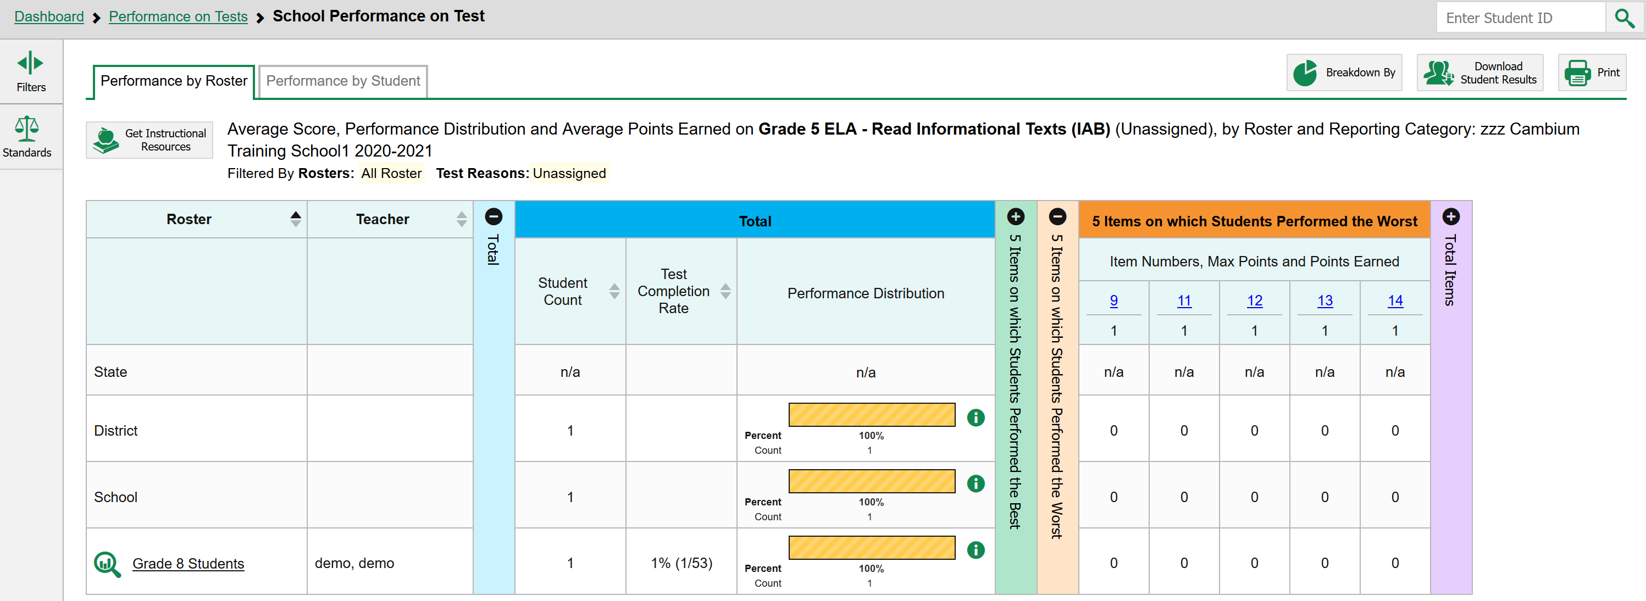
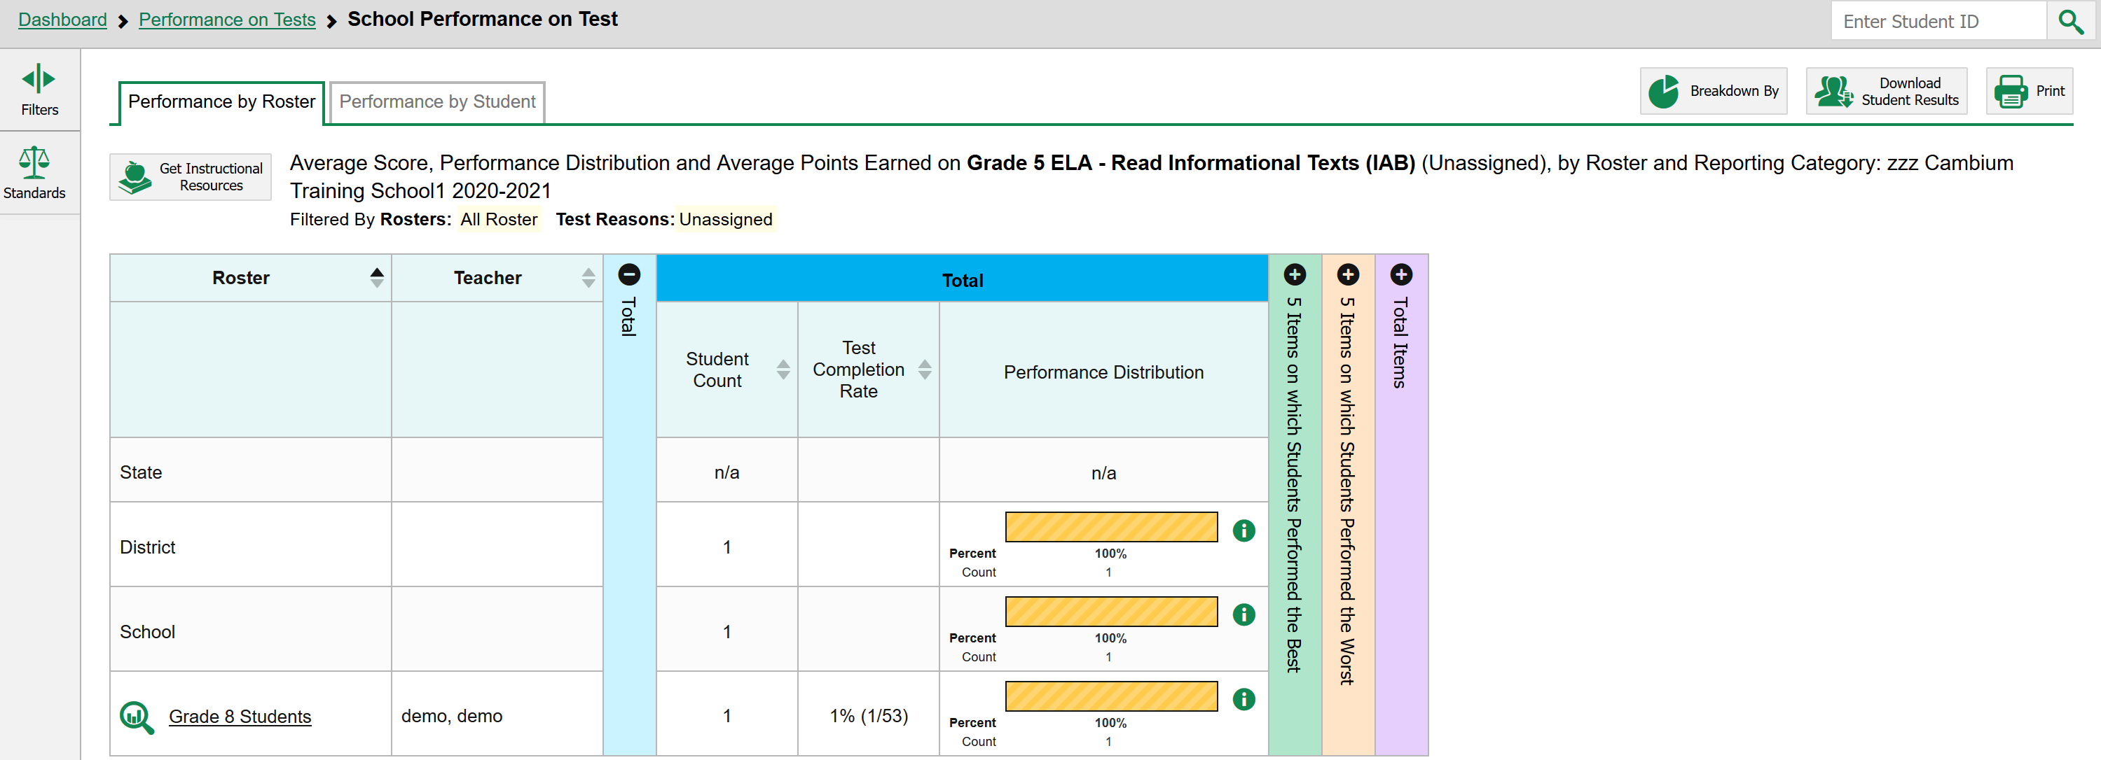
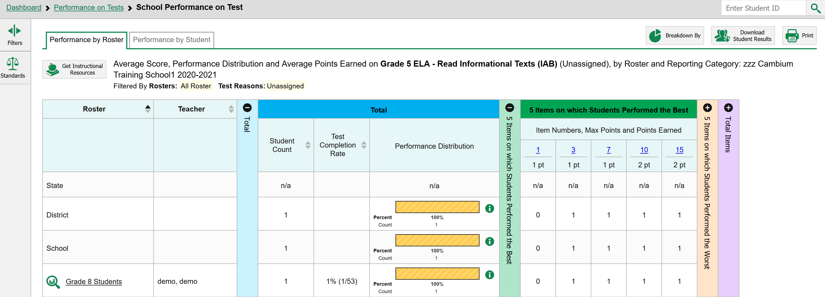
ELA Example of CRS School Reports for an Interim Assessment (IAB)
Notes:
Slide 18: ELA Example of CRS School Reports for Staff and Coaches (Facilitator 1)
In this slide we take a closer look at the ELA IAB Performance list at the school level.
[Click Animation] First educators will be able to see all the information associated with this IAB in the top header.
[Click Animation] [Click Animation] Within the school report educators can view overall performance of this IAB in comparison to other schools in the district that have administered the same IAB or even across the state.
[Click Animation] [Click Animation] The educator can drill down and view their roster of students and make similar comparisons.
[Click Animation] [Click Animation] When looking at school reports educators are able to view the IAB down to the item level to evaluate how students performed on individual items and their associated standards.
[Click Animation] [Click Animation] One feature in CRS is the ability to view which items the class as a whole performed the best in answering.
[Click Animation] [Click Animation] Another feature in CRS allows educators to view which items were identified as the worst based on student performance and therefore needing additional support in instruction.
[Click Animation] [Click Animation] Each item is hyperlinked at the top allowing educators to click on the item and view how the item was presented to students.
[Click Animation] [Click Animation] As reminder this report is available by an overall roster or at the student level which we will show next.

Slide 19
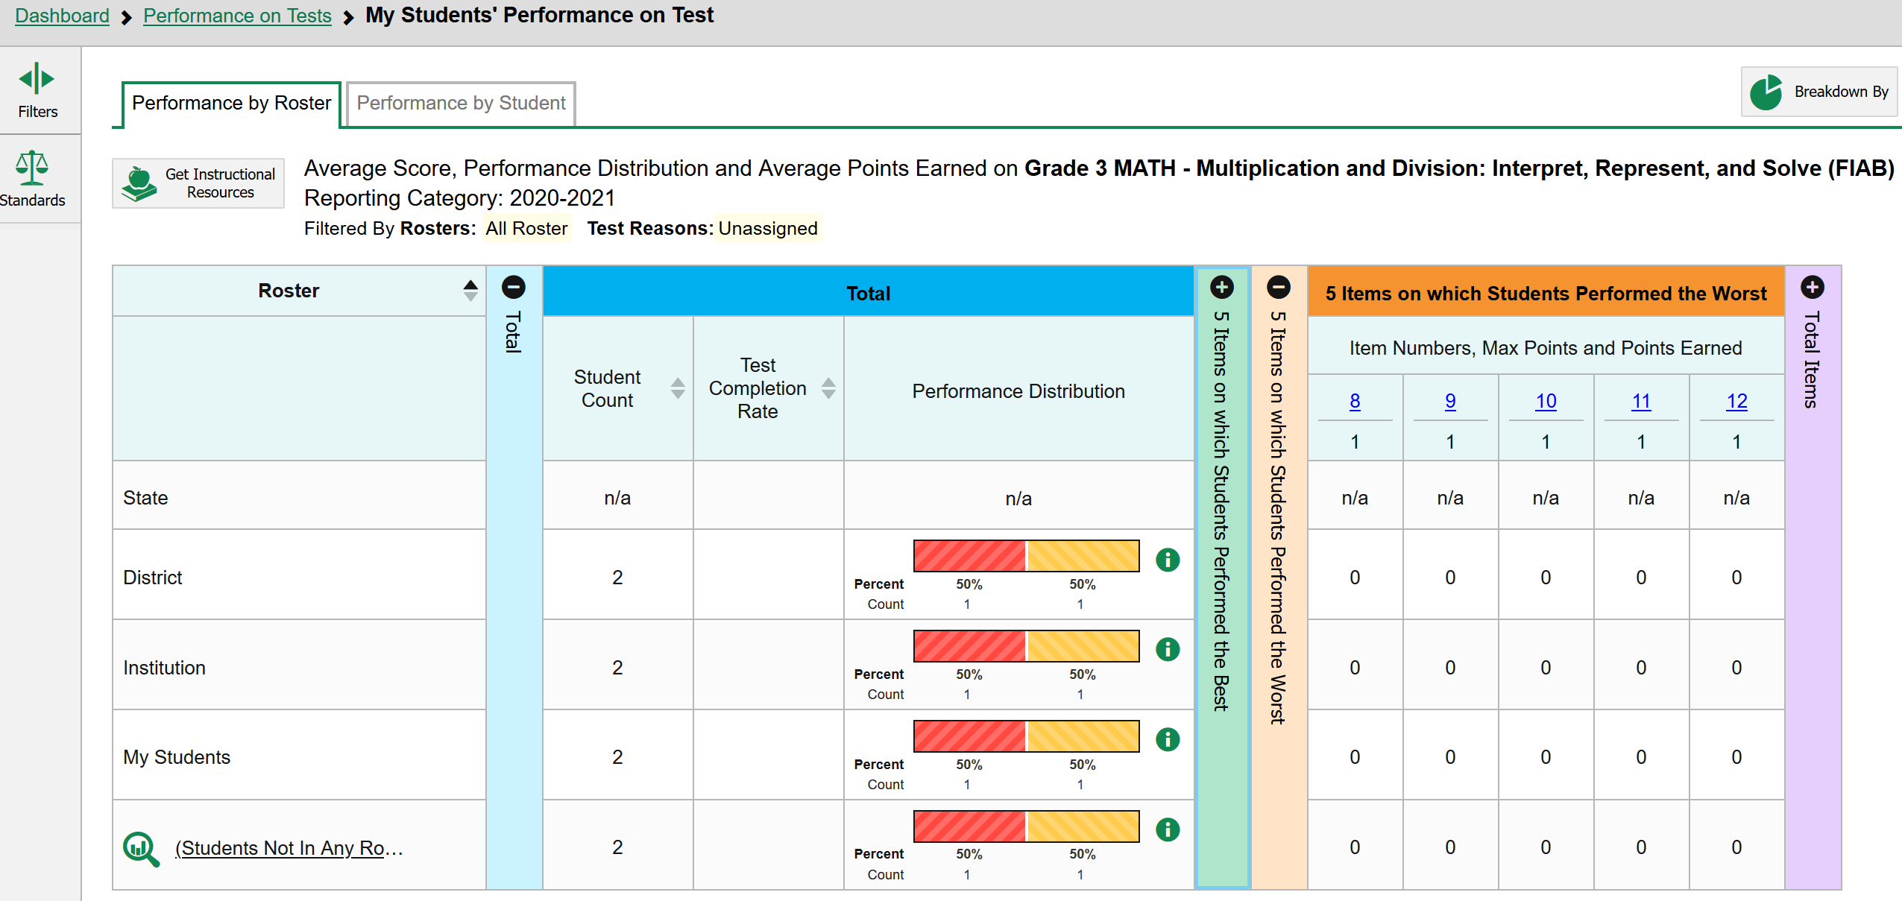
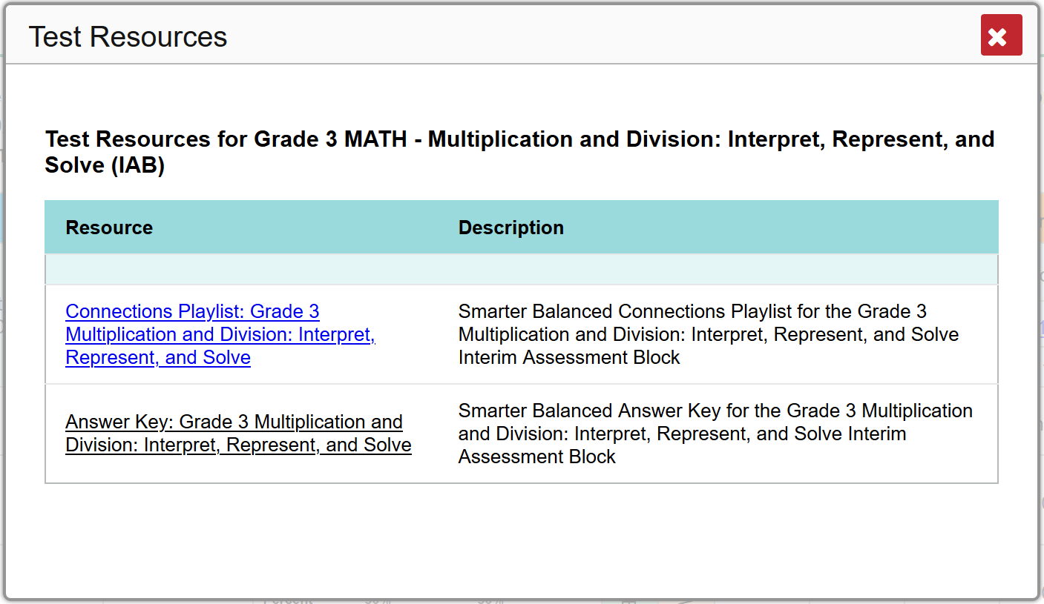
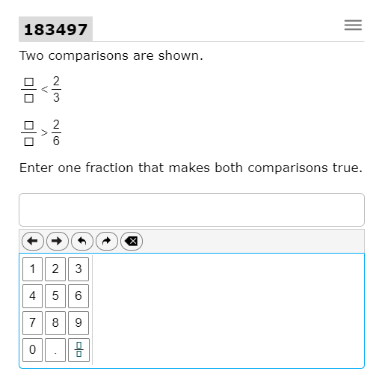
Math Example of CRS Roster Reports for a Interim Assessment (FIAB)
Notes:
Slide 19: Math Example of CRS Roster Reports for a Interim Assessment (FIAB) (Facilitator 1)
In this slide we will look at a Math example of a roster report. Within roster reports [Click Animation] educators can also view performance by roster or student.
[Click Animation] [Click Animation] If an educator is a looking at subset of students for a specific roster, than can make the same comparison as previous reports but can also compare against roster performance and the class as a whole. This might be the case if a educator is working with a small group of students in an RTI model.
[Click Animation] [Click Animation] Similar to the other reports educators can drill down to see performance on specific items.
[Click Animation] [Click Animation] The CRS iterim assessment system for ELA and Math is designed to immediately make connections to instructional resources in the Tools for Teachers website discussed in Session 6. Again this resources were developed by teachers for teachers in alignment to assessment targets and standards.
[Click Animation] [Click Animation] By selecting instructional resources a pop-up window will appear with a direct link to an interim assessment connection playlist with multiple instructional lessons and activities aligned to this specific IAB.
[Click Animation] [Click Animation] Additionally, in selecting a specific item from the item performance list, [Click Animation] that specific IAB item will appear allowing educators to see how the item was presented in alignment to full rigor of the standard and its performance expectation.

Slide 20
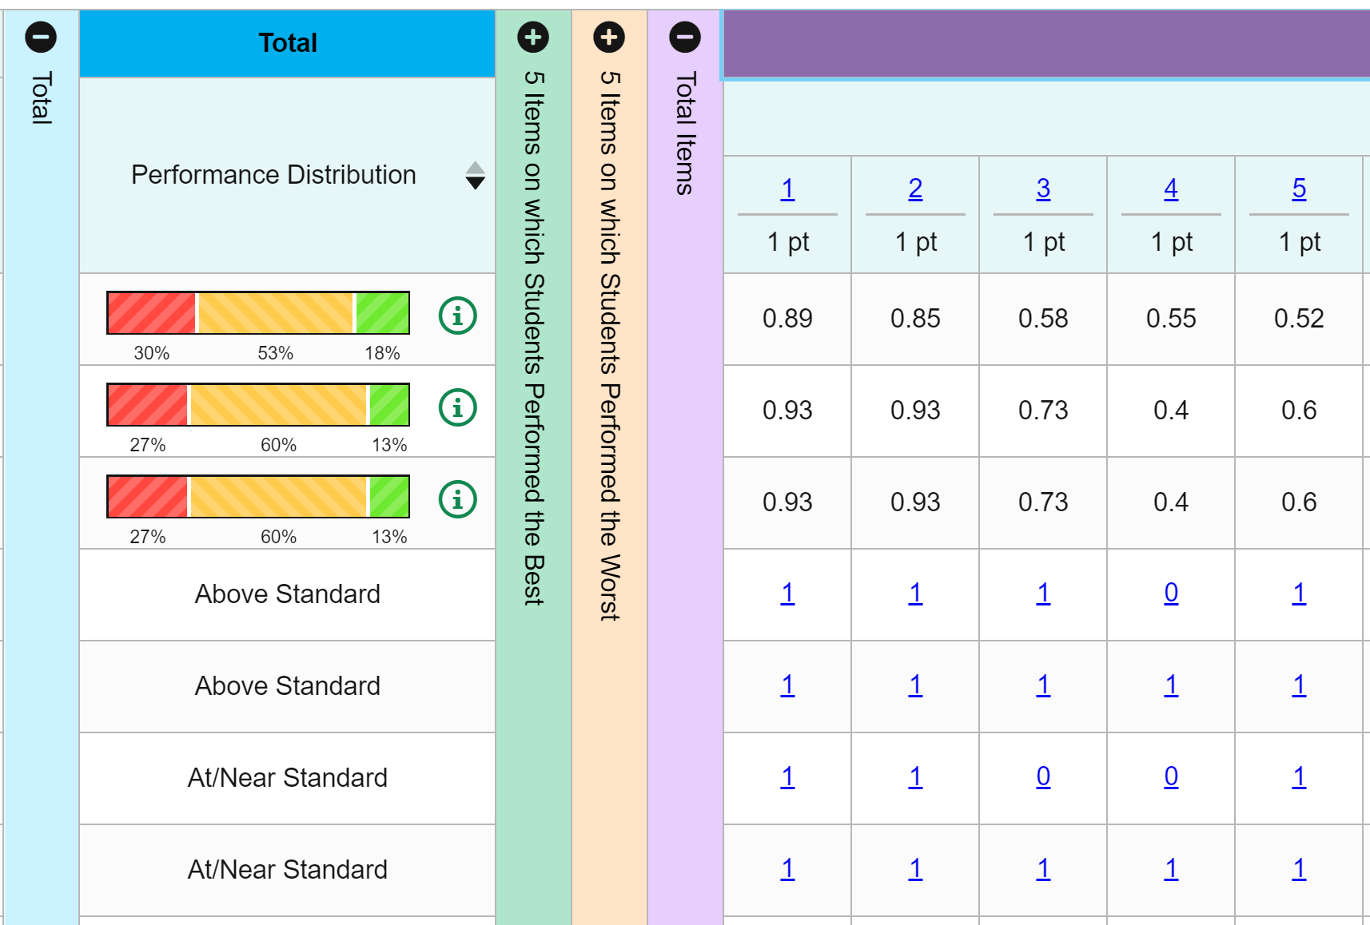
Viewing Interim Assessment Items and Student Responses
Viewing
Items
View
Student
Response
Notes:
Slide 20: Viewing Interim Assessment Items and Student Responses (Facilitator 1)
Building off the roster report, [Click Animation] and selecting individual items for viewing. Unlike the summative assessment the interim assessment system allows educators to not only see the assessment item, it also allows the educator to [Click Animation] view a student’s response to identify where the student may be struggling with the item and where further clarification and instructional support is need.
Again the interim assessment serves as a bridge between daily formative assessment practice activities and end of year summative assessment expectattions allowing educators to modify instruction and further support student learning towards proficiency of grade level standards.

Slide 21
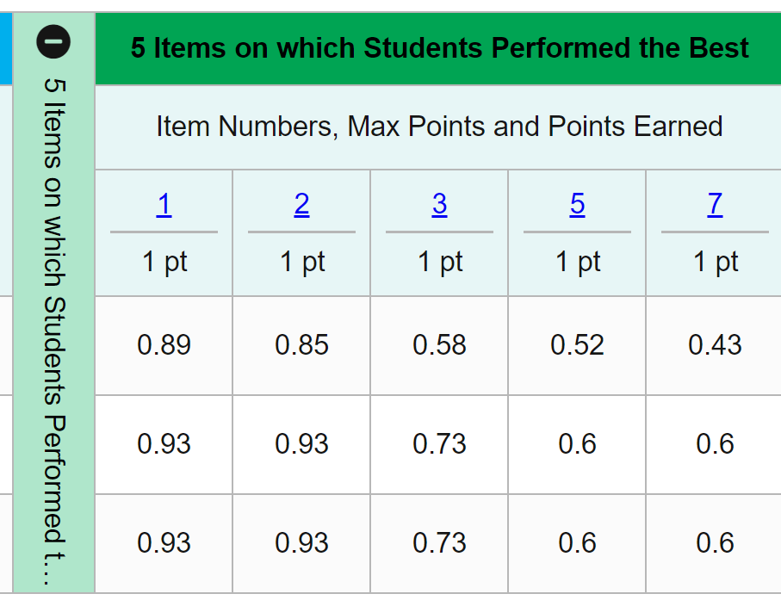
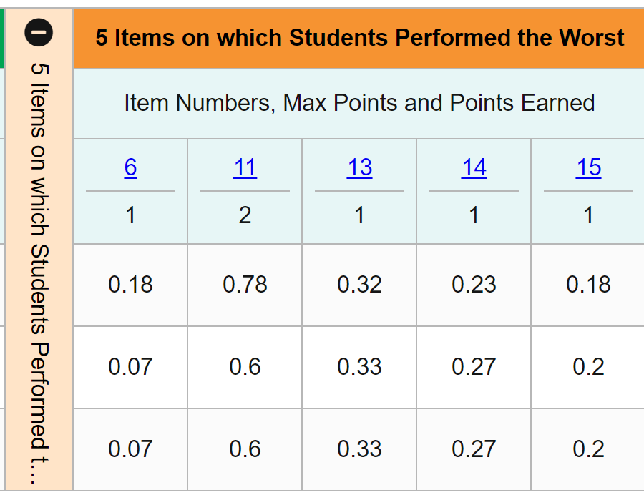
5 Items on which Students Performed the Best or the Worst
Educators can collect evidence for the class as a whole on concepts where students demonstrated proficiency on the rigor of the standards.
Educators can collect evidence for the class as a whole on concepts where students need additional instruction or support based on item level performance
Notes:
Slide 21: 5 Items on which Students Performed the Best or the Worst (Facilitator 1)
[Click Animation] One of the strengths of the Centralized Reporting System is being able to look at roster and student performance at the item level.
Educators [Click Animation] can look at the percentile of proficiency by individual items to identify were instruction supported the class as a whole and collect evidence towards proficiency of a standard. As stated previously educators can still drill down to view specific students that may need additional instructional support on that assessment target and associated standard.
[Click Animation] [Click Animation] Educators can also identify items were the class as a whole did not meet proficiency based on the assessment target and associated item and standard. [Click Animation] By looking at the item performance percentile an educator can select the items to view not only the item presented to students, but make connection back to the standard associated with that item for further instructional support.

Slide 22
Accessing the Interim Assessment Centralized Reporting System (CRS) for Science
Notes:
Slide 22: Interim Training Requirements (Facilitator)
Now we will talk about accessing the Interim Assessment Centralized Reporting System for Science.

Slide 23
Accessing the Interim Assessment Centralized Reporting System (CRS)
Notes:
Slide 23: Accessing the Interim Assessment Centralized Reporting System (CRS)
As stated previously, the Centralized Reporting System is accessed through the Interim Assessments button on the OSASportal.
From the Interim Assessments browser you will choose Centralized Reporting System. You will notice that this button has a lock icon on it which indicates you will need to use your user name and password to log in.

Slide 24
CRS Science District Reports for
Staff and Coaches
Notes:
Slide 24: CRS Science District Reports for Staff and Coaches
After logging in to the Reporting System, teachers and school- and district-level users see the dashboard. Test information and results are displayed for the students assigned to you based on your role.
Teachers are able to view data for all students in their rosters who have completed assessments. They can also view data for students to whom they have administered assessments in the current school year.
School and district level users are able to view data for all students in their schools who have completed assessments.
You will notice in the science card that there are no scale scores or achievement levels available for the 20-21 school year. Data will be provided in raw scores and averages.
Filtering, setting preferences, sorting, and breaking down demographic groups are important functions for all users so that test data applies specifically to their needs. The graphic objects shown on the dashboard and on the report pages allow you to make these choices.
Again, the test cards are sorted from left to right, then top to bottom based on the date last taken. When you click the test name or the magnifying glass button, the Performance on Tests report displays.

Slide 25
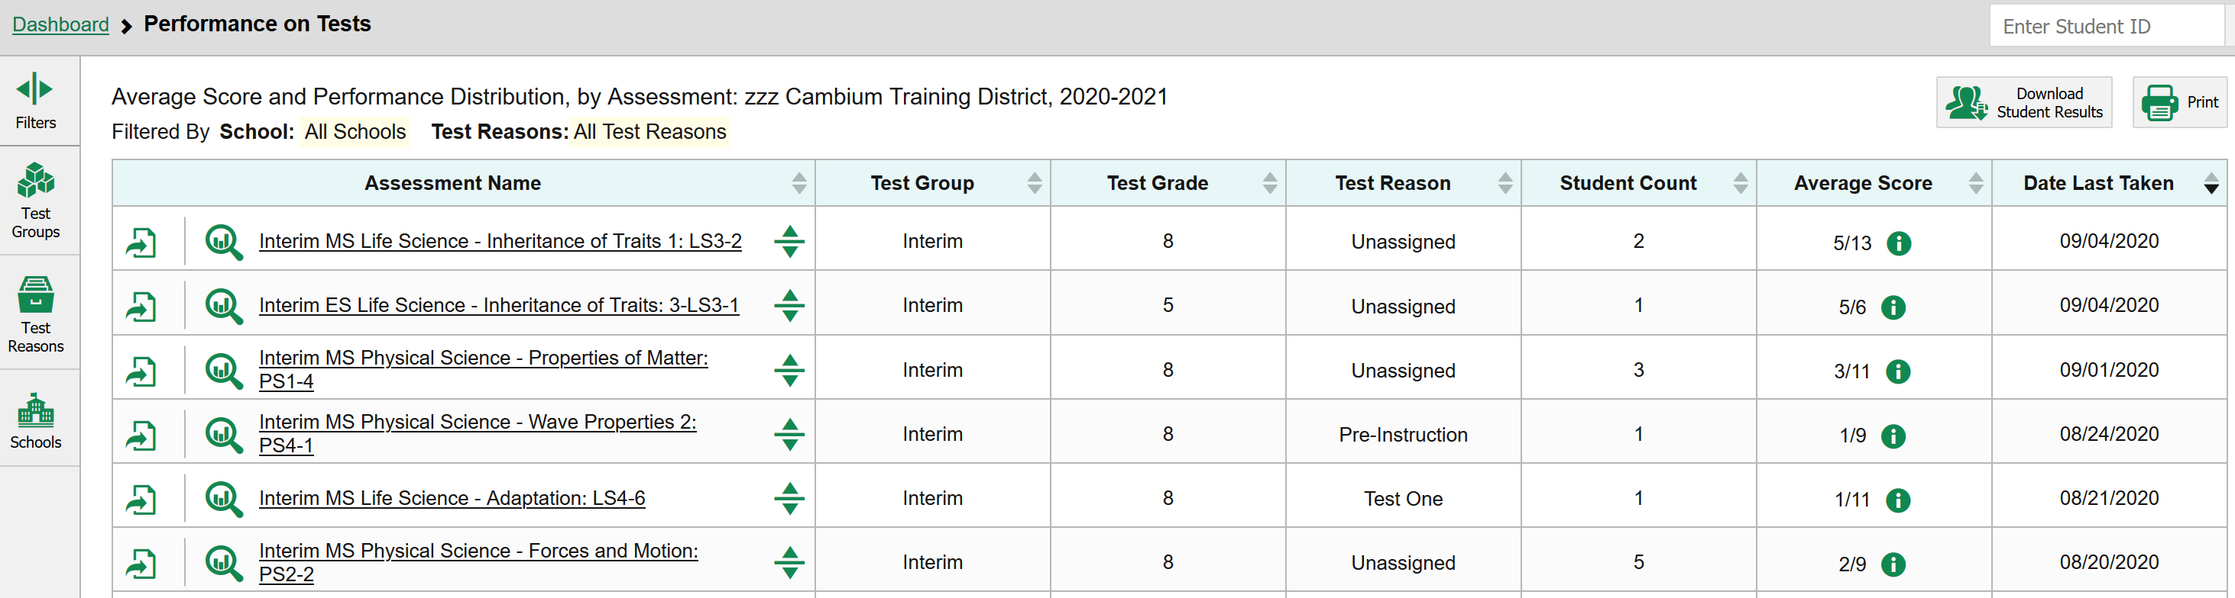
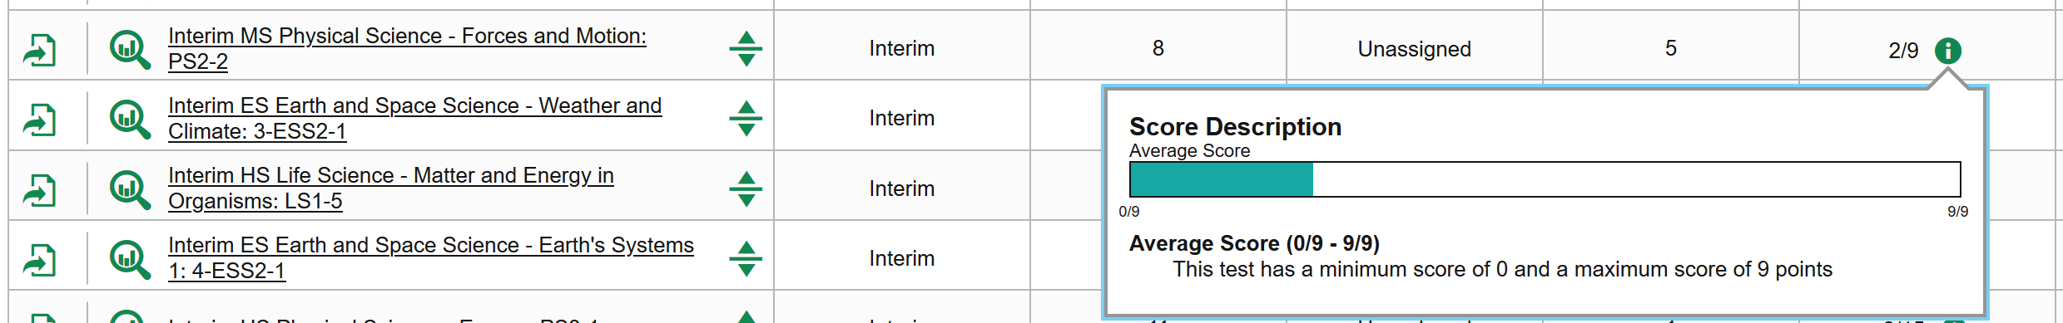
Science Example of CRS District Reports for Staff and Coaches
Notes:
Slide 25: Science Example of CRS District Reports for Staff and Coaches
Here is a science performance on a test report. (click)
Again, it is important to use the filtering features on the left hand side of the screen to more greatly specify the data to be aggregated within the table.
For science, you will notice in the column headers (click)
that average scores for each assessment are provided rather than a performance distribution.
By clicking on the information button next to the average score you will be able to see a Score Description describing the average number of raw points earned out of the maximum possible.

Slide 26
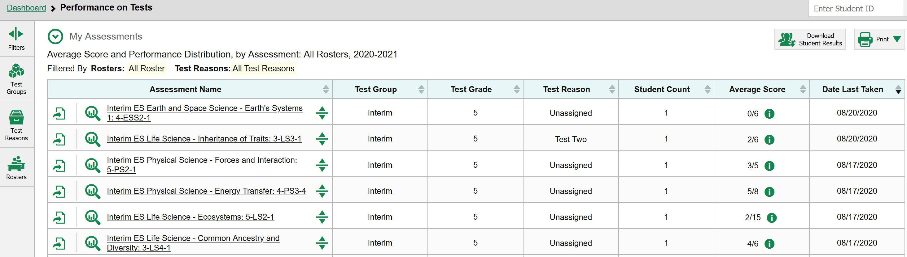
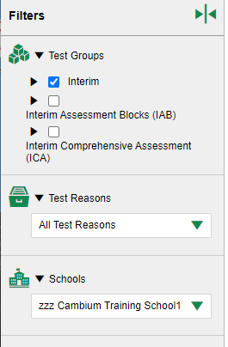

Science Example of CRS School Reports for Staff and Coaches
Notes:
Slide 26: Science Example of CRS School Reports for Staff and Coaches.
You can drill down to the school level in your filter on the left hand side of the screen (click, click) and the same information will be provided at the school level for each interim test that was provided at the district level including the school average scores for each science interim assessment.
By clicking on the down arrow you can easily compare school performance with district and state performance.
Clicking on the assessment name or magnifying glass will take you to the Performance by Roster and Performance by Student which we will take a closer look at.

Slide 27
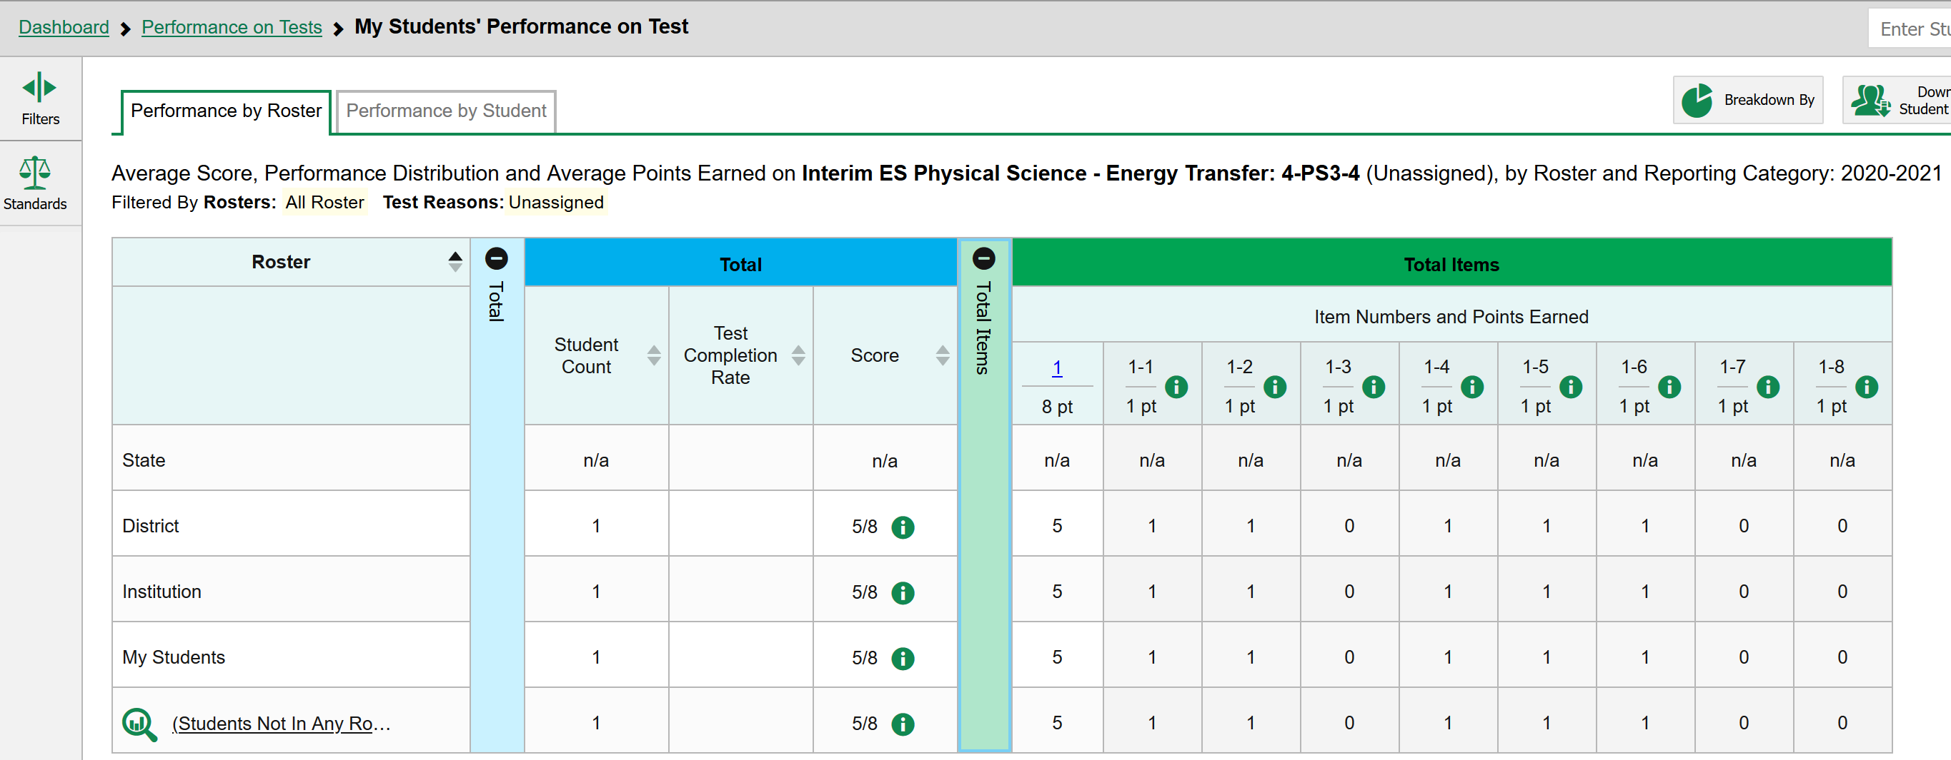
Science Example of CRS Roster Reports for an Interim Assessment
Notes:
Slide 27: Science Example of CRS Roster Reports for an Interim Assessment
Here we have the science example of a CRS Roster Report for the interim. (click) Selecting between the tabs, you can look at either performance by roster or student performance. (click) Within the roster table, you can see the comparison of state, district, school, and roster performance in the interim test.
Remember that each interim test is comprised of 1 cluster/task assessing 1 standard. Within the cluster/task there are many student interaction Parts. (click) The table headers display how many raw points can be earned in each part of the cluster. (click) The first column shown as (1) here lists the total points possible for the entire task. Each successive column lists the total points possible for that part of the task (example Part 1 is worth 1 point).
By clicking on the information icon next to the points possible, you can read the scoring assertion for that part of the task. a scoring assertion describes the correct answer that a student should have responded with and what understanding or ability is evidenced by that response.
(click)
This table allows you to see the average scores and average points earned for each Part (click) of the cluster task at the state, district, school, and roster level. In this way you can better understand areas of relative strength and need for support among students in your district and roster.

Slide 28
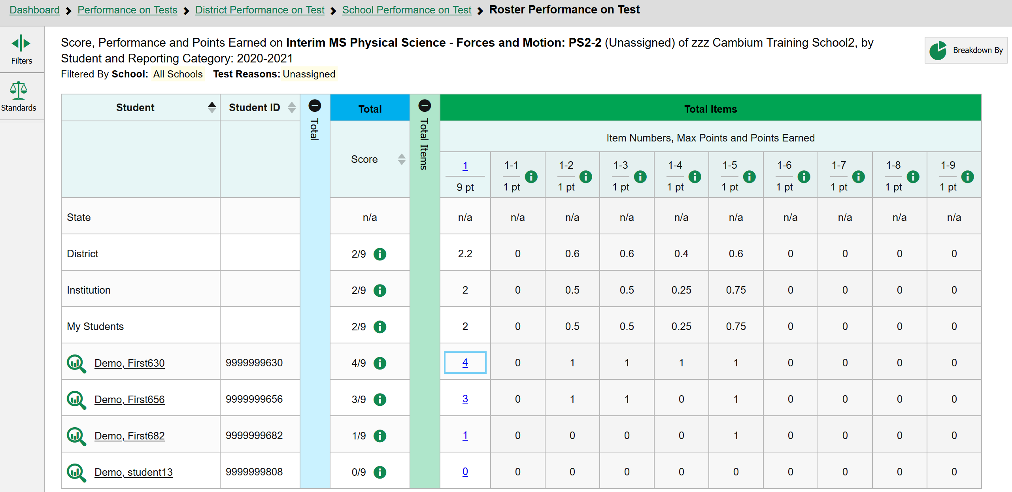
Science Example of CRS Student Reports for an Interim Assessment
Notes:
Slide 28: Science Example of CRS Student Reports for an interim assessment
By clicking on the roster you will see a version of the student report table that shows individual student scores.
You can look for areas of relative strength or need for support by analyzing the performance for each part of the cluster. By reading the scoring assertion, you can see what the part of the task was assessing. In this way you can use the interim tasks formatively to help you identify areas that need to be re-visited within your instruction.
If you would like to see the item and scoring assertions together along with a copy of the task, click on the number representing the cluster average score for the student in the table.

Slide 29
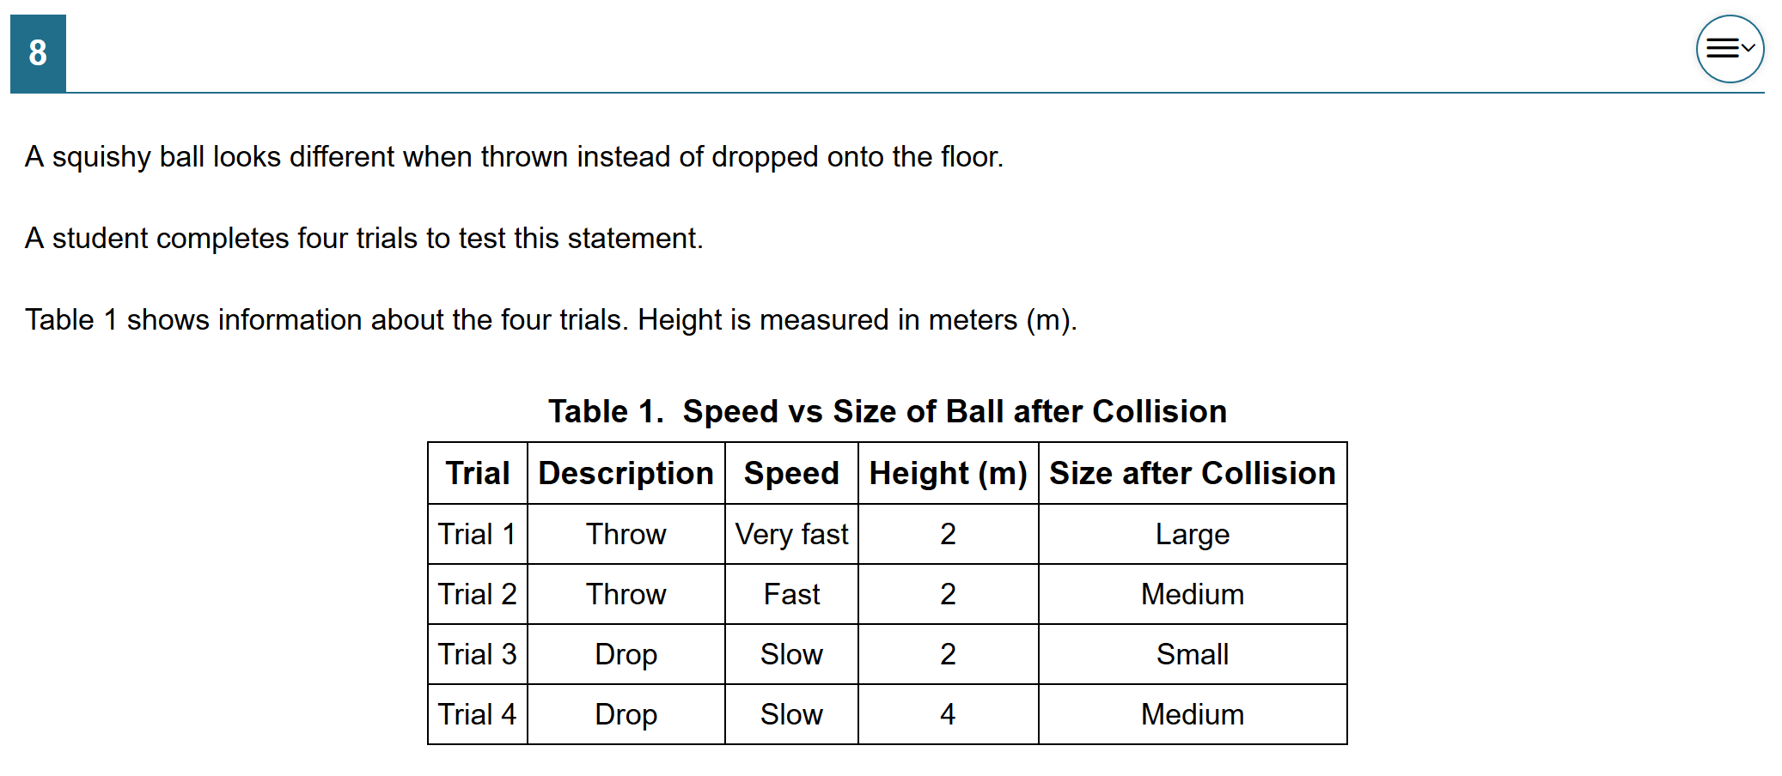
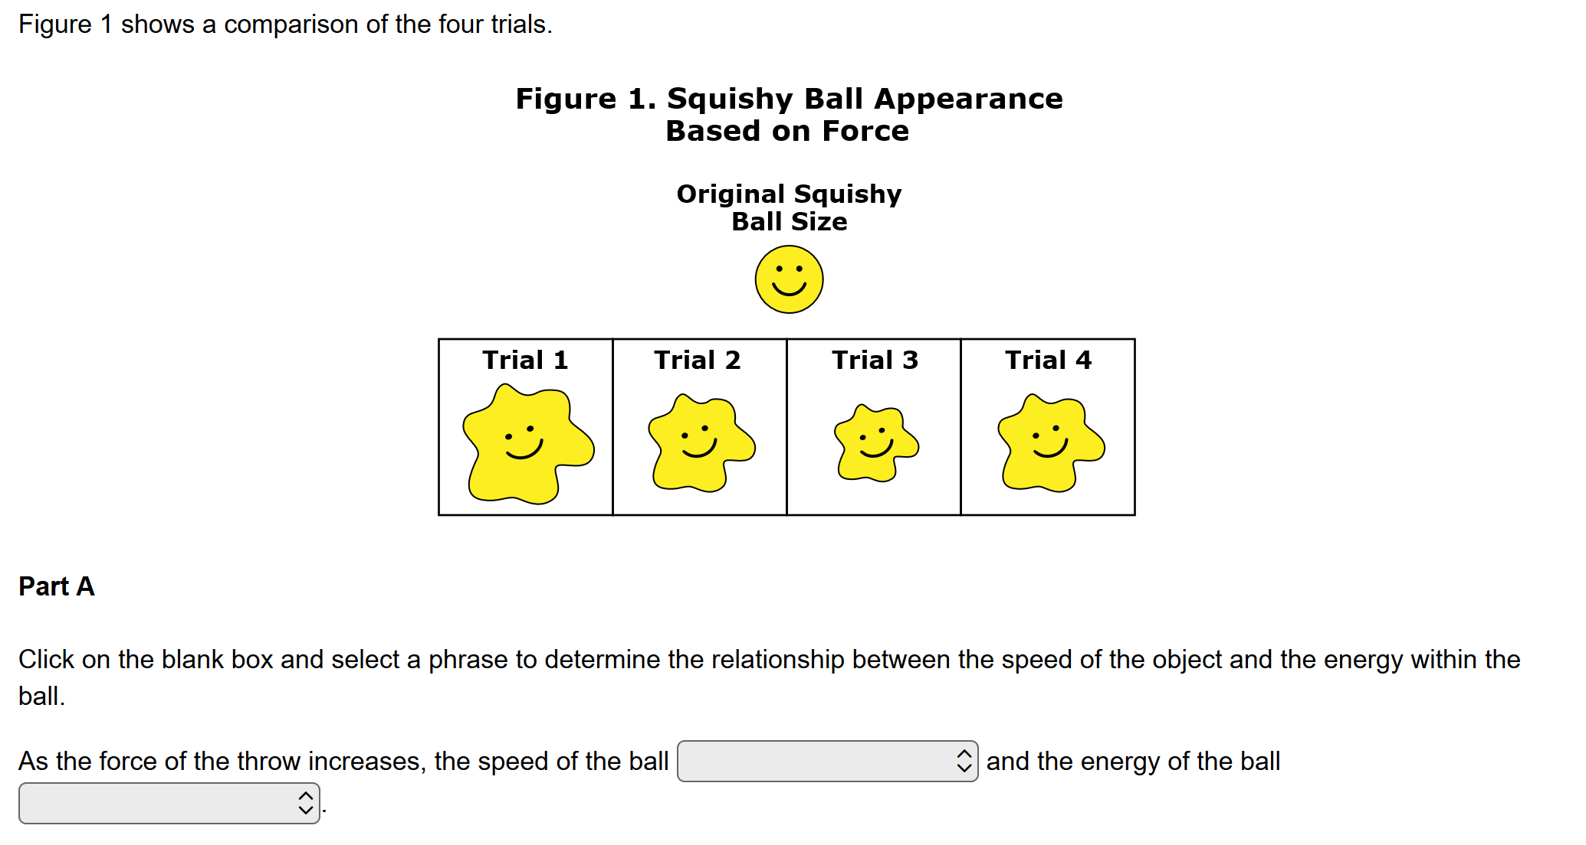
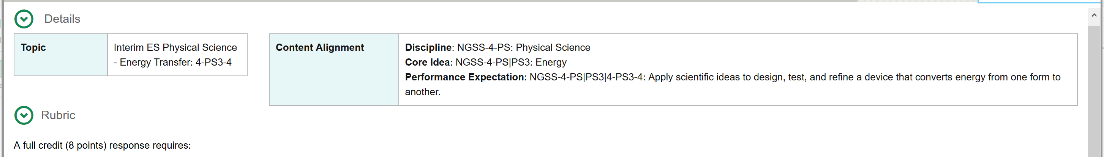
Science Example of CRS Roster Reports for an Interim Assessment
Exploring a
Science Cluster Item in CRS
Rubrics provide descriptive evidence required within each cluster item and the scoring dependencies that may be present.
Notes:
Slide 29: Exploring a Science Cluster Item in CRS
In addition to seeing the item and scoring assertions on the Item and Score tab, you will also have access to the rubric and resources tab for the item.
The Rubric and Resources tab identifies the standard and provides a descriptive of the evidence required within each part of the cluster task item to earn points, as well as the number of points earned by correct responses in each part. Sometimes the science cluster/tasks have dependent scoring meaning that the correct response to one part may be dependent on how the student responded in a previous part of the cluster task. For example, the student chooses what they will test in their simulation and their answer to the following question is based on what they tested. Since there are multiple variables within the simulation that may be tested, there are also multiple outcomes that could occur in the simulation.
These dependencies are described in the rubric and in this way, educators can see the logic of the scoring and make more connections to where students may be struggling.
We hope that you can see how interim assessments can be used both for learning to support instructional decision making and of learning to evaluate student learning.

Slide 30
Hand Scoring within the
Centralized Reporting System (CRS)
Hand Scoring within the
Centralized Reporting System (CRS)
Notes:
Slide 30: Hand Scoring within the Centralized Reporting System (CRS)
(Facilitator 1)
Hand Scoring within the Centralized Reporting System (CRS)

Slide 31
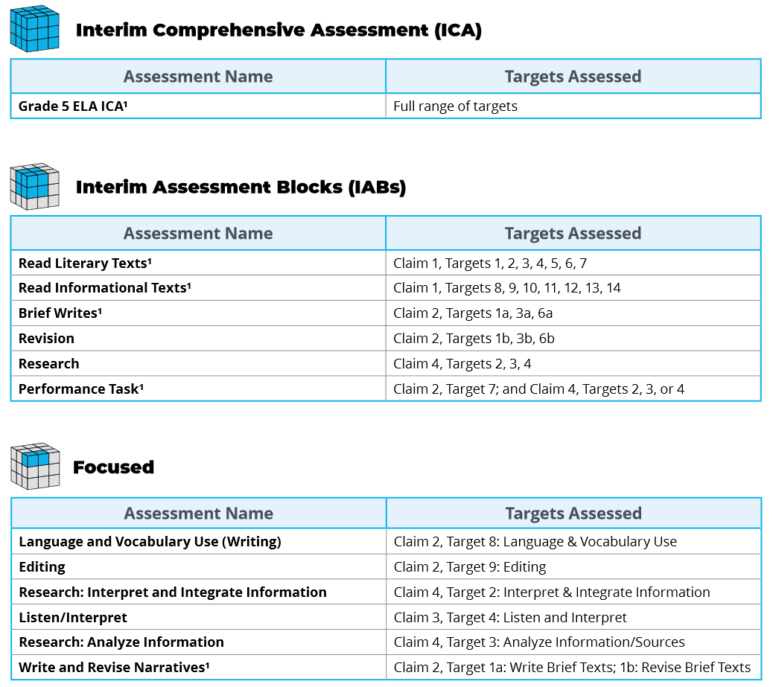
ELA Grade 5 Interims
ELA Grade 5 Interims
Notes:
Slide 31: ELA Grade 5 IABs (Facilitator 1)
The following is an example of the interim assessments included for 5th grade ELA. As you can see some of the interim assessments have a footnote 1 located next to their title indicating there are hand-scoring items within that specific (Click Animation) ICA, and IAB (Click Animation) such as Read Literary Text, Read Informational Text, and Brief Writes, (Click Animation) including the Performance Tasks.
Resources:
ELA and Mathematics Interim Assessment Overview​
​​This document describes the interim assessments, including their purpose, use, and varieties.

Slide 32
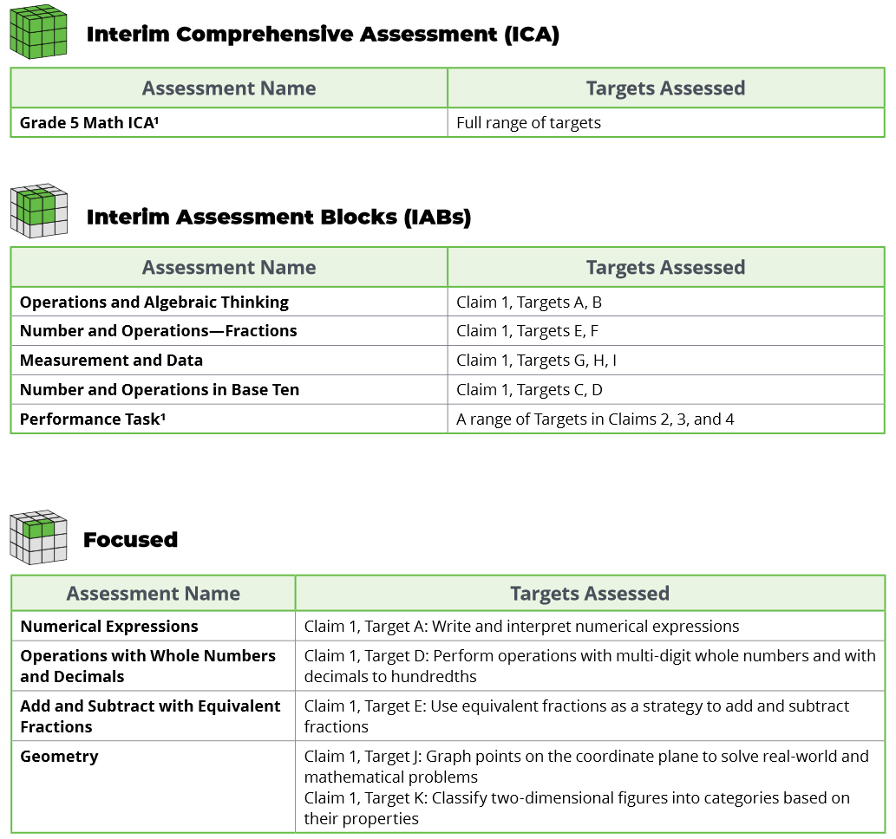
Math Grade 5 Interims
Math Grade 5 Interims
Notes:
Slide 32: Math Grade 5 IABs (Facilitator 1)
In the Math portion of the Interim Assessment system hand-scoring items are associated with either the (Click Animation) Math ICA during the performance task section and (Click Animation) the individual IAB specific to performance tasks.
Resources:
ELA and Mathematics Interim Assessment Overview​
This document describes the interim assessments, including their purpose, use, and varieties.

Slide 33
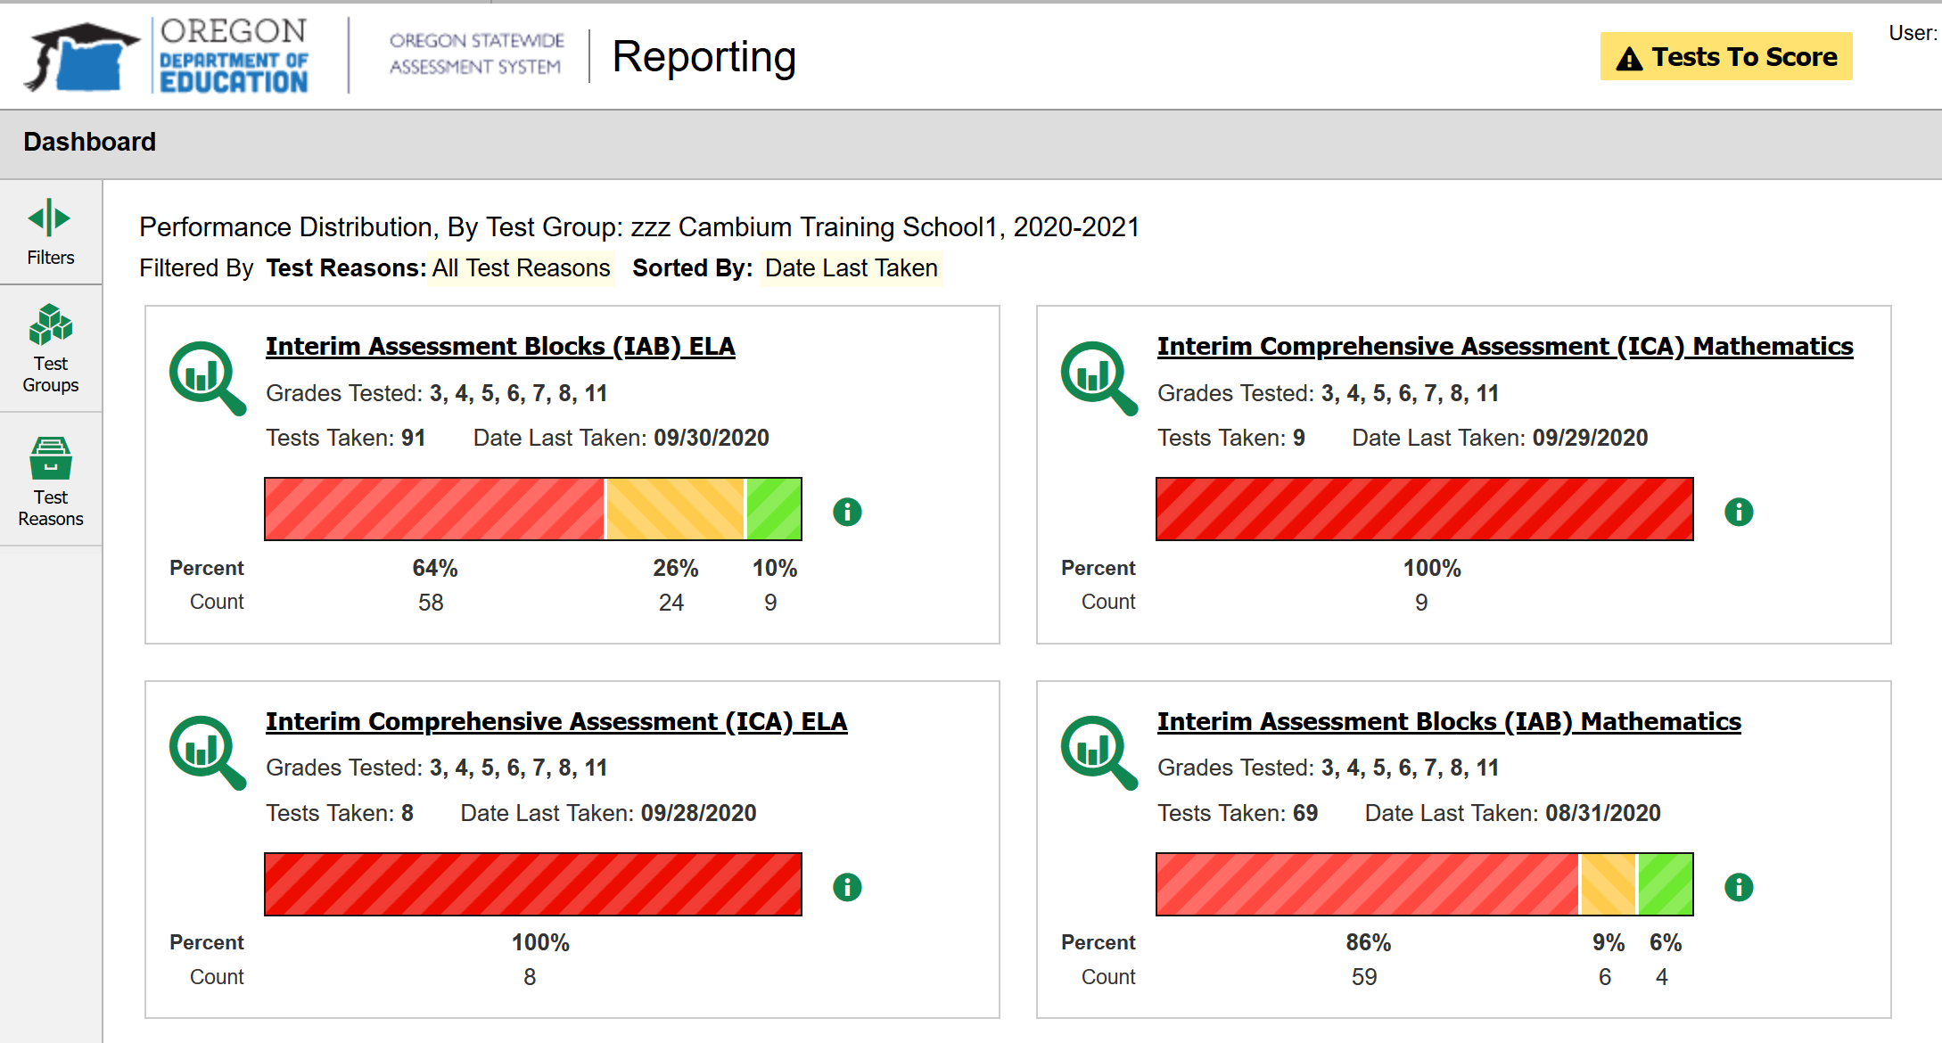
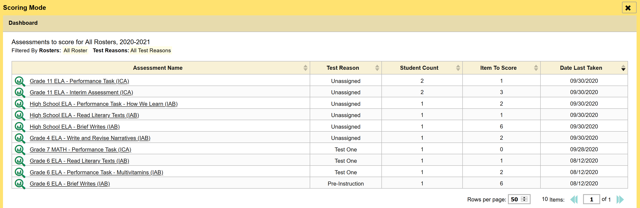
Identifying Hand Scoring Requirements in CRS
Notes:
Slide 33: Identifying Hand Scoring Requirements in CRS (Facilitator 1)
The Centralized Reporting System allows authorized users to score certain items on interim and benchmark tests.
When you have tests with unscored items, (Click Animation) a Tests to Score notification appears in the banner. By clicking on ‘Tests to Score’ in the banner a (Click Animation) (Click Animation) new scoring mode window will open displaying a (Click Animation) list of tests with unscored items. The table on the scoring mode dashboard (Click Animation) indicates how many test opportunities and unscored items are available for each test. You can navigate this table just as you would any table of assessments. (Click Animation)
(Click Animation) Click the name of the test you wish to score or the magnifying glass symbol beside it. The test scoring page appears displaying a list of students and items awaiting scoring for the selected test.
To enter scores for an item, click the score link for the required item in the required student’s row and the item view window opens.

Slide 34
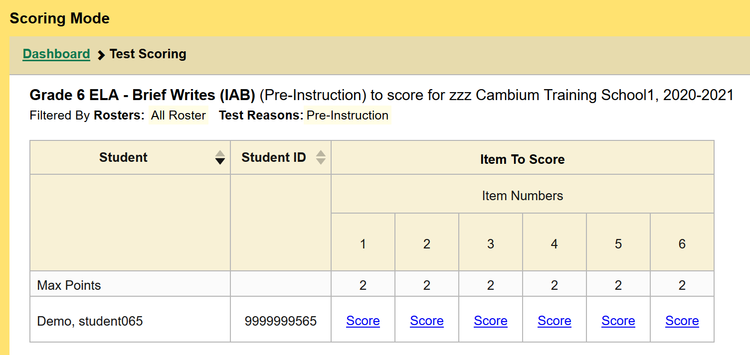
Hand Scoring an
Individual Item in CRS
Notes:
Slide 34: Hand Scoring an Individual Item in CRS (Facilitator 1)
One of the first things you will notice is (Click Animation) the test scoring page appears displaying the name of the interim assessment you have opened.
Additionally (Click Animation) (Click Animation) a list of students will appear identifying which items are awaiting hand scoring for the selected test. In this example we have one Demo student pending a final score on the IAB due to outstanding hand-scoring scores still needed.
To simply enter scores(Click Animation) (Click Animation) for an item, click the score link for the required item in the required student’s row and the item view window opens.

Slide 35
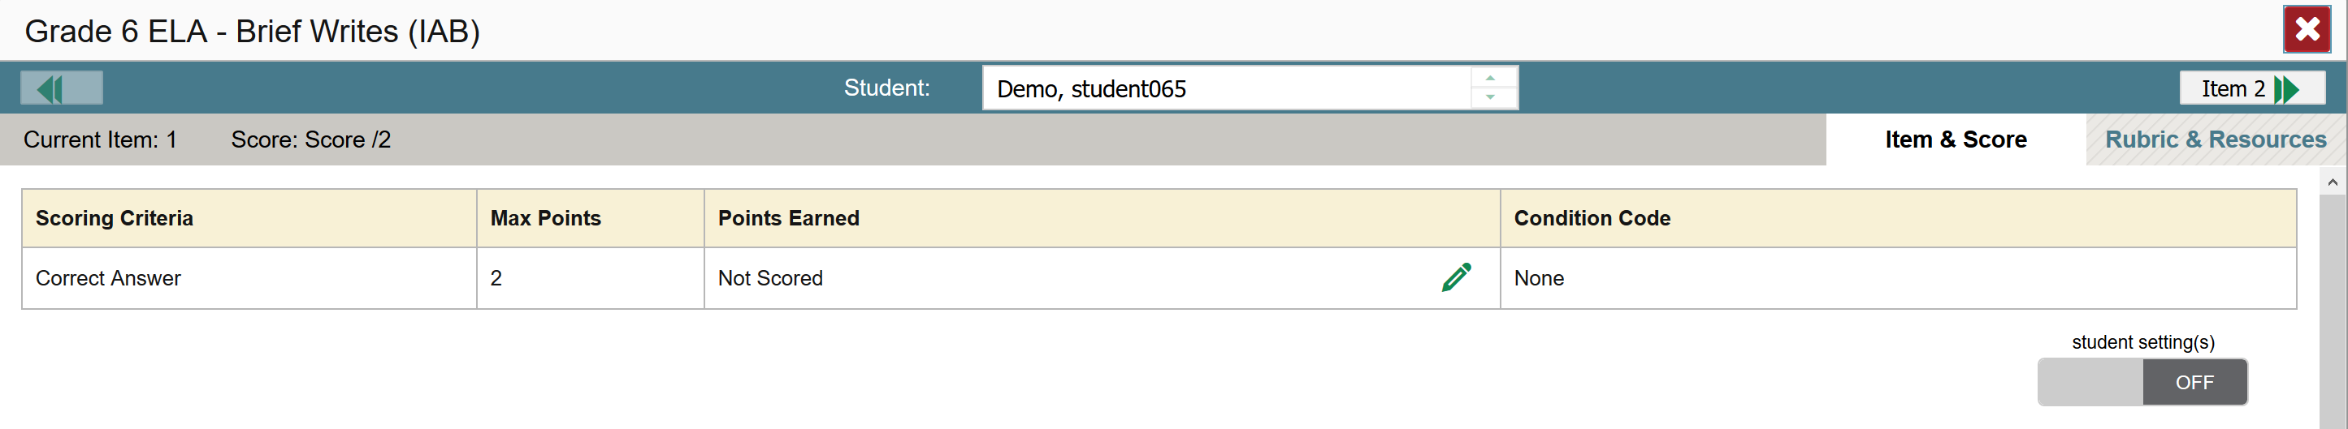
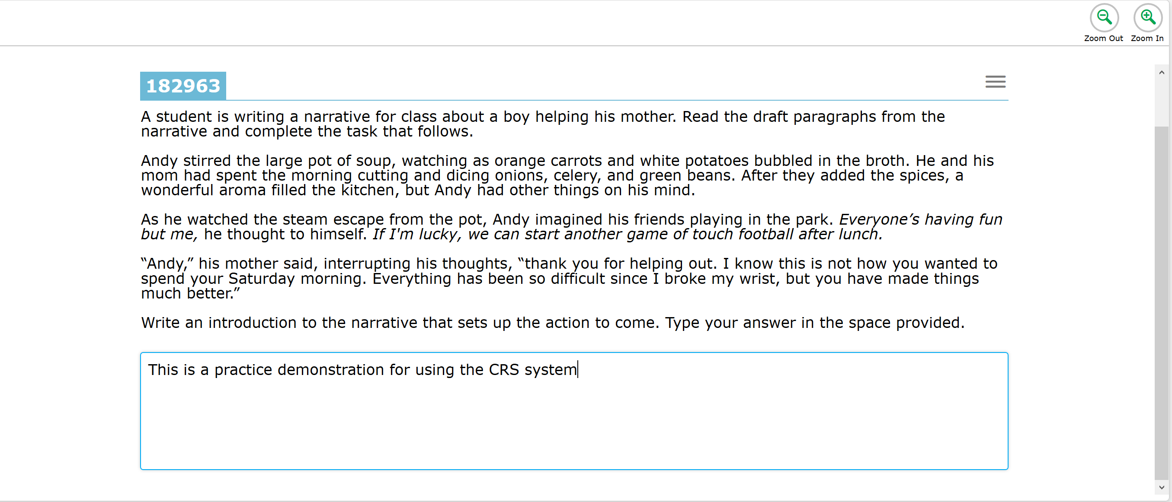
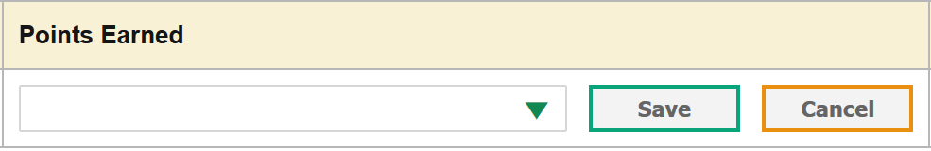
Entering Scores for
Hand Scoring Items in CRS
Notes:
Slide 35: Entering Scores for Hand Scoring Items in CRS (Facilitator 1)
In the item view window for hand scoring, educators will have access to the (Click Animation) scoring rubrics and support resources. At the top (Click Animation) (Click Animation) is the Student name in which you are viewing and allows educators to quickly navigate to other students who may need to have the same item scored in the system.
(Click Animation) (Click Animation) Just below the student name is the points panel which show the current score assigned. It also has a green pencil which allows educators to modify or edit a student’s score based on their response. (Click Animation) (Click Animation) When selecting the green pencil and new window will appear to select a score from the drop down menu.
As a reminder, please make sure to save your work to have it carried over to the roster report.

Slide 36
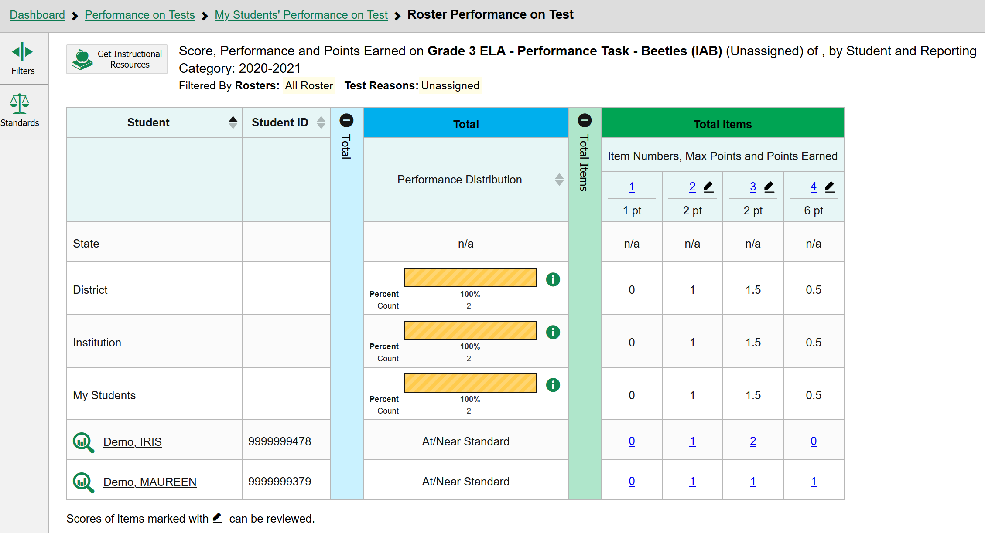
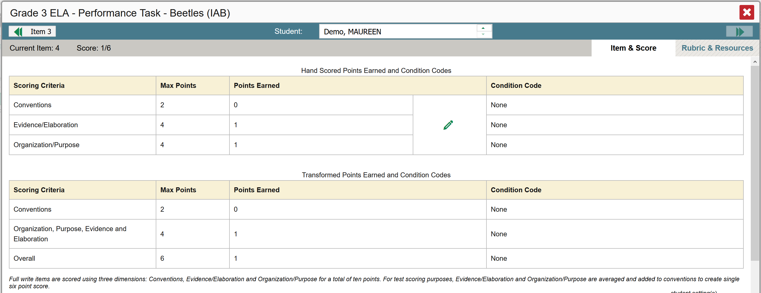
Hand Scoring Items in CRS at the Student Level
Notes:
Slide 36: Entering Scores for Hand Scoring Items for ELA Performance Tasks (Facilitator 1)
The ELA Performance Tasks are a bit more complicated in that they contain full composition responses or full writes and have multiple scoring assertions. (Click Animation) One of the first icons you will notice is the pencil icon. This is (Click Animation) also is included in the table next to individual items.
(Click Animation) Each item will also have a (Click Animation) point value next to the item. In this example we can see this selected item is worth 6 points. (Click Animation) We can also look down the table to see how each student performed on this item.
When we click on the individual student score a new window will appear (Click Animation) (Click Animation)
At the top (Click Animation) an educator will be able to see the student name and quickly navigate within this item to score other students who also need hand-scoring to be completed.
Additionally (Click Animation) there is a preliminary score assigned based on AI scoring using an artificial intelligence algorithm built for that specific ELA Performance Task. Again, AI scoring is only available for ELA PT items and does not apply to other hand-scoring items. As you will see educators have permissions to over-ride the AI scoring.
Similar to the other hand-scoring items educators will (Click Animation) will use the green pencil icon to change or enter scores. (Click Animation)
(Click Animation) At the bottom educators will see a transformed score table which contributes to the 6 point score. The reason for a transformed score is (Click Animation) because Organization and Purpose are combined and averaged with Evidence and Elaboration.
As Session 5 serves as an overview to the central reporting system, ODE will be hosting several hand-scoring training sessions in November and December which provides a deeper dive into both the CRS system and scoring calibration. These trainings will be shared out through our DTCs, Assessment and Accountability Newsletter, and the ODE ELA Newsletter. Educators can sign up for both newsletters using the embedded links in the facilitator guide.
Resources:
AA Newsletter Update: Subscribe
ODE ELA Listserv: Oregon English Language Arts Update

Slide 37
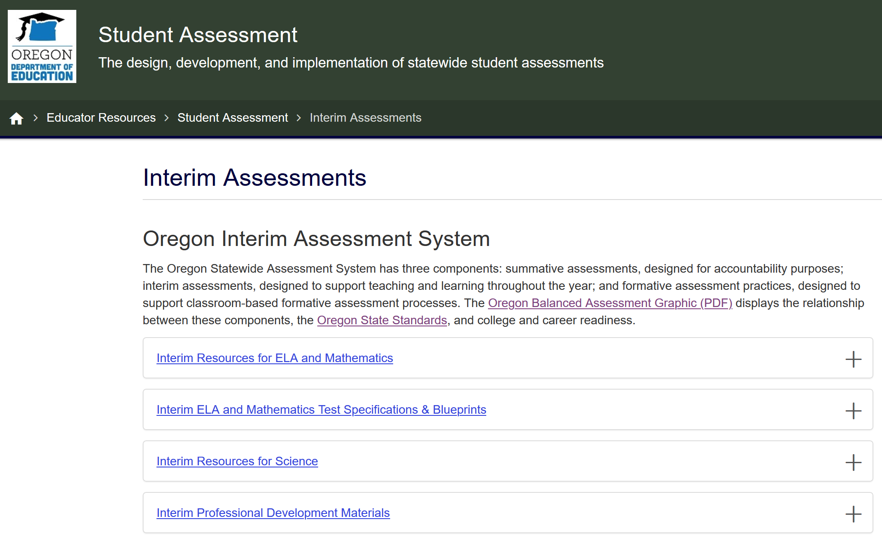
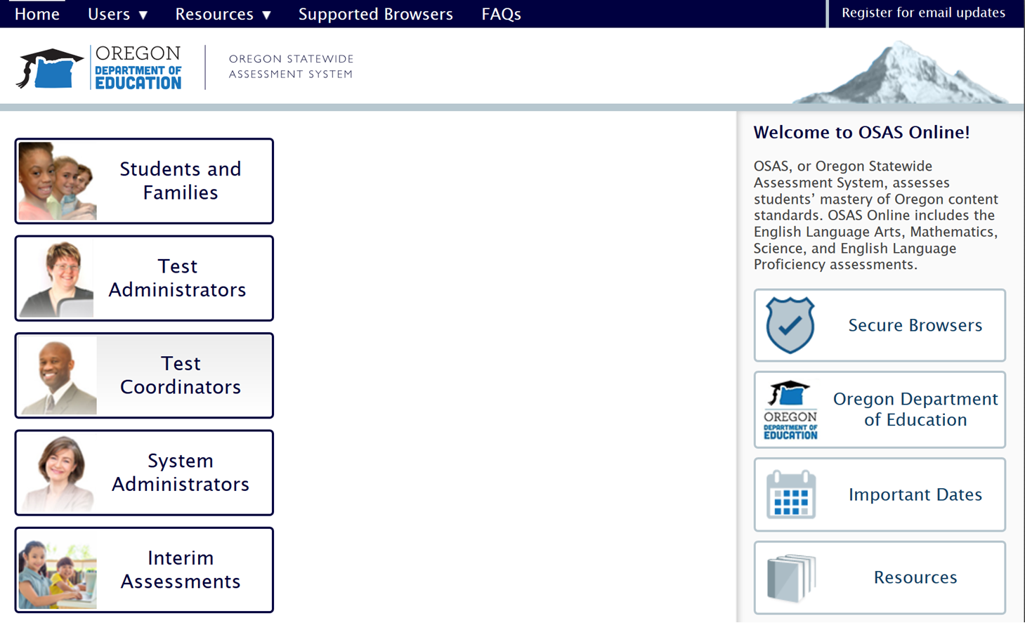
Interim Test Administration Resources
ODE Interim Assessment webpage
OSAS Portal
Notes:
Slide 37: Interim Test Administration Resources (Facilitator 1)
For access to any of the interim assessment resources discussed in this session or past sessions, please navigate to ODE Interim Assessment webpage or the Resources section of the OSAS Portal webpage.

Slide 38
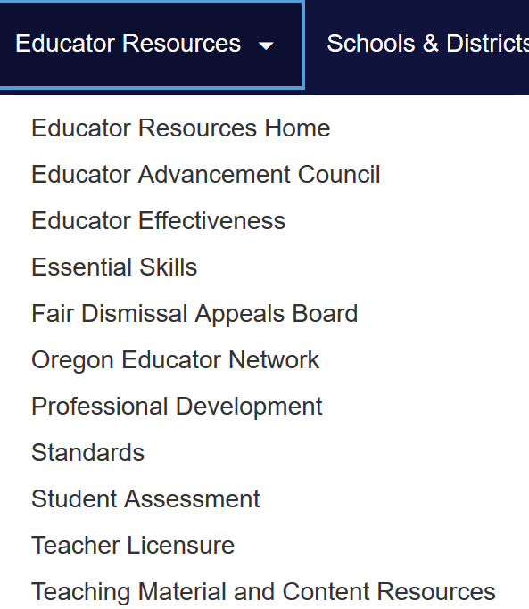

Contact Us! www.oregon.gov/ode
Dan Farley: Director of Assessment
Noelle Gorbett: Science Assessment
Andrew Byerley: Mathematics Assessment
Tony Bertrand: ELA and Social Sciences Assessment
Ben Wolcott: English Language Proficiency Assessment
Photo by Volodymyr Hryshchenko on Unsplash
Notes:
Slide 38: Contact Information and Additional Resources (Facilitator 1)
In addition to these professional development resources, the ODE Assessment team is available to support districts and schools with general or content specific assessment questions.
For contact information including email or telephone, please visit the ODE Assessment homepage and select the Assessment Contact button.
Information specific to the Interim Assessment System, including supporting resources and additional session presentations, are available on the ODE Interim Assessment webpage.
Resources:
ODE Assessment Contacts

