Slide 1
Granting Permission to Administer Tests using Test Groups in TIDE New Process for 2020-2021 For District and School Test Coordinators

Slide 2
Overview
When TIDE rolls over from the 2019-2020 to 2020-2021 school year, all users will remain in TIDE with the same user role.
Because Oregon now has an Interim Assessment system statewide, there exists a need to grant access to different aspects of the Oregon Statewide Assessment System:
The new “Test Group” field accounts for this
No users will have the ability to start a test session until this Test Group field is assigned.

Slide 3
“Test Group” Field
DTCs, DLUs and/or STCs must update user accounts to add permission to administer tests by Test Group.
Test Group permissions may be added via Upload Users or individually by opening an account in the View/Edit Users module.
DTCs must contact their Regional ESD Partner to request that Test Group permissions be assigned for their own DTC account.

Slide 4
“Test Group” Field
The Test Group field is organized into three categories with permissions to the following tests:
ELPA Screener | Interim | Summative
ELPA Screener | ELA Interims | ELA
 | Math Interims | Math
 | Science Interims (if purchased) | Science
 |  | ELPA Summative

Slide 5
Step 1 – Identify Test Administration Permission Needs
DTC/STCs identify which users need permission to act as a Test Administrator for a given Test Group (ELPA Screener, Interims, Summatives).
DTC/STCs track user completion of required test administrator training.
Decide whether you want to create an upload file or modify user accounts individually. If you want to create an upload file, proceed to Step 2. If you want to change user accounts individually, skip to Step 5.

Slide 6
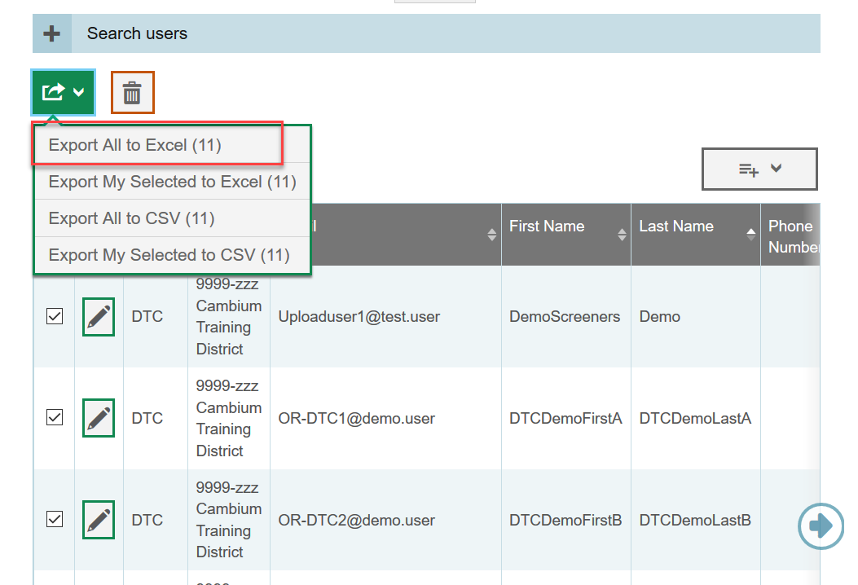
Step 2 (For Upload Method) – Create User Export
DTCs or STCs log in to TIDE (password reset required).
Go to View/Edit/Export Users and run a report of all users in your district or institution.
Export the search results OR ask your ESD Partner for a pre-formatted user file.

Slide 7
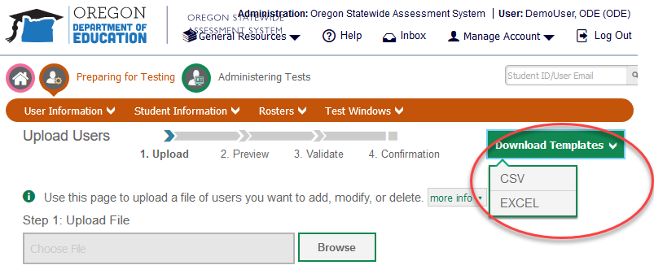
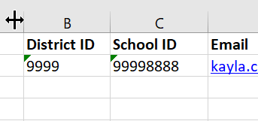
Step 3 (For Upload Method) – Create User Upload
Download the template from the Upload Users module.
Enter the respective 4-digit DistrictID and 8-digit SchoolID fields for each row.(The SchoolID is a combination of the 4 digit DistrictID and 4 digit SchoolID)

Slide 8
Step 3 (For Upload Method) – Create User Upload, cont.
Copy/paste the user information from the user search results in Step 2c into the Role, Email, First Name, Last Name, Phone fields.
In the Test Group field, select the option(s) associated with the tests the user will need to administer.
In the Action field (Column I) enter Add. If a user needs to be deleted, you may enter Delete into this column.

Slide 9
Step 3 (For Upload Method) – Create User Upload, cont.
If a user needs permission to administer multiple Test Groups the dropdown in the Excel file provides combination options. Test Groups were defined in Slide 4.
Save your file.

Slide 10
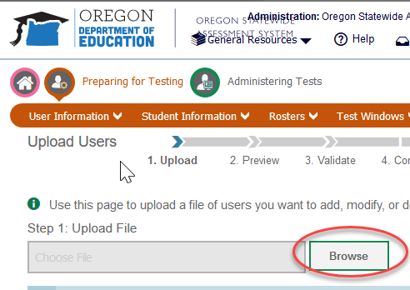
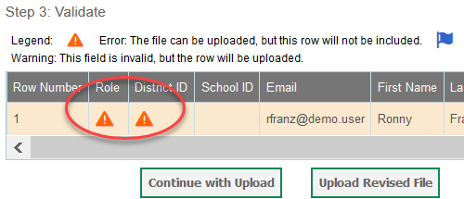
Step 4 – Upload User File
Return to the User Information/Upload Users Module.
Browse for the file you created in Step 3 and upload it.
Ensure that you correct any errors flagged during the validation step .

Slide 11
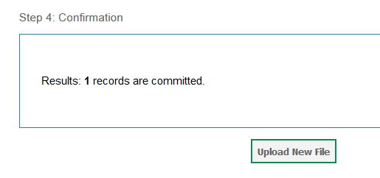
Step 4 – Upload User File, cont.
The system will verify the number of records that have been committed as part of your upload.
To check your work, you can search for a given user and ensure the Test Group permissions were applied.
If you have followed Steps 2-4 you have completed the task.

Slide 12
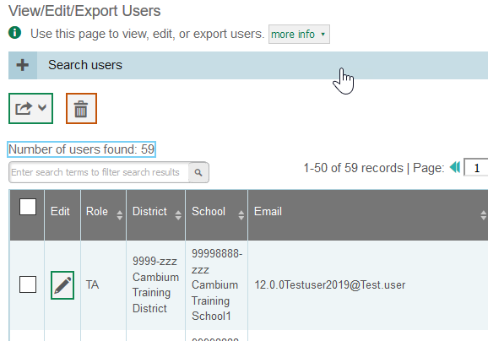
Step 5 Applying Test Group Permissions Individually
DTCs/DLUs/STCs log in to TIDE (password reset required)
In the View/Edit/Export Users module, enter search parameters and identify users
Click on the pencil button next to a user account and a user account will open.

Slide 13
Step 5 - Applying Test Group Permissions Individually
In the Test Group field, select the option(s) associated with the tests the user will need to administer.
Click Save.
Repeat steps A-E
provided in slides 12
& 13 to update more
user accounts.

Slide 14
User Support
More information is available in the TIDE User Guide or contact your Regional ESD Partner
Contact the OSAS Helpdesk if you need assistance using TIDE or adding Test Group permissions.
Email Support: osashelpdesk@cambiumassessment.com
Toll-Free Phone Support: 1-866-509-6257
Chat Support: https://osasportal.org/chat.stml

