Slide 1
Addressing Instruction, Assessment, and Curricula:
Understanding Writing Performance Tasks,
Scoring Rubrics, and Instructional Implications
(3rd – 8th & HS)
Notes:
This presentation is intended for school leaders and leadership teams to support an understanding of the Oregon ELA summative assessment performance tasks and their use as part of an interim and formative assessment system.

Slide 2

Workshop Goals
  Understand components of a Performance Task and skills required for students to be successful.
  Identify current trends in ELA PT performance for the Oregon Summative Assessment and review samples of student work which receive a scoring condition code.
  Examine recommendations for differentiated instructional strategies to support performance task development and student achievement on writing performance tasks.
  Discuss and collaborate in professional development opportunities to support teachers’ understanding of performance task activities.
Notes:
The session will provide participants with an overview of the writing performance task on the Oregon ELA summative assessment. Features will explore characteristics and values in using performance task activities throughout instruction and provide strategies to address the high number of students receiving a score of zero due to an assigned condition code.

Slide 3
Workshop Goals
  Understand components of a Performance Task and skills required for students to be successful.
  Identify current trends in ELA PT performance for the Oregon Summative Assessment and review samples of student work which receive a scoring condition code.
  Examine recommendations for differentiated instructional strategies to support performance task development and student achievement on writing performance tasks.
  Discuss and collaborate in professional development opportunities to support teachers’ understanding of performance task activities.
Notes:
During the first component, educators will review how performance task are distributed in the Oregon ELA summative assessment. In addition participants will refresh their understanding of the Smarter Balanced Scoring Rubric and make a comparison with the Oregon Official Writing Scoring Guide.
It should be stressed in this section of the presentation that performance tasks should be utilized as part a balanced instructional system. They can be used throughout the school year and should be more than a one time occurrence (Oregon ELA summative assessment).
Additionally, PTs can be used across content areas, giving students an opportunity to become familiar with PTs in a variety of settings, thus potentially increasing their confidence and performance when given the ELA summative assessment.

Slide 4

Full Write Purposes and Scoring
Narrative (grades 3-8)
Informational (grades 3-5)
Explanatory (Grades 6-11)
Opinion (grades 3-5)
Argumentative (grades 6-11)
Organization/Purpose = 4 points
Evidence/Elaboration = 4 points
Conventions = 2 points
Notes:
Describe the 3 purposes included on the ELA Summative Assessment which align to the targets on Oregon ELA Blueprint.
Note: Facilitator can provide a copy of the Oregon ELA Blueprint: https://www.oregon.gov/ode/educator-resources/assessment/Documents/OR_ELA_Blueprint.pdf

Slide 5
Performance Task Scoring
Organization / Purpose: How well did you state your thesis / main idea with a logical progression from beginning to end? How well did you narrow your thesis / main idea so you can develop a conclusion? How well did you use a variety of transitions? How effective were your introduction and your conclusion?
Evidence / Elaboration: How well did you integrate relevant and specific information from the sources? How well did you elaborate on your ideas? How well did you clearly state ideas using precise language that is appropriate for your audience and purpose?
Conventions: How well did you follow the rules of grammar usage, punctuation, capitalization, and spelling?
Notes:
Identifies and describes the three areas in which full write are assessed on the SB rubric.
Note: Facilitator can extend this information by providing participants an opportunity to compare the SB rubric and Official W
https://www.oregon.gov/ode/educator-resources/assessment/Documents/Offical%20Writing%20Guide%20%20SB%20Scoring%20Guide.pdf
riting Scoring Guide. The Official Writing Scoring Guide provides the 6 + 1 traits for formative assessment feedback.

Slide 6
Value of Source-based PTs?
Source-based writing is a major component of the Common Core State Standards.
Promotes the development of skills needed to be college and career ready.
Inclusion of supplementary texts can enrich the learning experience of students.
Allow for multiple approaches to developing and organizing ideas
Notes:
Identifies shifts in instructional practices aligned to Oregon CCSS and preparing students to be College and Career Ready (CCR): real world writing, analyzing information, completing multi-step problems, etc.

Slide 7
Performance Tasks
Measure capacities such as…
Depth of understanding
Research skills
Complex analysis
Identification or providing of relevant evidence
Notes:
Identifies specific targets and standards

Slide 8
Characteristics of Performance Tasks
Require student-initiated planning, management of information and ideas, interaction with a variety of other materials.
Require production of extended responses, such as oral presentations, exhibitions, and other scorable products, including more extended writing responses which might be revised and edited.
Reflect a real-world task and/or scenario-based problem; tasks are multi-stepped and allow for reflection and revision.
Notes:
Connections can be made between characteristics of Performance Tasks and skills aligned to being CCR.

Slide 9
Turn & Talk
How are the PTs similar to (or different from) what you are already doing/seeing in your classroom/school/district?
How do PTs differ from traditional methods of teaching writing?
Based on your current understanding, what are your recommendations for instruction for next year?
Notes:
5 - 10 min: reflective activity for educators to discuss strengths and concerns at the local level.
5 min: facilitator can call on table groups to share out observations, ideas, or topics for future professional development presentations.

Slide 10
Workshop Goals
  Understand components of a Performance Task and skills required for students to be successful.
  Identify current trends in ELA PT performance for the Oregon Summative Assessment and review samples of student work which receive a scoring condition code.
  Examine recommendations for differentiated instructional strategies to support performance task development and student achievement on writing performance tasks.
  Discuss and collaborate in professional development opportunities to support teachers’ understanding of performance task activities.
Notes:
Note: As facilitator is preparing slide presentation.
After slide 17 presenter can insert local data to align to 16 – 17 State of Oregon data.
After slide 18 presenter can insert local data to align to 17 – 18 State of Oregon data.
After slide 19 presenter can insert local data to align to State of Oregon (4 year trend).

Slide 11
Background Information for Analysis
ODE received an inquiry around the number of 3rd grade ELA Performance Task (PT) Narrative items with a condition code resulting in a score of “0”.
This inquiry lead to an internal analysis of student writing responses from the reporting district, which prompted a larger analysis across the entire state.
Notes:
This slide provides background information into ODE’s analysis of condition codes being assigned on performance tasks.

Slide 12
Background Information for ELA PTs
ELA PT items consist of the three writing purposes.
  Narrative ( 3rd – 8th only)
  Informative / Explanatory
  Opinion / Argumentative
If a student writing sample receives a condition code, as identified in the Smarter Balanced Hand-Scoring Rules (Appendix G: Field Test Condition Codes), this results in a default “0” score in all measured writing components of the ELA PT.
Notes:
This is an opportunity to revisit the writing purposes described in goal 1 and provide a resource to participants about where these hand scoring rules can be found.

Slide 13
Students receiving 0 points on Full Write
What kinds of responses earn 0 points?
  Blank
  Insufficient
  Written in a language other than English
  Off Topic
  Off Purpose (Mode)
Notes:
Blank and written in a language other than English are self-explanatory.
Off Topic example: the task was about candy and the student wrote about cows.
Off Purpose and Insufficient will be explained more on the next slide.

Slide 14
Background Information for Condition Codes
Condition Code
B
I
Condition Code Category
Blank
Insufficient
Student has not provided a meaningful response (Random keystrokes, Undecipherable text, I don’t care, Response consists entirely of profanity, etc.)
Student’s original work is insufficient to make a determination whether he or she is able to organize, cite evidence/elaborate, and use conventions as defined in the rubrics, or response is too brief to make a determination regarding whether it is on purpose or on topic
Notes:
Source: Smarter Balanced Scoring Guidelines

Slide 15
Background Information for Condition Codes
Condition Code
L
T
M
Condition Code Category
Non-Scorable Language
Off Topic
A writing sample will be judged “off topic” when the response is unrelated to the task or the sources or shows no evidence that the student has read the task or the sources.
Off Purpose
A writing sample will be judged off purpose when the student has clearly not written to the purpose designated in the task.
Notes:
Source: Smarter Balanced Scoring Guidelines

Slide 16
Initial Analysis: Goals and Outcomes
Determine the cause of ELA Performance Task student responses receiving a condition code and score of “0”.
Determine instructional guidance to educators to decrease the number of ELA PT student writing responses identified by this classification.
Notes:
Based on the original inquiry conducted, ODE was able to look at student samples and analyze root causes and provide recommendations.

Slide 17
ODE Percent of Student Responses Receiving Condition Code by Writing Purpose.
Notes:
Activity:
At this time facilitator is only explaining how to read the chart and is not yet sharing analysis of trends.
Information disaggregated by grades and purpose types.

Slide 18
ODE Percent of Student Responses Receiving Condition Code by Writing Purpose.
Notes:
Activity:
At this time facilitator is only explaining how to read the chart and is not yet sharing analysis of trends.
Information disaggregated by grades and purpose types.

Slide 19
Overall Percent of Student Responses Receiving Condition Code by Assessment Year
Notes:
Activity:
At this time facilitator is only explaining how to read the chart and is not yet sharing analysis of trends.
Data is disaggregated by instructional years starting in 2014 – 15 to current.
Note: These data points include all condition codes assigned to all purpose types.

Slide 20
Examining a Sample Data Set
Noticings: What positives do you notice about this sample data set? What concerns?
Questions: What questions does this data set generate for you?
Notes:
Activity
5 – 10 mins. Data should be provided to participants in print form to reference. Educators sit in table groups to examine data and address questions 1 and 2 on graphic organizer (see below).
5 mins. whole group share out amongst peers.
Questions and graphic organizer taken from Learning Forward.
Facilitator can create a four square graphic organizer with the following questions:
Noticings: What positives do you notice about this sample data set? What concerns?
Questions: What questions does this data set generate for you?
Connections: What connections can you make to your own setting? What information or data will you want or need?
Aspirations / Planning: What aspirations in your own settings does this create for you? What professional development have you conducted or would like to conduct in the future?

Slide 21
Review of Narrative Writing Student Samples with Condition Code “I” Score
ODE conducted numerous random samples of students who received a condition code of “Insufficient”.
The purpose of reviewing student samples was to verify if a condition code was appropriately assigned for student work.
The parameters of the review would be a verification of 100% agreement of the numerous random samples appropriately receiving a score due to a condition code reason.
If agreement was less than 100%, a new random sampling would be conducted.
Notes:
Summary of the process and guidelines ODE used to examine the issue of conditions codes being assigned to performance task activities.

Slide 22
Results of Narrative Writing Student Sample Review with Condition Code Score
ODE confirmed that 100% of the random student samples should have received a score of “0” based on a condition code descriptor.
Additionally ODE evaluated student responses to identify the most common factors resulting in condition codes.
Notes:
Summary of findings conducted by ODE

Slide 23
Causes of 0 points
Insufficient: The response is too brief to score.
    Example 1: “IDK” and “I don’t care”
    Example 2: student has not provided enough of their own, original writing to determine whether or not they are on purpose (mode); response may include too much copied text verbatim from the prompt or from the sources.
Off Purpose (Mode): The response does not follow the mode of writing given in the prompt.
    Example: When told to write a narrative based on the information in the sources, student writes an informational response
Notes:
The arrow shows the example that we can hopefully address in regards to insufficient codes.
In Example 2, students may have a desire to produce a high quality response. However, students may lack the skills to summarize the sources into their own words resulting in insufficient which may be addressed through instruction.
A connection could be made between teaching students how to read a math prompt: underline the question, circle given information, eliminate distracting information, choose an equation, and solve.
Writing strategy connection explored later: purpose, audience, task.

Slide 24
Statewide Data
Are more students earning 0 points this year compared to last year?
  No, the percent of non-scorable responses (full write items earning zeros) has decreased from Spring 2014 to Spring 2018.
What trends can be seen in the data?
  Insufficient responses are the cause of most zeros.
  Off-purpose (mode) responses are more common in the Narrative mode than in the other two modes.
Notes:
Presenter may want to develop their own similar slide for local data

Slide 25
Sample of Narrative Writing Student Directions
Astronauts Narrative Performance Task
Task:
Your class has been learning about different types of jobs to prepare for your school's job week. Your teacher has asked each person to learn about a different job. You think being an astronaut must be an interesting job so you decide to learn about what it is like to be an astronaut. You have found two sources about being an astronaut.
After you have reviewed these sources, you will answer some questions about them. Briefly scan the sources and the three questions that follow. Then, go back and read the sources carefully so you will have the information you will need to answer the questions and complete your research. You may click on the Global Notes button to take notes on the information you find in the sources as you read. You may also use scratch paper to take notes.
In Part 2, you will write an story on a topic related to the sources.
Notes:
Presenter purpose: During this section the presenter will use a sample performance task from the Sample Test. The purpose has been changed to narrative to address the data trends.
These two slides will be duplicated later to demonstrate the PAT strategy of Purpose, Audience, and Task.

Slide 26
Sample of Narrative Writing Student Directions
Astronauts Narrative Performance Task
Part 2
You will review your notes and sources, and plan, draft, revise, and edit your writing. You may use your notes and go back to the sources. Now read your assignment and the information about how your writing will be scored, then begin your work.
Your Assignment:
Your teacher is creating a bulletin board display in the school library to show what your class has learned about different types of jobs. You choose to write a story on astronauts. For your story, imagine that you are an astronaut in space. In your story tell about an exciting adventure that you have as an astronaut.
Your story will be read by other students, teachers, and parents. When writing your story, find ways to use information and details from the sources to improve your story. Make sure you develop your character(s), the setting, and the plot. Use details, dialogue, and description where appropriate.
Notes:
The following slide will be examples of student-like responses which resulted in receiving a condition code of insufficient or off purpose.
Note: These are not actual student responses and reflect trends in the types of responses receiving a condition code.

Slide 27
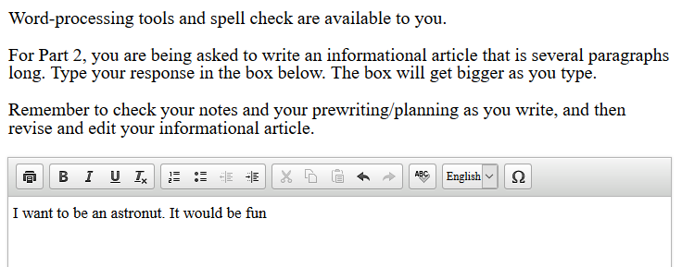
Examples of Narrative Writing Student Sample Responses with Condition Code “I” Score
For Part 2, you are being asked to write a story that is several paragraphs long. Type your response in the box below. The box will get bigger as you type.
Remember to check your notes and your prewriting/planning as you write and then revise and edit your story.
Student has not provided a meaningful response: Student response is connected to sources about being an astronaut.
Notes:
Note: These are not actual student responses and reflect trends in the types of responses receiving a condition code.
These samples are based on the 3rd grade ELA PT sample test astronauts to ensure test security and student confidentiality.

Slide 28
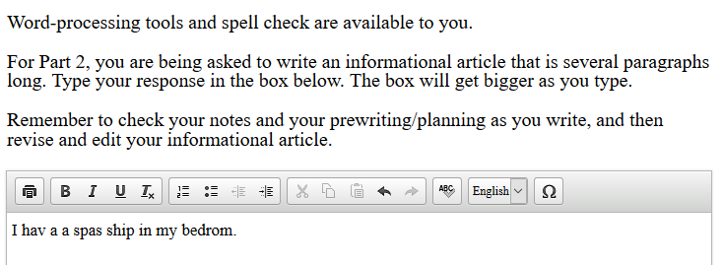
Examples of Narrative Writing Student Sample Responses with Condition Code “I” Score
For Part 2, you are being asked to write a story that is several paragraphs long. Type your response in the box below. The box will get bigger as you type.
Remember to check your notes and your prewriting/planning as you write and then revise and edit your story.
Student has not provided a meaningful response: Student response is connected to sources about being an astronaut.
Notes:
Note: These are not actual student responses and reflect trends in the types of responses receiving a condition code.
These samples are based on the 3rd grade ELA PT sample test astronauts to ensure test security and student confidentiality.

Slide 29
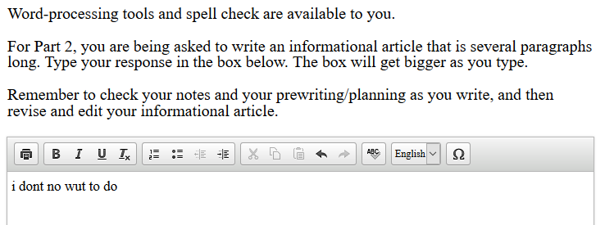

Examples of Narrative Writing Student Sample Responses with Condition Code “I” Score
For Part 2, you are being asked to write a story that is several paragraphs long. Type your response in the box below. The box will get bigger as you type.
Remember to check your notes and your prewriting/planning as you write and then revise and edit your story.
Student has not provided a meaningful response.
Notes:
Note: These are not actual student responses and reflect trends in the types of responses receiving a condition code.
These samples are based on the 3rd grade ELA PT sample test astronauts to ensure test security and student confidentiality.

Slide 30
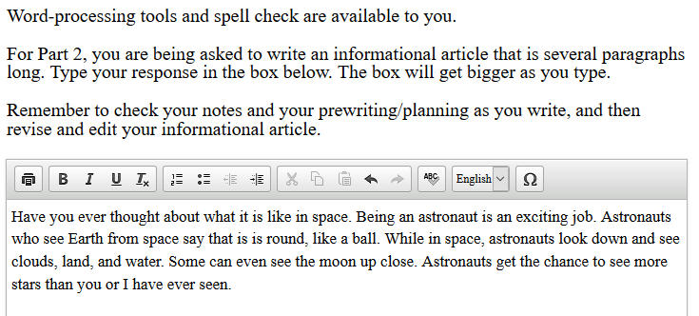
Examples of Narrative Writing Student Sample Responses with Condition Code “I” Score
For Part 2, you are being asked to write a story that is several paragraphs long. Type your response in the box below. The box will get bigger as you type.
Remember to check your notes and your prewriting/planning as you write and then revise and edit your story.
Student’s original work is insufficient: Student has copied the text verbatim from one of the primary sources.
Notes:
Note: These are not actual student responses and reflect trends in the types of responses receiving a condition code.
These samples are based on the 3rd grade ELA PT sample test astronauts to ensure test security and student confidentiality.

Slide 31
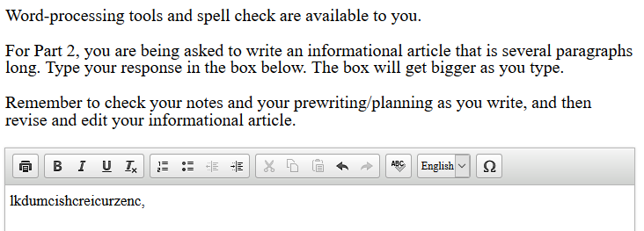
Examples of Narrative Writing Student Sample Responses with Condition Code “I” Score
For Part 2, you are being asked to write a story that is several paragraphs long. Type your response in the box below. The box will get bigger as you type.
Remember to check your notes and your prewriting/planning as you write and then revise and edit your story.
Student has not provided a meaningful response: Student work is undecipherable text.
Notes:
Note: These are not actual student responses and reflect trends in the types of responses receiving a condition code.
These samples are based on the 3rd grade ELA PT sample test astronauts to ensure test security and student confidentiality.

Slide 32
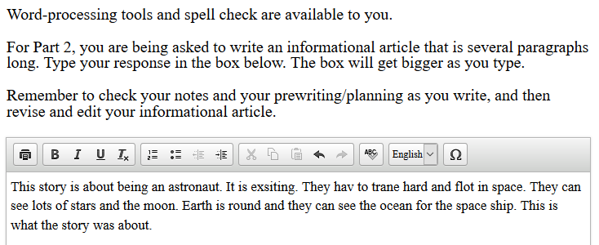
Examples of Narrative Writing Student Sample Responses with Condition Code “I” Score
For Part 2, you are being asked to write a story that is several paragraphs long. Type your response in the box below. The box will get bigger as you type.
Remember to check your notes and your prewriting/planning as you write and then revise and edit your story.
Not written to the purpose designated in the task: Student work is a basic summary of the sources more appropriate for an informative performance task purpose.
Notes:
Note: These are not actual student responses and reflect trends in the types of responses receiving a condition code.
These samples are based on the 3rd grade ELA PT sample test astronauts to ensure test security and student confidentiality.

Slide 33
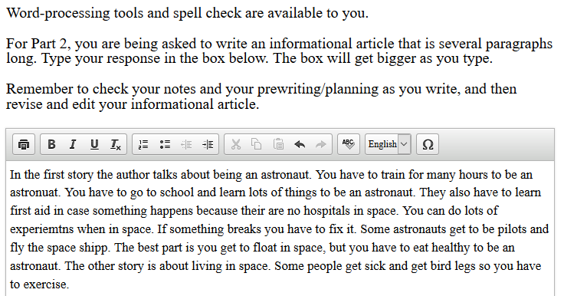
Examples of Narrative Writing Student Sample Responses with Condition Code “I” Score
For Part 2, you are being asked to write a story that is several paragraphs long. Type your response in the box below. The box will get bigger as you type.
Remember to check your notes and your prewriting/planning as you write and then revise and edit your story.
Not written to the purpose designated in the task: Student work is a more comprehensive summary of the sources more appropriate for an informative performance task purpose.
Notes:
Note: These are not actual student responses and reflect trends in the types of responses receiving a condition code.
These samples are based on the 3rd grade ELA PT sample test astronauts to ensure test security and student confidentiality.

Slide 34
Examining a Sample Data Set
Connections: What connections can you make to your own setting? What information or data will you want or need?
Notes:
Activity
5 – 10 mins. Data should be provided to participants in print form to reference. Educators sit in table groups to examine data and address question 3 on graphic organizer (see below).
5 mins. whole group share out amongst peers.
Questions and graphic organizer taken from Learning Forward.
Facilitator can create a four square graphic organizer with the following questions:
Noticings: What positives do you notice about this sample data set? What concerns?
Questions: What questions does this data set generate for you?
Connections: What connections can you make to your own setting? What information or data will you want or need?
Aspirations / Planning: What aspirations in your own settings does this create for you? What professional development have you conducted or would like to conduct in the future?

Slide 35
Workshop Goals
  Understand components of a Performance Task and skills required for students to be successful.
  Identify current trends in ELA PT performance for the Oregon Summative Assessment and review samples of student work which receive a scoring condition code.
  Examine recommendations for differentiated instructional strategies to support performance task development and student achievement on writing performance tasks.
  Discuss and collaborate in professional development opportunities to support teachers’ understanding of performance task activities.
Notes:
Note: As facilitator is preparing slide presentation, additional strategies can be incorporated.

Slide 36
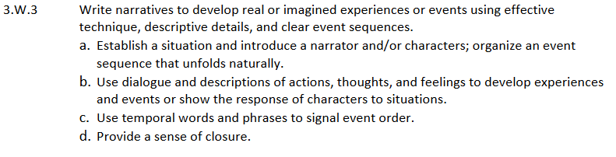
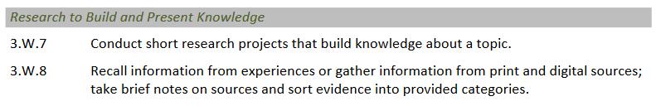
Oregon Common Core Standards
Oregon Common Core State Standards
Notes:
Note: Due to the higher number of condition codes assigned to narrative performance tasks in 3rd grade Oregon CCSS 3.W.3 is highlighted.
A connection can be made between these standards and a message clearly articulated to educators that these standards do not have to be viewed in isolation. Narrative PTs are clearly asking students for skills from all three standards, not just one.
Oregon CCSS Anchor Standard W.7 addresses reading sources in the ELA PT to build knowledge or enhance prior knowledge.
Oregon CCSS Anchor Standard W.8 addresses gathering information from to recall information or gather information from various sources.

Slide 37
Best Practices in Writing Instruction
Daily practice
Real purpose, real audience (relevant)
Diverse source materials (in content and format – text, audio, visual)
Use of mentor texts
Teacher modeling
Student choice, voice
Consistent feedback
Clear rubric(s)
Notes:
These points reflect a few out of many practices which can contribute to improved writing instruction and can be used as a baseline towards professional development at the local level.

Slide 38
What It Looks Like In Practice
Teacher as writer
Whole group, small group, individual write time
Embedded across content areas
Collaboration among peers (CCR skill)
Student ownership in process and evaluation
Prompt feedback based on rubric
Notes:
These are just a few examples of what quality writing instruction may look like. The facilitator may edit to reflect best practices within a given district.

Slide 39
Guidance for Educators
How can teachers help students prepare for full writes?
  Clarify all modes of writing and have students write for different purposes using resource texts
    Grades 3-5: narrative, opinion, informational
    Grades 6-8: narrative, argumentative, explanatory
    Grades HS: argumentative, explanatory
  Show students how to use informational texts to inspire narratives
  Teach students to develop their own thoughts first, then add quotations from the sources to support as evidence, and follow up with explanations of the text evidence to make connections.
Notes:
In addition to instructional strategies and practices, the following are suggestions that can be included when administering a performance task assignment as part of a formative or interim practice.

Slide 40
Two Strategies for Success
5Ws – Who, What, When, Where, Why (+How)
P.A.T. – Purpose, Audience, Task
Suitable for any level (K-12) and content
Applicable to any mode
Useful for other constructed response tasks
Addresses both insufficient and off-purpose scores
Notes:
During this part of the presentation the facilitator can make a connection back to purpose, audience, and task. Additionally, when reviewing the sample performance task “Astronauts” the corresponding colors will appear.

Slide 41
Sample of Narrative Writing Student Directions
Astronauts Narrative Performance Task
Task:
Your class has been learning about different types of jobs to prepare for your school's job week. Your teacher has asked each person to learn about a different job. You think being an astronaut must be an interesting job so you decide to learn about what it is like to be an astronaut. You have found two sources about being an astronaut.
After you have reviewed these sources, you will answer some questions about them. Briefly scan the sources and the three questions that follow. Then, go back and read the sources carefully so you will have the information you will need to answer the questions and complete your research. You may click on the Global Notes button to take notes on the information you find in the sources as you read. You may also use scratch paper to take notes.
In Part 2, you will write an story on a topic related to the sources.
Notes:
Purpose = green
Audience = blue
Task = purple

Slide 42
Sample of Narrative Writing Student Directions
Astronauts Narrative Performance Task
Part 2
You will review your notes and sources, and plan, draft, revise, and edit your writing. You may use your notes and go back to the sources. Now read your assignment and the information about how your writing will be scored, then begin your work.
Your Assignment:
Your teacher is creating a bulletin board display in the school library to show what your class has learned about different types of jobs. You choose to write a story on astronauts. For your story, imagine that you are an astronaut in space. In your story tell about an exciting adventure that you have as an astronaut.
Your story will be read by other students, teachers, and parents. When writing your story, find ways to use information and details from the sources to improve your story. Make sure you develop your character(s), the setting, and the plot. Use details, dialogue, and description where appropriate.
Notes:
Purpose = green
Audience = blue
Task = purple

Slide 43
Observation Questions
Are the writing process steps clear, posted, and referred to frequently?
Do students regularly discuss open-ended questions that prompt deep discussion about texts?
Do students use PAT, the 5Ws, or another strategy with every constructed response?
Do students make claims, use evidence, and refer to sources orally and in writing?
Do students consistently use a rubric to help themselves and their peers improve?
Notes:
Point out that these questions are all asking about observable and objective evidence of instructional practices.

Slide 44
Workshop Goals
  Understand components of a Performance Task and skills required for students to be successful.
  Identify current trends in ELA PT performance for the Oregon Summative Assessment and review samples of student work which receive a scoring condition code.
  Examine recommendations for differentiated instructional strategies to support performance task development and student achievement on writing performance tasks.
  Discuss and collaborate in professional development opportunities to support teachers’ understanding of performance task activities.
Notes:
During this section of the presentation, facilitator can provide back ground context to allow for more time in Professional Learning Teams.

Slide 45
Examining a Sample Data Set
Aspirations: What aspirations in your own settings does this create for you?
Planning: What professional development have you conducted or would like to conduct in the future?
Notes:
Activity
5 – 10 mins. Data should be provided to participants in print form to reference. Educators sit in table groups to examine data and address questions 4 on graphic organizer (see below).
5 mins. whole group share out amongst peers.
Questions and graphic organizer taken from Learning Forward.
Facilitator can create a four square graphic organizer with the following questions:
Noticings: What positives do you notice about this sample data set? What concerns?
Questions: What questions does this data set generate for you?
Connections: What connections can you make to your own setting? What information or data will you want or need?
Aspirations / Planning: What aspirations in your own settings does this create for you? What professional development have you conducted or would like to conduct in the future?

Slide 46
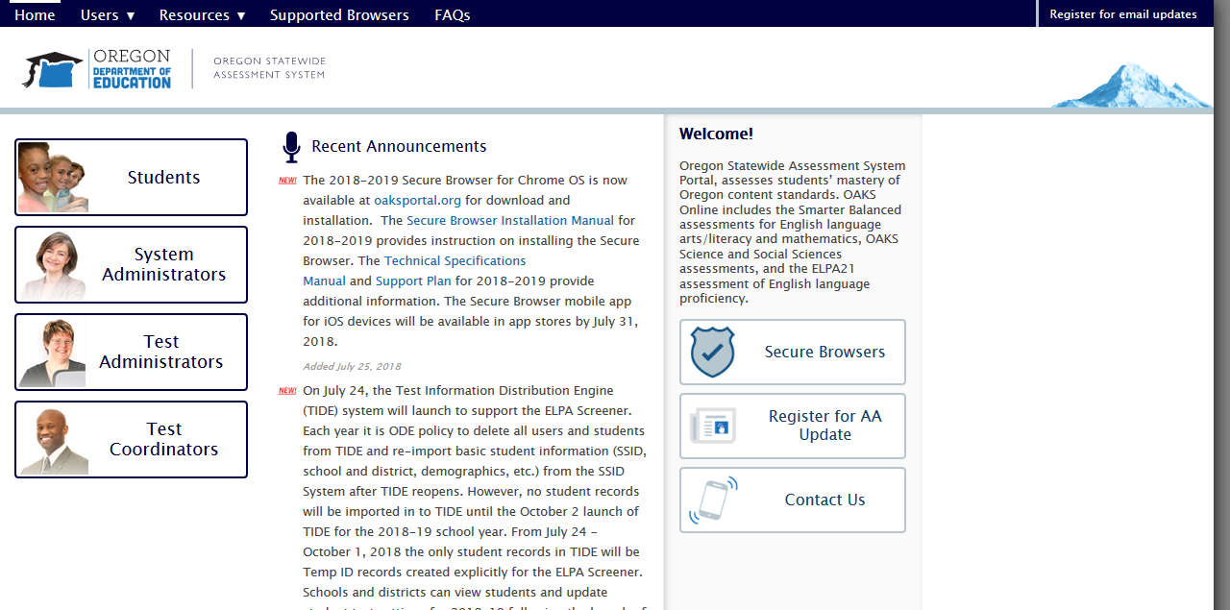
OAKS Portal
Notes:
Sample of the new www.oaksportal.org website. Most educators will go in under test administrator.

Slide 47
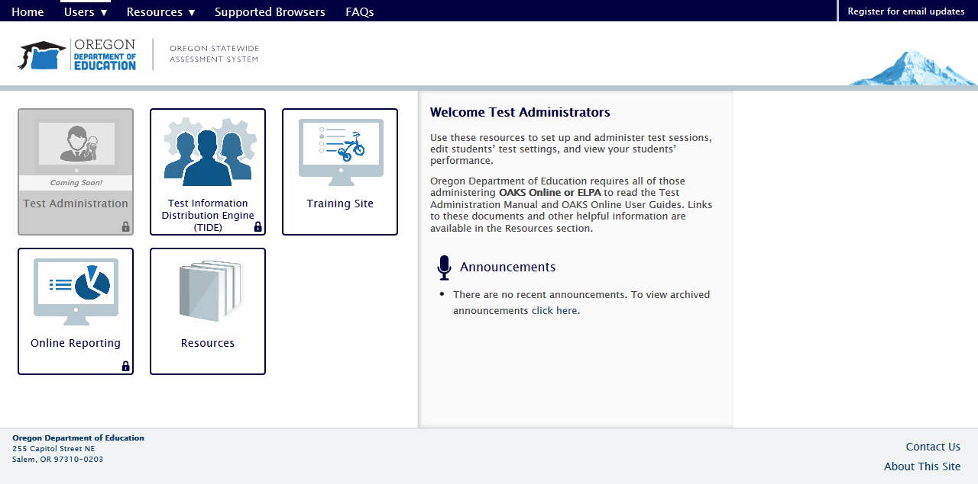
ORS
Notes:
On the following screen educators will access data through the online reporting system: Retrieve student results.
Note: Based on the level of the users accounts District Testing Coordinators (DTC) might need to pull high level data for district, schools, or individual teachers using the “Export to Inbox” button.
Results will appear in the users oaksportal inbox once finished processing.

Slide 48

Contact Information
Contact Information
Marie C. Ballance, Ed.D.
ELA Content Education Specialist
É503-947-5603
* marie.ballance@state.or.us
Tony Bertrand
ELA & Social Sciences Assessment Specialist
É503-947-5832
* tony.bertrand@state.or.us
Notes:
Please verify contact information is current prior to your presentation or modify to provide local contact information as needed.

Slide 49
Stakeholder Engagement / Feedback
Presentation Survey: https://goo.gl/forms/IQhxekqdSwreGE5H2
ODE ELA Listserv: http://listsmart.osl.state.or.us/mailman/listinfo/or_engla_teachers
Notes:
Enter or replace presentation survey as need. Current link is a sample of the survey ODE request during the 2018 COSA Conference in Eugene, OR.
ODE provides and ELA Listserv to communicate to educators across the State of Oregon.

