Slide 1
DTC Learning Session Assessment Record Management in ARUA
June 4, 2025

Slide 2
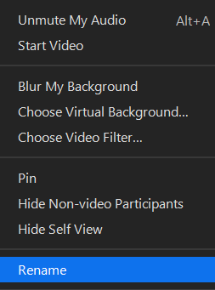
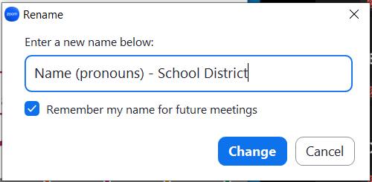
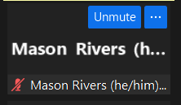
Please rename yourself…
Step 2
Step 3
Step 1

Slide 3
Regional ESD Partners are your best contact for Assessment and Accountability support
Assessment
Amy Rockwell
503-540-4444
Amy.Rockwell@wesd.org
Data Collections & Accountability Support
Karen Brown Smith
1-800-706-4447 ext. 3124
Karen.Brown@imesd.k12.or.us
Peter Campbell
1-800-706-4447 ext. 3203
Peter.Campbell@imesd.k12.or.us
Joe Doherty (ADM, SSID, 9OT)
1-800-706-4447 ext. 3140
Joe.Doherty@imesd.k12.or.us

Slide 4
Assessment Team Contacts
Andrea Lockard, Director of Assessment
Tony Bertrand, English Language Arts and Social Sciences
Andy Byerley, Math
Sody Fearn, K-2 Balanced Assessment
Audrey Lingley, Survey Specialist
Carla Martinez, Administrative Support
Crys Plattner, Administrative Support
Mason Rivers, Special Education
Mariela Salas Bao, Science
Ben Wolcott, English Language Proficiency

Slide 5

Welcome!
What is one of your summer vacation or “staycation” plans?
Photo by Scott Goodwill on Unsplash

Slide 6
Managing Assessment Records in ARUA

Slide 7
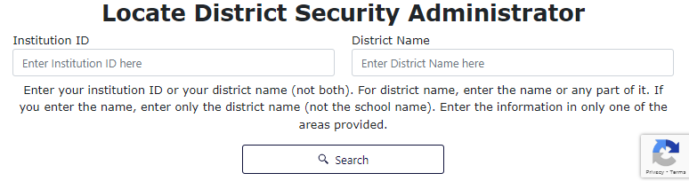
Managing Test Records
All summative tests are managed in Assessment Record Updating Application (ARUA) on the ODE District Data Site.
Don't have access? Your District Security Administrator (DSA) can provide you with access.
Look up who your DSA is here: https://district.ode.state.or.us/apps/login/searchSA.aspx

Slide 8
ODE Assessment Applications
Assessment Record Updating Application (ARUA)
(also known as the Assessment Transactional System)
The only ODE assessment application that allows edits
Test record management (correcting errors, looking up test records)
Entering administration codes (opt-outs, foreign exchange/homeschool, etc.)
Secure Assessment Reports (SAR)
“Official” pdf formatted reports: ISRs, Class Roster, Class Summary
Achievement Data Insight (ADI)
Assessment Report Validations
Student Performance: English Language Arts, Mathematics, Science Next Gen
On-Track to English language proficiency, SEEDS, ELP Standards
Accountability Warehouse Extract (AWE)
Download “Official” Assessment records in a spreadsheet/table format
**Overview in DTC Learning
Session on June 12 @ 9:00 a.m.

Slide 9
Managing Summative Test Records
Managing Test Records During the Summer
Summer Contact Form
Last batch of test records will load by July 11th
Enter administration codes before the editing window closes on August 22nd
Complete list of administration codes can be found in the TAM - Table 27

Slide 10
Opt-Outs and Exemptions in ARUA
Entering opt out and requests for exemption in TIDE
Must be entered before TIDE closes for the year on July 18th
Opt outs and requests for exemption entered in TIDE will automatically load on the virtual record in ARUA
Entering opt out and requests for exemption in ARUA
Virtual records loaded on May 30th
Test records can be edited until the edit window closes on August 22nd

Slide 11
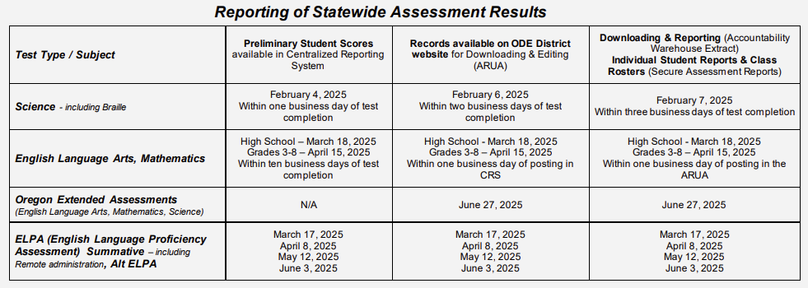
Reporting of Statewide Assessment Results
AA Checklist - page 51

Slide 12
Virtual (Non-Participation) Test Records
Virtual Records/Non-Participation Test Records
Loaded on May 30th
A placeholder record for any student enrolled on the first school day in May without a valid test record
ODE refreshes the data weekly until the editing window closes on August 22nd (except week after July 4)
If a student has both a virtual record and a valid test record, enter the administration code on the valid test record

Slide 13
Test Record Load Schedule
June 3 – Final ELPA batch (including Alt ELPA)
June 27 – Extended assessments
June 27 – Partial science test records
July 11 – Partial ELA and math records

Slide 14
Which test records can I edit in ARUA?
Which test records can I edit in ARUA?
The student must be a resident of your district.
Changes to test records may only be entered at the school district level.
The last day to edit 2024-25 test records in ARUA is August 22nd.

Slide 15
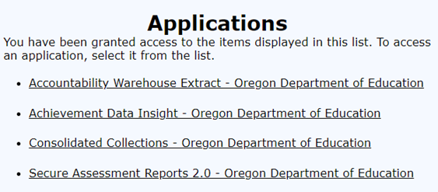
ODE Central Login Application – ARUA (1/6)
Where do I enter assessment administration codes?
Log in to the ODE District Data Site: https://district.ode.state.or.us/apps/login/
Select the Consolidated Collections Application from the Applications list
(if you do not have access, contact your DSA and request access to Consolidated Collections and Assessment Test Staging/ARUA)

Slide 16
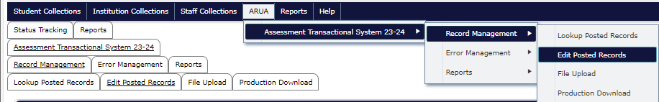
ODE Central Login Application- ARUA (2/6)
To make changes to individual test records:
Select the ARUA menu
Assessment Transactional System 24-25
Record Management
Edit Posted Records

Slide 17
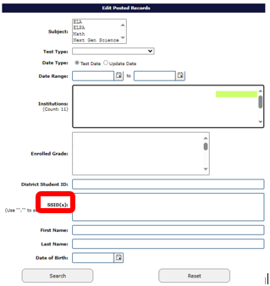
ODE Central Login Application- ARUA (3/6)
Search for the student by entering their SSID
Click search

Slide 18
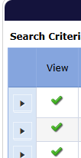
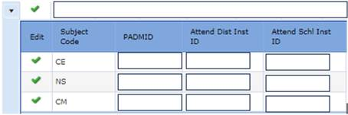
ODE Central Login Application- ARUA (4/6)
Click on the small black triangle in the far-left margin to expand the view and see the subject codes that are loaded for the student
Click on the green checkmark for the subject code that you want to edit
(CE- Common Core ELA; CM- Common Core Math; NS- Next Gen Science; EL- ELPA)

Slide 19
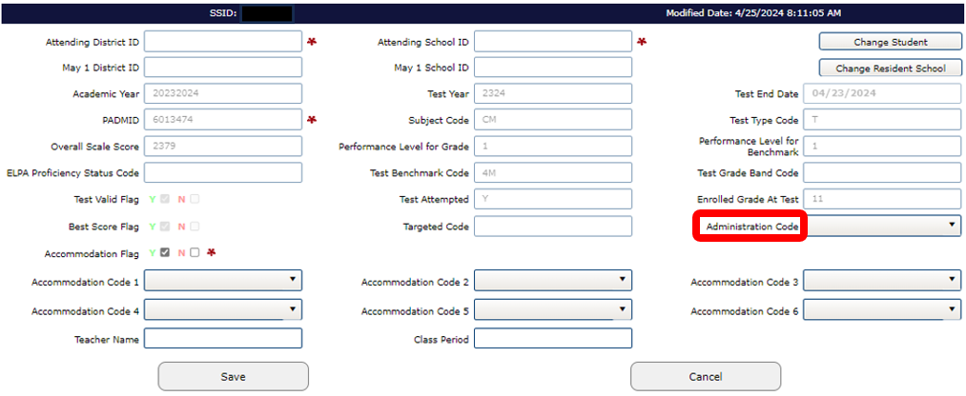
ODE Central Login Application- ARUA (5/6)

Slide 20
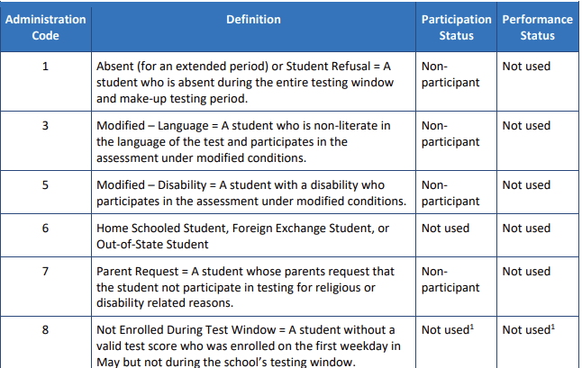
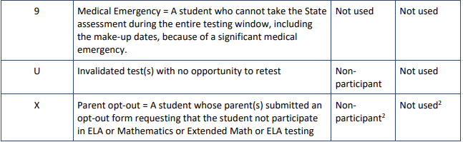

ARUA Administration Codes
TAM - Table 27

Slide 21
ODE Central Login Application- ARUA (6/6)
In the Administration Code field on the far-right select the appropriate Administration Code (see TAM tables 27 and 28).
Click Save. Repeat above steps for other subjects/students.

Slide 22
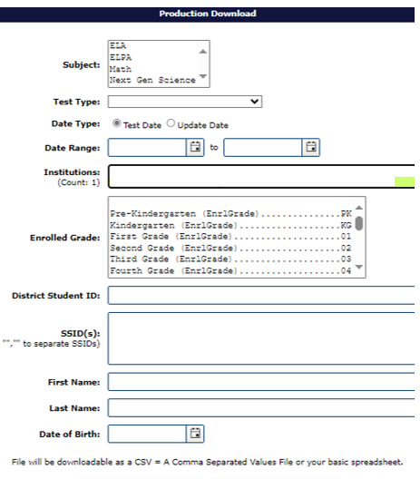
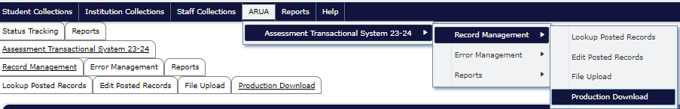
Processing Multiple Records (1/3)
How do I make changes to multiple records with a file upload?
To make changes using a data file for multiple records, select the ARUA menu/Assessment Transactional System 24-25/Record Management/Production Download
Narrow your search by filtering, or click Submit with no
filters applied to download all records and subjects

Slide 23
Processing Multiple Records (2/3)
3. A secure file transfer will be sent to your email from ode.helpdesk@ode.oregon.gov.
4. Open the email and download the file.
5. Make the necessary changes and save the file.
Assessment Transactional System File Format
Column U = SrtTstTypCd (E=ELPA, T=OSAS, X=Extended, V=Virtual)
Colum AO = CalcAdmnCd
6. Go back to the ARUA menu (Assessment Transactional System/Record Management/File Upload)
7. Choose the file and then Upload

Slide 24
Processing Multiple Records (3/3)
After the file is uploaded:
You will be sent an email with a summary of the upload: number of records saved, number of records in error, etc.
After the file processes, check for errors by going to ARUA/Assessment Transactional System/Error Management/Review District Errors
Correct any errors that exist
Order another production download to ensure the changes saved

Slide 25
Review Errors
Review District Errors vs. Review Vendor Errors
District errors = Records that error based on a change to that error record
Vendor errors = Records that error when loading into ARUA
Common Examples
SSID merge
Special Education flag is not marked Y
Administration Code is not valid

Slide 26
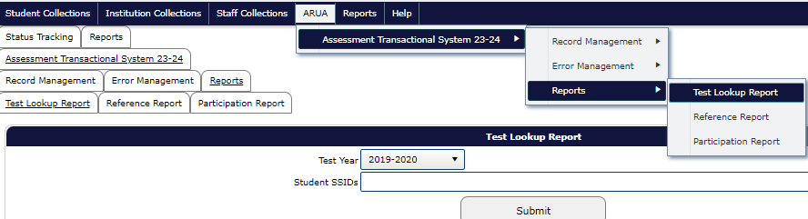
Test Lookup Report (1/2)
Test Lookup Report
Allows user to look up what tests are associated with a student, regardless of which district the student tested in.
No performance data is provided in this report.
Go to the ARUA menu/Assessment Transactional System 24-25/Reports/Test Lookup Report
Select a year from the “Test Year” drop-down list
Enter one or more SSID numbers
Click Submit

Slide 27
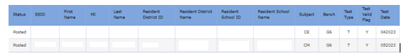
Test Lookup Report (2/2)
Test Lookup Report (cont.)
This report is helpful when you want to download historical test data for a student and want to confirm what year and subjects are available. If your school has claimed the student in the SSID System, you will be able to see results in the Accountability Warehouse Extract and Secure Assessment Reports applications.

Slide 28
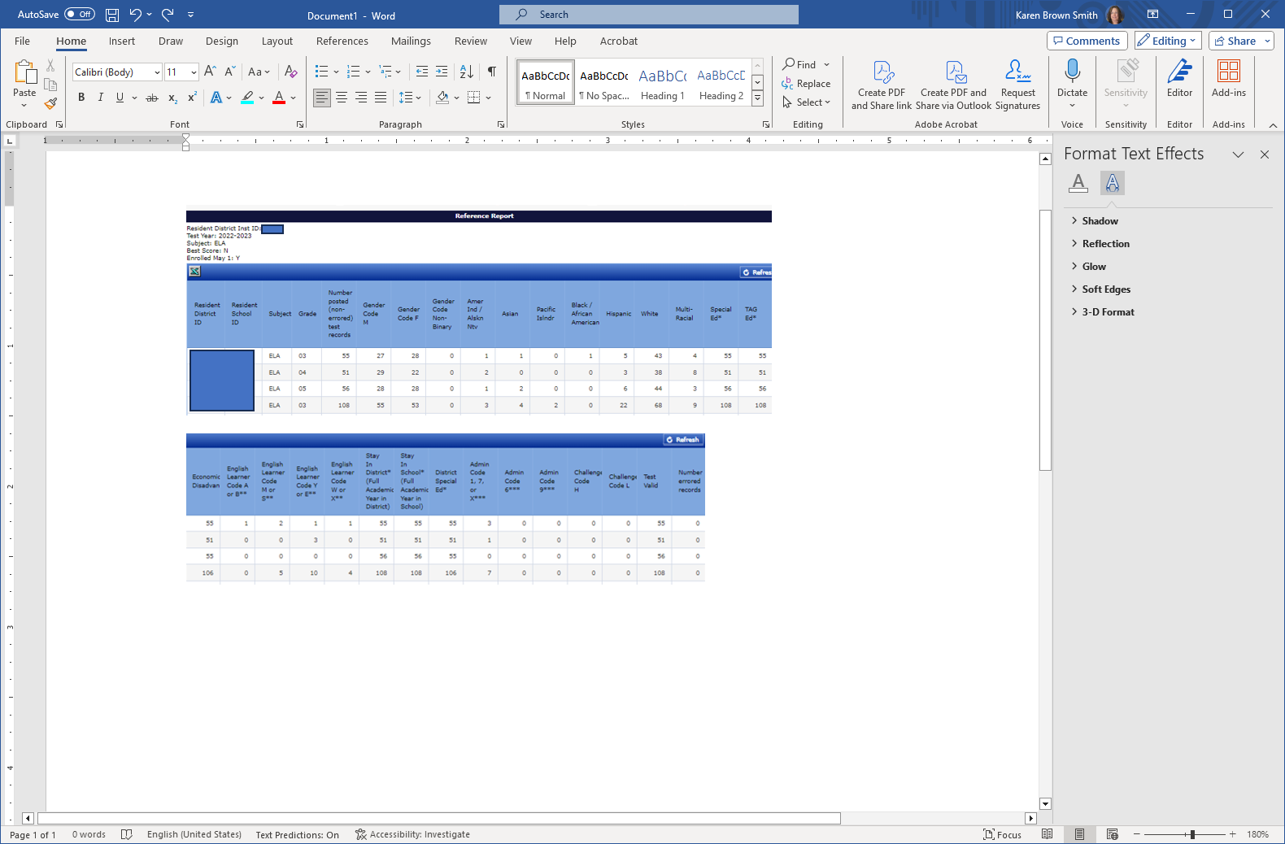
Reference Report
Reference Report
This report is organized by Resident School ID, Subject, and Enrolled Grade, includes counts of posted (non-error) records, a demographic breakdown of those records, and a count of records with errors in the last column.
A key under the table defines any asterisks that may be on the report.

Slide 29
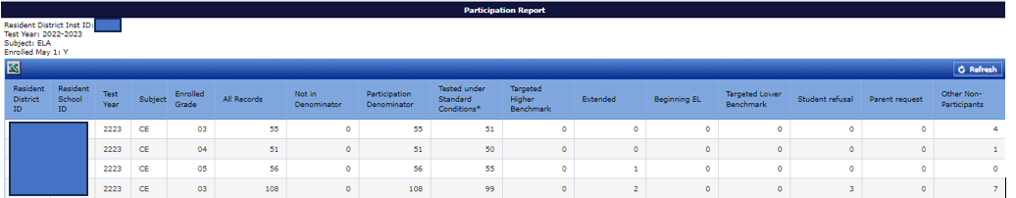
Participation Report
Participation Report
This report is organized by Resident School ID, Subject, and Enrolled Grade, includes counts of posted (non-error) records in the Participation numerator and denominator columns, with a breakdown by types of Participants and Non-Participants.

Slide 30
Managing ELPA Screener Records

Slide 31
Merging Temp IDs with SSIDs
Merging temp IDs with SSIDs
To complete a Temp ID to SSID merge, the following rules must be met:
Temp IDs must be merged in the school year they were created and before TIDE is taken offline (no later than July 18)
The SSID must be in TIDE
The school and birth date fields must be an exact match on the Temp ID and SSID
The legal first and legal last name fields must be a close match on the Temp ID and SSID

Slide 32
Merging One Record at a Time
Merge one record at a time (See TIDE User Guide pages 23-24)
In TIDE, go to Preparing for Testing/Student Information/View-Edit-Export Student Test Settings and Tools
Search for the student… Select the School, Enter the student’s Temp ID in the SSID field, then click Search
Click on View Results
Click on the pencil icon to open the record
Click on the pencil icon for the SSID field, then enter the SSID number and click Save

Slide 33
Merging Multiple Records
Upload a file to merge multiple Temp IDs to SSIDs (See TIDE User Guide page 23)
In TIDE, go to Preparing for Testing/Student Information/Update Temp ID to SSID
Complete the Template - enter the Temp ID in column A and the SSID it should be merged to in column B
Save the template and close it when you are finished
Go back to the path in step 1, and click on “Choose File” and select the file
Click Next and preview the file.
Click Next to proceed to Validation step, and review errors/warnings
Choose to “Upload Revised File,” “Continue with Upload” or “Download Validation Report”

Slide 34
Resources
Assessment Transactional System (ARUA) file format
Assessment Transactional System (ARUA) User Guide
How to Edit Demographic and Program Fields for Assessment Records
ESD Partner handout – How to enter assessment administration codes
2/13/25 ARUA, AWE, and SAR 2.0 Training and PowerPoint
TIDE User Guide
ARUA/Assessment Transactional System Collection Webpage
5/15/25 Editing Data/3rd Period ADM/EL for Accountability Training and PowerPoint

Slide 35
Thank You! Next Session: ODE Assessment Applications 2 Thursday, June 12 @ 9:00 a.m. – Register here

