Slide 1
ELA Item Design
Design framework
Item development
Cognitive complexity
Sample items
Notes:
Once we’ve selected the types of items we want to develop, we then need to think about design frameworks, the alignment of items to the standards, and other issues of cognitive complexity. We’ll cover some of those ideas in this chapter.

Slide 2
4 building blocks
Learning Progression
Item Design
Assessment Quality
Outcomes/Scoring
Notes:
We’re still working on the second building block of the BEAR Assessment System – item design.

Slide 3
Item Design Framework
BEAR Assessment System Step 2
A match between what is taught and what is assessed
Constructive alignment → aligning teaching and assessment to the learning outcomes/standards (Biggs, 2003)
Proposed items are located along the LP map
One Framework
(Wilson & Sloane, 2000)
Learning Outcomes/Standards
Teaching & Instruction
Assessment Task
Notes:
This is based on the principle that there should be a match between what is taught and what is assessed. In fact, things work best when there is an alignment between teaching, assessment, and the desired learning outcomes (in our case the Common Core standards). We work to achieve this by locating our proposed items along our map of the learning progression.

Slide 4
Alignment framework
Item design framework used by Smarter-Balanced Assessment under the evidence-centered design approach (Mislevy, Steinberg, & Almond, 2003)
Defined as the degree to which expectations and assessments work together to improve and measure students learning
Notes:
The Smarter Balanced assessment also uses the idea of alignment, which is defined as the degree to which expectations and assessments can be used to both measure and improve student learning.

Slide 5
4 criteria to determine the degree of alignment
Categorical concurrence
  Commonality between the content categories of the standards and those of the assessment items
Range of knowledge correspondence
  Number of objectives within each standard covered by item(s)
Balance of representation
  Relative coverage of content categories by items in a test
Depth of Knowledge consistency
  Match between the cognitive demand of items and the level of cognitive demand communicated by the wording of the objectives
Notes:
The Smarter Balanced consortium uses 4 criteria to determine the degree of alignment of items to the standards. These are defined as follows:
First, Categorical concurrence: This is the commonality between the content categories of the standards and those covered by the assessment items
Second is range of knowledge correspondence: Which is defined as the number of objectives within each standard covered by item(s) in question
Third is balance of representation: Relative coverage of content categories by items in a test – how many items represent each of the content categories that we intend to cover
Finally, we consider depth of knowledge consistency: This is the degree of match between the cognitive demand of items and the level of cognitive demand communicated by the wording of the objectives

Slide 6
Item development
Universal design
  Design item that accurately assess the targeted competency for all students
  Ensure item fairness – make sure that items are equally difficult for groups of equal ability (e.g. males and females; urban and rural)
Vocabulary & language
  use content-specific language appropriate to the assessed grade
  For non-content-specific material, use vocabulary/language from previous grade levels
Notes:
Other issues to consider when developing items are the ideas of universal design, and the issues of vocabulary and language
Universal design requires that we
Design item that accurately assess the targeted competency for all students, including those with special needs
We must also ensure item fairness – we need to make sure that items are equally difficult for groups of equal ability (e.g. males and females; urban and rural). For example, we should take care not to develop items that might draw too heavily on specific sports knowledge that might be less familiar to girls on average, or on farming ideas that would be more familiar to students in a rural environment than an urban one.
We should pay attention to vocabulary & language by
using content-specific language that is appropriate to the assessed grade.
For non-content-specific material, use vocabulary and language from previous grade levels.

Slide 7
Item development
Grade appropriateness
  Design items that assess a primary content domain/standard of the appropriate grade
  “For non-reading items, the reading level is approximately one grade level below the grade level of the test, except for specifically assessed content terms or concepts” (SBAC, 2012)
Using items to link tests
  For pre-post test designs, include some items that appeared on previous test(s) to measure student progress
    If the time between tests is relatively long (i.e. 2-3 months), the same test can be used
    If the time is short (i.e. 2-3 weeks), pick a few items to reuse and include new ones
Notes:
More issues include
Grade appropriateness
We should design items that assess a primary content domain or standard of the appropriate grade, not focusing on either an earlier or later grade.
For non-reading items, the Smarter Balanced consortium recommends that the reading level be approximately one grade level below the grade level of the test
Sometimes, we must use the same items on more than one test. This is called linking
It is most common in pretest-posttest designs, where we often include some items that appeared on previous tests to measure student progress
We must be careful, however, that progress is real progress, and not just students’ memory of specific items
If the time between tests is relatively long (say, around 2 to 3 months), the same test can usually be reused, unless it included very long or unusual items
If the time is short (say 2 to 3 weeks), it is best to pick a few items to reuse and include new ones

Slide 8
Cognitive complexity
Use of Modified Bloom’s Taxonomy
  Definition
An example of Cognitive Rigor Matrix (Hess, et al., 2009)
Demonstration on how to align standards and proposed item(s) on the LP map
Notes:
In the previous chapter, we mentioned the issue of cognitive complexity. The Smarter Balanced consortium represents this using the Cognitive Rigor matrix, which was included with the Chapter 5 video. This is based on a modification of Bloom’s taxonomy, which we’ll be looking at next. Then we will examine some sample items and how they align to both the learning progression and the cognitive rigor matrix.

Slide 9
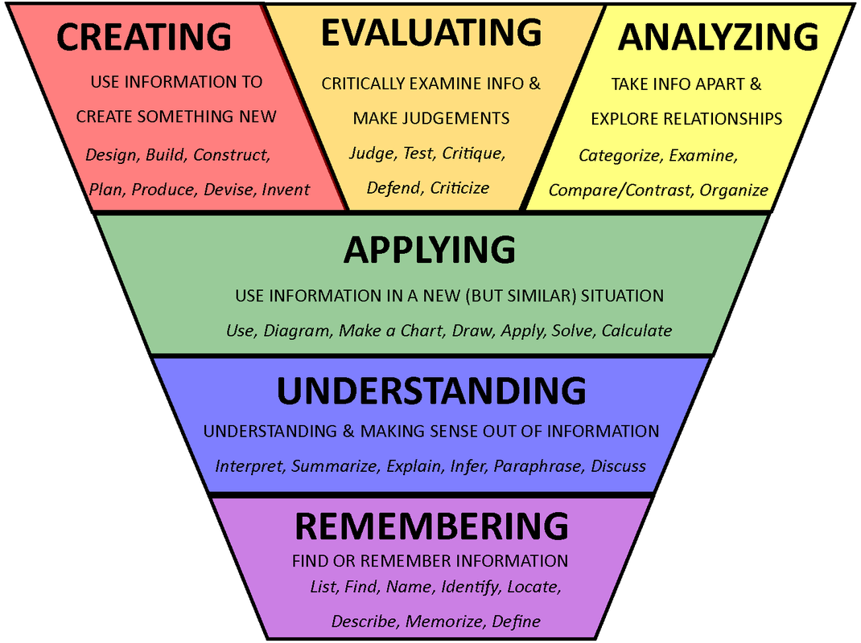
Modified Bloom’s Taxonomy
Modified by Anderson & Krathwohl (2001)
Evaluation
Synthesis
Analysis
Application
Comprehension
Knowledge
Old Bloom’s Taxonomy (Bloom, 1956)
Notes:
The original Bloom’s taxonomy is on the right, the modification is on the left. In the original taxonomy, demonstrating knowledge was considered the lowest level skill, while evaluation was seen as the highest.
Although this was useful, it was sometimes not the case that the levels were ordered as expected.
In the newer, “cognitive process” version, several changes were made.
First, some of the cells are renamed. The lowest level is now simply remembering information. The highest levels include evaluating and analyzing, but also creating something new
Second, the top three levels are not seen as hierarchical. Creating, evaluating, and analyzing are all seen as highest-level skills
Finally, this new version includes in each cell a number of verbs that can be used in item creating to cue students as to which of the skills to use in constructing their responses. For example, remembering could be cued by “describe” or “identify”, while analyzing could be cued by “compare and contrast” or creating by “design” or “construct”

Slide 10
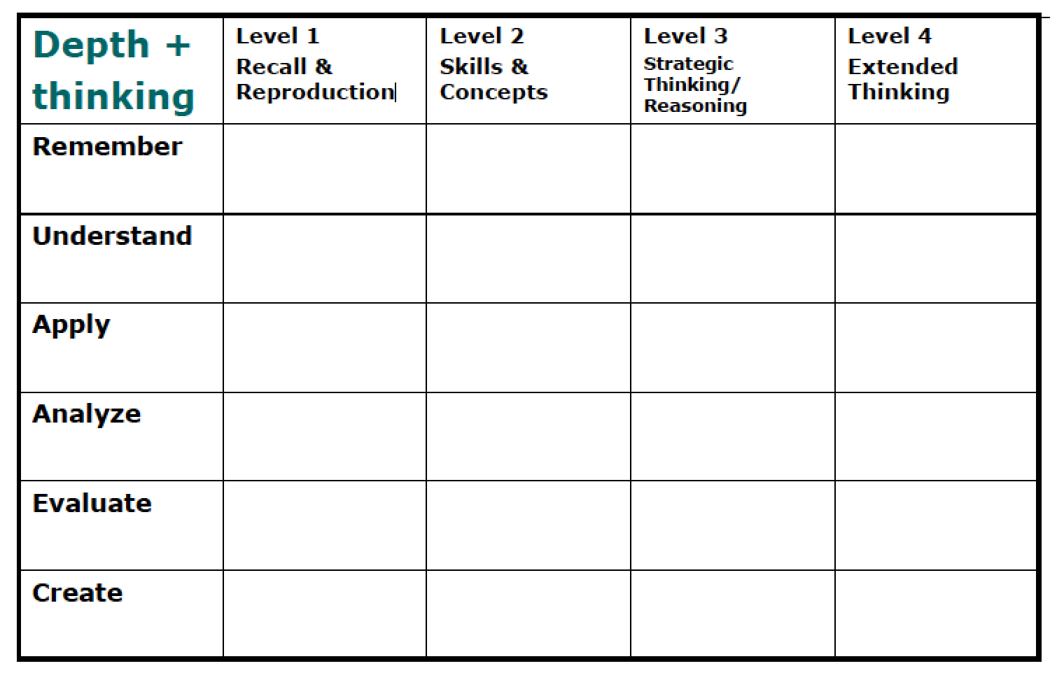
Cognitive rigor matrix
Notes:
Here is the cognitive rigor matrix outline.
The new cognitive process levels are listed as the row headers, and levels of knowledge depth are listed as the column headers. In the version of the matrix you have, each cell contains a detailed description of the kinds of skills a student using those cognitive processes, at that depth of knowledge, would be required to use.
This can be used to classify items based on their depth of knowledge.

Slide 11
Sample items focus on Application process
Process | Level 1: Recall & Reproduction | Level 2: Skills & Concepts | Level 3: Strategic Thinking/ Reasoning | Level 4: Extended Thinking
Apply: Carry out or use a procedure in a given situations; carry out (apply to a familiar task) or use (apply) to an unfamiliar task. | Follow simple/routine procedures. Apply an algorithm or formula. | Solve routine problems applying multiple concepts or decision points. | Use or apply concepts to solve non-routine problems. | Select or devise an approach among many alternatives to solve a novel problem.
Notes:
The sample items we will be examining focus on the Analyze process. Here are the descriptions of each level.
At level 1, students break into constituent parts or deconstruct point of view.
At level 2, students identify the use of literary devices, and distinguish between relevant and irrelevant information or between fact and opinion.
At level 3, students analyze authors craft, viewpoint, or potential bias.
And, at the highest level of extended thinking, students must analyze multiple works, genres, time periods, or discourse styles

Slide 12
Sample itemS
Intended levels: Grade 6,7,8
Intended Claim: Claim #1
  Students can read closely and analytically to comprehend a range of increasingly complex literary and informational texts.
Strand: Reading Literary Text
Anchor Domain: Craft & Structure
Anchor Standards:
  Interpret words and phrases as they are used in a text, including determining technical, connotative, and figurative meanings, and analyze how specific word choices shape meaning or tone.
Standards: 8.RL.4, 7.RL.4, 6.RL.4
Assessment Target: Target #7 on Language use
Notes:
Here is the information about our sample items – grade levels, Smarter Balanced claim (reading), the anchor domain of craft and structure within the strand of reading literary texts, and the specific standards of interpreting words and phrases within texts.

Slide 13
SAMPLE ITEMs’ SPECIFICATION
 | Grade 6 | Grade 7 | Grade 8
DOK | 3 | 2 | 3
Grade-specific Standard: RL-4 | Determine the meaning of words and phrases as they are used in a text, including figurative and connotative meanings; analyze the impact of a specific word choice on meaning and tone. | Determine the meaning of words and phrases as they are used in a text, including figurative and connotative meanings; analyze the impact of rhymes and other repetitions of sounds (e.g., alliteration) on a specific verse or stanza of a poem or section of a story or drama. | Determine the meaning of words and phrases as they are used in a text, including figurative and connotative meanings; analyze the impact of specific word choices on meaning and tone, including analogies or allusions to other texts.
Assessment Standards for Target #7 – Language Use | Interpret figurative language use (e.g., personification, metaphor), literary devices, or connotative meanings of words and phrases used in context and their impact on reader interpretation | Interpret impact or intent of figurative language use (e.g., alliteration, onomatopoeia, imagery), literary devices (e.g., flashback, foreshadowing), or connotative meanings of words and phrases used in context and their impact on reader interpretation | Determine or interpret impact or intent of figurative language/literary devices or connotative meanings of words and phrases used in context and the impact of those word choices on meaning and tone.
Notes:
Here is the item specification information for our sample items, from the Smarter Balanced Assessment information. These include the depth-of-knowledge specification we saw before, the grade-level-specific standards addressed by each item, and the Smarter Balanced Assessment target at each grade level

Slide 14
Sample item Grade 8
Stimulus Text: Below is an excerpt from American Indian Stories. As you read the excerpt, consider how the author’s word choice develops certain aspects of the narrator’s experience and then answer the questions that follow.
“The Legends”
From American Indian Stories
By Zitkala-Sa
At the arrival of our guests I sat close to my mother, and did not leave her side without first asking her consent. I ate my supper in quiet, listening patiently to the talk of the old people, wishing all the time that they would begin the stories I loved best. At last, when I could not wait any longer, I whispered in my mother's ear, "Ask them to tell an Iktomi story, mother."
Soothing my impatience, my mother said aloud, "My little daughter is anxious to hear your legends." By this time all were through eating, and the evening was fast deepening into twilight.
As each in turn began to tell a legend, I pillowed my head in my mother's lap; and lying flat upon my back, I watched the stars as they peeped down upon me, one by one. The increasing interest of the tale aroused me, and I sat up eagerly listening to every word. The old women made funny remarks, and laughed so heartily that I could not help joining them.
The distant howling of a pack of wolves or the hooting of an owl in the river bottom frightened me, and I nestled into my mother's lap. She added some dry sticks to the open fire, and the bright flames leaped up into the faces of the old folks as they sat around in a great circle.
Notes:
Here is a sample item for Grade 8. Take a moment to read the story on this page (you can pause the video until you are done reading), and then we’ll move to the next page to see the question the students must answer

Slide 15
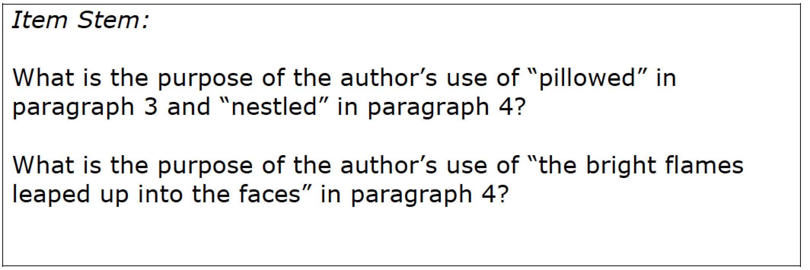
Sample item grade 8, cont’d
LP Standard | SBAC Standard | Cognitive Rigor
8.RL.4. Determine the meaning of words and phrases as they are used in a text, including figurative and connotative meanings; analyze the impact of specific word choices on meaning and tone, including analogies or allusions to other texts. | Determine or interpret impact or intent of figurative language/literary devices or connotative meanings of words and phrases used in context and the impact of those word choices on meaning and tone. | Analyze, Level 3 (Analyze author’s craft/concept)
Notes:
The item is: What is the purpose of the author’s use of “pillowed” in paragraph 3 and “nestled” in paragraph 4? As a reminder, we’ve included the learning progression standard that this item is intended to address, as well as the smarter balanced assessment standard, and the location of the question in the cognitive rigor matrix.

Slide 16
Sample item Grade 7
Stimulus text: This poem is spoken in the voice of a male mermaid, whose wife has decided to leave the ocean and return to life on land.
The Forsaken Merman By Matthew Arnold Come, dear children, let us away; Down and away below! Now my brothers call from the bay, Now the great winds shoreward blow, Now the salt tides seaward flow; Now the wild white horses play, Champ and chafe and toss in the spray. Children dear, let us away! This way, this way! Call her once before you go— Call once yet! In a voice that she will know: "Margaret! Margaret!" Children's voices should be dear (Call once more) to a mother's ear; | Children's voices, wild with pain— Surely she will come again! Call her once and come away; This way, this way! "Mother dear, we cannot stay! The wild white horses foam and fret." Margaret! Margaret! Come, dear children, come away down; Call no more! One last look at the white-wall'd town And the little grey church on the windy shore, Then come down! She will not come though you call all day; Come away, come away! | Children dear, was it yesterday We heard the sweet bells over the bay? In the caverns where we lay, Through the surf and through the swell, The far-off sound of a silver bell? Sand-strewn caverns, cool and deep, Where the winds are all asleep; Where the spent lights quiver and gleam, Where the salt weed sways in the stream, Where the sea-beasts, ranged all round, Feed in the ooze of their pasture-ground; Where the se a-snakes coil and twine, Dry their mail and bask in the brine; Where great whales come sailing by, Sail and sail, with unshut eye, Round the world for ever and aye? When did music come this way? Children dear, was it yesterday?
Notes:
Now, let’s move to the 7th grade sample item. Here, the item focuses on a poem that is spoken in the voice of a male mermaid, whose wife has decided to leave the ocean and return to life on land. Again, take a moment to read the text, pausing the video as needed. Pay particular attention to the lines highlighted in red, as they are the four possible responses to the multiple choice item on the next page.

Slide 17
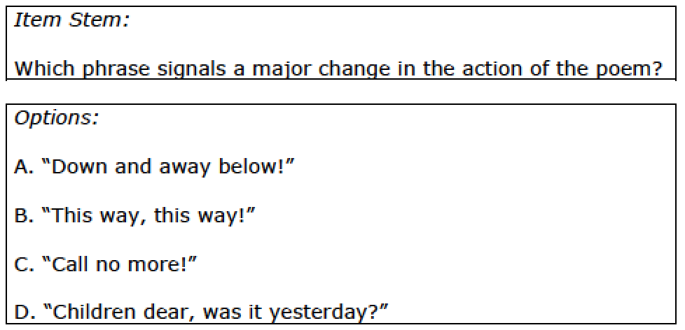
Sample item grade 7, cont’d
Notes:
Here is the multiple choice item: Which phrase signals a major change in the action of the poem?

Slide 18
LP and cognitive rigor
LP Standard | SBAC Standard | Cognitive Rigor
7.RL.4. Determine the meaning of words and phrases as they are used in a text, including figurative and connotative meanings; analyze the impact of rhymes and other repetitions of sounds (e.g., alliteration) on a specific verse or stanza of a poem or section of a story or drama. | Interpret impact or intent of figurative language use (e.g., alliteration, onomatopoeia, imagery), literary devices (e.g., flashback, foreshadowing), or connotative meanings of words and phrases used in context and their impact on reader interpretation | Analyze, Level 2 (Identify use of literary devices)
Notes:
Again, here is a reminder of the learning progression level addressed by this item, as well as the smarter balanced assessment standard, and the location of the question in the cognitive rigor matrix.

Slide 19
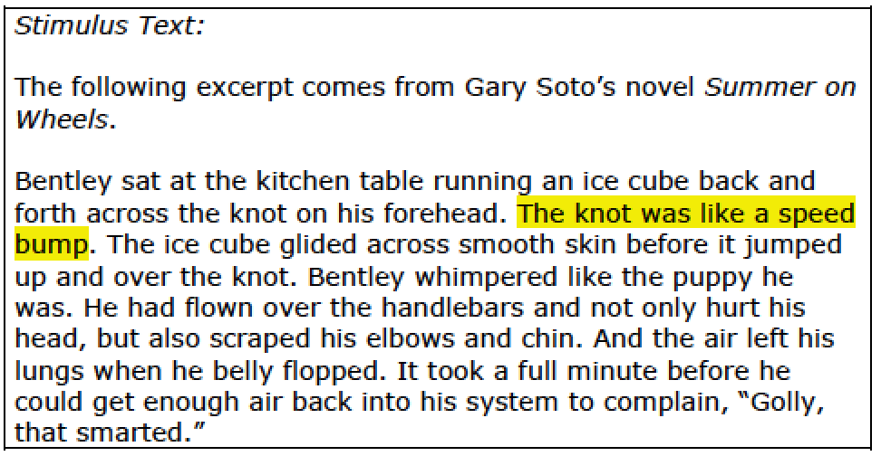
Sample item Grade 6
The highlighted sentence from Summer on Wheels includes a literary device
What does the literary device mean?
Why did the author most likely select the literary device for this description?
Write a 2-3 sentence answer responding to these questions
Notes:
Finally, here is the 6th grade sample item. Take a moment to read the text, pausing the video as needed. Here, the questions addressing the text are included on this slide (as the text is quite a bit shorter):
The highlighted sentence from Summer on Wheels includes a literary device
What does the literary device mean?
Why did the author most likely select the literary device for this description?
Write a 2-3 sentence answer responding to these questions

Slide 20
LP and cognitive rigor
LP Standard | SBAC Standard | Cognitive Rigor
6.RL.4. Determine the meaning of words and phrases as they are used in a text, including figurative and connotative meanings; analyze the impact of a specific word choice on meaning and tone. | Interpret figurative language use (e.g., personification, metaphor), literary devices, or connotative meanings of words and phrases used in context and their impact on reader interpretation. | Analyze, Level 3 (Analyze author’s craft, viewpoint, or potential bias)
Notes:
And, as before, a reminder of the learning progression level addressed by this item, as well as the smarter balanced assessment standard, and the location of the question in the cognitive rigor matrix. You can see that it is possible to address most grade levels with several levels of cognitive rigor; here, the 6th and 8th grade questions are at level 3, while the 7th grade question is at level 2.

Slide 21
Bibliography
Bloom, B. S. (1956). Taxonomy of educational objectives. Handbook I: The Cognitive Domain. New York, NY: David McKay Co.
Anderson, L. W., & Krathwohl, D. (2001). A Taxonomy for Learning, Teaching, and Assessing: A Revision of Bloom's Taxonomy of Educational Objectives. New York, NY: Longman.
Common Core Standards Initiative. (2014). Common core standards for English language arts & literacy in history/social studies, science, and technical subjects. Retrieved from http://www.corestandards.org/ELA-Literacy/
Hess, K., Carloc, D., Jones, B., & Walkup, J., (2009). What exactly do “fewer, clearer, and higher standards” really look like in the classroom? Using a cognitive rigor matrix to analyze curriculum, plan lessons, and implement assessments. Paper presented at CCSSO, Detroit, Michigan.
Nitko, A. J., & Brookhart, S. (2007). Educational assessment of students. Upper Saddle River, NJ: Pearson Education, Inc.
McMillan, J. H. (2007). Classroom assessment. Principles and practice for effective standard-based instruction (4th ed.). Boston: Pearson - Allyn & Bacon.
Oregon Department of Education. (2014, June). Assessment guidance.
(2014).CCSS Toolkit: ELA/Literacy Claim 1 Sample Summative Items (6-8). Retrieved from http://www.ode.state.or.us/search/page/?id=3714
Webb, N. (2007). Aligning assessments and standards. Retrieved from http://www.wcer.wisc.edu/news/coverStories/aligning_assessments_and_standards.php
Wilson, M. (2005). Constructing measures: An item response modeling approach. New York, NY: Psychology Press, Taylor & Francis Group.
Wilson, M., & Sloane, K. (2000). From principles to practice: An embedded assessment system. Applied Measurement in Education, 13 (2), pp. 181-208.
Smarter Balanced Assessment Consortium. (2012, April). General item specifications.
CCSS
Notes:
That’s the end of our chapter on item design. If you would like any additional information about what has been covered in this chapter, here are some possible references for you.

Slide 22
Creative Commons License
Item Design (ELA) PPT by the Oregon Department of Education and Berkeley Evaluation and Assessment Research Center is licensed under a CC BY 4.0.
You are free to:
Share — copy and redistribute the material in any medium or format
Adapt — remix, transform, and build upon the material
Under the following terms:
Attribution — You must give appropriate credit, provide a link to the license, and indicate if changes were made. You may do so in any reasonable manner, but not in any way that suggests the licensor endorses you or your use.
NonCommercial — You may not use the material for commercial purposes.
ShareAlike — If you remix, transform, or build upon the material, you must distribute your contributions under the same license as the original.
Oregon Department of Education welcomes editing of these resources and would greatly appreciate being able to learn from the changes made. To share an edited version of this resource, please contact Cristen McLean, cristen.mclean@state.or.us.

