Slide 1
English Language Arts
Learning Progression
Introduction
ELA Selected Themes
Assessment targets
Progress Map
Notes:
In this set of slides we’ll be discussing the specific theme we’ll use throughout the next few chapters, and in the homework assignments we’ll ask you to do before coming to the live discussion we’ll be hosting in November.

Slide 2
4 building blocks
Learning Progression
Item Design
Assessment Quality
Outcomes/Scoring
Notes:
The first stage of the BEAR Assessment system is to design or select a learning progression on which to base the assessment we’ll be developing.

Slide 3
Introduction
Bear Assessment System Stage 1
Focus on the process of learning and on individual student’s progress through that process
Progress maps
  At a grade level, a learning progression map can represent one content standard/cluster within which standards are ranked in the order of cognitive complexity
  Across grade levels, a learning progression map represent several related content standards/clusters each of which standards are ranked in the order of cognitive complexity
Notes:
As mentioned in the previous chapter on the BEAR Assessment System, we use a learning progression because we base this system on a developmental perspective of student learning.
Rather than simply focusing on what a student does and doesn’t know at one particular point in time, we’d like to focus on the process of learning and on students’ progress through that process.
We illustrate this using what we call a progress map, or a map of the learning progression:
This sketches out what different performance levels might look like, starting where students are likely to be when they arrive in our school or class, and ending where we want them to be after instruction
If we were designing a map for a single year, we could use one or a small number of content standards or clusters, ranking the standards within a cluster in their order of complexity or in the order in which they should be learned.
Across grade levels we can use several related content standards or clusters in their order of complexity or in the order in which they should be learned.

Slide 4
How to Read ELA Standards
Strand
Anchor Domain
Anchor Standard
Grade-specific Standards
Grade level
Notes:
Here’s a reminder of how the ELA standards are organized; they are labeled first by strand, then by anchor domain (here, Vocabulary acquisition and use), then by anchor standards, and finally by a cluster of grade-specific standards, here for the 4th grade.

Slide 5
ELA selected theme
Claim #1 : Reading
Anchor domain: Craft & structure
Anchor standard: #1 on the interpretation of words and phrases
Rationale:
  Simple to identify and understand in the content specifications
Notes:
And a reminder that our selected theme, used to build our learning progression, is within the Reading strand, and the anchor domain of Craft and Structure – and we’ll be focusing specifically on determining and clarifying the meaning of unknown and multiple-meaning words and phrases within this. This is associated with the Smarter Balanced Assessment Claim #1 for reading.

Slide 6
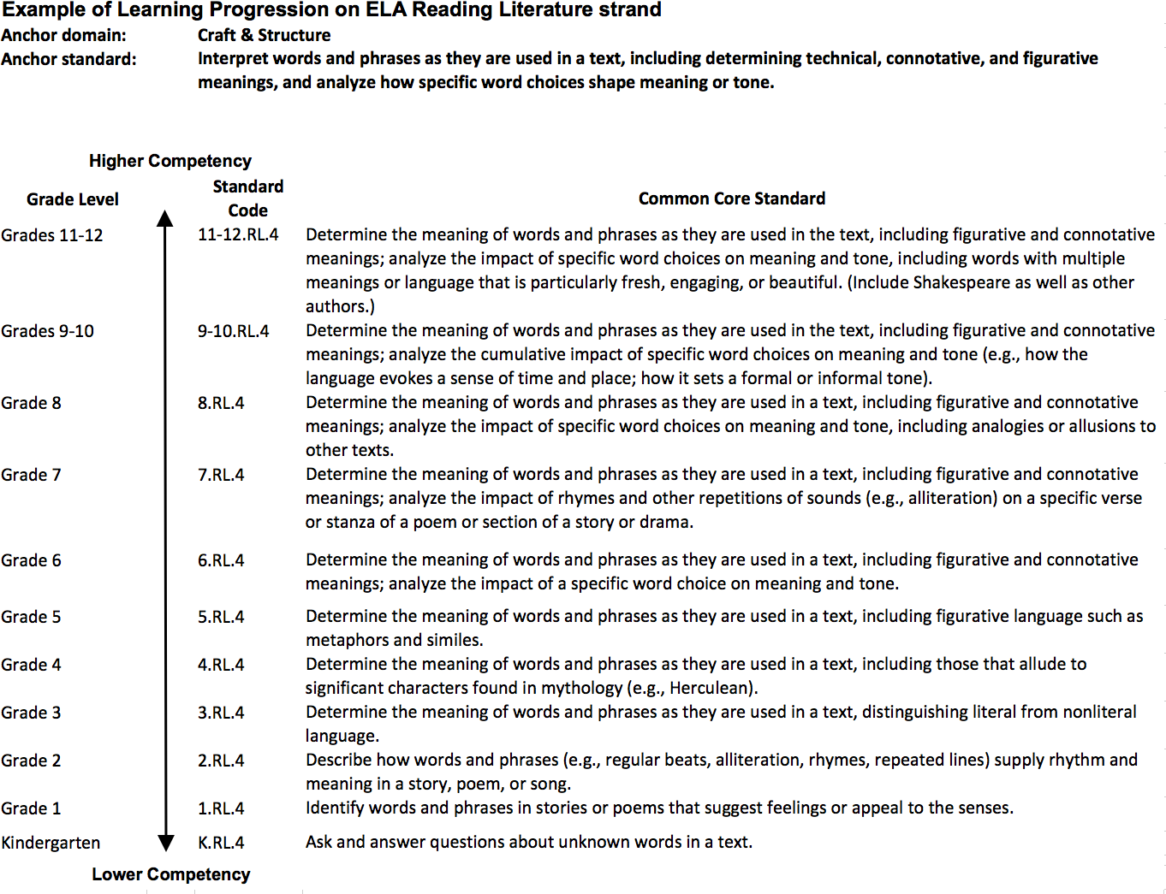
A glimpse at the whole LP!
We’ll be looking at an example from this portion, upper elementary to middle school
Notes:
As you can see, the whole learning progression from kindergarten through high school quite large, and we don’t expect you to read it here. Remember, though, we’ve provided it in a document that you can read through as needed. We’ll show you a smaller portion, from upper elementary through middle school, in the next slide.

Slide 7
Example LP (upper elementary and middle school; Interpreting words and phrases)
Grade | Code | Specific Common Core Standards
8 | 8.RL.4 | Determine the meanings of words and phrases as they are used in a text, including figurative and connotative meanings; analyze the impact of specific word choices on meaning and tone, including analogies or allusions to other texts.
7 | 7.RL.4 | Determine the meanings of words and phrases as they are used in a text, including figurative and connotative meanings; analyze the impact of rhymes and other repetitions of sounds (e.g. alliteration) on a specific verse or stanza of a poem or section of a story or drama.
6 | 6.RL.4 | Determine the meanings of words and phrases as they are used in a text, including figurative and connotative meanings; analyze the impact of a specific word choice on meaning and tone.
5 | 5.RL.4 | Determine the meanings of words and phrases as they are used in a text, including figurative language such as metaphors and similes.
4 | 4.RL.4 | Determine the meanings of words and phrases as they are used in a text, including those that allude to significant characters found in mythology (e.g. Herculean).
Notes:
This slide shows how interpreting words and phrases looks from Grades 4 (at the bottom) to grade 8.
At grade 4, the focus is on words that have to do with mythological characters;
grade 5 introduces metaphors and similes generally;
grade 6 focuses on figurative and connotative meanings, and the impact of word choice on meaning and tone
grade 7 introduces the effect of rhymes and alliteration
and grade 8 includes analogies and allusions
Each of these becomes more subtle and complex. Note that a student at grade 6 may not notice all figurative language, but may still be able to understand simile and metaphor, and is thus making progress toward the goal.

Slide 8
Assessment targets
In SBAC, each claim has specific assessment targets
Each assessment target can overarch several common core standards across different anchor domains/standards
For example:
  Strand: Reading Literary Text
  Grade: 8
  Claim: #1
  Total assessment targets: 7
  Specific assessment target: Language Use (Target #7)
  Standards involved: RL-1, RL-4, L-5 (DOK 3)
DOK → Depth of Knowledge as listed in the Cognitive Rigor Matrix (SBAC, 2012). Numbers represent level.
Notes:
It should be noted that in the Smarter Balanced assessment, each of the four claims mentioned in Chapter 1 has specific assessment targets. For example, in 8th grade reading, which was in claim 1, there are 7 total targets.
Our specific example is most clearly related to Language use, which is target 7.
The specific standards involved are at a Depth of Knowledge of 3
This comes from the Cognitive Rigor Matrix, which shows the depth of knowledge required to take some action

Slide 9
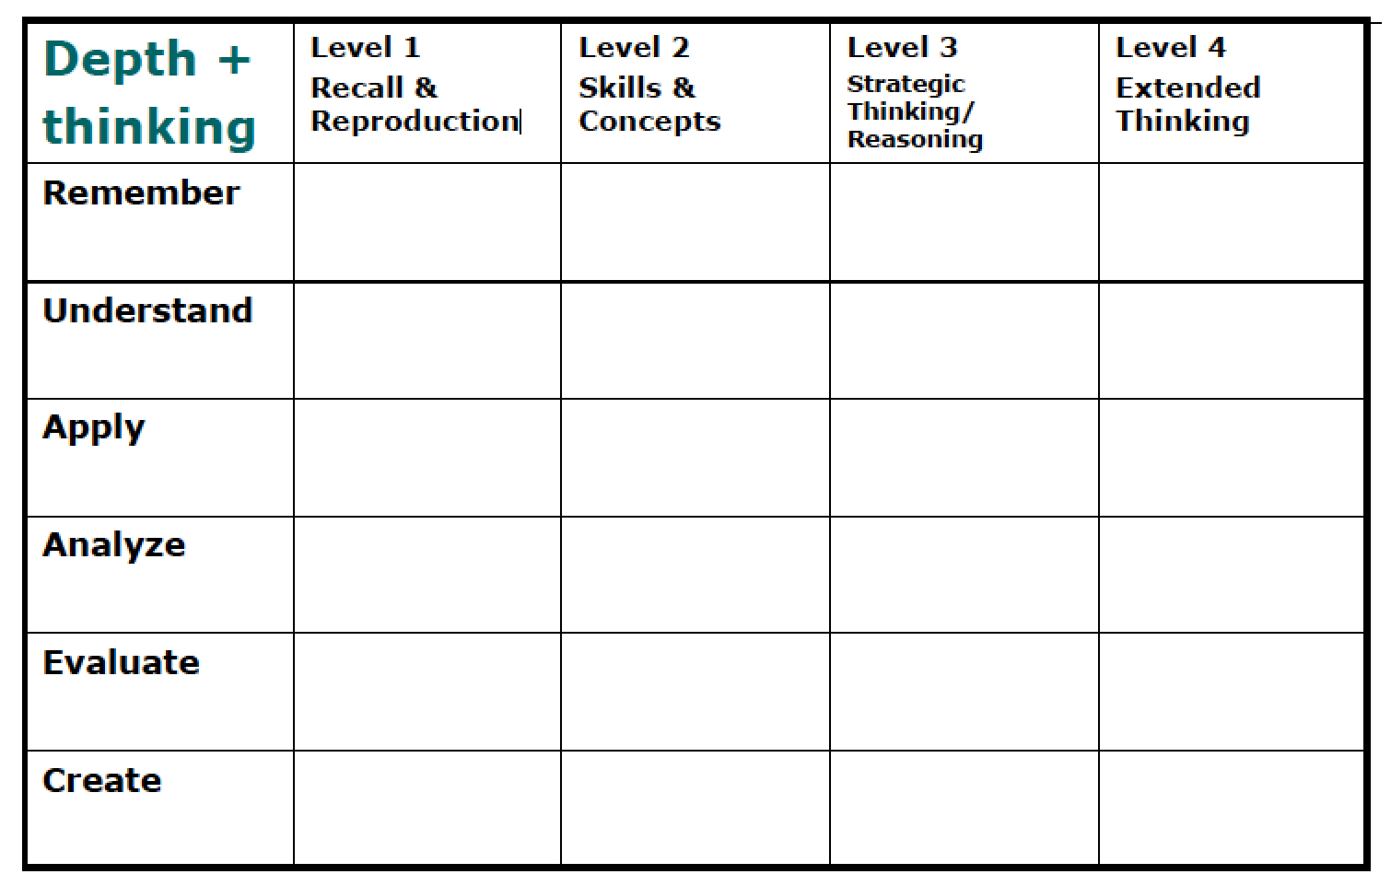
Cognitive rigor matrix
Notes:
This is the Cognitive Rigor Matrix. It classifies two ways of thinking about what students have to do to solve a problem. The columns are labeled by the depth of knowledge, from recall and reproduction at the lowest level, to using skills and concepts, to strategic thinking and reasoning to extended thinking at the highest level. The rows are labeled by a modification of Bloom’s taxonomy : remember, understand, apply, analyze, evaluate, and create. These grow generally more complex from top to bottom, but are not so strictly ordered. A copy of the Cognitive Rigor Matrix, with a description in each cell of the actions this combination entails, is available for you along with this chapter, for you to study as you wish.

Slide 10
Bibliography
Common Core Standards Initiative. (2014). Common core standards for English language arts & literacy in history/social studies, science, and technical subjects. Retrieved from http://www.corestandards.org/ELA-Literacy/
Hess, K., Carlos, D., Jones, B., & Walkup, J., (2009). What exactly do “fewer, clearer, and higher standards” really look like in the classroom? Using a cognitive rigor matrix to analyze curriculum, plan lessons, and implement assessments. Paper presented at CCSSO, Detroit, Michigan.
Oregon Department of Education. (2014, June). Assessment guidance.
Webb, N. (2007). Aligning assessments and standards. Retrieved from http://www.wcer.wisc.edu/news/coverStories/aligning_assessments_and_standards.php
Wilson, M. (2005). Constructing measures: An item response modeling approach. New York: Psychology Press, Taylor & Francis Group.
Wilson, M., & Sloane, K. (2000). From principles to practice: An embedded assessment system. Applied Measurement in Education, 13 (2), pp. 181-208.
Smarter Balanced Assessment Consortium. (2012, April). General item specifications.
Smarter Balanced Assessment Consortium. (2013, June). Appendix B: Grade Level Tables for All Claims and Assessment Targets and Item Types. Retrieved from http://www.smarterbalanced.org/wordpress/wp-content/uploads/2011/12/ELA-Literacy-Content-Specifications.pdf
Notes:
That’s the end of our chapter on the Common Core-based mathematics learning progression. If you would like any additional information about what has been covered in this chapter, here are some possible references for you.

Slide 11
Creative Commons License
Introduction to Learning Progressions (ELA) PPT by the Oregon Department of Education and Berkeley Evaluation and Assessment Research Center is licensed under a CC BY 4.0.
You are free to:
Share — copy and redistribute the material in any medium or format
Adapt — remix, transform, and build upon the material
Under the following terms:
Attribution — You must give appropriate credit, provide a link to the license, and indicate if changes were made. You may do so in any reasonable manner, but not in any way that suggests the licensor endorses you or your use.
NonCommercial — You may not use the material for commercial purposes.
ShareAlike — If you remix, transform, or build upon the material, you must distribute your contributions under the same license as the original.
Oregon Department of Education welcomes editing of these resources and would greatly appreciate being able to learn from the changes made. To share an edited version of this resource, please contact Cristen McLean, cristen.mclean@state.or.us.

