Slide 1
Math
Learning Progression
Introduction
Math Selected Themes
Assessment targets
Progress Map
Notes:
In this set of slides we’ll be discussing the specific theme we’ll use throughout the next few chapters, and using to develop and score our items.

Slide 2
4 building blocks
Learning Progression
Item Design
Assessment Quality
Outcomes/Scoring
Notes:
The first stage of the BEAR Assessment system is to design or select a learning progression on which to base the assessment we’ll be developing.

Slide 3
Introduction
Bear Assessment System Stage 1
Focus on the process of learning and on individual student’s progress through that process
Progress maps
  At a grade level, a learning progression map can represent one content standard/cluster within which standards are ranked in the order of cognitive complexity
  Across grade levels, a learning progression map represent several related content standards/clusters each of which standards are ranked in the order of cognitive complexity
Notes:
As mentioned in the previous chapter on the BEAR Assessment System, we use a learning progression because we base this system on a developmental perspective of student learning.
Rather than simply focusing on what a student does and doesn’t know at one particular point in time, we’d like to focus on the process of learning and on students’ progress through that process.
We illustrate this using what we call a progress map, or a map of the learning progression:
This sketches out what different performance levels might look like, starting where students are likely to be when they arrive in our school or class, and ending where we want them to be after instruction
If we were designing a map for a single year, we could use one or a small number of content standards or clusters, ranking the standards within a cluster in their order of complexity or in the order in which they should be learned.
Across grade levels we can use several related content standards or clusters in their order of complexity or in the order in which they should be learned.

Slide 4
How to Read Math Standards
Grade Level
Domain
Content standard
(Cluster, containing a, b, c)
Standard
(8.EE.8.c)
Notes:
Here’s a reminder of how the math standards are organized; they are labeled first by grade level, then by domain (EE for Expressions and Equations), then by a cluster of content standards (here, three specific standards within the cluster Analyze and solve linear equations and pairs of simultaneous linear equations at the 8th grade level)

Slide 5
MATH selected theme
Selected Theme: Problem-solving (Claim #2)
Rationale:
    Applies across all mathematics topics
    Addresses mathematical practice
    Allows for posing of non-traditional problem types
Notes:
And a reminder that our selected theme, used to build our learning progression, is problem solving – and we’ll be focusing specifically on algebraic skills within this.

Slide 6
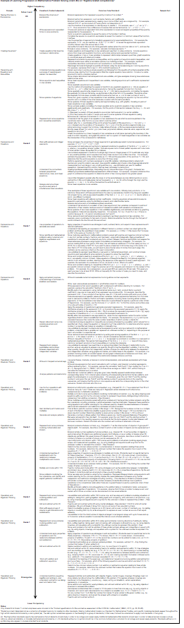
A glimpse at the whole LP!
We’ll be looking at an example from this portion, upper elementary to middle school
Notes:
As you can see, the whole learning progression from kindergarten through high school is so big, it would cover quite a number of slides. Remember, though, we’ve provided it in a document that you can read through as needed. We’ll show you a smaller portion, from upper elementary through middle school, in the next few slides.

Slide 7
Example LP (upper elementary and middle school; Algebraic problem solving)
Grade | SBAT | Specific Common Core Standards
8 | 8.EE.B8.EE.C | Work with radicals and integer exponents (8.EE.1 – 8.EE.4). Understand the connections between proportional relationships, lines, and linear equations (8.EE.5 – 8.EE.6). Analyze and solve linear equations and pairs of simultaneous linear equations (8.EE.7 – 8.EE.8c).
7 | 7.EE.A 7.EE.B | Use properties of operations to generate equivalent expressions. Use properties of operations to generate equivalent expressions (7.EE.1 – 7.EE.2). Solve real-life and mathematical problems using numerical and algebraic expressions and equations (7.EE.3 – 7.EE.4b).
6 | 6.EE.A 6.EE.B 6.EE.C | Apply and extend previous understandings of arithmetic to algebraic expressions (6.EE.1 – 6.EE.4). Reason about and solve one-variable equations and inequalities (6.EE.5 – 6.EE.8). Represent and analyze quantitative relationships between dependent and independent variables (6.EE.9).
Notes:
This slide and the next few show the progression of skills involved in algebraic problem solving, marked by grade and Smarter Balanced Assessment Target label – here, you see the middle school grades. Although each of you likely teaches only one or two grades, it is very helpful to be familiar with the learning progression levels just above, and those just below, what you yourself are teaching; some of your students will likely be at those levels.

Slide 8
Example LP (upper elementary and middle school; Algebraic problem solving)
Grade | SBAT | Specific Common Core Standards
5 | - | Write and interpret numerical expressions (5.OA.1 – 5.OA.2). Analyze patterns and relationships (5.OA.3).
4 | 4.OA.A | Use the four operations with whole numbers to solve problems (4.OA.1 – 4.OA.3). Gain familiarity with factors and multiples (4.OA.4). Generate and analyze patterns (4.OA.5).
Notes:
OA = Operation and Algebraic Thinking domain
EE = Expressions and Equations domain
SBAT = Smarter Balanced Assessment Targets as required to achieve Claim #2
Notes:
These are some of the upper elementary precursors to the algebraic skills with equations developed in the middle school grades. Note that, for example, in 4th grade students “generate and analyze patterns” whereas in 5th grade they “analyze patterns and relationships” – a slightly higher set of skills.

Slide 9
Example LP (upper elementary and middle school; Algebraic problem solving)
Grade | SBAT | Specific Common Core Standards
6 | 6.EE.A 6.EE.B 6.EE.C | Apply and extend previous understandings of arithmetic to algebraic expressions (6.EE.1 – 6.EE.4). Reason about and solve one-variable equations and inequalities (6.EE.5 – 6.EE.8). Represent and analyze quantitative relationships between dependent and independent variables (6.EE.9).
5 | - | Write and interpret numerical expressions (5.OA.1 – 5.OA.2). Analyze patterns and relationships (5.OA.3).
Notes:
Here, note that, for example, in the 5th grade students “write and interpret numerical expressions” which is a precursor to “apply and extend previous understandings of arithmetic (e.g. numerical expressions) to algebraic expressions” in the 6th grade

Slide 10
Example LP (upper elementary and middle school; Algebraic problem solving)
Grade7 and 6 | SBAT | Specific Common Core Standards
7 | 7.EE.A 7.EE.B | Use properties of operations to generate equivalent expressions. Use properties of operations to generate equivalent expressions (7.EE.1 – 7.EE.2). Solve real-life and mathematical problems using numerical and algebraic expressions and equations (7.EE.3 – 7.EE.4b).
6 | 6.EE.A 6.EE.B 6.EE.C | Apply and extend previous understandings of arithmetic to algebraic expressions (6.EE.1 – 6.EE.4). Reason about and solve one-variable equations and inequalities (6.EE.5 – 6.EE.8). Represent and analyze quantitative relationships between dependent and independent variables (6.EE.9).
Notes:
And now in 7th grade, students should learn to use both numeric and algebraic expressions to “Solve real-life and mathematical problems using numerical and algebraic expressions and equations”
Notice that a 7th grade student who has not yet mastered the targets for grade 7, may try to use arithmetic skills and numerical expressions to deal with algebraic problems. Although this student is not at the desired level, they are nonetheless showing some progress toward that goal, and the learning progression allows us to see this.

Slide 11
Example LP (upper elementary and middle school; Algebraic problem solving)
Grade | SBAT | Specific Common Core Standards
8 | 8.EE.B 8.EE.C | Work with radicals and integer exponents (8.EE.1 – 8.EE.4). Understand the connections between proportional relationships, lines, and linear equations (8.EE.5 – 8.EE.6). Analyze and solve linear equations and pairs of simultaneous linear equations (8.EE.7 – 8.EE.8c).
7 | 7.EE.A 7.EE.B | Use properties of operations to generate equivalent expressions. Use properties of operations to generate equivalent expressions (7.EE.1 – 7.EE.2). Solve real-life and mathematical problems using numerical and algebraic expressions and equations (7.EE.3 – 7.EE.4b).
Notes:
Now, in 8th grade, work that has been done with single algebraic expressions and equations, gets extended to pairs of equations, as in “Analyze and solve linear equations and pairs of simultaneous linear equations”

Slide 12
Assessment targets
In SBAC, each claim has specific assessment targets
Assessment targets for Claim #2 on problem solving:
    A = Apply mathematics to solve well-posed problems in pure mathematics and those arising in everyday life, society, and the workplace (DOK 2, 3)
    B = Select and use appropriate tools strategically. (DOK 1, 2)
    C = Interpret results in the context of a situation. (DOK 2)
    D = Identify important quantities in a practical situation and map their relationships (e.g., using diagrams, two-way tables, graphs, flowcharts, or formulas).(DOK 1, 2, 3)
DOK → Depth of Knowledge as listed in the Cognitive Rigor Matrix (SBAC, 2012).
Numbers represent level.
Notes:
It should be noted that in the Smarter Balanced assessment, each of the four claims mentioned in Chapter 1 has specific assessment targets. For problem solving, which was claim 2, these are
To apply mathematics to solve well-posed problems in pure mathematics and those arising in everyday life, society, and the workplace
To select and use appropriate tools strategically.
To interpret results in the context of a situation
To identify important quantities in a practical situation and map their relationships (for example using two-way tables, graphs and so forth)
Each of these targets is marked with a number associated with the Cognitive Rigor Matrix, which shows the depth of knowledge required to take some action

Slide 13
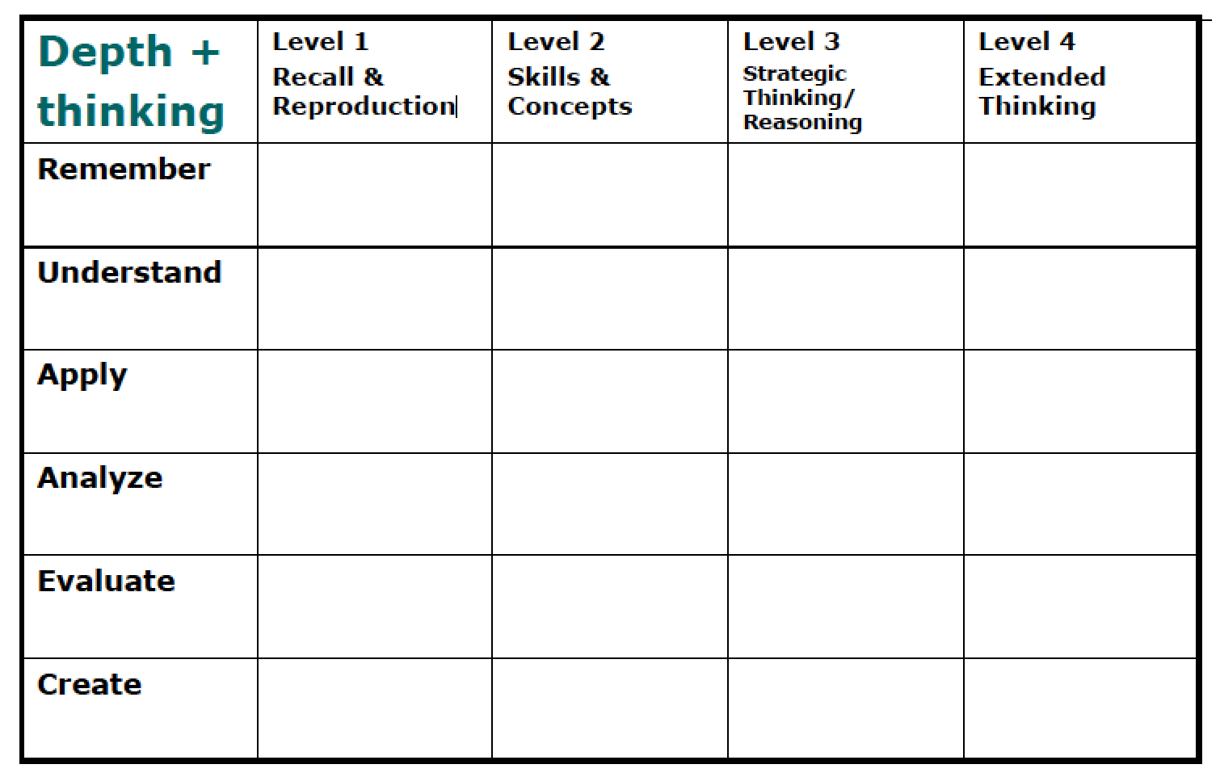
Cognitive rigor matrix
Notes:
This is the Cognitive Rigor Matrix. It classifies two ways of thinking about what students have to do to solve a problem. The columns are labeled by the depth of knowledge, from recall and reproduction at the lowest level, to using skills and concepts, to strategic thinking and reasoning to extended thinking at the highest level. The rows are labeled by a modification of Bloom’s taxonomy : remember, understand, apply, analyze, evaluate, and create. These grow generally more complex from top to bottom, but are not so strictly ordered. A copy of the Cognitive Rigor Matrix, with a description in each cell of the actions this combination entails, is available for you along with this chapter, for you to study as you wish.

Slide 14
Bibliography
Common Core Standards Initiative. (2014). Common core standards for mathematics. Retrieved from http://www.corestandards.org/Math/
Common Core Standards Initiative. (2014). Common core standards for English language arts & literacy in history/social studies, science, and technical subjects. Retrieved from http://www.corestandards.org/ELA-Literacy/
Hess, K., Carloc, D., Jones, B., & Walkup, J., (2009). What exactly do “fewer, clearer, and higher standards” really look like in the classroom? Using a cognitive rigor matrix to analyze curriculum, plan lessons, and implement assessments. Paper presented at CCSSO, Detroit, Michigan.
Oregon Department of Education. (2014, June). Assessment guidance.
Webb, N. (2007). Aligning assessments and standards. Retrieved from http://www.wcer.wisc.edu/news/coverStories/aligning_assessments_and_standards.php
Wilson, M. (2005). Constructing measures: An item response modeling approach. New York: Psychology Press, Taylor & Francis Group.
Wilson, M., & Sloane, K. (2000). From principles to practice: An embedded assessment system. Applied Measurement in Education, 13 (2), pp. 181-208.
Smarter Balanced Assessment Consortium. (2012, April). General item specifications.
Smarter Balanced Assessment Consortium. (2013, June). Content specifications for the summative assessment of the Common Core State Standards for Mathematics. Revised draft.
Notes:
That’s the end of our chapter on the Common Core-based mathematics learning progression. If you would like any additional information about what has been covered in this chapter, here are some possible references for you.

Slide 15
Creative Commons License
Introduction to Learning Progressions (Math) PPT by the Oregon Department of Education and Berkeley Evaluation and Assessment Research Center is licensed under a CC BY 4.0.
You are free to:
Share — copy and redistribute the material in any medium or format
Adapt — remix, transform, and build upon the material
Under the following terms:
Attribution — You must give appropriate credit, provide a link to the license, and indicate if changes were made. You may do so in any reasonable manner, but not in any way that suggests the licensor endorses you or your use.
NonCommercial — You may not use the material for commercial purposes.
ShareAlike — If you remix, transform, or build upon the material, you must distribute your contributions under the same license as the original.
Oregon Department of Education welcomes editing of these resources and would greatly appreciate being able to learn from the changes made. To share an edited version of this resource, please contact Cristen McLean, cristen.mclean@state.or.us.

