Slide 1
Oregon Statewide Assessment System English Language Arts & Mathematics Test Training
Required for DTCs, STCs, and TAs
Notes:
Welcome to the Oregon Statewide Assessment System training module for the ELA and Mathematics state tests. This module is a required part of annual training for all district and school test coordinators, as well as ELA and Mathematics test administrators.

Slide 2
Module Topics
OSAS ELA and Mathematics Test Details
Scheduling
Administration
Key Elements
Resources
Notes:
The topics covered in this module include: a brief overview of Oregon’s state tests in both ELA and mathematics for the current school year, scheduling considerations, appropriate administration, key elements of each test, and available resources including features related to online testing.
References to specific sections of Oregon’s Test Administration Manual and the Oregon Accessibility Manual are included within slides, where applicable. These resources are also hyperlinked at the end of this presentation. We encourage you to bookmark these in your browser for future reference, as well as the ODE Student Assessment homepage.

Slide 3
Acronym Guide
CAT: Computer Adaptive Test STC: School Test Coordinator
CRS: Centralized Reporting System TA: Test Administrator
DTC: District Test Coordinator TAM: Test Administration Manual
ELA: English Language Arts TIDE: Test Information Distribution Engine
OAM: Oregon Accessibility Manual
ODE: Oregon Department of Education
OSAS: Oregon Statewide Assessment System
PT: Performance Task
Notes:
Before we begin, here is a helpful list for your reference of acronyms that you will find in these slides.

Slide 4
ELA and Mathematics Test Updates
Changes to and important reminders about the OSAS ELA and Mathematics Tests for the current academic year.
Notes:
TOPIC 1 :: ELA and Mathematics Updates
This section includes any changes to the ELA and Mathematics Tests for the current school year, as well as some important reminders about newer features to each test.

Slide 5
OSAS ELA & Math Test Overview
The OSAS ELA & Math Tests both consist of two components: the Computer Adaptive Test (CAT) and the Performance Task (PT).
The ELA CAT consists of approximately 25 items.
The ELA PT contains 1 research item and 1 full-write composition.
The Math CAT consists of approximately 20 items.
Beginning in Grade 6 the Math CAT includes two segments: one where an embedded calculator is allowed and one where it is not.
Specifics on OSAS test specifications and blueprints can be found on ODE’s ELA Assessment and Math Assessment webpages.
Notes:
Both the OSAS ELA and Mathematics Tests consist of two components: A computer adaptive test, or CAT, and a performance task, or PT.
The ELA CAT consists of approximately 25 items across all grade levels. The ELA performance Task consists of 1 research item and 1 writing extended response or full write composition.
The Math CAT consists of approximately 20 items. Starting in Grade 6, the CAT includes two segments: one where a calculator is allowed and one where it is not.
Be sure to check out ODE’s ELA and Math Assessment webpages for more specifics on OSAS test design and blueprints.

Slide 6
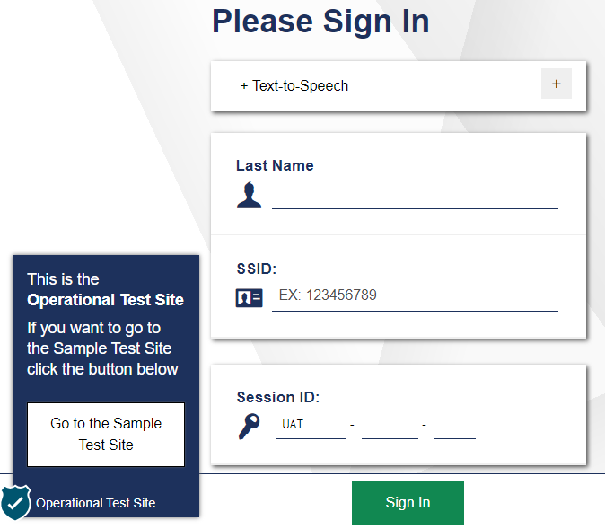
OSAS ELA & Math Test Update: Student Login
Beginning in 2023-24, students will access OSAS with their Legal Last Name and SSID.
Notes:
Beginning in the 2023-24 school year, all students will access the Oregon Statewide Assessment System by logging in with their legal LAST name and SSID rather than their first name. The “last name” entered by the student must exactly match information recorded in TIDE. Test Administrators should double check that students with the same last name receive their correct SSID number prior to testing to avoid testing improprieties.

Slide 7
OSAS ELA Test Update: Pausing PTs
To make student testing most efficient, TAs should review the testing interface with students prior to the testing session. Because the ELA PT often spans multiple testing sessions, students should know the difference between pausing the session and submitting their test.
ODE has updated the language around pausing PTs in student test directions
Use the Sample and Training Tests to become familiar with the testing interface
Notes:
In recent years, ODE has received numerous requests to reopen student tests that were accidentally submitted rather than paused. This interrupts and prolongs students’ testing experiences, and often requires additional test sessions to be planned for students to complete their test once reopened.
To support a more efficient testing experience, ODE has updated the student test directions to include a caution when students pause the ELA PT before completing their full write portion.
Test Administrators can use the Sample and Training Tests in the OSAS Portal to help students become familiar with the testing interface prior to testing.

Slide 8
OSAS Math Test Updates: Accessibility
Accessibility Features:
NEW! Setting the test’s Presentation to Spanish activates a Language Toggle that allows students to switch between English and Spanish translations rather than seeing a stacked display. This is an embedded designated support.
REMINDER! Spanish Text-to-Speech (TTS) is available as an embedded designated support.
REMINDER! Math Manipulatives are available as non-embedded designated supports. Follow administration guidelines in the OAM.
Oregon Accessibility Manual (OAM), Table 2.3 and 2.4: Embedded and Non-Embedded Designated Supports
Notes:
In 2023-24, students taking the OSAS Math Test in Spanish will have the ability to toggle between English and Spanish rather than seeing a stacked display. This language toggle on the OSAS Math Test now functions in exactly the same way as on the OSAS Science Test. As a reminder, setting the presentation language to Spanish is an embedded designated support.
Two additional reminders for the OSAS Math Test: First, Spanish-language Text-to-Speech is available as a designated support. This will require a Spanish language pack to be installed on the student’s device. Second, math manipulatives are available for use as non-embedded designated supports. Follow the administration guidelines set forth in the Oregon Accessibility Manual.

Slide 9
OSAS Math Test Updates: Blueprints
ODE’s test blueprints are transitioning to align with the 2021 Oregon Math Standards. While standards were revised across K-12, the nature of changes in high school were more substantial.
In Grades 3-8, there are no blueprint changes in 2023-24.
ODE anticipates field testing Data Reasoning items in 2024-25.
In Grade 11, items have been removed from the pool that no longer align to Oregon’s standards. See ODE’s Math Assessment webpage for full details.
The overall number of items remains unchanged from 2022-23.
ODE anticipates field testing Data Reasoning items in 2024-25.
Click: ODE Math Assessment Webpage
Notes:
In order to align with the 2021 Oregon Math Standards, the OSAS Math Test blueprints will be changing over the next few years. In 2023-24, there are no changes to test blueprints in Grades 3-8. In Grade 11, however, the pool of test items has been reduced to remove items that no longer align with Oregon standards. In all grades, the length of the test will not change from 2022-23. ODE anticipates field testing additional items in 2024-25, including Data Reasoning items unique to Oregon standards. Be sure to visit ODE’s Math Assessment webpage for full details.

Slide 10
Scheduling
Ensures students have sufficient time to complete both
the OSAS ELA and Mathematics Tests.
Notes:
TOPIC 2 :: Scheduling
Attention to scheduling ensures that students have sufficient time to complete both the ELA and Mathematics tests.

Slide 11
Statewide Test Windows
Statewide test windows have been developed to provide districts with the flexibility to manage available resources.
Federal and state laws require that at least 95% of students in grades 3-8 and 11 take the OSAS ELA and Math tests each year.
Districts are responsible for testing all students enrolled on the first school day in May.
Statewide Testing Windows for In-Person and Remote Administration
Grades 3 – 8: April 2 – June 14, 2024
Grade 11: February 6 – June 14, 2024
TAM, Appendix A
TAM, Section 5.2: School-Level Test Windows
Notes:
ODE has developed test windows to provide districts with flexibility in scheduling and managing the logistics of test administration. Within these statewide dates, schools may set shorter school-level test windows.
Federal and state laws require that at least 95% of all students in grades 3-8 and 11 participate in state testing in ELA and Math each school year.
The statewide test windows for the current school year are shown here.
Please note that schools are responsible for testing all students enrolled on the first school day in May. Students who enroll after the first school day in May will NOT be included in the school’s accountability calculations; however, they may still be tested.
The complete list of OSAS test windows can be found in Appendix A of the TAM.
More information about school-level test windows can be found in Training Module 1 and Section 5.2 of the TAM.

Slide 12
General Considerations
The OSAS ELA and Mathematics Tests should be given on separate days; finish one before starting the other.
It is recommended, but not required, that the CAT be administered first.
Neither the OSAS ELA or Mathematics Tests are timed; students should be allowed to continue working as long as they are making progress.
TAM, Section 5.1: Testing Time
TAM, Section 8.0: English Language Arts & Mathematics Assessments
Notes:
Here are some guidelines and recommended practices for scheduling the OSAS ELA and Math Tests.
The tests should be given on separate days; students should finish one before starting the other. Whichever is administered first, students should NOT have both the tests open at the same time.
It is recommended, but not required, that the CAT be administered first.
Neither the OSAS ELA nor Math tests are timed, meaning students should be allowed to continue working as long as they are making progress. However, schools should use the average testing times in Section 5.1 of the TAM to guide local planning and maximize instructional time.

Slide 13
Estimated Testing Times (in hrs:min)
Test and Grade Band | Computer Adaptive Test | Performance Task | Total Time
ELA: Grades 3 – 5 | 1:10 | 2:20 | 3:30
ELA: Grades 6 – 8 | 1:05 | 1:50 | 2:55
ELA: Grade 11 | 0:55 | 1:20 | 2:15
Math: Grades 3 – 5 | 0:55 | 0:45 | 1:40
Math: Grade 6 | 0:55 | 0:50 | 1:45
Math: Grades 7 – 8 | 0:55 | 0:35 | 1:30
Math: Grade 11 | 0:45 | 0:30 | 1:15
TAM, Section 5.1: Testing Time
Notes:
Estimated testing times can be helpful in planning the length of test sessions. This table reflects the approximate time it will take most students to complete the specified test at each grade level based on the previous year’s statewide administration. Note that these times are estimates to be used for planning purposes only. Actual student testing times may vary.

Slide 14
Grade 12 Assessment Opportunities
ODE will continue to provide Grade 12 ELA and Mathematics testing options for students who wish to participate for college placement purposes.
Test Administration Manual (TAM): Appendix B
OAR 581-022-0104
HECC College Course Placement Policy
Notes:
As in previous years, ODE will continue to provide Grade 12 ELA and Mathematics testing options.
While grade 12 participation is not mandatory for accountability, districts should make the option available for those students who wish to participate for college placement purposes.

Slide 15
Grade 10 Assessment Opportunities
ODE provides the “challenge up” option for Grade 10 students who have completed advanced coursework in ELA and/or mathematics participate in the respective Grade 11 state test.
Please contact your DTC if you have eligible students who wish to “challenge up”
Eligible Grade 10 students are not required to “challenge up”
If a Grade 10 student successfully meets the high school achievement standard, the score will be banked and reported in the student’s Grade 11 year
If the student does not meet the high school achievement standard, the student must retest in their Grade 11 year or they will be counted as a non-participant
TAM: Appendix B
Notes:
ODE will also provide a Grade 10 challenge up option. The option to take the Grade 11 assessment is only available to grade 10 students who have completed advanced coursework in the respective ELA and/or mathematics content area.
The decision to challenge up should be made with the student and their family. Participation during a student’s Grade 10 year is not required, even if the student has successfully completed advanced coursework.
If a Grade 10 student successfully meets the high school achievement standard, the score will be banked and reported in the student’s Grade 11 year.
If the student does not meet the high school achievement standard, the student must retest in their Grade 11 year or they will be counted as a non-participant.

Slide 16
Administration
Ensure equitable access for all students.
Notes:
TOPIC 3 :: Administration
This section covers Administration Guidelines, which ensure equitable access for all students.

Slide 17
Administering the ELA and Mathematics Tests
Ensure students are taking the correct content area assessment.
Verify instructional resources (posters, visuals, etc.) have been covered up or removed from testing environment.
Read required directions for the specific content area assessment being administered.
TAM, Section 7.2: Student Directions for Administration
Notes:
This slide begins a list of administration guidelines.
First, ensure that the test administrator has activated the assessment for the correct content area.
Second, all instructional visuals, stimuli, and posters must be removed from the physical testing environment; and
Third, test administrators should have read the approved directions from the Test Administration Manual before beginning the assessment.

Slide 18
Administering the ELA and Mathematics Tests, cont.
Ensure that all embedded designated supports and accommodations are set in TIDE for students who should have access
Examples: Spanish presentation (designated support), text-to-speech on ELA CAT (accommodation)
Make available any non-embedded universal tools, designated supports, and accommodations for students who need them
Examples: scratch paper (universal tool), math manipulatives (designated support), scribe (accommodation)
OAM, Tables 2.2 – 2.6
Notes:
This list continues from the previous slide.
Test Coordinators and Test Administrators should ensure that all embedded designated supports and accommodations are set in TIDE for students who should have access. An embedded feature is one that is delivered in the secure browser as part of the test interface. An example of an embedded designated support is Spanish presentation for a student’s math assessment. An example of an embedded accommodation is text-to-speech for the ELA CAT. As a reminder, accommodations require documentation in a student’s IEP or Section 504 plan. Decisions around both designated supports and accommodations are to be made with the student’s school support team, the student themself, and the student’s family.
Similarly, Test Administrators should make available any non-embedded universal tools and/or designated supports for students who need them. A non-embedded feature is one that exists outside of the testing interface. An example of a non-embedded universal tool is scratch paper. An example of a non-embedded designated support is the use of math manipulatives. An example of a non-embedded accommodation is the use of a scribe.
Finally, we offer a caution. Historical data shows that adult-initiated behaviors are the leading cause of reported test improprieties – ensuring that all test administrators in your school and district are consistent in these administration practices will greatly reduce the risk of test improprieties and, at worst, invalidated student assessments.

Slide 19
Scratch Paper
Scratch paper is a non-embedded universal tool available to all students.
Scratch paper must be collected and securely shredded at the end of each test session.
Scratch paper cannot be retained for CAT items.
Scratch paper used for notes on the PT may be retained and securely stored between test sessions.
OAM, Table 2.2: Non-embedded Universal Tools
Notes:
Scratch paper is one example of a non-embedded universal tool available to all students. Scratch paper may be securely retained between testing sessions for the performance task, but it may not be retained for the CAT.
If retained between test sessions, Test Administrators must direct students to write their names (or some appropriate identifying information) on their scratch paper, and then collect and inventory the scratch paper at the end of the test session.
Retained scratch paper must be kept in a securely locked room or cabinet that can only be opened by authorized staff. When students have completed and submitted their test, all retained scratch paper should be securely shredded.

Slide 20
Pause Rules and Test Expiration
Tests can be paused at any time – students get a warning message to verify they want to pause.
Students should be sure to pause a PT and not submit if they intend to resume the PT in a future session.
If the ELA or Mathematics CAT is paused less than 20 minutes, students may review questions already answered.
If the ELA or Mathematics CAT is paused for 20 minutes or more, students may not review or change questions already answered.
TAM, Section 6.4: Pause Rules and Test Expirations
OAM, Table 2.1: Embedded Universal Tools
Notes:
One embedded universal tool available to all students is the ability for tests to be paused at any time.
When a student selects the Pause button on the screen, that student will get a warning message to verify they want to pause their test. Students should take care to not accidentally submit their test when they intend to pause.
If an ELA or Mathematics CAT is paused for fewer than 20 minutes, a student may review questions already answered.
If an ELA or Mathematics CAT is paused for 20 minutes or more, a student may not review or change questions already answered.

Slide 21
Pause Rules and Test Expiration, cont.
When resuming after a pause, the student sees the first page that has unanswered questions.
If a test is idle for over 20 minutes, the system will automatically pause the test and log the student out.
There are no pause limits for the PT portion of the OSAS ELA and Mathematics tests.
Both the CAT and PT in both the OSAS ELA and Math tests have a 20-day expiration period from the time a student begins each respective component.
TAM, Section 6.4: Pause Rules and Test Expirations
OAM, Table 2.1: Embedded Universal Tools
Notes:
If a test is active but idle for over 20 minutes, the system will automatically pause the test and log the student out.
There are no pause restrictions for either the ELA or Mathematics Performance Tasks. If a PT is paused for 20 minutes or more, the student can return to the section they were in and continue entering their response. Please note, however, that students may not navigate between segment 1 and segment 2 on the ELA PT.
Finally, tests can only be active for 20 days after they have been started. After this, they expire and their contents are scored as they appear.

Slide 22
Key Elements
Know the different features of each test.
Notes:
TOPIC 4 :: Key Elements
This section covers Key Elements of the OSAS ELA and Mathematics tests, in order for test administrators to know the different features of each test.

Slide 23
Assessment Components
OSAS ELA and Mathematics Tests: Item Types
Multiple Choice – Single Correct Response
Multiple Select – Multiple Correct Responses
Hot-Text – Text Highlighting
Drag-and-Drop
Matching Interaction
Table Interaction
Technology-Enhanced/Enabled Items (e.g. Graphing, Equations)
TAM, Section 8.0: English Language Arts & Mathematics Assessments
Notes:
The OSAS ELA and Mathematics tests are adaptive, which means the question difficulty adjusts as the student works through the test, providing either easier or more difficult items based on correct and incorrect student responses.
Students will interact with different items such as Multiple Choice where there is a Single Correct Response
Multiple Select where there are Multiple Correct Responses
Hot-Text or Text Highlighting
Drag-and-Drop
Matching items, and other table interactions
Some items are technology-enhanced or enabled to allow students to enter an equation or create a graph.
For more information about item type please refer to the Resources section later in this module

Slide 24
Key Elements for ELA
Oregon’s summative ELA assessment combines four elements (claims) of ELA into one test: Reading, Writing, Listening, and Research.
Students will receive an overall composite score, and claim scores for reading and writing.
Listening items will require each student to have headphones.
Students at ALL tested grades will be doing a Performance Task which will require them to write an essay.
Check the Oregon Accessibility Manual for specific allowable supports.
Notes:
The OSAS ELA Test combines four elements (claims) of English Language Arts into one test: Reading, Writing, Listening, and Research.
Students will receive an overall composite score, as well as claim scores for reading and writing.
As in previous years, listening items will require each student to have headphones.
Students at ALL tested grades will be required to participate in a Performance Task which will require them to write an extended essay.
Check the Oregon Accessibility Manual for specific allowable supports.

Slide 25
Key Elements for Mathematics
The OSAS Math Test assesses four elements (claims):
Claim 1: Concepts and Procedures
Claim 2: Problem Solving
Claim 3: Communicating Reasoning
Claim 4: Modeling & Data Analysis
Reporting in 2023 – 24:
Students will receive an overall score and a Claim 1 score.
Schools and districts will be able to access all claim- and target-level data for program evaluation.
Notes:
The OSAS Math Test also combines four areas (or claims) of Mathematics into one test: Claim 1 is Concepts & Procedures, Claim 2 is Problem Solving, Claim 3 is Communicating Reasoning, and Claim 4 is Modeling & Data Analysis.
For this school year, students will receive an overall composite score and a Claim 1 score. Schools and districts will still have access to claim- and target-level data for program evaluation and planning.
Again, check the Oregon Accessibility Manual for specific allowable supports.

Slide 26
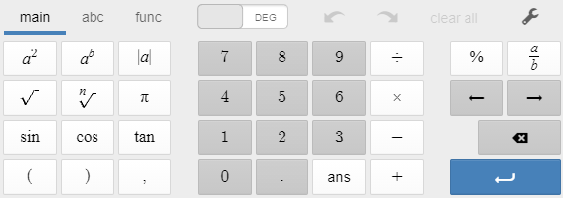
Embedded Calculators
Desmos calculators are embedded in the OSAS Math Tests in Grades 6 – 8, and 11.
Grade 6: four-function calculator
Grades 7 & 8: scientific calculator
Grade 11: graphing calculator
Check the Oregon Accessibility Manual for specific allowable supports.
KEYPAD
Notes:
Desmos calculators continue to be an embedded support within some mathematics items in grades 6-8 and grade 11. In grade 6, a four-function calculator is available. In grades 7 and 8, a scientific calculator is available. In grade 11, a graphing calculator is available. More information about the specific functionality of these calculators can be found on the Desmos website at www.desmos.com/testing/Oregon. Note that the OSAS science test uses the same embedded calculators as those found on the OSAS Math test.

Slide 27
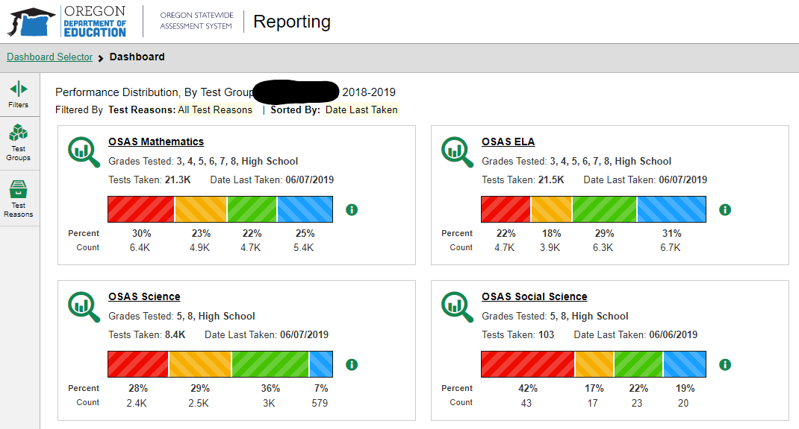
Centralized Reporting System
OSAS Portal → Centralized Reporting System (CRS)
CRS contains all summative
and interim assessment results.
New! Cross-Sectional Target
Reports allow districts and
schools to monitor system-wide
student performance on
assessment targets over time.
Notes:
One final key element of Oregon’s statewide tests in ELA and Mathematics is data access. As a Test Administrator, you have access to summative and interim assessment data through the Centralized Reporting System (or CRS) in the OSAS Portal.
CRS provides educators access to individual student level results as well as to aggregated data for each assessment target. Target Reports show the performance of groups of students on specific assessment targets, rather than simply an overall picture. New in 2023-24, cross-sectional target reports allow districts and schools to include up to 3 years worth of target data to monitor system-wide trends.
District Test Coordinators, School Test Coordinators, and Test Administrators have access to these reports and can use them in their collaboration and professional learning. District Test Coordinators may also create accounts for non-Test Administrators to access district or school-level data.

Slide 28
Resources
Adequately prepare teachers and students.
Notes:
TOPIC 5 :: Resources
Our final topic to share is resources to adequately prepare teachers and students.

Slide 29
OSAS Training and Sample Tests
Training Test
ELA is organized by grade band 3-5, 6-8, and high school
Math is organized by grade band 3-5, 6, 7-8, and high school
6-9 questions, which include all item types
Sample Test
Organized by specific grade level
Approximately 30 items of varying difficulty
Both Training and Sample Tests include all embedded universal tools, designated supports, accommodations, and language supports.
OSAS Portal
TAM, Section 6.3: Preparing Students for Testing
Notes:
There are two different practice tests available through the OSAS Portal.
First is the training test, which is aligned to grade bands. Training tests include 6-9 questions and are designed to allow students to try out embedded tools and supports, as well as to interact with each of the different item types. In ELA, training tests are available for grades 3-5, grades 6-8, and high school. For Math training tests, available grade bands are grades 3-5, grade 6, grades 7-8, and high school.
The second is the sample test, which is aligned to specific grades. Sample tests provide students and educators a look at the grade-specific operational assessment. Sample tests include approximately 30 items that vary in difficulty. Scoring guides for the sample tests are available on the OSAS Portal under the Resources tab.
Both training and sample tests include all embedded universal tools, designated supports, accommodations, and language supports.

Slide 30
Training Tests vs. Sample Tests
Use the Training test if:
You want to familiarize students how to navigate the test, including universal tools and supports
You want students to learn how to complete the different item types
Your intent is NOT to look at grade level content or items at the appropriate level of difficulty.
Use the Sample test if:
You want students to see grade level items and practice responding to those items.
You want students to experience items across all claim areas.
OSAS Portal
TAM, Section 6.3: Preparing Students for Testing
Notes:
To most effectively use training and sample tests, it is helpful to consider their purpose.
Use the training test if you want to familiarize students with how to navigate the test, including universal tools and embedded supports. Also, use the training test to help students learn how to interact with each of the different item types.
Use the sample test if you want students to interact with specific grade level items or you want students to experience items across all claims.

Slide 31
Oregon ELA and Mathematics Test Documents
Test Blueprints | Content Specifications | Item Specifications
Number of items Score points (weighting) Depth of Knowledge (DOK) | List of all assessment targets Identify which standard each target assesses | Broken out by grade level, claim, and target Contain Task Models and stems for items
ELA Test Specifications and Blueprints Mathematics Test Specifications and Blueprints
Notes:
Several documents outline the structure of the OSAS ELA and Math tests. Links to access these resources are provided at the end of this slide show. Educators should spend time looking at these materials to help inform how they prepare students to be successful on the tests.
Test blueprints indicate the number of items included on each test, how each test is scored, and the depth of knowledge intended to be used by students when answering items.
Content specifications list all assessment targets within each claim, as well as the ELA or Math standards aligned to those targets.
Item specifications provide task models and appropriate stems for each item type, and are broken out by grade level, claim, and target.

Slide 32
Online Resources
OSAS Portal (Training & Sample Test)
ELA Test Specifications and Blueprints
Mathematics Test Specifications and Blueprints
Test Administration Manual
Oregon Accessibility Manual
Notes:
This slide contains a list of linked resources that have been referenced throughout this training.
First, the OSAS Portal links to all components of the assessment system, including training and sample tests.
Second, you can get more information on Test Blueprints, test design, assessment targets, and the number of items from each claim by visiting the ELA and Math Assessment websites.
Finally, the Test Administration Manual and Oregon Accessibility Manual provide technical support for districts, schools, and educators.

Slide 33
Q&A Discussion
What are the local considerations and challenges around scheduling the OSAS ELA and Math Tests within your school or district?
What are some effective approaches you could use to address these challenges?
What resources or strategies do you plan to use to prepare for administering OSAS ELA and Math Tests?
Notes:
This is an optional point in the required training to pause and discuss the questions provided or a locally developed set of relevant questions. If you would like to pause, please pause now.
Suggested activities:
-Small groups: use post-its to capture local considerations and challenges, one per sheet. Mount post-its.
-Large group: facilitate review/summary of considerations/challenges from across the large group
-Small groups: share effective approaches, look at artifacts
-Large group: facilitate share out, writing down approaches via chart pack
-Small group or individual: use note organizer to capture take-homes, next steps

Slide 34
Thank you!
Tony Bertrand
ELA & Social Sciences Assessment Specialist
Tony.Bertrand@ode.oregon.gov
Andrew Byerley
Mathematics Assessment Specialist
andrew.byerley@ode.oregon.gov
Notes:
This concludes the required ELA and Mathematics Summative Assessment training module. Thank you for your time and attention!

