Slide 1
Interim Assessment Administration and Test Security
Oregon Statewide Assessment System (OSAS)
Required for DTCs, STCs, and TAs
Notes:
This is the test administrator training module for Oregon’s Statewide Interim Assessment System, required for all district and school test coordinators, as well as all test administrators.

Slide 2
Topics
Overview of the Oregon Balanced Assessment System and Interim Assessment Features
Interim Assessment Use, Test Security, and Administration Features
Notes:
This training module includes an:
Overview of the Oregon Balanced Assessment System and Interim Assessment Features
Interim Assessment Uses, Test Security, and Administration Features

Slide 3
Interim Training Requirements
DTCs or STCs will need to apply the “Interim” Test Group to each user that will administer the interim assessments. The decision to allow access to the Interim Assessment System is determined by the educators’ district.
Users will not be able to administer the interim assessments if the Test Group permission is not assigned to their TA user account.
If the TA is a returning user from 2020 – 21 , there are no additional requirements required to apply the “Interim” Test Group other than Module – 8.
However, if an educator does not have a TA user role from the prior year or has transitioned to a new district, they must complete the reading requirements in Table 5 of the Test Administration Manual and the ODE-provided training Modules 2 – 4 and 8 posted to the Assessment Training Materials webpage.
Notes:
The interim assessment must be activated for educators by either their District Testing Coordinator or their local School Testing Coordinator. The decision to allow educators access to the interim assessments is determined by their district.
(animation) If the educators has completed the prior years TA requirements they will only need to provide evidence they have completed the Module 8 - Interim Assessment Administration and Test Security training
(animation) If an educator did not have a TA user account from the prior instructional year or if the educator has transitioned to a new district which is different from last year. They must complete the reading requirements in Table 5 of the Test Administration Manual and in addition to completing this Module 8, they must complete training module 2, 3 , and 4.

Slide 4
Overview of the Oregon Balanced Assessment System and Interim Assessment Features
Notes:
Overview of the Oregon Balanced Assessment System and Interim Assessment Features

Slide 5
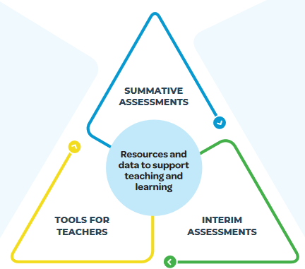
“The Right Assessment for the Right Purpose”
The Oregon Statewide Assessment System consists of three components: end-of-year summative assessments designed for accountability purposes, interim assessments designed to support teaching and learning throughout the year, and formative assessment practices. For ELA and Mathematics, we now have a suite of tools and resources in Tools for Teachers that support classroom-based formative assessment practices.
(FORMATIVE PRACTICES)
Notes:
The Oregon Statewide Assessment System consists of three components: this training module pertains to the Interim Assessment System designed to support teaching and learning throughout the year. However, the interim assessment system also includes tools and resources in Tools for Teachers that support classroom-based formative assessment practices.

Slide 6
Utilizing the Interim Assessment System
For most students, grade-level interim assessments, rather than tests aligned to the prior grade’s content standards, will provide the most actionable information for teachers in support of their students’ learning.
ELA Interims
Read Literary Text
Read Informational Text
Brief Writes
Revisions
Performance Tasks
Research
Math Interims
Concepts and Procedures
Problem Solving
Modeling and Data Analysis
Communicating Reasoning
Science Interims
3-D
Earth/Space
Life Science
Physical Science.
Notes:
This training includes the following interim assessment systems: English language arts, mathematics, and science.
Please note that though the Interim Assessments provide both in grade and out of grade level administration, interim assessments aligned to the grade level instructional standards provide the most actionable data.

Slide 7
Features of Interim Assessments
Free statewide access to ELA, Mathematics, and Science interim assessments
Both ELA and math have access to the instructional and formative assessment resources in Tools for Teachers
Flexible administration options better support local purposes.
Items include all the accessibility resources available in the summative assessment (Refer to Module 3 - Accessibility Supports).
Student performance on Interim Assessments reported within the same Centralized Reporting System as summative assessments
Notes:
The Oregon Interim Assessment System for ELA, mathematics, and science is free to educators statewide. This includes the instructional and formative assessment resources in Tools for Teachers for ELA and mathematics
(animation) ODE has work with both Smarter Balanced and Cambium Assessment Incorporated to provide educators and students with remote administration options for more information on remote certification please refer to the slides later in this training.
(animation) The Interim Assessment system provides the same Accessibility Supports as the OSAS Summative Assessments and all student data is reported in the Centralized Reporting System through the OSAS portal.

Slide 8
Additional Features of Interim Assessments
May be used to measure students’ knowledge and skills in grade levels other than the students’ enrolled grades.
Cover the range of cognitive demand described in Oregon’s State Standards.
Allow educators access to view the test questions and their students’ responses to the test questions as part of educators’ instructional process to address students’ relative strengths and needs for improvement.
Notes:
Educators have further flexibility in administration by providing access to out-of-grade level interim assessments aligned to both the Oregon State standards and (animation) the full complexity of those standards.
(animation) An additional feature allows teachers to access ELA and math items at the individual level within Tools for Teachers. This fetaure will be further discussed in the Interim test security section of this training module.

Slide 9
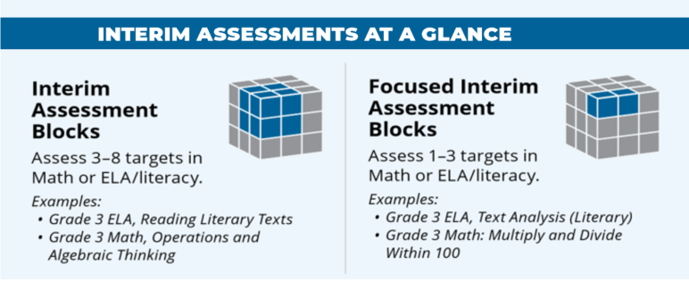
Oregon’s Interim Assessment System
Interim Assessment Blocks (IABs) provide more detailed information for instructional purposes.
The ELA/ Mathematics system offers the following interim assessments:
Focused IABs provide educators with a finer grained understanding of student learning.
Notes:
The Oregon Interim Assessment System provides flexibility in the types of assessments available for educator administration.
Interim Assessment Blocks or IABs are available in all content areas and target a wide range of connected standards. For (animation) for both ELA and mathematics Focused Interim Assessment Blocks or Focused IABs are available. These FIABs target a smaller scope targets, usually 1 or 2 and a more precise set of associated standards.
Please note the Science Interim Assessments contain only Interim Assessment Blocks at this time.

Slide 10
Interim Assessments at a Glance
Assesses fewer (3-8) targets
Short item sets (6- 18 items)
Associated with a Tools for Teachers formative assessment resources Connections Playlist
If administered in a standardized way (secure testing environment), the approximate expected testing time length would be the length of a class period.
Interim Assessment Blocks (ELA & Math)
Over 100 IABs in total across all tested grades
Examples:
Grade 5 ELA, Reading Literary Text
Grade 5 Math, Operations and Algebraic Thinking
(IABs) provide more detailed information for instructional purposes.
Notes:
There are over 100 different interim assessment blocks available for ELA and Mathematics which are all aligned to the Oregon state standards and assessment targets.
In this visual, the cube consists of fewer targets within each IAB compared to the summative assessment. This allows educators to gather evidence and information associated with specific assessment targets and associated standards.
[Click Animation]
This allows educators to focus on assessment targets within a Claim, such as literary text from Claim 1 Reading, or Operations and Algebraic Thinking from the Mathematics Claim 1 Concepts and Procedures. The approximate testing time for the IABs is a 45- 55 minute class session.
[Click Animation]
Further, these IABs are shorter in length consisting of 6 – 18 items and can be directly connected to the associated Tools for Teacher instructional resources.

Slide 11
Interim Assessments at a Glance
Assesses 1 - 3 targets
Short item sets (10 - 15 items)
Associated with a Tools for Teachers formative assessment resources Connections Playlist
If administered in a standardized way (secure testing environment), the approximate expected testing time length would be the length of a class period.
Focused Interim Assessment Blocks (ELA & Math)
(FIABs) provide more detailed information for instructional purposes.
Examples:
Grade 5 ELA, Text Analysis (Literary)
Grade 5 Math, Operations with Whole Numbers and Decimals
Notes:
The last type of interim assessments available in the ELA and Math Interim Assessment System is the Focused Interim Assessment Blocks or Focused IABs. In this image, there are even fewer assessments targets within the interim assessment and provide the most detailed information in alignment to the assessed targets and standards.
[Click Animation]
This allows educators to dive deeper within a claim to get to very specific assessment targets within a Claim, such as Text Analysis or Operations with whole numbers and decimals.
[Click Animation]
The Focused IABs also provide educators with direct connections to the Tools for Teachers instructional resources and consist of about 10 – 15 items. The approximate testing time for the Focused IABs is also a 45 -55 minutes class session. Please not that some of the IABs or Focused IABs do require some educator hand-scoring components. Please refer to the ODE Interim Assessment Webinar presentations for more information on hand-scoring.

Slide 12
Interim Assessments at a Glance
Aligned to 1 Standard (NGSS PE)
Cluster (4-8 Interactions)
Scoring Assertion information is provided for teachers to describe the knowledge and skills measured by the interaction.
If administered in a standardized way (secure testing environment), the approximate expected testing time length would be 10-20 minutes.
Science Interim Assessment Blocks
(IABs) provide more detailed information for instructional purposes.
Over 70 IABs in total across all tested grades
Examples:
Grade 5: ESS_EarthSys_2-5
HS: LS_StructureFunc_1-11
Notes:
The Interim Assessment Blocks available for Science slightly differ in their design.
[Click Animation]
Rather than a learning target approach, they are organized and aligned direct to the Oregon State Science Standards. For example, the entire task would be aligned to a standard such as 5-PS1-1.
[Click Animation]
Further, the Science IABs are organized by Cluster items which may include up to 4 or 8 interactions to engage in the 3 dimensional design of the assessment. The science interim assessment blocks require a testing time, ranging from 10 – 20 minutes to administer, and because there is no hand scoring requirement, scores are available immediately after administration.

Slide 13
Standardized vs. Non-Standardized Interim Assessment Administration
Standardized Administration | Non-Standardized Administration
Individual and independent testing Single administration allows for a reliable “point-in-time” spot check of student knowledge Following summative policies and procedures, such as a secure test environment (e.g., no cell phones, guiding resources, etc.) | Non-secure, non-public Working on assessment items collaboratively Students working with other students to answer items Teacher guides students through items Students use resources to help them answer questions
Notes:
Additional flexibility allows educators to administer the Interim Assessments in both a standardized, on-demand format similar to the summative assessment, or in a non-standardized administration allowing for flexibility of use during direct classroom instruction.
This allows educators to use individual items in real-time instruction. We will discuss the test security requirements for individual use of items in the next section of this module.

Slide 14
Interim Assessment Uses, Test Security, and Administration Features
Notes:
Interim Assessment Uses, Test Security, and Administration Features

Slide 15
Interim Assessment Use and Test Security
Know the purpose for administering the interim assessment (or test items). For example, what new information do you need about your students’ skills?
Choose which interim assessment will provide the best information or whether presenting an interim item during instruction will best meet your needs.
Match the conditions with the purpose including:
the student’s environment (access to external information),
accessibility resources,
and timing based on when instruction was provided.
Use the results to inform next steps in instruction.
Do not post the test items on the internet or a public page
Do not email interim test items
Notes:
Test Administrators should follow the following guidance when administering interim assessments whether in person or in a remote setting.
(animation) Know the purpose for administering the interim assessments, choose the interim assessment that will provide the best information, provide necessary supports and considerations in order for students to demonstrate their knowledge and skills, use information to guide next steps or additional support within instruction.
(animation) The following provide examples of what should not be done within the context of interim assessment administration.
Do not post items on the internet or on any public page, and Do not email interim assessment test items. If an educator has printed off individual items to be used during classroom instruction, the educator should collect the interim assessment items prior to students leaving the class and properly secure the items. Once the educator is done using the interim assessment items as part of their formative assessment cycle of learning, educator should securely dispose the items using the same test security protocols as outlined for the summative assessment.

Slide 16
Access Interim Assessment User Guides & Resources
Notes:
Within the OSAS Portal educators will use (animation) the Interim Assessment Button to navigate to the Oregon Interim Assessment System and Resources.
Educators will use the same process as described in Module 2 Test Administration to activate or assign an interim assessment for students.

Slide 17
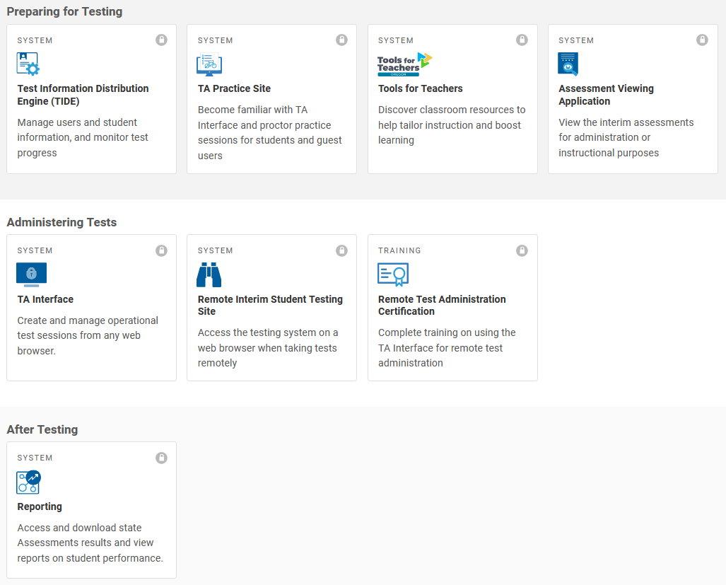
Accessing the Interim Assessment System
Notes:
Once an educator has selected the Interim Assessment portal, educator can activate or assign interim assessments by clicking on the TA interface tile.
Educators will use the same process as described in Module 2 Test Administration to activate or assign an interim assessment for students.
One feature available for educators in the Assessment Viewing Application, which allows educators to preview items included in the different types of interim assessments available for use. As reminder, following the test security guidance, educators can use this function as part of their non-standardized use to enhance classroom instructional practices.
After administering an interim assessment to view student results or complete any hand-scoring of items Within the OSAS Portal educators will use (animation) the Reporting interface tile to navigate to the Centralized Reporting System.

Slide 18
Remote Test Administration and Certification Course
Notes:
As previously stated educators have the option of remote administration of the interim assessments.
Prior to administering any interim assessments remotely the TA must first complete (animation) the Remote Test Administration Certification Course. Once competed the TA will automatically have this feature activated in their TA account. There are no additional steps required by the DTC or STC.
(animation) For students to access the interim assessments remotely, the students would use the (animation) Remote Interim Student Testing Site. The specific details on remote administration for educators and students is included in the Remote Test Administrator Certification Course.
Again, remote administration options are an enhanced feature and not required in the Oregon Interim Assessment System, please use local context for remote administration considerations.

Slide 19
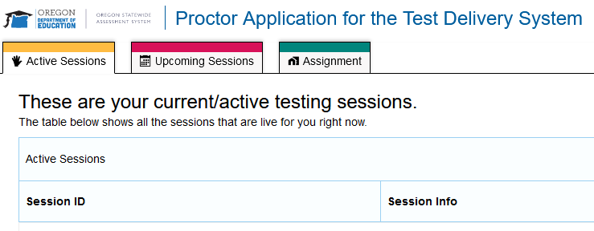
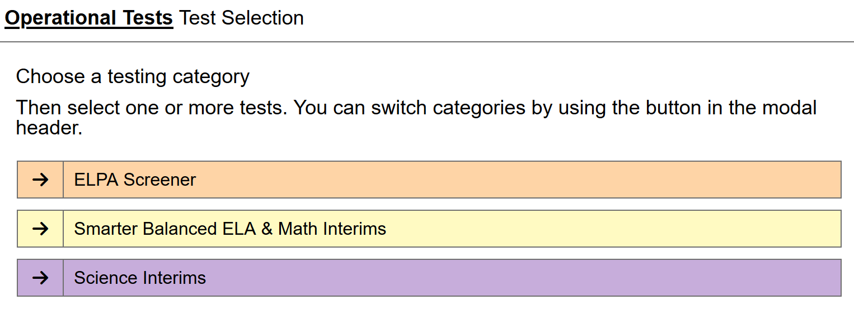
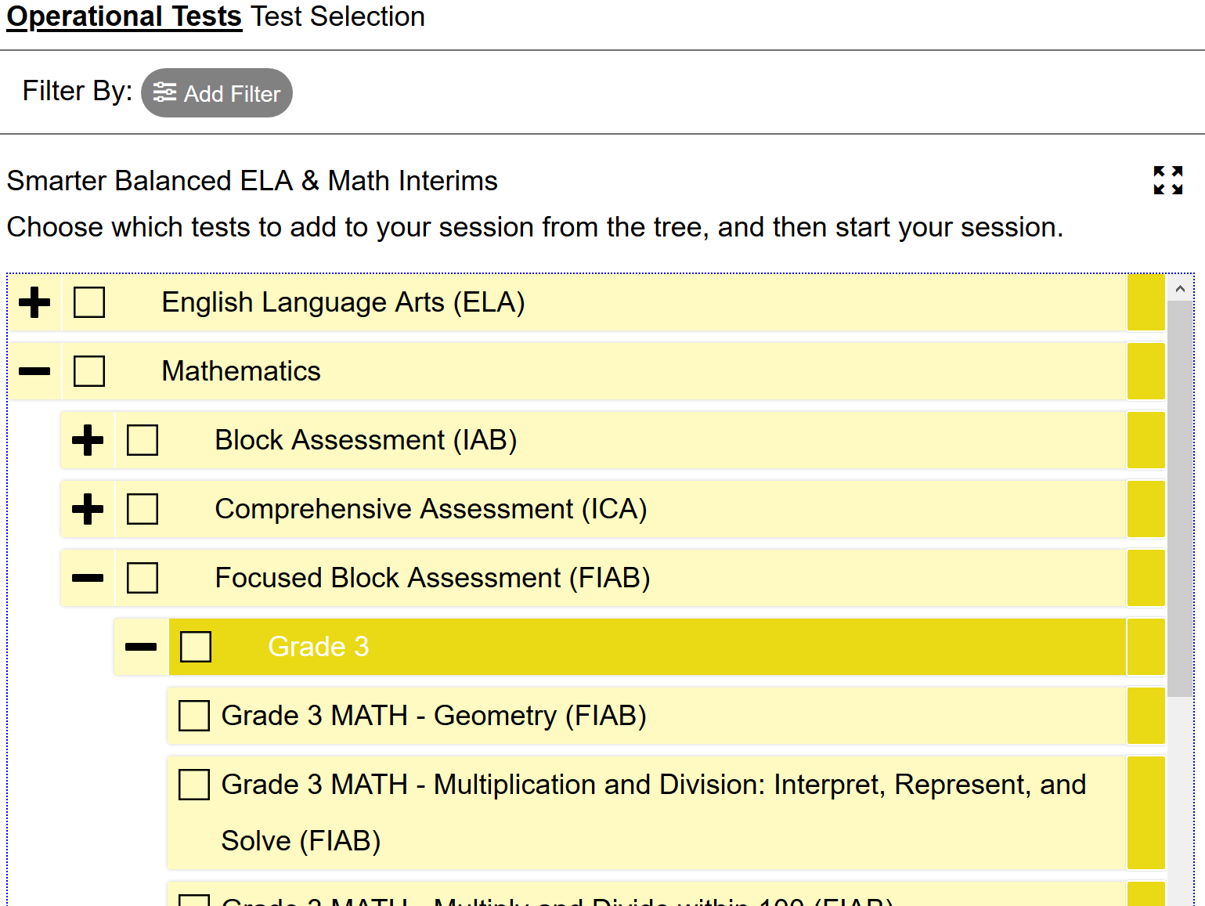
Remote and In-Person or Remote Administration of Interim Assessments
Notes:
Regardless of administration for remote or in-person administration.
Once a TA has accessed the TA interface, they will see the Proctor Application for Test Delivery System landing page.
To activate or assign an Interim Assessment, educators will select the (animation) Start a New Session Now tile.
This will allow the educator to choose which IAB or Focused IAB to administer.
As shown a teacher can choose (animation) the content area they would like to administer. (animation) And…the grade level they would like to access and which interim assessment to administer or assign.

Slide 20
Accessing Interim Assessment Data
Notes:
As previously stated educators will access interim assessment results by clicking on the reporting tile. The information will appear in the Centralized Reporting System. Educators will access to school, class and student level data. Additionally they will be able to look at how students performed on an individual item. Detailed information on this process is included on the ODE Interim Assessment webpage under the interim assessment webinar modules.
If an interim assessment requires hand-scoring, they will complete the hand-scoring within the OSAS portal Centralized reporting system. Again detailed information on this process is included on the ODE interim assessment webpage.

Slide 21
Accessing Tools for Teachers Resources
Notes:
The final training slide provide a brief overview on how to access Tools for Teachers for ELA and Mathematics.
By selecting the Tools for Teachers tile, educators will be able to access the platform using their same OSAS sign-in credentials. Within Tools for Teacher, educators will be able to access numerous instructional activities aligned to both the interim and summative assessments. The Tools for Teachers website also provides detailed student performance progressions for use in classroom instruction or for developing evidence of learning or establishing learning success criteria. Additionally the platform provides numerous formative assessment strategies and suggestions for students.

Slide 22
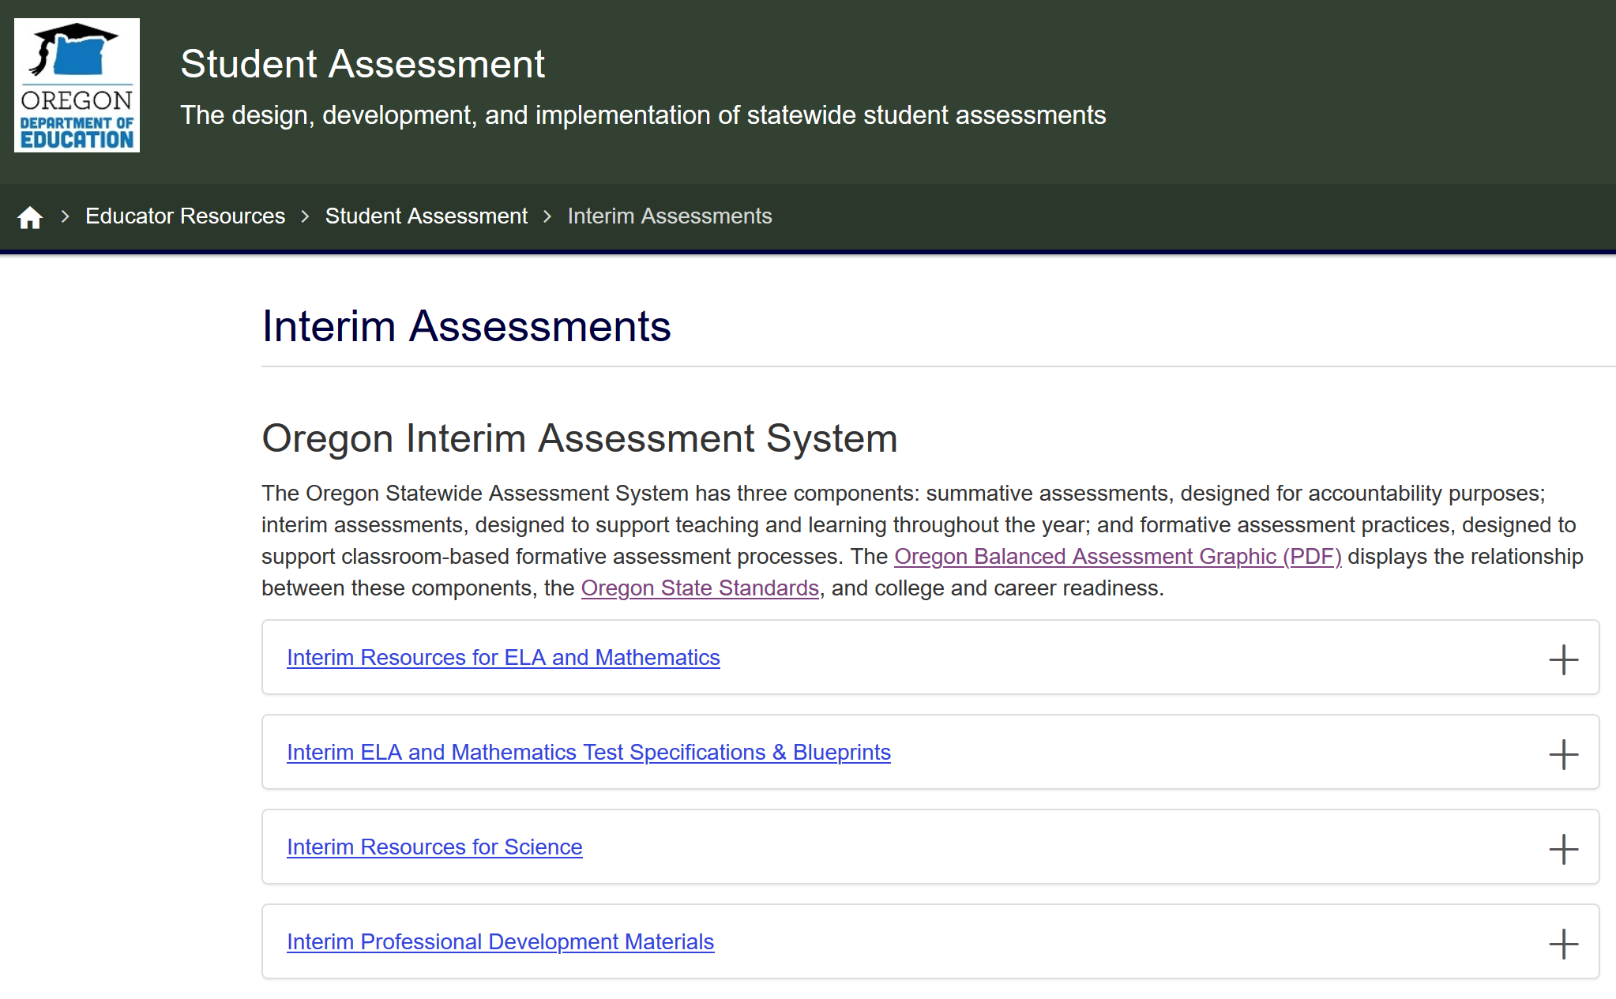
Interim Test Administration Resources
ODE Interim Assessment webpage
Notes:
For access to resources discussed in this training or for additional resources for the Interim Assessment System, please navigate to ODE Interim Assessment webpage.
This concludes the Module 8 - Interim Assessment Administration and Test Security

