Slide 1
Overview of BEAR Assessment System
Review of BAS
Learning progression
Item design
Outcomes/Scoring
Assessment quality
Outline
Notes:
I’d like to start with a review of some of the topics covered in the first set of slides. In particular, I’ll be reviewing the four building blocks of the BEAR Assessment system and their relationship to our chapters.

Slide 2
BEAR Assessment system (BAS)
A comprehensive, integrated system for assessing, interpreting, and monitoring student performance Tools for teachers to do the following:
  Assess student performance on central concepts and skills in the curriculum
  Set standards of student performance
  Track student progress over the year on the central concepts
  Provide feedback for themselves, students, administrators, parents, or other audience about student progress and the effectiveness of the instructional materials and classroom instruction
Notes:
As I mentioned in the previous chapter, the BEAR Assessment System is a comprehensive, integrated system for assessing, interpreting, and monitoring student performance. It includes tools for teachers to do the important tasks of assessment, including:
Assessing student performance on central concepts and skills
Setting standards of student performance in their classrooms
Tracking student progress over the year on the central concepts they teach
And providing feedback for themselves, students, administrators, parents, and other audiences about student progress and the effectiveness of the instructional materials and classroom instructional activities

Slide 3
4 building blocks
Learning Progression
Item Design
Assessment Quality
Outcomes/Scoring
Notes:
The BEAR Assessment System consists of four building blocks, starting with the construction or identification of a learning progression, leading to the design of items, and then of the outcome space (how to code the results from the administration of the items); finally, we have the evaluation of assessment quality. Each building block leads to the next one in the process, and as you can see, the process is cyclical, and often consists of several cycles before a particular client is satisfied with the quality of all of them.

Slide 4
Components of bas
Building Block | Principle | Activity | Main Product
Learning Progression | Assessment should be based on a developmental perspective of student learning | Define knowledge development aspects within LP | Map of knowledge development
Item Design | A match between what is taught and what is assessed | Link assessment tasks to learning progression; different types for different purposes | Items
Outcomes/ Scoring | Teachers must be the managers of the system, with the tools to use it efficiently and effectively | Judge students' work and use results to plan instruction | Scoring guides and exemplars
Assessment Quality | Evidence of quality in terms of reliability and validity studies and evidence of fairness are needed | Create maps of learning and evaluate reliability and validity evidence | Maps and related reports
Notes:
Here’s another way to look at the four building blocks of the BEAR Assessment system. The column on the far left contains the four building blocks. Each of these was based on a principle, which are shown in the next column to the right. Each of these necessitates an activity, shown in the next column to the right, and each results in a product, shown in the rightmost column.
So, the learning progression building block was based on the principle that assessment should be based on a developmental perspective of student learning, it necessitates the definition of the knowledge development one wants to focus the assessment on, and it results in a map of knowledge development
The item design building block is based on the principle that there should be a match between what is taught and what is assessed, it requires the linking of all the assessment tasks to the learning progression, and it results in high quality items.
The outcome space building block is based on the principle that teachers should be the managers of any assessment system used in the classroom, and that they should have the tools to use it effectively. It requires the judgment of student work, and the use of the results to plan further instruction, and it results in useful scoring guides, and exemplars – sets of examples of actual student work at every level of the scoring guide
Finally, the building block of assessment quality is based on the need for evidence of reliability, validity and fairness, not only of large-scale tests, but of classroom assessments as well. It requires the creation of empirical maps of student learning, and the collection of reliability and validity evidence, and leads to empirical maps and other reports. We’ll be learning more about this in a later chapter.

Slide 5
Spending time on assessment aids in high-quality teaching
Provides information about students’ progress “just in time” to reteach or expand when necessary
Allows diagnosis of individual students who are having difficulty or who are ready for more in-depth material
Provides deeper understanding of where students really are – for example, do they understand conceptually, or have they simply learned a set of steps?
Provides a chance for teachers to think reflectively about what they are doing: what works, what doesn’t, what they might change next time

Slide 6
Remember the BAS is a cycle
Learning Progression
Item Design
Assessment Quality
Scoring
Notes:
Describe four blocks
Teachers of course revisit assessment as part of teaching, but this provides a systematic model for

Slide 7
Often contains sub-cycles
Learning Progression
Item
Design
Inner Loop
Assessment
Quality
Scoring

Slide 8
Reasons for the cyclical nature
Begins with theory-based ideas for LP levels, item design, order, and so on
Makes extensive use of empirical evidence to improve on theory and relate to actual practice
Draws heavily on ideas of validity evidence and the improvement of validity (i.e. response processes, internal structure, etc.)

Slide 9
We often don’t see this cycle
Before the beginning of the Common Core, most teachers at most times used packaged curricula and assessments
However, all curriculum developers and assessment developers have gone through several cycles of development – but behind the scenes, where teachers mostly don’t see them

Slide 10
Learning Progressions
Learning Progression
Item Design
Assessment Quality
Outcomes/Scoring
Notes:
Now, let’s talk about the first building block: the learning progression.

Slide 11
BAS #1: Learning Progression
Focus on the process of learning and on an individual student’s progress through that process
Assessment should be based on a developmental perspective of student learning
Define knowledge development aspects or learning targets within LP:
  Upper level
  Lower level
  Middle levels → LP Building blocks
Notes:
A learning progression should focus on the process of learning and on an individual’s progress through that process. The LP levels are defined by
an upper anchor (the target knowledge for students at the end of a unit, course, or year),
a lower anchor (where the least able students start at the beginning of the unit, course, or year),
and the middle levels, or building blocks.
You can use the guideline and templates provided for developing learning progressions to help you in this process

Slide 12
An example learning progression
Example based on measurement of student understanding of density and buoyancy
Accompanied a curriculum called “Why Things Sink and Float”
Science unit designed for middle school classrooms
Notes:
We’ll be showing an example of a learning progression developed for an instructional unit for density and buoyancy called “Why Things Sink and Float.” This unit was developed for middle school science, and is most often used at the 7th grade level. We chose this because it is a relatively simple example of a learning progression, and does not require a large amount of specific subject matter knowledge to understand.

Slide 13
Curriculum units
Notes:
Here’s an illustration of what the instructional sequence looked like. The order in which the ideas were taught is shown on the left; the center column includes the titles of some of the lessons (the ones including embedded formative assessments – called reflective lessons in this unit), and the right column contains the titles of these assessments

Slide 14
The learning progression
Notes:
Here is the learning progression developed by the team who worked on the curriculum.
Students at the lowest levels (shown at the bottom of the page) either left no response, or provided a response that was completely irrelevant to the question.
At the next level, students attended to some aspect of the floating object to explain its floating, but it was considered an unconventional feature such as the shape of the object, or that it was hollow.
As students moved up, they first attended to either mass or volume, then to both mass and volume, then to the density as formally defined.
The goal of the curriculum was to have students compare the density of the object to the density of the medium (such as water, oil, or rubbing alcohol) in which the object was floating. This is called relative density

Slide 15
The item design
Learning Progression
Item Design
Assessment Quality
Outcomes/Scoring
Notes:
Once we have established the learning progression, we can then use it to develop items: the item design

Slide 16
BAS #2: Item Design
A match between what is taught and what is assessed
Link assessment tasks to learning progression
Different types for different purposes
Use Assessment Blueprint and Item-Writing Template as provided
Notes:
The item design ensures a match between what is taught and what is assessed.
It requires us to link assessment tasks to the learning progression
It allows the use of a variety of different item types to match the specific purpose
You can use the assessment blueprint and item writing templates provided to help you develop items

Slide 17
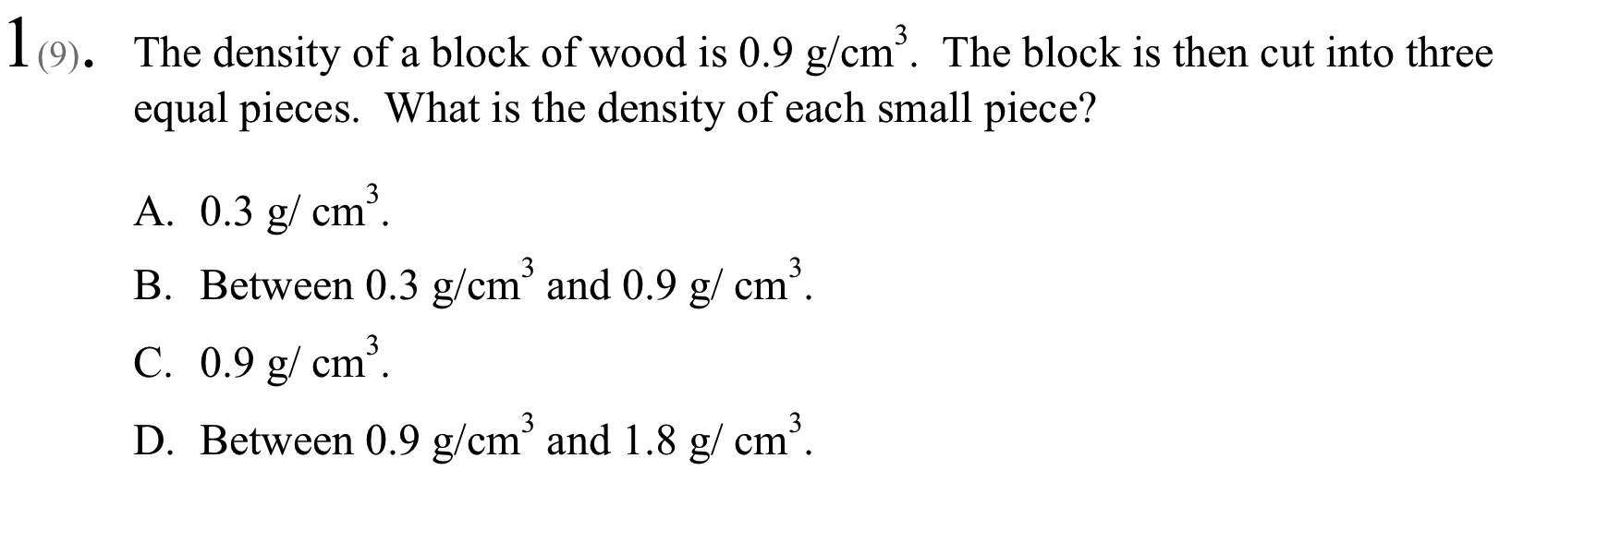
A forced-choice item
Notes:
Here is one of the multiple choice items used on the pretest and posttest for Why Things Sink and Float.
Students are told the density of a piece of wood, and asked what effect cutting the wood into pieces will have on density
The correct answer is C; each piece will have the same density as the original piece.
This item measures Level D (density) in the Learning Progression shown on the previous slide; a student who does not understand density as an inherent property of matter will not choose the correct answer. This is one way to connect the items to the learning progression

Slide 18
An Open-ended item
Explain below why things sink and float. Write as much information as you need to explain your answer. Use evidence and examples to support your explanation
Notes:
Here is an open-ended item used in many of the reflective lessons throughout the course. Students are asked to explain, as best they can, why things sink and float, using evidence and examples. This item connects to all levels of the learning progression, as we will see in the section on outcome spaces

Slide 19
An ordered multiple choice item
What is the most important reason why things sink and float?
Mass or weight – anything will sink if it is heavy enough | M/V
Shape – anything will float if it is the right shape | UF
The ratio of mass to volume – things float if they are light for their size | D
Hollowness – things float only when they have air inside | UF
Notes:
Here is a special kind of multiple choice item that we might make based on student responses to the previous open-ended item. This is called an ordered multiple choice item, because the distractors are not coded as simply wrong. They are, instead, taken as evidence of a particular level of the learning progression.
Students who choose response A show evidence of being at the level that considers only mass.
Students who choose B or D show evidence of attending to unconventional features;
While students who choose C show evidence of being at the level that considers density.

Slide 20
outcomES/Scoring
Learning Progression
Item Design
Assessment Quality
Outcomes/Scoring
Notes:
Now, let’s move on to the Outcome Space – the coding of student responses and the relating of various responses to different levels of the learning progression

Slide 21
BAS #3: Outcomes/Scoring
Teachers must be the managers of the system, with the tools to use it efficiently and effectively
Judge students' work and use results to plan instruction
Development and use of scoring rubrics
  Use the item-writing template to design the scoring rubrics
  Typical student’s understanding/misunderstanding reflected in their item responses can delineate the different levels of the scoring criteria
The difference between scoring and grading
Normally occurs in closer tandem with item development (BAS #2)
Notes:
The outcome space is designed to help teachers effectively judge student work and use the results to plan instruction
For open-ended items, this involves the development and use of scoring guides or rubrics
The item writing template can be use to aid in the development of rubrics
We will clarify in future chapters the difference between scoring and grading
We also want to point out that this process usually occurs in closer tandem with item development, but they have been separated for this series of chapters.

Slide 22
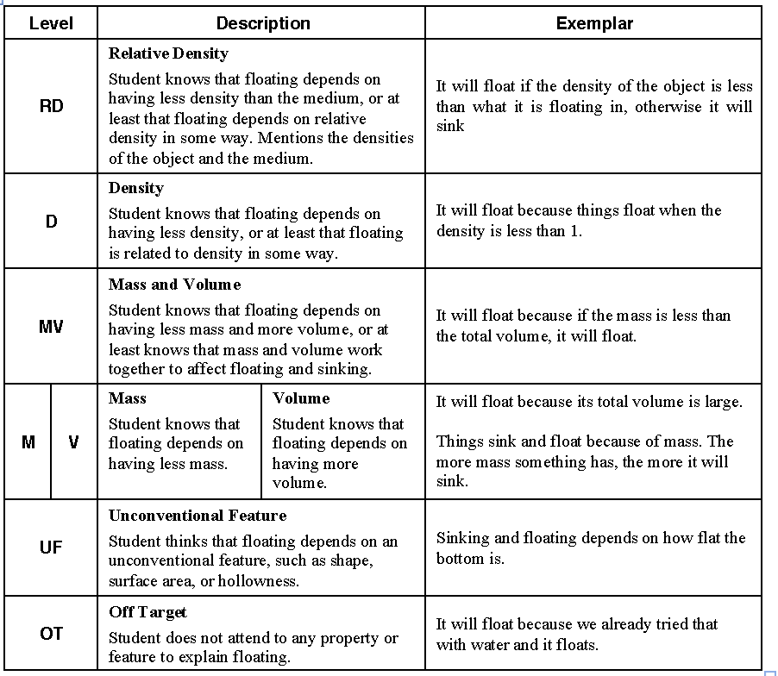
Scoring Guide for open ended items
Notes:
Here is the scoring guide that was used for the open-ended question about why things sink and float.
You can see that the levels of the scoring guide in this case are equivalent to the levels of the learning progression, given on the left.
There is an objective description of each type of response in the middle column,
while on the right is an actual example of such a response, given by a student who answered the item.
Not all scoring guides are just restatements of the scoring guide (some need to be much more specific) and not all open-ended items address all levels of the learning progression (some address only a few).

Slide 23
Assessment quality
Learning Progression
Item Design
Assessment Quality
Outcomes/Scoring
Notes:
Finally, let’s talk a bit about the final building block: assessment quality

Slide 24
BAS #4: Assessment Quality
Provide evidence and analysis of quality of the assessment tasks in terms of reliability, validity and fairness
Cycle back to any preceding stages, if necessary
The work in the outcome space and assessment quality will build upon the work in the learning progression and item design.
Notes:
Finally, measures of assessment quality provide evidence regarding reliability, validity, and fairness
This may require us to cycle back to preceding stages to improve the process

Slide 25
Assessment Quality
How do you know if your assessment is performing as you intended?
  Includes reliability and validity evidence (see future chapters)
  Includes predictions for which items should be easy and which difficult, matched with actual data
  Includes predictions for student performance, matched with actual data
Notes:
This is how you ensure that your assessment is performing as you intended
This can include formal reliability and validity evidence, which will be discussed in a future chapter
It is also very useful to predict (before test administration) which items you expect to be easy for your students, which moderately difficult, and which most difficult. It is then possible to match this with actual test data from your class
It is also useful to predict which students you expect to do well (based on homework, class discussion, and other information you have), and which you expect to do poorly. This can be matched with actual test performance.
When predictions for items or students deviate greatly from actual data, it is useful to see if you can determine why (perhaps the wording of a simple item confused many students? Perhaps a top student had a bad day, or a lingering misconception?)

Slide 26
Iterative process of bas
Learning Progression
Item Design
Assessment Quality
Outcomes/Scoring
Notes:
Finally, we want to reiterate that ideally, the BEAR Assessment System is an iterative process. Evidence of lack of assessment quality leads to revision of the learning progression, the items design, and the outcome space, which leads to the collection of additional data regarding item quality, often over several uses of the assessment.

Slide 27
Bibliography
American Educational Research Association, American Psychology Association, & National Council on Measurement in Education. (2014). Standards for educational and psychological testing (3rd ed.). Washington, DC: Author.
Nitko, A. J., & Brookhart, S. (2007). Educational assessment of students. Upper Saddle River, NJ: Pearson Education, Inc.
McMillan, J. H. (2007). Classroom assessment. Principles and practice for effective standard-based instruction (4th ed.). Boston: Pearson - Allyn & Bacon.
Wilson, M. (2005). Constructing measures: An item response modeling approach. New York: Psychology Press, Taylor & Francis Group.
Wilson, M., & Sloane, K. (2000). From principles to practice: An embedded assessment system. Applied Measurement in Education, 13 (2), pp. 181-208.
Notes:
That’s the end of our introductory chapter; if you’d like more general information, here are some references for you.

Slide 28
Creative Commons License
Overview of BEAR Assessment System PPT by the Oregon Department of Education and Berkeley Evaluation and Assessment Research Center is licensed under a CC BY 4.0.
You are free to:
Share — copy and redistribute the material in any medium or format
Adapt — remix, transform, and build upon the material
Under the following terms:
Attribution — You must give appropriate credit, provide a link to the license, and indicate if changes were made. You may do so in any reasonable manner, but not in any way that suggests the licensor endorses you or your use.
NonCommercial — You may not use the material for commercial purposes.
ShareAlike — If you remix, transform, or build upon the material, you must distribute your contributions under the same license as the original.
Oregon Department of Education welcomes editing of these resources and would greatly appreciate being able to learn from the changes made. To share an edited version of this resource, please contact Cristen McLean, cristen.mclean@state.or.us.

