Slide 1
Preparing [DISTRICT NAME] students for college & Career
Setting a New Baseline for Success

Slide 2

Higher Standards, Better Assessments
Whether they want to go to college or straight into the workplace,
our students need to be able to think critically and solve complex problems.

Slide 3
Why new standards? Why now?
Old standards were not adequate for success after high school.
Nationally, 40% of students in college need remediation in at least one academic subject.
In Oregon, 66% of graduates who go on to community college take remedial classes in math, English, or both.
By 2020, 74% of jobs will require more than a high school diploma.
Customize

Slide 4
Oregon leaders support new standards
“Oregon’s college-and career-ready standards are a promise to our students that we will provide them with the best instruction.”
Nanette Lehman,
2013 Oregon Teacher of the Year
Customize

Slide 5
What are Oregon’s new standards?
More rigorous expectations for what students should know and be able to do to be college and career ready
Ask students to demonstrate and apply their knowledge and skills in areas such as critical thinking, analytical writing, and problem solving
Are only for math and English
They are not a curriculum
Customize

Slide 6

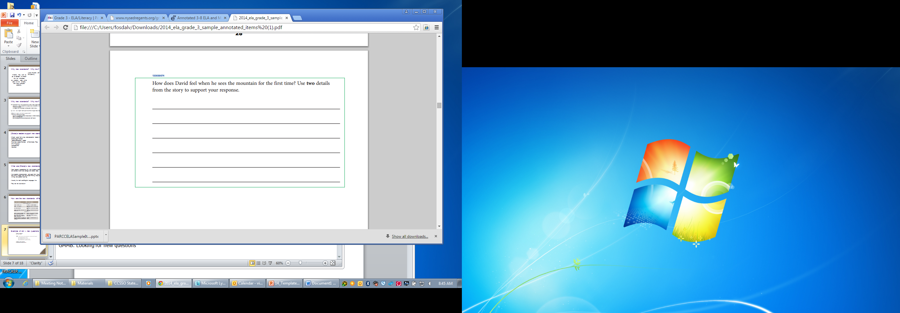
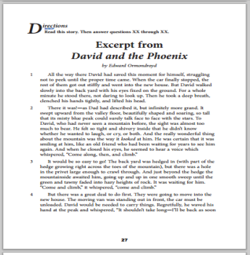
Example of OAKS vs. Smarter Balanced questions
Grade 3 ELA: Old Question
NY State Test, 2008
Simple multiple choice question. Students do not need to understand passage to answer correctly.
Grade 3 Math: New Question
EngageNY Common Core Test 2014
This two-step question requires students comprehend the passage, and then compose a response that uses the story to support their answer.
Customize

Slide 7
How are we measuring the new standards?
Oregon is part of the Smarter Balanced testing consortium
Questions for the tests were developed by teachers
500 teachers from Oregon were involved in the writing process
All test questions are aligned to the new standards
Customize

Slide 8
How will students be scored?
Students receive a numerical score:
Level 1 = the greatest need for improvement
Level 4 = the strongest performance.
Students who score a Level 3 or above are deemed on the right track to be college- and career ready when they graduate from high school.
Students who score below a Level 3 have not fully met some of the goals that were set for them in the current school year and need additional assistance to reach a Level 3 in the future.
Customize

Slide 9
How will scores compare to old tests?
Scores are not comparable to previous state tests
We are setting a new baseline for student performance
Proficiency levels have changed
We’re asking students to challenge themselves to think critically and analyze data
We’re putting all students on the right path to college and career
Customize

Slide 10
What do the results mean for students?
Because our standards are more rigorous, we anticipated fewer students would meet the higher bar this first year. However, our students performed better than anticipated, showing that students and teachers are rising to the challenge of higher standards
Students who receive a level 3 or 4 (on a 4-point scale) are considered on track to graduate high school college- and career-ready
Smarter Balanced is one approved option for meeting the Essential Skills requirement
No student will be held back a grade or kept from graduating based on the results alone

Slide 11
What do the results mean for teachers?
Student learning gains on this new test will be one factor in how educators are evaluated
The transition to new tests will require patience and persistence
Test results will provide important feedback to educators to address learning gaps early and better prepare students for success.
Teachers need clear, consistent information about test results so they are able to communicate with parents and students.

Slide 12
What do the results mean for schools?
Schools will not be rated this first year
The new scores set a new baseline
Results will improve over time. We know we can do better and we are committed to helping all students achieve at high levels
The results help us address gaps for students, improve educational outcomes, and replicate successes

Slide 13
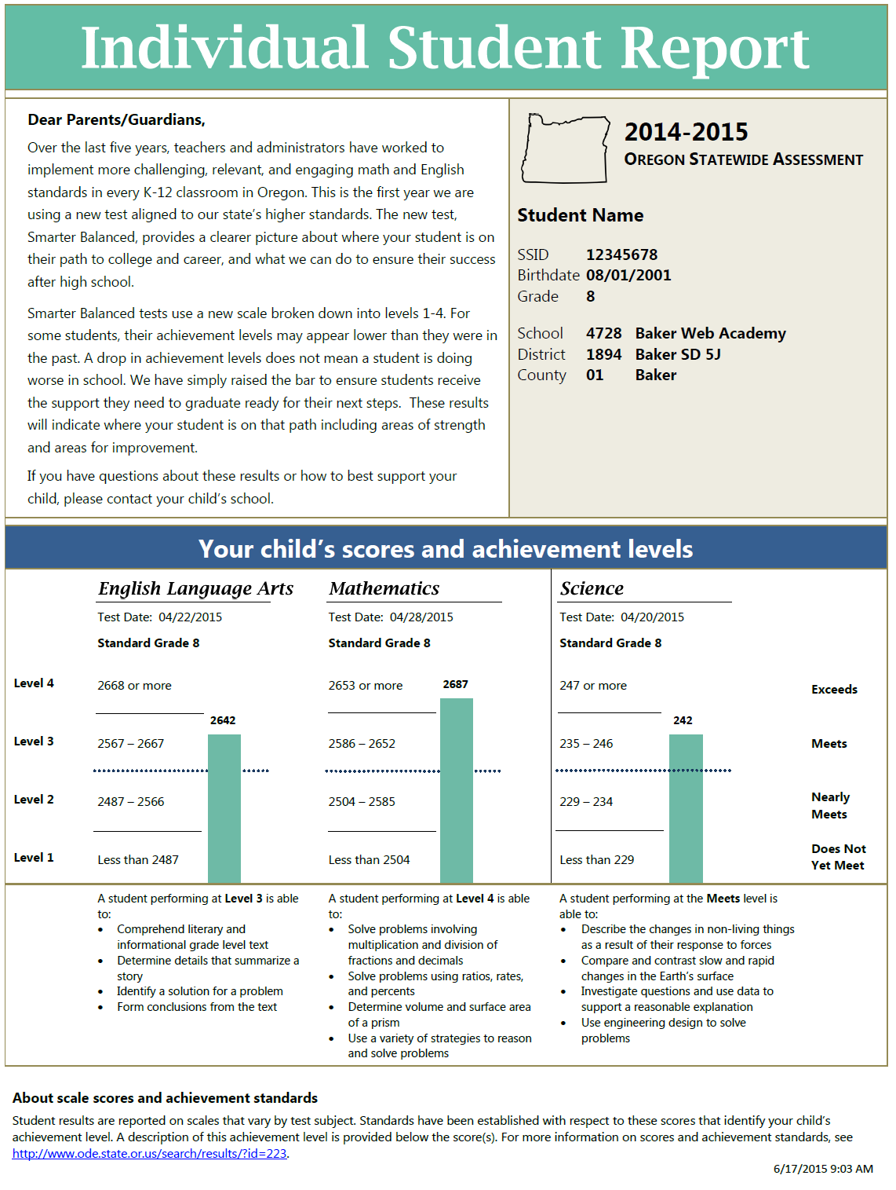
2 New Score Reports
This form shows 3 content areas: English, Math, and Science – and your child’s progress.
Talk to your child’s teacher about the results and how to address areas needing work.

Slide 14
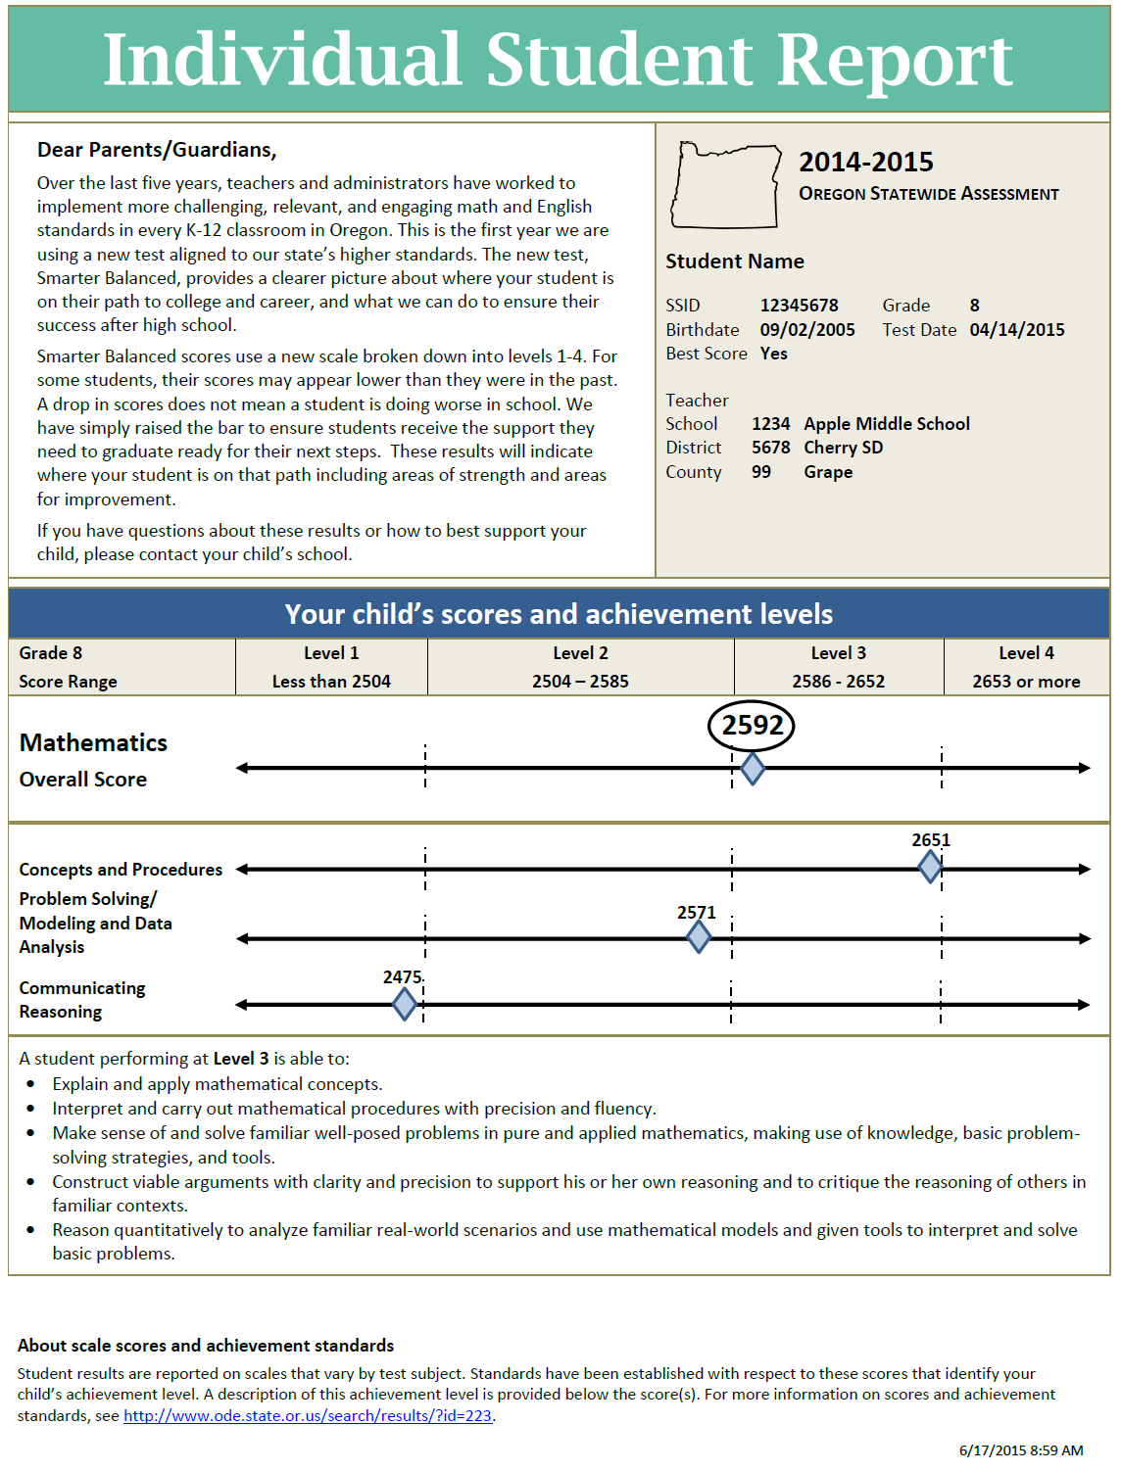
2 New Score Reports
This form shows Math and English scores, including an overall score and scores in each subject to help identify students’ strengths and areas of improvement.

Slide 15
What does it mean if scores are low?
We have raised the bar to better prepare students for future success
This is a new baseline
It will take time for students to acclimate to the new higher standards
We’re providing a more accurate indicator of whether students are prepared for college-level coursework
It does NOT mean that students aren’t learning or proficiency levels have dropped
Customize

Slide 16
What can teachers do with the results?
Continue to focus on the standards
Attend professional development trainings
Seek guidance/support from mentors
Use differentiated strategies to meet different students’ learning needs
Familiarize students with the computerized format of the assessment
Customize

Slide 17
What can [DISTRICT] do with the results?
Use data to inform school improvement processes
Continue to provide professional development and support for teachers
Compare progress with other schools in the district, state and across the country to assess performance
Remember that test scores are only one data point
Customize

Slide 18
What can parents do with the results?
Support their child’s learning at home – particularly in growth areas
Work with teachers to develop strategies to improve student performance
Encourage children and reassure them that test scores are only one indicator of progress
Customize

Slide 19
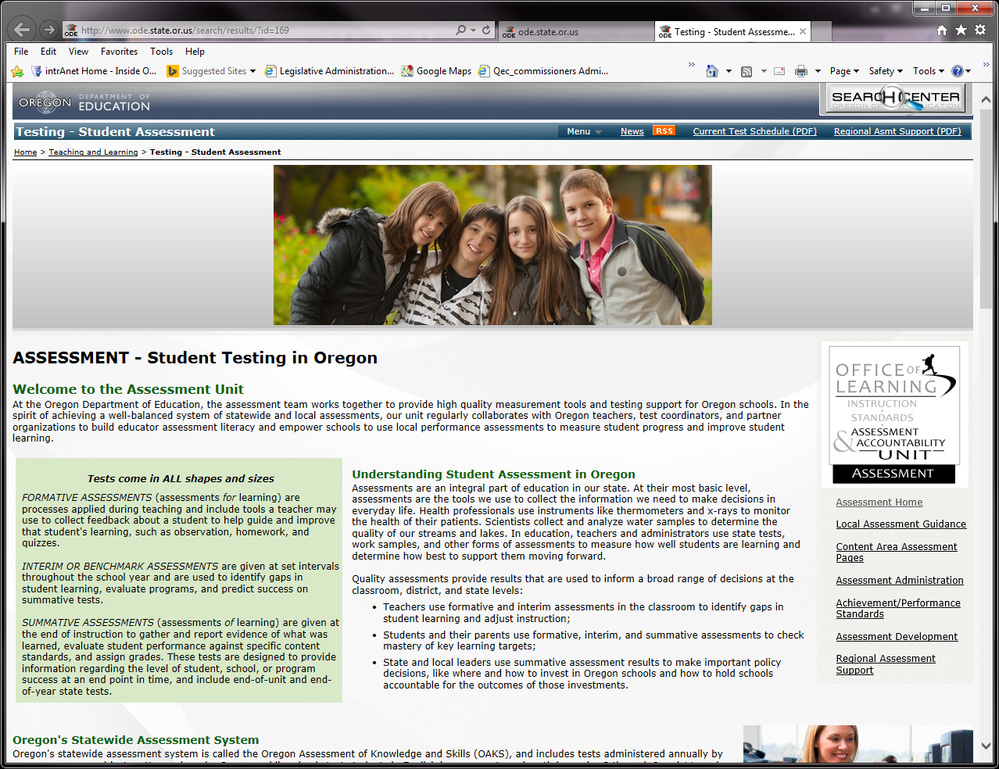
Where can I go to learn more?
Oregon Department of Education’s Assessment Webpage
Customize

