Slide 1
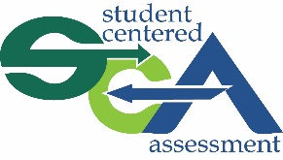

Social and Emotional Learning To Support Formative Assessment
Self-Regulation

Slide 2
Learning objectives
By the end of this session, participants will be able to:
Define self-regulation
Understand the importance of self-regulation for formative assessment
Feel familiar with the research base in this area
Use actionable strategies to implement self-regulation interventions with students
Train other adults using the materials provided

Slide 3
Self-regulation: What’s in a name?
Self-control
Emotional Competence
Self-discipline
Self-regulation
Executive function
Self-management

Slide 4

Self-Regulation
Self-regulation: What’s in a name?
Future orientation
Self-control
Perseverance
Grit
Notes:
Self-regulation is an umbrella term that encompasses other things like Future Orientation, Self-Control, Perseverance and Grit. These represent some of the skills, beliefs and capacities that youth need to navigate their way into the future. Self-regulatory skills and perseverance allow young people to rise above the distractions and temptations of the moment, stay on task, and navigate obstacles to long-term growth and achievement. Such abilities make it possible for students to set goals and consistently progress towards achieving them over the long term.

Slide 5
Future orientation
“Future time perspective” is a key feature that develops significantly in adolescence.
Personally valued future goal
Sub-goals
Self-regulatory behaviors
Goal achievement
Notes:
This term has been used to refer to a collection of loosely related affective, attitudinal, cognitive, and motivational constructs,
including the ability to imagine one’s future life circumstances (Greene, 1986; Nurmi, 1989a), the extent to which one thinks about or considers the future (‘‘time perspective’’; Cauffman & Steinberg, 2000), the extent to which one is optimistic or pessimistic about the future (Trommsdorff & Lamm, 1980), the extent to which one believes he or she has control over his or her future (McCabe & Barnett, 2000), and the extent to which one engages in goal setting or planning (Nurmi, 1989b).
Here’s how the Youth Development Executives of King County (YDEKC) conceptualize it:
“Once a young person commits to a personally valued future goal, he or she develops a system of proximal sub-goals and self-regulatory behaviors to achieve it. Goal orientation is an important component of academic success when school work is seen as relevant to future goals and instrumental to their attainment.” (Miller & Brickman, 2004; Tabachnick, Miller & Relyea, 2008).

Slide 6
Example of future orientation
Marina was feeling a little lost during her junior year of high school. Part of her wanted to go to community college after high school to study child development, because she liked little kids and was interested in being a preschool teacher. But another part of her had always assumed she wouldn’t go to college. She was worried about sliding into an unfulfilling job after high school and being unhappy. Her older sister encouraged her to volunteer a couple of days a week at a preschool to see if she really liked being a preschool teacher. She loved it, and found that she fit in really well with the teachers at the school. She decided to find out the requirements for admission in the child development program, and started studying hard to pull her grades up in order to apply.
Notes:
A young person with a hopeful attitude and an optimistic vision of their future self may be more motivated to pursue educational and vocational goals over the long term. Accordingly, hope is a strong predictor of success in middle school, high school, college, and beyond (Snyder, et. al., 2002) Youth who are not hopeful or goal-oriented may lack a clear sense of direction, and become overwhelmed by external pressures and expectations. Positive future orientation also predicts better social and emotional adjustment, and can help to mediate the effects of stress in youth (Wyman, Cowen, Work & Kerley, 1993).

Slide 7
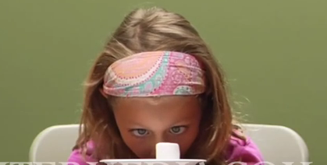
Self-control
Notes:
https://www.youtube.com/watch?v=0mWc1Y2dpmY
https://www.ted.com/talks/joachim_de_posada_says_don_t_eat_the_marshmallow_yet?language=en
Who can tell me what marshmallows might have to do with self-control?
The “marshmallow” studies were conducted by Walter Mischel and his colleagues in the 1970s. In these studies, preschoolers were given a choice between having one marshmallow whenever they wanted or having two marshmallows if they waited. Children’s responses varied greatly, ranging from eating one marshmallow in a few seconds to waiting a full 15 minutes to have 2 marshmallows. Years later, researchers have followed up with the participants and found significant positive correlations between children’s ability to wait as preschoolers and a range of outcomes in their childhood, adolescence, and even adult lives. Self-regulation allows students to put aside activities that may distract or tempt them in the short term so they can pursue tasks that are important to their long-term success.
TEdX video showing that this is a cross-cultural phenomenon (replicated in Colombia). On average, about 2/3 eat the marshmallow without some intervention. Interventions can include picturing it as a cloud, or imagining a bug on it. Kids are able to wait a lot longer with such interventions, suggesting that self-control is not fixed, and it’s not a destiny—it is malleable, and there are strategies to promote it at different developmental stages.

Slide 8


Self-control
Tune out distractions and temptations
Stay on task
Navigate obstacles

Slide 9
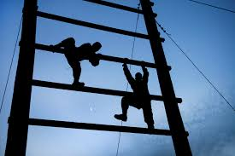
Perseverance and grit
Perseverance and related constructs such as “grit” emphasize self-management and the ability to overcome setbacks
Linked to the achievement of long-term goals, such as college attendance, but recent results are mixed.
Notes:
It is important to distinguish between self-control, which involves the ability to resist temptation and control impulses in the short-term, and perseverance, which add the element of time. Another well-known construct called “grit,” emphasizes perseverance in the pursuit of long-term goals.
Example from the research (Duckworth et al., 2007): Grit accounted for an average of 4 percent of the variance in success outcomes, including educational attainment. Grittier individuals attained higher levels of education than less gritty individuals of the same age, controlling for conscientiousness and other Big Five traits. Results suggest that persisting with long-range goals over time enables completion of high levels of education.
BUT: a more recent study that grit was less important than conscientiousness in predicting academic achievement (Rimfeld et al, 2016).

Slide 10
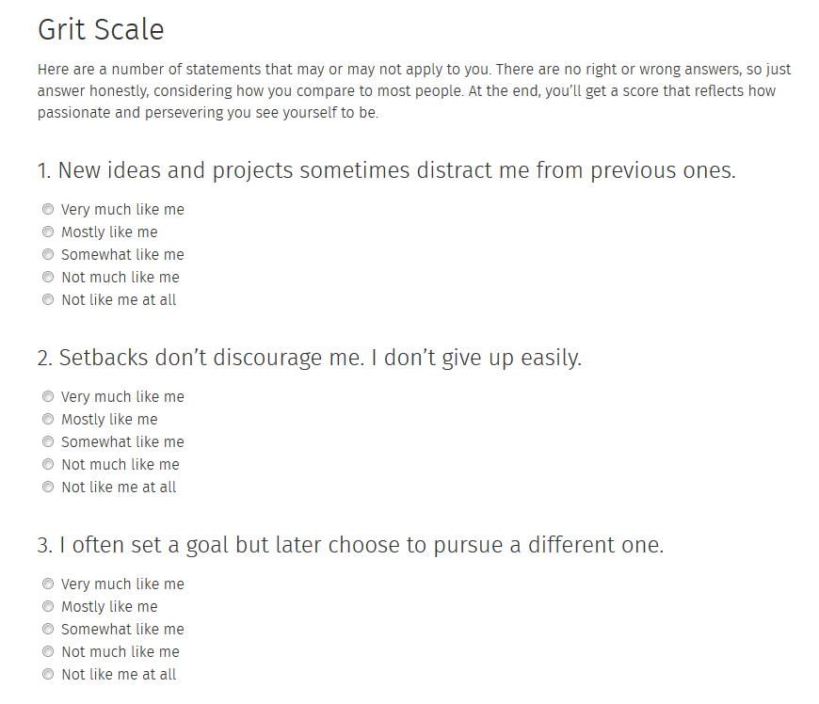
Am I gritty?
http://angeladuckworth.com/grit-scale/
Notes:
Here is the most commonly used tool for measuring grit, from research by Angela Duckworth’s lab.

Slide 11
Discussion about Grit
Does the idea of “grit” risk blaming youth for their circumstances?
How can adults take responsibility for fostering self-management, perseverance, and grit through changes to the environment?
Notes:
Interventions directed toward individuals hold promise, but are ultimately limited. Children and youth whose lives are affected by poverty, racism, and other forms of oppression face challenges that are difficult to rise above through individual agency alone. Educators and community members need to focus not only on individual children and youth, but also on the environments in which they spend their time and the adults with whom they interact. We need to work toward structural and institutional changes that will afford all children the opportunity to both imagine and achieve the future they desire.

Slide 12
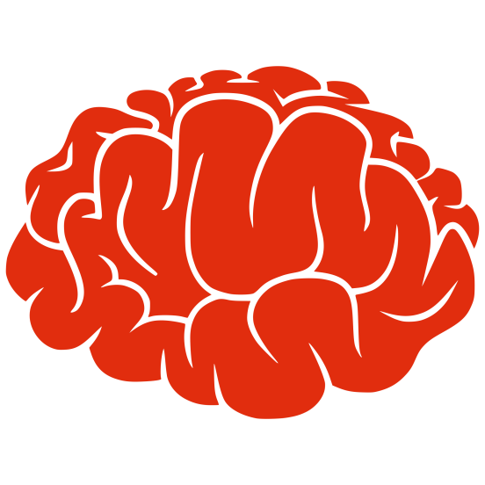
How does self-regulation relate to formative assessment?
Physical/physiological relationship
Unregulated stress responses distract from thinking
Notes:
Self-regulation skills play into formative assessment in a few ways. First, let’s consider the physiological side. For formative assessment to work, teachers have to design lessons that make it possible for students to reveal their thinking, such as by answering an open-ended question, sketching a diagram, writing an explanation, participating in a debate with other students—there are many ways for teachers to ask students to show their thinking. Crucially, students have to be willing to reveal what they are thinking, even if that means they reveal things they misunderstand or are just beginning to understand. Especially when students aren’t used to demonstrating their thinking in such ways or the content matter is especially challenging for them, this can make students feel vulnerable and stressed. When they’re feeling vulnerable and stressed, they may feel a variety of physical changes—tense muscles, knots or butterflies in their stomachs, sweaty palms, racing heart beats, dry mouths—that can interfere with their ability to think and learn. This is especially true for students suffering from trauma or adverse childhood experiences (ACEs), whose fight, flight, or freeze responses can be triggered by stressors in the classroom that have nothing to do with the original source of their trauma.

Slide 13
How does self-regulation relate to formative assessment?
Physical/physiological relationship
Stress management minimizes the distraction
Notes:
It’s very important to remember it’s normal to feel confused, frustrated, and stressed when we’re learning something new—I’m sure you can remember a time you struggled to learn something and it took a while for the concept to “click.” Thus the key point isn’t to try to remove stress entirely from classrooms. Rather, we can make classrooms less stressful by building social belonging within them and we can help students learn to notice and manage their stress, an important part of self-regulation.

Slide 14
How does self-regulation relate to formative assessment?
Metacognitive relationship
Metacognition is thinking about one’s own thinking
Over time, students develop self-monitoring or self-assessment skills and new learning strategies
Students thus regulate their own learning and become independent learners
Notes:
The second aspect of self-regulation that relates to formative assessment is metacognition, or thinking about one’s own thinking. Over the long-term, a goal of formative assessment is for students—not just teachers—to monitor their own understanding of academic materials and become independent learners. Teachers help students learn to self-monitor or self-assess their learning, and introduce students to new learning strategies they can try, like rereading materials, talking to a peer, asking the teacher questions, looking for more research on the subject, etc. When students engage in self-assessment and take action to correct or deepen their understanding, they’re engaging in formative assessment.

Slide 15
How does self-regulation relate to formative assessment?
Perseverance relationship
Teacher delivers instruction
Student responds
Teacher interprets student response
Teacher provides feedback and/or adjusts
Notes:
One final way in which self-regulation relates to formative assessment is through perseverance. When teachers and students use formative assessment practices, they’re committing to an ongoing learning process in which both need to keep trying and adjusting.

Slide 16
How does self-regulation relate to formative assessment?
Perseverance relationship
Teacher delivers instruction
Student responds
Teacher interprets student response
Teacher provides feedback and/or adjusts
Notes:
If a student is struggling with a concept or is working on very challenging material, the teacher and student may go through many cycles of instruction, student response, feedback, and more instruction. Both teacher and student need to be able to persevere. For students, perseverance is made possible when students are able to focus on the learning task and keep at it. Self-regulation helps them keep that focus.

Slide 17
Promoting self-regulation: What can we do?
Tune out distractions and temptations
Belonging
Stay on task
Stress management
Navigate obstacles
Mindfulness

Slide 18
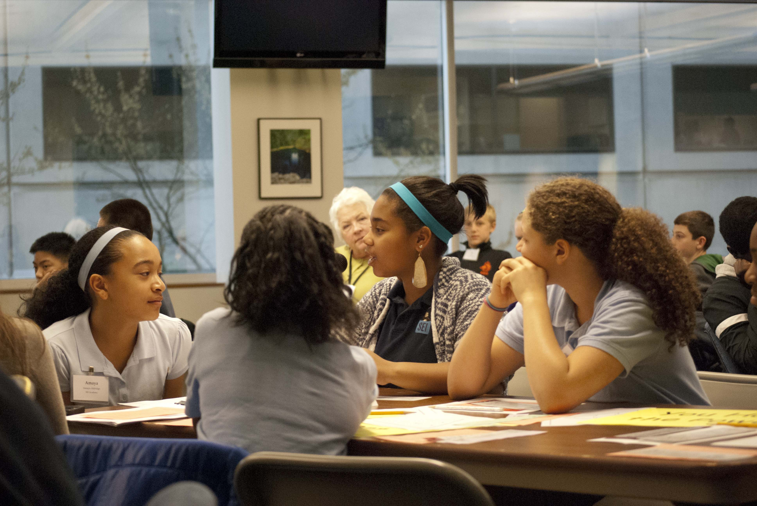
Classroom strategies to promote self-regulation
Start by promoting belonging
Notes:
Since self regulation is conditioned by context, cultivating school and program climates that promote belonging is a key foundational practice. In her research on high school dropouts, Carol Dweck found that positive relationships and a sense of social belonging were linked to goal orientation generally and persistence in school in particular (Dweck, Walton & Cohen 2014). Targeted interventions based on social belonging can also be effective in promoting future orientation in young people. Walton and Cohen (2007) found that an intervention designed to affirm social belonging in an academic context by framing adversity as a universal and temporary condition improved the optimism, sense of belonging, and ultimately academic performance of African American students.

Slide 19
Classroom strategies to promote self-regulation
Give students a quiet space they can retreat to if they need a few minutes to calm themselves
Teach students to take slow, deep breaths when they’re feeling stressed
If kids have sports practice, recess, and/or PE, encourage them to advantage of those times to play and be active
Encourage empathy and patience
Practice mindfulness
Notes:
These practices are especially important for students with adverse childhood experiences or other forms of trauma in their background.

Slide 20

Mindfulness experiment
Students picture a safe place where they feel protected and in control—a caring, supportive, and encouraging place. Before a task, students spend a few minutes breathing deeply and imagining their safe space.
A small-group counseling intervention, Student Success Skills, was provided to 53 fourth- and fifth-grade African American students in an inner-city environment. Compared with the control group, students who received the treatment reported significant changes in metacognitive skill, feelings of connectedness to school, and executive function (related to self-regulation).
Lemberger, M. E., & Clemens, E. V. (2012).

Slide 21
Exercise To Promote Self-Regulation: Possible Selves

Slide 22

Possible selves exercise
Students take part in a workshop in which they are asked to imagine a future “possible self,” list the obstacles they might encounter to realizing that self, and strategies they can use to overcome the obstacles.
An intervention designed to help low-income and minority eighth-graders imagine “possible selves” increased success in moving toward APS goals: academic initiative, standardized test scores, and improved grades. Depression, absences, and in-school misbehavior also declined. The effects were still present during a two-year follow-up.
Oyserman, D., Bybee, D., & Terry, K. (2006)

Slide 23
Possible selves exercise
Group discussions and/or writing exercises in which students reflect on their possible future selves to develop their vision of their own future
Students imagine themselves as successful adults
Students spend time connecting future possible selves to current school involvement
Students plan a path to attain their vision
Notes:
Detailed instructions for the Possible Selves Exercise are packaged under separate cover.

Slide 24
Possible selves exercise
Expands sense of academic identity and engagement in school
By promoting academic identity, students can build sense of belonging with school
School is important to my future and I belong here.

Slide 25
Thank You
SEL for Formative Assessment by Davidson, S., Bates, L., McLean, C. and Lewis, K. is licensed under a Creative Commons Attribution-NonCommercial-ShareAlike 4.0 International License.

