Slide 1
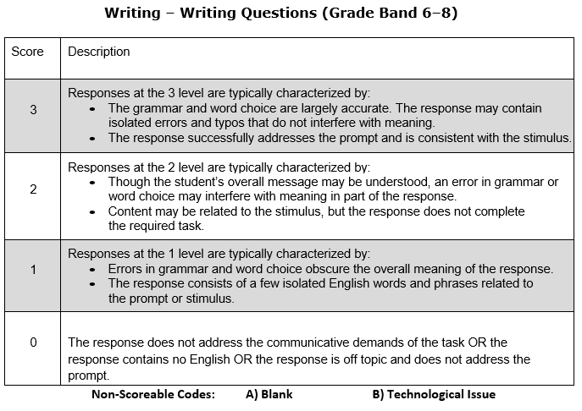
Step 3 THSS Local Scoring Rubric for Grade Band 6-8 Writing Questions

Slide 2
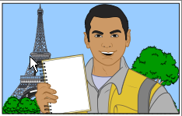
Step 3 THSS Local Scoring Example for Grade Band 6-8 Writing Questions
Listen to an announcement from the Class President. Follow the speaker’s directions for a writing task.
I have great news, everyone. A famous journalist is going to come to our school. His name is Jose Medina. He is going to visit next week! I am collecting questions from students before Mr. Medina visits. Mr. Medina has traveled all over the world covering news stories. He currently writes for a very popular news magazine.
Write three questions that you want to ask the visitor. Be sure to write in complete sentences.

Slide 3
Step 3 THSS Local Scoring Example for Grade Band 6-8 Writing Questions
Write three questions that you want to ask the visitor. Be sure to write in complete sentences.
Now, write the first question for the visitor here. | Student’s first response
Now, write the second question for the visitor here. | Student’s second response
Now, write the third question for the visitor here. | Student’s third response
Example Student Responses
Why did you want to become a journalist? I have a camera, I like pics! How you chose what to wrote about for you stories? Hi. How are you? Do you play Fortnite? Who has been your favorite person to interview? Por qué querías trabajar como periodista? How long it take for interview someone a storee? | What college you go for journal? Is it hardd to be a jurnalist? What were the steps you took to become a journalist? Yo are inturvuu lots of people? How long have you been a journalist? Hufehqwfu igfvwejqifqio iojfjewqfjqfjiffr23i1rijgvw2fi Why do yoo kom her todai 2 tac we al?

Slide 4
Step 3 THSS Local Scoring Example for Grade Band 6-8 Writing Questions
Write three questions that you want to ask the visitor. Be sure to write in complete sentences.
Now, write the first question for the visitor here. | Student’s first response
Now, write the second question for the visitor here. | Student’s second response
Now, write the third question for the visitor here. | Student’s third response
Example Student Responses
Why did you want to become a journalist? (3) I have a camera, I like pics! (0) How you chose what to wrote about for you stories? (2) Hi. How are you? (0) Do you play Fortnite? (0) Who has been your favorite person to interview? (3) Por qué querías trabajar como periodista? (0) How long it take for interview someone a storee? (2) | What college you go for journal? (2) Is it hardd to be a jurnalist? (3) What were the steps you took to become a journalist? (3) Yo are inturvuu lots of people?(1) How long have you been a journalist? (3) Hufehqwfu igfvwejqifqio iojfjewqfjqfjiffr23i1rijgvw2fi (0) Why do yoo kom her todai 2 tac we al? (1)
Notes:
1. Rationale:
“Why did you want to become a journalist? ” is an appropriate and accurate response to the prompt and meets all criteria at the 3-point level.
“I have a camera, I like pics!” receives zero points because it does not address the communicative demands of the task. The task is to ask the journalist a question, not to issue a statement.
“How you chose what to wrote about for you stories?” meets the criteria at the 2-point level. Though the student’s overall message may be understood, errors in grammar or word choice may interfere with meaning in part of the response.
“Hi. How are you?” receives zero points because it does not address the communicative demands of the task. The question must be for the visitor but does not need to be asked of the visitor. Wide latitude is given in terms of what questions are asked. It does not need to relate to the visitor’s background, career, or field of expertise. Any reasonable, general question is acceptable.
“Do you play Fortnite?” receives zero points because it does not address the communicative demands of the task. The question must be for the visitor but does not need to be asked of the visitor. Wide latitude is given in terms of what questions are asked. It does not need to relate to the visitor’s background, career, or field of expertise. Any reasonable, general question is acceptable.
“Who has been your favorite person to interview?” is an appropriate and accurate response to the prompt and meets all criteria at the 3-point level.
“Por qué querías trabajar como periodista? ” is a Spanish question being asked of the journalist. The rubric states specifically that responses in a language other than English will receive zero points.
“How long it take for interview someone a storee?” meets the criteria at the 2-point level. Though the student’s overall message may be understood, errors in grammar or word choice may interfere with meaning in part of the response.
“What college you go for journal?” meets the criteria at the 2-point level. Though the student’s overall message may be understood, errors in grammar or word choice may interfere with meaning in part of the response.
“Is it hardd to be a jurnalist?” meets the criteria at the 3-point level. The grammar and word choice should be largely accurate. The response might contain some errors or typos, but the meaning is not obscured.
“What were the steps you took to become a journalist?” is an appropriate and accurate response to the prompt and meets all criteria at the 3-point level.
“Yo are inturvuu lots of people?” meets the criteria at the 1-point level. A response was attempted but the errors interfere with overall meaning. There are some isolated English words and/or phrases that are related to the prompt or stimulus.
“How long have you been a journalist?” is an appropriate and accurate response to the prompt and meets all criteria at the 3-point level.
“Hufehqwfu igfvwejqifqio iojfjewqfjqfjiffr23i1rijgvw2fi “ meets the criteria at the 0-point level because the response does not address the communicative demands of the task.
“Whi du yoo kom her todai 2 tac we al? “meets the criteria at the 1-point level because errors in grammar and word choice obscure the overall meaning of the response. The response consists of a few isolated English words and phrases related to the prompt or stimulus.

Slide 5
Step 3 THSS Local Scoring Rubric (notes) for Kindergarten Speaking – Show and Share Questions

Slide 6
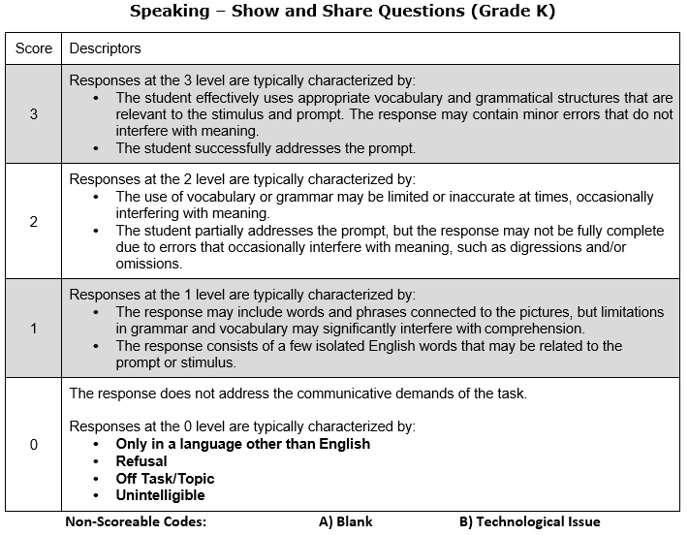
Step 3 THSS Local Scoring Rubric for Kindergarten Speaking – Show and Share Questions

Slide 7
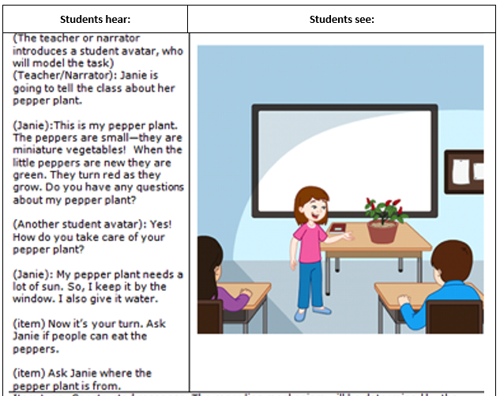
Step 3 THSS Local Scoring Example for Kindergarten Speaking – Show and Share Questions
Now it’s your turn. Ask Janie if people can eat the peppers.
Example Student Responses
Janie. Peppers? People eat peppers? Could everybody eat peppers? Puede la gente comer pimientos? Could people eat the peppers? Yes. …(no response)… I like pepper. Can people comer pimientos?

Slide 8
Step 3 THSS Local Scoring Example for Kindergarten Speaking – Show and Share Questions
Now it’s your turn. Ask Janie if people can eat the peppers.
Example Student Responses
Janie. Peppers? (1) People eat peppers? (2) Could everybody eat peppers? (3) Puede la gente comer pimientos? (0) Could people eat the peppers? (3) Yes. (0) …(no response)… (0) I like pepper. (1) Can people comer pimientos? (1)
Notes:
“Janie. Peppers?” meets the criteria at the 1-point level. The response consists of a few isolated English words that may be related to the prompt or stimulus.
“People eat peppers?” meets the criteria at the 2-point level. The student partially addresses the prompt, but the response may not be fully complete due to errors that occasionally interfere with meaning, such as digressions and/or omissions.
“Could everybody eat peppers?” meets the criteria at the 3-point level. The student effectively uses appropriate vocabulary and grammatical structures that are relevant to the stimulus and prompt. The response may contain minor errors that do not interfere with meaning.
“Puede la gente comer pimientos?” is a Spanish question being asked about eating peppers. The rubric states that responses at the 0 level are typically characterized by being dictated in only a language other than English.
“Could people eat the peppers?” meets the criteria at the 3-point level. The student successfully addressed the prompt.
A student response of, “Yes, No, I don’t know,” is considered a refusal and should be scored a “0.”
If no words are spoken by the student, it is considered a zero score.
“I like pepper?” meets the criteria at the 1-point level. When a student responds with a word or phrase that can be tied to the stimulus, it can receive a score point of “1.”
“Can people comer pimientos?” meets the criteria at the 1-point level. The response consists of a few isolated English words (“can people”) that may be related to the prompt or stimulus. The remaining words “eat pimientos” are Spanish words that translate to “eat peppers.”

Slide 9
Step 3 THSS Local Scoring Example for Kindergarten Speaking – Show and Share Questions
Ask Janie where the pepper plant is from.
Example Student Responses
Where from piment? Where from pepper? Where did you get the pepper plant? Mexico! Did you get that outside? Where is the pepper plant from? De dónde es la planta de pimienta? Where did you get it? My mom grows peppers in the garden.

Slide 10
Step 3 THSS Local Scoring Example for Kindergarten Speaking – Show and Share Questions
Ask Janie where the pepper plant is from.
Example Student Responses
Where from piment? (1) Where from pepper? (1) Where did you get the pepper plant? (3) Mexico! (0) Did you get that outside? (2) Where is the pepper plant from? (3) De dónde es la planta de pimienta? (0) Where did you get it? (2) My mom grows peppers in the garden. (0)
Notes:
“Where from piment?” meets the criteria at the 1-point level. The response consists of a few isolated English words (“where from”) that may be related to the prompt or stimulus. The remaining word “piment” means “pepper plant” in French.
“Where from pepper?” meets the criteria at the 1-point level. The response may include words and phrases connected to the pictures, but limitations in grammar and vocabulary may significantly interfere with comprehension.
“Where did you get the pepper plant?” meets the criteria at the 3-point level. The student successfully addressed the prompt.
“Mexico!” is an off task response because it is a statement, rather than a question. Off task responses receive a score of zero.
“Did you get that outside?” meets the criteria at the 2-point level. The student partially addresses the prompt, but the response may not be fully complete due to errors that occasionally interfere with meaning, such as digressions and/or omissions.
“Where is the pepper plant from?” meets the criteria at the 3-point level. The student successfully addressed the prompt.
“De dónde es la planta de pimienta? ” is a Spanish question being asked about the location of the peppers. The rubric states that responses at the 0 level are typically characterized by being dictated in only a language other than English.
“Where did you get it?” meets the criteria at the 2-point level. The student partially addresses the prompt, but the response may not be fully complete due to errors that occasionally interfere with meaning, such as digressions and/or omissions.
“My mom grows peppers in the garden” is an off task response because it is a statement, rather than a question. Off task responses receive a score of zero.

