Slide 1

2011-12
State Scoring Guide
Professional Development:
Assessing the Essential Skill of Reading
Level 3 – In-Depth Training for Content Area Teachers
Information provided by
Oregon Department of Education
2011-12
Notes:
This PowerPoint presentation is intended to be used as part of a 2.5 to 3 hour in-depth training session. This version is focused toward content area teachers and emphasizes using Reading Work Samples in their classrooms. Ideally, participants should have attended an introductory training session previously, although that is not mandatory.

Slide 2
Goals
Participants will
Understand current information about Adolescent Literacy Instruction and Assessment
Be able to apply the Official Reading Scoring Guide to Student Work accurately
Be aware of Common Core State Standards for Literacy in the Content areas.
Know about resources & further professional development available
Notes:
Goals for the training session

Slide 3
Information Sources
CCSS
Assessments - Adolescent Literacy
Oregon Literacy Framework
Oregon Literacy Framework
Common Core State Standards for English Language Arts & Literacy in Science, Social Studies and Technical Subjects
Assessments to Guide Adolescent Literacy Instruction (Center on Instruction)
Notes:
These are the three key documents used as rationale and direction for this workshop. The direct ties to the Reading Scoring Guide are very clear and make continued (and increased) use of the scoring guide a beneficial exercise for teachers and students in all subject areas.

Slide 4

What is Adolescent Academic Literacy?
The ability to construct meaning in content-area texts and literature including the following:
Photo by Randy L. Rasmussen The Oregonian
Notes:
From Assessments to Guide Adolescent Literacy Instruction by Center on Instruction. The full document is available at http://www.centeroninstruction.org/files/Assessment%20Guide.pdf

Slide 5
Slide 5 Blank Title
Ability to
  Make inferences
  Learn new vocabulary from context
  Link ideas across texts
  Identify & summarize important ideas
  Read for initial understanding and think about meaning in order to make inferences or draw conclusions
Torgesen, Houston, Rissman, et al., 2007
Assessments to Guide Adolescent
Literacy Instruction
Center on Instruction
Notes:
Important reading skills – these skills will help students deepen their understanding of content area material they are asked to read.

Slide 6
Three Goals for Adolescent Literacy Instruction
To increase overall levels of reading proficiency
To help students meet increasingly difficult standards in middle and high school.
To assist students who are reading below grade-level to acquire the skills and knowledge necessary to reach high school standards.
Assessments to Guide Adolescent
Literacy Instruction
Center on Instruction
Notes:
There is evidence that current average reading levels of students graduating from high school are not sufficient to meet post-secondary literacy demands, both in many workplace settings and at community colleges and universities (Biancarosa & Snow, 2006; Williamson, 2004). More about lack of reading skills among high school graduates will appear later in this workshop.

Slide 7
Demonstrating Proficiency in Reading
1. OAKS Reading/Literature Assessment
Score of 236
2. Other Options
ACT or PLAN | 18
WorkKeys | 5
Compass | 81
Asset | 42
Accuplacer | 86
SAT/PSAT | 440/44
AP & IB | various
Notes:
This should be information participants have seen before in earlier workshops. It is just a reminder of the options for demonstrating proficiency: 1. OAKS assessment and 2. other standardized assessments, with required scores. Some of these may be helpful to some students, but more are likely to benefit from the next option: Reading Work Samples
On March 11, 2011 the State Board of Education adopted additional tests and scores for proficiency in the Essential Skill of Reading. They are listed below:
AP English Literature & Composition, AP Macroeconomics, AP Microeconomics, AP Psychology, AP United States History, AP World History, AP European History, AP United States Government & Politics, AP Comparative Government & Politics
All AP tests require a score of 3 or higher to meet proficiency requirements for the Essential Skill of Reading.
IB English Language , IB History of Americas, IB History of Europe, IB 20th Century Topics, IB Economics, IB Psychology, IB Social Anthropology
All IB tests require a score of 4 or higher to meet proficiency requirements for the Essential Skill of Reading.

Slide 8

Local Work Sample
Reading Work Sample scored
using Official State Scoring Guide
Two Reading Work Samples Required
Students must earn a score of 12 or higher on each work sample
Notes:
Option 3 -- Reading Work Samples and the requirements

Slide 9

Reading Work Samples
Reading work samples may provide the opportunity that some students need to show their reading skills.
Reading work samples are an effective strategy to help students comprehend content information more thoroughly.
Notes:
All students can benefit from learning to explain their reading and using the scoring guide. Some students may increase their proficiency as a result of work samples and the scoring guide which may lead to meeting the standard using work samples or increasing their scores on the OAKS test to meet the standard. Strategies used in reading work samples will carry over into students’ post secondary plans.

Slide 10

Official Scoring Guide Traits
Demonstrate understanding
Develop an interpretation
Analyze text
Notes:
This is a review opportunity. Have participants use highlighters to mark key words and phrases as you go through each trait in the next set of slides. Use the Facilitator’s Suggestions for Leading Student Scoring to help you lead the discussion.
Remember, there are 2 versions of the Scoring Guide, one to be used with Informational text and one to be used with Literary text. The Informational version is provided for this workshop. (Demonstrate Understanding and Develop an Interpretation are the same whether the selection is informational or literary. Analyze Text differs between the two types of reading selections, which is why there are two scoring guides.)

Slide 11
Demonstrate Understanding
“Getting the gist”
Main ideas, relevant details, sequence of events, relationships among ideas, facts/opinions
Literal Comprehension
Notes:
Overview of Demonstrate Understanding. This trait is focused on literal comprehension. Students demonstrate understanding by explaining things like main ideas, details, fact versus opinion, etc.

Slide 12

Develop an Interpretation
“Reading between the lines”
Unstated main ideas/themes
Inferences, interpretations, conclusions, generalizations, and predictions
Inferential Comprehension
Notes:
Overview of Develop an Interpretation. This trait focuses on deriving meaning by inference. Students demonstrate this trait by explaining how they came up with an interpretation, generalization, inference, etc.

Slide 13
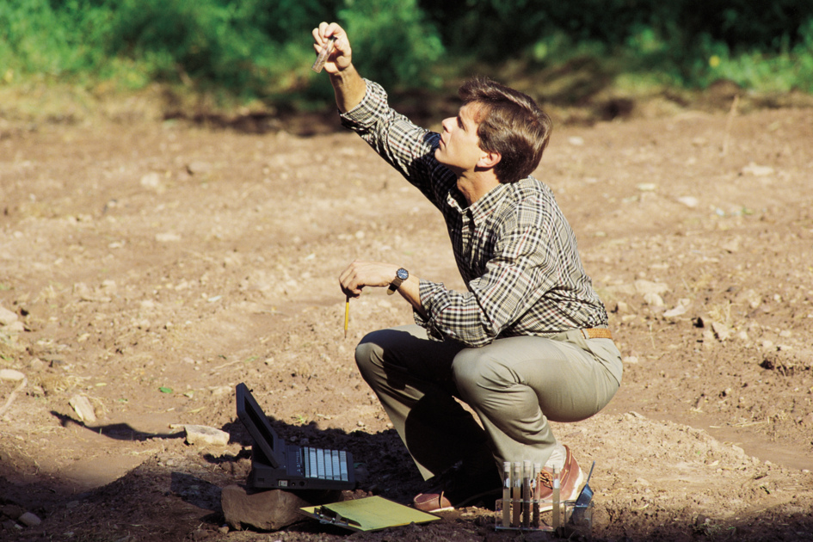
Analyze Text ― Informational
“Looking at the author’s craft”
Author’s purpose, ideas and reasoning
Writer’s Strategies
Textual evidence
Notes:
Overview of Analyze Text. For informational text, students are asked to analyze the author’s purpose and reasoning and the use of various stylistic techniques. The focus is always on the effect of the author’s decisions on the impact of the writing. Students must give specific examples from the text.

Slide 14

Let’s Score Some Student Papers!
Notes:
The next activity will be scoring 10 student papers. The PowerPoint presentation should be paused during the scoring session and training. Refer to the Facilitator’s Packet for guidance in leading participants through the scoring activity.

Slide 15
Demonstrate Understanding Example
This article is about kids from the western U.S. competing in a robotics team representing their school. Each team of high schoolers must design their own robot and compete against others. This article also gets the message across that we need to work together all the time to solve our problems.
It’s kind of like being a “good sport.” Everyone is helping everyone and cheering on everyone. An example of this is when Eric and Ian were helping the Spokane team so they could compete.
Notes:
Information in Facilitator’s Guide to Leading the Scoring Session.
These are examples of responses to “Robotics” that are at a score level of 4.

Slide 16
Develop an Interpretation Example
3.) From Venn diagram:
Athletic sports | Similarities | Robotics competitions
Doing whatever it takes to put your competition at a disadvantage | Trying to beat your Competition | Helping your competition
Physical conditioning | Trying to get better | Mental conditioning
Mostly female or male, not mixed | Working as a team | Mixed gender
Most teams the same size | Traveling to face Opponents | Different sized teams
 | Playoff system
 | Rely on teammates
Notes:
Instructions are included in Facilitator’s Guide to Leading the Scoring Session.
This is an example of some responses that different students made to Question #3. All reflect level 4 interpretation.

Slide 17
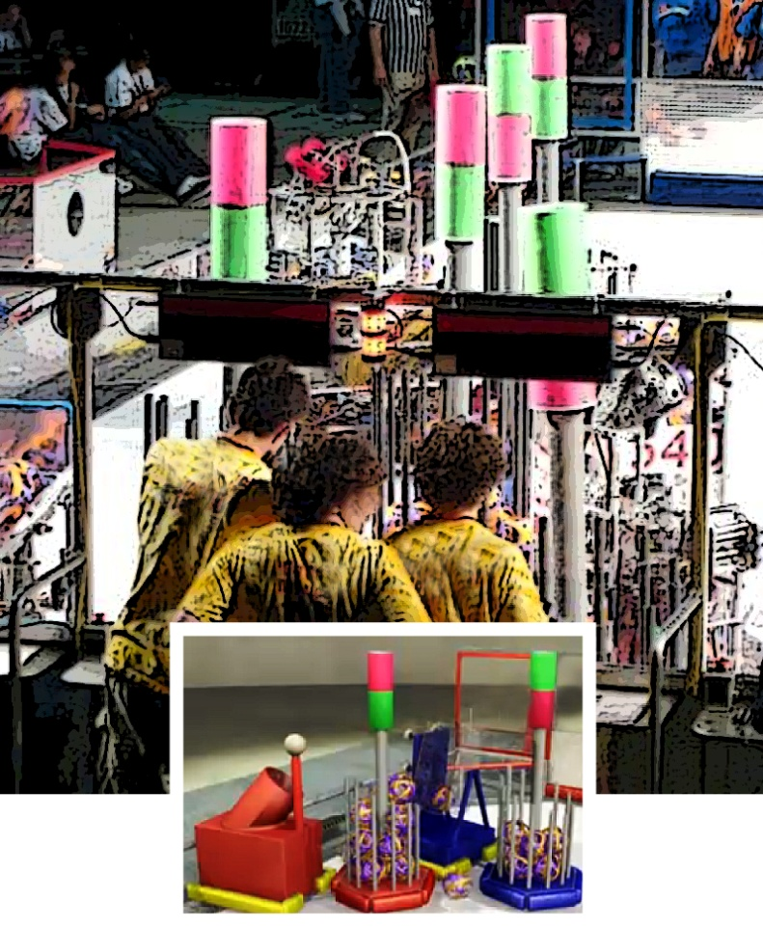
Develop an Interpretation Example, cont.
4.) I think she likes the concept but not fierce competition and the emotions that come with it. “but we took out the bad part…” “…the trying to crush your opponent”
Notes:
Info in facilitator’s packet. Another example of level 4 Develop an Interpretation

Slide 18
Analyze Text: Informational
Question 5
Text from article | How it makes the writing effective
“just as the modern workplace does” | Shows how it will be preparing you for how things will be used when you’re older working a real job
“Robots battle for supremacy in Portland this weekend” | Makes the role of the robots more exciting
Notes:
Directions in facilitator’s packet. Examples of level 4 responses

Slide 19
Analyze Text: Informational, cont.
6.) The author makes the robot competition more exciting by calling it a battle. The word battle makes people think about fighting which is more exciting than how they later explain that they will be “moving soccer sized balls into their opponents trailers.” He also uses people who he knows will have nothing but good things to say about the subject like Erica Smith did.
Notes:
Information in Facilitator’s Packet: Example of 4 level response to Analyze Text

Slide 20

How do Work Samples fit into the big picture?
Notes:
Intro to talking about using the scoring guide in classrooms for multiple purposes and the importance of increased literacy skills for our students.

Slide 21
Multiple Uses for the Scoring Guide
Instructional Tool
  Makes targets explicit to students
  Opportunities to show students models from website or other examples
Formative & Interim Assessments
  Inform instructional strategies
  Provide data on student progress
Classroom/ Summative Assessment
  End of unit, course, etc. or Essential Skills
Notes:
Teachers can use Reading Work Samples to determine student progress throughout their courses or on a planned schedule. They do not have to assign all parts of the work sample or score all elements – for example, after a lesson on text analysis, having students respond to only questions on text analysis would be an appropriate use of the scoring guide. As students become increasingly familiar with the Scoring Guide, (student language version was provided in Intro Level 2 workshop and is available on ODE website) they will better understand what good readers do and how to demonstrate those skills so a rater can see the student’s proficiency.

Slide 22

Slide 22 Blank Title
What are the Common Core State Standards for Literacy in Science, Social Studies & Technical Subjects?
How do they fit in with reading work samples and the scoring guide?
Notes:
Teachers should be aware of the new Common Core State Standards. Many districts are beginning curriculum alignment to the standards.
In the participant packet is a handout listing the literacy standards for reading in the content areas for High School. Standards listed under Key Ideas and Details link to Demonstrate Understanding and Develop Interpretation, while Craft and Structure relate to Analyze Text.

Slide 23
Changes in Text Complexity Requirements
Text Complexity Grade Band in the Standards | Old Lexile Ranges | Lexile Ranges Aligned to CCSS expectations
K–1 | N/A | N/A
2–3 | 450–725 | 450–790
4–5 | 645–845 | 770–980
6–8 | 860–1010 | 955–1155
9–10 | 960–1115 | 1080–1305
11–CCR | 1070–1220 | 1215–1355
Notes:
An important change in the CCSS is the level of text complexity students are expected to be able to read independently. Note that the current target score for reading work sample text (1070) is at the low end of current 11th grade expectations. In the new CCSS expectations, 1070 is below expected reading level for grade 9, and well below expectations for grades 11 – College & Career Ready. This chart is also in Participant’s Packet.

Slide 24

College Remediation Needs
1/3 of high school graduates need remedial reading classes in college.
42% of high school graduates need remedial reading in community colleges
Costs for remedial education post high school are nearly $3.7 billion annually
Notes:
Handout in participant packet gives further information about this problem.

Slide 25
Three Challenges
Educators Must Address
the need for fundamental change in attitudes and instructional practices,
the need to resolve tensions between teachers and administrators about the types of formative assessments each prefer, and
the need to change educators’ attitudes and beliefs about indicators of student success.
All will require new thinking about the purposes of assessment, student abilities, and teaching methods; attention to new instructional resources; and the development of new assessment and pedagogical skills.
Assessments to Guide Adolescent
Literacy Instruction, pg 4
Notes:
For content area teachers, the CCSS require attention to reading and writing (Literacy) in content classes. Using reading work samples to determine students ability to comprehend and interpret content information and including the concepts from the reading scoring guide will not only meet some of those standards, but will help students with the content in current classes and their ability to understand content text in college, community college, post-secondary training, the military or the work force. Bu fundamental change is required!

Slide 26
Resources
Oregon Literacy Framework: Assessment Section
http://www.ode.state.or.us/search/page/?id=2834
Work Samples
www.ode.state.or.us/go/worksamples
Oregon Data Project:
http://www.oregondataproject.org/
Assessment of Essential Skills Toolkit:
http://assessment.oregonk-12.net/
Common Core State Standards for Oregon:
http://www.ode.state.or.us/search/page/?id=2860
Notes:
Here are some sites for reading assessment resources. The go/worksamples address does not work as a link, but if you type /go/worksamples in the address line of your browser on the ODE homepage following www.ode.state.or.us, it will take you directly to a page of information on work samples. You can also use the search feature and type in worksamples as one word. Many resources are available in the Resources and Promising Practices section for Reading Work Samples and more are added frequently.
Oregon Data Project provides training in establishing assessment systems and analyzing data, as well as in the specific Essential Skills of Reading, Writing and Mathematics.
The Assessment of Essential Skills Toolkit provides a step by step approach to designing a district assessment system geared to students meeting diploma requirements.
The Common Core State Standards for Oregon provides a lot of information and resources for teachers in making the transition to the new standards and upcoming SMARTER-Balanced assessments.

Slide 27

Future Reading Work Sample Trainings
Introduction to the Reading Scoring Guide
    Dates:
Reading Work Sample Task Development
    Dates:
Contact Information:
Photo courtesy of The Statesman Journal
Notes:
Fill in any workshop dates you have scheduled and your contact information here. Hopefully, participants in Level 3 workshops will have attended the introduction (level 2) workshop – but they may recommend it to colleagues. Level 4, Work Sample Task Development, will help them use their content material to assess students ability to read and comprehend it.

