Slide 1


Using the Writing Scoring Guide –
An Introduction for Content Area Teachers
The Essential Skill of Writing
Updated for 2011-12
Notes:
This introductory workshop is targeted to content area teachers at the high school level, although it could be used at the middle school as well. There is a separate workshop designed specifically for middle level teachers.
A companion introductory/refresher workshop is available for language arts teachers.
If you have a mixed group of content teachers and language arts teachers, this would be the best workshop format to use, perhaps providing the language arts teachers with the handouts from the companion workshop.

Slide 2
Goals for this workshop
1. Introduce
    Oregon’s Writing Scoring Guide
    principles of Writing across the Curriculum
    classroom uses of the Writing Scoring Guide
2. Examine
    student work samples
    Essential Skill Standard for Writing
  3. Set the stage for follow-up training
Notes:
These three goals help set the stage. Be sure that participants know that this is an introductory session and that further training would be needed to score student work samples for the diploma. However, this workshop will give them some tools to use in their classrooms.
There will be a series of in-depth training sessions available to provide content teachers with the necessary background and calibration to feel confident scoring papers to demonstrate proficiency in the Essential Skill of Writing.
Remind participants that they have the PowerPoint slides in their handout to take notes on, if they wish.

Slide 3

OAR: 581-22-0615
For students first enrolled in grade 9 during the 2009-2010 school year, school districts and public charter schools shall require students to demonstrate proficiency in the Essential Skills listed
(A) Read and comprehend
a variety of text; and
(B) Write clearly and
accurately
Notes:
This is the Oregon Administrative Rule, adopted by the State Board of Education, that sets the diploma requirements for the Essential Skills. These Essential Skills are also required for subsequent entering freshmen classes. The Essential Skill of Apply math will be implemented for students who first enrolled in 9th grade in 2010-11.

Slide 4
Essential Skill Proficiency 1
3 options for diploma requirement
  OAKS Statewide Writing Assessment
      Score of 40 or higher
  Other approved standardized assessments
      SAT Writing Assessment score of 460 or higher
Notes:
For the 2011-13 biennium, students will only be allowed to take the OAKS writing assessment once during their 11th grade year. As a result, many schools will be implementing the use of Work Samples (on the next slide) as an important means of meeting the Essential Skill Graduation Requirement.
On March 11, 2011 the State Board of Education approved the SAT Writing Assessment as the first standardized test approved for proficiency in the Essential Skill of Writing. The minimum score required is 460. The SAT Writing Test is a direct writing assessment. The Assessment of Essential Skills Review Panel, the group that makes recommendations to the State Board for standardized test options, is committed to recommending only tests that include a direct writing component.
For most students the SAT is taken during the senior year and most teachers and students will want to be sure Essential Skill proficiency is taken care of before then. The third option, on the next slide, using work samples will most likely be an important opportunity for many students.

Slide 5


Option 3 – Writing Work Samples
    2 work samples
    1 expository or persuasive
    1 any mode (expository, persuasive or narrative – personal or fictional)
    Score of 4 or higher in 4 traits on Official Scoring Guide
Notes:
In March 2012, the State Board of Education approved a change to the requirement for writing work samples to be used for Essential Skills proficiency to bring writing into alignment with reading and mathematics.
To demonstrate proficiency in the Essential Skill of Writing using work samples, students must meet all criteria listed here – 2 work samples, one of which must be either expository or persuasive, with scores of 4 or higher in the required traits of Ideas/Content, Organization, Sentence Fluency, and Conventions.
This presentation will cover many important issues for schools who want to implement a planned system for students to use work samples to meet the Essential Skill of Writing proficiency requirement.

Slide 6

Essential Skill Proficiency 2
How do students use writing in your classroom?
Notes:
Use this and the following slide for some participant interaction. Either whole group discussion (if your workshop size is small), or break into small groups and report out using chart paper (allow at least 10 minutes) or pair and share and report out loud (allow 5-7 minutes). See facilitator’s agenda for details.

Slide 7

Essential Skill Proficiency 3
How do you grade writing?
Notes:
Point out that the scoring guide you are going to share can make the job of reviewing writing easier (particularly if teachers rate only some traits) and provide consistent feedback to students from all their classes.
You can use this as a group activity also, if desired – even splitting the group so that some respond to the previous slide and some to this slide.

Slide 8

Writing Work Samples
What is the difference between a writing work sample and any other kind of writing?
Notes:
The next several slides lay out key differences in types of writing assignments that can be scored and used for essential skill proficiency.
However, all classroom writing activities provide important practice toward successful essential skill work samples as long as students receive consistent feedback.

Slide 9

Work Sample Design 1
Local work samples must be designed to elicit student writing that is long enough and complex enough to be scored using the Writing Scoring Guide.
Notes:
Key words are long enough and complex enough
Refer to Handout: Guidelines for High School Writing Work Samples (2 pages)

Slide 10
Work Sample Design 2
What is long enough/complex enough?
sustained writing – single author
specific focus & sufficient details
intro, body, & conclusion to score for Organization
No length requirement – However,
1 ½ - 2 pages handwritten is about the minimum
Notes:
Refer to handout: “Tips for Writing Work Samples” in Participant Packet.
This is the ONE resource teachers should keep at their fingertips to answer just about any question about writing work sample requirements.
Review the categories of information on the handout, but go over only the “Design” section--on this slide.
Tell them they’ll be referring to the other sections later in the presentation.

Slide 11
Work Sample Design 3
Expository Mode:
  Explain problem, process, concept, etc.
  Analysis of issues, events, speakers, etc.
  Comparison/contrast
  Brief research or response papers (2-3 pages)
Persuasive Mode:
  Essay taking a stand on an issue
  Pro/Con and call to action
Narrative Mode:
  Relating an experience
Notes:
Ask teachers to identify assignments they currently use that might fit these categories or topics they cover that could be turned into a writing assignment like one of these.
Long research papers complicate scoring and create more potential for plagiarism, intended or unintended.
Persuasive papers also attempt to convince. Papers that acknowledge and respond to opposing points present a stronger argument.
A handout in the Participant Packet shows the modes of writing required in the Common Core State Standards – including standards in literacy for History/Social Studies, Science and Technical Subjects. These modes match Oregon’s with slightly different titles and emphasis.

Slide 12

Work Sample Design 4
Which mode of writing is most likely to be used in your content area?
What writing assignment could you give that would elicit an essay in one of these modes?
Notes:
Handout -- “Criteria for Effective Writing Prompts”– highlight some key points; suggest participants refer to this when planning their next writing assignment.
Handouts – “Sample Writing Prompts Across the Curriculum” – ask participants to check at least two that they could use or modify in their classrooms. Report out if time allows.

Slide 13
Work Sample Design
Unsuitable (NOT long or complex enough)
Short answers to questions (even a couple of ¶)
Journals
Logs; responses to activities or summaries
Tests or quizzes
Workbook or work sheet activities
Book reports
Group projects
Notes:
Refer participants to Handout – “Work Samples: Appropriate Forms and Modes” (in Participant Packet). This slide summarizes the information from the last few slides on one page as a handy reference when planning writing assignments.
Some of the types of assignments on the slide are very good for students to practice writing skills, but they are not good for use as a work sample because they tend to be too short and sometimes simplistic.

Slide 14
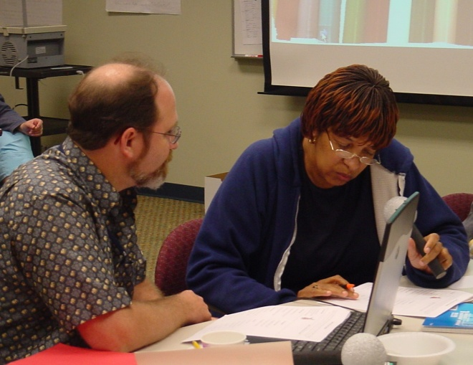
The Writing Scoring Guide 1
Background
  Developed in Oregon by Oregon Teachers
  Introduced in late 1980’s
  Reviewed and Updated Frequently
  State Assessment since early 1990’s
  Authentic Assessment
  Strongly tied to instruction
  High inter-rater reliability
  National recognition
Notes:
Bring out your sales skills! Oregon has lots of reasons to be proud of our scoring guide and to recognize that it can be an important classroom tool for instruction, formative assessment, and summative assessment.
Refer to the Scoring Guide in the Participant Packet. The packet contains the “Portrait” version of the Scoring Guide because it allows for easy comparison of the 3 and 4 score level, which is the most critical to understand. It can also be found on-line at http://www.ode.state.or.us/search/page/?id=32.

Slide 15

The Writing Scoring Guide 2
Purposes
  Instructional Tool
  Formative Assessment
  Summative Assessment
  Demonstrate Proficiency in the Essential Skill of Writing to earn an Oregon Diploma
Notes:
Focus participants on different ways they can use the scoring guide to support writing improvement for students. This will ultimately lead to more students meeting the Essential Skill requirement on the OAKS assessment or on work samples.

Slide 16
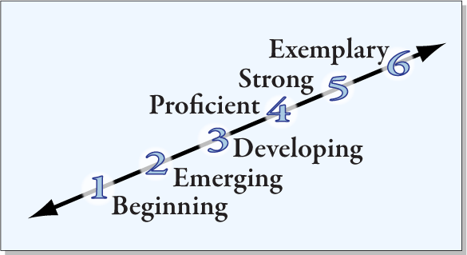
Writing Scoring Scale
Notes:
This is intended to be a visual of the scoring categories. Remind them that the scoring guide contains detailed descriptions of each level for each of the six writing traits.
Point out that the lower end of the scale refers to writers who are beginning, developing etc. Intent is not to categorize the student, but to identify the stage of a single piece of writing on a continuum.

Slide 17

Six Writing Traits
1. Ideas and Content *
2. Organization *
3. Voice
4. Word Choice
5. Sentence Fluency *
6. Conventions *
* Must meet score of 4 for proficiency
Notes:
Point out that the traits with an asterisk are required for Essential Skill proficiency. . However, giving students feedback on Voice and Word Choice in classroom assignments and formative assessments will increase the liveliness and interest of their writing.

Slide 18
Ideas and Content
Ideas and Content
Clear
Focused
Enough
Details
Relevant
Details
Notes:
Each of the following slides gives a broad overview of the components of each trait.
You may want to have participants look at the description of a score of 4 on the Official Scoring Guide (portrait version) as you go through these slides and highlight or comment on key descriptors.
These 4 elements reflect the major concepts in Ideas and Content.

Slide 19
Organization
Introduction
Body
Conclusion
Reader can follow ideas
Good transitions
Paragraph Breaks
Good Beginning
Well Developed
Well developed
Satisfying ending
Notes:
Basic organization – most teachers feel pretty comfortable with this trait. Some students may have more sophisticated organizational structures, but a nice basic organization is all that is required at the score of 4.

Slide 20
Sentence Fluency
Easy to Read Aloud?
Supply Punctuation where natural
Enough Variety?
Sentence Structure
Sentence Beginnings
Stylistic Control?
Effective fragments
Natural dialogue
Sentence Lengths
Notes:
Many teachers feel a little uncomfortable with this trait.
Point out the sequence – first, is the writing easy to read (ignore punctuation errors and read aloud)? Second is there variety or do you notice most sentences starting the same way, being simple declarative sentences or does the writer vary beginnings, ask questions, etc.? Stylistic control is last issue here and teachers can address it to the degree they themselves feel comfortable.

Slide 21
Conventions 1
Kinds of Errors
Significance of Errors
Proportion of Errors
Notes:
Facilitator – use the information below to firm up your understanding of the different issues here, but remember that content teachers don’t want a lot of detail about conventions – at least at this overview level of workshop
Kinds of errors – are errors occurring when using more sophisticated conventions, or are the errors ones you would expect most high school students to have mastered in grade school or middle school, such as run-on sentences or misspellings of common words?
Significance of errors – How important are these errors at the high school level? Some are more significant than others. For example, run-on sentences are very significant, as are misspellings of common words. However, at the 10th grade level, noun/pronoun agreement is NOT considered a significant error; it is a minor error. (An example of the latter: "The principal announced that EACH STUDENT should get THEIR backpacks from THEIR lockers.") (The Guidelines chart--the one with different conventions expectations for different grade levels--will help make this determination. It says "Correct end-of-sentence punctuation," but says only "general control of noun/pronoun agreement.")
Proportion of errors is important as it relates to overall text length and complexity – a longer, more sophisticated paper may be forgiven a few errors, where a short, 1 page simple paper with end of sentence punctuation or basic capitalization errors would not. Proportion of Errors in relation to overall text length and complexity: How many errors occur in proportion to the amount and complexity of the writing? For example, a dense, two-page, complex paper with two or three ineffective sentence fragments might still meet the standard (depending on the nature and frequency of other errors), whereas a shorter, one-page paper with large handwriting that has two or three ineffective fragments might not.

Slide 22

Conventions 2
Correct end-of-sentence punctuation?
  Run-on sentences (none or very few)
  Fragments (none or just a few effective ones)
Correct spelling of common words? (grade level appropriate)
Correct capitalization?
Notes:
Most teachers feel pretty comfortable with the list above.
It is when English teachers expect them to catch more sophisticated internal punctuation or structural errors that content teachers want to skip conventions.

Slide 23
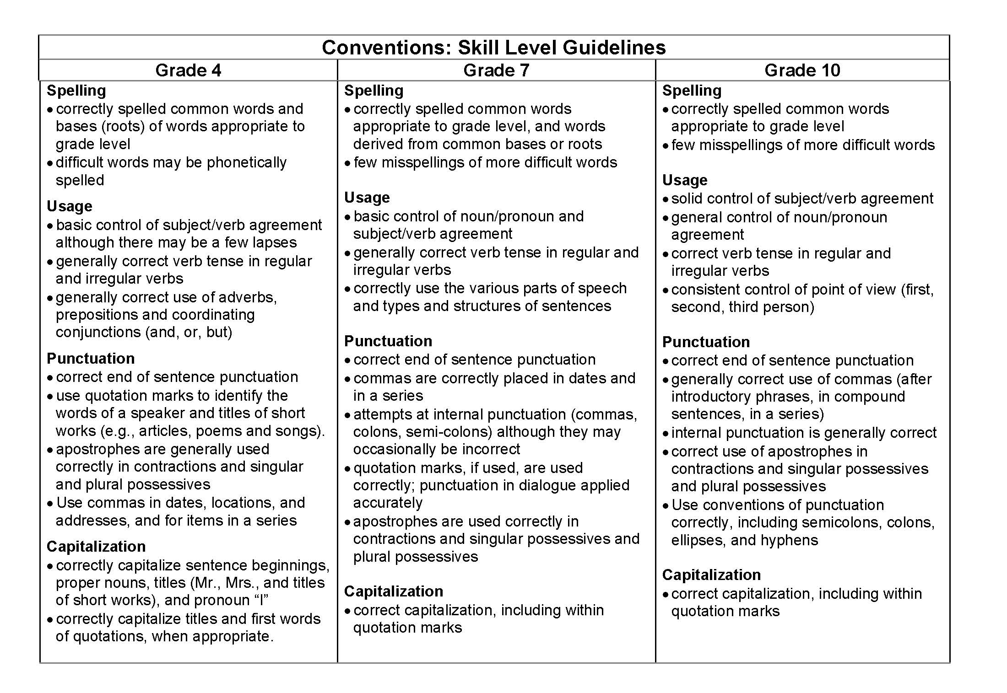
Grade Level Expectations
Notes:
Point out that there are different grade level expectations for each trait and especially for conventions. Also note that we are scoring “usage” not “grammar” – students ability to use standard English in writing not the ability to name parts of speech. Participants will receive this handout if they take the more in-depth scoring training.
For facilitator background, specific expectations for each trait/each grade level can be found on ODE website at: http://www.ode.state.or.us/wma/teachlearn/testing/dev/testspecs/asmtwrtestspecshs_0910.pdf

Slide 24
Voice (Score is not required)
Commitment to Topic
Sincere, engaging
Appropriate
Voice?
Topic, Mode
Audience, level of formality
Writer’s Voice Present?
Notes:
Although voice is not a required trait for the Essential Skills, it is what makes writing lively and interesting. Giving students a score for voice provides good feedback about how their writing impacts the reader and may provide some motivation for students to think about audience when writing.

Slide 25
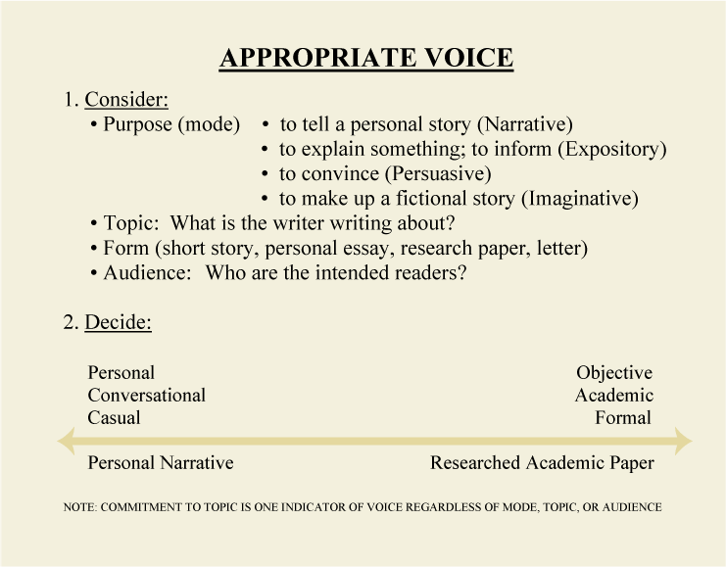
Blank for accessibility
Notes:
This page give some additional info about voice, including the fact that if students are writing a more formal paper, the voice should be more objective and academic. This handout will be included in the in-depth training materials.

Slide 26
Word Choice (Score is not required)
Functional?
Appropriate?
Enough Variety?
Specific Enough?
Notes:
Again, this trait is not required. Some teachers may not feel confident about this trait or may not see its value. Point out that raters are not looking for students who know how to use a thesaurus, but for good specific language rather than vague terms. “The difference between the almost right word & the right word is really a large matter--it's the difference between the lightning bug and the lightning.” Mark Twain

Slide 27

The Writing Process
Drafting
Revising
Pre-writing
Editing/
Proof-
reading
Final
Copy
Notes:
Briefly walk through each stage of the writing process. Encouraging students to use these steps will likely produce better writing. Consistent use of these terms across the curriculum also helps students to see importance.
Teachers do not need to provide time for or require evidence of each stage for every assignment, but including some emphasis on the process and allowing some time when working on big assignments, helps to reinforce importance of writing. Following slides will give some suggestions for using the scoring guide in writing process and across the curriculum.

Slide 28

Writing Across the Curriculum 1
Uses in your classroom
Not all writing needs to be scored
Not all traits need to be scored every time
Notes:
Really important to reassure content teachers that they can contribute to the improvement of writing in their school without taking on the full responsibility of becoming “a writing teacher.”

Slide 29

Writing Across the Curriculum 2
Using the Scoring Guide
as an instructional tool
(during prewriting, drafting)
Set expectations for writing activity
Teacher or peers give feedback during rough draft stage on ideas/content & organization
Notes:
These are examples teachers can easily implement – give their students the Student Language Version of the Scoring Guide (in Participant Packet) when the assignment is given and tell them their grade will be based on two or three (or more) of the traits.

Slide 30
Writing Across the Curriculum 3
Using the Scoring guide as an instructional tool (during editing, revising, and proofreading)
Peer feedback on Sentence Fluency and Word Choice
Students self-assess on Ideas/Content, Organization & Conventions
Students complete Student Guide to Revision before turning in final draft
Notes:
Refer to Handout: “Student Language Scoring Guide: High School Condensed Version” (in Participant Packet)
GREAT resource for use with students in classroom--ONE PAGE front and back--can be used in many activities such as those suggested here
Refer to Handout: “High School Guide to Revision” for final bullet (in Participant Packet).
Students can exchange papers or do a self-rating if given time in class. Teachers can also ask students to fill out the High School Guide to Revision and turn it in (along with a self-rating) with the final paper. Creates some accountability for students to examine their writing.

Slide 31

Formative Assessment
Use for pre- and post- tests
Focus on Ideas/Content & Organization as they relate to your content area
Don’t forget Sentence Fluency & Word Choice within your discipline
Notes:
Here is where teachers can use the scoring guide literally – Highlight a score and several bullets indicating what a student did right on a given writing assignment. Can the student raise his/her grade by revising and improving?
Some teachers like to use a quarter sheet of paper with all the traits listed in sequence (provided in Participant Packet). Then the teacher writes score next to those rated. Can also ask student to rate him/herself before teacher sees paper.

Slide 32

Summative Assessment
End of unit assessment
Final (semester) exams
Student self-assessment using writing from different times during course
OAKS Statewide Writing Assessment
Meet requirement for local performance assessment
Demonstrate Proficiency in Essential Skill of Writing to receive Oregon Diploma
Notes:
These are the many ways the Writing Scoring Guide can be used for summative assessment.
Bullet #3 refers to the idea of keeping samples of a student’s writing during a semester or year and then returning several papers from different times as a packet to show both teacher and student the growth over time.

Slide 33
Essential Skill Proficiency
Requirements for Writing Essential Skill Proficiency Using Work Samples
    2 work samples
        1 expository or persuasive
        1 any mode
    Score of 4 or higher in
    4 traits on Official Scoring
    Guide
Notes:
This is summary reminder of the requirements for a student to demonstrate mastery of the Essential Skill of Writing using work samples. (repeated from earlier in the presentation)
Question to group is “How is our school set up to help students succeed with this?”

Slide 34

Work Sample Implementation 1
Design:
Highly recommended: build a writing process into work samples
Highly recommended: integrate writing work samples into the regular curriculum, rather than separate, stand-alone assessments
Notes:
Refer to Handout – “Incorporating the Writing Process” (in Participant Packet) -- stress quality and time investment vs. quantity of work samples.
One quality writing assignment per semester in every content area class would make a big difference in student writing.
Summarize example of process on handout.

Slide 35

Work Sample Implementation 2
Administration
  Work samples must be the product of an individual
Work samples must be supervised by an authorized adult;
Students may not work on work samples outside a supervised setting.
Notes:
Students should be allowed ample time to do their best work. Generally, three one-hour sessions are recommended.
According to Appendix M of the 2011-12 Test Administration Manual, students may use outside resources for one of the three writing work samples (as in a research paper), but the student must then provide additional evidence that the work is his/hers alone.
http://www.ode.state.or.us/search/page/?=486 Select Appendix M

Slide 36

Work Sample Implementation 3
Administration
Word processed papers are permitted.
Grammar and spell-check features may be used.
Students should have time to do their best work. Generally, three one-hour sessions are recommended.
Notes:
Reminders that students may use word processors with grammar and spell check features. One issue to consider is how to keep work in progress secure so that students cannot access it from outside the supervised setting.

Slide 37
Work Sample Implementation 4
Scoring
All work samples must be
scored using Oregon’s Official Writing Scoring Guide.
All raters must have been
trained to use the Scoring Guide.
Only one set of scores is required for a work sample. (Districts may want more than one rater for borderline papers.)
Notes:
Teachers who rate student work samples for the purpose of demonstrating proficiency in the Essential Skill of Writing, must be well-trained in using the scoring guide. Additional workshops will be available for those who wish to do this.
Also, a reminder that only one rater is required. However, a number of districts are considering having two raters for papers that are in the 3 – 4 range.

Slide 38
Work Sample Implementation 5
Feedback and Revision
FEEDBACK: Only 2 options
Oregon’s Official Scoring Form
Highlighting Oregon’s Scoring Guide
STUDENT REVISION:
Students are allowed to revise and resubmit their work samples following scoring/feedback.
Most papers should be revised only once.
Notes:
Students may receive feedback after a work sample has been scored and they may revise the work sample (in a supervised setting) and resubmit it to be scored again. Typically, this would be offered to students whose paper nearly meets the standard of all 4’s rather than for papers in the 1 & 2 range where more instruction may be needed.
Refer to Handout – Writing Scoring Form (in Participant Packet)

Slide 39

Resources & Coming Attractions
ODE Website: www.ode.state.or.us/go/worksamples
Follow-up workshops
(List any scheduled)
Contact information
(List your information here)
Notes:
Please adjust this slide to reflect your information. You can either list dates if you have specifically scheduled future workshops, or you can leave it blank with just “Follow-up workshops” and indicate that additional workshops are available on request or will be scheduled later.
Put your contact information or someone else participants can contact with follow-up questions etc.

Slide 40

A Parting Thought
“Writing and learning and thinking are the same process.”
William Zinsser
Notes:
Asking students to do more writing in content area classes will not only improve their writing, it will improve their learning of the content.
William Zinsser is a journalist and the author of On Writing Well which is an excellent book about what quality writing looks like in various fields of study, business, science, sports, history, etc.
This slide provides a nice closing and a focal point if you plan to have some Q & A before going into scoring student papers.

