Slide 1





A Refresher Training for English Language Arts Teachers
The Essential Skill of Writing
Using the Writing Scoring Guide
Updated for 2011-12
Notes:
This refresher workshop is targeted to English Language Arts teachers at the high school level.
A companion introductory/refresher workshop is available for content area teachers.
If you have a mixed group of content teachers and language arts teachers, use the Introduction for Content Area Teachers format, perhaps providing the language arts teachers with the handouts from this workshop.

Slide 2

Goals for this workshop
1. Review
Oregon’s Writing Scoring Guide
Classroom uses of the Writing Scoring Guide
Supporting colleagues in writing across the curriculum
2. Understand
Options for Demonstrating Proficiency in the Essential Skill of Writing for the Oregon Diploma
3. Score student papers and recalibrate to scoring standards
4. Set the stage for follow-up training
Notes:
These four goals help set the stage. It may be helpful to have a show of hands to know which teachers have been trained before and use the scoring guide regularly in their classes. Be sure that participants know that this is a review session. This session will help teachers feel confident that their scores are in line with essential skill standard expectations.
There will be a series of in-depth training sessions available to provide ELA teachers or content teachers with the necessary background and calibration to feel confident scoring papers to demonstrate proficiency in the Essential Skill of Writing.
If it has been a while since participants were trained, it would be wise for them to sign up for more in-depth training sessions before scoring student work samples for the diploma.
Remind participants that they have the PowerPoint slides in their handout to take notes on, if they wish.

Slide 3

OAR: 581-22-0615
For students first enrolled in grade 9 during the 2009-2010 school year, school districts and public charter schools shall require students to demonstrate proficiency in the Essential Skills listed
(A) Read and comprehend
a variety of text; and
(B) Write clearly and
accurately
Notes:
This is the Oregon Administrative Rule, adopted by the State Board of Education, that sets the diploma requirements for the Essential Skills. These Essential Skills are also required for subsequent entering freshmen classes. The Essential Skill of Apply Math will also be implemented for students who first enroll in 9th grade in 2010-11.

Slide 4
Essential Skill Proficiency
Three options for diploma requirement
OAKS Statewide Writing Assessment
Score of 40 or higher
Other approved standardized assessments
SAT Writing Assessment score of 460 or higher
Notes:
For the 2011-13 biennium, students will only be allowed to take the OAKS writing assessment once during their 11th grade year. As a result, many schools will be implementing the use of Work Samples (on the next slide) as an important means of meeting the Essential Skill Graduation Requirement.
On March 11, 2011 the State Board of Education approved the SAT Writing Assessment as the first standardized test approved for proficiency in the Essential Skill of Writing. The minimum score required is 460. The SAT Writing Test is a direct writing assessment. The Assessment of Essential Skills Review Panel, the group that makes recommendations to the State Board for standardized test options, is committed to recommending only tests that include a direct writing component.
For most students the SAT is taken during the senior year and most teachers and students will want to be sure Essential Skill proficiency is taken care of before then. The third option, on the next slide, using work samples will most likely be an important opportunity for many students.

Slide 5

Option 3 -- Writing Work Samples
2 work samples
1 expository or persuasive
1 any mode (expository, persuasive or narrative – personal or fictional)
Score of 4 or higher in 4 traits on Official Scoring Guide
Notes:
In March 2012, the State Board of Education approved a change to the requirements for writing work samples used for Essential Skills proficiency to bring them into alignment with reading and mathematics. To demonstrate proficiency in the Essential Skill of Writing using work samples, students must meet all three criteria listed here – 2 work samples, one of which must be expository or persuasive, with scores of 4 or higher in the required traits of Ideas/Content, Organization, Sentence Fluency, and Conventions.
This presentation will cover many important issues for schools who want to implement a planned system for students to use work samples to meet the Essential Skill of Writing proficiency requirement.

Slide 6

Essential Skill Proficiency, cont.
How do you use the Writing Scoring Guide with your students?
Notes:
Use this and the following slide for some participant interaction. Either whole group discussion (if your workshop size is small), or break into small groups and report out using chart paper (allow at least 10 minutes) or pair and share and report out to group (allow 5-7 minutes). See Facilitator’s Agenda for details.

Slide 7

Essential Skill Proficiency, cont. 2
How do you use the writing scoring guide to assess student writing?
Notes:
Point out that the scoring guide makes the job of reviewing writing easier and that if all teachers in the school use this, students will benefit from consistent feedback in all their classes.
You can use this as a group activity also, if desired.

Slide 8

Let’s Review the Scoring Guide!
Notes:
Remind participants that this will be a quick walk-through of the traits. More detailed training is available in a series of in-depth workshops.

Slide 9
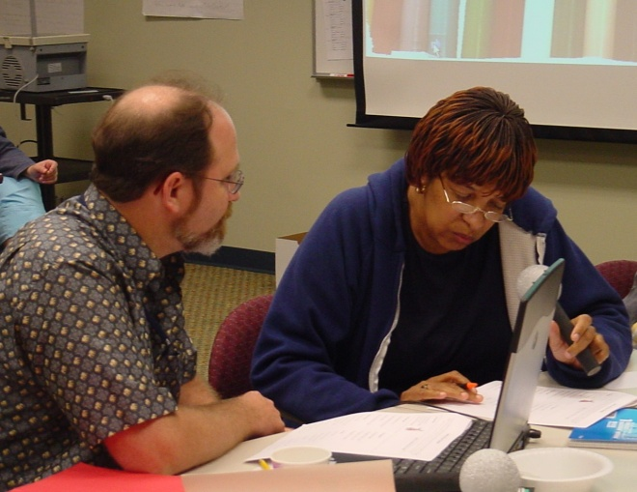
The Writing Scoring Guide: Background
Developed in Oregon by Oregon Teachers
Introduced in late 1980’s
Reviewed and Updated Frequently
State Assessment since early 1990’s
Authentic Assessment
Strongly tied to instruction
High inter-rater reliability
National recognition
Notes:
Bring out your sales skills! Oregon has lots of reasons to be proud of our scoring guide and to recognize that it can be an important classroom tool for instruction, formative assessment, and summative assessment.
Refer to the Official Writing Scoring Guide in the Handouts. (A Portrait version of the Scoring Guide is presented first which allows for easy comparison of the 3 and 4 score level). It can also be found on-line at http://www.ode.state.or.us/search/page/?id=32.

Slide 10
Six Writing Traits
1. Ideas and Content *
2. Organization *
3. Voice
4. Word Choice
5. Sentence Fluency *
6. Conventions *
* Must meet score of 4 for proficiency
Notes:
Point out that the traits with an asterisk are required for Essential Skill proficiency. However, giving students feedback on Voice and Word Choice in classroom assignments and formative assessments will increase the liveliness and interest of their writing – many ELA teachers already do this.

Slide 11
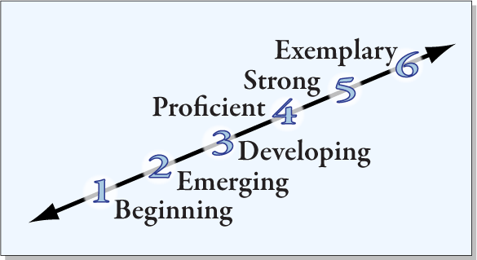
Writing Scoring Scale
Notes:
This is intended to be a visual of the scoring categories. Remind participants that the scoring guide contains detailed descriptions of each level for each of the six writing traits.
Point out that the lower end of the scale refers to writers who are beginning, developing etc. Intent is not to categorize the student, but to identify the stage of a single piece of writing on a continuum.

Slide 12
Ideas and Content
Ideas and Content
Clear
Focused
Enough
Details
Relevant
Details
Notes:
These 4 elements reflect the major concepts in Ideas and Content.
Each of the following slides gives a broad overview of the components of each trait. Have participants look at the descriptions of scores at the 4 and 3 levels on the Official Scoring Guide as you go through these slides focusing on the differences between the two.
You can ask participants to highlight key words and phrases in their scoring guides in the 3 and 4 sections if you wish.

Slide 13
Organization
Introduction
Body
Conclusion
Reader can follow ideas
Good transitions
Paragraph Breaks
Good Beginning
Well Developed
Well developed
Satisfying ending
Notes:
This shows a basic organizational structure – it is not intended to suggest that the 5-paragraph essay is the ultimate goal of high school writing (introduction and conclusion do not have to be set aside as separate paragraphs). Teaching students more sophisticated organizational structures will improve their writing, but a nice basic organization is all that is required to achieve a score of 4.

Slide 14
Sentence Fluency
Easy to Read Aloud?
Supply Punctuation where natural
Enough Variety?
Sentence Structure
Sentence Beginnings
Stylistic Control?
Effective fragments
Natural dialogue
Sentence Lengths
Notes:
Many content teachers feel a little uncomfortable with this trait. ELA teachers can help by teaching to this trait, sharing ideas with colleagues, and possibly even scoring a colleague’s papers for sentence fluency and conventions until he/she becomes more comfortable and familiar with the scoring guide.
Point out the sequence – first, is the writing easy to read? (Ignore punctuation errors and read aloud.) Second, is there variety in sentence structure, beginnings and lengths? Stylistic control, such as parallel structure, effective use of fragments, natural sounding dialogue contribute to scores of 4 or higher, but are not required to earn a score of 4.

Slide 15
Conventions
Kinds of Errors
Significance of Errors
Proportion of Errors
Notes:
Because this is just a review session, this is an overview of the issues in Conventions. There are lots more training issues and materials which are covered in the in-depth training session. Pages immediately following the scoring guide in the Participant Handout Packet contain more detailed information and examples of Conventions errors.
Kinds of errors – are errors occurring when using more sophisticated conventions, or are the errors ones you would expect most high school students to have mastered in grade school or middle school, such as run-on sentences or misspellings of common words?
Significance of errors – How important are these errors at the high school level? Some are more significant than others. For example, run-on sentences are very significant, as are misspellings of common words. However, at the 11th grade level, noun/pronoun agreement is NOT considered a significant error; it is a minor error. (An example of the latter: "The principal announced that EACH STUDENT should get THEIR backpacks from THEIR lockers.") (The Guidelines chart--the one with different conventions expectations for different grade levels--will help make this determination. It says "Correct end-of-sentence punctuation," but says only "general control of noun/pronoun agreement.")
Proportion of errors is important as it relates to overall text length and complexity – a longer, more sophisticated paper may be forgiven a few errors, where a short, 1 page simple paper with end of sentence punctuation or basic capitalization errors would not. Proportion of Errors in relation to overall text length and complexity: How many errors occur in proportion to the amount and complexity of the writing? For example, a dense, two-page, complex paper with two or three ineffective sentence fragments might still meet the standard (depending on the nature and frequency of other errors), whereas a shorter, one-page paper with large handwriting that has two or three ineffective fragments might not.

Slide 16

Conventions, cont.
Correct end-of-sentence punctuation?
Run-on sentences
Comma splices
Fragments (none or just a few effective ones)
Internal punctuation
Correct spelling of common words? (grade level appropriate)
Correct capitalization?
Notes:
This is an area that many content teachers feel unsure about. In their session, conventions focuses on basic issues like end of sentence punctuation, correct spelling and capitalization. Generally, papers that are very competent in conventions and papers that are really low in conventions will be obvious to most teachers.
English Language Arts teachers may wish to offer support to colleagues by reviewing borderline papers for conventions.

Slide 17
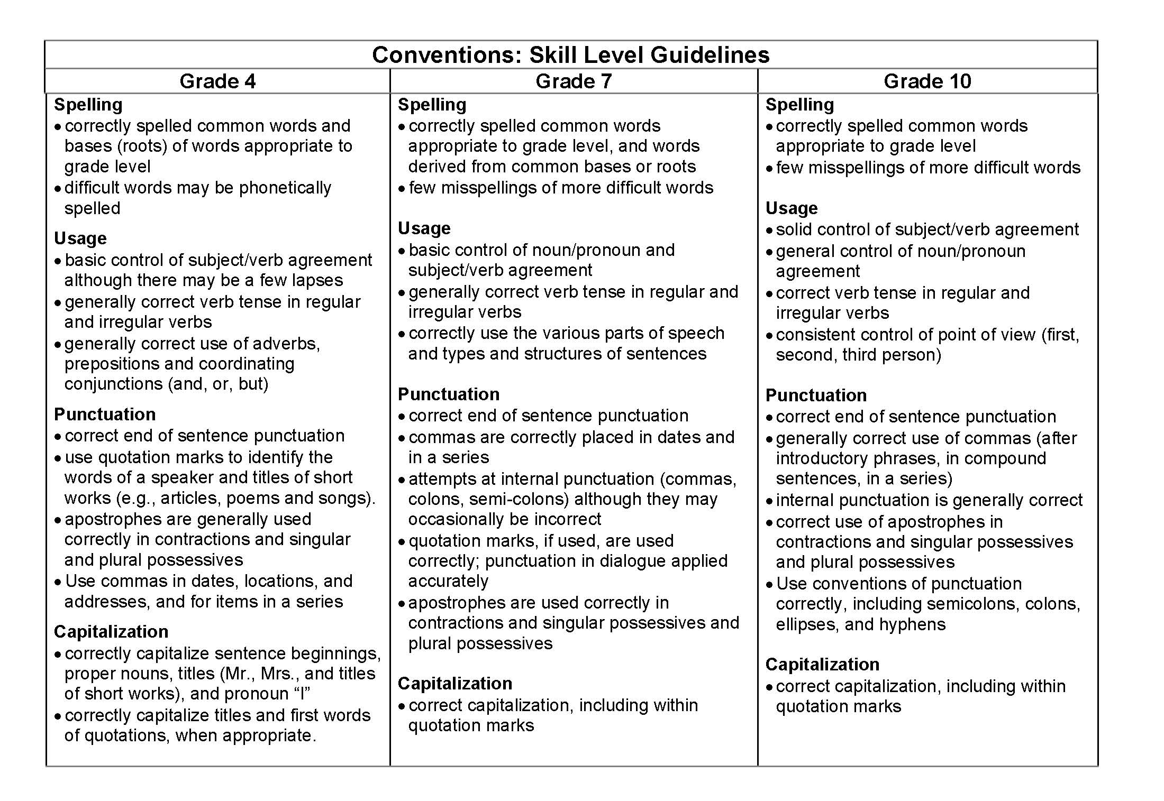
Grade Level Expectations
Notes:
Point out that there are different grade level expectations for each trait and especially for conventions. Also note that we are scoring “usage” not “grammar” – students’ ability to use standard English in writing not the ability to name parts of speech. Refer to this handout in the packet so that teachers are aware of differences in expectations for various grade levels.
For facilitator background, specific expectations for each trait/each grade level can be found on ODE website at http://www.ode.state.or.us/wma/teachlearn/testing/dev/testspecs/asmtwrtestspecshs_0910.pdf

Slide 18
Voice (Score is not required)
Commitment to Topic
Sincere, engaging
Appropriate
Voice?
Topic, Mode
Audience, level of formality
Writer’s Voice Present?
Notes:
Although voice is not a required trait for the Essential Skills, it is what makes writing lively and interesting. Giving students a score for voice provides good feedback about how their writing impacts the reader and may provide some motivation for students to think about audience when writing.

Slide 19
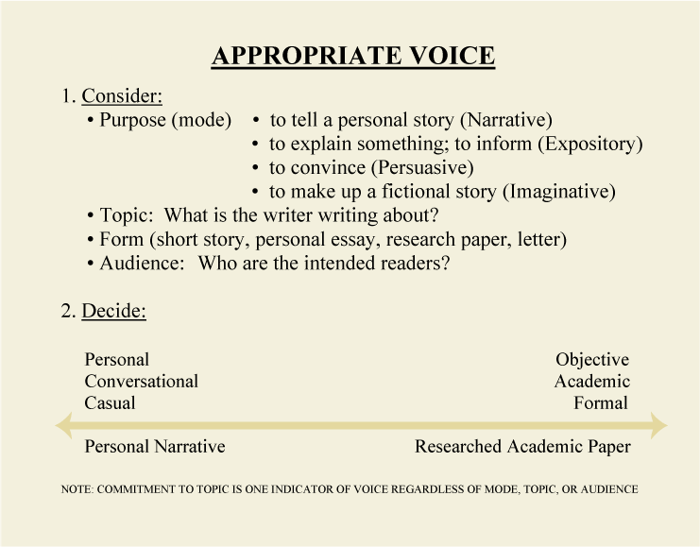
Blank for accessibility
Notes:
This page gives some additional info about voice, including the fact that if students are writing a more formal paper, the voice should be more objective and academic. This page is included in the handout materials. Remind ELA teachers that content teachers sometimes view voice as purely an English Teacher Thing – especially relevant to narrative or imaginative writing. But good writing in any subject is engaging and uses an appropriate voice for the topic. Point out the note at the bottom of this handout.

Slide 20
Word Choice (Score is not required)
Functional?
Appropriate?
Enough Variety?
Specific Enough?
Notes:
Again, this trait is not required. Point out that raters are not looking for students who know how to use a thesaurus, but for good specific language rather than vague terms. “The difference between the almost right word & the right word is really a large matter--it's the difference between the lightning bug and the lightning.” Mark Twain

Slide 21

The Writing Process
Drafting
Revising
Pre-writing
Editing/
Proof-
reading
Final
Copy
Notes:
ELA teachers are familiar with the writing process. Use this opportunity to have them share some strategies they use to incorporate the writing process in their classrooms. Refer to the handout Incorporating the Writing Process in Work Samples or Classroom Activities.
Next few slides will offer some suggestions to include the scoring guide in the writing process. This is another area where ELA teachers could share ideas and offer support to content teachers in trying to incorporate some writing process in their writing assignments. You may want to have teachers pair and share, small group report out, etc. since it has been a while since they were active participants in this workshop.
Teachers do not need to provide time for or require evidence of each stage for every classroom assignment, but including some emphasis on the process and allowing some time when working on big assignments, helps to reinforce importance of writing. Following slides will give some suggestions for using the scoring guide in writing process and across the curriculum.

Slide 22

The Writing Scoring Guide: Purposes
Instructional Tool
Formative Assessment
Summative Assessment
Demonstrate Proficiency in the Essential Skill of Writing to earn an Oregon Diploma
Notes:
English Language Arts teachers already use writing in the first 3 manners listed, even if they have not been using the terms formative and summative. Reinforce using the scoring guide frequently and for different purposes.

Slide 23

Using the Scoring Guide as an instructional tool during prewriting and drafting
Set expectations for writing activity
Teacher or peers give feedback during rough draft stage on ideas/content & organization
Notes:
Have participants review Handout: “Student Language Scoring Guide: High School Condensed Version”
GREAT resource for use with students in classroom--ONE PAGE front and back--can be used in many activities such as those suggested here. Student understanding of the scoring guide and their ability to apply it to anonymous sample student papers greatly improves their ability to self-assess their own writing. Encourage teachers to use sample student papers from ODE’s website to have students practice scoring other papers and practice re-writing to improve lower scores on model papers.
Discuss whether or how they might use it in addition to the two suggestions here. Can be an activity.

Slide 24

Using the Scoring guide as an instructional tool
during editing, revising, & proofreading
Peer feedback on Sentence Fluency and Word Choice
Students self-assess on Ideas/Content, Organization & Conventions
Students complete Student Guide to Revision before turning in final draft
Notes:
Have participants review the Handout: “High School Guide to Revision” for final bullet. Although this resource is provided to students as part of the State Writing Assessment, it is also useful for classroom writing assignments.
Point out Quarter page scoring form in Handouts which can be used to return scores with student work. Remind teachers that it is ok to select one, two or three traits to focus on during instruction and formative assessment. Not all papers need to be scored for all traits all the time!
Students can exchange papers or do a self-rating if given time in class. Teachers can also ask students to fill out the High School Guide to Revision and turn it in (along with a self-rating) with the final paper. Creates some accountability for students to examine their writing.

Slide 25
Formative Assessment
In order to target instruction effectively, to re-teach when necessary, to offer needed support, and to provide appropriately challenging assignments, teachers must have an ongoing and accurate understanding of their students’ literacy capabilities.”
Torgeson & Miller, 2009
Notes:
This quote from research on effective literacy instruction emphasizes the importance of identifying student strengths and weaknesses in writing and targeting instruction to increase skills. The Oregon Writing Scoring Guide is uniquely suited to analyze the various traits of writing and provide important information to teachers, students and parents.
Ultimately, as English Language Arts teachers, our mission is literacy!

Slide 26

Summative Assessment
End of unit assessment
Final (semester) exams
Student self-assessment using writing from different times during course
OAKS Statewide Writing Assessment
Meet requirement for local performance assessment
Demonstrate Proficiency in Essential Skill of Writing to receive Oregon Diploma
Notes:
These are the many ways the Writing Scoring Guide can be used for summative assessment.
Bullet #3 refers to the idea of keeping samples of a student’s writing during a semester or year and then returning several papers from different times as a packet to show both teacher and student the growth over time – sort of a mini-portfolio.

Slide 27
Essential Skill Proficiency, cont.2
Requirements for Writing Essential Skill Proficiency Using Work Samples
2 work samples
1 expository or persuasive
1 any mode
Score of 4 or higher
in 4 traits on Official
Scoring Guide
Notes:
This is summary reminder of the requirements for a student to demonstrate mastery of the Essential Skill of Writing using work samples. (repeated from earlier in the presentation)
Refer to Handout – Guidelines for Writing Work Samples.
Discussion question for whole group or small groups is “How is our school set up to help students succeed with writing work samples? What is our role as English Language Arts instructors in this process?” Excellent activity – allow enough time for group discussions and report out to large group – 10 - 20 minutes.

Slide 28

Writing Work Samples
What is the difference between a writing work sample and any other kind of writing?
Notes:
The next several slides lay out key differences in types of writing assignments that can be scored and used to demonstrate proficiency in the essential skill of writing.
However, all classroom writing activities provide important practice toward successful Essential Skill work samples as long as students receive consistent feedback.

Slide 29

Work Sample Design
Local work samples must be designed to elicit student writing that is long enough and complex enough to be scored using the Writing Scoring Guide.
Notes:
There is an element of design to work samples.
Key words are long enough and complex enough
Refer to Handout: Guidelines for High School Writing Work Samples (2 pages)

Slide 30
Work Sample Design, cont.
What is long enough
and complex enough?
sustained writing – single author
specific focus & sufficient details
intro, body, & conclusion to score for Organization
No length requirement – However,
1 ½ - 2 pages handwritten is about the minimum
Notes:
Point out the importance of sufficient student writing to be able to apply the scoring guide and for students to meet the standard.
Refer to handout: “Tips for Writing Work Samples.”
This is the ONE resource teachers should keep at their fingertips to answer just about any question about writing work sample requirements.
Review the categories of information on the handout, but go over only the “Design” section of the handout -- on this slide.
Tell them they’ll be referring to the other sections later in the presentation.

Slide 31
Work Sample Design, cont.2
Expository Mode:
Explain problem, process, concept, etc.
Analysis of issues, events, speakers, etc.
Comparison/contrast
Brief research or response papers (2-3 pages)
Persuasive Mode:
Essay taking a stand on an issue
Pro/Con and call to action
Narrative Mode:
Relating an experience
Notes:
Ask teachers to share how they address various modes of writing in their English Language Arts courses – including the types of assignments they currently give that could potentially qualify as work samples.
Long research papers complicate scoring and create more potential for plagiarism, intended or unintended.
Refer to the handouts – Writing Work Samples – Appropriate Forms and Modes -- to help teachers increase student understanding of how to write to various modes.

Slide 32
Work Sample Design, cont. 3
Unsuitable (NOT long or complex enough)
Short answers (even a couple of ¶)
Journals
Logs; responses to activities or summaries
Tests or quizzes
Workbook or work sheet activities
Book reports
Group projects
Notes:
Refer participants to Handout – “Work Samples: Appropriate Forms and Modes.”
Some of these activities are very good for students to practice writing skills, but they are not good for use as a work sample because they tend to be too short and sometimes simplistic.

Slide 33

Work Sample Design, cont. 4
Key to Success: Good Prompts
Clear, concise wording
Identify task and mode
Be open-ended
Be free from bias
Encourage fresh, original thinking
Notes:
Refer participants to Handout – Criteria for Effective Writing Prompts. This slide summarizes some key points in that handout, but it is worth spending a little time going through the handout together or in small groups.
Also included in handouts is a set of High School Writing Prompts (Grades 9-10-11-12) which are prompts from State Writing Assessments that have been released for practice purposes or classroom activities. Curriculum-embedded prompts are much better for classroom work and can be used as work samples; however, these may be useful for students to practice writing to an assigned prompt.

Slide 34

Work Sample Implementation
Administration
Work samples must be the product of an individual
Work samples must be supervised by an authorized adult;
Students may not work on work samples outside a supervised setting.
Notes:
Students should be allowed ample time to do their best work. Generally, three one-hour sessions are recommended.
According to Appendix M of the 2011-12 Test Administration Manual, students may use outside resources for one of the three writing work samples (as in a research paper), but the student must then provide additional evidence that the work is his/hers alone.
J:\ASMT\Essential Skills Assessments\Math Page M-5
Discussion Question for participants: How is the use of outside resources in Essential Skills work samples addressed in your school?

Slide 35

Work Sample Implementation, cont.
Administration
Word processed papers are permitted.
Grammar and spell-check features may be used.
Students should have time to do their best work. Generally, three one-hour sessions are recommended.
Notes:
Reminders that students may use word processors with grammar and spell check features. One issue to consider is how to keep work in progress secure so that students cannot access it from outside the supervised setting.
Refer to handout: The Power of Word Processing for the Student Writer by Steven Graham.
This is a good opportunity for some participant interaction. Consider a jigsaw activity dividing the participants into 3 groups with each group responsible for one of the three main chapters in the article. Each group then plans a short explanation for the whole group of the section of the handout they read. This activity should take about 15 - 20 minutes, depending on the size of the group: 2-3 minutes to read a section; 3-5 minutes to plan which important points to emphasize; 10+ minutes to report out to whole group. Remember, busy teachers are unlikely to read the whole handout later on their own! You can summarize introduction to begin activity and use comments from the group reports to highlight key ideas from the Final Comment section.

Slide 36
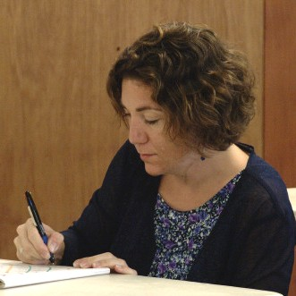
Work Sample Implementation, cont. 2
Scoring
All work samples must be
scored using Oregon’s Official Writing Scoring Guide.
All raters must have been
trained to use the Scoring Guide.
Only one set of scores is required for a work sample. (Districts may want more than one rater for borderline papers.)
Notes:
Teachers who rate student work samples for the purpose of demonstrating proficiency in the Essential Skill of Writing, must be well-trained in using the scoring guide. Additional in-depth workshops will be available for those who wish to extend their knowledge
Also, a reminder that only one rater is required. However, a number of districts are considering having two raters for papers that are in the 3 – 4 range. Questions: How is your school/district planning to score writing work samples for the Essential Skill?

Slide 37
Work Sample Implementation, cont. 3
Feedback and Revision
FEEDBACK: Only 2 options
Oregon’s Official Scoring Form
Highlighting Oregon’s Scoring Guide
STUDENT REVISION:
Students are allowed to revise and resubmit their work samples following scoring/feedback.
Most papers should be revised only once.
Notes:
Refer to Handout: Official Writing Scoring Form.
Students may receive feedback after a work sample has been scored and they may revise the work sample (in a supervised setting) and resubmit it to be scored again. Typically, this would be offered to students whose paper nearly meets the standard of all 4’s rather than for papers in the 1 & 2 range where more instruction may be needed.

Slide 38

Resources & Coming Attractions
ODE Website: www.ode.state.or.us/go/worksamples
Follow-up workshops
(List any scheduled)
Contact information
(List your information here)
Notes:
Please adjust this slide to reflect your information. You can either list dates if you have specifically scheduled future workshops, or you can leave it blank with just “Follow-up workshops” and indicate that additional workshops are available on request or will be scheduled later.
Put your contact information or someone else participants can contact with follow-up questions etc.
Final 2 pages in Participant’s Handout packet show the 10 main writing standards from the Common Core State Standards and the detailed information about each mode of writing called for in the CCSS. This should be good news to ELA teachers because of the close alignment to Oregon’s existing writing content standards and Official Writing Scoring Guide!

Slide 39

A Parting Thought
“Be yourself. Above all, let who you are, what you are, what you believe, shine through every sentence you write, every piece you finish.”
John Jakes
Notes:
This slide provides a nice closing and a focal point if you plan to have some Q & A before going into scoring student papers.
Next step will be going through the sample student paper packet for practice/ calibration scoring.

