Slide 1
The Essential Skill of Writing
Ideas/Content and Organization
An In-Depth Training Session
For English Language Arts Teachers
Notes:
Intro slide – get participants comfortable and oriented
You may want to do a show of hands on how recently teachers have had training or “recalibrated” to the writing scale. The purpose of this session is to assure that teachers around the state are operating from the same reference for each score point on the scale, but especially in distinguishing between a score of 3 and a 4 for the purpose of establishing proficiency in the Essential Skill of Writing.

Slide 2

Goals for this Workshop
Participants will
Understand the key components of the traits of Ideas/Content and Organization
Recognize student performance at different score levels for Ideas/Content and Organization
Notes:
There are four main goals for this session (on this slide and next). They are listed in priority order – 2 most important: refresh understanding of traits of Ideas/Content and Organization; re-calibrate to scale, especially at the 3 and 4 score points. Remind participants that there are other sessions for Sentence Fluency and Conventions and for Voice and Word Choice (optional).

Slide 3
Goals, continued
Develop expertise in scoring student writing for classroom and Essential Skills purposes in Ideas/Content and Organization
Understand how CCSS for English Language Arts align with Oregon’s writing assessment model
Notes:
Goal 3 has to do with sufficient practice – so teachers in this session will be reviewing a lot of papers! Goal 4 is more at an information level – to see how the new Common Core State Standards for English Language Arts align with Oregon’s Writing Scoring Guide and instruction.

Slide 4
The Essential Skill of Writing: Scoring Issues
Notes:
This section will allow you to briefly take participants through some of the issues that affect raters. Some are not as critical for classroom use, but it is helpful for teachers to think through how they may be influenced when scoring student work. It will not reoccur in the subsequent in-depth trainings on other traits.

Slide 5
Scoring Issues
Four modes – Expository, Persuasive, Narrative, Imaginative
Rater bias
Response to topic
Purpose of assessment
Notes:
Short section follows on each of these topics.

Slide 6
Oregon aligns with Common Core State Standards
Oregon Modes of Writing
CCSS Text Types & Purposes
Arguments supporting and defending claims
Informative/Explanatory
Narratives – real or imagined
Persuasive
Expository
Narrative
Imaginative
Notes:
This shows how Oregon’s existing Modes of writing are reflected in the CCSS. Purpose is for teachers to see that these modes have been around a long time and will continue in the future. Refer to 2 handouts in Participant’s packet which show this in more detail.

Slide 7
Writing is Part of the Core of ELA
“If students are to make knowledge their own, they must struggle with the details, wrestle with the facts, and rework raw information and dimly understood concepts into language they can communicate to someone else. In short, if students are to learn, they must write.”
National Commission on Writing
Notes:
Students need to improve writing not only to earn a diploma, but to prepare themselves for success as a producer, consumer, family member and citizen in the future.

Slide 8
The Essential Skill of Writing:
Rater Bias
What influences student scores?
Notes:
Introduce idea of rater bias. Teachers need to be aware of sources of bias when scoring their own students’ work and especially when scoring any student work for Essential Skills.

Slide 9
Sources of Rater Bias
Appearance of paper (neat, legible, etc.)
Conflict with personal opinions, beliefs, values
Religious or political themes
Profanity or extreme violence
Sympathy score (student really tries hard)
Pet Peeves
Notes:
Walk through this short list to see what participants think about each. Have them add any others that they believe may influence them. By examining biases, teachers should seek to avoid allowing these to influence their score for a paper.

Slide 10
The Essential Skill of Writing:
Response to topic
Purpose of Assessment
Notes:
Two areas that are different depending on whether the assessment is a classroom assignment or a work sample for Essential Skills proficiency.

Slide 11
Classroom Assessment versus Essential Skills
Response to Topic:
  Important for Classroom Assignments
  Does not affect scores for Essential Skills Work Samples
Notes:
Teachers may choose to penalize students if they do not adhere to a classroom assignment. (Hint: were expectations complete and clear: did students see models, have checkpoints along the way, etc.) For Essential Skills work samples, the student does not need to respond exactly to the prompt – they may take an idea in a different direction, and it can still be a valid work sample for the purpose of Essential Skill proficiency.

Slide 12
Classroom Assessment versus Essential Skills, cont.
Purpose of Assessment
  Consider purpose when deciding which traits to score – Classroom assignment? Formative assessment? Summative assessment? Essential Skills Work Sample?
Notes:
As teachers think about different uses of writing, they may also consider which traits to score for a particular purpose. For Essential Skills, the 4 required traits of Ideas/Content, Organization, Sentence Fluency, and Conventions must be scored.

Slide 13
Ideas and content
Notes:
Time to dig into the meat of the session! Use your experience and skills to help participants internalize the important considerations in Ideas and Content.

Slide 14
Ideas and Content: Key Elements
Clear?
Focused?
ENOUGH developmental details?
Details relevant to main ideas?
Notes:
These are key elements addressed in the 4 level of the scoring guide. It is important for participants to see that a paper that scores a 4 in Ideas and Content is not perfect – but it has more strengths than weaknesses.
Use this slide and the next as you walk participants carefully through the key concepts in Ideas and Content. Recommended: Teachers use highlighters to mark words or phrases that help them understand this trait. Refer to Facilitator’s Instructions for Scoring Student Papers.

Slide 15

Let’s Review the Scoring Guide
Highlight words and phrases that help distinguish a score of 3 from a 4 in Ideas and Content
Notes:
The most critical differentiation occurs at the 3 and 4 score points. Don’t neglect the other scores, however.

Slide 16
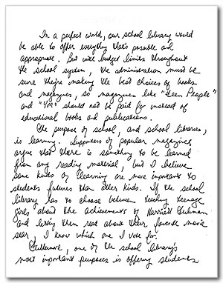
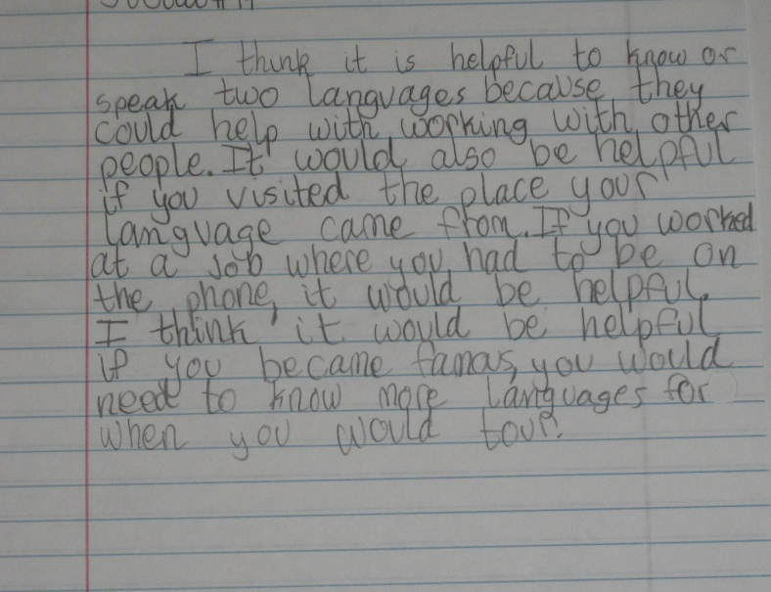
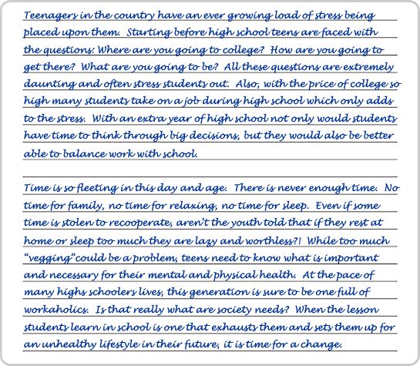
Let’s Score some Papers!
Notes:
You have a set of papers with scores and commentary. Suggestions are included in the facilitator’s packet for which papers to score for Ideas and Content. Participants have the student papers, but no commentary. These papers will be referenced again and scored during other in-depth training session on the remaining traits.
Recommended: do not provide commentary to participants until all training sessions have been completed – A. Ideas/Content and Organization; B. Sentence Fluency and Conventions; C. (optional) Voice and Word Choice.

Slide 17
Organization
Notes:
Introduction to Organization

Slide 18
Organization: Key Points
Can you follow the writing?
Introduction: developed?
Conclusion: developed?
Transitions: present? kinds of? (between and within paragraphs)
Paragraph breaks?
Notes:
These are key points from the scoring guide. Again, walk participants through the traits. Use highlighters as recommended in facilitator’s instructions.
Next 2 slides add more information about Organization.

Slide 19

Let’s Review the Scoring Guide, again
Highlight words and phrases that help distinguish a score of 3 from a 4 in Organization
Notes:
Again, focus is on helping participants distinguish between a 3 and 4, but go over other score points as well.

Slide 20
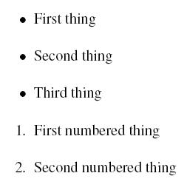
Many Ways to Organize
X
a
b
c
d
X
xx
xx
Y
yy
yy
Z
zz
zz
X
Y
Z
Notes:
This slide is intended to reinforce to English teachers that explicitly teaching students different organization patterns is very useful. However, a basic organizational structure of Intro, Body, Conclusion is not wrong, nor is it penalized when scoring for Essential Skills. As much as many teachers hate the formula “5 paragraph essay,” for some students that structure may be what is needed to meet the standard score of 4 in Organization. English teachers can provide students instruction in different types of organization – including those that emerge “organically.”

Slide 21
Let’s Score some Papers! again
Notes:
You have a set of papers with scores and commentary. Suggestions are included in the facilitator’s packet for which papers to score for Ideas and Content. Participants have the student papers, but no commentary. Papers will be referenced again during other in-depth training session on the traits.
Recommended: do not provide commentary to participants until all training sessions have been completed – A. Ideas/Content and Organization; B. Sentence Fluency and Conventions; C. (optional) Voice and Word Choice.

Slide 22
Common Core State Standards
Adopted by Oregon State Board of Education
Include Reading, Writing, Speaking & Listening, and Language
Also include Literacy in History/Social Studies, Science and Technical Subjects
Notes:
Participants’ packet includes the Common Core Standards for Writing as well as a Crosswalk between the Oregon Writing Scoring Guide and the CCSS standards for writing. See Facilitator’s Guide for suggestions on using these materials.

Slide 23
Resources to Practice Scoring
ODE High School Writing Samples: http://www.ode.state.or.us/search/page/?=527
OPEN Scoring Site: http://www.openc.k12.or.us/scoring/
Clackamas ESD Writing Samples http://www.clackesd.k12.or.us/cie/writing.html
Notes:
These are three resources where teachers can find papers to score for Ideas & Content and then compare their scores with the official scores. Additional papers and practice opportunities will be added as resources allow.

Slide 24

Thank you for your attention!
Notes:
Final slide – Remind participants of training sessions on Sentence Fluency & Conventions and on Voice & Word Choice (optional). If you have scheduled these sessions, give the dates and encourage participation.

