Slide 1
The Essential Skill of Writing
Sentence Fluency and Conventions
An In-Depth Training Session
For English Language Arts Teachers
Notes:
Intro slide – get participants comfortable and oriented
This is the second in a series of 3 in-depth training sessions. For English Language Arts teachers, this session will particularly emphasize the detailed issues that arise in scoring conventions.
The purpose of this session is to assure that teachers around the state are operating from the same reference for each score point on the scale, but especially in distinguishing between a score of 3 and a 4 for the purpose of establishing proficiency in the Essential Skill of Writing.

Slide 2
Goals for this Workshop
Participants will
Understand the key components of the traits of Sentence Fluency & Conventions
Recognize student performance at different score levels for Sentence Fluency and Conventions
Develop expertise in scoring student writing for classroom and Essential Skills purposes in Sentence Fluency and Conventions
Notes:
There are three goals for this session. Refresh understanding of traits of Sentence Fluency and Conventions; re-calibrate to scale, especially at the 3 and 4 score points; and develop expertise through sufficient practice -- so teachers in this session will be reviewing a lot of papers!

Slide 3
Sentence Fluency
Notes:
Time to dig into the meat of the session! Use your experience and skills to help participants internalize the important considerations in Sentence Fluency.

Slide 4
Sentence Fluency: Key elements
Is the writing fairly easy to read aloud? (Supply punctuation wherever natural)
Enough variety of:
sentence structures?
sentence beginnings?
sentence lengths?
Notes:
These are key elements addressed in the 4 level of the scoring guide. It is important for participants to see that a paper that scores a 4 in Sentence Fluency is not perfect – but it has more strengths than weaknesses.
Recommended: Teachers use highlighters to mark words or phrases that help them understand this trait. Refer to Facilitator’s Instructions for Scoring Student Papers.
General Comments about Sentence Fluency:
• Looking for underlying structures of language (many students often have more sense of this than we expect due to oral language and a natural sense of structures and flow; beware of leaping to judgment about Sentence Fluency because of weak Conventions)

Slide 5
Sentence Fluency: Key Concepts
Marking punctuation is scored under conventions. “Sense of sentence” shows when reading aloud.
Missing words can affect fluency
Inverted word order can affect fluency
Notes:
Key Concepts
VERY IMPORTANT to read through punctuation errors. Reading aloud, even if done “in your head,” really helps. Fragments usually connect easily to a sentence before or after. Comma splices allow for a natural pause. Run-ons are more problematic; some provide a natural stopping point because of the structure, but others do not permit a reader to pause, especially those with endless “and,” “so,” “and then,” etc. The error in correctly marking the end of the sentence (or not) is scored in conventions, not in sentence fluency.
Point out value of short, punchy sentences at meaningful points (suspense, excitement, etc.). Watch for examples in training papers. (This helps illustrate bullet regarding variety of sentence length)
Missing words affect fluency--one or two OK (copying errors), but pattern of repeatedly leaving out words is not OK (or consistently missing articles--a, an, the)
Inverted word order also affects fluency

Slide 6
Let’s Review the Scoring Guide
Highlight words and phrases that help distinguish a score of 3 from a 4 in Sentence Fluency
Notes:
The most critical differentiation occurs at the 3 and 4 score points. Don’t neglect the other scores, however.

Slide 7
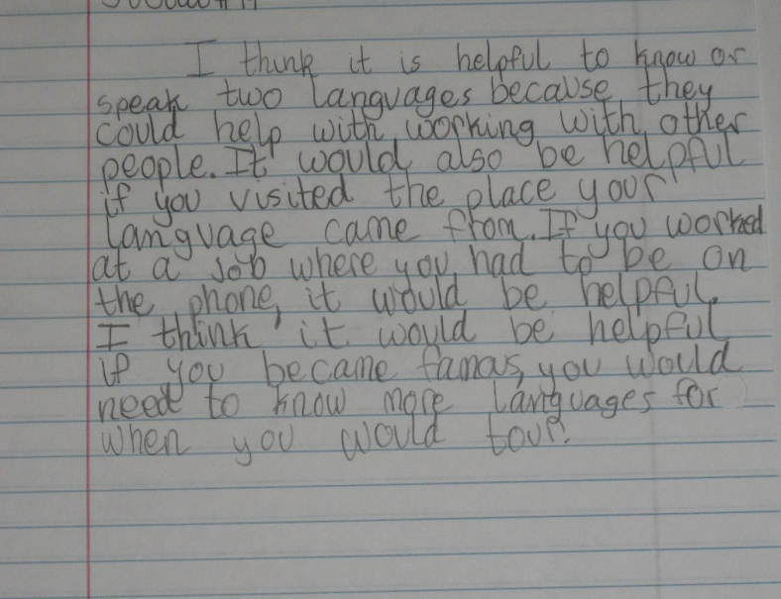
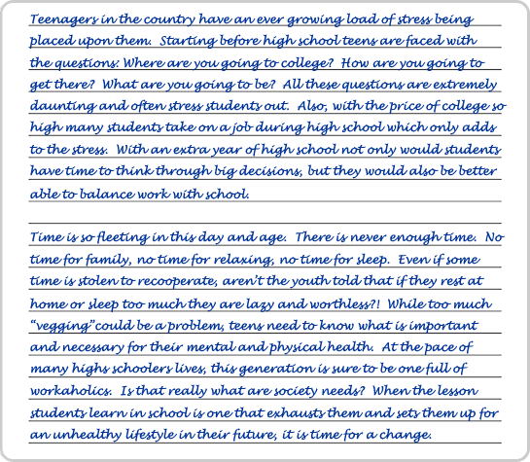
Let’s Score some Papers!
Notes:
You have a set of papers with scores and commentary. Suggestions are included in the facilitator’s packet for which papers to score for Sentence Fluency. Participants have the student papers, but no commentary. Some of these papers may have been used in the previous in-depth training session on Ideas & Content and Organization. Others may be referenced again and scored during subsequent training sessions on Voice and Word Choice.
Recommended: do not provide commentary to participants until all training sessions have been completed – A. Ideas/Content and Organization; B. Sentence Fluency and Conventions; C. (optional) Voice and Word Choice.

Slide 8
Conventions
Notes:
Introduction to Conventions

Slide 9
Conventions: the basics
Capitalization
End of sentence punctuation
Spelling
Fragments
Comma splices
Pronoun agreement
Run-on sentences
Quotation marks
Internal comma use
Apostrophes
Noun/verb agreement
Point of view
Notes:
Conventions contains many details. Generally, content area teachers feel comfortable scoring basic conventions such as spelling, run on sentences, and end of sentence punctuation.
This session will hone in on some of the details that professional English Language Arts teachers are more likely to discern and need guidance in how to score.

Slide 10
Conventions, Analyze:
Kinds of errors
Significance of errors (refer to grade-level expectations in Skill Level Guidelines)
Proportion of errors relative to overall text length and complexity
Notes:
These are key points from the scoring guide. Again, walk participants through the trait. Use highlighters as recommended in facilitator’s instructions.
Following slides add more information and show some examples of errors in Conventions.

Slide 11
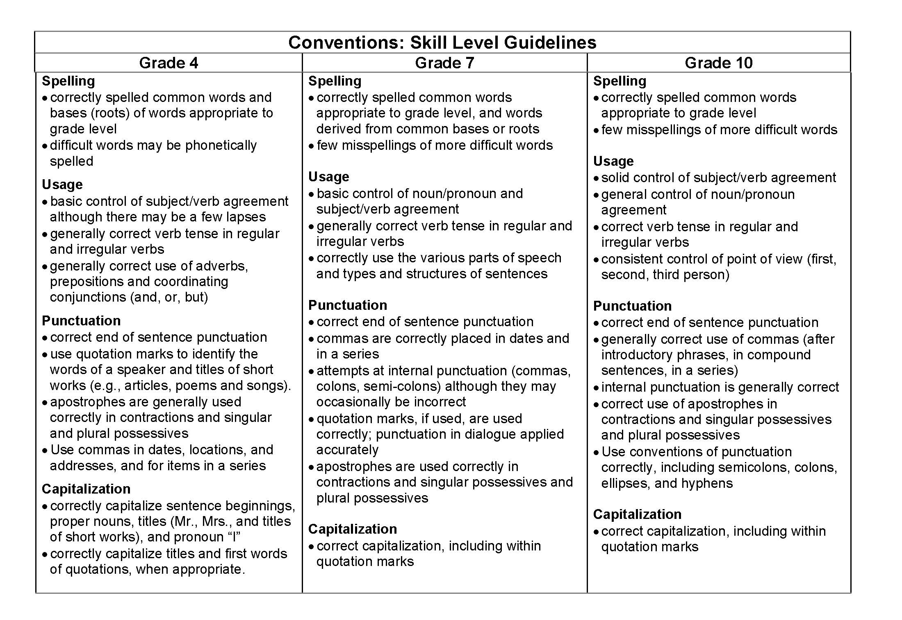
Conventions, Reference Chart
Notes:
Have participants refer to their handout packet for this chart. It is a useful reference when scoring student papers.
IMPORTANT: Ask participants to make particular note of the adjectives that describe each skill (e.g., “general control of...” is less important than “solid control of...”). These adjectives will help raters understand which skills are considered really important to have mastered at the given grade level.
Relative importance of the skill at the grade level is a significant factor in assigning a score.

Slide 12
Conventions, guiding Scoring Questions
Correct end-of-sentence punctuation?
Run-on sentences (none or very few)
Comma splices (none or very few)
Fragments (none or just a few effective ones)
Correct spelling of common words? (grade level appropriate)
Correct capitalization?
Notes:
This slide and the next lay out questions to ask about Conventions in a given paper. Answers of “yes” mean the paper is at least a 4.
• Tell raters they’ll be looking more closely at end-of-sentence punctuation in slides that follow.
• No magic spelling list; tell raters to trust their judgment about grade level common words.

Slide 13
Conventions guiding Scoring Questions, cont.
Correct usage?
10th: subject-verb agreement
10th: verb tense: correct? consistent?
10th: point of view (1st , 2nd, and 3rd person) consistent?
If dialogue present, correctly punctuated & paragraphed?
Correct internal punctuation (commas, etc.)?
Notes:
Participants will look at examples of verb tense and point of view in slides that follow.

Slide 14
Slide 14 Blank Title
Notes:
• Emphasize the importance of end-of-sentence punctuation in order to earn a 4, but also even a 3. (However, if other conventions are fairly solid, a paper can still earn a 3 with several end-of-sentence punctuation errors.)

Slide 15
Slide 15 Blank Title
Notes:
Read examples or have a participant read them aloud. Do not assume participants know these terms and rules. This review is to really solidify their understanding of what terms in the scoring guide mean and how they might appear in student work.

Slide 16
Slide 16 Blank Title
Notes:
First, define a comma splice: A comma splice is the use of a comma to join two independent clauses where the clauses are not connected by a conjunction, semicolon, or period/full stop.
Mention that comma splices are a major contributing factor to papers scoring a 3 in Conventions at the middle and high school levels.
Review examples by reading aloud or having a participant read aloud.

Slide 17
Slide 17 Blank Title
Notes:
Fragments can be very effective. Do not to penalize a paper that includes effective use of fragments. Watch dialogue as it may be an appropriate place for fragment use.
Continue to read and discuss examples aloud.

Slide 18
Slide 18 Blank Title
Notes:
Verb tense switches often occur in narrative papers that begin in past tense. Then, when the action becomes exciting or suspenseful, students switch to present and begin to switch back and forth between past and present.
Participants should be alert to verb tense switches.

Slide 19
Slide 19 Blank Title
Notes:
It is ok to be somewhat forgiving of a switch to second person when the writer is trying to generalize about something or is attempting to give generic directions for something.
Weigh the effectiveness in that case; if the switches don’t occur too often, the paper is generally consistent in point of view, and conventions are otherwise fairly clean, it could still earn a 4.

Slide 20
Slide 20 Blank Title
Notes:
Refer to this handout in the participants’ packet.
These errors often occur with ELL papers. The purpose of this handout is to be sure participants are being thoughtful about the kinds of errors they’re seeing and assigning lower scores in only the appropriate trait.
Review the examples, which were drawn from real student writing for the statewide writing assessment. Emphasize which trait is affected and discuss why so that participants feel comfortable that they can recognize and correctly score these types of errors.
Papers for the statewide assessment and for Essential Skills worksamples, must be scored for Standard Written English. Note that an occasional error can be overlooked – it is the pattern of repeated error that lowers the score.

Slide 21
Let’s Review the Scoring Guide Again
Highlight words and phrases that help distinguish a score of 3 from a 4 in Conventions
Notes:
Again, focus is on helping participants distinguish between a 3 and 4, but go over other score points as well.

Slide 22
Let’s Score some Papers! Again
Notes:
You have a set of papers with scores and commentary. Suggestions are included in the facilitator’s packet for which papers to score for Conventions. Participants have the student papers, but no commentary. Papers may be referenced again during other in-depth training session on the traits.
Recommended: do not provide commentary to participants until all training sessions have been completed – A. Ideas/Content and Organization; B. Sentence Fluency and Conventions; C. (optional) Voice and Word Choice.

Slide 23
Resources to Practice Scoring
ODE High School Writing Samples: http://www.ode.state.or.us/search/page/?=527
OPEN Scoring Site: http://www.openc.k12.or.us/scoring/
Clackamas ESD Writing Samples http://www.clackesd.k12.or.us/cie/writing.html
Notes:
These are three resources where teachers can find additional papers to score for any of the traits and then compare their scores with the official scores. Additional papers and practice opportunities will be added as resources allow.

Slide 24
Thank you for your attention!
Notes:
Final slide – Remind participants of training sessions on Voice & Word Choice (optional). If you have scheduled this sessions, give the dates and encourage participation.

