Slide 1
Mental Health and Social Support Guidance For School Counselors, Administrators and Other Mental Health Professionals
March 31, 2020

Slide 2
Overview
Governor Brown’s directive.
Challenges and strengths.
Tiered approach for mental health and social support.
What guidance do you need?

Slide 3
Giving feedback
For mental health guidance questions please:
Post question in Zoom chat area.
List a theme for your question (e.g. seniors, equity, crisis support).
Be concise.
We will:
Respond to as many questions as possible.
Create a FAQ area with additional responses soon.
We will not be able to respond to questions regarding last night’s guidance.

Slide 4
Directive from Governor Brown
Provide guidance to school districts and communities to ensure continuity of mental health services to children and families.

Slide 5
Questions to consider re challenges and strengths
What challenges do we face?
How do we care for children and adults?
How can we adapt?
How can we leverage our strengths and expertise?
How do we meet students/families where they are?

Slide 6
Equity considerations
Be culturally-responsive to needs and strengths.
Be aware of access to technology and internet.

Slide 7
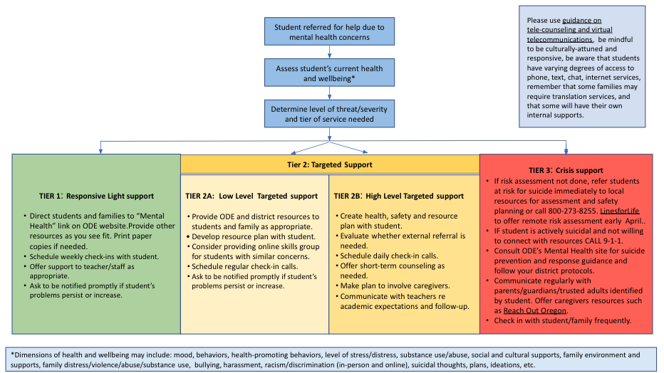
A tiered approach to serving our communities

Slide 8
Assessment and referral
When you receive a student referral:
Use established district procedures.
Assess student’s health and wellbeing.
Determine level of severity and tier of service.
If student is in crisis, immediately move to Tier 3 recommendations.
Please heed the guidance on School Counselor and Virtual School Counseling: https://www.schoolcounselor.org/asca/media/asca/PositionStatements/PS_Virtual.pdf

Slide 9
Tier 1 – Responsive, light support
Student has very low levels of distress.
Direct to ODE “Mental Health” Covid-19 link.
Schedule weekly check-ins with student as needed.
Offer support to teacher/staff.
Ask teacher to notify you if student problems persist or worsen.

Slide 10
Tier 2A – Low level Targeted Support
Student has moderate levels of distress.
No need for one-on-one intervention:
Direct to ODE “Mental Health” Covid-19 link.
Develop resource plan.
Consider group skill building supports.
Schedule regular check-ins once per week.
Ask teacher to notify you if problems persist or worsen.

Slide 11
Tier 2B – High-level Targeted Support
Student has high levels distress.
Create a health, safety and resource plan.
Consider external referral. Facilitate a warm hand-off.
Offer short-term counseling.
Involve caregivers.
Communicate with teachers re academic expectations.
Ask teacher to notify you immediately if symptoms worsen or student in crisis.

Slide 12
Tier 3 – Crisis support
Student is at risk for suicide or imminent harm.
If you can’t conduct a formal risk assessment:
Determine risk for imminent harm - CALL 9-1-1.
Call the National Suicide Hotline (800-273-8255).
LinesforLife will provide remote risk assessment and safety planning.
Consult ODE’s How to Prevent Suicide guidance.
Refer to outside mental health provider.
Communicate regularly with parents, guardians and trusted adults.
Offer caregivers resources such as Reach Out Oregon.
Check in frequently with student, family and teacher (as appropriate).

Slide 13
We want your feedback
We will do our best to answer mental health and social supports specific guidance questions.
What guidance do you need to help support your students and their families?
What guidance do you need to help support you in your work?

Slide 14
Thank you!
Contact information:
B Grace Bullock grace.bullock@ode.state.or.us
Beth Wigham beth.wigham@ode.state.or.us

