Slide 1
Submission of “Preliminary Description of the Proposed Social Emotional Learning Standards Framework Report: HB 2166”
A Report to the State Board of Education
Required by HB 2166 (2021)
September 22, 2022

Slide 2
Agenda
Background & Purpose
Timeline
Phase 1 overview
COSA Engagement
Report Recommendations
Next steps
Feedback, Q&A
Figure 1. Hands and Heart. Perrin, J. 2021, Sarasota. Retrieved from: https://www.sarasotamagazine.com/health-and-fitness/2021/11/how-to-practice-gratitude,

Slide 3
Timeline
2024
School districts implement SEL Framework & Standards
03
Phase 2 SEL Advisory Group established to develop SEL Framework & Standards to be considered for adoption by SBE by September 2023.
2023
02
2022
01
Phase 1 SEL Advisory Group established to write the “Preliminary Description of the Proposed SEL Framework & Standards Framework: HB 2166” Report & submitted to SBE on September 22, 2022.
HB 2166, Section 4
directs the ODE to convene an advisory group to propose to SBE recommendations for:
1)SEL Framework, and
2) K-12 SEL Student Standards.
2021
00

Slide 4
HB 2166 Phase 1
Charge: To develop a report that provides a preliminary description of a SEL Framework and Standards that the SBE will use when considering adoption in September 2023.
Acknowledgements:
HB 2166 Advisory Group members
Region 16 Comprehensive Center and SeeChange
Teacher Standards & Practices Commission (TSPC)
Early Learning Division (ELD)
Student Success Plan Coordinators & Advisory members
State Advisory Council for Special Education (SACSE)
English Learners (EL) Advisory Group
Community members and students
ODE Staff/Policy experts
Figure 2. Starling Murmurations. BirdSpot. Retrieved from: https://www.birdspot.co.uk/bird-behaviour/starling-murmurations

Slide 5
COSA Eugene Engagement Themes
All teachers are SEL teachers.
Worry about the socio-political landscape of SEL and how to communicate this is a need to caregivers and communities.
Appreciation for focusing on adult SEL & the potential for it to help with educator retention.
Appreciation for a systemic approach to SEL (including crosswalks to the Student Success Plans) and alignment to other ODE initiatives.
Appreciation for integrating SEL in teacher practice & across content and contexts throughout the day.
Need to provide adequate assistance and supports for SEL implementation (e.g., staffing, time, resources)
Recognizing SEL must be culturally & linguistically responsive.
Need to not take a one-size fits all approach.

Slide 6
“Preliminary Description of the Proposed SEL Standards and Framework: HB 2166” Report

Slide 7
Report Overview
HB 2166 Preliminary Description of the Proposed Social Emotional Learning Standards Framework Report includes:
Forward
Executive Summary
Background on HB 2166 and advisory group
Research and benefits of SEL
National and Oregon context on SEL
Preliminary description of the proposed SEL Standards and Framework
Figure 3. Report. Meta, 2012, Retrieved from: https://about.fb.com/news/2021/11/facebook-widely-viewed-content-report-q3-2021/

Slide 8
Preliminary Description of SEL Framework
Implementation Considerations & Opportunities: System supports for students and adults
Recommended SEL Framework
Implementation Opportunities
System Standards: Conditions to support students (what the system needs to do)
Student Standard Fundamentals
System Standards Fundamentals
Student Standards: Constructs & Competencies (what students need to know and do)
Guiding Principles: Foundational beliefs
Guiding Principles

Slide 9
SEL Framework: Guiding Principles
Equity-Centered
Strengths-Based
Transform Systems through Inclusive Practices
Trauma-Informed
Developmentally Appropriate
Student, Caregiver & Community Partnership
Alignment with other ODE efforts
Figure 4. Transformative Social Emotional Learning. American Educator, 2021. Retrieved from: https://www.aft.org/ae/summer2021/jagers_skoog-hoffman_barthelus_schlund

Slide 10
SEL Framework: System Standards
Student Success Plan Groups: African American/Black, American Indian/Alaska Native, Latino/a/x, LGBTQ2SIA+, English Language Learner and Special Education.
Identified Student Success Plan domains & key components that are related to SEL:
School Conditions
Community Collaboration
State Role
Figure 5.Community of Hands. Stock Photo. Retrieved from: https://www.canstockphoto.com/community-of-hands-29794194.html

Slide 11
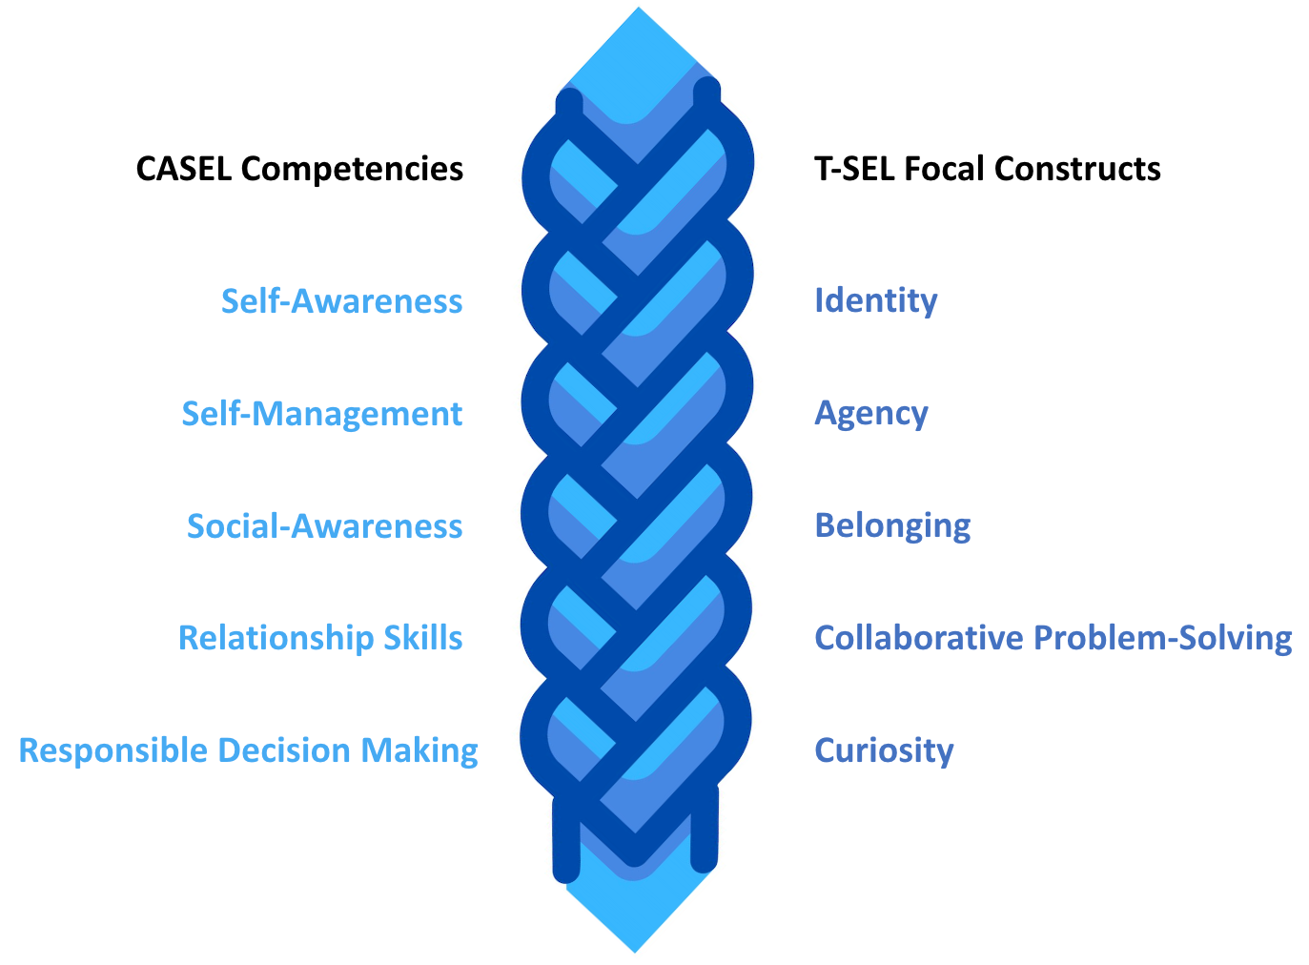
SEL Framework: Student Standards
“Transformative SEL is a process whereby young people and adults build strong, respectful, and lasting, relationships that facilitate co-learning to critically examine root causes of inequity, and to develop collaborative solutions that lead to personal, community, and societal well-being.”
- CASEL

Slide 12
SEL Implementation Considerations
Student Standards
Apply across content and context
Include adults
Do not perpetuate historic harm
System Standards
Further engagement
Resources (capacity, time, professional learning, FTE)
Integrate SEL implementation into cost modeling when it updates the QEM
Figure 6. Source unknown.

Slide 13
Next Steps

Slide 14
HB 2166 Phase 2
Charge: To develop K-12 SEL standards and framework to present to SBE for adoption by September 2023.
Currently reviewing and selecting members for Phase 2 SEL Advisory Group
Develop an engagement plan throughout the Standards work to include historically underserved groups and student voice
Figure 7. Starling Murmuration. Biber, J. 2018. World Photography Organization. Retrieved from: https://www.canstockphoto.com/community-of-hands-29794194.html

Slide 15
Thank you!
Questions?

