Slide 1
Investigating Substance Use
Data-driven Decisions
Grades 11–12

Slide 2

Essential Questions (1)
How do statistics and facts about substance use and misuse inform my choices and actions in my community?
How do I make informed choices and work to address social injustices after analyzing information?

Slide 3

Learning Goals
I can analyze local data on substance use and misuse using a data dashboard or data tables.
I can identify data trends within my community
I can reflect on how evidence-based information can guide personal choices and community action.

Slide 4
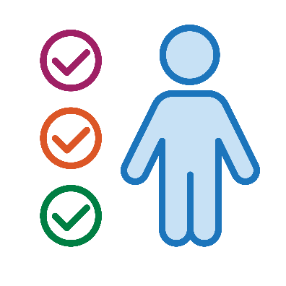
How would your peers respond? (1)
Select all of the tobacco products they used in the past month.
Cigarettes
Vaping product or other e-cigarettes
Chewing tobacco, such as Skoal or Copenhagen
Cigarillos or little cigars, such as Swisher Sweets
Hookah or waterpipe
Any other tobacco project
None of these products

Slide 5
How would your peers respond? (2)
How old were they when they had their
first drink?
They have never had a drink of alcohol other than a few sips
12 years old or younger
13 years old
14 years old
15 years old
16 years old
17 years old
I am not sure

Slide 6
How would your peers respond? (3)
During the past 30 days, did they use prescription opioid drugs such as Oxycontin, Percocet, Vicodin or Codeine without a doctor’s orders or differently than how a doctor told them to use it?
Yes
No
I am not sure
I prefer not to answer

Slide 7
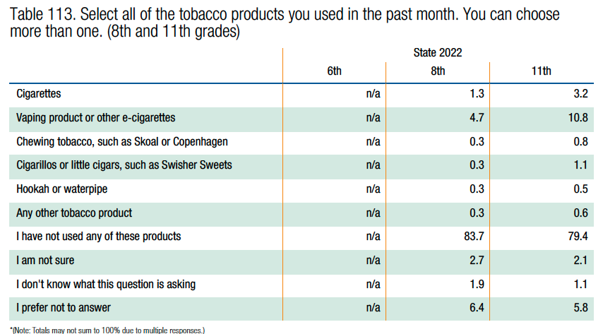
Oregon Student Health Survey Responses (1)

Slide 8
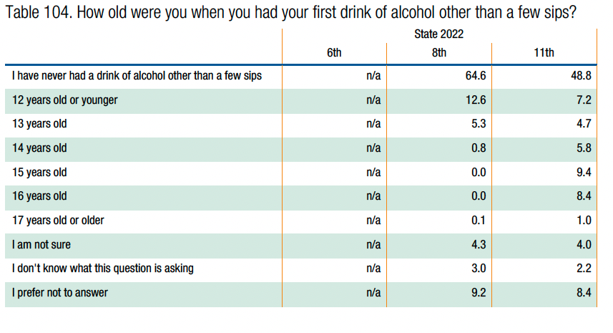
Oregon Student Health Survey Responses (2)

Slide 9
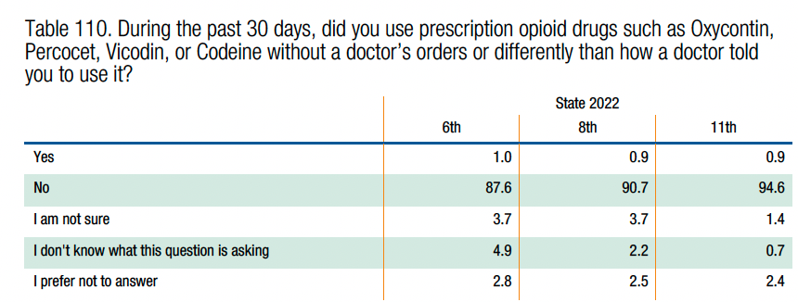
Oregon Student Health Survey Responses (3)

Slide 10
Essential Questions (2)
How do statistics and facts about substance use and misuse inform my choices and actions in my community?
How do I make informed choices and work to address social injustices after analyzing information?

Slide 11

Community Agreement
Statistics are more than just numbers. There are people and stories behind the data.
Take care of yourself and take care of our classroom community as we dig into the data.

Slide 12
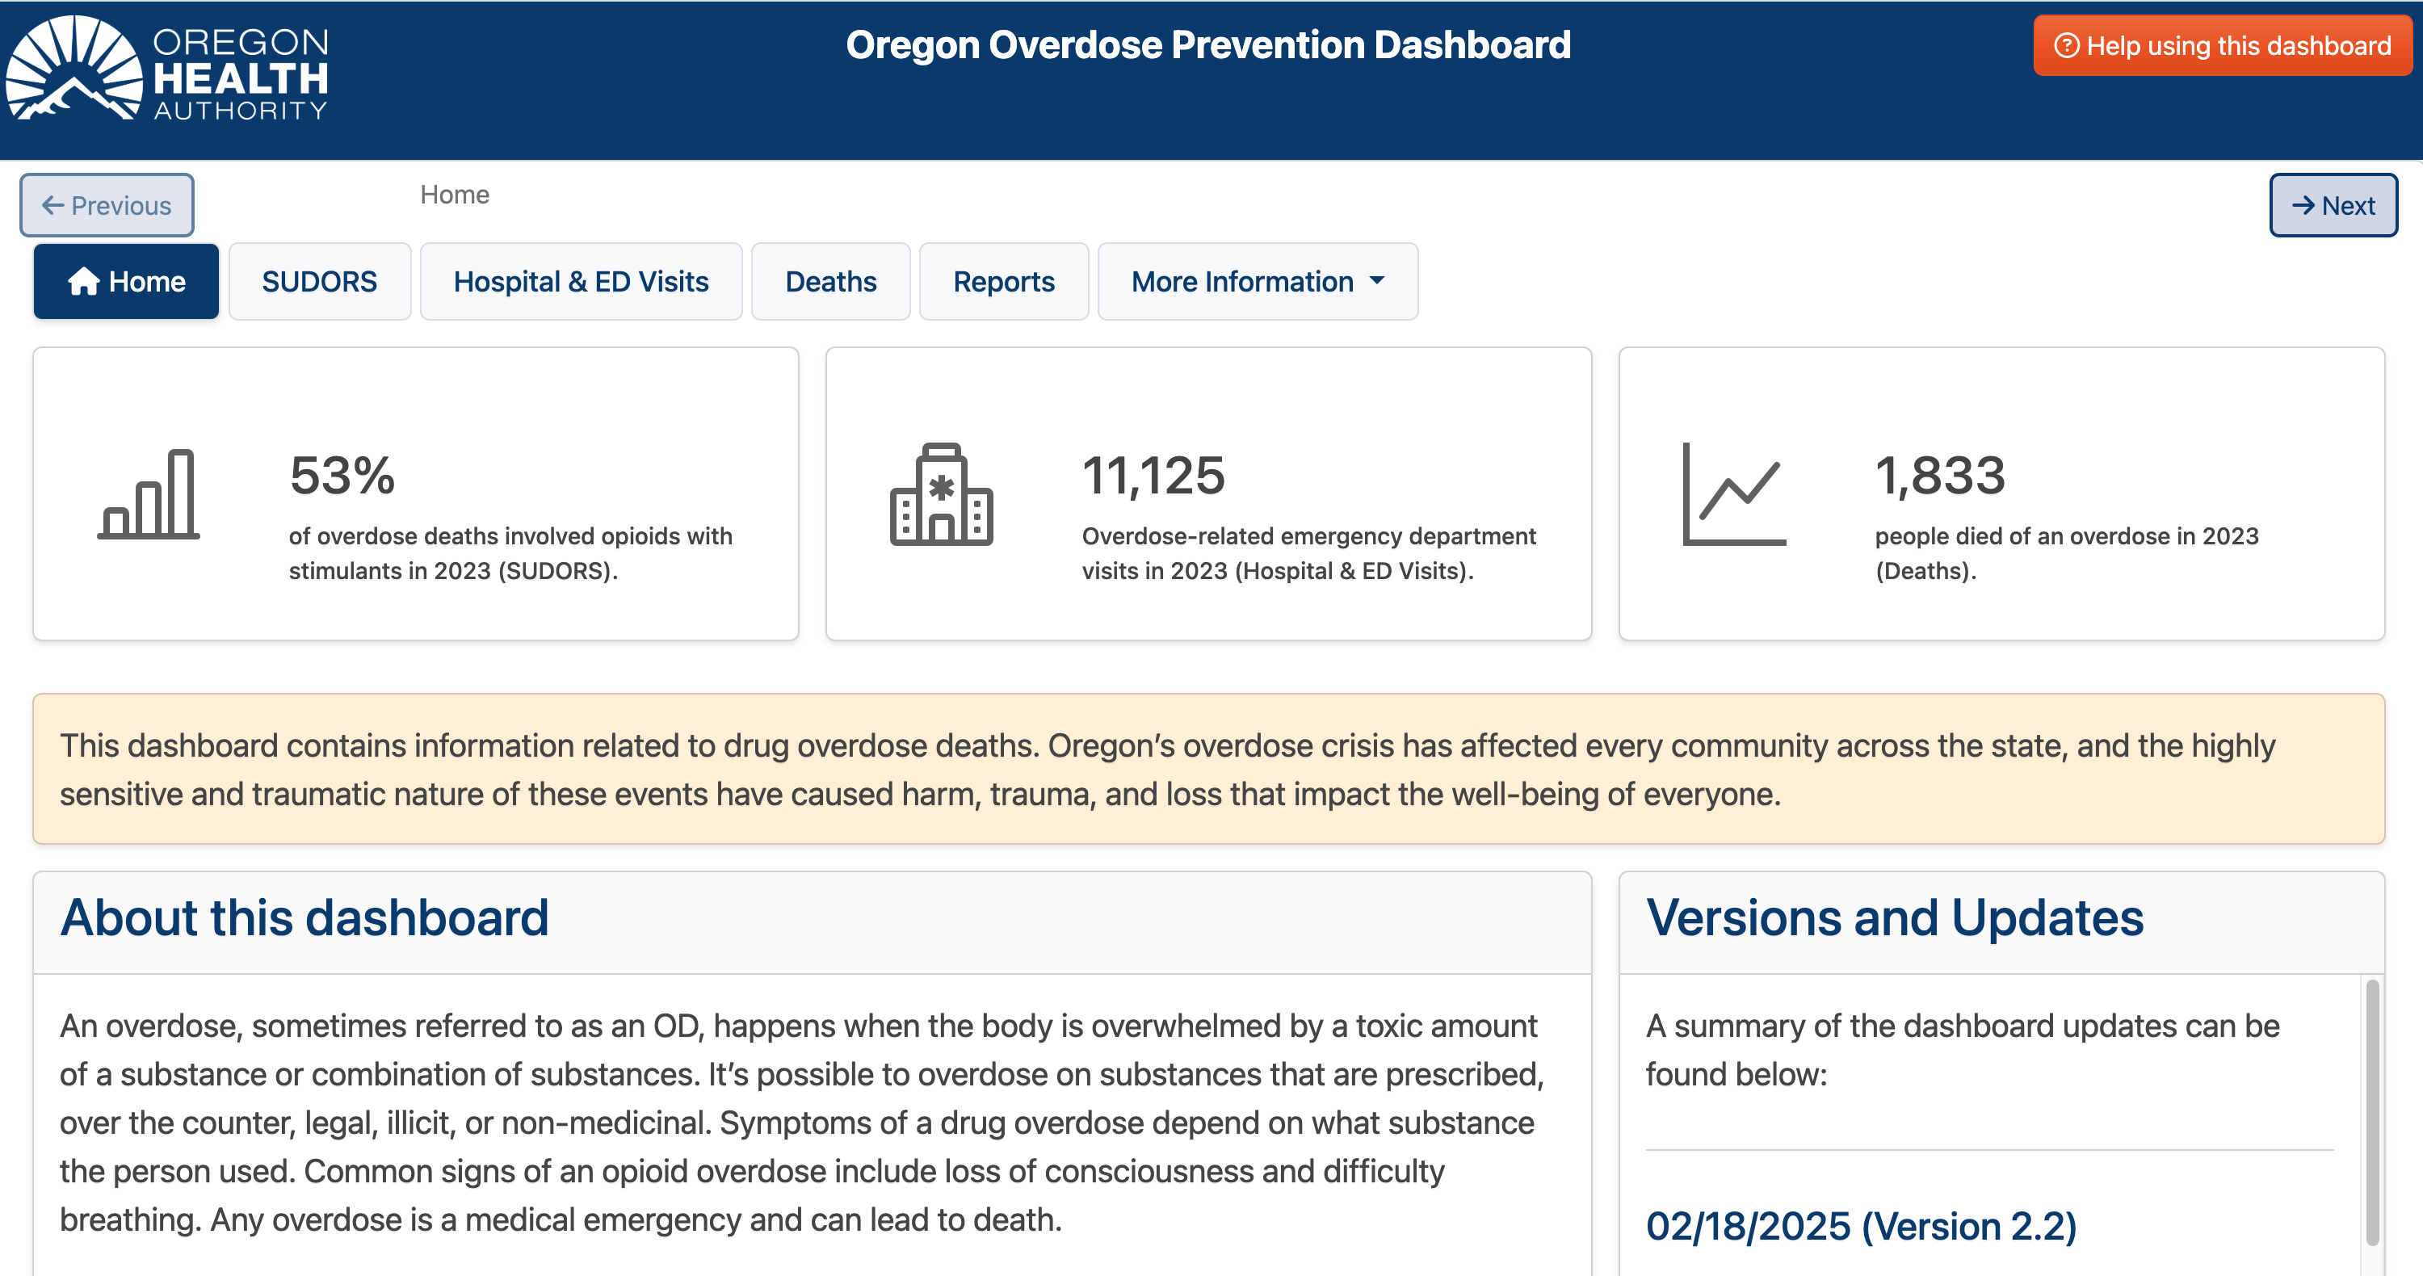
Oregon Overdose Dashboard
Go to https://oregoninjurydata.shinyapps.io/overdose/

Slide 13

Activity Instructions
Open the dashboard.
Use the scavenger hunt to get oriented.
Use the questions to get deeper into the data.
  What substances have the highest rate of misuse among teens?
  How have overdose rates changed over the last five years?
  What do you notice about your county?
What does the data tell you?
  Capture your questions.
  Capture your a-ha’s.
  Find something that you would like to share with the class.

Slide 14

Connecting Data to Actions
What can we do to promote personal, family and community well-being?
Consider the role of education, policy, resources and access.
How might you think about prevention and harm reduction?

Slide 15
Closing
What data trend surprised you most?
How does this data connect to your personal choices?
What micro-step could you take to help your community address substance use and misuse?

